Slide 1

1990 Us census – cluster analysis
Daniel dai

Slide 2
Problem formulation/data source
Goal: Determine key demographic clusters within the United States population to guide public policy
Strategy:
Evaluate and select relevant features within the 1990 US Census dataset
Clean and prepare data for analysis
Identify optimal cluster count for analysis
Analyze cluster features individually within cluster, and comparatively across clusters
Determine most impactful clusters and their feature characteristics for public policymaking
Data Description
1990 US Census Data Set at the UCI Machine Learning Repository
2.5 million randomly selected individuals
68 features, either categorical or discretized
No processing or cleansing required

Slide 3
Feature selection
Feature Selection
Removed features with vague descriptions
Selected features hypothesized to have greater impact on policymaking
Single features were selected out of similar features
RpIncome over RpEarnings and specific income features
Military over specific military service periods
Work limitation disability over other disability
1989 work features
Fertility over other child count features
Spouse over marital
Selected Features
Age | Education Level
Work Departure Time | Ancestry
English Proficiency | Industry
Fertility | Occupation
Hours Worked 1989 | Place of Birth
Poverty | US Citizenship
Total Income (RpIncome) | Disability/Work Limitation
Sex | Languages Spoken
Travel Time to Work | Transport Means
Weeks Worked 1989 | Military Service
Marital Status (Spouse) | Weight

Slide 4
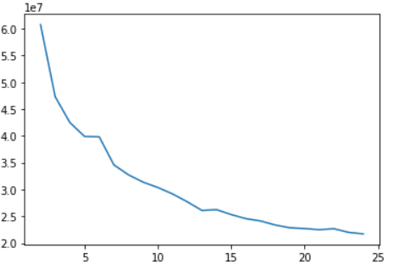
model design/Analysis
Categorical features were one hot encoded into dummy features, ordinal features were left as is
K-Means clustering was performed, costs were plotted from k = 2 to k = 25
Elbow method was utilized to determine optimal cluster count of 13
Cluster centers were identified and formatted into a table for analysis
Features were evaluated within individual clusters and then comparatively across all clusters. Concerning features will be highlighted in red
Similar clusters were grouped together, then evaluated within their groupings
Cost vs Cluster Count

Slide 5
Clusters 0 (436380 Individuals)/6 (154460 individuals)
Cluster Means Description
Age 4.04/4.12, 20-39 years old with higher concentration of younger individuals
Sex 0.25/0.40, 75% and 60% males
Cluster 0 Income 2.95, under $60000 per year
Cluster 6 Income 2.55, around $30000 per year
Education 10.43/10. 99 High School Diploma or GED
Cluster 0 Poverty 1.92, above poverty-threshold
Cluster 6 Poverty 1.77, below average
40-hour work week with 52 weeks per year. Around 30 minutes to work, mainly by car
Born in America with European descent
High rates of never-married for both clusters at 32%
Cluster 0
Industries | Occupations | Military
Manufacturing Retail Finance Business Professionals | Professional Managerial Technical Sales Operators Laborers | 22% past 2% active 3% reserves 73% none
Cluster 6
Industries | Occupations | Military
Manufacturing Agriculture Public Administration | Agriculture Production Labor | 18% past 2% active 2% reserves 77% none

Slide 6
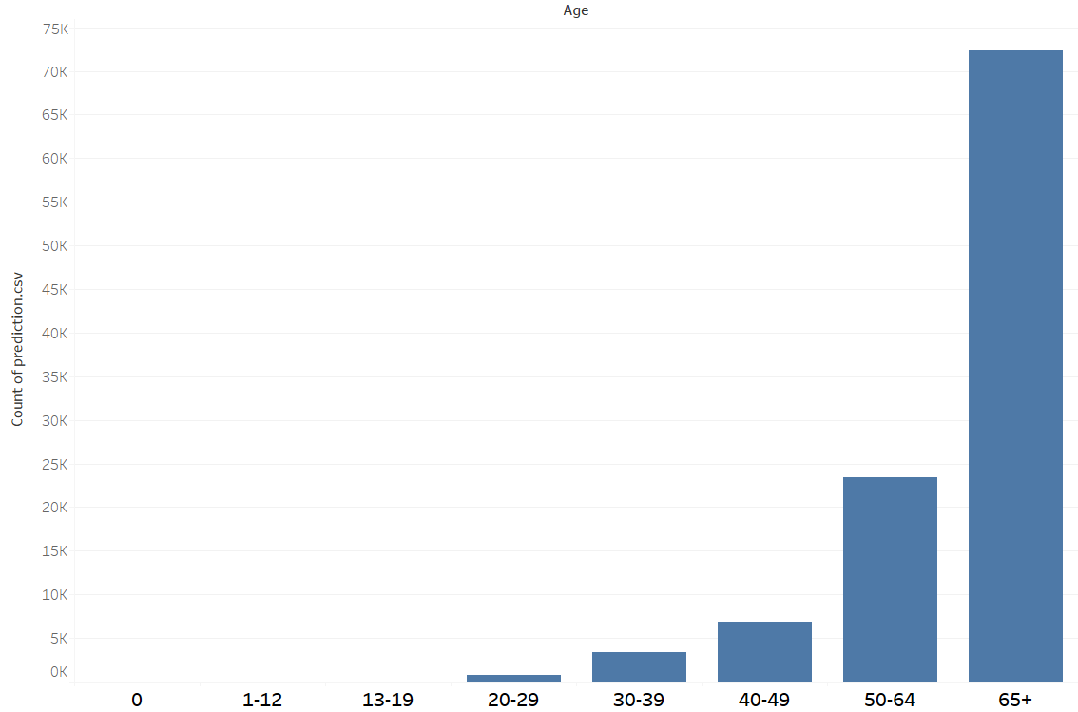
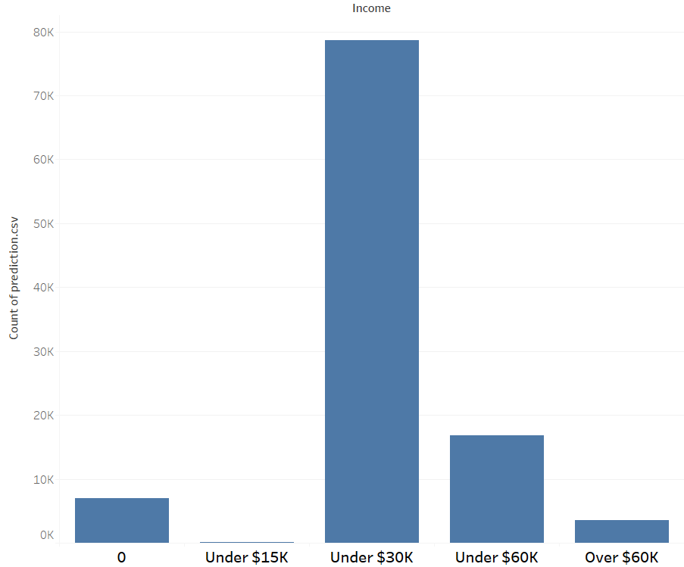
Cluster 1 (106719 individuals)
Cluster Means Description
Age 6.53, tied for highest with average age 65+
Sex 0.25, 75% male
Income 2.11, average under $30000 per year
Education 5.29, Middle School
Poverty 1.68, many are below poverty threshold
Majority did not work
Those that did work worked in craft/labor
Highest rate of working limiting disabilities at 49%
29% military service in the past
Mostly European descent, with high rate of non-Hispanic Americans
55% married, 21% divorced. Highest rate of never-married out of elderly clusters at 12%
Age Distribution
Income Distribution

Slide 7
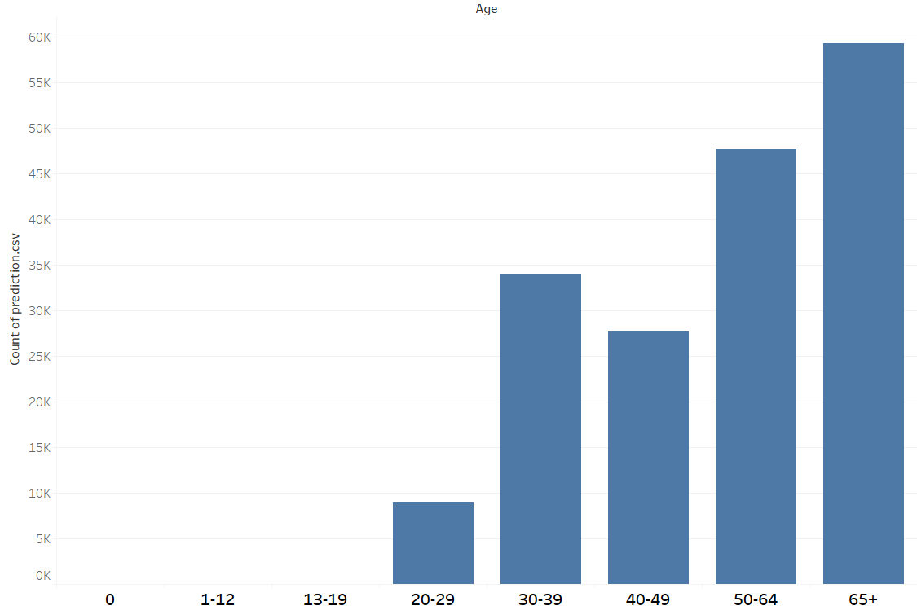
Cluster 2 (177547 individuals)
Cluster Means Description
Age 5.64, mainly above 40 years old
Sex 1.00, all females
Income 1.35, average under $15000 per year. Lowest among eligible clusters
Education 10.91, High School Diploma or GED
Poverty 1.84, average poverty levels
Fertility 4.00, average of 3 children
Born in America with European descent
Majority did not work, or worked in administrative services
72% Married with 17% widowed
Age Distribution
Takeaway: Cluster 2 generally seems to be comprised of stay-at-home mothers, with some taking on lower-level employment. No immediate concern with poverty rates despite low income, possibly due to partners with full-time employment

Slide 8
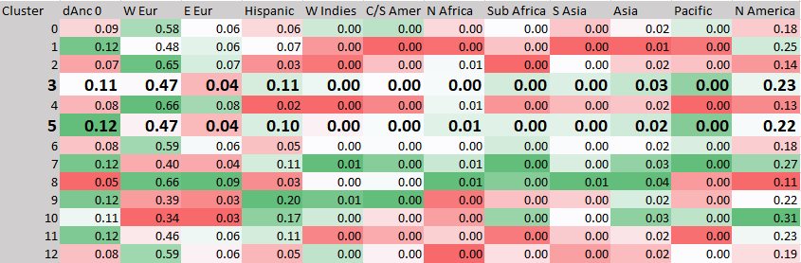
Clusters 3 (365405 individuals)/5 (225065 individuals)
Cluster Means Description
Cluster 3 Age 1.32, schoolchildren to teenagers
Cluster 5 Age 0.90, infants and young children
Sex .48/.49, even split between genders
Labor and marriage related statistics were all near 0 due to being non-applicable
Relatively high rates of minority ancestries, indicating US population is increasing in diversity (see chart below)

Slide 9
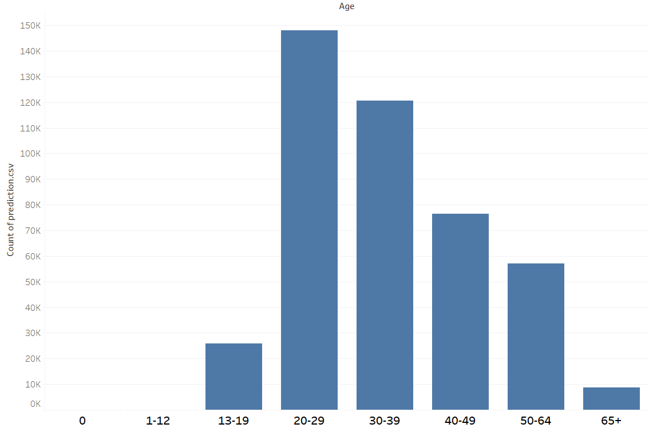
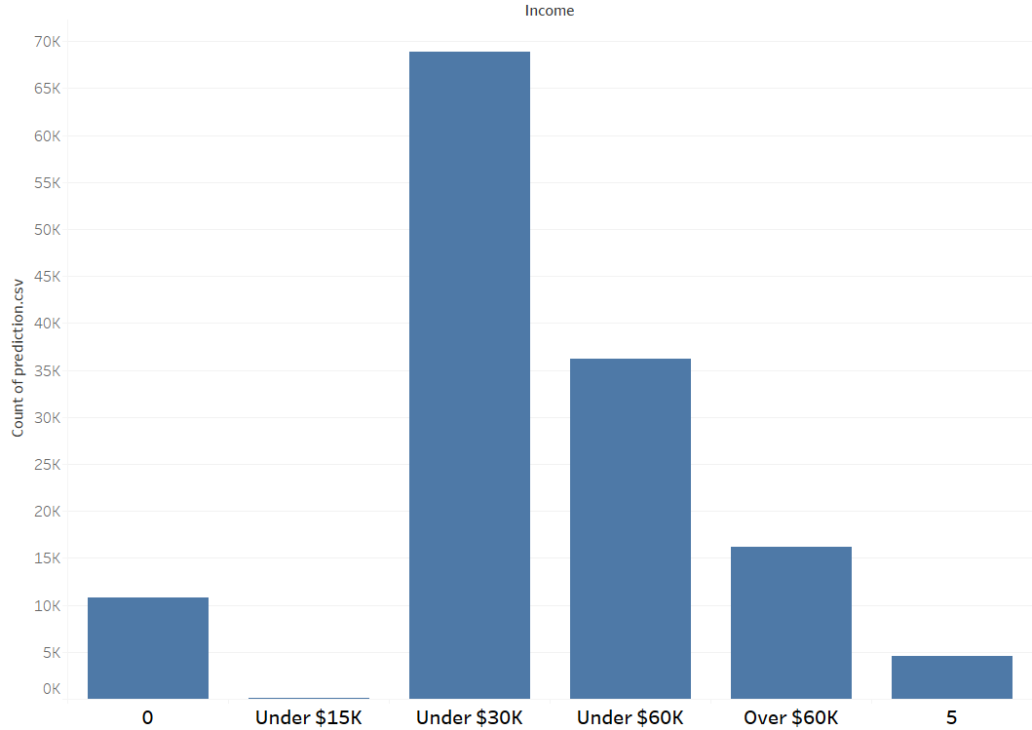
Cluster 4 (136756 individuals)
Cluster Means Description
Age 6.53, ages 50+
Sex 0.38, 62% male
Income 2.44, average under $30000 per year average
Education 11.32, some college education
Poverty 1.82, about average poverty
Most are not working, assuming retirement
36% have work limiting disabilities
39% have previous military service, highest out of all clusters
60% married, 19% widowed. 11% never-married, high rate for elderly cluster
Age Distribution
Income Distribution

Slide 10
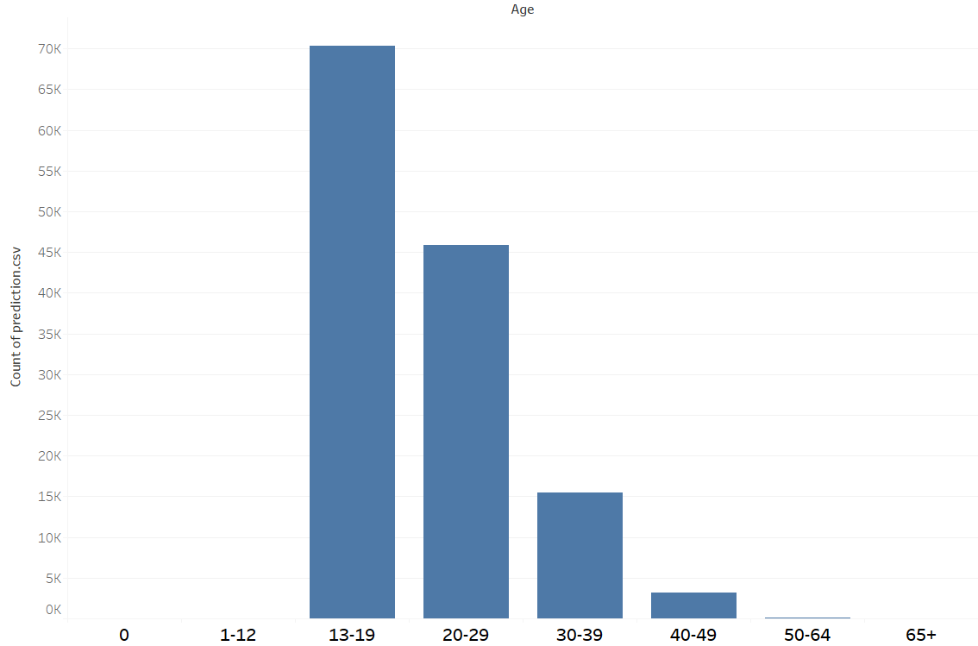
Cluster 7 (134782 individuals)
Cluster Means Description
Age 2.64, late teens and young adults
Sex 0.55, 55% female
Income 1.00, average under $15000 per year
Education 8.74, some High School
Poverty 1.59, highest poverty rate among all clusters
Only 57% worked, mostly part-time occupations. Highest unemployment rate
High representation of minority ancestry
High rate of second language, high rate of non-citizenship
Age Distribution
Industries | Occupations | Military
Retail | Service Laborers | 94% no service

Slide 11
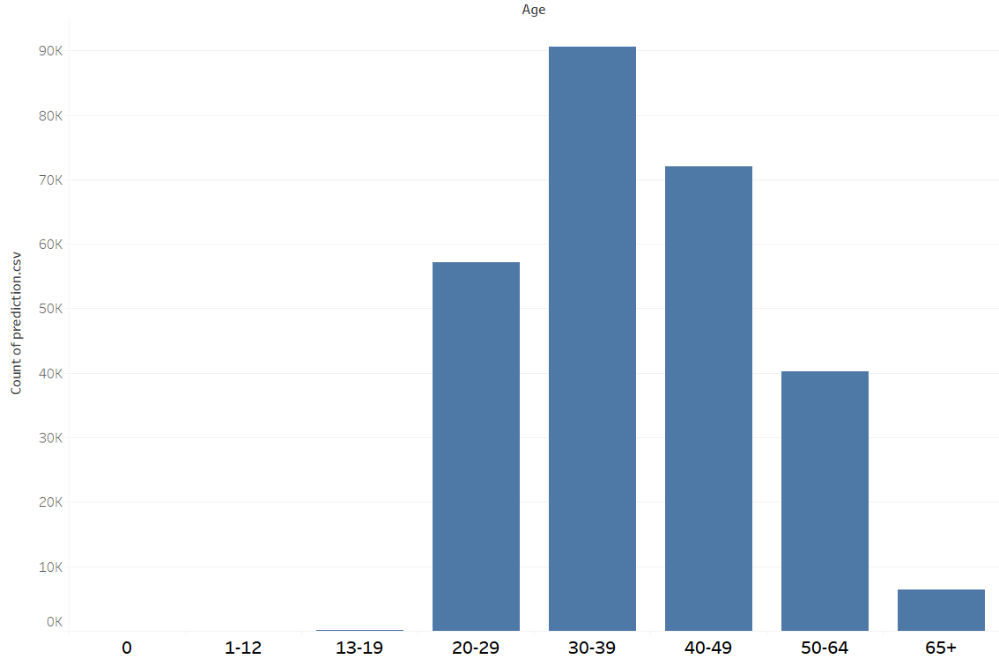
Cluster 8 (266525 individuals)
Cluster Means Description
Age 4.43, 30-50 years old
Sex 0.40, 60% male
Income 3.52, average $60000 per year. Highest of all clusters
Education 14.37, Bachelor’s Degree
Poverty 1.97, virtually non below poverty line
Full employment with full time jobs and vehicles
Mainly European descent, with highest African and Asian representation. High percentage of naturalized citizens
66% married, 22% single. 8% divorce rate
Age Distribution
Industries | Occupations | Military
Professional Manufacturing Finance Real Estate | Managerial Professional Technical Sales | 1% active 16% past 3% reserves 80% none

Slide 12
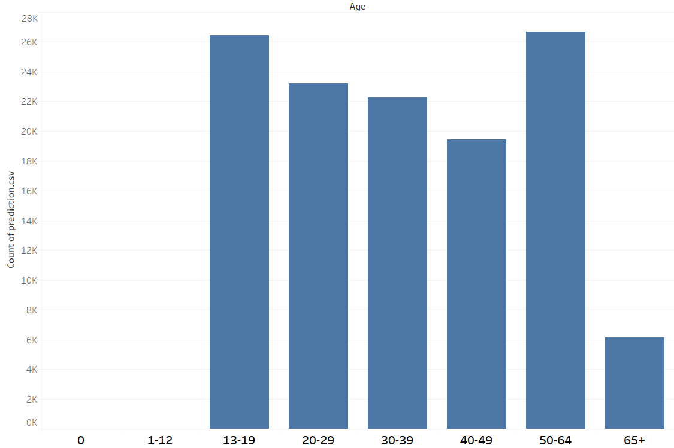
Cluster 9 (124181 individuals)
Cluster Means Description
Age 4.12, mean is 30-40 years old
Sex 0.32, 68% male
Income 2.38, $30000-$60000 per year
Education 6.10, Middle School
Poverty 1.87, relatively low poverty rate
High employment rates with part-time/full-time work. Many have vehicles, some walk
Low rate of European descent, highest rate of Hispanic descent among all clusters. High rate of naturalized or non-citizens
Poor English comparatively, 28% speak a second language
Age Distribution
Industries | Occupations | Military
Manufacturing Retail Repair Personal Services | Precision production Laborers Servicers Agriculture | 0% active 11% past 1% reserves 87% none

Slide 13
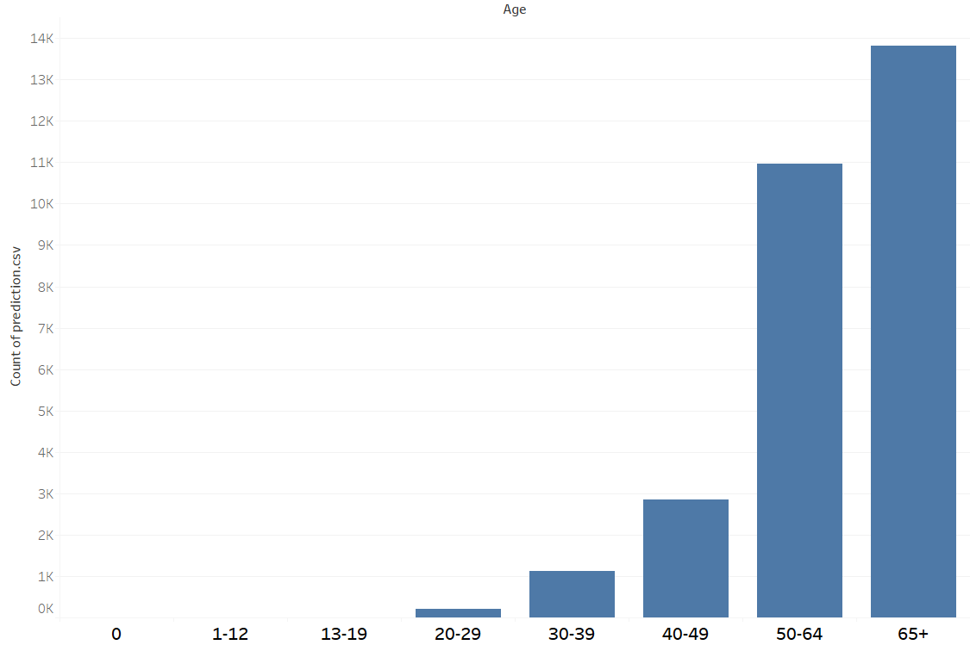
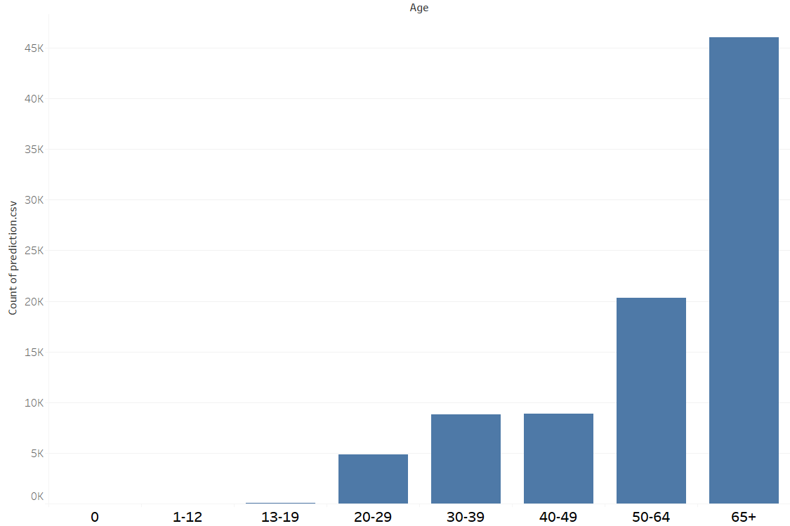
Clusters 10(28956 Individuals)/11 (88972 individuals)
Cluster Means Description
Age 6.27/6.06, ages 50 and over
Sex 1.00, all female for both clusters
Income 1.65/1.66, under $30000. Lowest of all eligible clusters
Education 5.87/5.83, Elementary/Middle School
Poverty 1.69/1.56, high poverty levels
Fertility 8.78/4.00, 7 and 3 children, highest of all clusters
Not employed or with part-time jobs. 35% have work limiting disabilities
Poor English comparatively, about 25% speak a second language
Relatively low percentage of European descent. High percentages of Hispanic and American descent
High percentage born in the Americas. High rate of naturalized and non-citizens
Around 35% of both clusters are widowed
Cluster 10
Age Distribution
Cluster 11
Age Distribution

Slide 14
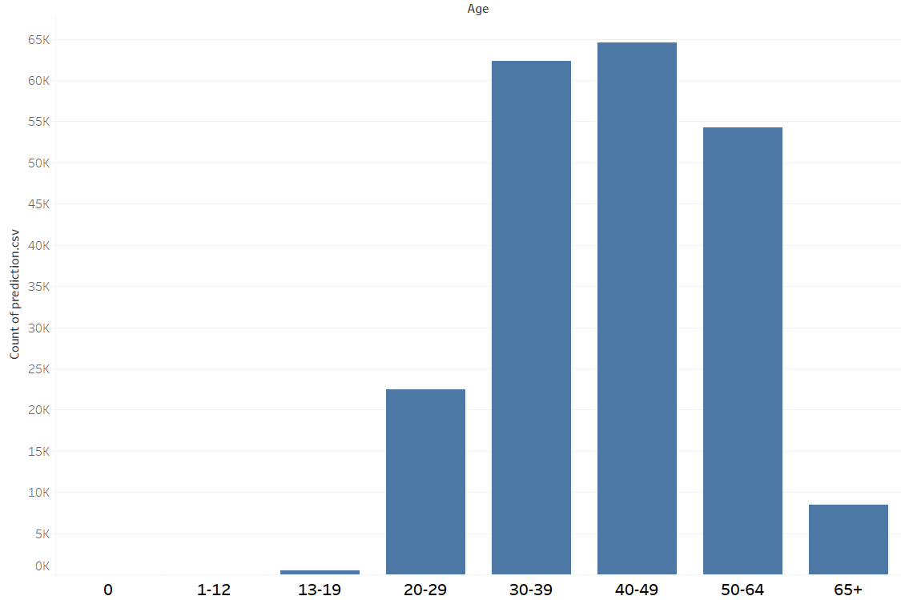
Cluster 12 (212537 individuals)
Cluster Means Description
Age 4.82, ages 30-50
Sex 1.00, all female
Income 2.47, $30000-$60000 per year
Education 10.49, High School Diploma or GED
Poverty 1.93, very low poverty rate
Full employment with part-time and full-time jobs. Travels 20 minutes to work by personal vehicles
Average representation for all ancestral demographics
71% are married. 15% divorce rate, highest of all clusters by nearly double
Age Distribution
Industries | Occupations | Military
Finance/Insurance Retail Professional Public Administration | Technical Sales Admin Service | 0% active 1% past 0% reserves 99% none

Slide 15
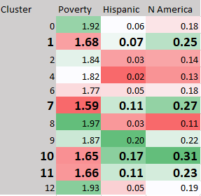
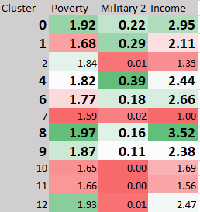
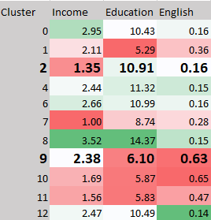
Areas of concern
Clusters with the worst poverty levels also had high levels of Hispanic and N American ancestry
Clusters with military representation had higher incomes and lower poverty, except for Cluster 1
While better education and English levels usually resulted in higher income, the opposite was true for clusters 2 and 9

Slide 16
limitations
Due to discretization of continuous variables, some cluster means were not as accurate and precise as they could have been
K-means isn’t best suited for binary and discrete variables, other clustering algorithms such as k-Modes may have yielded better results
Cluster density visualization is difficult with discrete variable, as points stack at each interval. Thus, they were omitted
Some categorical clusters had values for N/A or no report. Imputation could have been performed to normalize the dataset
Broader categorical features were chosen to limit the number features so that analysis could be contained within report limit. Features such as specific periods of military duty and specific sources of income would have yielded more in-depth analysis
Groupings for Ancestry, Industry, and Occupation were broad. Having the original individual codes for each feature would have made for a more precise model
Further clustering could have been performed on each cluster. It would have been interesting to see what clusters would be discovered among non-laborer clusters, elderly clusters, male/female clusters, etc.

