Slide 2
Outline
Introduction
  Motivations
  Objectives
Overview of authentication on AAA architecture
Local authentication control scheme
Numerical results
Conclusions and future work

Slide 3
Introduction
Motivation
  Authentication is the first step to protect the communication security
    Verify user’s identity to protect resource availability
    Generate keys to protect information secrecy and integrity
  Authentication has great effects on system performance
    Computation complexity costs more power and time
    Many authentication messages on architectures cause more signaling cost and longer time
  Current authentication, authorization, accounting (AAA) architecture cannot meet the QoS requirements
    Traffic and mobility patterns are not concerned
    Remote authentication imposes heavy cost burden

Slide 4
Introduction (Cont.)
Objectives
  To propose a local authentication protocol to establish local security associations for inter-domain roaming mobile users
  To account for mobility and traffic patterns in evaluating the authentication cost
  To determine a threshold life time for a security association and optimize authentication cost
  To reduce the authentication cost and delay significantly

Slide 5
Introduction
Overview of authentication on AAA architecture
  Security association
  Challenge/response authentication
  AAA architecture
Local authentication control scheme
Numerical results
Conclusions and future work

Slide 6
Overview of Authentication on AAA Architecture
Security association: a trust relationship between a sender and a receiver that affords security services to the traffic with parameters like key and lifetime
Challenge/response authentication
HAS
AAA-Arch
MU
AP
LAS
Request
Request
LAS: Local AAA Server
Challenge
Challenge
HAS: Home AAA Server
Response
Challenge/
Response
Challenge/
Response
AP: Access Point
Response
MU: Mobile User
Approval
Approval
AAA-Arch: AAA Architecture
Approval
Approval
Fig. 1 Inter-domain Challenge/Response Authentication in Wireless Networks

Slide 7
Overview of Authentication on AAA Architecture (Cont.)
AAA architecture
PAS
PAS
PAS
AP
LAS
HAS
PAS
PAS
AP
Home Wireless Domain
AP
MU
: Inter-domain roaming
AP: Access Point
PAS: Proxy AAA Server
MU: Mobile User
HAS: Home AAA Server
LAS: Local AAA Server
: PAS Sequence
: Security Association
Fig. 2 AAA Architecture in Wireless Networks

Slide 8
Outline
Introduction
Overview of authentication on AAA architecture
Local authentication control scheme
  Overview of proposed scheme
  Local authentication and SA establishment protocol
  Determine a threshold for optimization
Numerical results
Conclusions and future work

Slide 9
Overview of Proposed Scheme
Arrival of Inter-Domain
Authentication
[Yes]
Check if an SA exists
between the MU and LAS
[No]
Authenticate the MU
Locally with the SA
Check if the residence time
of an MU is greater than
a threshold value
[Yes]
[No]
Authenticate the MU remotely
with AAA architecture
Authenticate the MU
create an SA for the MU
End
Fig. 3 Overview of Local Authentication Control Scheme

Slide 10
Local Authentication and SA Establishment Protocol
MU
LAS
HAS
Req-Challenge
Challenge
Response
Forward
Verify
Yes
Generate SA?
Reply (SA_{K1})
Reply(K₁)
New Request
Req-Challenge
Challenge
Response_{SA}
Verify
Reply
Terminate SA
when MU’s out
LAS: Local AAA Server
SA: Security Association
HAS: Home AAA Server
MU: Mobile User
Fig. 4 Authentication and Local SA Establishment Protocol

Slide 11
Operations of Identities
Operations after authentication approval
  HAS: generates key
  HAS and PAS: relay a message as
  between chain servers i and i-1
K_{u1} = HMAC -MD5(K₀, {R₁||ID_{MU}})
{K_{u1},ALGORITHM, F₀, F_{i}, {R₁,ALGORITHM, F₀}_{K0}}_{Ki}
LAS
PAS
PAS
PAS
PAS
HAS
n
n-1
i
i-1
1
0
K_{u1}: key for local SA between MU and LAS
R₁: random number
K₀: pre-shared key between MU and HAS
F_{i}: random number
K_{i}: pre-shared key between AAA servers i and i-1
i: index of AAA server
ID_{MU}: identification number of an MU

Slide 12
Operations of Identities (Cont.)
  LAS: sends {R₁,ALGORITHM, F₀}_{K0}||{LIFETIME}_{Ku1} to an MU and generates a local SA for it as
  SA::={UID; SPI; ALGORITHM; DIRECTION; KEY; LIFETIME}
  MU: generates a similar local SA as the LAS
  Lifetime is equal to residence time of an MU, which is critical to authentication efficiency
UID: Unique user identification
SPI: Security parameter index
ALGORITHM: Algorithm used in this local SA
KEY: Key for authentication
LIFETIME: Time to keep this SA
DIRECTION: Used for packet arriving or leaving

Slide 13
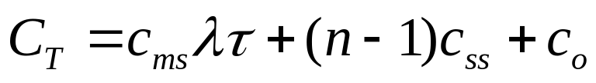
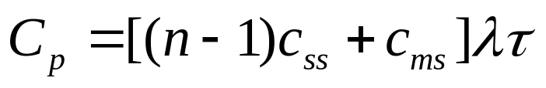
Determine a Threshold Time for Optimization
Accumulative authentication cost with proposed scheme, C_{T}
Accumulative authentication cost with remote authentication each time, C_{p}
c_{o}: maintenance cost of local SA
n: number of hops between MU and HAS
c_{ms}: authentication cost on the hop
between MU and LAS
c_{ss}: authentication cost on the hop
between servers
λ: arrival rate of the authentications
of the MU
τ: residence time of an MU
in the network

Slide 14
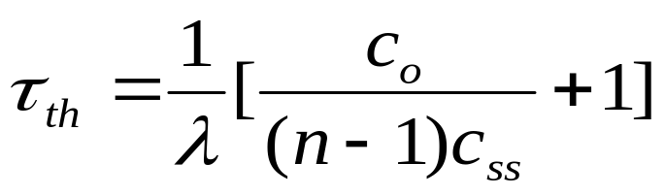
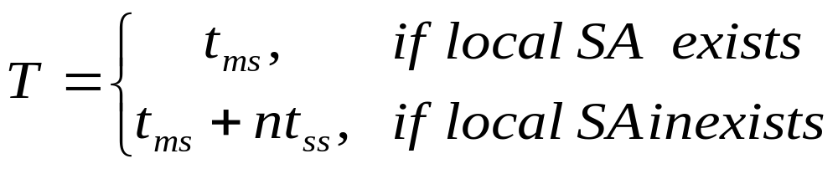
Determine a Threshold Time for Optimization (Cont.)
Threshold time for optimization can be obtained by comparing C_{T} and C_{P}
Evaluation of authentication delay per request, T
t_{ms}: authentication time on the hop between MU and LAS
t_{ss}: authentication time on the hop between authentication servers

Slide 15
Outline
Introduction
Overview of authentication on AAA architecture
Local authentication control scheme
Numerical results
Conclusions and future work

Slide 16
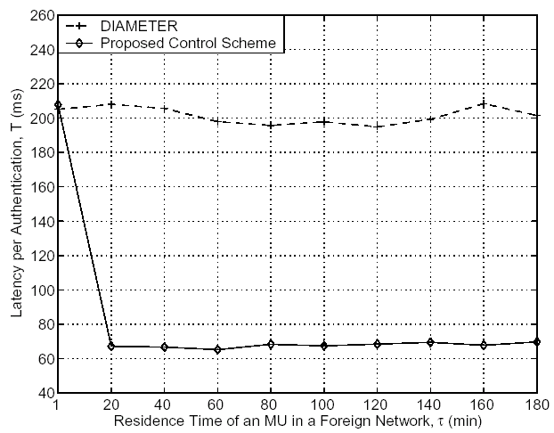
Numerical Results
Improvement is about 68%
Benefit comes from using local SA for authentication
Fig. 5 Authentication Time vs. Residence Time of an MU

Slide 17
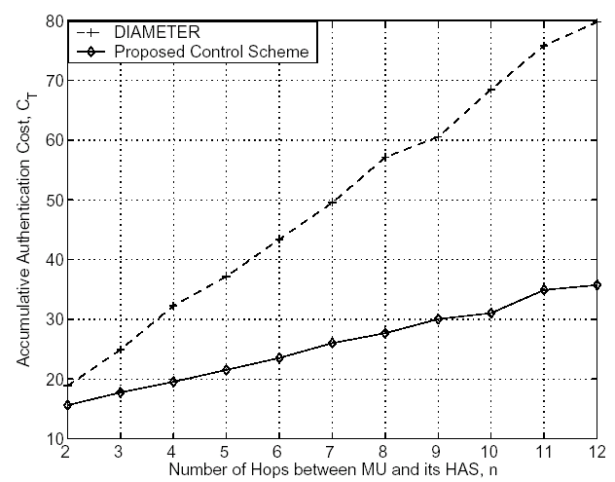
Numerical Results (Cont.)
Improvement is increased with n, and it is 50% at nine hops
Benefit also comes from the utilization of local SA
Fig. 6 Authentication Cost vs. Number of Hops

Slide 18
Conclusions and Future Work
Conclusions
  New authentication protocol is proposed to establish local security association
  Threshold residence time is determined for optimization based on mobility and traffic patters
  Authentication cost and latency are reduced greatly
Future work
  Analyze more performance like throughput and power
  Discuss possibility to implement proposed scheme on mobile ad hoc networks

Slide 19
Thank You!
Questions?

