Slide 1
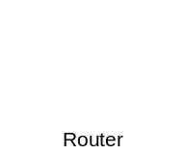




NETWORK SWITCH
HOST
HOME AGENT
HOME AGENT
HOST
MN
MN
RADIUS
RADIUS
Application
Application
TCP/UDP/SSL/TSL
TCP/UDP
TCP/UDP/SSL/TSL
TCP/UDP
IP/IPSEC/MIP
IP
IP/IPSEC/MIP
IP/IPSEC/MIP
802.3/802.11b/g/802.16
802.3/802.11b/g/802.16
802.3/802.11b/g/802.16
802.3/802.11b/g/802.16
Physical
Physical
Physical
Physical

