Slide 1
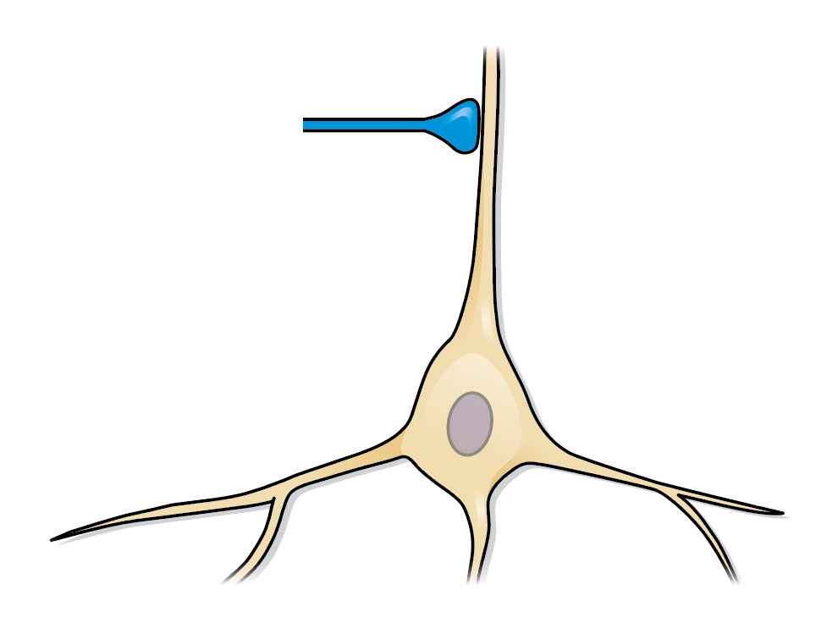

Presynaptic spike
Connectivity
Activity
Postsynaptic potential
Voltage
5 mV
Time
5 ms

Slide 2
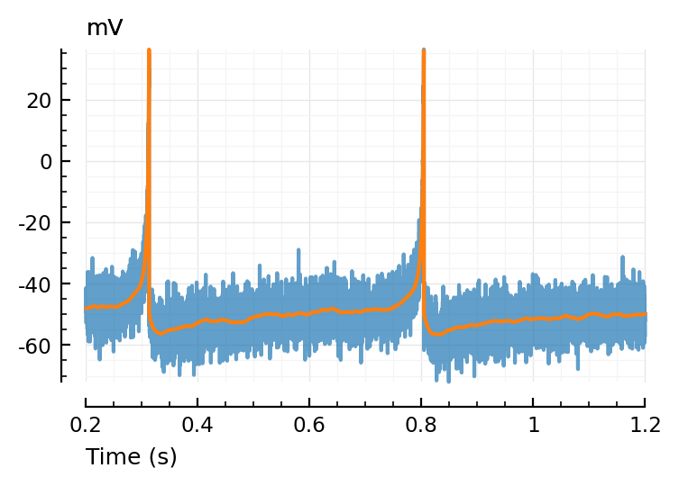
Simulated membrane voltage
Spike times of a
possible input neuron
Notes:
From 2022-05 PGR_Conf.pptx

Slide 3
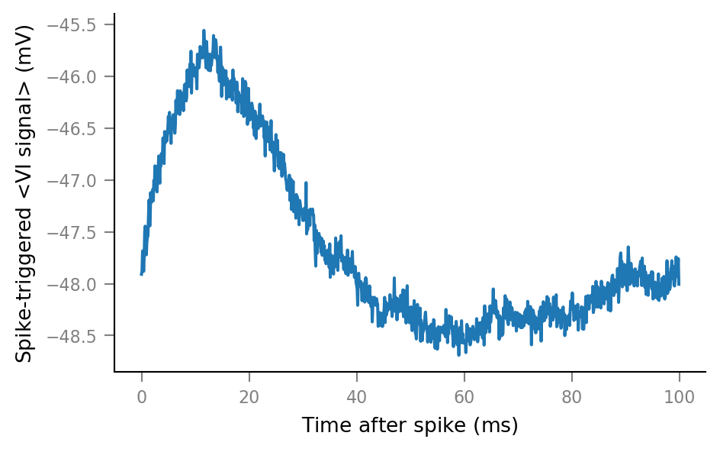
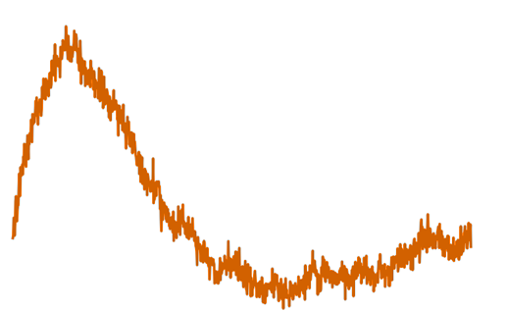
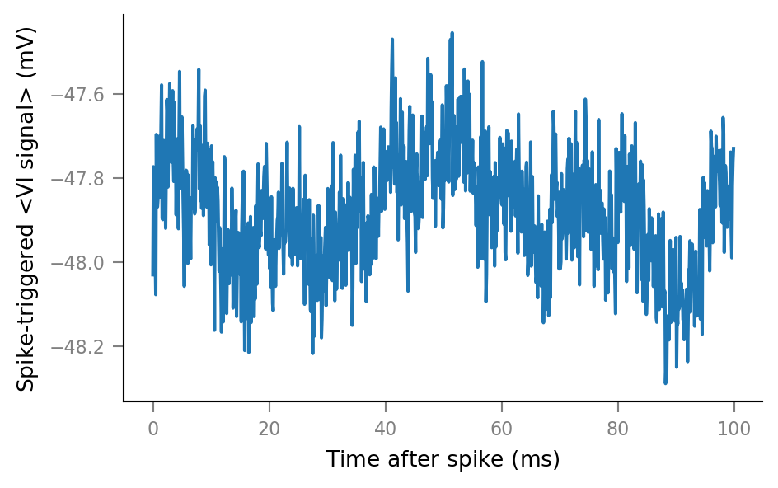
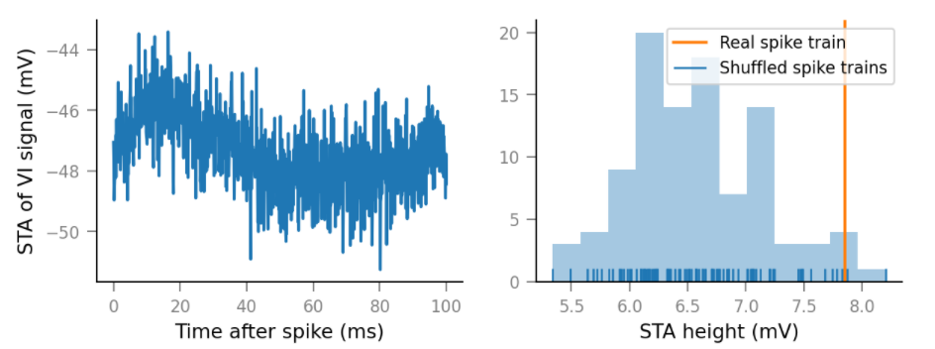
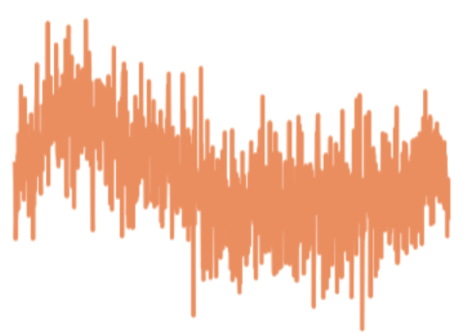
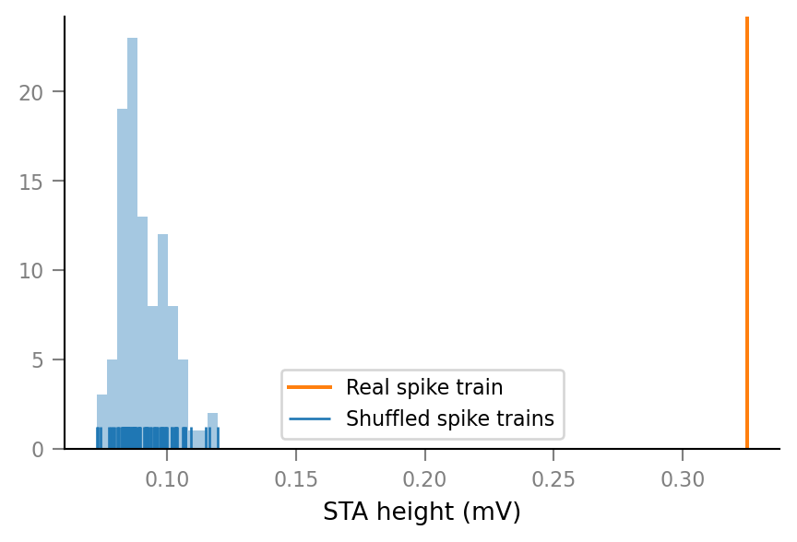
Spike-Triggered Average (STA)
..with spike train of input neuron M
STA height
..with shuffled spike train of same input neuron M
Membrane voltage (mV)
p = 0.02
Membrane voltage (mV)
STA height
Time after presynaptic spike (ms)
Time after spike (ms)
Membrane voltage (mV)
..with spike train of another, non-input neuron
Shuffled spike train
Original spike train
STA height
p < 0.01
Time after spike (ms)
STA height
Notes:
From 2022-05 PGR_Conf.pptx

Slide 4
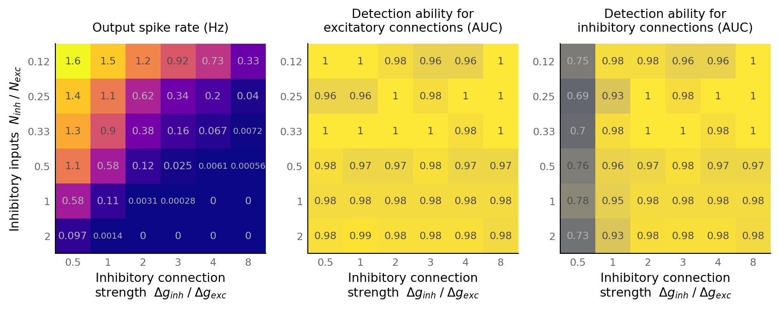
Output spike rate (Hz)
Connection test performance for
excitatory connections (AUC)
Connection test performance for
inhibitory connections (AUC)
N_{inh} / N_{exc}
(Proportion inputs inhibitory)
Inhibitory connection strength Δg_{inh} / Δg_{exc}
Inhibitory connection strength Δg_{inh} / Δg_{exc}
Inhibitory connection strength Δg_{inh} / Δg_{exc}

