Slide 1
Recap SW5 - RTOS
Kilian Ineichen und Silvano Stecher

Slide 2
RTOS Why RTOS?
Solves synchronization problems
Quasi-concurrent execution of services
Close to Hardware → better performance
OS needs Driver
RTOS direct connected
Correct Result at correct time, independent of System load, in a deterministic and foreseeable way
Requirements for standard OS and RTOS are different
Notes:
Wir nehmen es als fast gleichzeitig wahr
Ist nicht AS FAST AS POSSIBLE
General purpose OS kann das nicht erfüllen

Slide 3
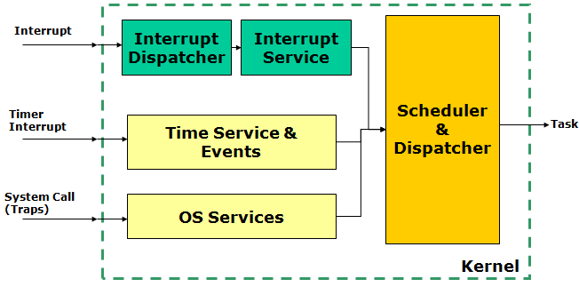
RTOS Kernel
Catching Interrupts
Time base (Timer/Tick Interrupt)
System Call and Traps (Trigger Interrupt)
Notes:
Diese drei Eingänge hat der Kernel
Aufgaben: verteilt die Ressourcen, Kontrolle des Zugriffs

Slide 4
RTOS Scheduler
Tick passes control to scheduler
Scheduler can schedule other Task
Opportunities: Tick, Wait(), Yield(), Sync()
Notes:
Der Scheduler sagt welcher Tast nun zeit bekommt zum rechnen, verschiedene Prinzipien (Roud Robin) nach einer gewissen Zeit kommt nächster hinter anfangen

Slide 5
RTOS OS Process States
Only one Task running

Slide 6
FreeRTOS Architecture
Kernel
Small Kernel, implemented in C
Preemptive or cooperative scheduler mode (at compile time)
Kernel only needs tick interrupt and software interrupt
’Ticks’ provide time base for RTOS (Typically 10 ms or 1 ms tick period)
Notes:
Bis hier Silvano
Es gibt zwei arten preemtive and cooperative
Haben wir vorhere schon gesehen mit Interrupts

Slide 7
FreeRTOS Architecture
Tasks
Tasks are running with stack in the ’heap’
Tasks are (usually) staying in an endless loop
Software interrupt used to switch task context

Slide 8
FreeRTOS Kernel Control
Starts the scheduler ( Init -> Running)
Creates IDLE task (configMINIMAL_STACK_SIZE, tskIDLE_PRIORITY)
Runs the highest priority task

Slide 9
FreeRTOS Kernel Control
Puts the kernel from Active to Suspended state
Puts the kernel from Suspended to Active state

Slide 10


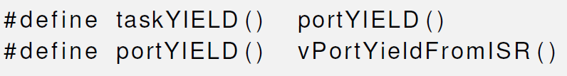
FreeRTOS Kernel Control
Forces a context switch with Software Interrupt
Required for cooperative multitasking

Slide 11
FreeRTOS Tasks
Preemptive Scheduling
Always run the highest-priority ready task
Multiple tasks with the same priority: time-slicing

Slide 12
FreeRTOS Tasks
vTaskDelay() => blocked

Slide 13
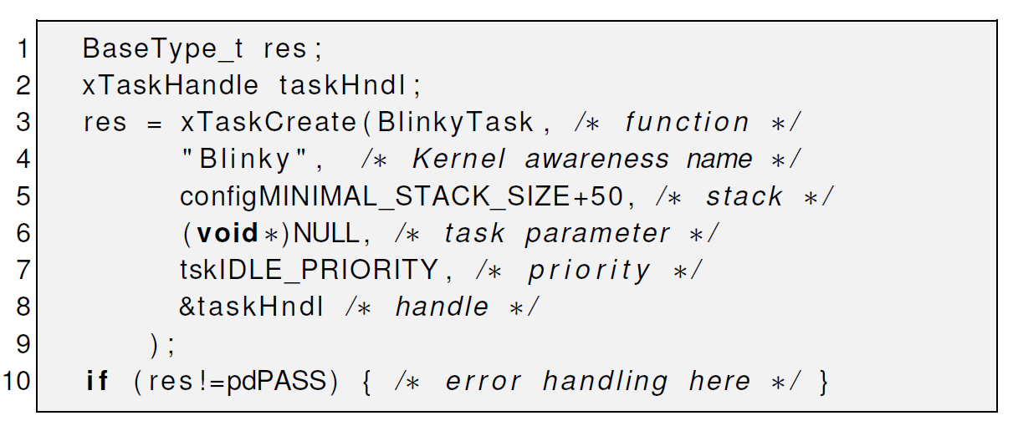
FreeRTOS Task creation

Slide 14
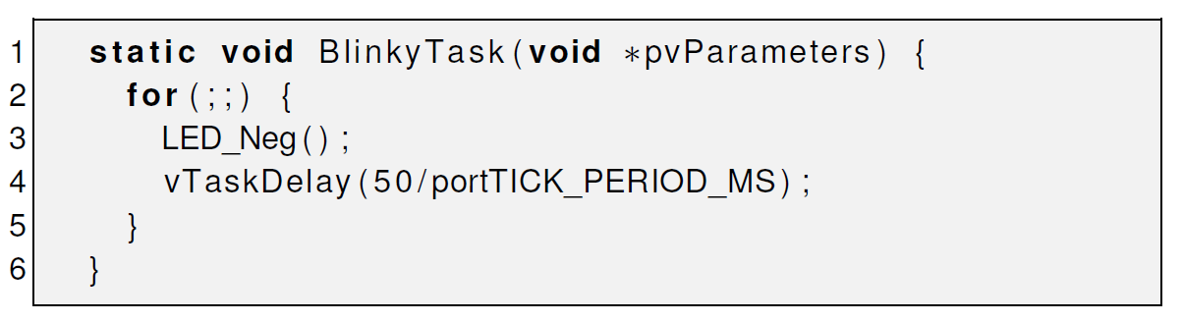
FreeRTOS Task

Slide 15
Questions:
What does RTOS mean?
Real Time Operation System
What are Pros and Cons for using RTOS in PREN?
+ Quasi-concurrent
- Uses more Memory
What is Preemptive Scheduling?
Multiple tasks with the same priority: time-slicing
Always run the highest-priority ready task

Slide 16
How can a Task force a context switch ( switch Task )?
taskYield
How can you prevent, that your Task ends?
For(;;){}

