Slide 1
Recap SW5 - RTOS
Kilian Ineichen und Silvano Stecher

Slide 2
RTOS Why RTOS?
Solves synchronization problems
Quasi-concurrent execution of services
Close to Hardware → better performance
OS needs Driver
RTOS direct connected
Correct Result at correct time, independent of System load, in a deterministic and foreseeable way
Requirements for standard OS and RTOS are different

Slide 3
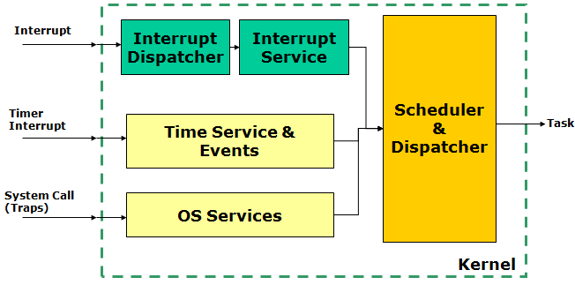
RTOS Kernel
Catching Interrupts
Time base (Timer/Tick Interrupt)
System Call and Traps (Trigger Interrupt)

Slide 4
RTOS Scheduler
Tick passes control to scheduler
Scheduler can schedule other Task
Opportunities: Tick, Wait(), Yield(), Sync()

Slide 5
RTOS OS Process States
Only one Task running

Slide 6
FreeRTOS Introduction
Open Source, free-of-charge
OpenRTOS: commercial supported version
SafeRTOS: special version dedicated to safety critical systems
Processor Expert component

Slide 7
FreeRTOS Architecture
Kernel
Small Kernel, implemented in C
Preemptive or cooperative scheduler mode (at compile time)
Kernel only needs tick interrupt and software interrupt
’Ticks’ provide time base for RTOS (Typically 10 ms or 1 ms tick period)
RTOS creates and runs in IDLE task

Slide 8
FreeRTOS Architecture
Tasks
Tasks are running with stack in the ’heap’
Tasks are (usually) staying in an endless loop
Software interrupt used to switch task context

Slide 9
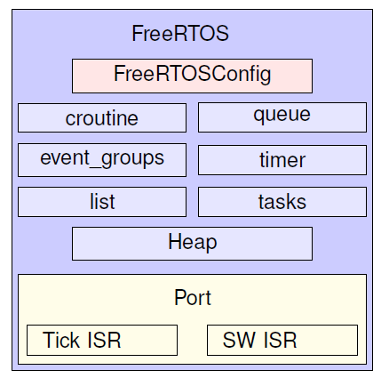
FreeRTOS Architecture

Slide 10
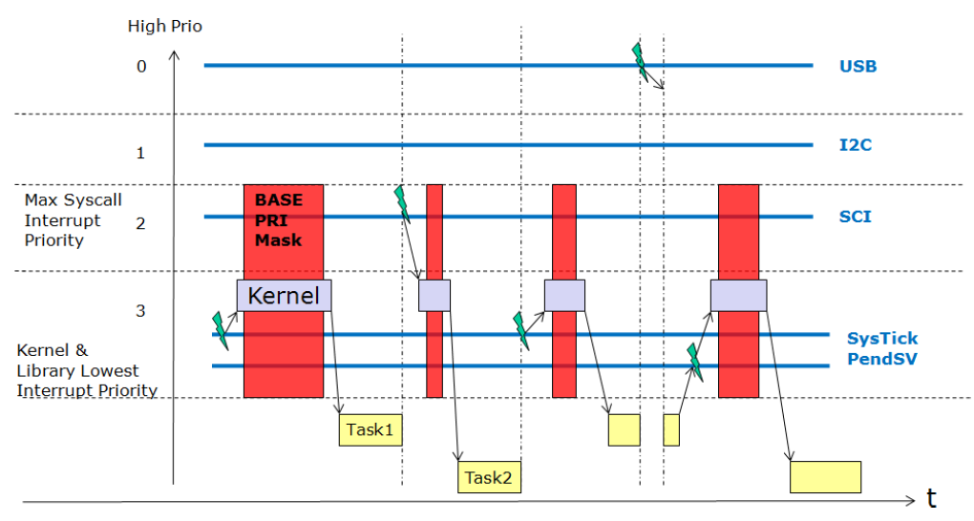
FreeRTOS Architecture
Kernel and Interrupts
Tick Interrupt: SysTick
Software Interrupt: SVCall, PendableSrvReq
Other interrupts: under application control
Do not call RTOS API from ISR
using PRIMASK to mask interrupts
configMAX_SYSCALL_INTERRUPT_PRIORITY

Slide 11
FreeRTOS Kernel Control
Starts the scheduler ( Init -> Running)
Creates IDLE task (configMINIMAL_STACK_SIZE, tskIDLE_PRIORITY)
Runs the highest priority task

Slide 12
FreeRTOS Kernel Control
Puts the kernel from Active to Suspended state
Puts the kernel from Suspended to Active state

Slide 13


FreeRTOS Kernel Control
taskYield
Forces a context switch with Software Interrupt
I Required for cooperative multitasking

Slide 14
FreeRTOS Tasks
Preemptive Scheduling
Always run the highest-priority ready task
Multiple tasks with the same priority: time-slicing

Slide 15
FreeRTOS Tasks
vTaskDelay() it will block

Slide 16
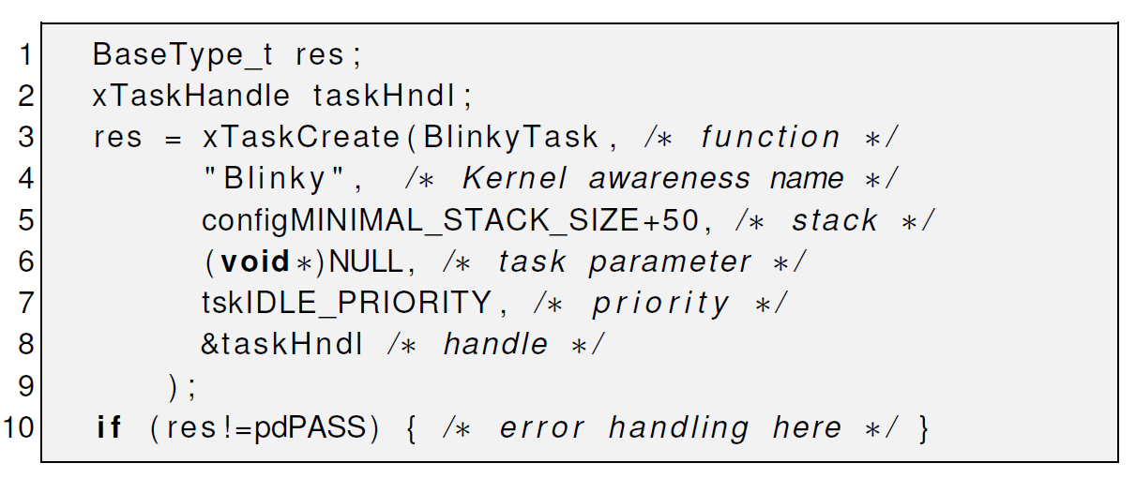
FreeRTOS Task creation

Slide 17
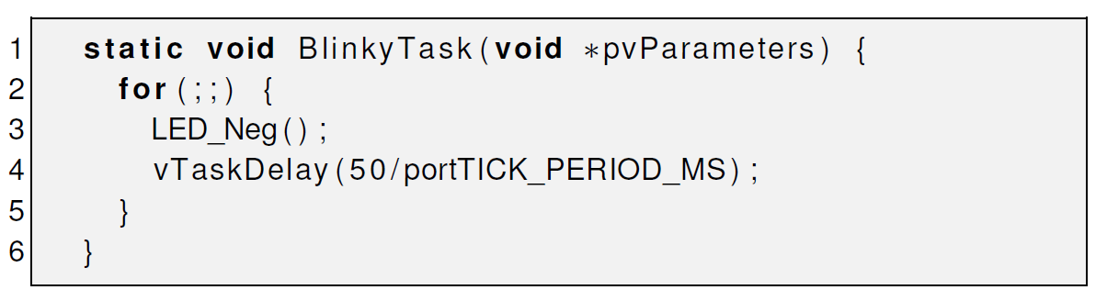
FreeRTOS Task

Slide 18
Questions:
What are Pros and Cons for using in PREN an RTOS?
+ Quasi-concurrent, Priorityhandling with Tasks with ISR
- Controller needed, Memory for OS ??
What is Preemptive Scheduling?
Multiple tasks with the same priority: time-slicing
Always run the highest-priority ready task

Slide 19
How can you force a context switch ( switch Task )?
taskYield
In which modes can the Scheduler put the Tasks?
Tick, Wait(), Yield(), Synch()
How can a Task be destroyed?
It can’t. I can only be suspended

