Slide 1
Recap SW5 - RTOS
Kilian Ineichen und Silvano Stecher

Slide 2
RTOS Why RTOS?
Solves synchronization problems
Quasi-concurrent execution of services
Close to Hardware → better performance
OS needs Driver
RTOS direct connected
Correct Result at correct time, independent of System load, in a deterministic and foreseeable way
Requirements for standard OS and RTOS are different

Slide 3
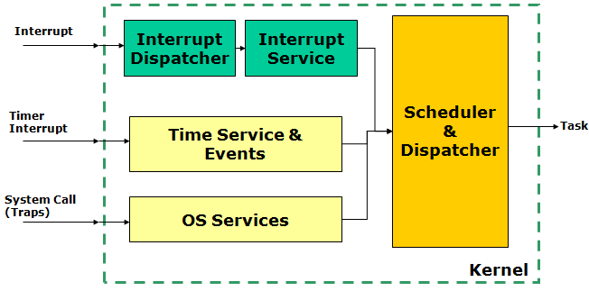
RTOS Kernel
Catching Interrupts
Time base (Timer/Tick Interrupt)
System Call and Traps (Trigger Interrupt)

Slide 4
RTOS Scheduler
Tick passes control to scheduler
Scheduler can schedule other Task
Opportunities: Tick, Wait(), Yield(), Sync()

Slide 5
RTOS OS Process States
Only one Task running

Slide 6
FreeRTOS Architecture
Kernel
Small Kernel, implemented in C
Preemptive or cooperative scheduler mode (at compile time)
Kernel only needs tick interrupt and software interrupt
’Ticks’ provide time base for RTOS (Typically 10 ms or 1 ms tick period)
Notes:
Bis hier Silvano

Slide 7
FreeRTOS Architecture
Tasks
Tasks are running with stack in the ’heap’
Tasks are (usually) staying in an endless loop
Software interrupt used to switch task context

Slide 8
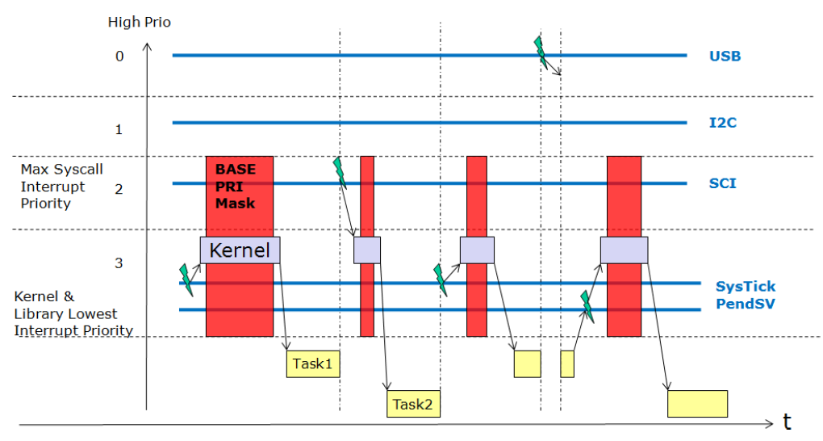
FreeRTOS Architecture
Kernel and Interrupts
Tick Interrupt: SysTick
Software Interrupt: SVCall, PendableSrvReq
Do not call RTOS API from ISR
Cortex-M0+: Kernel disables global interrupts

Slide 9
FreeRTOS Kernel Control
Starts the scheduler ( Init -> Running)
Creates IDLE task (configMINIMAL_STACK_SIZE, tskIDLE_PRIORITY)
Runs the highest priority task

Slide 10
FreeRTOS Kernel Control
Puts the kernel from Active to Suspended state
Puts the kernel from Suspended to Active state

Slide 11


FreeRTOS Kernel Control
taskYield
Forces a context switch with Software Interrupt
Required for cooperative multitasking

Slide 12
FreeRTOS Tasks
Preemptive Scheduling
Always run the highest-priority ready task
Multiple tasks with the same priority: time-slicing

Slide 13
FreeRTOS Tasks
vTaskDelay() => blocked

Slide 14
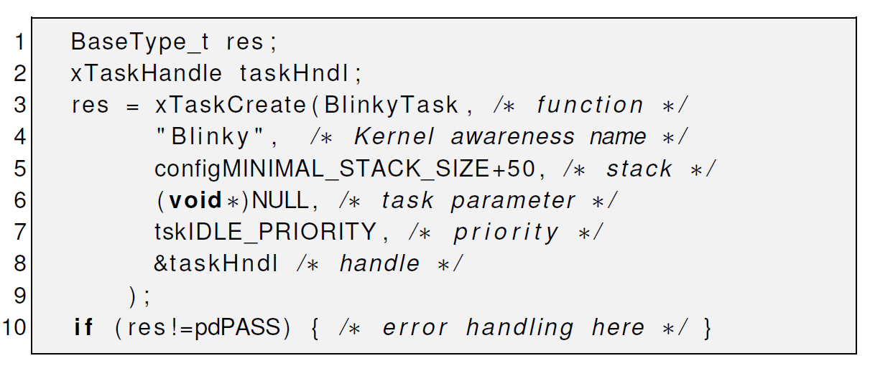
FreeRTOS Task creation

Slide 15
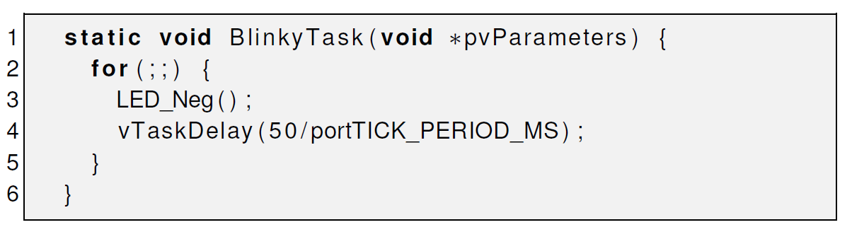
FreeRTOS Task

Slide 16
Questions:
What does RTOS mean?
Real Time Operation System
What are Pros and Cons for using RTOS in PREN?
+ Quasi-concurrent
- Uses more Memory
What is Preemptive Scheduling?
Multiple tasks with the same priority: time-slicing
Always run the highest-priority ready task

Slide 17
How can a Task force a context switch ( switch Task )?
taskYield
How can you prevent, that your Task ends?
For(;;){}

