Slide 1
Sparse Matrix Performance
Chai Capili
Thomas Fisher
Praneeth Mari
Sara Romero

Slide 2
The Hypothesis
Optimal performance of sparse matrices is bounded by O(n) non-zero values in the matrix.
Performance will be analyzed through communication costs, storage overhead, and operation runtime (Algorithms)

Slide 3
Our Dataset
20 Matrices used by all team-member implementations
10 matrices of 100x100 [10% dense – 90% dense]
10 matrices of 1000x1000[10% dense – 90% dense]
Our smallest Density is the Diagonal Matrix

Slide 4
Sparse Matrix Communication

Slide 5
COO, CSR, CSC Format
Dense COO CSR CSC
[1,0,2]
[0,3,0]
[4,0,5]
Values: [1, 2, 3, 4, 5]
Cols: [0, 2, 1, 0, 2]
Rows: [0, 0, 1, 2, 2]
Values: [1, 2, 3, 4, 5]
Cols: [0, 2, 1, 0, 2]
Rowptrs: [0, 2, 3, 5]
Values: [1, 4, 3, 2, 5]
Rows: [0, 2, 1, 0, 2]
Colptrs: [0, 2, 3, 5]

Slide 6
Ping Pong Tests (Communication Costs)
P0
P1
5000 iterations of ping-pong per matrix ​
MPI_Pack and MPI_Unpack are used with MPI_Send/MPI_Recv on each of the COO,CSR, CSC​
The dense format just uses a basic MPI_Send/MPI_Recv

Slide 7
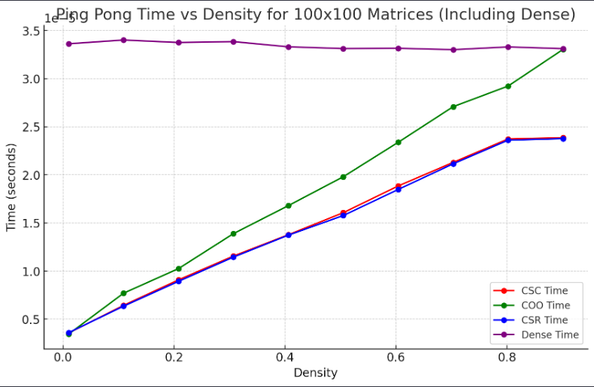
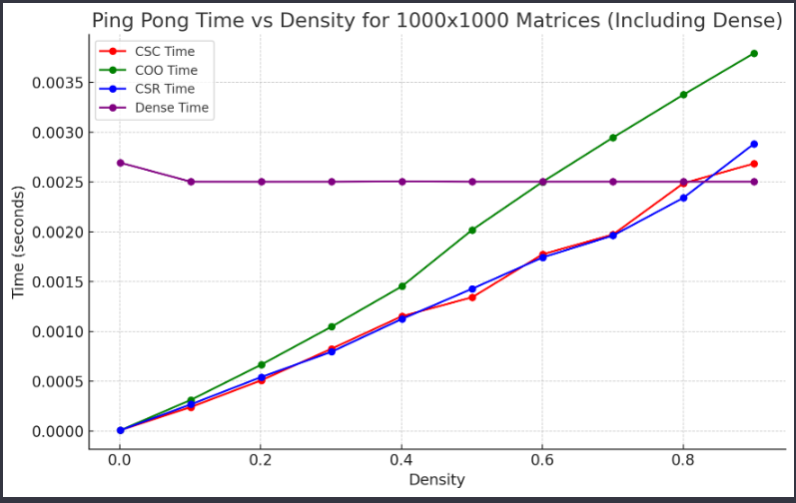
Ping Pong Timings

Slide 8
100 x 100 Analysis
These ping pong timings show the general trend for communication performance between the different formats
I was expecting to see dense outperform the other formats, but this occurs at 1000x1000
We see that the best communication performance is at O(n) sparsity

Slide 9
1000 x 1000 Analysis
At about 0.8 density, the cost of communication for the dense format outperforms the other formats
Again, We see that the best communication performance is at O(n) sparsity

Slide 10
Sparse Matrix Storage Analysis

Slide 11

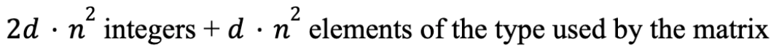
Theoretical Analysis
Mathematical modeling of matrix formats
Dense
COO
CSR
CSC

Slide 12
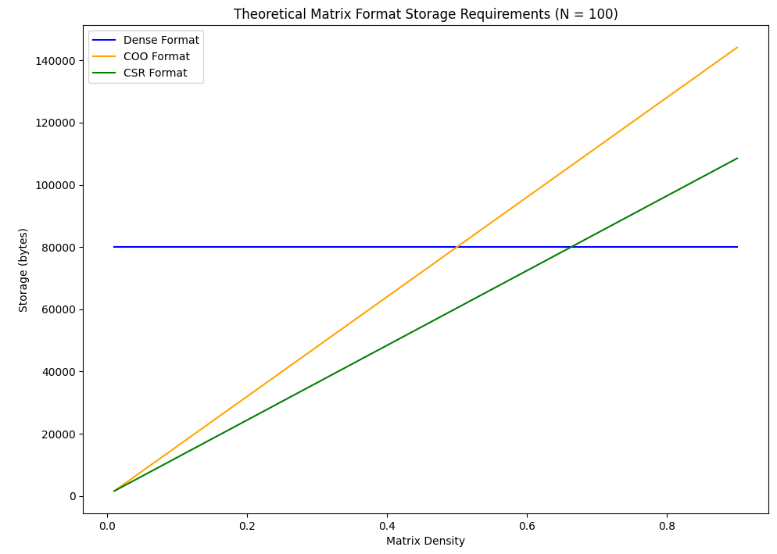
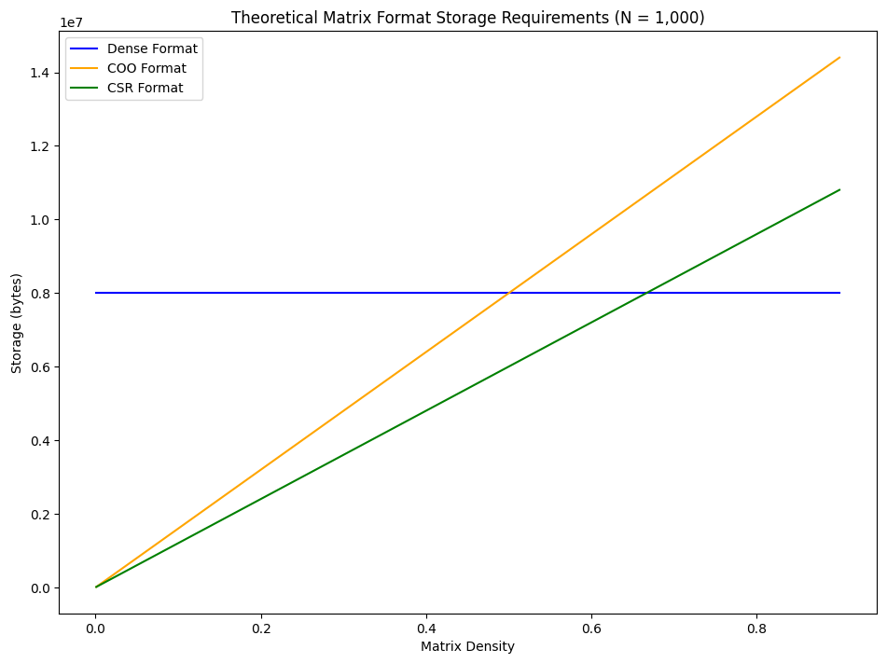
Theoretical Results

Slide 13
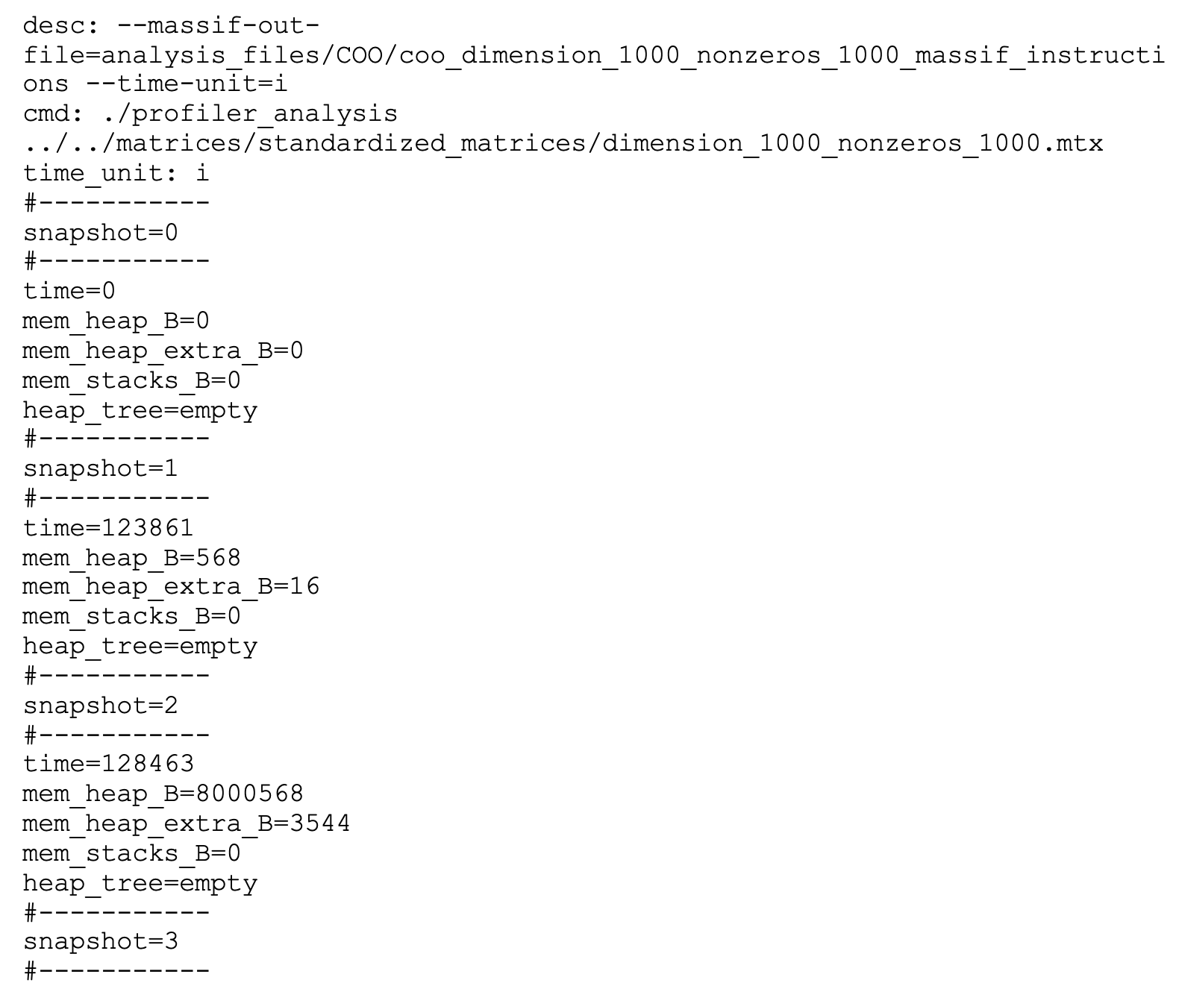

Experimental Analysis
Used Valgrind's massif tool to measure heap usage.
Generated 10 data files each for dimensions 100 and 1,000.

Slide 14
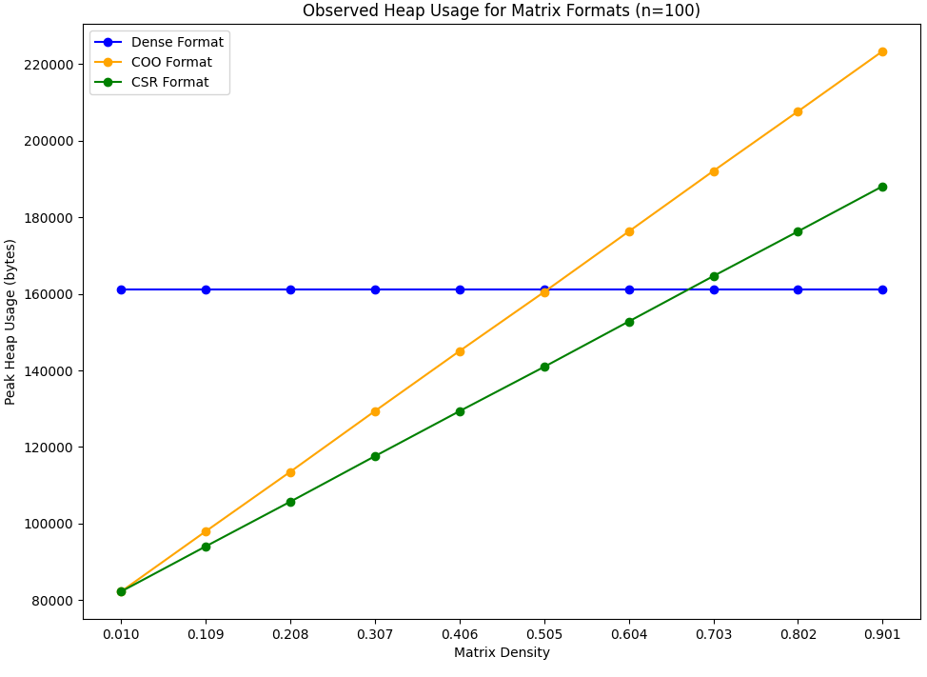
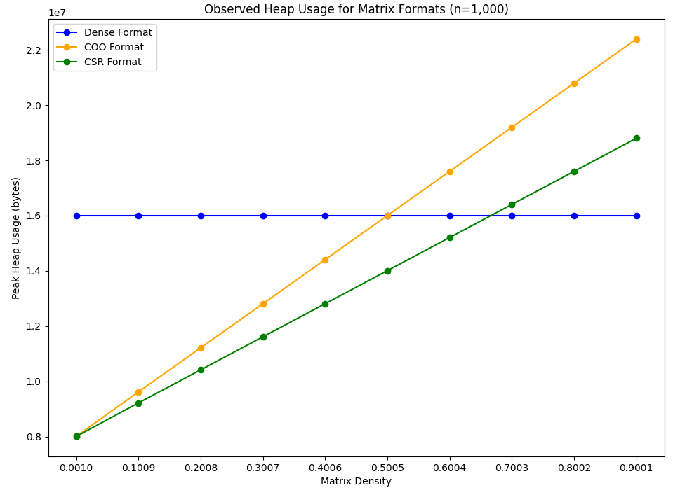
Experimental Results

Slide 15
Sparse Matrix Transpose

Slide 16
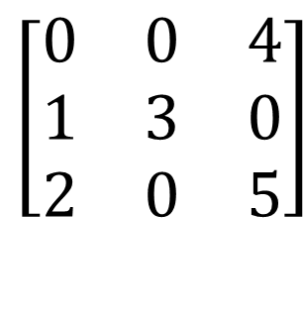
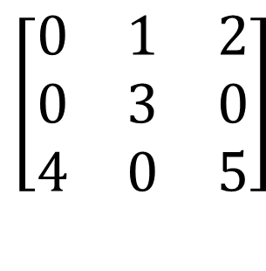
CSR Transpose
“Transpose of a matrix,” Math Doubts, https://www.mathdoubts.com/matrix/transpose/ (accessed Dec. 3, 2023).
$$\left[\begin{matrix}0 & 1 & 2 \\ 0 & 3 & 0 \\ 4 & 0 & 5\end{matrix}\right]$$
$$\left[\begin{matrix}0 & 0 & 4 \\ 1 & 3 & 0 \\ 2 & 0 & 5\end{matrix}\right]$$
Values: {1, 2, 3, 4, 5}
Row Pointers: {0, 2, 3, 5}
Columns: {1, 2, 1, 0, 2}
Values: {4, 1, 3, 2, 5}
Row Pointers: {0, 1, 3, 5}
Columns: {2, 0, 1, 0, 2}

Slide 17
Something interesting to observe…
$$\left[\begin{matrix}0 & 1 & 2 \\ 0 & 3 & 0 \\ 4 & 0 & 5\end{matrix}\right]$$
$$\left[\begin{matrix}0 & 0 & 4 \\ 1 & 3 & 0 \\ 2 & 0 & 5\end{matrix}\right]$$
Values: {4, 1, 3, 2, 5}
Column Pointers: {0, 1, 3, 5}
Rows: {2, 0, 1, 0, 2}
Values: {4, 1, 3, 2, 5}
Row Pointer: {0, 1, 3, 5}
Columns: {2, 0, 1, 0, 2}
If we represent the original matrix in CSC, it’s equivalent to the transposed CSR matrix

Slide 18
CSR Transpose Algorithm
$$CSR$$
𝐶𝑆𝑅
$$CSR$$
𝐶𝑆𝑅
$${CSR}^{T}$$
〖𝐶𝑆𝑅〗^𝑇
$$CSC$$
𝐶𝑆𝐶
Same algorithm as converting CSR to CSC, just different variable names

Slide 19
Dense Algorithm
Partition
Partition matrix A into square blocks
Transpose
Transpose block
Insert
Insert block into matrix t_A

Slide 20
CSR vs Dense Transpose
Averages of 100 iterations:
Not the expected trade-off in runtime at O(n) non-zeros
CSR has better operational runtime across all densities
Hard to effectively compare due to extremely different algorithms

Slide 21
Parallelizing the algorithm
Challenging
Calculating each row pointer relies on summing the value of the previous pointer
What can be parallelized?
Counting the number of non-zeros in each column of the original matrix.
This is used to later to calculate the transposed row pointer

Slide 22
Varying Communication Overhead
Averages of 100 iterations:

Slide 23
What about CSC and COO Transpose?
CSC is the same algorithm as CSR, just different variable names
COO is trivial
Just swap the row and column arrays

Slide 24
Major communication and storage overhead
Averages of 100 iterations:

Slide 25
CSR vs COO vs Dense Transpose
Averages of 100 iterations:
Unexpectedly, COO outperforms CSR in operational runtime
CSR transpose algorithm has increased complexity due to row pointers

Slide 26
Sparse Matrix-Matrix Multiplication

Slide 27
Experimental Analysis using COO, CSR
Performance comparison of different matrix formats (COO, CSR)
Observed trend: CSR outperformed COO
Also observed findings that support the hypothesis O(n) non-zero values maximize performance.
Challenges faced: Implementing parallel version of sparse matrix-matrix multiplication. Ran into segmentation faults.

Slide 28
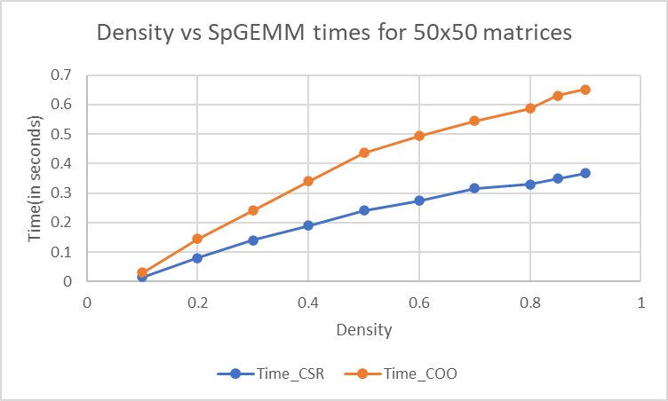

Slide 29
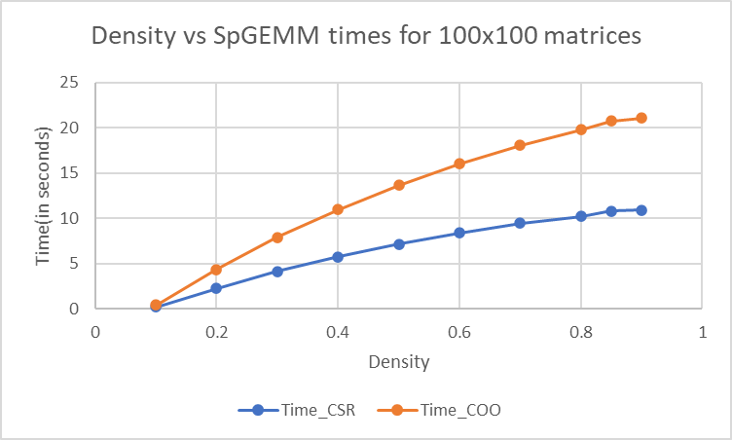

Slide 30
What’s next?

Slide 31
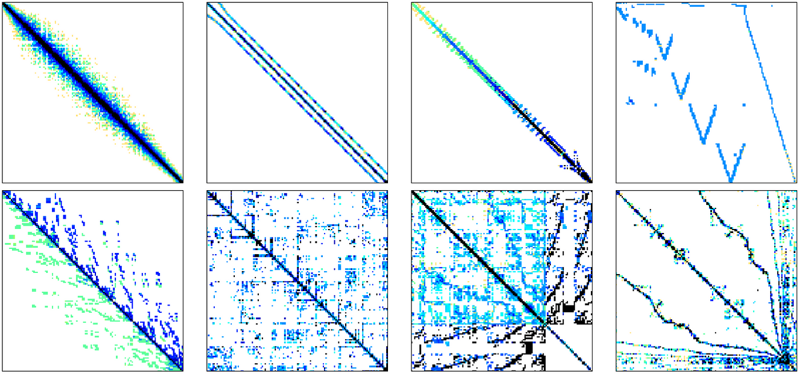
The effects of sparsity patterns
Increased parallelism and optimization
CUDA applications
“Sparse matrix-vector multiplication with Cuda,” Medium, https://medium.com/analytics-vidhya/sparse-matrix-vector-multiplication-with-cuda-42d191878e8f (accessed Dec. 3, 2023).

Slide 32
Conclusion
Our team investigated how density and format affect sparse matrix performance across a variety of metrics.
We explored sparse matrix operation cost, communication cost, and storage cost.
Our analysis supports the hypothesis that O(n) non-zero values in a sparse matrix maximizes performance.
Entire code base (utilities, matrices, analysis files, etc.) created from scratch.

Slide 33
Acknowledgements
The CSR transpose algorithm is based off algorithms developed by SciPy for Python, check out their GitHub repository:
https://github.com/scipy/scipy/blob/8a64c938ddf1ae4c02a08d2c5e38daeb8d061d38/scipy/sparse/sparsetools/csr.h#L419
For more information visit https://scipy.org/
We would like to thank the UNM Center for Advanced Research Computing, supported in part by the National Science Foundation, for providing the research computing resources used in this work.

