Slide 2
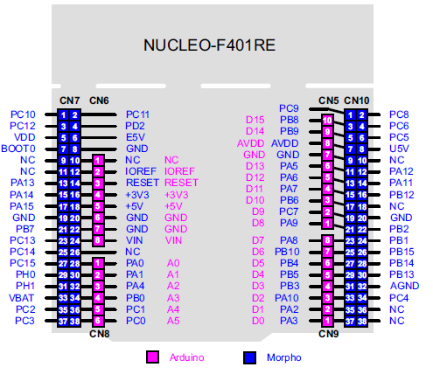
ardiuno Nucleo F401RE Pin JogButtom
D2 PA10 But_SW
D3 PB3 LED_R
D4 PB5
D5 PB4 LED_G
D6 PB10 LED_B

Slide 3
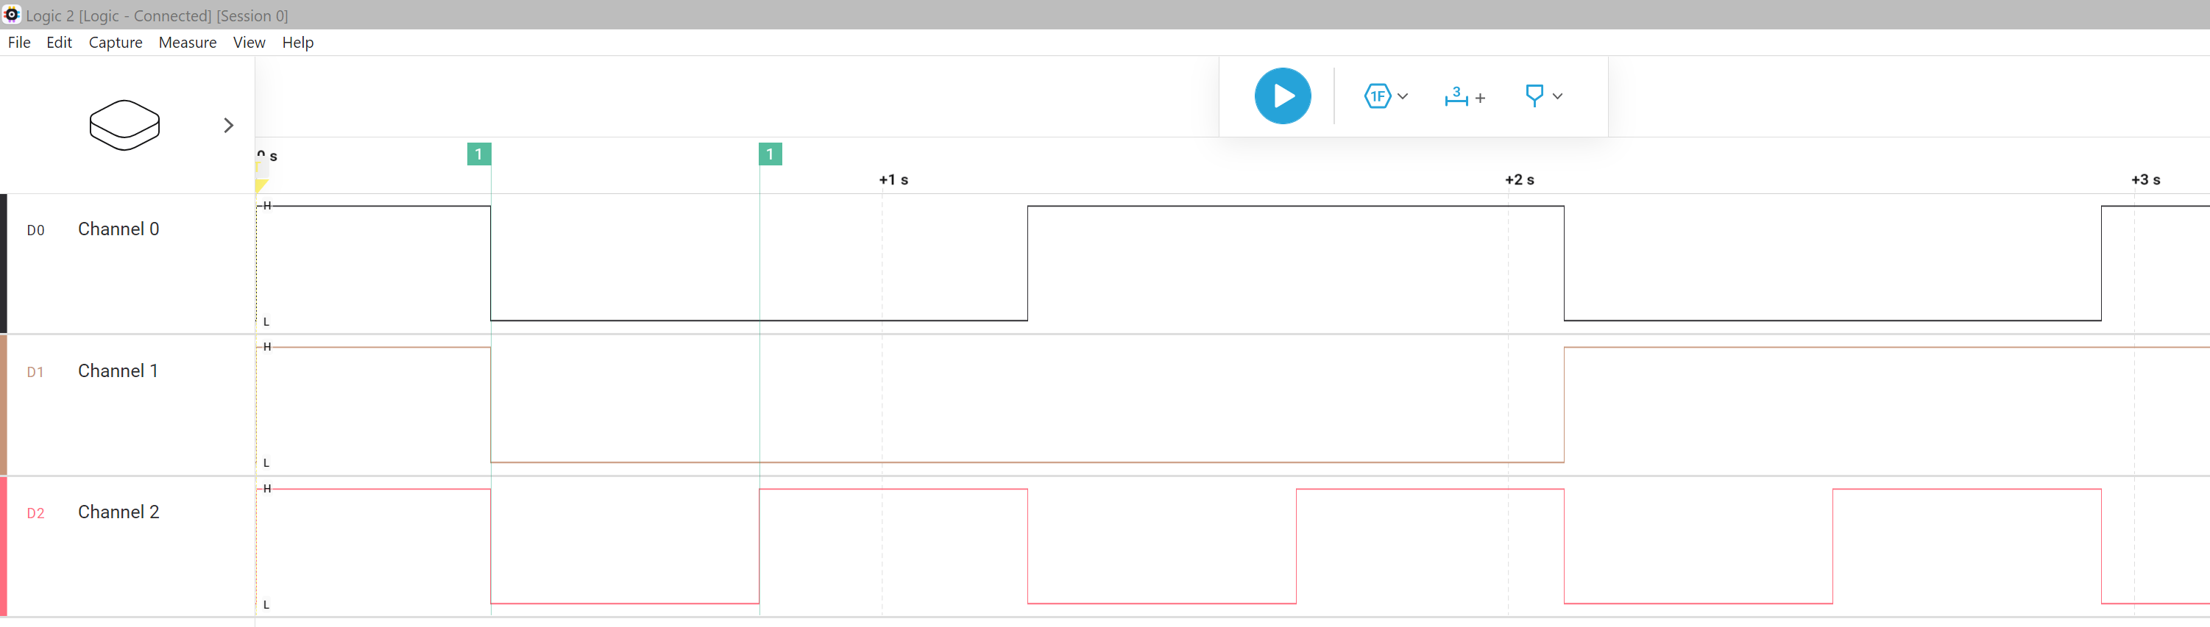
429 ms

