Slide 1
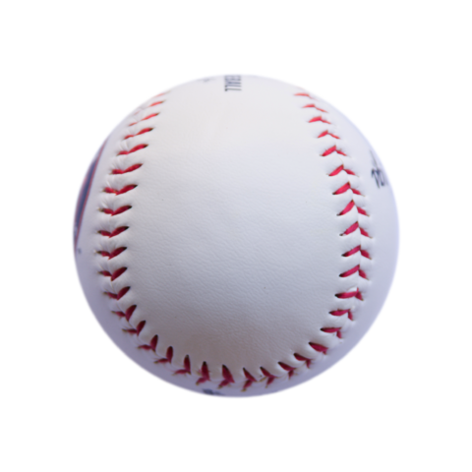

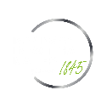
Predicting MLB player performance. A product of the Statcast era.
Trevor Flanagan

Slide 2
Presentation Overview
1
2
3
Business Importance
What is the Statcast Era?
How does this generate useful insights?
Modeling Process
What is our source of data?
How are we measuring performance?
How do different models perform?
Next Steps
How will the model perform on new data?
What could improve model reliability?

Slide 3
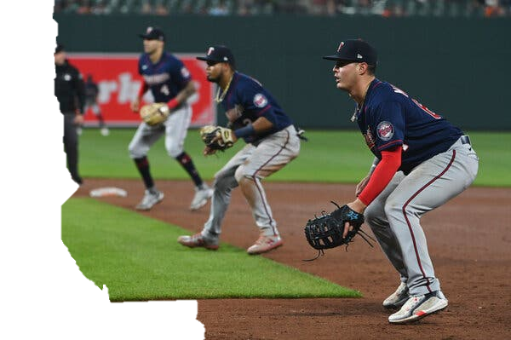
What is the Statcast era?
Overview Statcast = State of the art tracking technology Installed in all 30 parks in 2015 Industry has adapted to run off this data
Statcast Influences Front Office Decision Making Manager Decision Making Training and Conditioning

Slide 4
How does can we translate predicting MLB player performance to business insights?
Team Management
Decisions
Sports Betting odds Calculations
Cross–Industry Applications of Concepts

Slide 5
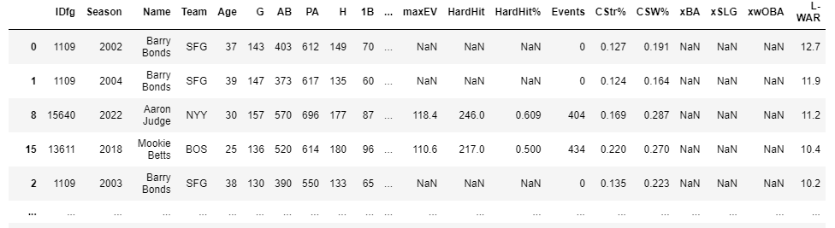
Modeling Process
Data Source Pybaseball – Python module Pulls Data from: FanGraphs Baseball Reference Baseball Savant Filtering Data: Data pulled within last 20 seasons Players need to have at least 200 plate appearances Exclude players with only 1 season of data Final Table: 7,114 Rows (Player Seasons) 320 Columns (Players Season Statistics)
01 Load Values
02 Assign X & y
03 Build & Evaluate First Simple Model
04 Reduce Underfitting
05 Reduce Overfitting
06 Evaluate Final Model

Slide 6
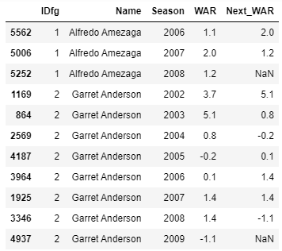
Modeling Process
Target Variable Selection Target Variable = Next season WAR (Wins above replacement) Add new variable: Next_WAR
01 Load Values
02 Assign X & y
03 Build & Evaluate First Simple Model
04 Reduce Underfitting
05 Reduce Overfitting
06 Evaluate Final Model
Predictor Variables Selection Sequential Feature Selector Forward Selection for 15 most useful predictors

Slide 7
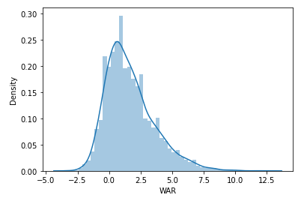
Modeling Process
Linear Regression Model y = m₁x₁ + m₂x₂ + … + mx₁₅ + b Train-Test-Split Training data = 75% of original set Testing data = 25% of original set
01 Load Values
02 Assign X & y
03 Build & Evaluate First Simple Model
Evaluating Model Performance RMSE Training Data = 1.649 Validation = 1.658 WAR STD = 1.933
04 Reduce Underfitting
05 Reduce Overfitting
06 Evaluate Final Model

Slide 8
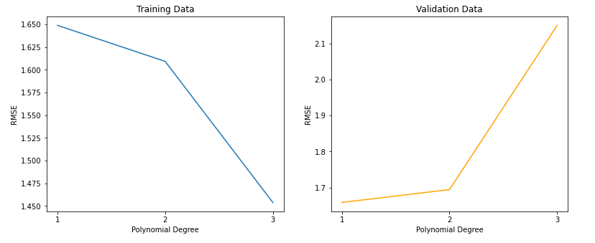
Modeling Process
Adding Polynomial Features y = a₀ + a₁x₁ + a₂x² + … +a_{n}x^{n} + b Choosing # of Polynomial Features
01 Load Values
02 Assign X & y
03 Build & Evaluate First Simple Model
04 Reduce Underfitting
05 Reduce Overfitting
Evaluating Model Performance Simple Linear Regression Model: Training Data = 1.649 Validation = 1.658 Models with Polynomial Transformations:
06 Evaluate Final Model
Degree (1)
Training Data = 1.649
Validation = 1.658
Degree (2)
Training Data = 1.609
Validation = 1.694
Degree (3)
Training Data = 1.454
Validation = 2.15

Slide 9
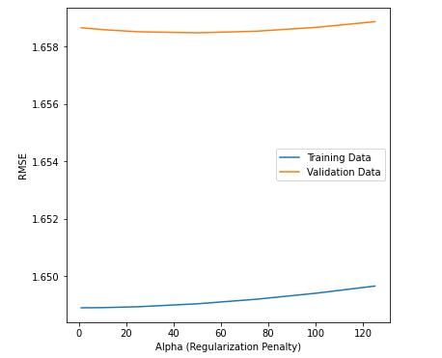
Modeling Process
Regularization using Ridge Model Adding a regularization penalty α
01 Load Values
02 Assign X & y
03 Build & Evaluate First Simple Model
04 Reduce Underfitting
05 Reduce Overfitting
Evaluating Model Performance Simple Linear Regression Model: Training Data = 1.649 Validation = 1.6586 Ridge Regression Model Training Data = 1.649 Validation = 1.6585
06 Evaluate Final Model

Slide 10
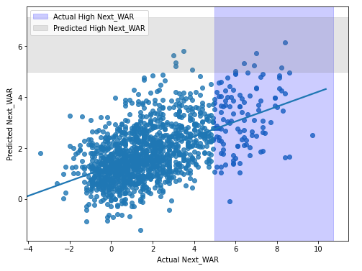
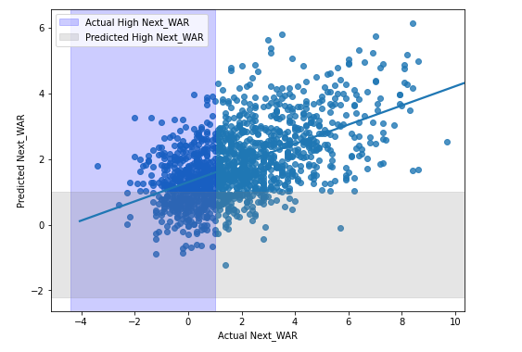
Data Process
Address level of irreducible error present Factors that can lead to increased model error: Breakout performances Statcast era effects on performance Off season changes
01 Load Values
02 Assign X & y
03 Build & Evaluate First Simple Model
04 Reduce Underfitting
05 Reduce Overfitting
06 Evaluate Final Model

Slide 11
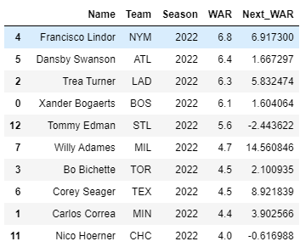

Next Steps
What Could Bolster Model Performance? Add data from Minor Leagues Account for WAR effect on later seasons than just the next one Principal Component Analysis (PCA)
Keep an eye on Model Performance next season Table showing top 10 short stops in the 2022 season and their predicted WAR in 2022
What Could Bolster Model Performance? Add data from Minor Leagues Principal Component Analysis (PCA) Account for WAR effect on later seasons than just the next one

Slide 12

Thank you for your time
Any questions?
Trevor Flanagan
tflanagan@deloitte.com

