Slide 1
SUDOKU SOLVER
COMPSCI 271 Project
Liangjian Chen
Yu Guo
Shengnan Wang
Shutao Xiao

Slide 2
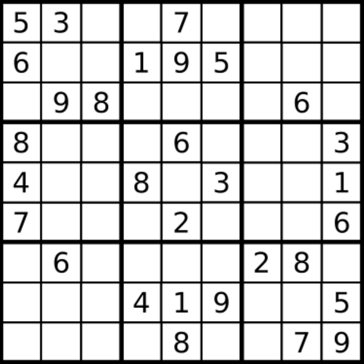
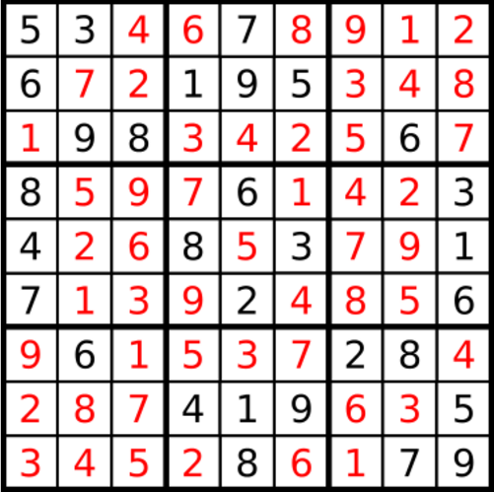
Introduction
Sudoku: Fill in all the empty squares such that no digit appears twice in any row, column, or 3 × 3 subbox.
Initial State
Goal State

Slide 3
Outline
Introduction
Method
Backtracking without constraint
Optimization
Constraint propagation
Heuristic
Minimum-remaining-values (MRV)
Least-constraining-value (LCV)
Dancing links
Current results
Future work

Slide 4
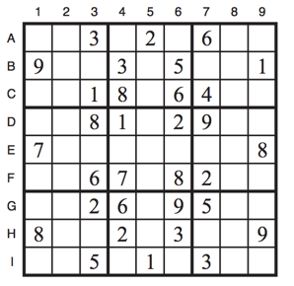
Problem definition
Variables: Using the variable names A1 through A9 for the top row (left to right), down to I1 through I9 for the bottom row.
Domains: The empty squares have the domain {1, 2, 3, 4, 5, 6, 7, 8, 9} and the pre-filled squares have a domain consisting of a single value.
Constraints:
Alldiff (A1, A2, A3, A4, A5, A6, A7, A8, A9)
Alldiff (B1, B2, B3, B4, B5, B6, B7, B8, B9)
···
Alldiff (A1, B1, C1, D1, E1, F1, G1, H1, I1)
Alldiff (A2, B2, C2, D2, E2, F2, G2, H2, I2)
···
Alldiff (A1, A2, A3, B1, B2, B3, C1, C2, C3)
Alldiff (A4, A5, A6, B4, B5, B6, C4, C5, C6)
···

Slide 5
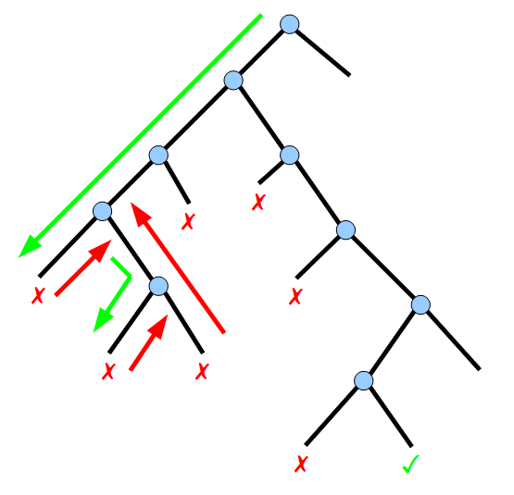
Method: CSP
Backtracking:
Backtracking search is used for a depth-first search that chooses values for one variable at a time and backtracks when a variable has no legal values left to assign.

Slide 6
Method: CSP
Constraint Propagation:
If a square has only one possible value, then eliminate that value from the other 20 squares in the same row, column, or subbox.
If a unit has only one possible place for a value, then put the value there.
Ex: A1, A2, A3, A4, A5, A6, A7, A8, A9
A1: 7
if it none of A3 ~ A9 has a 3
A2 = 3

Slide 7
Method: CSP
Heuristic:
MRV: Choosing the variable with the fewest “legal” values. It picks a variable that is most likely to cause a failure soon, thereby pruning the search tree.
LCV: Once a variable has been selected, the algorithm must decide on the order in which to examine its values. This heuristic is trying to leave the maximum flexibility for subsequent variable assignments.

Slide 8
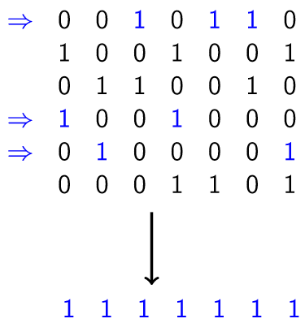
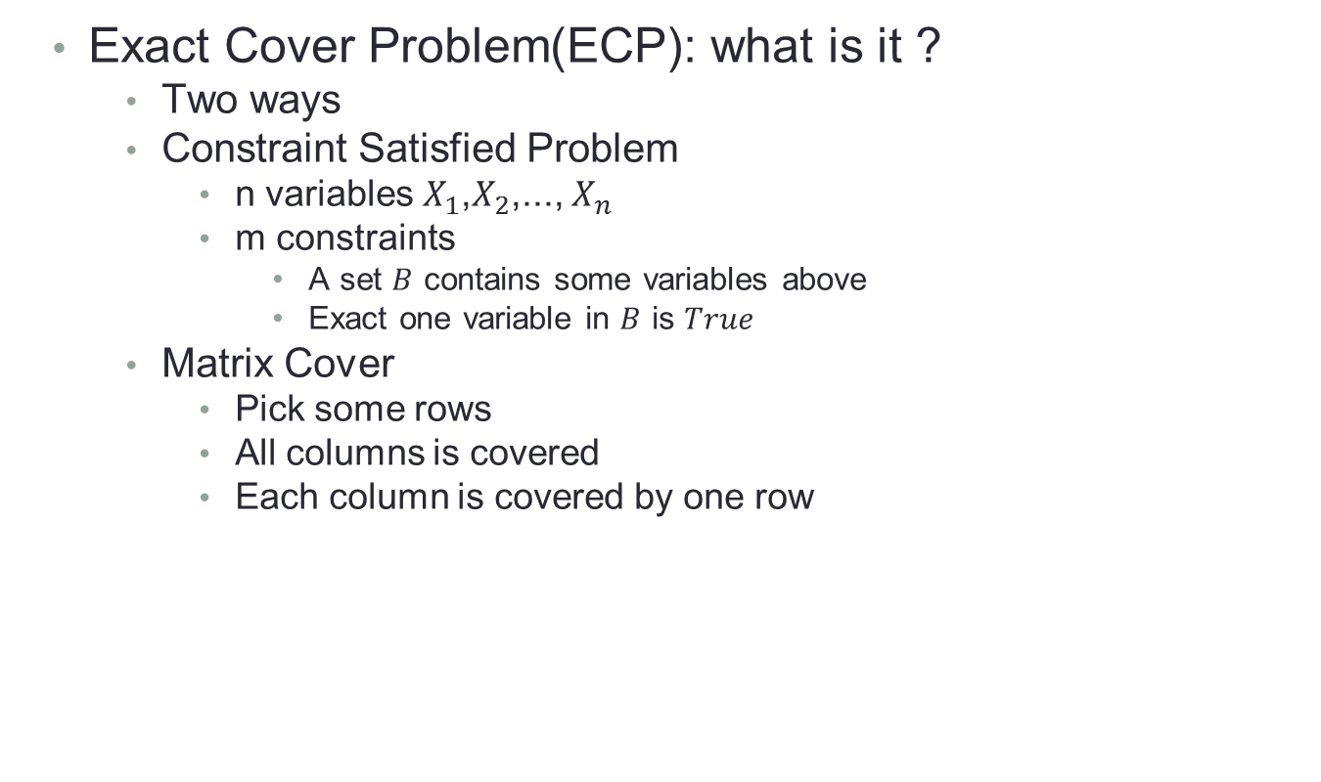
Algorithm X with Dance-Link(DLX)
Exact Cover Problem(ECP): what is it ?
Two ways
Constraint Satisfied Problem
n variables $X_{1}$,$X_{2}$,..., $X_{n}$
m constraints
A set $B$ contains some variables above
Exact one variable in $B$ is $True$
Matrix Cover
Pick some rows
All columns is covered
Each column is covered by one row

Slide 9
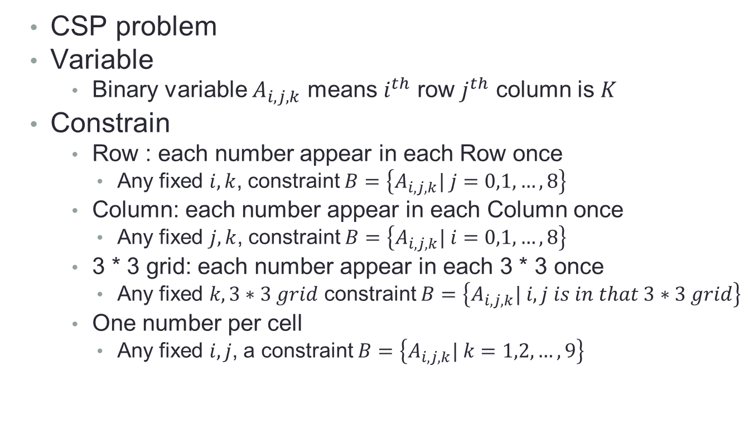
Convert Sudoku to ECP
CSP problem
Variable
Binary variable $A_{i,j,k}$ means $i^{th}$ row $j^{th}$ column is $K$
Constrain
Row : each number appear in each Row once
Any fixed $i,k$, constraint $B=\left\{A_{i,j,k}| j=0,1,…,8\right\}$
Column: each number appear in each Column once
Any fixed $j,k$, constraint $B=\left\{A_{i,j,k}| i=0,1,…,8\right\}$
3 * 3 grid: each number appear in each 3 * 3 once
Any fixed $k,3∗3 grid$ constraint $B=\left\{A_{i,j,k}| i,j is in that 3∗3 grid\right\}$
One number per cell
Any fixed $i,j$, a constraint $B=\left\{A_{i,j,k}| k=1,2,…,9\right\}$

Slide 10
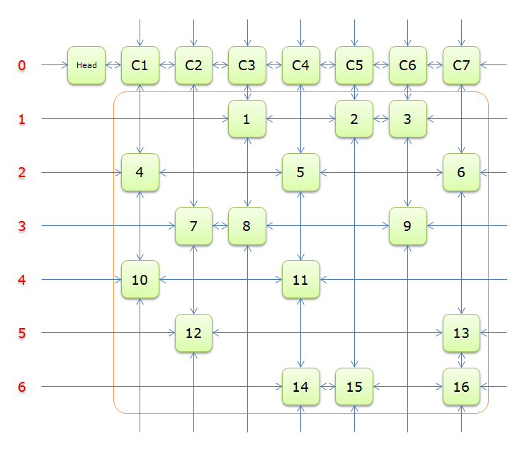
DLX- What is it?
Donald.E.Knuth in 2000
A represent of Matrix
Bidirectional Cross link list
Main nodes
Only keep 1
Accessory nodes
head
check empty
Column list
How many nodes

Slide 11
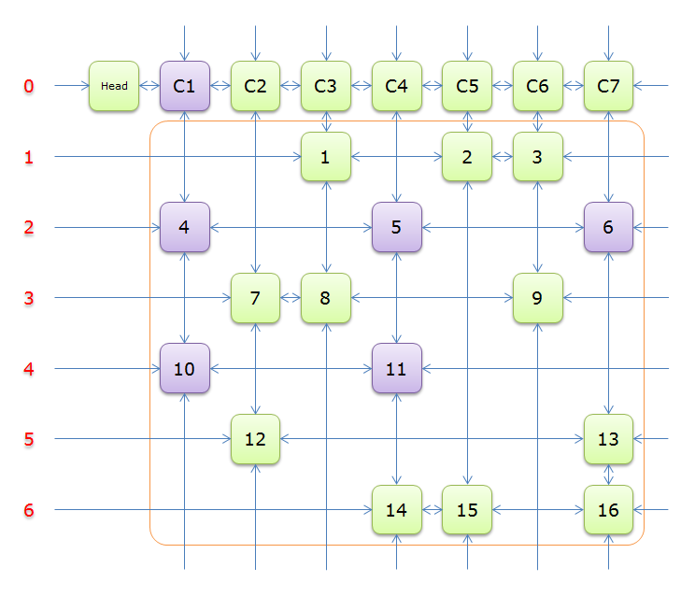
DLX -- How it works

Slide 12
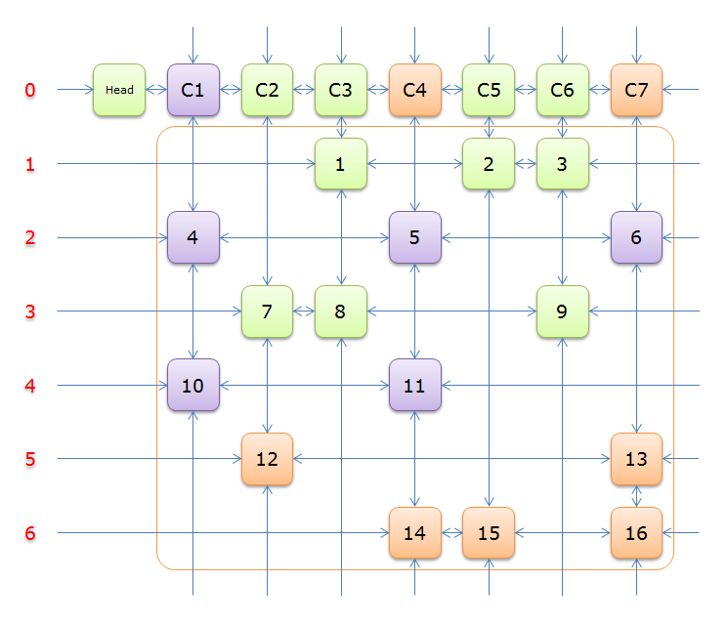
DLX -- How it works

Slide 13
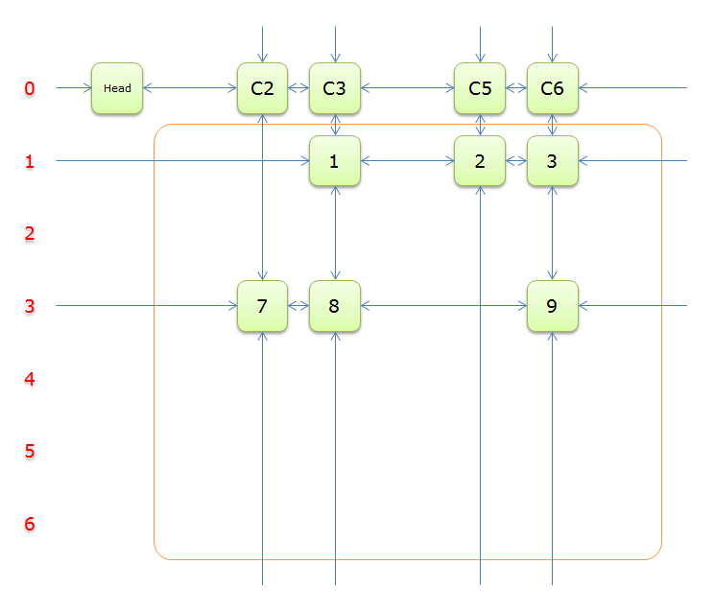
DLX -- How it works

Slide 14
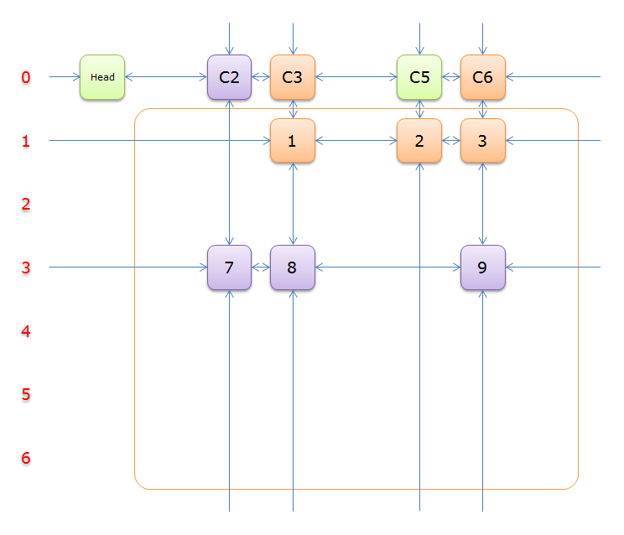
DLX -- How it works

Slide 15
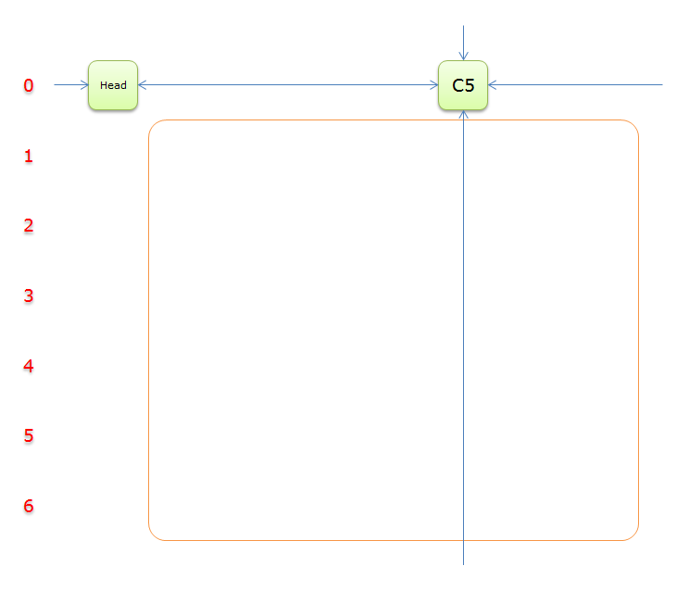
DLX -- How it works

Slide 16
DLX--why it works
Extremely efficient
Delete
a->l->r = a->r
a->r->l = a->l
Insert
a->l->r = a->r->l = a
DLX is suitable to back-tracking

Slide 17
Comparation
Text case: 50 difficult Sudoku problems online.
Test in 2013 Macbook pro 15’
Algorithm | Algorithm X with DLX | CSP with heuristic | Naive DFS
Running Time | 0.04s | 2.54s | > 10s

Slide 18
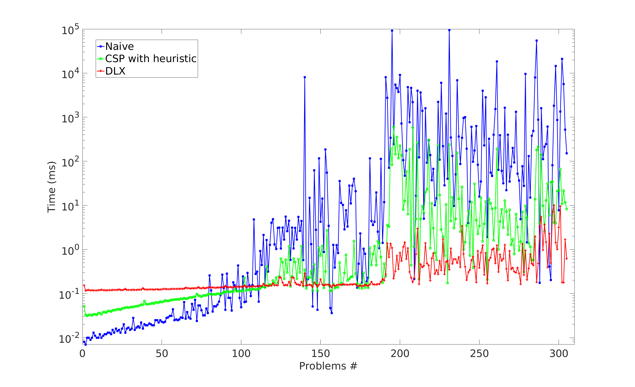
More Results
OS: Ubuntu 14.04
CPU: Intel® Core™2 Quad CPU Q9400 @ 2.66GHz × 4
Memory: 8G

Slide 19
Future work
Add more constraints:
Arc-consistency
K-consistency
Run more tests with various inputs in different difficulty levels
Finish the report

