Slide 1
0
0
-2
5-2=3
5-2=3
6-3=3
2-2=0
5-5=0
5-4=1
-2
6-1=5
5-1=4
6-2=4
5-2=3
3-5=-2
6-4=2
-2
6-5=1
5-5=0
6-3=3
6-3=3
6-6=0
3-5=-2
3-5=-2
3-5=-2
3-2=1

Slide 2
0
0
-2
5-2=3
5-2=3
6-3=3
2-2=0
5-5=0
5-4=1
0
6-1=5
5-1=4
6-2=4
5-2=3
3-5=-2
6-4=2
From left to right
-2
6-5=1
5-5=0
6-3=3
6-3=3
6-6=0
3-5=-2
3-5=-2
3-5=-2
3-2=1

Slide 3
0
0
-2
5-2=3
5-2=3
6-3=3
2-2=0
5-5=0
5-4=1
-2
6-1=5
5-1=4
6-2=4
5-2=3
3-5=-2
6-4=2
From right to left
-2
6-5=1
5-5=0
6-3=3
6-3=3
6-6=0
3-5=-2
3-5=-2
3-5=-2
3-2=1

Slide 4
0
0
-2
5-2=3
5-2=3
6-3=3
2-2=0
5-5=0
5-4=1
-2
3-5=-2
5-1=4
6-2=4
5-2=3
6-1=5
6-4=2
From left to right (optimal)
-2
Change leaf order
3-5=-2
5-5=0
6-3=3
6-3=3
6-6=0
6-5=1
3-5=-2
3-5=-2
3-2=1

Slide 5
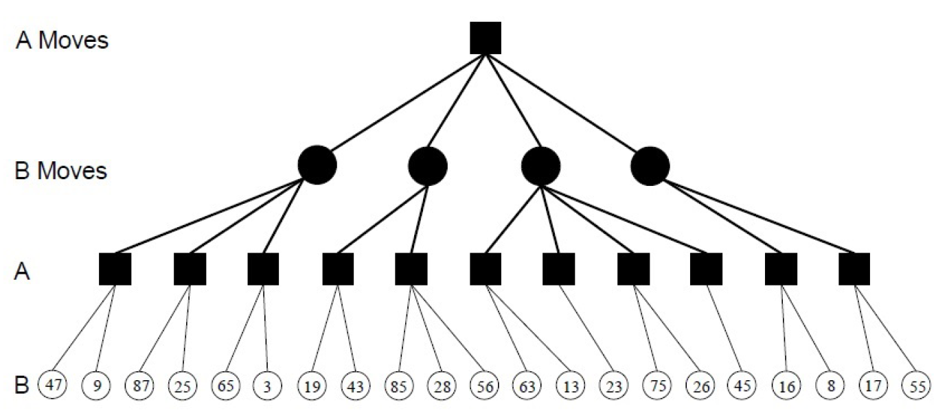
move to choose
(47,inf)
(47,47)
(-inf,63)
(47,47)
(-inf,43)
(-inf,23)
(-inf,16)
(47,47)
(87,inf)
(65,inf)
(43,43)
(63,63)
(23,23)
(16,16)

