Slide 1
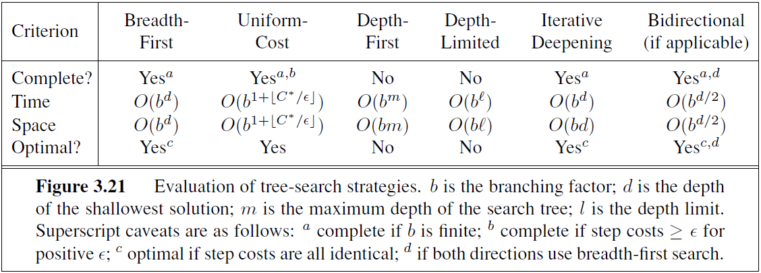
Gready Best-first
No
No
A*
Yes
Yes
tree-search version of A* is optimal if h(n) is admissible
graph-search version is optimal if h(n) is consistent.

