Slide 1
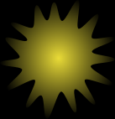
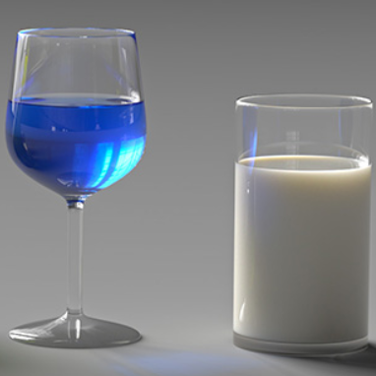

Radiative transfer
Notes:
Radiative transfer theory is used to model how light interacts with participating media.

Slide 2
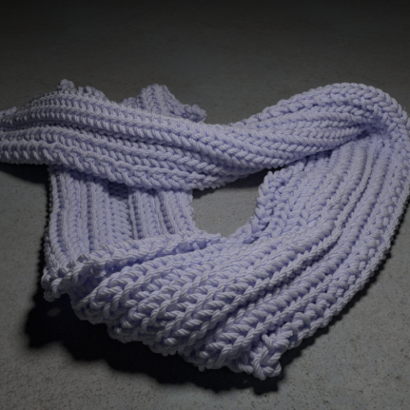
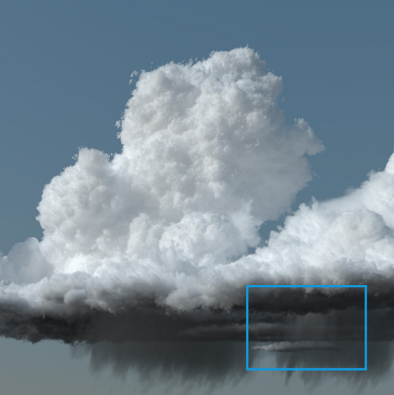
Types of media
Isotropic
Anisotropic
Spatially Correlated
RTT
Generalized RTT
Notes:
Recently this theory has been generalized to handle materials with organized microstructures,

Slide 3

Limitation
Far-field approximation
$$∞$$
Notes:
To derive the bulk scattering parameters used by the RTT, existing methods rely on far-field approximation and independent scattering, neglecting important near-field interaction between particles, including inter-particle diffraction.

Slide 4

Our method
Near-field scattering in cluster
Far-field approximation between clusters
$$∞$$
Hybrid mode
:scatterer
:cluster
Notes:
We relax this assumption by introducing a particle-clusters-based technique to systematically compute the scattering parameters of media composed by clusters of particles.

Slide 5
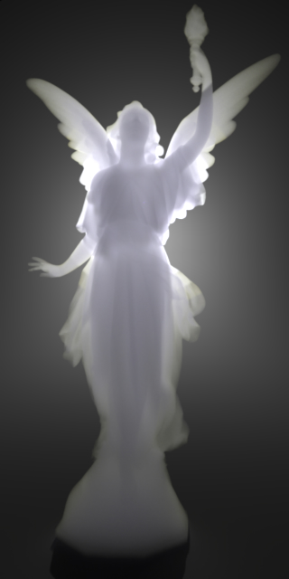
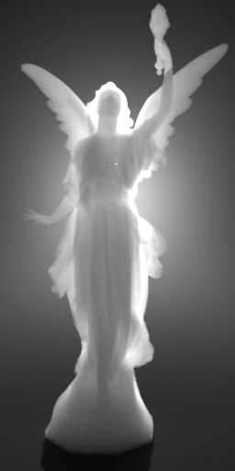
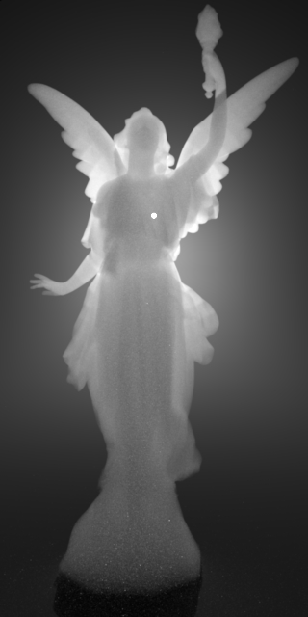
Results
Spatially Correlated
Multi-spectral
Anisotropic
Notes:
With our method, we can simulate, for example, multi-spectral effects for anisotropic and spatially correlated scatters distributions.

Slide 6
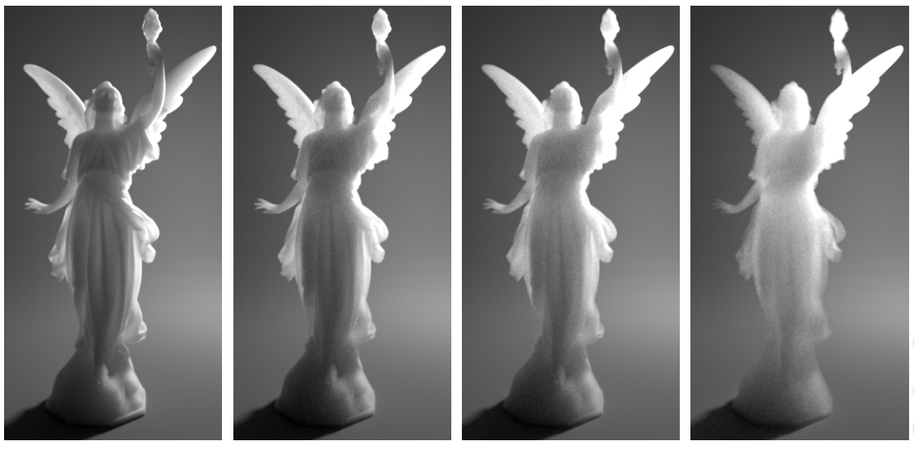
Beyond Mie Theory: Systematic Computation of Bulk Scattering Parameters based on Microphysical Wave Optics
Notes:
For more details, please come to our talk.

