Slide 1
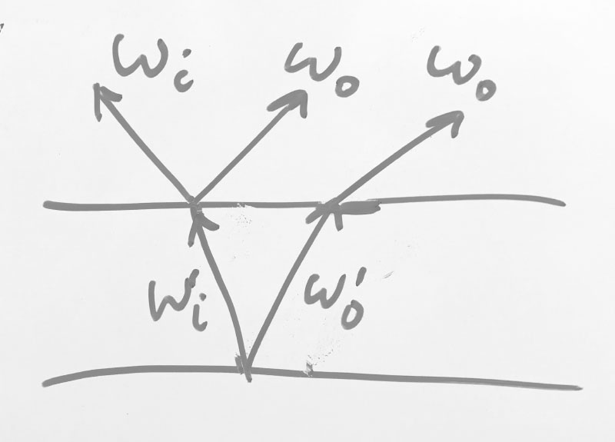
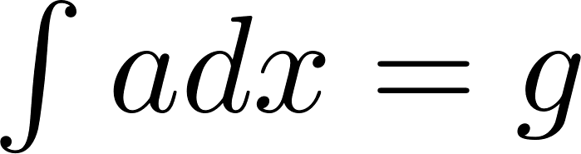

Slide 3





Slide 4



Slide 6





Slide 7
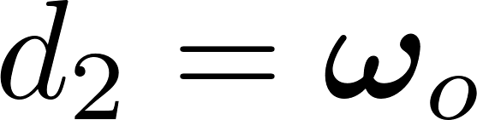

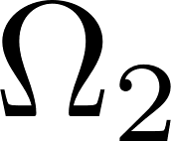
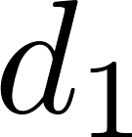

Slide 8
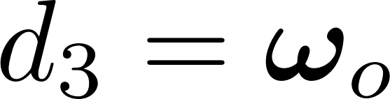
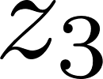
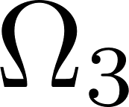
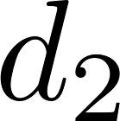

Slide 9


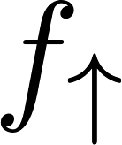



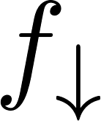
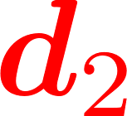

(a)
(b)

Slide 10
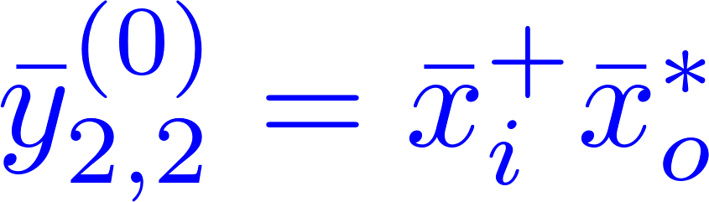
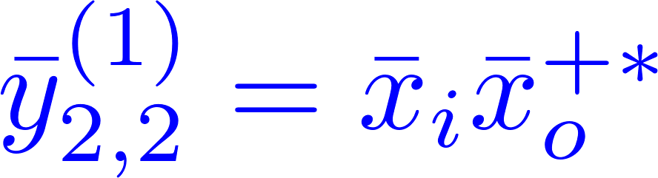

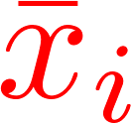






(a)
(b)
(c)

Slide 11


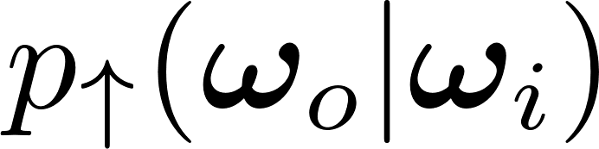




Slide 12


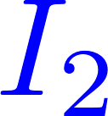


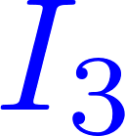
layer 1
layer 1
layer 2
layer 2

Slide 13
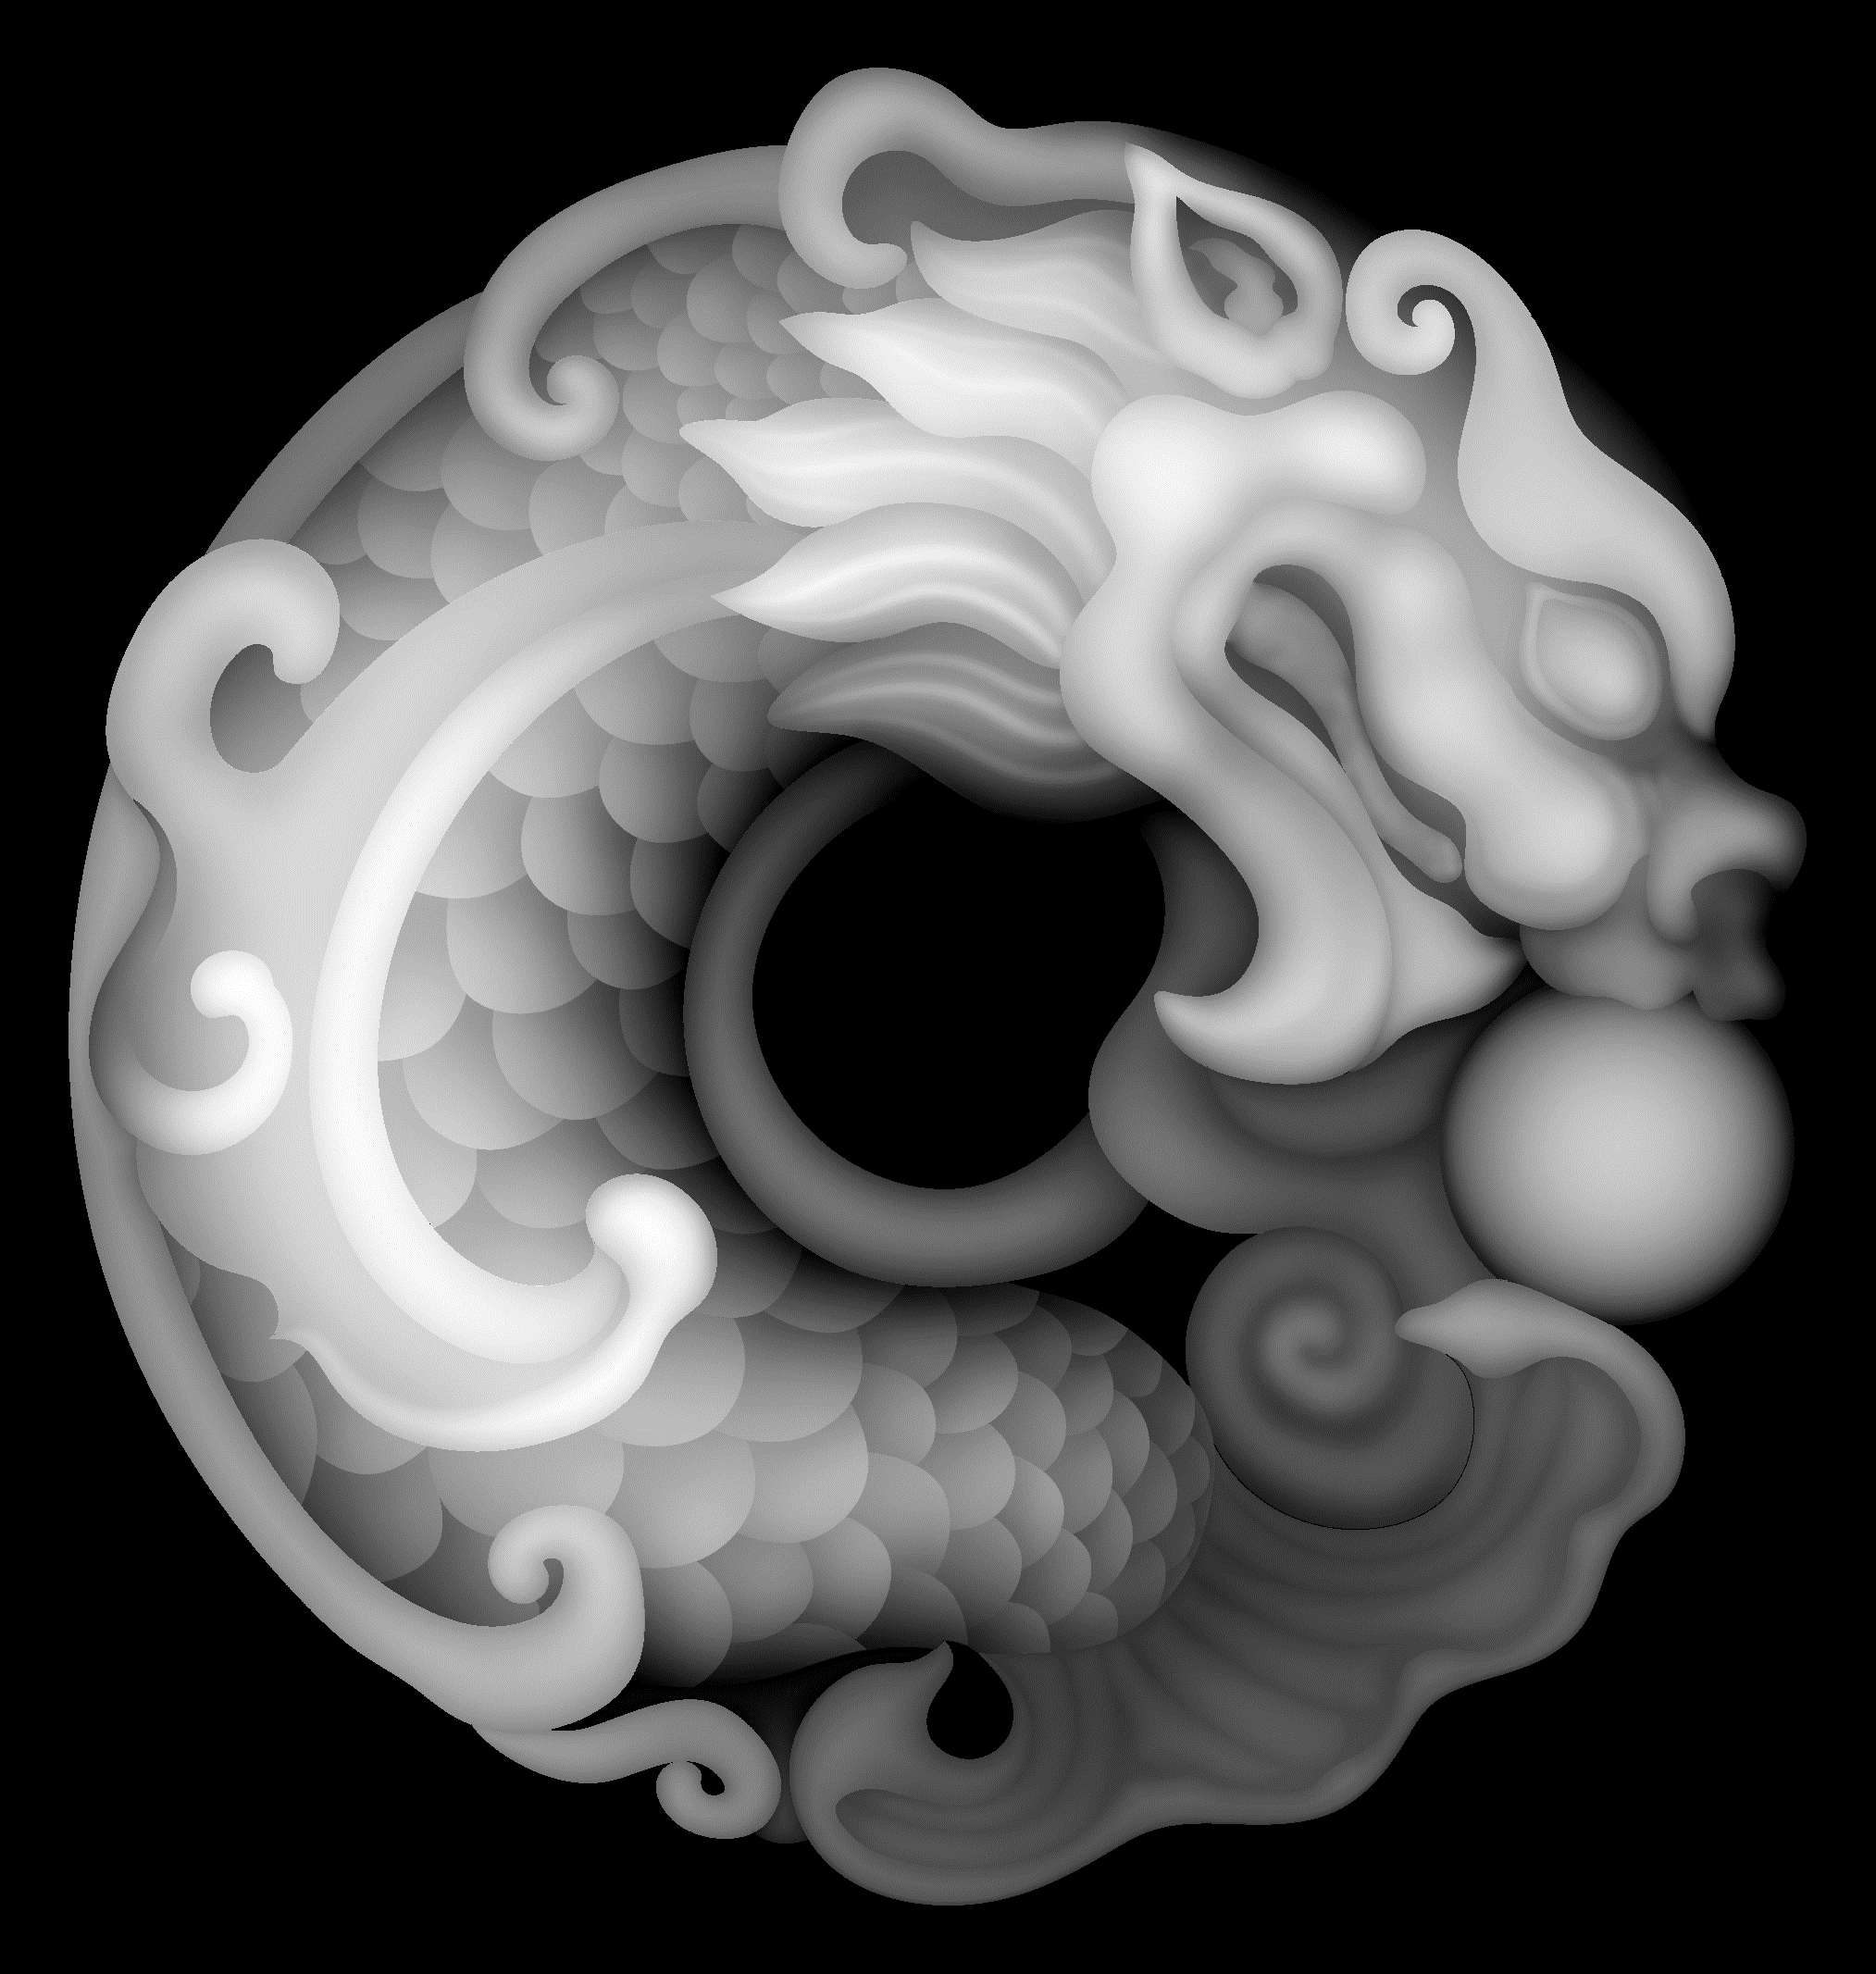
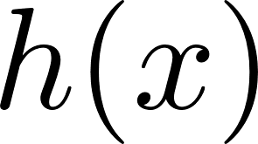

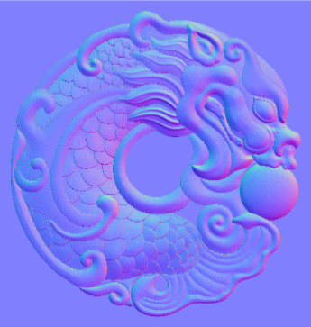
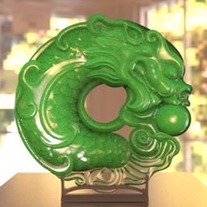
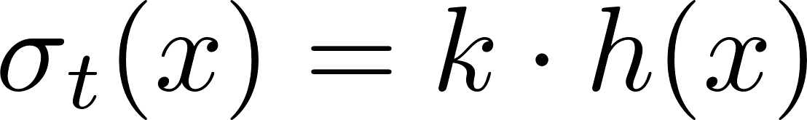
Top surface height map
Spatially varying BSDF parameters

Slide 14

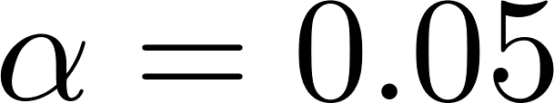
Textured normal map (scratch)
Green absorbing medium
Textured normal map (noise function)
Conductor (Hg)

Slide 15
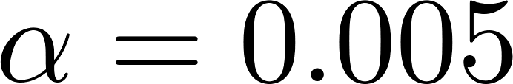
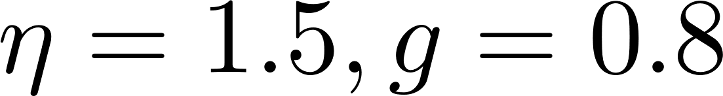
Normal map (dragon)
Spatially variance scattering and absorption ( )

Slide 16

Normal map (scratch)
Green absorbing medium ( )
Normal map (noise)
Conductor (Hg)

Slide 17

Normal map (noise)
Anisotropic medium ( )
Diffuse
Diffuse

Slide 18
Normal map (poeny)
Blue painting ( )
Rough diffuse (diffuse albedo = 1)

Slide 19
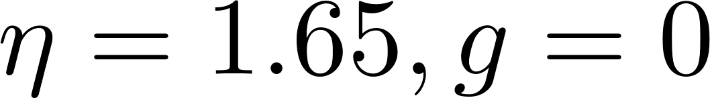

Normal map (scratch)
Normal map (dragon)
Normal map (poeny)
Normal map (noise)
Green absorbing medium ( )
Scattering and absorption ( )
Blue painting ( )
Anisotropic medium ( )
Normal map (noise)
Rough diffuse (diffuse albedo = 1)
Diffuse
Conductor (Hg)
Diffuse
(b2)
(c2)
(d2)
(e2)

