Slide 1
Lean Six Sigma & Continuous Improvement
International Certificate in Project Management and Organizational Performance
Module 3 — Methods, Tools and Operational Efficiency · Session 4, morning
17 October 2026 · 09:00–12:00 (Brasília time) · Online
Prof. Dr. Thiago Lima

Slide 2
SUMMARY
The puzzle — Fremont, 1984
Value, seen from the customer backwards
The anatomy of waste
The efficiency paradox — and variation
The Toyota Production System, as a system
Lean in the language of capital
DMAIC — conducting improvement, analysing problems
The third equation: V = C × (A + P)
Group activity — the Value Case
Where the morning ends
One claim, three hours
Operational efficiency is a consequence of what the customer values and of how work flows — not of how busy the resources are. The returns to everything an organisation buys are scaled by a capability it cannot buy.
Reading notes
Every definition, figure and source in this deck is in the reading notes, which stand on their own and are the reference for the module assessment. Nothing needed reading in advance.
Notes:
Agenda. State the claim once; the morning earns it. Point to the reading notes as the reference text for the written assessment.

Slide 3
WHAT THE SESSION ASKS OF YOU
Nothing to prepare — three things to have in mind, all about your own organisation, all answerable from what you already know.
1
2
3
One recurring process
Two rough figures
One authorised project
That you own or depend on, and that takes longer than it should. Contract approval, project initiation, monthly close, incident resolution.
How many projects are in flight in your unit, and how many closed in the last twelve months. Approximations are fine.
That you know well enough to defend. It closes the session as the group activity. A project you have private doubts about is better material than one you are proud of.
A note on framing: the examples run through factories because that is where the ideas were tested. Queues are queues and variability is variability — every block ends with a bridge to project management.

Slide 4
Part One
PART ONE
The puzzle
Fremont, California. Same building, same equipment, substantially the same people — and the opposite result. Hold your answer: everything that follows is a way of making it precise.

Slide 5
FREMONT, CALIFORNIA
1982 — General Motors closes the plant
1984 — reopens as NUMMI, with Toyota
Absenteeism near 20%
The most combative union local in the GM system, by GM's own description
Quality: the worst in General Motors
Substantially the same workforce rehired, including the union leadership
Same building. Same equipment.
Within roughly two years: quality and productivity approach Toyota's Japanese levels and lead the entire GM system
Same assets. Same people. What changed — and where would that change appear on a balance sheet?
Harder: GM had access to NUMMI from the inside for two decades. Why was it never replicated across the rest of the network?
Notes:
Pose both questions. Ask the room to write a one-line hypothesis now (chat or paper). We return to it in Part Eight with the identity built during the morning.

Slide 6
WRITE YOUR HYPOTHESIS DOWN
Before the argument starts. One line each, in the chat or on paper. We test it against the framework at the end of the morning — a hypothesis nobody wrote down cannot be wrong, and it is the error that teaches.
What changed at Fremont?
Why could GM not copy it?
“What changed was ______________, and it would appear on the balance sheet as ______________.”
“GM could see ______________ but could not transfer ______________.”
Keep the line. Part Eight asks you to grade it yourself.

Slide 7
Part Two
PART TWO
Value, seen from the customer backwards
“All we are doing is looking at the timeline — from the moment the customer gives us an order to the point when we collect the cash — and we are reducing that timeline by removing the non-value-added wastes.” — Taiichi Ohno

Slide 8
THREE KINDS OF ACTIVITY
Ohno's sentence does two things: it makes elapsed time from order to cash the unit of analysis, and it makes the customer — not the accounting system — the judge of what counts as work.
Type | Test | Typical share of elapsed time
Value-adding | Transforms the product or service in a way the customer would knowingly pay for | Under 5%
Necessary non-value-adding | The customer would not pay for it, but law, technology or contract requires it | 10–30%
Waste (muda) | Neither | The remainder
In value streams that have never been deliberately improved, value-adding time is a low single-digit percentage of elapsed time. Everything else is queue. This is the single most consequential number in operations — and almost no organisation measures it.

Slide 9
WHAT THE CUSTOMER IS ACTUALLY CHOOSING
Competitive priorities
Order winners and qualifiers (Hill)
Eight dimensions of quality (Garvin)
Cost · quality · delivery speed · flexibility — the operational determinants of willingness to pay. “What the customer would pay for” decomposes into these four.
A qualifier is a threshold: its presence attracts nobody, its absence eliminates you. A winner is what makes the customer choose you once you are in the set. Nobody picks a restaurant for its bathroom; plenty never return because it was dirty.
Quality is not one variable. Conformance lowers cost; reliability, durability and serviceability raise willingness to pay. The same quality effort pays twice, on two edges of value.
The uncomfortable consequence: effort poured into qualifiers above the threshold consumes capacity and produces no preference. A firm that is mid-table on every attribute has made no choice at all.
IN PROJECT TERMS
THE IDEA
A qualifier buys nothing above the threshold; only a winner creates preference.
IN A PROJECT
Most portfolio scoring models add strategic fit, NPV, risk and resource availability on one scale — which assumes every criterion is a winner. Compliance projects are qualifiers: they buy no advantage, and not doing them ends the business.
ON MONDAY
Split the list before scoring: if we do not do this, do we lose a deal or do we lose the licence? Fund the second kind to the threshold and no further.

Slide 10
THE VALUE STICK
Value created = WTP − SOC
WTP
Customer surplus
WTP − price
willingness to pay, minus supplier opportunity cost — Brandenburger & Stuart (1996)
Negotiating over price or supplier terms moves value between parties. Only two moves create it: push WTP up, or push SOC down.
Lean is unusual because it does both at once: removing waste lowers cost; the same work raises reliability and speed, which raise what the customer will pay.
That is the whole strategic claim of the method. The rest of the morning is the mechanism.
Firm margin
price − cost
Supplier surplus
cost − SOC
SOC

Slide 11
FROM VALUE CREATED TO ADVANTAGE
VC = (WTPA − CostA) − (WTPB − CostB)
the value firm A creates, minus the value created by its relevant rival B
Creating value and having an advantage are different things. A firm that raises WTP and lowers cost in a market where every competitor does the same has created value and captured none of the difference. Advantage is a comparison, so it has to be written as one.
The benchmark is a rival, not last year
Both terms can be attacked
Operational effectiveness erodes by construction
Cutting your own cost by 8% while the reference competitor cuts theirs by 12% makes the firm better and its position worse. Only the comparison detects it.
VC rises when A improves — and equally when B's advantage is made harder to sustain. That is why capability that resists imitation matters more than capability that does not.
If the improvement is visible and copyable, B makes the same move, the brackets converge and VC tends to zero. Porter's objection, as arithmetic.
One test for any improvement project: when the competitor does this too, what is left? If nothing — fund it to the threshold and no further. If something — name it. That residue is the advantage.

Slide 12
WHERE THE RESIDUE CAN LIVE
V = C × (A + P)
Lima (2026), Ch. 1 — after Van Mieghem & Allon (2015)
A — Assets
P — Processes
C — Capability
What the organisation owns: plants, machines, systems. Visible and purchasable.
How work flows across the assets. Partly visible, imitable with effort.
The organisation's repeated ability to improve P. Barely visible, rarely imitable — and a coefficient, not a term.
The form of the expression is the claim: assets and processes are additive and purchasable; capability multiplies them. Anything in the bracket is available to a competitor at roughly the same price, so improvements that live there move both parentheses of VC and the difference returns towards zero. Only the coefficient resists — it is the one term nobody can invoice you for. Part Eight returns to this once there is material to test it.

Slide 13
THE FIVE PRINCIPLES — AND WHERE EACH ONE IS TREATED
Womack and Jones reduced the method to five principles in sequence. The sequence is the argument: every principle after the first is meaningless until the first has been answered.
 | Principle | What it asks | Where
1 | Value | What is the customer actually paying for? Defined from the customer backwards, never from the process forwards. | This part
2 | Value stream | Which activities deliver that value, which merely enable it, and which do neither? The map is the instrument. | Part Three
3 | Flow | Can the work move without stopping? Stoppage, not slowness, is what makes lead time long. | Part Four
4 | Pull | Is work released by downstream demand, or pushed by upstream capacity and a plan? | Part Five
5 | Perfection | Does the cycle repeat, with the standard rewritten each time? This decides whether the first four survive. | Parts Seven and Eleven

Slide 14
Part Three
PART THREE
The anatomy of waste
Ohno catalogued seven wastes; modern practice adds an eighth. The list matters less than its structure: one of them is the root, and the others are symptoms.

Slide 15
THE EIGHT WASTES — FACTORY AND PROJECT
Waste | In a factory | In project and knowledge work
Overproduction — the root | Making more than demand | Reports nobody reads, features nobody uses, gold-plating
Waiting | Idle machines and people | Approval queues, decision latency, blocked dependencies
Transport | Moving materials | Handoffs between departments and systems
Over-processing | Machining beyond specification | Sign-off chains, redundant status meetings, precision beyond need
Inventory | Stockpiles and work in process (WIP) | Half-finished work packages, open tickets, projects started but unstaffed
Motion | Unnecessary movement of people | Searching for information, tool switching, duplicated data entry
Defects | Scrap and rework | Rework loops, failed deliverables, change requests from unclear requirements
Unused talent | Ignored operator ideas | Experts doing administration; front-line insight never reaching decisions
Overproduction generates the other six: it creates inventory, which needs transport and motion, which hides defects, which forces waiting. Attack it and the others shrink; attack the others individually and overproduction regenerates them.

Slide 16
MUDA IS THE SYMPTOM; MURA AND MURI ARE THE DISEASE
Muda — waste
Mura — unevenness
Muri — overburden
The eight items on the previous slide. The one executives usually learn, and the only one most programmes attack.
Irregular flow of work. Unevenness creates queues, and queues create the safety buffers that look like prudent management and are in fact inventory.
People and equipment pushed beyond reasonable limits. Overburden creates defects, breakdowns and absence — which create more unevenness.
This is why improvement programmes plateau after year one: the first wave removes visible muda and produces real gains. Then the gains stop, because the unevenness and overburden that generate muda were never touched.
IN PROJECT TERMS
THE IDEA
Mura and muri are not wastes; they are what manufactures the wastes.
IN A PROJECT
A specialist at 120% across four projects produces the entire symptom set at once: defects (divided attention), waiting (each project queues behind three others), unused talent (the expert spends the day reconciling status). The quarter-end delivery peak nobody levels is mura.
ON MONDAY
List everyone allocated above 100% and count projects per person. Two is a working limit; four is a queue with a name.

Slide 17
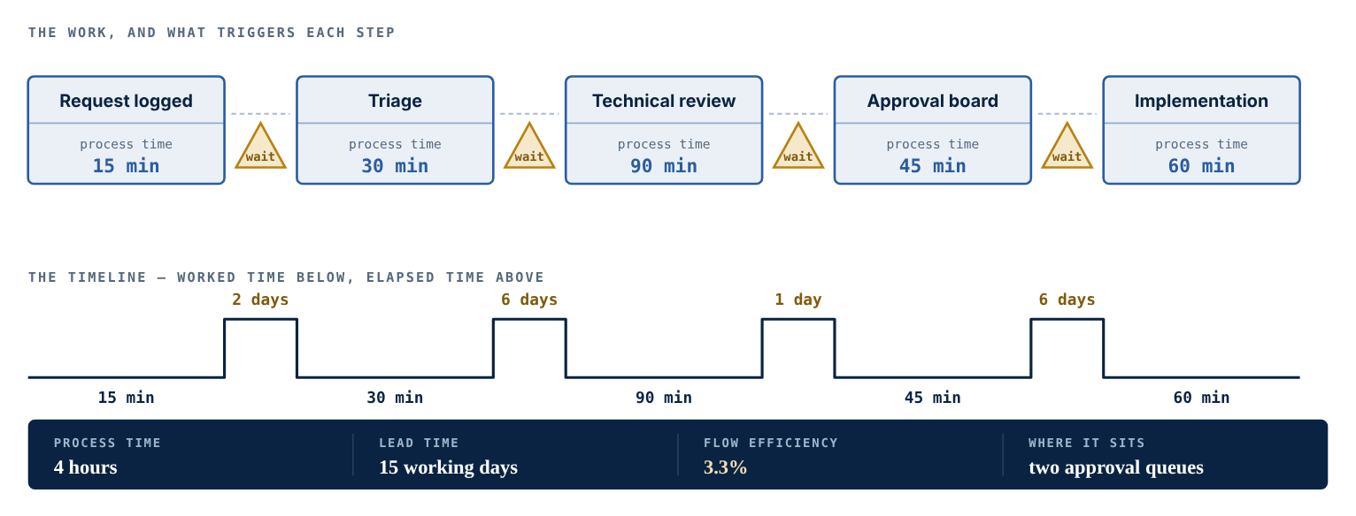
MAKING IT VISIBLE — THE VALUE STREAM MAP
Three layers, one number
The work — each step, in sequence, with who performs it. Reveals handoffs.
The information — what triggers each step. Reveals whether the stream is pulled or pushed.
The timeline — time worked and time elapsed per step. Produces flow efficiency, the number the map exists for.
Figure 1. A change request from arrival to implementation: four hours of work across fifteen working days, almost all of it in two approval queues.
4 h
15 days
3.3%
Current state, then future state
Every difference between the two maps must be attributable to a named change with an owner. A future state nobody can trace to interventions is a wish drawn in boxes.
process time — the time anyone is actually working on it
lead time — elapsed, first step to last
flow efficiency — typically 2–10% in administrative processes

Slide 18
MAP THE STREAM, NOT THE DELIVERABLE
IN PROJECT TERMS
THE IDEA
The elapsed time lives in the handoffs around the work, not in the work.
IN A PROJECT
The streams worth mapping are the administrative ones: change request to approved change, invoice to payment, defect reported to defect closed. They repeat, they can be timed, and they are where lead time accumulates. The characteristic finding is Figure 1 — four hours across fifteen days, the days sitting in two approval queues that exist because of an authority limit nobody has revisited since it was set.
ON MONDAY
Pick one of the three. Walk it with the people who perform each step, not from the procedure. Write two numbers on one line: hours worked, days elapsed. The ratio is the conversation.
A map is drawn by walking the process, not by assembling it from what people say in a meeting — which is why the first draft almost always contradicts the official procedure.
One more figure per step: the share of items arriving complete and accurate. A chain of steps each at 90% does not deliver 90% — the arithmetic is in Part Four.

Slide 19
Part Four
PART FOUR
The efficiency paradox
Lean is routinely introduced as “doing more with less”. Taken literally, that is the definition of the thing lean exists to correct.

Slide 20
RESOURCE EFFICIENCY VERSUS FLOW EFFICIENCY
Resource efficiency
Flow efficiency
Keep every person and every machine busy
Optimises what cost accounting measures — which is why organisations default to it
Generates queues, rework and expediting; destroys performance globally while every local unit looks efficient
Optimise the unit's journey through the system — it measures the order, not the resource
Process time over lead time: the ratio the value stream map was built to produce
Usually improves both once queues collapse — and almost nobody reports it
The physics of lead time
The sentence worth memorising
Variability must be absorbed by inventory, by capacity, or by time. Every organisation chooses one — usually without deciding to. Only one of the three is invisible in the P&L, which is why it is the one most organisations choose by default.
As utilisation rises toward 100%, queue time rises towards infinity. The curve is flat until roughly 80% and then climbs violently.
Raising utilisation does not raise the system's output. It raises the queue in front of the system.
The instinct to keep every resource busy is the direct mechanical cause of the inventory it was meant to avoid.

Slide 21
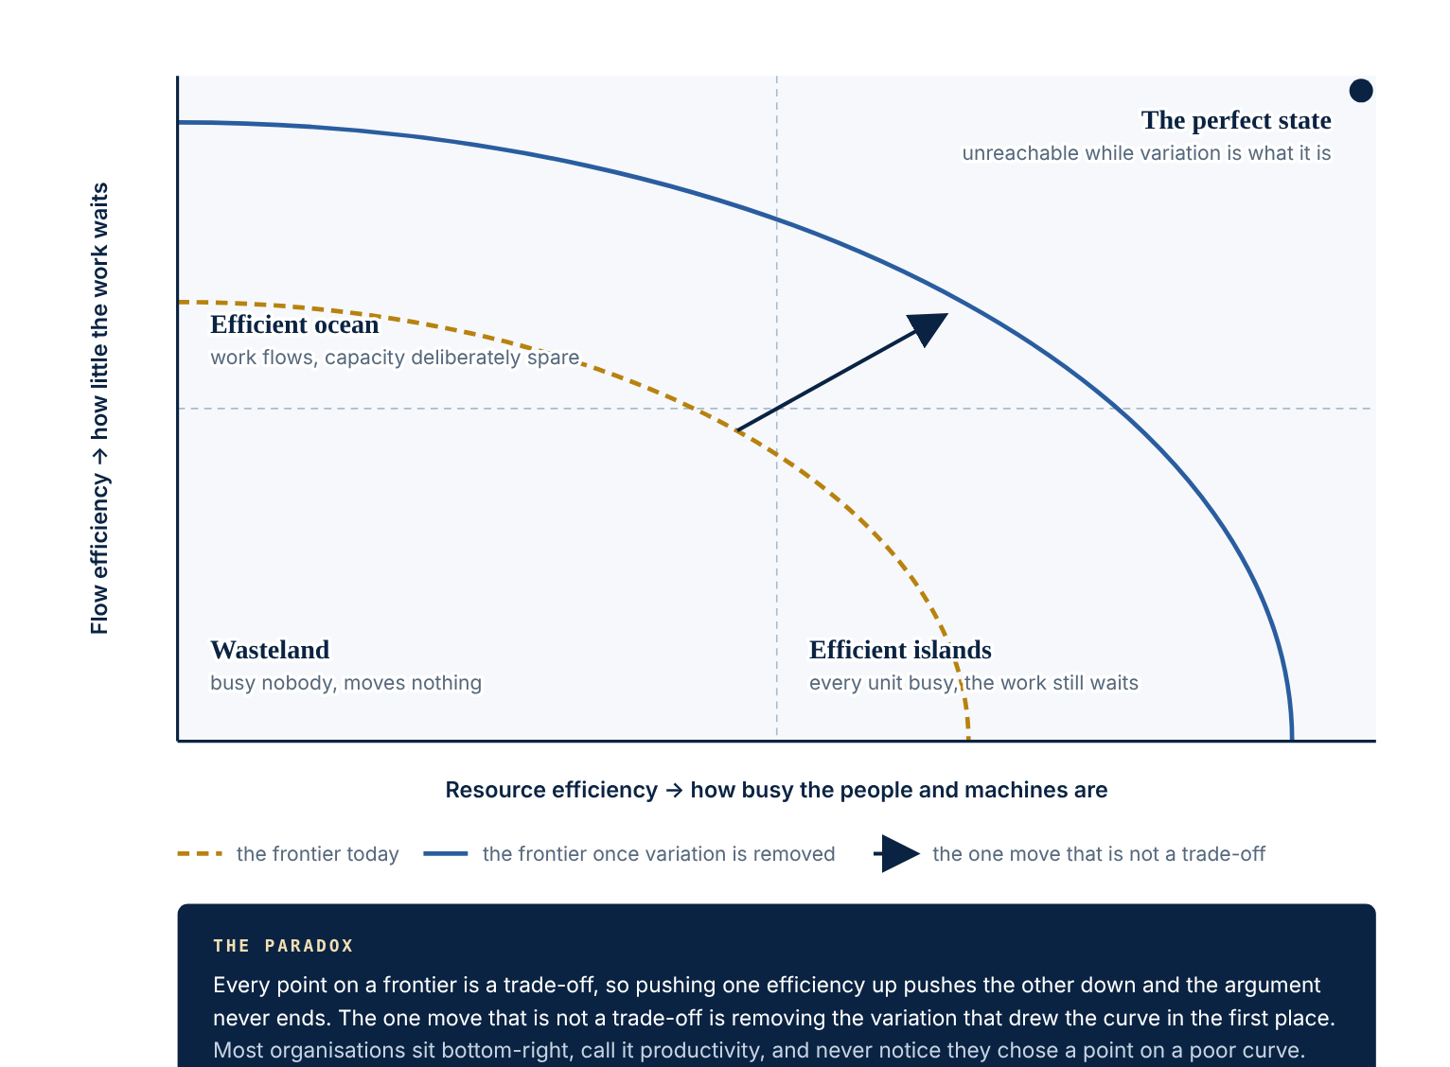
THE EFFICIENCY MATRIX
How to read it
Resource efficiency and flow efficiency are not two names for the same thing.
The curve is the reason they trade off: with variation at its current level, the combinations beyond the frontier cannot be bought with effort.
Removing variation is what moves the frontier towards the corner where both are high.
The figure is usually a shock the first time it is computed for a real process — and the shock is the point.
Figure 2. After Modig & Åhlström (2012).

Slide 22
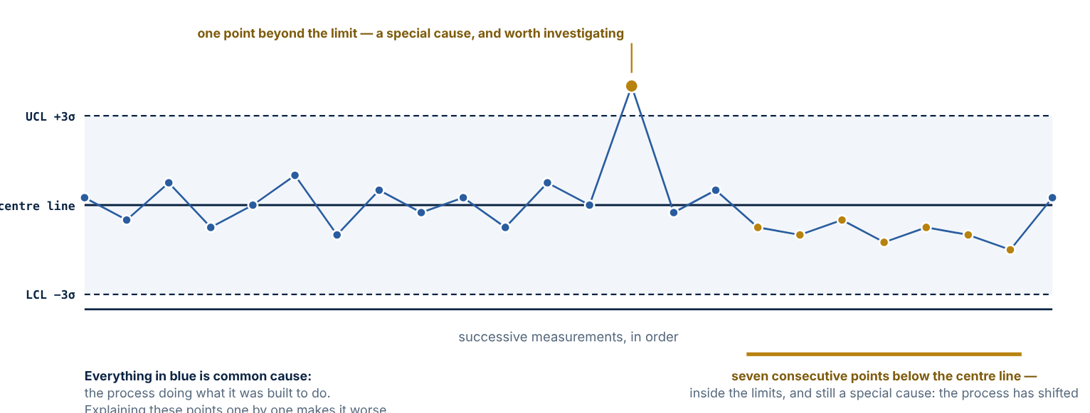
THE OTHER HALF OF THE METHOD — VARIATION
Lean attacks the time the work spends not being worked on. Six Sigma attacks the dispersion of the process — and dispersion is what makes lead time unpredictable. Two attacks on the same quantity, which is why the integration is more than a brand.
Common cause
Inherent in the process as designed. Investigating individual cases will not reduce it: every case has a different story and none of the stories is the cause.
Special cause
Comes from something that was not there before. It can be found and removed. Shewhart's distinction governs everything that follows.
Figure 3. Twenty-four measurements; limits calculated from the process, not from the target. Two signals — everything else is noise.
Reacting to common-cause variation as though it were special cause makes the process worse: each reaction is an unplanned adjustment to a stable system. The monthly meeting that demands an explanation for every variance against target is this error institutionalised — and the single most common misuse of a performance dashboard.

Slide 23
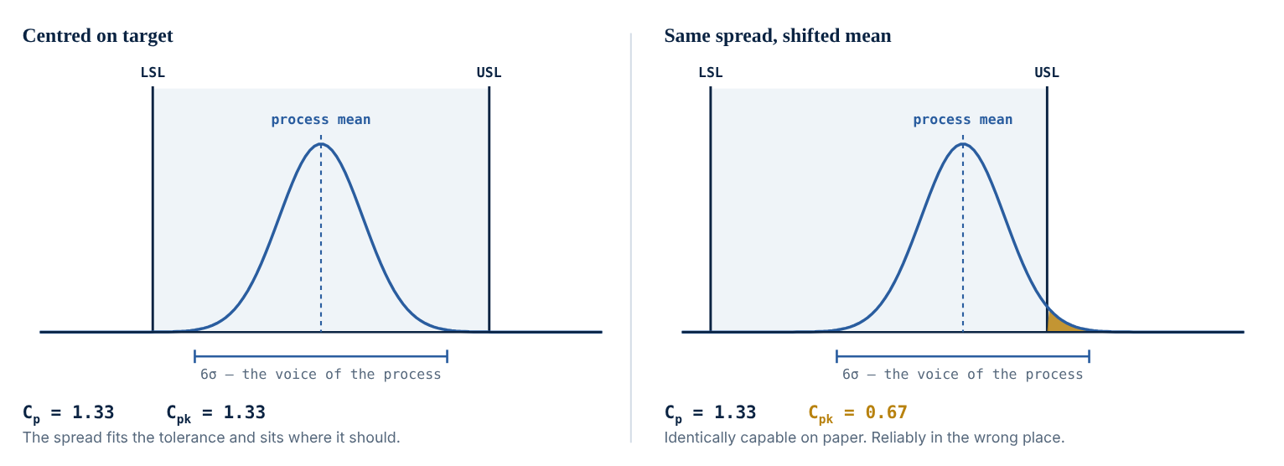
CAPABILITY — THE PROMISE IS THE SPREAD, NOT THE AVERAGE
Cp = (USL − LSL) / 6σ
the width the customer allows, over the width the process produces
Cp assumes the process is centred. Cpk removes that assumption and is the one that matters: a process can be admirably narrow and reliably in the wrong place. Conventional threshold: Cpk ≥ 1.33.
In services and projects the tolerance is a promise: a response committed at 48 hours with an average of 30 and a spread reaching 90 breaks its promise regularly while reporting comfortable averages.
Figure 4. Identical spread, opposite fates: only the centring changed. Cp is unmoved, Cpk halves, and the shaded tail is what the customer rejects.
The average tells you almost nothing about what the customer will experience; the spread, relative to the tolerance, tells you everything.

Slide 24
WHAT A SIGMA LEVEL ACTUALLY SAYS
Sigma level | Defects per million | Right first time | What it means in practice
3σ | 66,807 | 93.3% | Typical of a process nobody has studied. Feels acceptable in isolation.
4σ | 6,210 | 99.38% | A well-run process with active controls.
5σ | 233 | 99.977% | Requires design changes, not vigilance.
6σ | 3.4 | 99.99966% | The benchmark the method is named after.
A twenty-step process, every step right first time at…
Figures follow the convention of allowing a 1.5σ long-term drift in the mean — which is why 6σ is 3.4 per million rather than two per billion. A convention, not a law.
Quality is argued at the step and experienced across the chain. “Our quality is already good” is usually true at the step and false at the outcome. It also explains why removing steps is a quality intervention and not only a cost one: every handoff you delete is a term removed from that product.

Slide 25
WHY THE TWO HALVES NEED EACH OTHER
Lean without Six Sigma
Six Sigma without Lean
Removes steps and queues and then cannot hold the gain, because the variation that generated the queues is still there and rebuilds them as buffers.
Produces beautifully capable steps inside a process whose elapsed time is still ninety per cent waiting — a stable process delivering slowly and predictably.
Reducing variation lowers cost through less rework (the SOC edge) and raises reliability and conformance (the WTP edge) — the double movement the value stick predicted, now with a measurable instrument attached.
IN PROJECT TERMS
THE IDEA
Variability must be absorbed somewhere — inventory, capacity, or time. An organisation that has not chosen has chosen time.
IN A PROJECT
The three buffers have exact equivalents: WIP and half-finished deliverables; overtime, contractors and reserve; schedule contingency. A plan that allocates people at 100% has decided that every illness, late approval and changed requirement will be absorbed by the schedule. The resulting delay is the planning assumption working as specified.
ON MONDAY
Open the resource plan and find the allocation assumption. If it is 100%, the schedule is the buffer. Then find where contingency lives: if it is in every task, nobody will ever see it spent.

Slide 26
Part Five
PART FIVE
The Toyota Production System, as a system
The TPS is conventionally drawn as a house, and the drawing is an argument: a roof needs pillars, pillars need a foundation, and removing any element collapses the rest.

Slide 27
THE HOUSE
Goals — highest quality · lowest cost · shortest lead time · best safety · high morale
The terms, one line each
Takt time — the pace of customer demand
SMED — changeovers fast enough that small batches become economical
Genchi genbutsu — go and see, where the work happens
Autonomation — a machine that stops itself when something goes wrong
Andon — the signal by which anyone halts the line on a problem
Poka-yoke — a device that makes the error physically impossible
Heijunka — levelling volume and mix
4M — man, machine, material, method: the four sources of variation to stabilise first
Just-In-Time
Takt time · continuous flow · pull and WIP limits · SMED
People and teamwork
Kaizen · genchi genbutsu · structured problem solving.
The centre of the house, and the multiplier.
Jidoka
Autonomation · stop-and-fix · andon · poka-yoke
Stability — heijunka (levelling) · standardised work · 4M stability
The sequence is physics, not preference. Pull cannot function on an unstable, unlevelled base: it either starves or floods. Organisations that install kanban boards onto chaotic processes get chaos with better visualisation.

Slide 28
THE TWO PILLARS
Left pillar — Just-In-Time
Right pillar — Jidoka
Continuous flow — remove the interruptions, batching and breakdowns that convert value-adding time into elapsed time
Pull — produce nothing until a downstream signal indicates demand. The signal is what stops overproduction
SMED — kill the changeover and the economic batch size collapses towards one
Underneath all three sits heijunka: a schedule level enough for the pull signal to be worth following
Quality built in at the source, through three mechanisms of increasing cost and decreasing frequency:
Poka-yoke — design the process so the mistake cannot be made
Andon — signal the abnormality the instant it occurs, not at the end of the shift
Stop-and-fix — halt the line so the defect never travels downstream
Pull is not JIT, and neither is kanban. A pull system is a system that explicitly limits work in process — that is the definition. Kanban is one mechanism for limiting WIP; CONWIP is another. Treating the cards as the essence of the system is the most common conceptual error in the boardroom (Hopp & Spearman, 2004).
Stopping the line looks like the most expensive thing a factory can do, and that reading misses the trade. A problem that stops the line gets solved; a problem that is worked around does not. The cost of stopping is visible and immediate; the cost of working around is invisible and permanent.

Slide 29
WHY THE SYSTEM BEATS THE TOOLS
The best-evidenced claim in the field, and the reason the house is drawn as a house rather than as a menu.
Source | Finding
Milgrom & Roberts (1990) | Modern manufacturing is a system of complementarities: the return to any one practice rises with the adoption of the others. Partial adoption yields near-zero or negative returns.
MacDuffie (1995) | Bundles of mutually reinforcing practices explain performance — not individual practices.
Shah & Ward (2007) | Built the field's measurement instruments for lean exclusively on bundle logic.
A partial implementation can leave an organisation worse off than no implementation: a practice adopted without its complements imposes its costs without delivering its returns. This is the strongest available explanation for the failure rate of tool-led lean programmes.
IN PROJECT TERMS
ON MONDAY
Measure one lag: from the moment a problem is first known to someone on the team to the moment it reaches someone who can act. Then ask what happened, last time, to the person who reported red early. That is your andon policy, whatever the governance document says.

Slide 30
THE HOUSE, IN A PROJECT ORGANISATION
Toyota element | Project equivalent | Comment
Heijunka | Resource levelling | Exists — rarely done to the pull signal
Standardised work | Methodology, templates, checklists the PMO maintains | Exists
Poka-yoke | The mandatory field that will not let the form be submitted incomplete | Exists
Andon cord | No comfortable equivalent | Monthly status reporting is its opposite: it aggregates upward on a cycle, and a red status costs the reporter more than it costs the organisation
Most of the Toyota house already exists in a project organisation under other names. One element does not, and it is the one that matters most: a system designed to signal abnormalities early and loudly.

Slide 31
Part Six
PART SIX
Lean in the language of capital
Operational improvement that cannot be stated in financial terms does not survive the budget cycle. Fortunately, the translation is an identity rather than an argument.

Slide 32
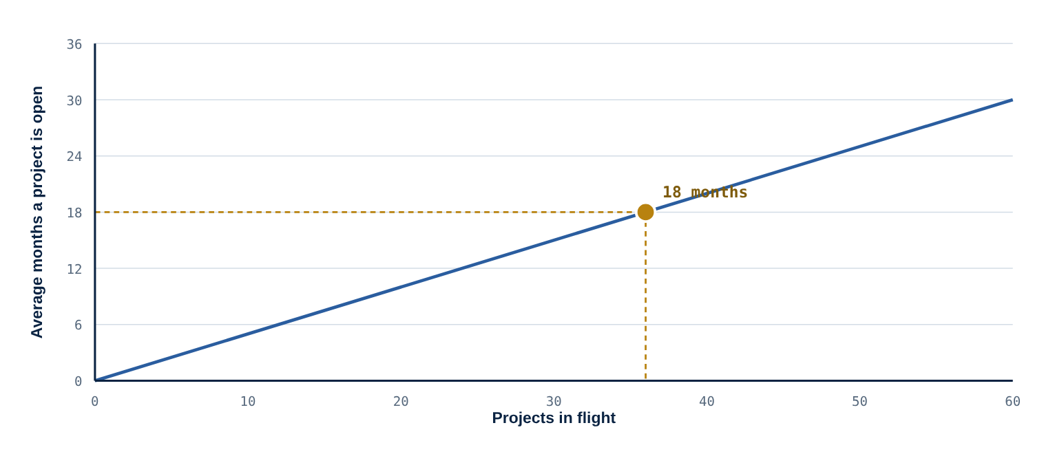
LITTLE'S LAW
WIP = Throughput × Lead Time
Little (1961) — an identity, not a model
lead time ↓ → WIP ↓ → inventory ↓ → invested capital ↓ → ROIC ↑
Hold throughput constant and the identity says something immediate: cutting lead time cuts work in process proportionally. And work in process is inventory, and inventory is invested capital. Flow improvement is a balance-sheet intervention that merely happens to take place on a shop floor.
Figure 5. For a given rate of completion, the time a project stays open grows in a straight line with the number in flight. The dot is your organisation.
Starting less finishes more
lead time = in flight ÷ completed per year
Twenty projects in flight, ten finished a year: a two-year average lead time, whatever the schedules say. Halve the number in flight and the lead time halves, with the same people and the same budget — and throughput usually rises, because the context switching that consumed the difference disappears.
the portfolio form

Slide 33
WE DO THIS CALCULATION LIVE
A
B
A ÷ B
Projects currently in flight in your unit — everything authorised and not yet closed, including the ones nobody touched this month. Those count: they are WIP.
Projects completed and closed in the last twelve months.
your real average project lead time, in years
Approximate figures are enough. The interesting number is not the result — it is the gap between that result and the lead time your organisation believes it has.
Two levers, one that works
Reading it honestly
Start less (36 → 22 in flight: 18 months → 11) or finish more (+20% capacity: 18 → 14.9). The second is the one everybody reaches for and the first is the one that works — because the first is a decision and the second is a budget.
The law holds on averages, for a stable system in which what starts eventually finishes. A portfolio that quietly abandons a third of what it begins is not described by the line — and the first useful thing it can do is count the abandonments.
Notes:
Run the Little's Law simulator from the reading notes with two or three figures volunteered by participants. The simulator shows the arithmetic strip and the comparison of the two levers.

Slide 34
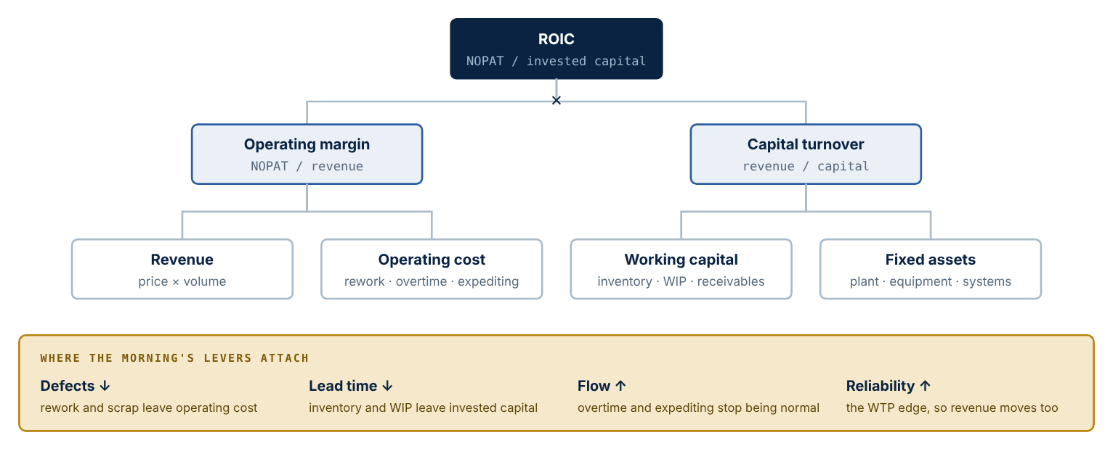
WHERE LEAN SHOWS UP IN RETURN ON INVESTED CAPITAL
Margin — the numerator
NOPAT ÷ revenue. Lean moves it through scrap, rework, yield and equipment effectiveness. Where every standard lean business case is written.
Capital turnover — the denominator
Revenue ÷ invested capital. Lean moves it through inventory, footprint, capacity buffers and the cash cycle. Where nobody in the operations meeting is looking.
Figure 6. ROIC decomposed. Removing defects and expediting lifts the left branch; removing lead time lifts the right one by taking capital out of the denominator.
A programme argued only as cost saving is claiming half of what it does.

Slide 35
A WORKED SCENARIO — THE DENOMINATOR DOES MORE WORK
Revenue 1,000 a year; fixed assets 500; each day of lead time ties up 15 of inventory; WACC 10%. Lead time is cut from 20 days to 8, and defect reduction lifts the margin from 8% to 10%.
Scenario | Lead time | Margin | Invested capital | ROIC | Economic profit
Baseline | 20 days | 8% | 800 | 10.0% | 0
Flow only | 8 days | 8% | 620 | 12.9% | +18
Cost only | 20 days | 10% | 800 | 12.5% | +20
Both | 8 days | 10% | 620 | 16.1% | +38
Margin improved by 25%. Capital turnover improved by 29%. The denominator did more work than the numerator — and the denominator is the half of the equation that operational business cases almost never mention. A firm exactly earning its cost of capital is now creating economic profit, without one additional unit of revenue. Note that the two levers together add more than the two gains added together: the higher margin is earned on a smaller base.
Try it with an unhelpful setting
Raise the margin as far as it goes and leave lead time at thirty days — and watch how much of the improvement the denominator eats. That is the shape of a cost-reduction programme that never touched flow.
Notes:
Run the ROIC simulator from the notes. Presets: baseline, flow only, cost only, both. In your own numbers, inventory per day of lead time is roughly annual cost of sales divided by working days.

Slide 36
BOTH PILLARS MOVE BOTH EDGES OF VALUE
Mechanism | Effect
Jidoka → cost | Defects removed at source; the cost of poor quality collapses. The classic business case.
Jidoka → WTP | Zero-defect delivery lets a B2B customer eliminate incoming inspection and cut safety stock. A willingness-to-pay argument with a hard number attached.
JIT → cost | Less inventory, handling, expediting and obsolescence; a smaller footprint.
JIT → WTP | Customers pay for speed and predictability, because short lead times cut their own forecasting risk.
The value stick said there are two ways to create value. The house delivers both at once — which is why a lean business case written only on cost is undersold twice: once on the WTP edge, once on the denominator.

Slide 37
Part Seven
PART SEVEN
DMAIC — conducting improvement, analysing problems
Everything so far describes what good looks like. DMAIC is the method for getting there from where you are — above all, for analysing a problem before paying to solve it.

Slide 38
THE FAILURE MODE IT EXISTS TO PREVENT
What everyone remembers
What matters
Six Sigma, Motorola, the 1980s; a process so consistent that specification limits sit six standard deviations from the mean — 3.4 defects per million opportunities. The statistical ambition is the part everyone remembers. It is not the part that matters most to a senior manager.
An experienced manager recognises a problem in seconds and already knows what to do. That recognition is pattern-matching: fast, frequently right, and entirely unverified. When it is wrong, the organisation finds out after it has paid — and because the supposed cause was never written down, the error teaches nothing.
DMAIC does not exist to distrust experience. It exists so that the experienced manager's hypothesis is written down before it is funded — and can therefore be refuted while refutation is still cheap.
Bridge from Part Two: C is the repeated ability to improve P. DMAIC is how that improvement is conducted.

Slide 39
THE FIVE PHASES
Phase | The question it answers | Representative tools
Define | What is the problem, whose is it, what does it cost, and where does the scope end? | Project charter · SIPOC · voice of the customer
Measure | What is today's performance, measured in a way anyone would trust? | Operational definitions · measurement system analysis
Analyze | What is the cause — verified, not assumed? | Five whys · Ishikawa · Pareto · hypothesis testing
Improve | Does the solution work in a pilot, before it is scaled? | Controlled pilot · poka-yoke · design of experiments
Control | Does the gain survive the dissolution of the project team? | Control charts · control plan · standardised work
Define and Measure are half the work
Not rival systems
They look like bureaucracy. A badly defined problem has no verifiable solution, and a measure nobody trusts ends every discussion in opinion. A phase is complete when its question has an answer somebody would stake a decision on.
Poka-yoke appears here and in the Jidoka pillar. Lean and Six Sigma share mechanisms and attack different enemies — flow and waste on one side, variation and defects on the other. The tools are named, not examined.

Slide 40
ANALYZE, IN PRACTICE — AND WHERE INITIATIVES DIE
Five whys — two rules
What the technique reliably demonstrates: the cause people name first is usually the third or fourth link in the chain — still a symptom. Pareto then answers a different question: of the many verified causes, which few account for most of the effect.
We do this live, on the queue your value stream sketch reveals in the group activity.
A cause attributed to a person is not a process cause. “Because he did not deliver on time” restates the symptom. The next question is always: what in the process allows that to happen without anyone noticing?
Stop when you reach something somebody controls. “Because the market is volatile” has gone one step too far; a chain that stops at the second link has not gone far enough.
In Analyze
In Control
The cheapest safeguard
The team arrives with its preferred solution and uses the phase to justify it. Symptom: the root cause turns out to be whatever someone already wanted to buy.
The gain exists for as long as the team exists. Once it disperses the process regresses within months, because nobody inherited the standard.
A tollgate at the end of each phase, chaired by the executive sponsor who owns the business result — not by the specialist running the project. Whoever conducts the work is not whoever approves it.

Slide 41
DMAIC AS A PROJECT — AND WHERE IT DOES NOT APPLY
IN PROJECT TERMS
THE IDEA
DMAIC is a project with the weight in a different place: a conventional plan commits to a solution at authorisation; DMAIC forbids naming one until a cause has been verified.
IN A PROJECT
The vocabulary overlaps almost exactly — charter, tollgates as stage gates, sponsor. The gate between Analyze and Improve is the one with no equivalent in most governance frameworks, and it is the one that does the work. Control maps onto benefits realisation and handover to operations — the phase every methodology describes and few organisations perform.
ON MONDAY
At the next approval, ask what the verified cause is. If the answer is a solution — “we need a new system”, “we need more people” — the project is at Define, whatever the gate it is passing through says.
Where the method does not apply. DMAIC assumes a repeatable process with a definable defect. Applied to the exploratory front end — research, invention, early-stage product discovery — it suppresses precisely the variation that discovery depends on. The organisation needs two regimes, one for exploring and one for exploiting, and clarity about which process is in which. The afternoon returns to this with Cynefin.

Slide 42
Part Eight
PART EIGHT
The third equation
The identity was stated in Part Two before there was anything to test it against. Everything since has been that test. This part puts the three terms back together — and answers the puzzle.

Slide 43
V = C × (A + P)
Term | What it is | Visibility
A — Assets | Plants, machines, systems. What the pillars stand on. | Visible and purchasable
P — Processes | How work flows across the assets. The pillars and the foundation. | Partly visible, imitable with effort
C — Capability | The repeated ability to improve P. The centre of the house. | Barely visible, rarely imitable
You can buy a plant, license a platform, hire a consultant to redraw a process. You cannot buy the organisation's repeated ability to improve. And if C approaches zero, V approaches zero regardless of what A and P are worth.
IN PROJECT TERMS
THE IDEA
Sort what a PMO owns by the three terms, and most of it lands in the bracket.
IN A PROJECT
Scheduling tool, portfolio platform, dashboards: A. Methodology, templates, gate model, certified staff: P. Both purchasable by every competitor at roughly the same price. C is what is left — whether this organisation reliably gets better at delivering, and whether that survives the people who drove it.
ON MONDAY
Three questions for the PMO: what do we deliver better this year than last, and how do we know? Which improvement survived its author leaving? What would remain if the tool were replaced tomorrow?

Slide 44
THE PUZZLE, ANSWERED
What changed at Fremont — and where does it appear?
Why was it never replicated across GM?
Not A: same building, same equipment. Not only P: the processes changed, but GM photographed and copied those for twenty years without the result. What changed was C — the organisation's repeated ability to find and fix its own problems, with the same people who had been unable to the year before. On the balance sheet it appears nowhere, which is the point. It shows up only in its consequences: quality, the inventory no longer needed, a return on capital no line item explains.
Because what GM could observe was the bracket, and what produced the result was the coefficient. Kanban boards, andon cords, standardised work sheets were visible and copied. The rules-in-use that made them work — how problems are surfaced, who may stop the line, how an improvement is run as an experiment — were not written down anywhere, because at Toyota nobody needed to write them down.
Now grade the line you wrote at 09:10. Did it name the bracket, or the coefficient?
That is the whole of the afternoon's argument about benchmarking — and why the day ends on how C is built rather than on where it can be bought.

Slide 45
THE EQUATIONS, IN ONE PLACE
Equation | What it establishes
Value stick — WTP − SOC | Lean pushes both edges outward at once: Jidoka and JIT each lower cost and raise willingness to pay.
Competitive advantage — VC = (WTPA − CA) − (WTPB − CB) | Creating value is necessary; creating more of it than the rival is what the firm is paid for. When an improvement is copyable, the two brackets converge and VC returns to zero.
Economic profit — ROIC vs. WACC | Lean lifts the numerator and cuts the denominator, moving return above the cost of capital.
VCAP — V = C × (A + P) | It does so only for organisations that build the multiplier rather than buying the bracket.
Porter's objection
Spear & Bowen's finding
Operational effectiveness is imitable, so its gains compete away; strategy-grade advantage must live somewhere harder to copy. Where, exactly — and what does that imply for a programme whose entire output is better processes?
What distinguishes Toyota is not its tools but its rules-in-use: tacit rules governing how flow paths are specified and how every improvement is run as a controlled experiment. Tacit rules can be observed and still not transferred.

Slide 46
Part Nine
PART NINE
Group activity — the Value Case
One real project, appraised through the three lenses built this morning: where it moves willingness to pay, where it removes waste, and what it actually builds. Groups of three or four; one scribe on the fillable canvas; one spokesperson.

Slide 47
WHY THIS APPRAISAL DIFFERS FROM A BUSINESS CASE
A conventional business case answers one question — does the return exceed the cost? Necessary, and silent on the three things that decide whether the return survives.
Which edge of value does this move?
Is the saving a named waste, or an aspiration?
More capable, or only better equipped?
A project that only lowers cost competes on the edge where every rival is also working. Raising willingness to pay is harder, rarer, and usually under-argued because the number is harder to produce.
“Improves efficiency by 15%” is a target. “Eliminates the three re-approvals caused by incomplete submissions” is a waste with a name — and only the second can be verified afterwards.
Assets and processes can be replicated by any competitor willing to spend the same money. A project that leaves the organisation better at improving cannot.
Those three questions are one question in disguise, and VC states it: a project is worth defending to the extent that it widens the gap between (WTP − cost) for your firm and the same quantity for the competitor you are actually losing deals to.
The raw material: one authorised project a member knows well enough to defend. Ninety seconds to choose — pick the one the group disagrees about, not the one with the best business case.

Slide 48
THE VALUE CASE CANVAS — SIX STEPS
1
The project
2
The WTP edge
3
Map the stream
What it is, who sponsors it, what it was approved to achieve.
Competitive priority moved; quality dimension; order winner or qualifier; who is the customer — and would they notice?
Three to six steps with who performs them; process time; lead time; where the gap sits.
4
The cost edge
5
What it builds
6
The verdict
Name the waste from the eight — not a benefit. Where it occurs today; order of magnitude.
Decompose into A, P and C. The test for C is strict: training people on the new system is delivering the asset.
How long before a competitor could replicate this? Fund · fund with conditions · do not fund — and what would have to be added to build C.
The group presents step 1 and step 6, with the reasoning that connects them. One spokesperson. The canvas is fillable online, saved in the browser as you type, and exportable — download before closing the tab.

Slide 49
WHAT TO EXPECT
Only one edge moves
C is empty
Most project portfolios are built almost entirely of cost-edge projects. That is not wrong, but it is a choice, and usually an unexamined one. The question it raises: what would it take for this same project to also move willingness to pay — and would that cost much more?
Projects deliver assets and processes because those are what can be specified, scheduled and signed off. Capability resists all three. The question it raises: if A and P are purchasable by any competitor, what in this portfolio is actually building advantage?
Neither result is a failure of the project you chose. Both are findings worth reporting.
Keep the export and bring it to the afternoon: Session 2 examines the digital tooling that project depends on. Module 3 closes with a group Execution Optimization Challenge, and an appraised project of your own is the kind of material it draws on.

Slide 50
Part Ten
PART TEN
Where the morning ends
One claim, five moves, four equations — and three things that should survive six months.

Slide 51
THE ARGUMENT, IN FIVE MOVES
1
Value is defined from the customer backwards. Order winners create preference, qualifiers only avoid elimination, and the value stick says there are exactly two ways to create value.
2
Waste is the gap between those two edges, and the value stream map makes it visible: a few hours of work inside weeks of elapsed time, almost all of it waiting.
3
The waiting is produced by utilisation, not cured by it. Flow efficiency, not resource efficiency, is what the customer experiences.
4
Variation is the other half of the method. Lean removes the time the work is not being worked on; Six Sigma narrows the spread that makes that time unpredictable. Neither holds its gain without the other.
5
All of it shows up in return on capital — in the margin through less rework, and in the denominator through less inventory. The denominator is the half that business cases forget.

Slide 52
FOUR EQUATIONS, ONE STAIRCASE
Value created = WTP − SOC
Where value comes from, and the only two moves that create it.
VC = (WTPA − CA) − (WTPB − CB)
Creating value is not having an advantage. Advantage is the difference — and a copyable improvement returns it to zero.
ROIC = margin × capital turnover
How the improvement reaches the people who fund it, through both levers at once.
V = C × (A + P)
Why two organisations with the same assets and processes get different results — and where the residue of advantage can live.

Slide 53
WHAT SHOULD SURVIVE SIX MONTHS
Count elapsed time, not effort
Starting less finishes more
Buy the bracket, build the coefficient
The question is never “how long does this take to do” but “how long does it wait” — and the answer is usually ninety per cent of the lead time.
Projects in flight divided by projects finished a year is your real lead time, whatever the schedules say — the one number on the slide nobody can argue with.
Every tool and every method is available to a competitor at the same price. What is not is the repeated ability to find and fix your own problems — what Fremont changed, and what GM could not copy.
IN PROJECT TERMS
IN A PROJECT
ONE PROCESS — take the recurring process you brought, walk it with the people who do it, and write two numbers on one line: hours of work, days of elapsed time. TWO COUNTS — projects in flight; projects closed in the last twelve months. Divide.
ON MONDAY
ONE QUESTION — at the next approval you sit in, ask which edge of value the project moves and what is left when the competitor does the same. If the answer is nothing, fund it to the threshold and not beyond.

Slide 54
WHAT THE AFTERNOON TESTS
The morning ended on a claim: value is not the sum of what an organisation owns and how it works, but that sum scaled by its capacity to improve. The afternoon tests the claim against the two things organisations buy when they want that capacity and cannot build it.
Technology
Other people's practices
Digital platforms — the most expensive thing on the list and the easiest to mistake for capability. Artificial intelligence as the extreme case of the same error.
Benchmarking — the only one that looks like it should work. Why GM toured NUMMI for twenty years and copied everything that could be photographed.
Bring two things: your Value Case canvas, and your NUMMI hypothesis with the resolution we reached. 14:00.

Slide 55
Prof. Dr. Thiago Lima
tflsixsigma@gmail.com
Reading notes, simulators and the Value Case Canvas:
tflsixsigma-png.github.io/lean-six-sigma-digital-tools-benchmarking
International Certificate in Project Management and Organizational Performance · Module 3, Session 4
THANK YOU

