Slide 1
BOARD CONFIDENTIAL
OE Group
Phase 1 Progress
Production build of the unified property & facilities platform for TFML and OEA
5 August 2026
Through Day 11 complete · Day 12 (security, compliance & go-live) in progress
Notes:
OE Group Phase 1 progress report for the board. As of 5 August 2026 the build is complete through Day 11 (OEA lettings, analytics console, vendor KPI/SLA evaluation), with Day 12 (security, compliance, UAT, go-live) in progress — started 4 Aug per GO_LIVE_CHECKLIST.md, not yet executed. Verified from BUILD_JOURNAL.md and PHASE1_WORKPLAN.md day-status notes.

Slide 2
The Phase 1 roadmap at a glance
Foundation, money, lettings, intelligence and launch. Where the build actually is today.
0
Preconditions — accounts, keys, environments
DONE
6.5
Operator-governed permission matrix
DONE
1
Environment split — demo frozen, Phase 1 on its own database
DONE
6.75
Property & unit enrolment (create/manage portfolio)
DONE
2
Brand isolation — each brand walled off, in and at rest
DONE
7
OEA tenant application + KYC intake
DONE
3
Omnichannel intake + AI triage, notification centre
DONE
8
Two-tier human review + approval
DONE
★
Foundation build — new UI, branding, asset register, vendor applications
DONE
9
Lease administration + rent roll
DONE
4
Segregated client-funds ledger + reconciliation
DONE
10
Interactive analytics dashboard
DONE
5
Live collections — checkout to receipt to ledger
DONE
11
Vendor KPI/SLA evaluation, work-order media, UX pass
DONE
6
Live remittance — vendor payouts + landlord rent, gated
DONE
12
Security audit, NDPA pack, UAT, go-live
IN PROGRESS
Notes:
The full roadmap. Fifteen of sixteen stages complete: Days 0–6, the inserted foundation build, 6.5, 6.75, and now 7–11 (OEA lettings, analytics console, vendor evaluation). Only Day 12 (security, compliance, UAT, go-live) remains, in progress since 4 Aug.

Slide 3

A
OE GROUP · USER JOURNEY · LANE A
built · live now
upcoming
1
2
3
4
5
6
+
Invite & onboard
Configure controls
Oversee all tickets & money
💧 Approve high-value pay
Go-live governance
staff · vendors · tenants → role
Analytics console
threshold · permissions · brand
🖥 org-scoped dashboard
above threshold · gated
filters, trends, exports
upcoming · Stage 12
ADMIN
Onboard people, set controls, oversee everything, sign off large payments.
INTAKE
TRIAGE
DISPATCH
WORK
VERIFY
EVALUATE
INVOICE
APPROVE
PAY/REMIT
RECONCILE
REPORT
Notes:
Admin lane: invite and onboard, configure controls, oversee all tickets and money, approve high-value payments (gated), analytics console (shipped Day 10). One upcoming ghost remains: go-live governance (Day 12, in progress).

Slide 4

B
OE GROUP · USER JOURNEY · LANE B
built · live now
upcoming
1
2
3
4
5
6
✓
My properties only
Dispatch
💧 Verify service delivered
Manage register
Review tenant application
Rent-roll & lease oversight
assign vendor to ticket
property · unit · asset
property-scoped requests
gate step ①
property-scoped queue
landlord-ready roll
FM / PM
Run assigned properties: dispatch, verify work, manage units & assets.
INTAKE
TRIAGE
DISPATCH
WORK
VERIFY
EVALUATE
INVOICE
APPROVE
PAY/REMIT
RECONCILE
REPORT
Notes:
FM/PM lane: see only my properties, dispatch, verify service delivered (gated), manage register, review tenant application (Day 8), rent-roll and lease oversight (Day 9). No upcoming ghosts remain in this lane.

Slide 5

C
OE GROUP · USER JOURNEY · LANE C
built · live now
upcoming
1
2
3
4
5
6
✓
✕
✓
$
%
Assigned work orders
Accept / decline
Mark complete
💧 Submit invoice
Payment history
Service catalog & pricing
jobs dispatched to me
respond to dispatch
update ticket status
gate step ②
every invoice, always
future · unscoped
VENDOR
Fulfil assigned work orders and get paid for completed jobs.
INTAKE
TRIAGE
DISPATCH
WORK
VERIFY
EVALUATE
INVOICE
APPROVE
PAY/REMIT
RECONCILE
REPORT
Notes:
Vendor lane: assigned work orders, accept/decline, mark complete, submit invoice (gated), payment history (the my-work page’s Payment status table, Day 10). One upcoming ghost remains: service catalog and pricing.

Slide 6

D
OE GROUP · USER JOURNEY · LANE D
built · live now
upcoming
1
2
3
4
5
6
7
8
9
Report an issue
AI triage
Ticket + acknowledgement
Track the request
Pay service charge
View statements
Apply for tenancy + KYC
Pay rent / lease online
"Track my request" timeline
📱 ✈ 🖥 WhatsApp · Telegram · web
category + priority
"check status" · "it's urgent"
live status updates
🖥 Paystack → receipt
payment history
on their phone, OEA
Paystack · receipt
raised → resolved
TENANT / RESIDENT
Report an issue, track it, pay charges — from their phone.
INTAKE
TRIAGE
DISPATCH
WORK
VERIFY
EVALUATE
INVOICE
APPROVE
PAY/REMIT
RECONCILE
REPORT
Notes:
Tenant lane: report an issue, AI triage, ticket + ack, track request, pay service charge, view statements, apply for tenancy + KYC (Day 7), “Track my request” timeline (Day 10). One upcoming ghost remains: pay rent / lease online — the ledger side is built (Day 9) but no tenant-facing checkout page was found yet.

Slide 7

E
OE GROUP · USER JOURNEY · LANE E
built · live now
upcoming
1
2
3
4
5
6
$
✓
Portfolio dashboard
Financial reports
💧 Receive remittance
Approve major spend
Market comps
E-sign documents
performance at a glance
portfolio statement · built
gate step ③ · payout
future · needs a board decision
future · unscoped
future · unscoped
OWNER/LANDLORD
Track portfolio health, get paid, sign off on major spend.
INTAKE
TRIAGE
DISPATCH
WORK
VERIFY
EVALUATE
INVOICE
APPROVE
PAY/REMIT
RECONCILE
REPORT
Notes:
Owner lane: portfolio dashboard, financial reports, receive remittance (gated), approve major spend. Two upcoming ghosts: market comps, e-sign documents.

Slide 8

F
OE GROUP · USER JOURNEY · LANE F
built · live now
upcoming
1
2
3
4
5
6
=
✓
$
Reconcile ledger
Batch-approve payouts
💧 Remit to owners
Generate reports
Tax & compliance filing
Multi-entity consolidation
work-order trace · built
org-wide P&L & statements
vendor invoices, in bulk
gate step ④ · payout run
future · unscoped
future · unscoped
FINANCE LEAD
Reconcile the ledger, batch-approve payouts, close the books.
INTAKE
TRIAGE
DISPATCH
WORK
VERIFY
EVALUATE
INVOICE
APPROVE
PAY/REMIT
RECONCILE
REPORT
Notes:
Finance Lead lane: reconcile ledger, batch-approve payouts, remit to owners (gated), generate reports. Two upcoming ghosts: tax and compliance filing, multi-entity consolidation.

Slide 9

G
OE GROUP · USER JOURNEY · LANE G
built · live now
upcoming
1
2
3
4
5
6
Review flagged transactions
Check supporting docs
💧 Approve / reject release
Approval audit trail
Delegate approval authority
Set approval policy & rules
high-value queue
invoices, photos, receipts
gate step ⑤ · final say
who approved what, when
future · unscoped
APPROVER
future · unscoped
Final sign-off on the largest payments before they release.
INTAKE
TRIAGE
DISPATCH
WORK
VERIFY
EVALUATE
INVOICE
APPROVE
PAY/REMIT
RECONCILE
REPORT
Notes:
Approver lane: review flagged transactions, check supporting docs, approve/reject release (gated final say), approval audit trail. Two upcoming ghosts: delegate approval authority, set approval policy and rules.

Slide 10
H
OE GROUP · USER JOURNEY · LANE H
built · live now
upcoming
1
2
3
4
5
6
💧
✕
Org-wide oversight
Client-funds ledger
Co-approve payments
Cannot execute a payout
Full audit trail
Executive analytics
every request, property, vendor
read in full · never post
above the threshold too
refused in the database
who did what, when
all columns, live
EXECUTIVE · MD / MANAGING PARTNER
See everything finance sees, co-hold approval — and never move the money.
INTAKE
TRIAGE
DISPATCH
WORK
VERIFY
EVALUATE
INVOICE
APPROVE
PAY/REMIT
RECONCILE
REPORT

Slide 11
I
OE GROUP · USER JOURNEY · LANE I
built · live now
upcoming
1
2
3
4
5
6
✓
+
My region only
Dispatch & close jobs
Verify service delivered
Enrol operational staff
Manage register
Nothing financial
region → project → site
assign vendor · close ticket
gate step ①
bounded to my region
property · unit · asset
no budgets, no payments
REGIONAL MANAGER
Run a region: dispatch, verify, manage the register, enrol operational staff.
INTAKE
TRIAGE
DISPATCH
WORK
VERIFY
EVALUATE
INVOICE
APPROVE
PAY/REMIT
RECONCILE
REPORT

Slide 12
J
OE GROUP · USER JOURNEY · LANE J
built · live now
upcoming
1
2
3
4
5
6
✓
📷
My jobs
Acknowledge
Record progress
Photo / video evidence
My own activity
Nothing organisational
dispatched to me
confirm I have it
status as work proceeds
on the work order
my actions, my scope
no register, no money
FM OPS STAFF
Do the jobs dispatched to me, and record what I did.
INTAKE
TRIAGE
DISPATCH
WORK
VERIFY
EVALUATE
INVOICE
APPROVE
PAY/REMIT
RECONCILE
REPORT

Slide 13
K
OE GROUP · USER JOURNEY · LANE K
built · live now
upcoming
1
2
3
4
5
6
✕
✕
Programme overview
Delivery progress
No tickets
No money
No people
Own notification settings
one honest page
stages and status
operational data withheld
ledger and payments withheld
the directory is not theirs
the one thing they own
VIEWER
An observer from outside the organisation: the programme, not the particulars.
INTAKE
TRIAGE
DISPATCH
WORK
VERIFY
EVALUATE
INVOICE
APPROVE
PAY/REMIT
RECONCILE
REPORT

Slide 14
What was delivered
FOUNDATION
Set up the workshop before any building began.
A separate development database, isolated from the live demo.
Live error monitoring and uptime watching switched on.
Payment gateway test keys obtained so money paths could be built safely.
Day 0
Preconditions in place
THE REAL DEMONSTRATION
Every account, key and environment needed for the build was confirmed in hand — a dedicated development Supabase database, Upstash rate-limiting, Sentry error tracking, an isolated Vercel project, and Paystack test keys — with nothing yet touching real money or the live demo.
COMPLETE
Notes:
Day 0 gate evidence from the Status board: dev Supabase, Upstash, Sentry, Vercel dev project, Paystack test keys. This stage is about readiness, not visible features.

Slide 15
What was delivered
TRACK A · FOUNDATION
A fresh Phase 1 workspace running on its own database.
The existing live demo left completely frozen and untouched.
Automatic protection against message floods on both intake channels.
Error reporting proven to be live and delivering.
Day 1
A world that cannot touch the demo
THE REAL DEMONSTRATION
The live demo and the new Phase 1 environment were shown running side by side — same app, different data — with the demo database provably unchanged. Rate-limiting blocked a flood on the sixth message; a test error arrived in monitoring within seconds.
COMPLETE
Notes:
Day 1 gate: seeding dev left demo untouched; limiter + Sentry proven live. Build journal confirms demo 26 tickets vs dev 22 on separate hosts.

Slide 16
What was delivered
TRACK A · FOUNDATION
TFML and OEA fully separated — on the way in, not just at rest.
Each brand's WhatsApp / Telegram number routes into its own account.
Four independent layers of isolation, each checked automatically.
The old shared hard-coded organisation removed entirely.
Day 2
Each brand walled off from the other
THE REAL DEMONSTRATION
A message sent to TFML's number appeared only under TFML; a message to OEA's number only under OEA — and neither brand could see a trace of the other. The separation held at all four layers under an automated isolation test.
COMPLETE
Notes:
Day 2 gate: verify-channel-routing, verify-jwt-claims. Kills hardcoded DEMO_ORG_ID; isolation proven at all four layers.

Slide 17
What was delivered
TRACK A · FOUNDATION
Residents can reach the platform by WhatsApp, Telegram or the portal.
AI reads each message, decides what it is and how urgent, and files it.
A personal notification inbox for every user, with channel preferences.
People can enrol their own colleagues by email invitation — no scripts.
Day 3
Requests in, from anywhere
THE REAL DEMONSTRATION
A message on any channel became a correctly-categorised ticket automatically, the right person was notified, and an emailed invitation carried a new user through sign-up into exactly the role and organisation they were granted — and nothing more.
COMPLETE
Notes:
Day 3 gate: verify-notifications, verify-cascade, verify-email-routing. Also invitation acceptance verified in-browser.

Slide 18
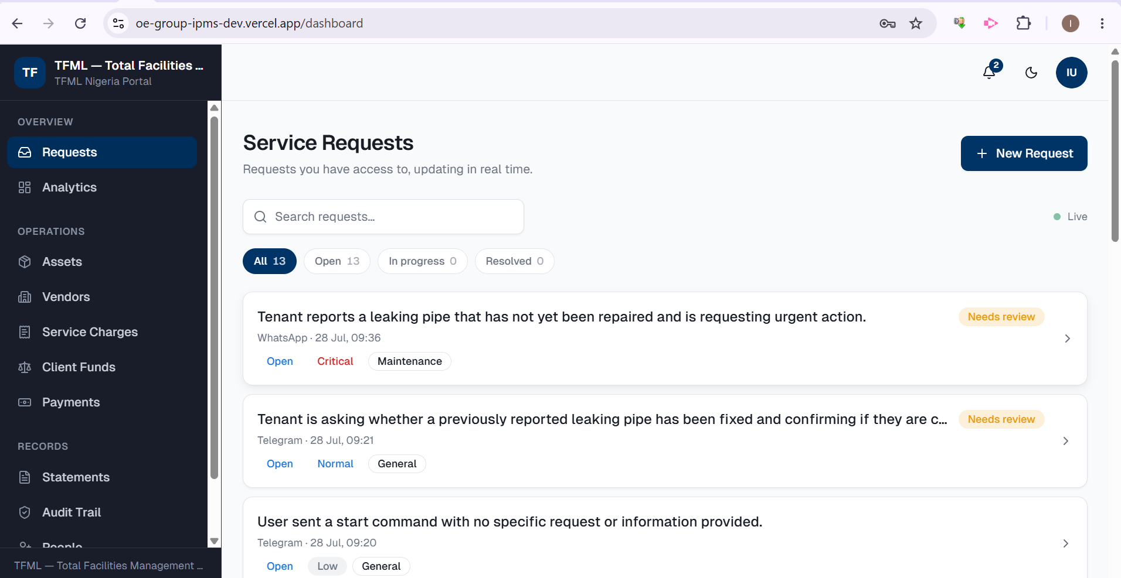
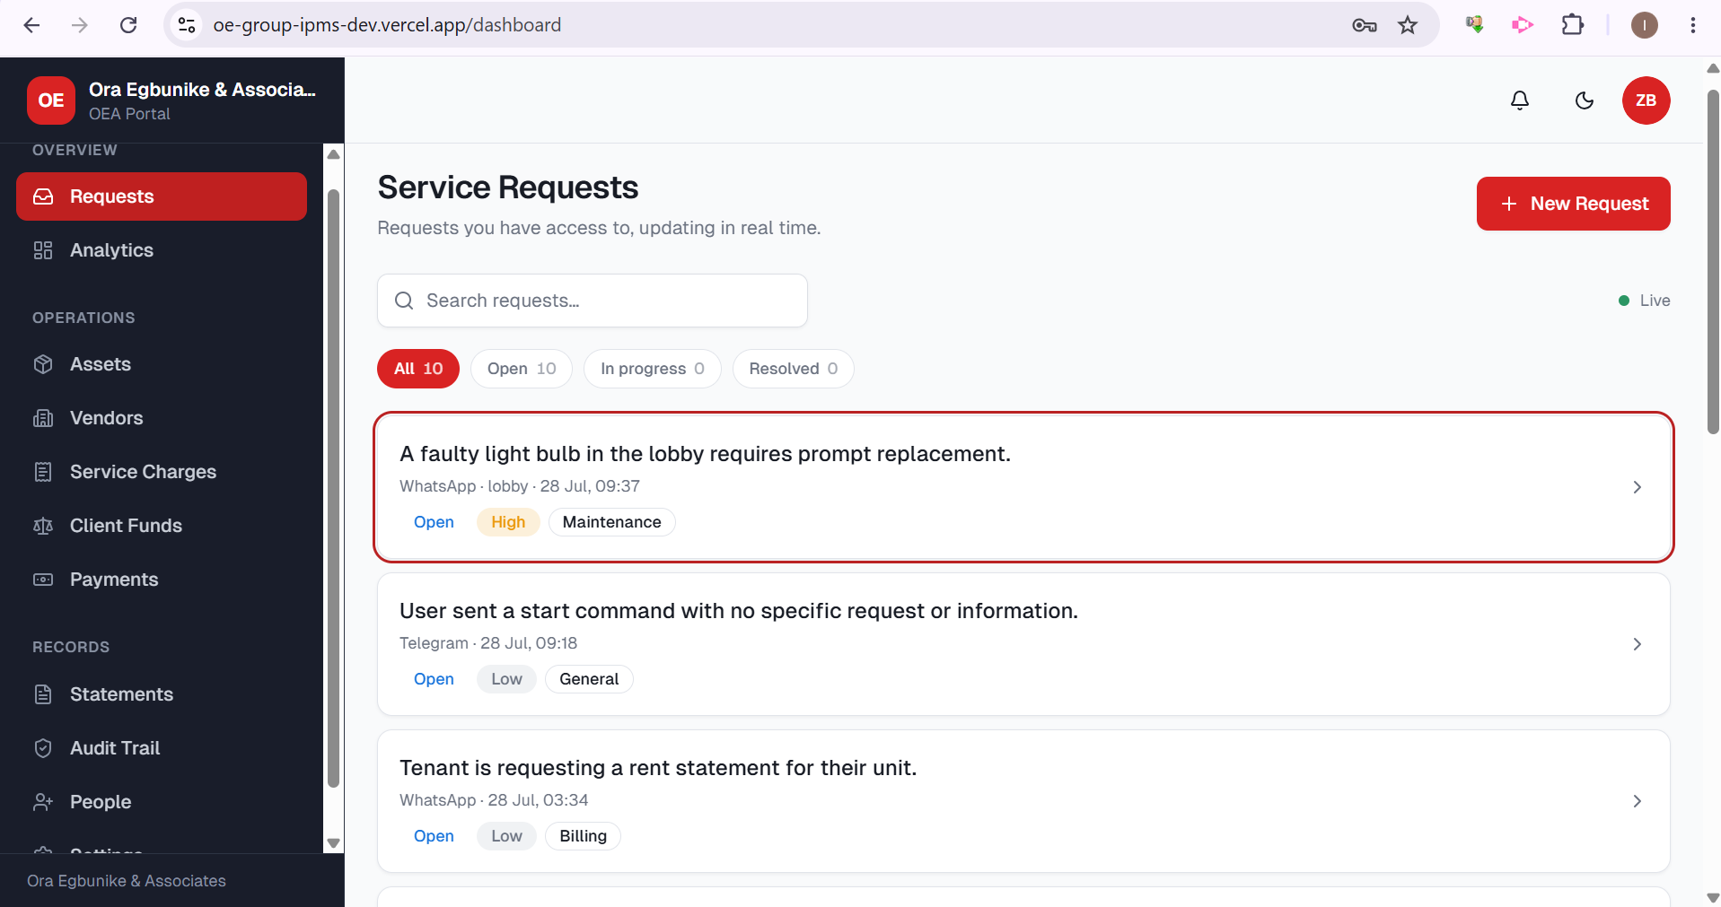
What was delivered
INSERTED SCOPE
Every screen restyled onto one modern, mobile-ready design system.
Each brand controls its own colours, logo, portal name and contacts — no code.
A complete asset register: property, equipment, compliance, custom fields, bulk import.
A public vendor application form with layered anti-abuse controls.
★
The platform gets its face and its assets
THE REAL DEMONSTRATION
Each brand's portal rendered in its own identity (TFML navy, OEA red) from admin settings alone; an asset import accepted valid rows and refused the bad ones with reasons; a vendor could apply publicly but became payable only after a human approved.
COMPLETE
TFML (navy) and OEA (red) portals — separate requests, separate branding, one shared backend.
Notes:
Inserted-scope gate: verify-org-theming, verify-asset-access, verify-asset-import, verify-vendor-applications, verify-invitations. This work was added between Days 3 and 4 after a scope check found asset management missing from Phase 1. TFML + OEA portal screenshots embedded (assets/01-portal-tfml.png, assets/02-portal-oea.png) — the paired shot is the visual proof of per-brand isolation.

Slide 19
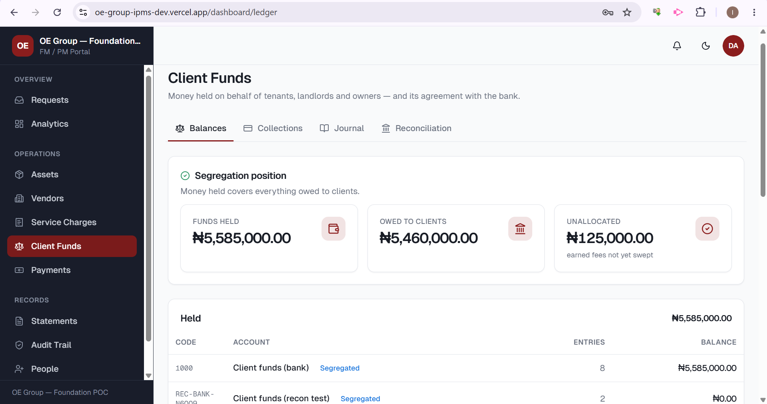
What was delivered
TRACK B · MONEY
A segregated, double-entry ledger for client funds.
Four safety rules enforced by the database itself, not just the app.
A daily bank-versus-ledger reconciliation that flags any variance.
Balances, journal and reconciliation screens to see it all.
Day 4
Client money gets a real ledger
THE REAL DEMONSTRATION
A clean bank statement reconciled to exactly zero variance. A hidden ₦75,000 debit was then deliberately planted — and the system flagged it, reported the line unmatched, and kept both runs on record. The gate that unlocks live payment keys.
COMPLETE
The segregated client-funds ledger: money held covers everything owed, per client account.
Notes:
Day 4 gate verbatim: clean statement reconciles to 0, planted 75,000 debit flagged. 39 checks across ledger + reconciliation. Client-funds ledger screenshot embedded (assets/03-ledger.png): ₦5,585,000 held / ₦5,460,000 owed / ₦125,000 unallocated.

Slide 20
What was delivered
TRACK B · MONEY
Rent and service-charge payments taken through Paystack and Flutterwave.
Every payment verified server-to-server, then posted to the ledger once.
Branded receipts generated on demand, always matching the ledger.
A real test-mode payment recorded live against the true gateway.
Day 5
Money coming in, end to end
THE REAL DEMONSTRATION
A test payment flowed from checkout to receipt to ledger. A forged webhook claiming ₦999,999,999 against a ₦400,000 invoice was ignored — only the ₦250,000 actually presented posted. A live Paystack test then recorded ₦287,000 against a ₦285,000 invoice and correctly flagged the mismatch.
COMPLETE
Notes:
Day 5 gate: verify-collections, verify-checkout-e2e — payload claiming 999,999,999 ignored, exactly-once under concurrency. Live Paystack test payment in the books: TFML 285,000 invoiced / 287,000 received, flagged.

Slide 21
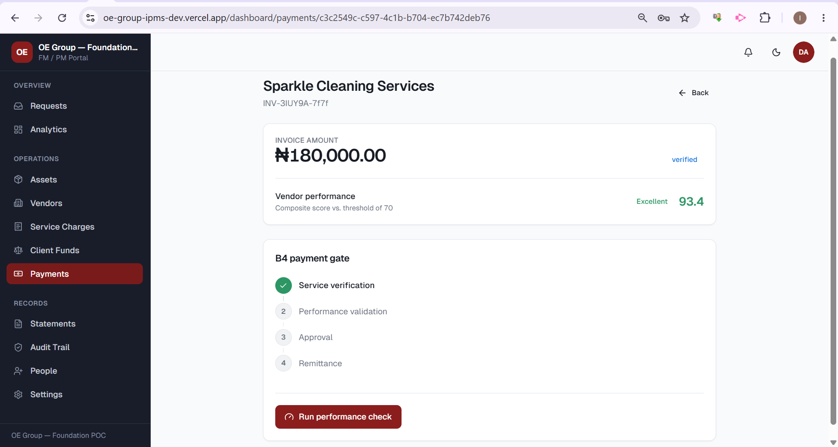
What was delivered
TRACK B · MONEY
Vendor payouts and custodial landlord rent remittance, both live.
No payment moves without passing verify → performance → approve → remit.
Management and admin fees retained; the landlord receives the balance.
Remittance advice, and a safe path if a transfer's outcome is ever unknown.
Day 6
THE REAL DEMONSTRATION
Money going out — only through the gate
The gate refused every unverified, unscored or unapproved payment. Three simultaneous attempts on one payout produced exactly one payment. Fees landed in fee income and the landlord received the net. An unrecognised ₦5,000,000 liability was refused, and a transfer of uncertain outcome was held for a person rather than guessed.
COMPLETE
The B4 payment gate: no vendor is paid until service is verified and performance clears the threshold — here 93.4 vs a 70 minimum.
Notes:
Day 6 gate: verify-remittance — gate refuses every incomplete payment; 3 concurrent claims -> 1 winner; re-confirming posts once; cannot pay more than owed; unknown stays unknown. Payment-gate screenshot embedded (assets/04-payment-gate.png): Sparkle Cleaning Services, INV-3IUY9A-7f7f, 180,000, verified, performance 93.4 Excellent vs threshold 70.

Slide 22
What was delivered
GOVERNANCE
Who can do what is now settings an operator toggles, not rules buried in code.
Only the OE Group operator portal can change them; each brand sees its own, read-only.
Money and audit controls are permanently locked, shown on screen with the reason.
Any drift from the board-approved baseline is badged, with one-click reset.
Day 6.5
Permissions become an operator's switches
THE REAL DEMONSTRATION
Flipping a single permission changed what the database itself returned — switch it off and the data disappeared, switch it back and exactly what was there returned. The locked money and audit controls refused to move; a brand administrator could view but not edit their own matrix, and could not see another brand's; and every change was recorded naming both organisations. Proven by 24 checks against live logins.
COMPLETE
Notes:
Day 6.5 gate evidence from BUILD_JOURNAL.md (2026-07-27 'Day 6.5 — the permission matrix'): verify-permissions.mjs, 24 assertions — a toggle changes what the DATABASE returns (revoke -> zero rows, restore -> exactly what was there); a revoked write is refused; four locked capabilities refuse to move; an invented capability is refused; a brand admin can read but not edit their own matrix and cannot see another's; a tenant cannot edit at all; isolation and identity survive every toggle off; the trail names both orgs. Commit 74f3816 (migrations 0050-0055). NOTE: the one-glance Status board table was not updated to mark this done; verified via the build journal + commit.

Slide 23
What was delivered
PORTFOLIO
Staff can now create and manage properties and units inside the app itself.
Units carry occupancy, bulk import, and facility-manager assignment.
Guardrails protect the service-charge split: unique unit names, positive shares.
A property or unit cannot be retired while occupants or unpaid charges remain.
Day 6.75
Properties and units can finally be enrolled
THE REAL DEMONSTRATION
Attaching a facility manager to a property immediately made it visible to them, and detaching removed it again — proven against live logins, so the assignment is the access, not a label. A bulk unit import was all-or-nothing, its preview showing each unit's resulting share of the service charge as a percentage; and a property still holding live units or unpaid charges refused to be retired. Confirmed by 17 checks.
COMPLETE
Notes:
Day 6.75 gate evidence from BUILD_JOURNAL.md (2026-07-27 'Day 6.75 — properties and units become manageable'): verify-properties.mjs, 17 checks — attaching an FM to a property makes it visible and detaching removes it, asserted against live sessions; all-or-nothing bulk import with a percentage-share preview; unique unit label per property and a strictly positive apportionment factor enforced in the DB; retire refuses while obligations remain, hard delete blocked. Commit 3ed049d (migration 0056). This stage was 'missed, not deferred' — every property had previously come only from seed scripts. NOTE: not reflected in the one-glance Status board table; verified via build journal + commit.

Slide 24
What was delivered
TRACK C — OEA LETTINGS
Prospective tenants apply on their phone — individual or corporate, documents attached.
Explicit NDPA consent is captured; a rejected application purges automatically after 90 days.
Save-and-resume: a half-finished application can be picked up later from an emailed link.
Which documents are mandatory is now admin configuration, not code.
Day 7
OEA's front door opens for applicants
THE REAL DEMONSTRATION
A live audit found submission silently blocked end to end — a document check that quietly returned zero rows instead of erroring, so every uploaded file read as missing. Closed at the database layer: the gate now lives inside the submission function itself, fields that had no reason to be readable were locked down, and the resume-by-email link the form promised was made to actually work. 48 checks across three suites confirm it end to end.
COMPLETE

Slide 25
What was delivered
TRACK C — OEA LETTINGS
Two-tier review: a scoped FM/PM recommends, admin or finance approves — never the same person.
Individual applications need one approval; corporate need two independent approvers.
Approval automatically creates the tenant's login and allocates the unit.
Every recommend, request-info, approve and reject is recorded with its author and reason.
Day 8
Applications move through review, not a spreadsheet
THE REAL DEMONSTRATION
A blocker found in review: every application arrived with no property attached, so a property-scoped reviewer's queue was correctly empty. Closed by having the applicant's own form carry the property forward. Verified live in the browser against a real applicant submission: the review queue, a live recommendation, and the system correctly refusing to let the recommender also approve their own case. 35 checks.
COMPLETE

Slide 26
What was delivered
TRACK C — OEA LETTINGS
Lease creation, term, rent and escalation — one unit can never be let twice over the same dates.
Rent billed annually in advance, the Nigerian norm, with each landlord's own fee rate honoured.
Renewal notices fire automatically at 90/60/30 days; rent demands now raise themselves too.
Rent reaches the ledger automatically, splitting the landlord's share and OE Group's fee.
Day 9
Leases, rent, and the roll a landlord can actually be handed
THE REAL DEMONSTRATION
Every rate is snapshotted onto the transaction the moment it's collected, so a later fee change can never silently rewrite a past landlord statement. A gap closed on 3 August: rent demands used to depend on someone remembering to click “Bill rent” — with rent billed a year at a time, that is a year's income never asked for. Demands now raise themselves daily, each one exactly once. 47 checks across three suites.
COMPLETE

Slide 27
What was delivered
TRACK D — INTELLIGENCE & EXPERIENCE
A filterable analytics console for both brands: date, property, vendor, category, status, trends.
Fastest/slowest vendor, completion by category, average time-to-resolve — computed live.
CSV export and a branded PDF report always match the numbers shown on screen.
A tenant's own “Track my request” timeline, and a vendor's own pipeline-and-scorecard view.
Day 10
A dashboard that answers the board's question live
THE REAL DEMONSTRATION
A fact nobody had written down: the system never recorded the moment a ticket resolved, so “average time-to-resolve” was uncomputable, until now — every average states on screen exactly what it measured. A partial period is no longer mistaken for a decline: three days of August against a full July used to print “−81% raised” in red — fixed before anyone saw it live. 32 checks.
COMPLETE

Slide 28
What was delivered
TRACK D — INTELLIGENCE & EXPERIENCE
Response and completion time are measured automatically against an admin-set SLA target.
Quality and compliance come from an FM/PM checklist; satisfaction from the tenant's own rating.
Photo and video evidence on every work order, capped, private, and ticket-scoped.
A measured accessibility pass: every tinted badge and muted text fixed for contrast, both themes.
Day 11
A vendor's score comes from a checklist and a clock, not a guess
THE REAL DEMONSTRATION
No free-typed score is possible anywhere in the write path — verified live in the browser as both roles: a tenant rates a job, an FM/PM completes the checklist, and the vendor's scorecard updates immediately to the composite the AURA weights actually specify. 26 checks on the scoring alone, plus 20 more on work-order media.
COMPLETE

Slide 29
Roadblocks — and how they are being handled
None of these stopped the build. Each is an external dependency waiting on paperwork or access, framed as issue → impact → status.
1
Meta / Facebook business verification
2
Paystack setup
Issue: Verification was held up because the information Facebook referenced in the business-registration document is inconsistent with the details submitted. Impact: OEA's WhatsApp display name and higher messaging limits stay pending. Status: Superseded, 4 Aug. Both numbers moved onto 360dialog as direct clients instead — TFML’s identity is confirmed verified via 360dialog’s own route; OEA is live under an interim display name pending the same.
Issue: Incomplete business-registration information is blocking the Paystack account from being fully set up. Of particular interest is the latest additions of the “SCUML Certificate” and “Proof of Identity and Addresses for shareholders that own up to 51% of TFML.” requirement. Impact: Live Naira collections cannot go live until the account clears (test mode works today). Status Still open — same registration pack as Flutterwave. Live (test-mode) Paystack collections and vendor/landlord remittances already run end to end on the dev deployment while the account clears.
3
Flutterwave setup
4
OEA email-domain routing
Issue: The same incomplete registration information is blocking the Flutterwave account. Impact: Foreign-currency collections cannot go live; the system refuses them cleanly for now. Status No longer blocks the build — the segregated FX ledger, Settings → Banking and FX checkout are fully built and verified (21 checks). Adding the live key is the one remaining step.
Issue: No access to OEA's email host, so the branded sending records cannot be created. Impact: OEA cannot yet send branded email from its own domain. Status Requesting host access from OEA; sending is configured and waiting on the DNS records.
Notes:
Four external-dependency roadblocks, all from the records. Meta verification is held up by inconsistent info in the referenced business-registration document (BUSINESS_VERIFICATION.md notes ~99% of rejections are detail mismatches). Paystack and Flutterwave both blocked by incomplete registration information. OEA email routing blocked by lack of access to OEA's email host. None blocked the build.

Slide 30
ROADBLOCK #5 · DISCOVERED DURING THE BUILD
A near-miss with TFML's live business email
ISSUE
Two problems surfaced while wiring email. The master brief carried the wrong TFML domain (tfmconsultant.com, which does not exist — the real one is tfmlconsultant.com). And adding email sending to the main domain would have pushed its sender records past a strict technical limit.
IMPACT
Under TFML's existing strict mail policy, crossing that limit would have caused genuine staff email to be rejected outright — not merely spam-foldered. A routine feature could have disrupted live business email across the company.
STATUS
Resolved. The domain was corrected at source, and each brand now sends from a dedicated, isolated sub-domain that leaves the main mail records untouched. Verified live: the main records are byte-for-byte unchanged and mail still delivers under full protection.
Notes:
The discovered fifth roadblock, taken from BUILD_JOURNAL.md (2026-07-25 'Email sending domain + reply routing'). The brief's TFML domain did not exist, and adding Resend to the root domain would have tipped its SPF past the 10-lookup RFC limit — under -all + DMARC p=reject that rejects genuine staff mail. Resolved by correcting the domain and sending from the notify. subdomain; verified live with root records unchanged.

Slide 31
Where we are, and what's next
15
3
1
stages complete
money tracks live
known money defects
of 16 on the roadmap
ledger · collect · remit
1 open (SC-budget race) · vendor-score gate fixed 6 Aug.
Current stage
Five more tracks have landed since: OEA applicants can now apply, be reviewed and approved straight into a tenancy; leases, rent billing and the rent roll are live with self-raising demands and renewal notices; the interactive analytics console answers the board’s own questions live; and a vendor’s score now comes from a checklist and a clock, not a free-typed guess. The foundation and full money-path tracks remain complete and verified against the real gateway.
The immediate next step
Day 12 — Security, compliance, UAT and go-live. The production security pass, NDPA compliance pack and multi-role UAT are underway. Of Monday’s two audit findings, the vendor-score/payment-gate defect was fixed 6 Aug with a regression test; a billing-race guard on SC budgets remains open. Go-live still needs the board: DPO designation, processor DPAs, live payment keys and the go/no-go after a clean UAT.
Board Confidential · 5 August 2026
Notes:
Summary: 10 of 16 roadmap stages done — the whole money path is live and verified, permissions are operator-governed, and property/unit enrolment now exists in-app. Next is Day 7 (OEA tenant application + KYC), opening the OEA lettings track (Days 7-9).

