Slide 1
Risk of vertical transmission mother to child
~gestational age
~stage of mother’s syphilis
Primary/Secondary = 60-100%
EL: 40% LL: <8%
from 1988 to 1998 at Parkland Memorial Hospital, Dallas, Sheffield and colleagues reported vertical transmission rates of 29%, 59%, 50%, and 13% in mothers with primary, secondary, early latent, and late latent infection, respectivel

Slide 2
FINAL MODEL
Uninfected
Susceptible
Diagnosed/
treated
Undiagnosed
P1
Primary
Treatment
STI Screening
Symthomatic testing
Screening among pregnant women
Contact tracing
P2
Secondary
Infectious for sexual transmission
diagnosis
Immediate trt
Relapse
P3
Early latent
Infectious for vertical transmission
Delayed trt
Late latent
Diagnosed/ Untreated
P4
P5
CNS
Tertiary

Slide 3
Uninfected
Types of transitions out of these stages:
Symptomatic
1) Progression of untreated disease to the next stage
Primary
Disease Stage
Secondary
Progression
Rate = 1/duration
Early latent
Next Stage
Late latent
2) Symptomatic testing through care seeking
asymptomatic
symptomatic
CNS
Tertiary
Symptomatic
testing

Slide 4
Source Code
Sourcing data managers, jheem engine, external scripts, etc
Specification
helper
Housing the functional forms for Elements
Specification
Base
Parameters
Housing the scalar values for Elements (parameters)
Calib parameters
Housing the variables used for calibration and their priors
Ontology mappings
Housing required functions to convert ontologies between different datasets and the model
Engine test
Setting up an instance of the code for testing
Pairing input manager
Sexual contact pairings
Data on sexual partnerships and collection of functions to extract related pairing parameters (by age, sex, race)
Likelihoods
Data_files / pairing
Register calibration
PAIRING.INPUT.MANAGER
Register and run calibration

Slide 5
Approach 1: Modeling two separate transitions out of this stage
Issue: The symptomatic testing applies to ”All” people within this stage and is not limited to the symptomatic subgroup
Solution: Modeling “symptomatic” vs “Asymptomatic” as separate states
Approach 2: Modeling symptomatic testing as a proportion of progression rate
Issue: Symptomatic testing wont have an impact on duration of disease
We will likely underestimate the impact of intervention targeting symptomatic testin: e.g., at home testing ?
asymptomatic
symptomatic
Progression
rate
Symptomatic
testing
asymptomatic
symptomatic
Progression
rate
Proportion
Symptomatic
testing

Slide 6
Knot.min/max
Will control the knot values
A. The first spline uses 2 knots and projected values in 2030 are unrealistic
Delta*after.modifier
Delta
Spline falling below 0
Min=0 will protect against this
2010
2020
2030
B. Using the 3 knots, a new spline is projected that has more realistic projections in 2030 and beyond
2010
2020
2030

Slide 7
Initial model proposed
Susceptible
Recovered/
Susceptible
Lacking components:
Immunity
Relapse secondary
neurosyphilis
Primary/
Secondary
Undiagnosed
Immediate trt
Early latent
We need a reinfection parameters
Is it less or more than one?
To look for cohort studies---
Imunity after treatment
Delayed trt
Late latent
Diagnosed/ Untreated
Tertiary

Slide 8
Susceptible
Susceptible
Susceptible
Relapse to secondary cases
Primary
Primary
Primary
Secondary
Early latent
asympthomatic
25%
75%
25%
25%
Secondary
sympthmatic
Early latent
Early latent
75%
Relapsed secondary
The issue is in
Late latent
Late latent
Late latent
Tertiary
Tertiary
Tertiary

Slide 9
Susceptible
Proportion:
Frame intervention as “prp of people on doxy”
Do we need separate box:
Advantages….
Different mixing for those on prep off prep
Primary
p
1-p
Secondary
symptomatic
25%
Early latent
asymptomatic
Does everybody develop secondary syphilis (p=1)?
is it only for symptomatic cases?
how do we define latent syphilis? Asymptomatic?
how much relapse from early latent to secondary?
How many times can relapse happen?
Can neurosyphilis start at any stage? Is the rate different?
Upon diagnosis, are they classified as teritiary?
Neurosyphilis
Late latent
Tertiary
Not neurosyphilis

Slide 10
Susceptible
Breaking down tertiary syphilis
What proportion of cases actually develop tertiary or get recovered?
Primary/
Secondary
Immunity?
25%
75%
Early latent
Neurosyphilis
Dominant stage
Need to make sure how it’s captured in the data
Relapsed secondary
Garnette: Over a period of 35 years, benign late syphilis had developed in one sixth of the men and one fifth of the women. For 953 patients, cardiovascular syphilis developed in 14% of men and 8% of women, and neurosyphilis developed in 31 of 331 men (9%) and 31 of 622 women (5%). Of 694 known to have died, syphilis was recorded as the primary cause of death in 74 (11 %).
If we assume a constant rate over 35 period, we can model probability of developing disease using an exponential growth model:
P=1-e^{−r⋅t}
P is the probability of developing the disease
r is the annual rate
t is the time in years
r=−ln(1−P)​/t
Cardio: Men: 0.43% per year Women: 24% per year
Gumm: Men: 0.52% per year, Women: 0.64% per year
Neuro: Men: 0.27% per year, Women: 0.15% per year
Late latent
72%
28%?
Recovered ?
Does it worth adding this?
Helps us map mortality better
Cardiovascular
Gross (2011): Chapter13: There is a 72% chance of spontaneous healing for all untreated patients, the remaining 28% patients will proceed to tertiary syphilis (after 3–10 years) or to quaternary syphilis (after 3 or 4 decades) [10].
Gummatous

Slide 11
Parametrizing the natural history
Primary
Incubation
Secondary
Incubation
Secondary
Disease
Latent
Disease
Exposure
First Chancre
Other studies
3weeks [3-90days]
2-6 weeks
2-8weeks
Secondary develops after chancre appears
4-8weeks
Heals in absence of treatment
9-19weeks assuming primary 3weeks
7-28 weeks assuming primary 1-12 weeks
Garnette
3weeks
6weeks
~14weeks
3.6months (1-12 months)
~[4-48weeks]
23weeks
Or
[13-57weeks]

Slide 12
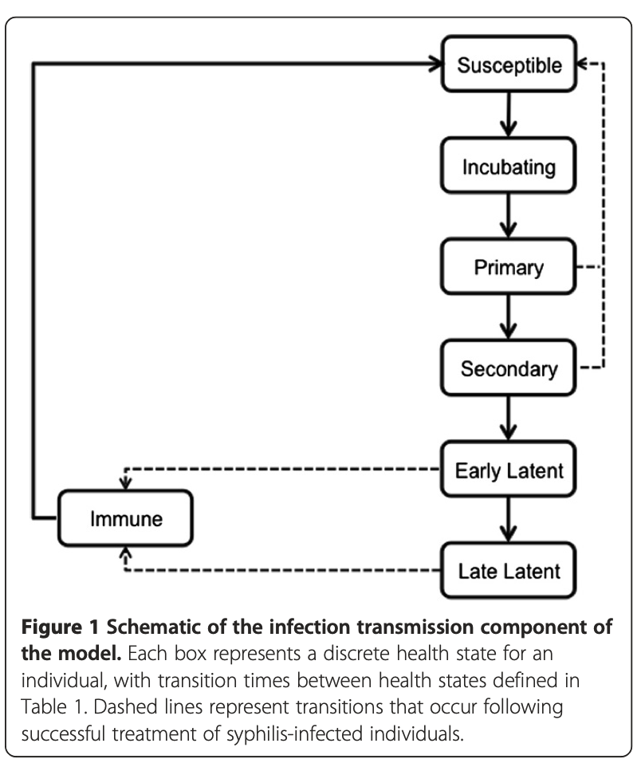
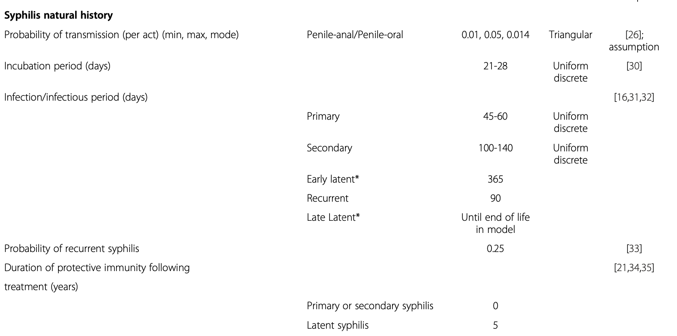
Screen more or screen more often? Tuite 2013
https://bmcpublichealth.biomedcentral.com/counter/pdf/10.1186/1471-2458-13-606.pdf

Slide 13
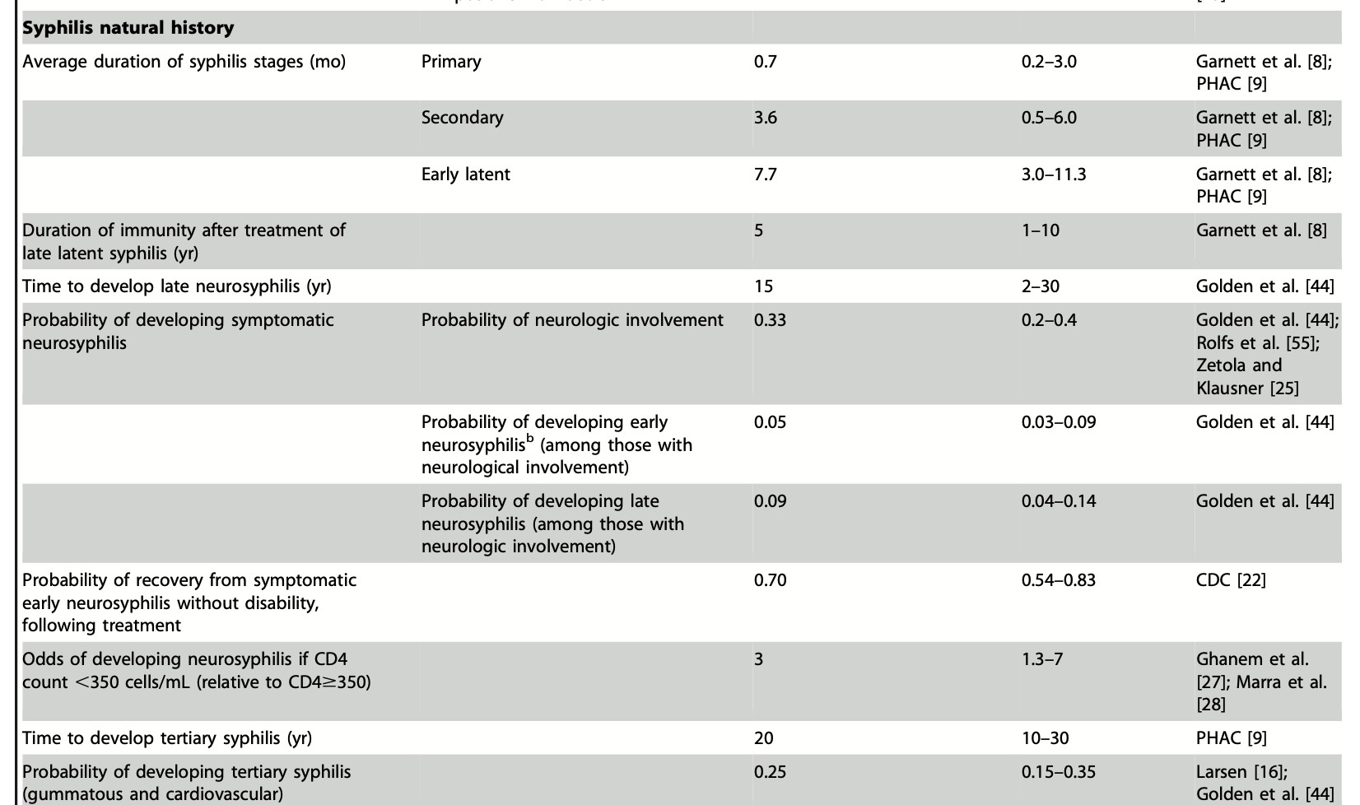
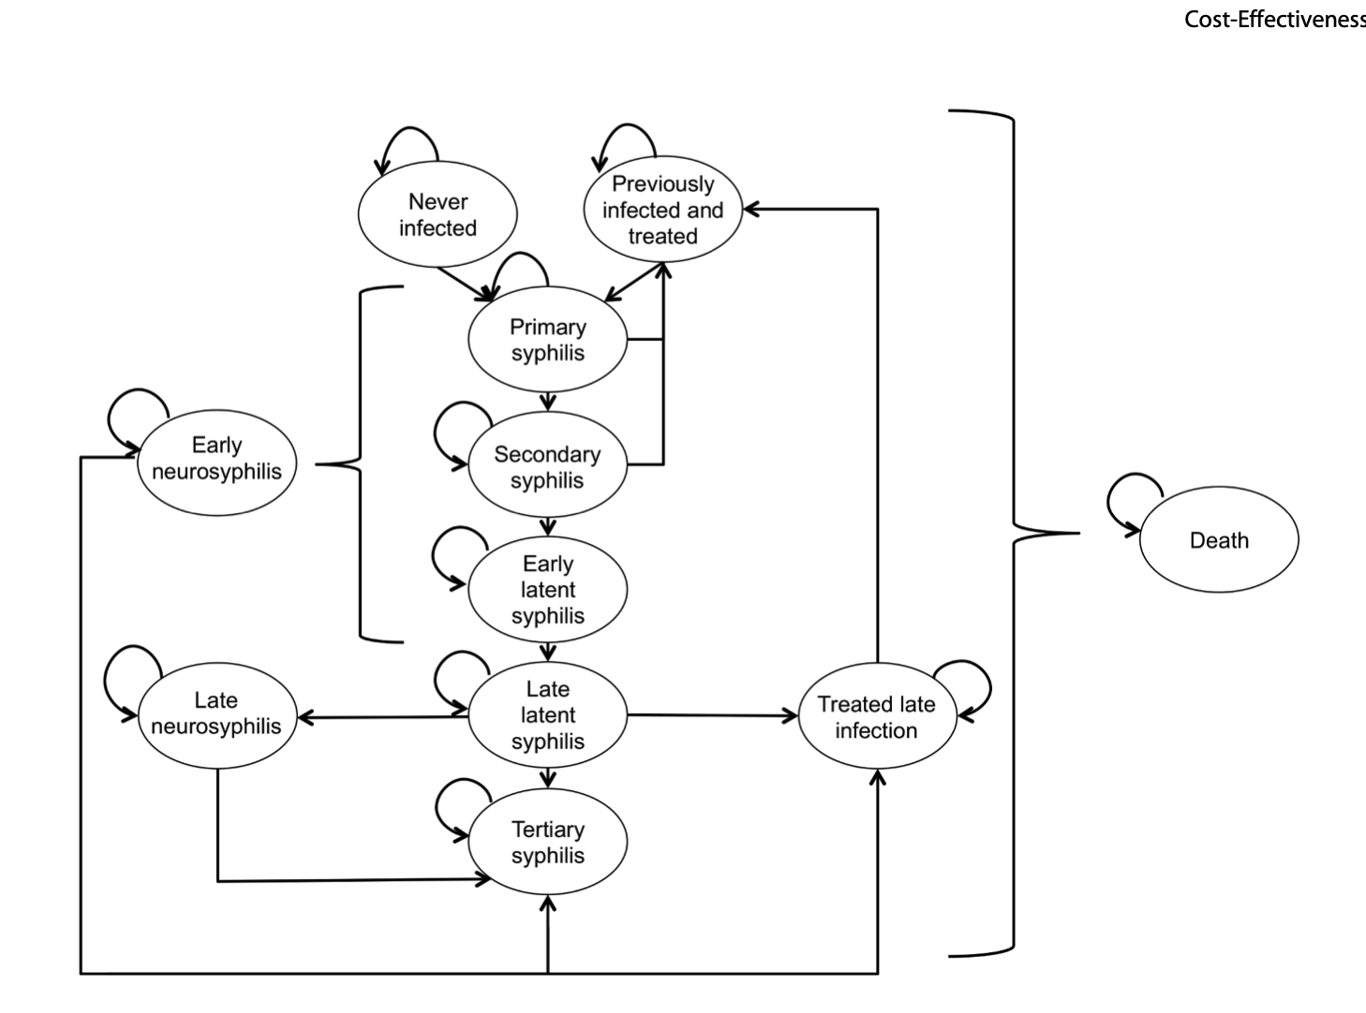
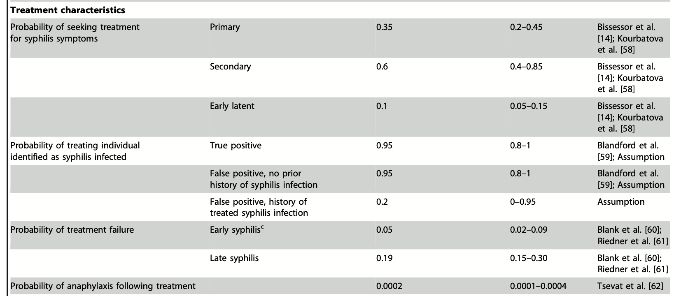
Cost effectiveness of enhanced screening Tuite 2014
Notes:
https://journals.plos.org/plosone/article/file?id=10.1371/journal.pone.0101240&type=printable

Slide 14
The natural course of syphilis, including its individual stages and clinical features, has been identified in three large comparative studies conducted at the turn of the first half of the 20th century. A common feature of these studies was that one group of patients was not treated, which raised ethical concerns. It is true, however, that no definitive treatment was available for syphilis at the time.
The first of the three large prospective studies of patients was conducted in Oslo from 1890 to 1910 by Boeck, and subsequently followed up retrospectively by Bruusgaard and later by Gjestland et al. Boeck was concerned that therapy available – mercurial – might be more toxic than the disease itself
In 1932, a second study of the natural history of ostensibly untreated syphilis was undertaken by the US Public Health Service in Macon County, Alabama, which is generally known as the “Tuskegee study.” It has been challenged in recent years on ethical grounds because written informed consent was never obtained from the involved patients; furthermore, patients were misled into participating by giving them the impression that they were receiving treatment. Because the study was limited to black males, some have chosen to view the study as essentially racist.
A third significant study of the natural course of syphilis was conducted by Paul Rosahn. It was based entirely on a cross-sectional review of all autopsies conducted at Yale University School of Medicine from 1917 to 1941; among almost 4,000 persons over 20 years of age at death, 9.7% had clinical, laboratory, or autopsy evidence of syphilis. About half of the patients had not been treated.

