Slide 1
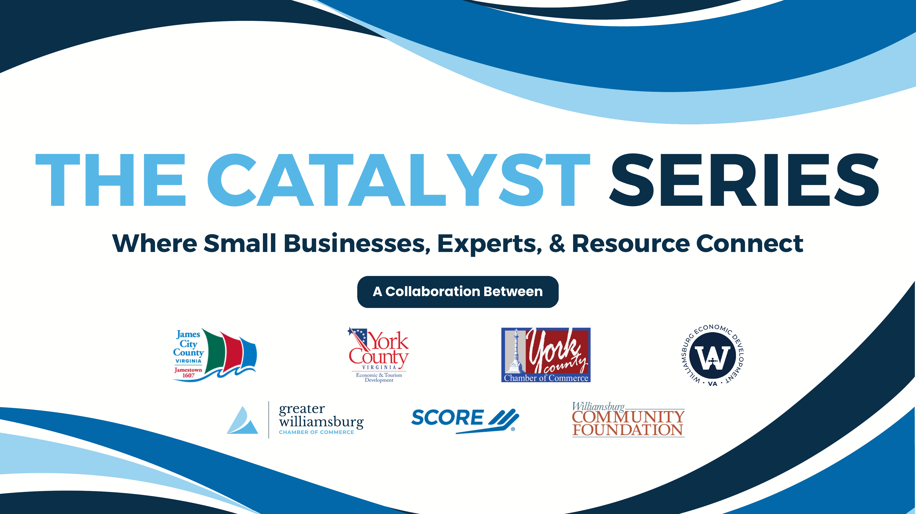
Notes:
Pre-session | Have this on screen as people arrive and find seats. Thank the Catalyst Series partners by name in your welcome — James City County, York County Economic & Tourism Development, both Chambers, Williamsburg Economic Development, SCORE, and the Williamsburg Community Foundation — then advance to the title slide to begin.

Slide 2

GREATER WILLIAMSBURG CHAMBER OF COMMERCE
DOG Street AI
Practical tools, straight answers, and a plan you can use Monday morning
Presented by Trenton W. Ford
twford@wm.edu • 90-minute interactive workshop
Notes:
0:00–0:03 | Welcome, thank the Chamber, one-line intro of yourself. Hook: quick story of a local owner drowning in reviews, scheduling, and social posts. Promise: no jargon, no hype — just what's useful. Presenter details are filled in.

Slide 3



HANDS ON • LIVE POLL
First — let's take the temperature of the room
Raise your hand if… you've ever used ChatGPT, Gemini, or Copilot — even once.
Keep it up if… you've received an email or text you suspect was an AI-written scam.
And be honest… who has no idea whether their business is already using AI?
Notes:
0:03–0:08 | Run the three hand-raises (or Slido/Mentimeter if you set it up). Count roughly out loud — 'about half the room' — so people feel seen. Use the result to calibrate: lots of ChatGPT users → go faster in Section 1; few → slow down. The scam-email question plants the seed for the misinformation section later.

Slide 4





Where we're headed today
1. Demystify
2. Automate
What AI actually is — in plain English — and where it's already hiding in your tools.
A simple framework for safely putting AI to work in marketing, operations, and customer engagement.
3. Navigate
4. Apply
How algorithms decide who sees you — and how to protect your brand from digital misinformation.
A five-question filter to decide which tools deserve your time and which to skip. You'll use it today.
Two hands-on activities • one break • a worksheet you take home
Notes:
0:08–0:10 | State the four takeaways plainly — this is the promise you'll deliver on. Flag the structure: two activities, a break at the midpoint, and a worksheet they keep. Sets the expectation that this is a workshop, not a lecture.

Slide 5
01
Demystifying AI
No jargon. No hype. What these tools actually are — and why they're not just for big companies.
Notes:
0:10 | Transition line: 'Let's start by clearing the fog.' Keep this slide up only a few seconds.

Slide 6

AI in one sentence
Software that has studied millions of examples so it can make useful predictions — the next word, the likely answer, the best match.
It predicts — it doesn't “know.”
That's why it's confident even when it's wrong. Your judgment stays essential.
It's trained, not programmed.
It learned patterns from examples — the same way it can learn the pattern of your voice and your business.
It's already cheap.
The tools you'll see today are free or under $30/month. This is not an enterprise-budget conversation.
Notes:
0:10–0:14 | Read the definition once, slowly. The three sub-points are your talking beats: (1) prediction not knowledge — sets up 'always review its work' later; (2) trained not programmed — why it can sound like you; (3) cost — kill the 'that's for big companies' myth immediately.

Slide 7
HANDS ON • SHOUT IT OUT
Guess the next word
Finish each phrase out loud — don't think, just say it:
1
Peanut butter and ______
(everyone, instantly, together)
2
Life, liberty, and the pursuit of ______
(you've heard this a few thousand times)
3
The fife and ______ corps
(a very Williamsburg pattern)
4
For lunch today, I'm thinking ______
(wait — why did the room disagree on this one?)
How did you know? A lifetime of hearing these patterns — your own “training data.” Hold that thought.
Notes:
0:14–0:16 | Rapid-fire — point and let the room shout. Rounds 1–3 land in unison; round 4 is the payoff: answers scatter (“pizza!” “a salad!” “tacos!”). Name what happened: 'Rounds 1–3 had one overwhelmingly likely answer. Round 4 had MANY plausible ones — you each picked a likely option, not a certain one.' That distinction is exactly what the next slide's dice make visible. NOTE: these 3 new slides add ~5 min to Section 1 — to stay on 90, run AI-or-Not with 3 rounds instead of 5, or trim Q&A.

Slide 8




HANDS ON • CALL IT
Now call the dice roll
I'm about to roll this die. Shout your prediction.
You can't know the outcome
But you do know the odds
Now imagine a loaded die
Any face can come up. Nobody in this room can call a single roll — and nobody's embarrassed about that.
Each face is exactly 1-in-6. You know the full menu of outcomes and precisely how likely each one is.
Weight one face so it lands 9 times out of 10. You still can't be certain — but now you'd bet on it.
Prediction isn't certainty — it's knowing the odds and playing them. Keep the loaded die in mind…
Notes:
0:16–0:18 | Bring a real die — the theater is worth it. Take 3–4 shouted predictions, roll, repeat once. Point out: nobody feels dumb for missing a roll, because everyone understands it's about odds, not knowledge. Then plant the loaded-die idea with your hands: 'weight one face… now you'd bet on it.' That's the exact machine we're about to reveal.

Slide 9

Put them together — that's generative AI
Peanut butter and ______
Build the loaded die
1
For every possible next word, score how likely it is — based on everything it read in training.
The model's “loaded die” for the next word:
jelly
92%
Roll it
2
chocolate
5%
Pick a heavily weighted word. Usually “jelly.” Occasionally “chocolate.” That's why answers vary.
crackers
2%
Repeat, word by word
3
pickles
<1%
Add the word, re-weight the die, roll again. A whole paragraph is thousands of tiny loaded rolls.
Weights come from patterns in millions of pages of training data — its lifetime of “hearing the phrase.”
This explains both: why it's so fluent (the odds are usually right) and why it “hallucinates” (a wrong word can still roll high).
Notes:
0:18–0:20 | The reveal. Walk it: the next-word game = you have a loaded die in your head; the dice = prediction is odds, not certainty; generative AI = a machine that builds a loaded die over EVERY possible next word and rolls it, over and over. Point at the bars: 'trained on millions of pages instead of one lifetime.' The bottom-right box is the payoff — fluency and hallucination are the SAME mechanism, which sets up the 'never publish unreviewed output' rule coming on the next slide.

Slide 10


Two myths to retire today
Myth: “AI is magic — or a menace”
Reality: it's a set of assistants
It doesn't think, feel, or want anything — it completes patterns.
It makes mistakes confidently (“hallucinations”) — never publish unreviewed output.
It won't replace the owner. Judgment, taste, and relationships are still yours.
It isn't one thing: chatbots, schedulers, and photo tools are all “AI.”
Great at first drafts: emails, posts, descriptions, replies.
Great at repetition: sorting, summarizing, scheduling, reminders.
Works at your scale — solo shop or 30-person crew.
You direct it. The more specific your instructions, the better the result.
Notes:
0:14–0:18 | Address the two emotional poles in the room: the hype-believers and the fearful. The 'confidently wrong' point gets a laugh if you share a quick personal example of AI making something up. Land on: 'assistants, plural — you're the manager.'

Slide 11




Surprise — you're already using it
Your inbox
Spam filtering, priority sorting, and those one-tap suggested replies — all AI, working quietly for years.
Square, QuickBooks, Toast
Sales forecasts, anomaly alerts, auto-categorized expenses, and invoice reminders are machine-learning features.
Google Business Profile
Suggested replies to reviews, auto-generated business descriptions, and the search ranking itself.
Your phone
Autocomplete, photo search, maps rerouting around traffic — prediction engines you trust every day.
The question isn't “should I use AI?” — it's “which AI is worth using on purpose?”
Notes:
0:18–0:21 | This slide lowers the intimidation factor: they're already AI users. Ask for a show of hands on who uses Square or QuickBooks — connect it live. The closing line is the pivot to intentional use, which is the theme of the rest of the session.

Slide 12



HANDS ON • QUICK GAME
AI or Not?
I'll show you five real examples. Vote by hand: was it made by a human — or generated by AI?
Round 1
Round 2
Round 3
Round 4
Round 5
A marketing email
A 5-star customer review
A product photo
A chatbot reply
A local news blurb
The point: if this room can't reliably tell the difference, neither can your customers — remember that for Section 3.
Notes:
0:21–0:28 | Prepare 5 example slides or printouts in advance (mix of genuine and AI-generated; make at least 2 counterintuitive). Keep energy high — 60-90 seconds per round. Reveal answers with a running score ('the room is 2 for 4!'). This is your setup for the misinformation section: call back to it at slide 22.

Slide 13



The mindset that makes this work
AI is an assistant.
You are the manager.
Delegate the drafts
Review everything
Keep the human moments
Hand it the first pass — never the final say.
You'd proof a new employee's work. Same rule.
Customers came to Williamsburg for people, not bots.
Notes:
0:28–0:30 | The one sentence to remember from Section 1. 'You already know how to manage people — manage the tool the same way: delegate, review, keep the relationship work for yourself.' Then transition: 'So what exactly should you delegate? Section 2.'

Slide 14
02
Practical Automation
A simple framework — and real examples across marketing, operations, and customer engagement.
Notes:
0:30 | Transition: 'Now the practical part — where does this actually fit in YOUR week?'

Slide 15
One rule decides everything
Automate the repetitive. Keep the personal.
Repetitive → automate
Personal → keep it human
Anything you do the same way weekly: drafts, sorting, scheduling, reminders, data entry.
Low stakes if imperfect — you review before it ships.
Test: “Could I write instructions for a new hire to do this?”
Complaints, condolences, negotiations, community relationships.
Anything where the customer would feel tricked to learn a bot wrote it.
Your voice, your story, your judgment calls.
Notes:
0:30–0:34 | This framework carries the whole section. Give one vivid example of each side: a wine shop automating its Tuesday newsletter draft vs. hand-writing a reply to an upset customer. The 'new hire instructions' test is the practical heuristic they'll use in Activity 1.

Slide 16
“Keep the personal” isn't sentiment — it's strategy
79%
prefer talking to a human over AI in customer service
SurveyMonkey, 2025
73%
say they're more loyal to companies that use people, not AI, for service
OnePoll / AnswerConnect, 2026
87%
want a real person when contacting a local service business
OnePoll survey of 6,000 adults, 2026
42%
would pay extra for access to human representatives
SurveyMonkey, 2025
The nuance: about half of consumers prefer a bot for instant answers. Automate the quick stuff, keep the human moments — exactly our rule.
Notes:
(+2 min in Section 2) | The framework isn't a feel-good preference — it's what customers are telling researchers. Land the 42% stat hardest: people will PAY for human service, which means your smallness is a pricing advantage, not a handicap. Note the 87% for local services specifically — that's this room. Then the nuance bar keeps you honest: roughly half prefer bots for immediate answers (availability and speed), so the framework cuts both ways. Sources: SurveyMonkey consumer AI study 2025; OnePoll surveys for AnswerConnect/ServiceForge 2026.

Slide 17

Marketing: your always-on drafting desk
Social posts
“Write 5 Instagram captions for our fall menu, casual tone, under 30 words each” — then pick and polish.
ChatGPT, Claude, Canva Magic Write
Email newsletters
Feed it last month's news + upcoming events; it drafts, you edit in your voice. 2 hours → 20 minutes.
Mailchimp AI, Constant Contact
Product descriptions
Turn a spec list into three description options — pick the one that sounds like you.
Shopify Magic, Claude
Images & flyers
Seasonal graphics and event flyers without a designer on retainer.
Canva, Adobe Express
Rule of thumb: AI writes the first draft — you supply the humanity it can't fake.
Notes:
0:34–0:38 | Read one full example prompt aloud (the Instagram one) so they hear what 'talking to AI' sounds like — specific, casual, with constraints. Emphasize the time math: newsletter from 2 hours to 20 minutes is the kind of number owners remember.

Slide 18


Operations: quiet hours given back
Scheduling
Books & invoices
Staff shifts, appointment booking, and no-show reminders that send themselves.
Auto-categorized expenses, receipt capture, and polite chase-up emails for late invoices.
Square Appointments, Homebase, Calendly
QuickBooks, Xero, Wave
Inventory & alerts
Paperwork & summaries
Reorder-point alerts and sales-pattern flags — know Tuesday's rush is coming.
Summarize a vendor contract, draft an SOP, turn meeting notes into a task list.
Square, Lightspeed, Toast
ChatGPT, Claude, Copilot
Notes:
0:38–0:41 | Frame as 'hours back, not headcount cut.' Ask: 'What would you do with four extra hours a week?' Pause and let someone answer. Note that most of these are features inside tools they already pay for — turn them on before buying anything new.

Slide 19

Customer engagement: fast, but still you
Review responses
Draft replies to every review — you personalize and post. Responding to reviews also helps local search.
FAQ chatbot
Answer “are you open Sunday?” at 11pm. Scope it to hours, location, parking, menu — and hand off anything else to a human.
Follow-ups & win-backs
“We haven't seen you in a while” notes and post-purchase check-ins, drafted from your templates.
Where to draw the line
Complaints, refunds, anything emotional: a human, every time. Disclose the bot (“I'm the shop's automated assistant”) — trust survives honesty, not discovery.
Notes:
0:41–0:44 | The disclosure point matters — one bad 'I thought I was talking to a person' moment undoes months of goodwill. Mention that responding to reviews (even with AI-drafted replies) is one of the few free levers that visibly helps local search ranking — bridge to Section 3.

Slide 20

Let's watch it work — live
The task: respond to a real (anonymized) 3-star review
1
2
3
4
Paste the review
Give it a role + rules
Read the first draft
Edit like a manager
“Food was great but we waited 40 minutes…”
“You're the owner. Warm, no excuses, under 80 words, invite them back.”
Notice: decent, but generic. It doesn't know our Saturday rush story.
Add the specific fix we made. Cut the corporate phrases. Now it's ours.
Watch for step 4. The edit is the skill. The tool gets you 70% of the way in 10 seconds — your 30% is what customers actually feel.
Notes:
0:44–0:50 | LIVE DEMO. Have ChatGPT/Claude open in a browser tab, review text pre-copied. BACKUP PLAN: screenshots of each step in your appendix in case wifi fails. Narrate your thinking as you edit the draft — that's the teachable moment. Deliberately show the draft being mediocre before your edit.

Slide 21




Four rules before you automate anything
1. Human reviews everything
2. Never paste sensitive data
Nothing AI writes reaches a customer without your eyes on it. No exceptions in year one.
No customer lists, card numbers, health info, or employee records into public AI tools. Assume anything you paste could be seen.
3. Start free, start small
4. One tool at a time
Pilot one tool on one task for two weeks before paying or expanding. Free tiers exist to be used.
Adopting three tools at once means abandoning three tools by March. Master one, then add.
Notes:
0:50–0:53 | Rule 2 is the one to slow down on — give the concrete example: 'Don't paste your customer email list into ChatGPT to "clean it up."' These four rules are printed on the take-home worksheet. Then: 'Time to make this about YOUR business.'

Slide 22

HANDS ON • ACTIVITY 1 • 10 MIN
Find your one task
Solo — 3 min
On your worksheet, list the 3 most repetitive tasks in your week. Be specific: “Monday inventory count,” not “admin.”
Pairs — 4 min
Compare lists with a neighbor. Use the test: “Could I write instructions for a new hire to do this?” Pick each person's best automation candidate.
Room — 3 min
A few volunteers share their pick. Keep your worksheet — you'll use this exact task again in Activity 2.
Meet someone new — this is a Chamber event, after all.
Notes:
0:53–1:03 | Distribute worksheets before the session so this starts instantly. Circulate during pair time — collect 2-3 good examples you overhear to call on during share-out (warm-call, don't cold-call). Timekeeping matters: use a visible phone timer. Debrief examples become your reference points for the rest of the session.

Slide 23

Take five
Stretch, refill, introduce yourself to your activity partner properly.
We restart in five minutes — on the dot. Next up: getting seen online, and staying safe there.
Notes:
1:03–1:08 | Say the restart time out loud twice 2014 the slide commits you to five minutes. Start again ON time even if a few are still chatting — it trains the room. Cue up your scam example for slide 23 during the break.

Slide 24
03
Navigating the Digital Landscape
How algorithms decide who sees your business — and how to protect your brand from what's fake.
Notes:
1:08 | Re-energize after break: 'Second half is about the outside world — being found, and not being faked.'

Slide 25
Where your customers actually look
53%
44%
60%
of U.S. adults get news from social media at least sometimes — Facebook (38%) and YouTube (35%) lead
of U.S. adults now use ChatGPT — up from 18% in 2023; half use some AI chatbot
have read AI-generated summaries at the top of their search results
…and the trust gap that comes with it:
Only 24%
say it's easy to tell what's true from what's false online
Only 29%
of chatbot users trust the information chatbots give them
Sources: Pew Research Center surveys, 2025–2026
Your customers are in feeds and AI summaries — and they're skeptical of what they find there. That's this whole section.
Notes:
(+2 min at start of Section 3) | Read the top row as one sentence: half your customers scroll for news, nearly half talk to AI, and most now see AI summaries before any search link. Then the turn: they don't trust what they see — only 24% find it easy to tell true from false, and only 29% of chatbot users trust the answers. The opportunity: a trusted, visible LOCAL business is exactly what a skeptical feed-scroller is looking for. Visibility (next slides) earns the eyeballs; authenticity keeps the trust. Sources: Pew social media & news fact sheet + news platform fact sheet, Aug 2025; Pew “Americans and AI 2026,” Feb 2026.

Slide 26
Who sees you isn't random
Every platform — Google, Instagram, Facebook, TikTok — ranks you on three signals:
Relevance
Recency & consistency
Engagement
Does your content match what they're searching or scrolling for? Keywords, categories, and complete profiles feed this.
Regular posting beats occasional brilliance. A profile updated last week outranks one updated last year.
Reviews, replies, saves, and shares tell the algorithm real humans value you. Responding to reviews counts double.
Good news: these are habits, not budgets. A consistent small shop beats an inconsistent big one in local results.
Notes:
1:08–1:12 | Demystify the algorithm the way you demystified AI: it's a ranking machine fed by signals you control. The 'habits, not budgets' line is the emotional core — small businesses CAN win locally.

Slide 27
The four levers that matter most locally
Claim & complete your Google Business Profile
Hours, photos, services, posts. The single highest-return hour you'll spend online — and it's free.
Ask for reviews, answer every one
A steady trickle of recent reviews (and owner replies) outweighs a big pile of old ones.
Post consistently, not constantly
One good post a week, every week, beats daily posting for a month followed by silence.
Use the words customers actually search
“Colonial Williamsburg lunch spot,” “dog groomer near Lightfoot” — put real phrases in your profile and captions.
Follower counts are vanity. Local search visibility pays rent.
Notes:
1:12–1:16 | Poll: 'Who has claimed their Google Business Profile? Who's updated it this year?' The gap between those two hand counts IS the opportunity. Local phrasing examples land well — swap in ones matching your audience mix (retail, restaurants, services, B&Bs).

Slide 28

The dark side: what's coming for your brand
Fake reviews
Impersonation
Competitors' bots or extortion schemes (“pay us or the 1-stars continue”). Report through the platform; never pay.
Cloned social accounts and copycat websites taking “deposits” from your customers under your name.
AI-polished phishing
Local misinformation
The typo-riddled scam email is gone. Now it's fluent, personalized, and knows your bank's name. Remember our game?
“They're closing,” “they failed inspection” — false posts in community groups spread faster than corrections.
Notes:
1:16–1:20 | Call back to the AI-or-Not game: 'Remember how many of you got fooled? That's the threat model.' Keep tone practical, not scary — every threat here has a defense on slide 24. If you have a real local example (anonymized), one sentence of it makes this section unforgettable.

Slide 29
HANDS ON • GROUP EXERCISE
Spot the scam — together
On the next screen: a real-looking email to a business owner. Call out every red flag you can find.
The six places to look (your take-home checklist):
Sender address — hover, don't trust the display name
Urgency — “within 24 hours or your listing is removed”
Links — does the URL match the real company, exactly?
The ask — gift cards, wire transfers, “verify” your password
Too-perfect personalization — knows your name, cites your reviews
Payment redirection — “we've changed our bank details”
When in doubt: don't click — call the company on the number you already have.
Notes:
1:20–1:26 | Prepare one realistic (fabricated) scam email as your next slide or a printed handout — a fake 'Google Business Support' or 'bank details change' email works well. Let the room find the flags before you reveal them. End on the golden rule: verify through a channel you already trust.

Slide 30
Your one-hour defense plan
Claim every profile — even platforms you don't use
Google, Yelp, Facebook, Instagram, Nextdoor. An unclaimed profile is an open door for impersonators.
1
20 min
Set a Google Alert for your business name
Free early-warning system: you hear about the fake post before your customers ask about it.
2
5 min
Turn on two-factor authentication everywhere
Email, bank, social. The single best defense against account takeover — non-negotiable.
3
15 min
Write your response plan while calm
Who checks reviews weekly? Who responds to a false post — and what's the tone? Decide now, not mid-crisis.
4
20 min
Total: one hour, one afternoon, mostly free. Cheaper than one crisis.
Notes:
1:26–1:30 | The time tags make this feel doable — stress it's ONE hour total. Suggest they calendar it for this week while motivation is high. This full checklist is on the take-home handout. Transition: 'Last piece — how to decide which tools deserve you.'

Slide 31
04
The Evaluation Filter
Five questions that separate the tools worth your time from the ones burning it.
Notes:
1:30 | 'Everything until now was knowledge. This section is the decision-making system you leave with.'

Slide 32
Ask these five questions — in order
1
Does it solve a problem I actually have?
Not a problem the ad says you have. Your Activity-1 task list is the honest answer key.
2
Can I try it free in under an hour?
If setup takes a weekend or starts with a sales call, walk away. Good tools prove themselves fast.
3
Does it save more time than it costs?
Count learning, fixing, and reviewing time — not just the demo. Net minutes per week is the score.
4
What happens to my data?
Where does it go, who can see it, can you export and leave? No clear answer = no.
5
Will I still use it in 90 days?
Tools only pay off as habits. If it doesn't fit a routine you already have, it's a toy.
A “no” at any step means stop — you don't owe a tool a chance.
Notes:
1:30–1:34 | Walk the five questions with one sentence each. Question 4 (data) connects back to Rule 2 from the safety slide. The 'in order / stop at any no' framing is what makes this a filter rather than a scorecard — emphasize it.

Slide 33
Skip it: six red flags
Guaranteed results
Opaque pricing
Wants your customer list up front
“Double your revenue in 30 days.” Real tools promise time saved, not miracles.
If you need a sales call to learn the price, the price is more than you want to pay.
Your data is the product being bought. See filter question 4.
Long contracts for unproven tools
“Replaces your staff” pitches
No export, no exit
Annual lock-in before a free trial is a confession about churn.
Tools that market to your fears usually can't deliver to your needs.
If you can't take your data and leave, you're not a customer — you're a hostage.
Notes:
1:34–1:37 | Deliver these with a bit of humor — the room will recognize pitches they've received. 'No export, no exit' usually gets nods. Invite one audience story of a tool pitch that smelled wrong.

Slide 34

Let's run one through — together
Example: a free AI chatbot for your website's FAQ (swap in any tool the room suggests)
Q1 — real problem?
“We answer the same 10 questions by phone daily” → yes, it's on our Activity-1 list.
Q2 — free trial, fast?
Free tier, ~40-minute setup with our existing FAQ page → pass.
Q3 — net time saved?
Est. 30 min/day of calls avoided vs. 20 min/week reviewing transcripts → strongly positive.
Q4 — data?
Chats stored by vendor; no customer payment data involved; export available → acceptable, with rules.
Q5 — habit in 90 days?
Lives on the website — works without us. Weekly transcript check added to Monday routine → yes.
Verdict: pilot it for two weeks — with the four safety rules on.
Notes:
1:37–1:41 | Model the thinking out loud, briskly — 45 seconds per question. If the room suggests a different tool, run THAT one instead; a live worked example beats a scripted one. This is the exact process they're about to do themselves.

Slide 35
HANDS ON • ACTIVITY 2 • 12 MIN
Now you: apply the filter
1. Your task
2. Your tool
Take the automation candidate you picked in Activity 1.
Pick one candidate tool for it — from today's examples or one you've been eyeing.
3. The filter
4. Share out
Run all five questions on your worksheet. Honest answers — a “skip it” verdict is a win too.
Two or three verdicts, aloud: task, tool, verdict, and the question that decided it.
This is the takeaway: you're leaving having actually evaluated a real tool for your real business — once here, repeatable forever.
Notes:
1:41–1:53 | Solo or pairs, their choice. Circulate and coach — the most common stall is question 3 (time math); help them estimate roughly. During share-out, celebrate at least one 'skip it' verdict publicly: it proves the filter has teeth. This activity IS the 'immediate application' goal delivered.

Slide 36

What you're walking out with
Demystified
A framework
AI is prediction software — a set of assistants you manage, already priced for small business.
Automate the repetitive, keep the personal — with four safety rules and your one task identified.
A defense plan
A repeatable filter
Four visibility levers, six scam red flags, and a one-hour brand-protection checklist.
Five questions, in order, any “no” means stop — and you've already run it once for real.
This week: calendar one hour for the defense plan, and pilot the tool that passed your filter.
Notes:
1:53–1:55 | Mirror of the roadmap slide — the promise, delivered. The 'this week' line converts the session into action: one calendar hold, one pilot. Keep this to 90 seconds; save time for Q&A.

Slide 37
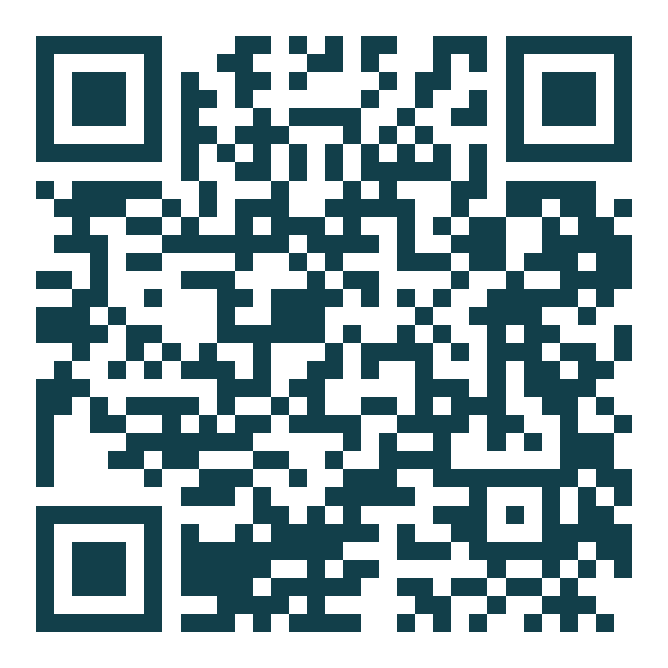
Take the toolkit home
Worksheet • five-question filter • defense checklist • tool list
tford9.github.io/talks/dog-street-ai
Questions — Reach out.
Trenton W. Ford • twford@wm.edu • (757) 903-3296
Notes:
1:55–2:00+ | Deliver the closing line, point to the QR 2014 it links to tford9.github.io/talks/dog-street-ai with the full toolkit. Open Q&A — budget generously; Chamber crowds warm up slowly, so have 2-3 seeded questions ready: 'What's the one tool you'd start with?' / 'Is AI content bad for Google ranking?' / 'What about employee use policies?' Stay after — the best conversations happen at the podium.

