Slide 1
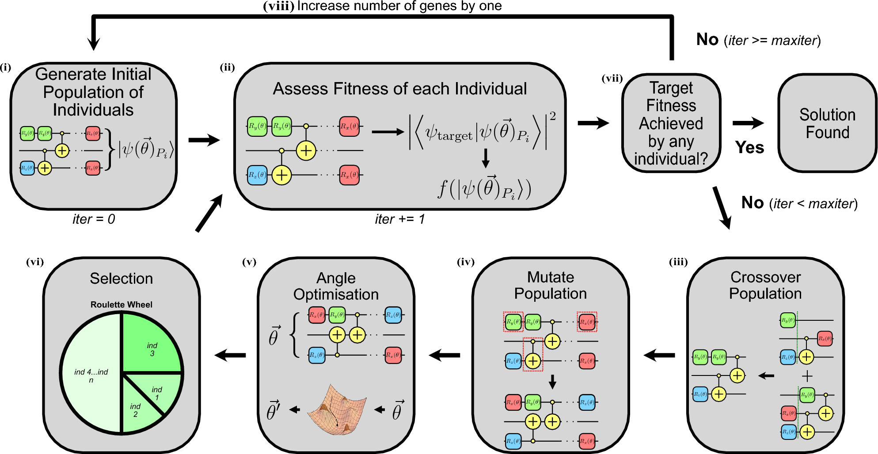

Slide 2
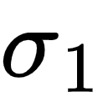
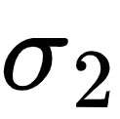
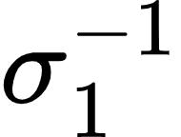
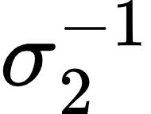
Generate Initial Population
(1st generation)
Initial random braidwords
Measure Fitness
Closeness to the target unitary
0.5
0.1
0.3
0.7
Selection
Choose minimum
Crossover
Produce offspring
Mutation
Apply small changes
New Generation

