Slide 1
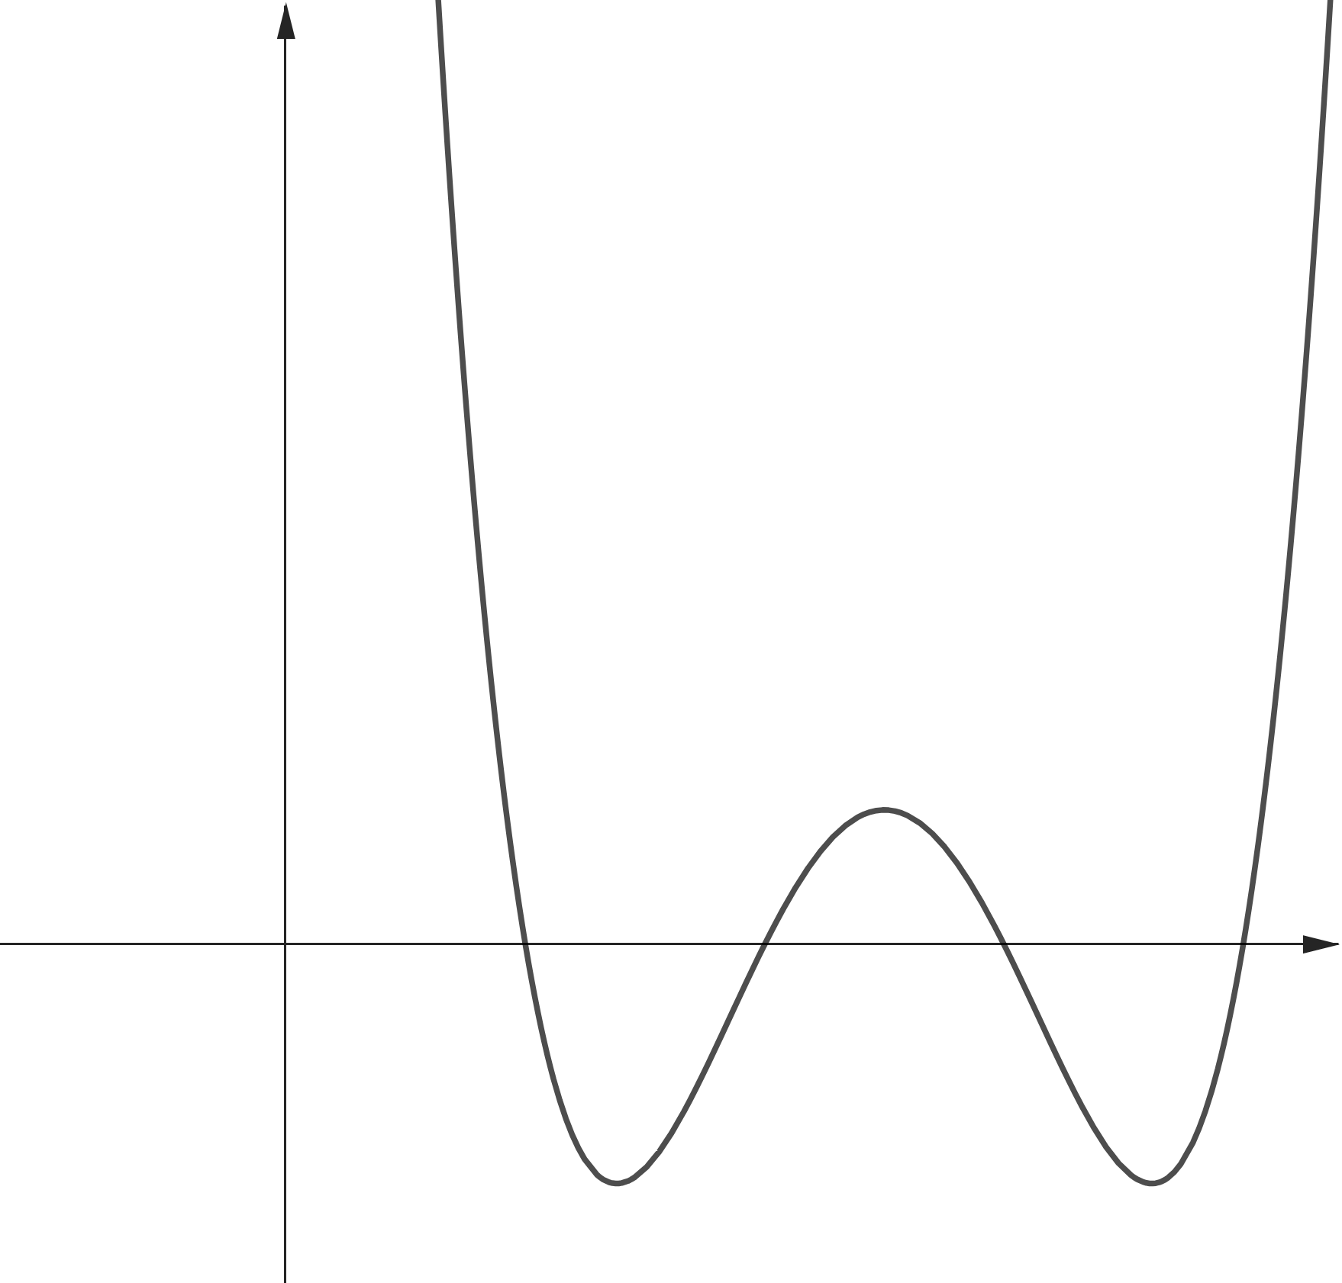
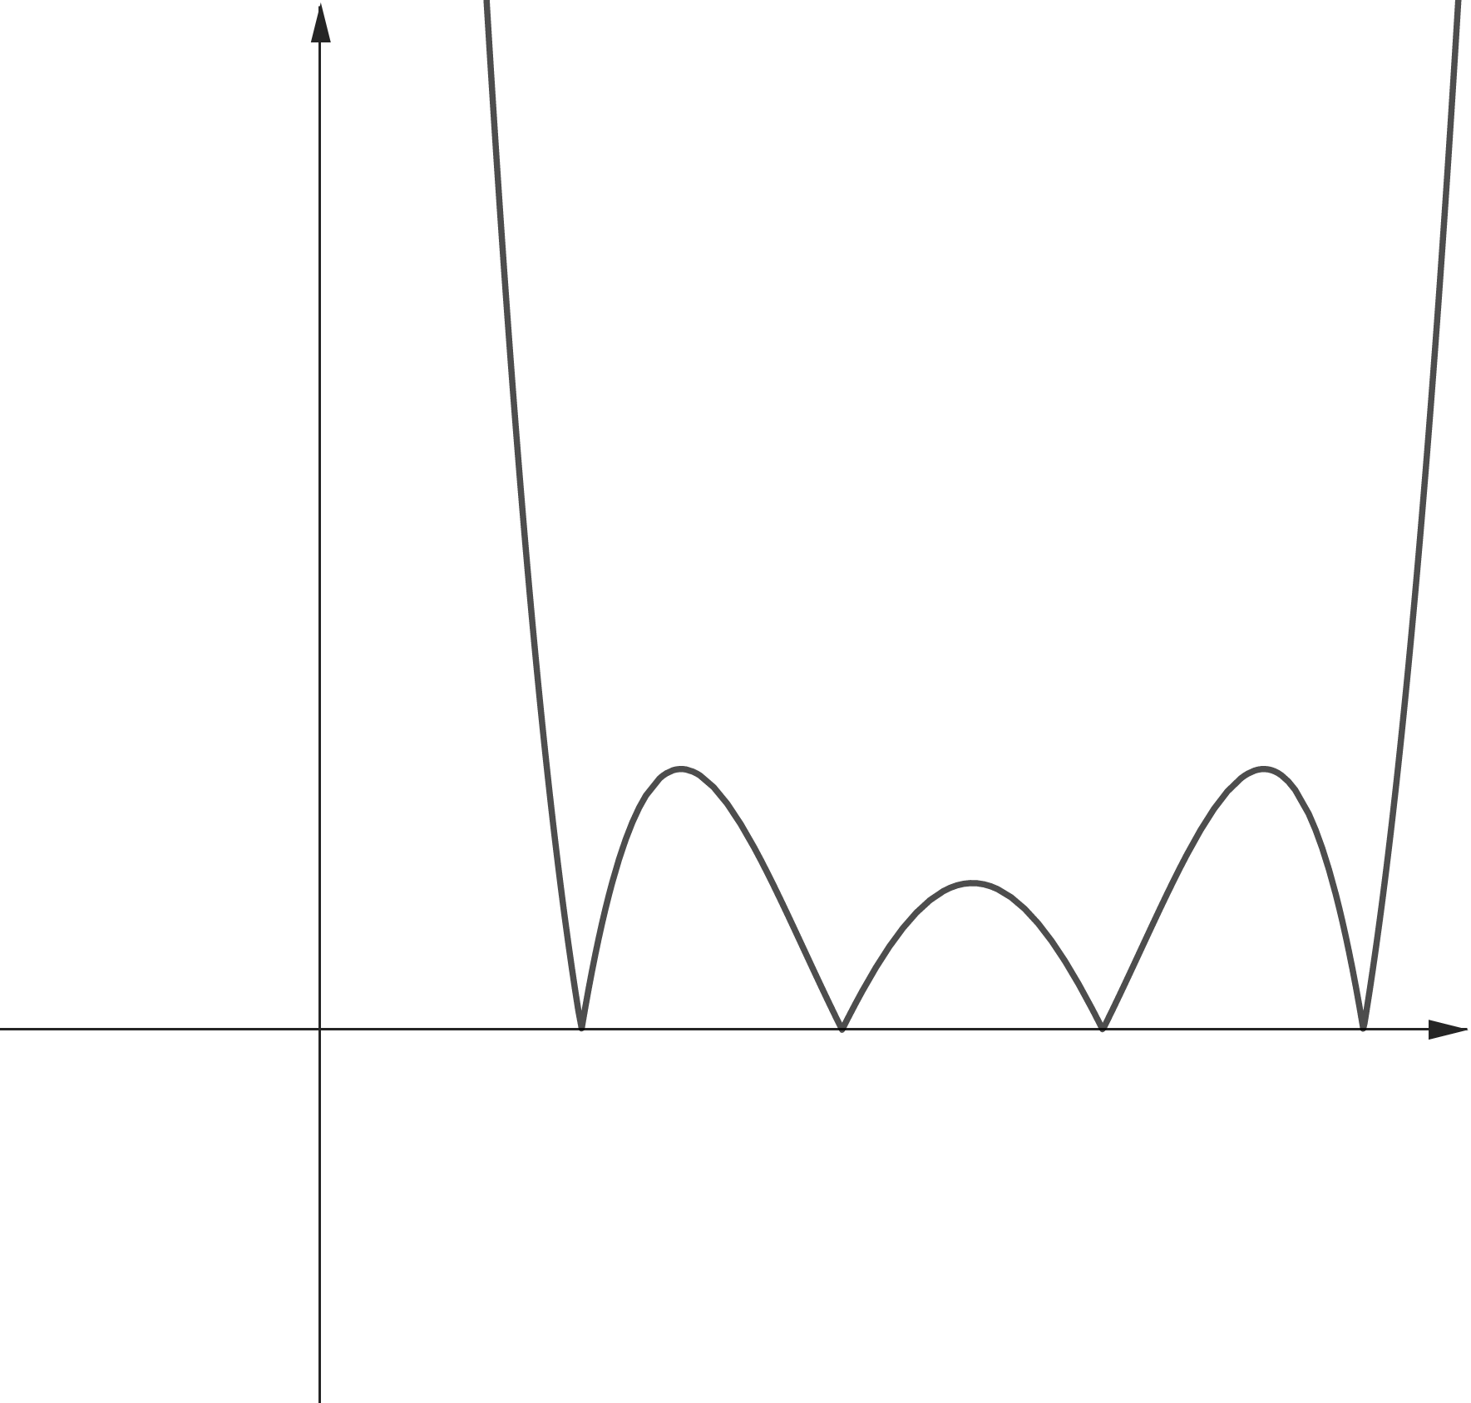
















$$y$$
$$y$$
$$y=f(x)$$
$$y=|f\left(x\right)|$$
$$x$$
$$x$$
$$O$$
$$1$$
$$2$$
$$3$$
$$4$$
$$O$$
$$1$$
$$2$$
$$3$$
$$4$$

Slide 2
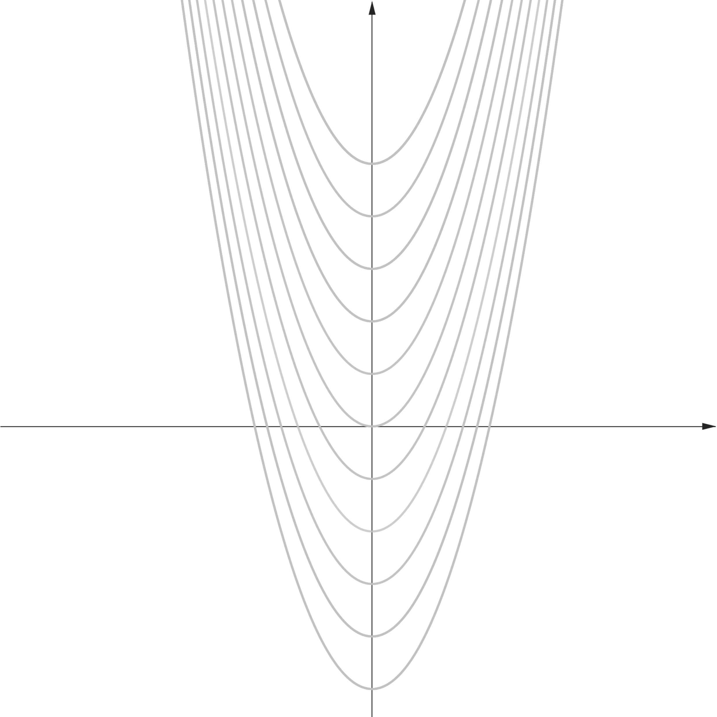
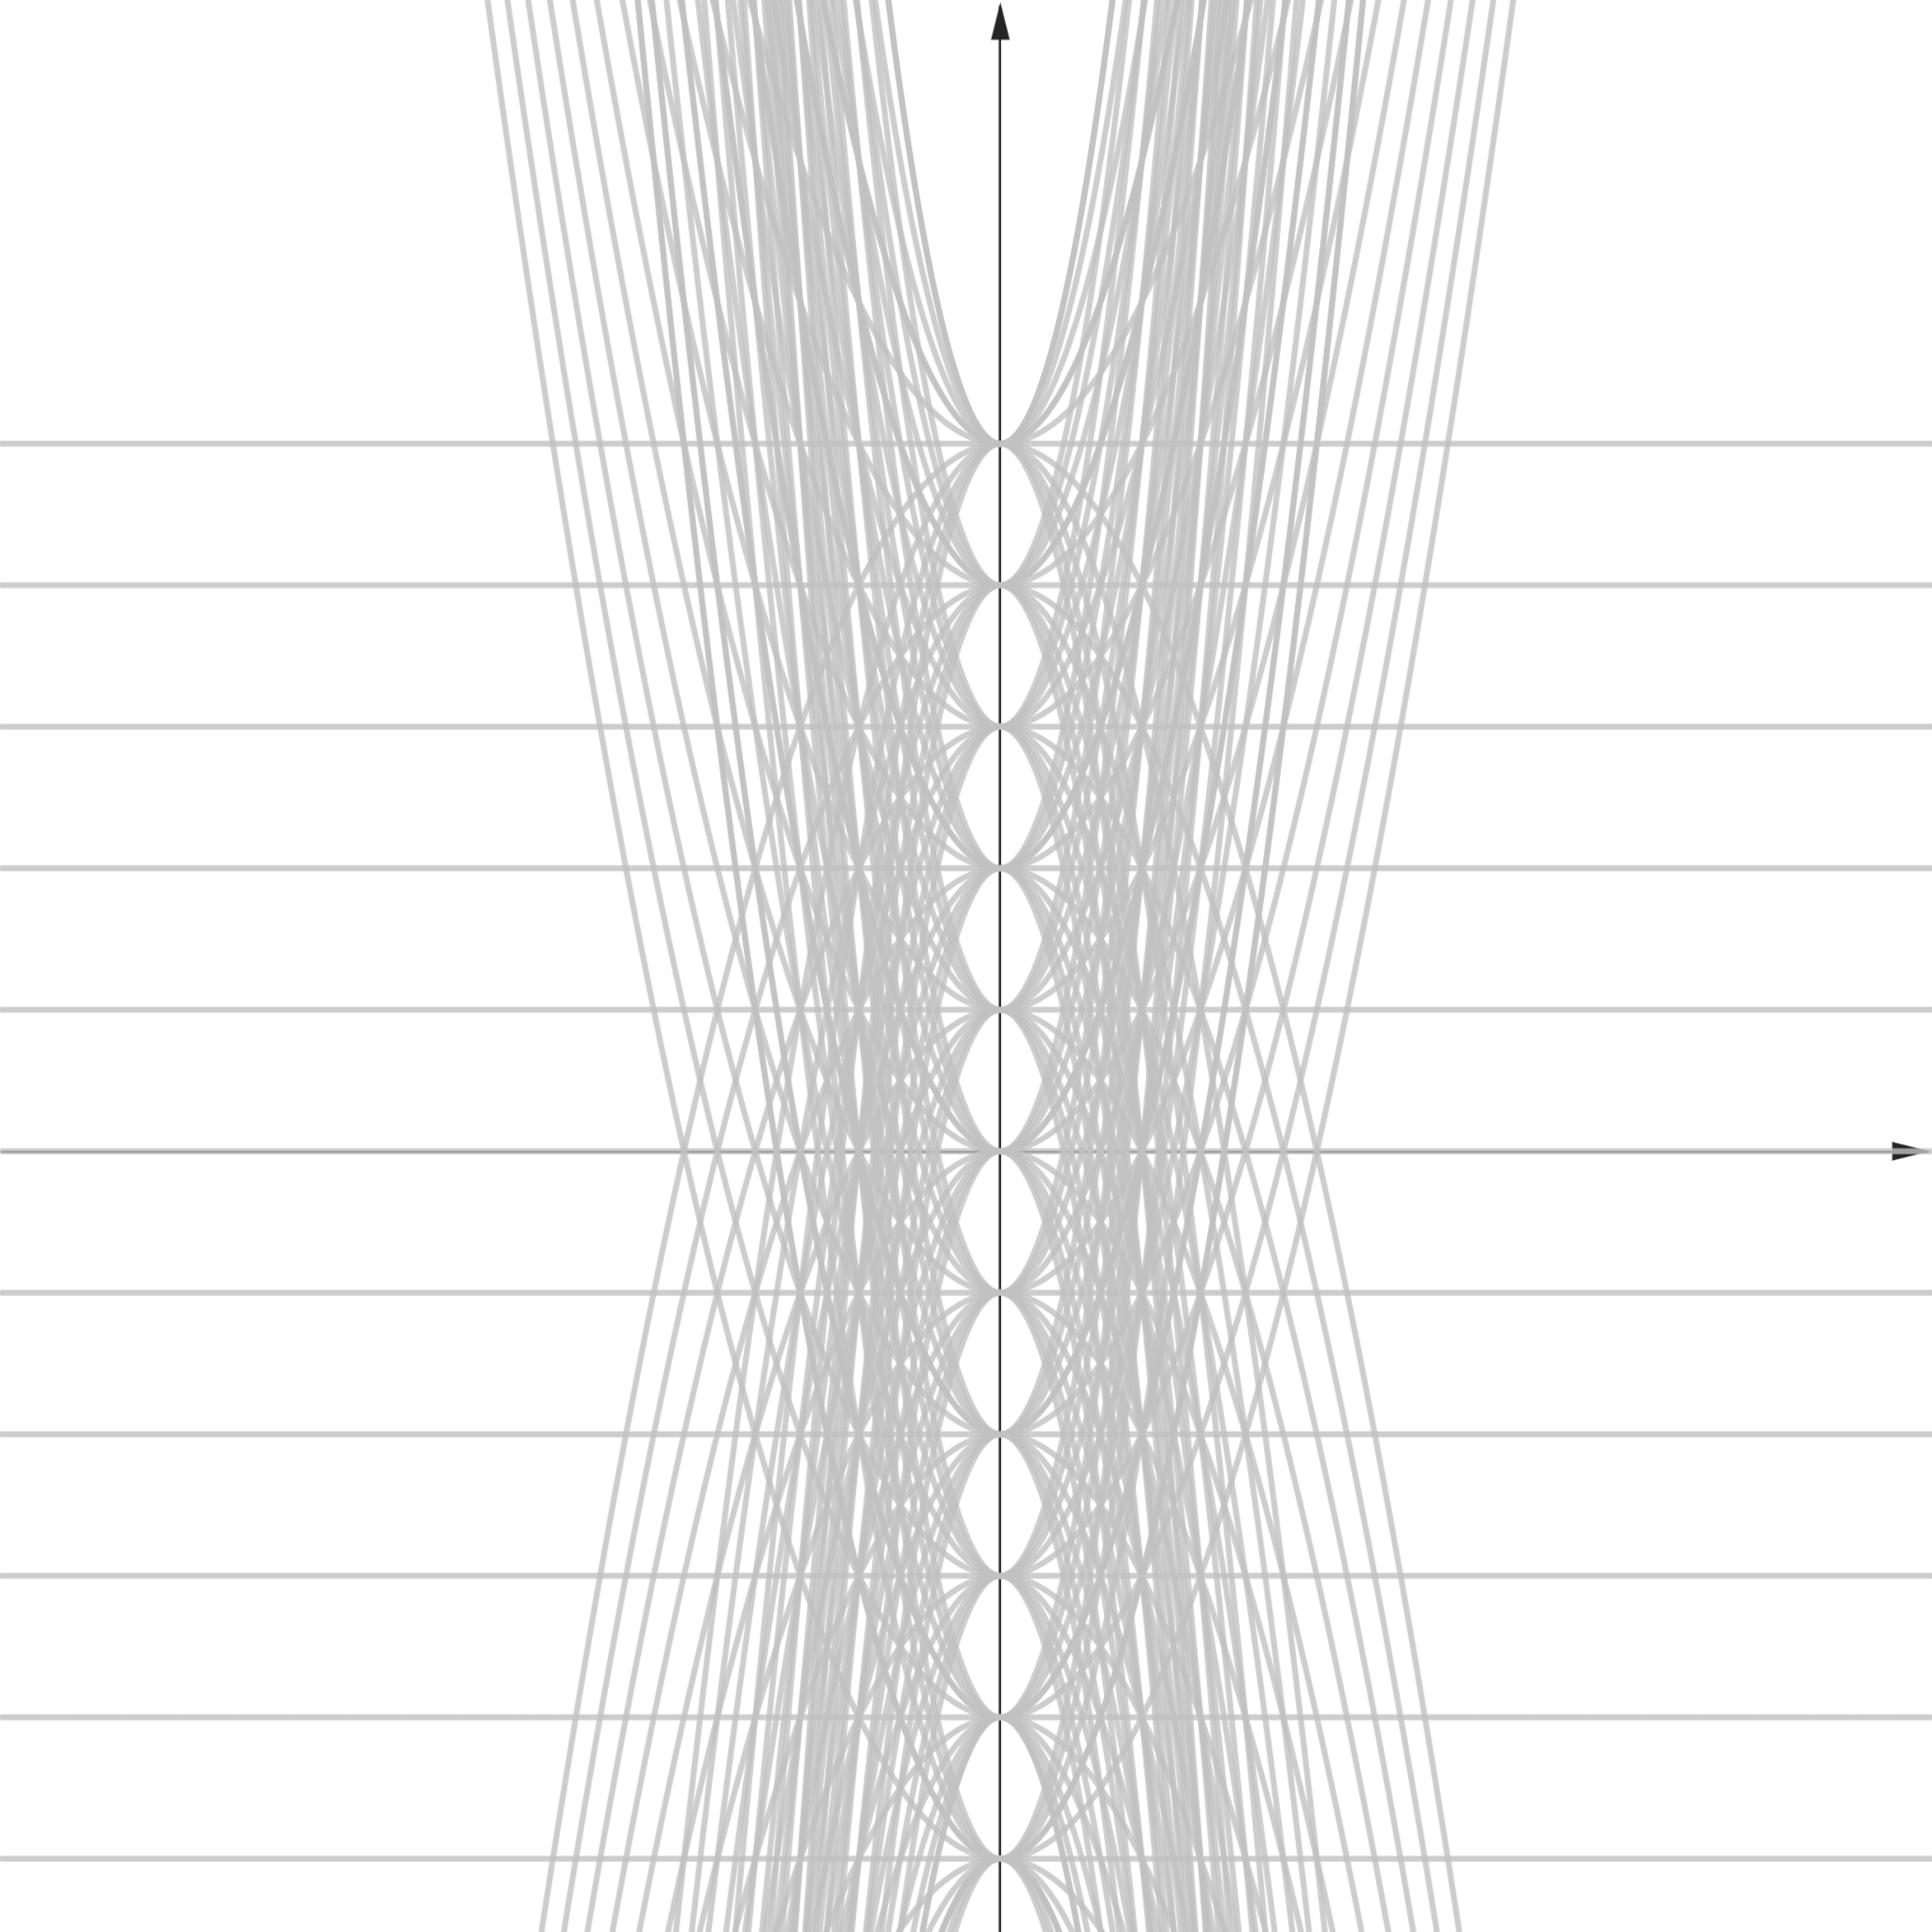








$$y$$
$$y$$
$$x$$
$$x$$
$$O$$
$$O$$
$$y=x^{2}+c$$
$$y={ax}^{2}+c$$

Slide 3
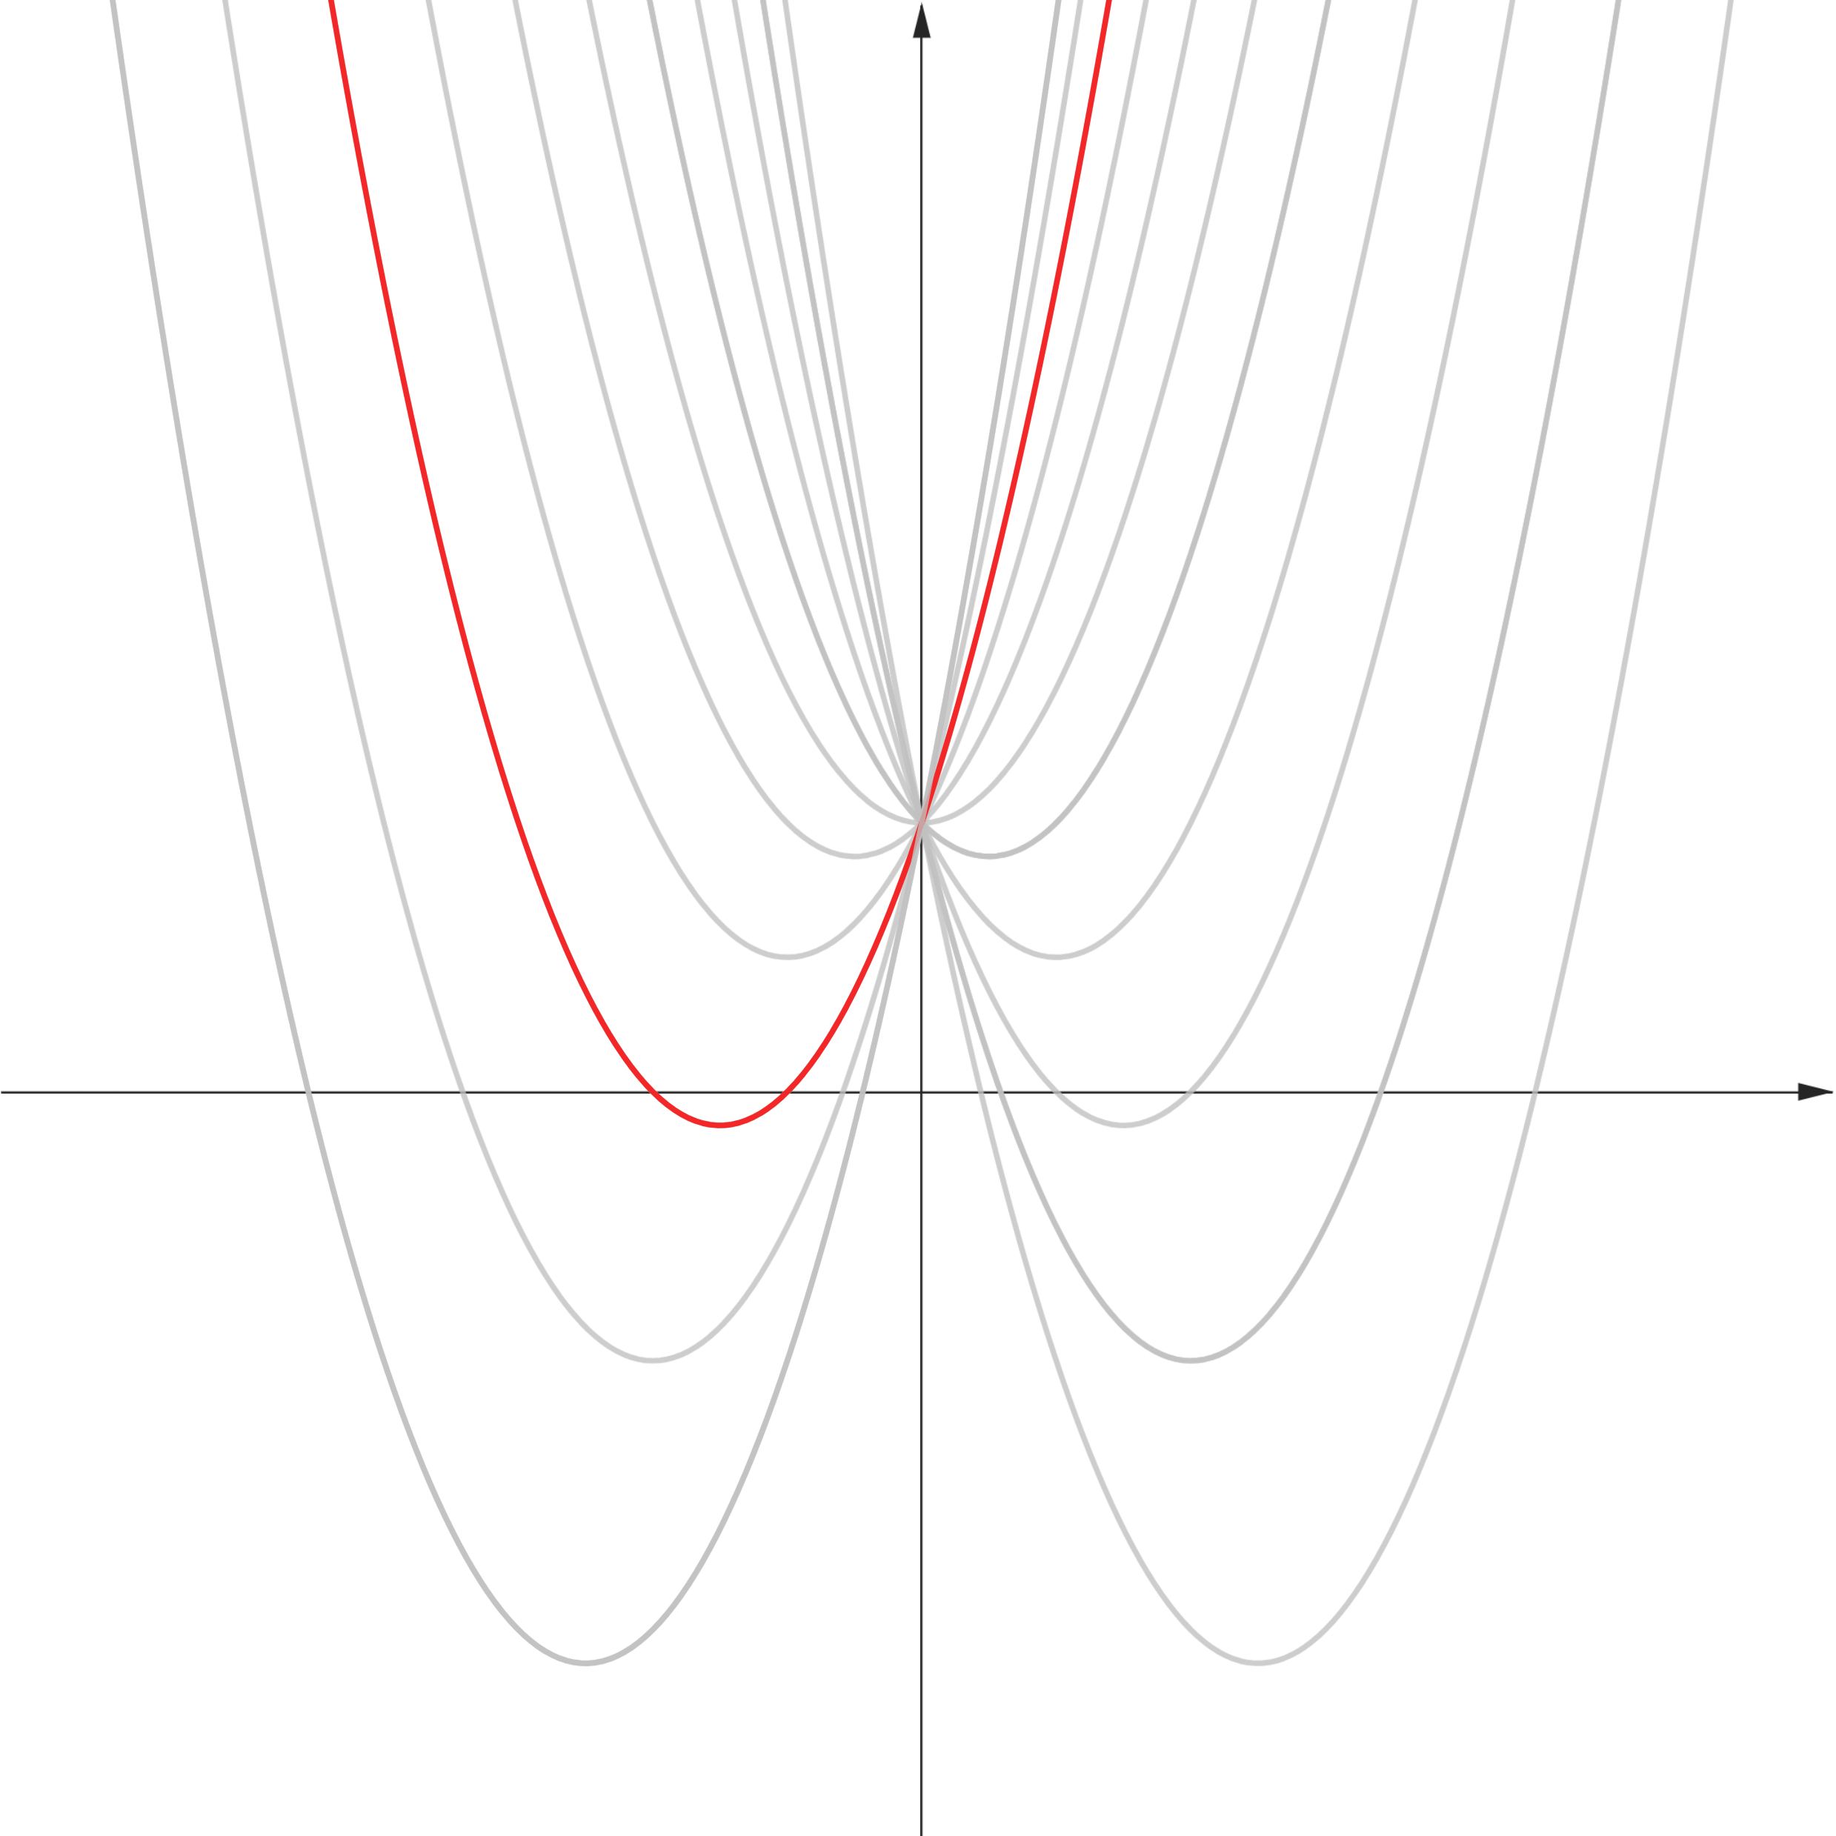





$$y$$
$$y=x^{2}+2x+3$$
$$x$$
$$O$$
$$y=x^{2}+ax+3$$

Slide 4
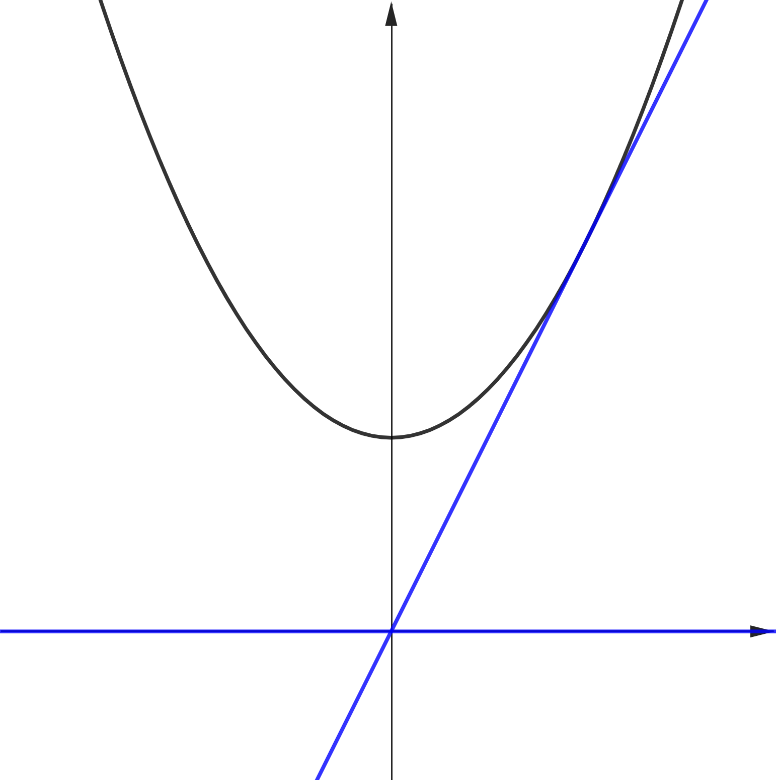






$$y$$
$$y=x^{2}+1$$
$$y=2x$$
$$O$$
$$x$$
$$y=0$$

Slide 5
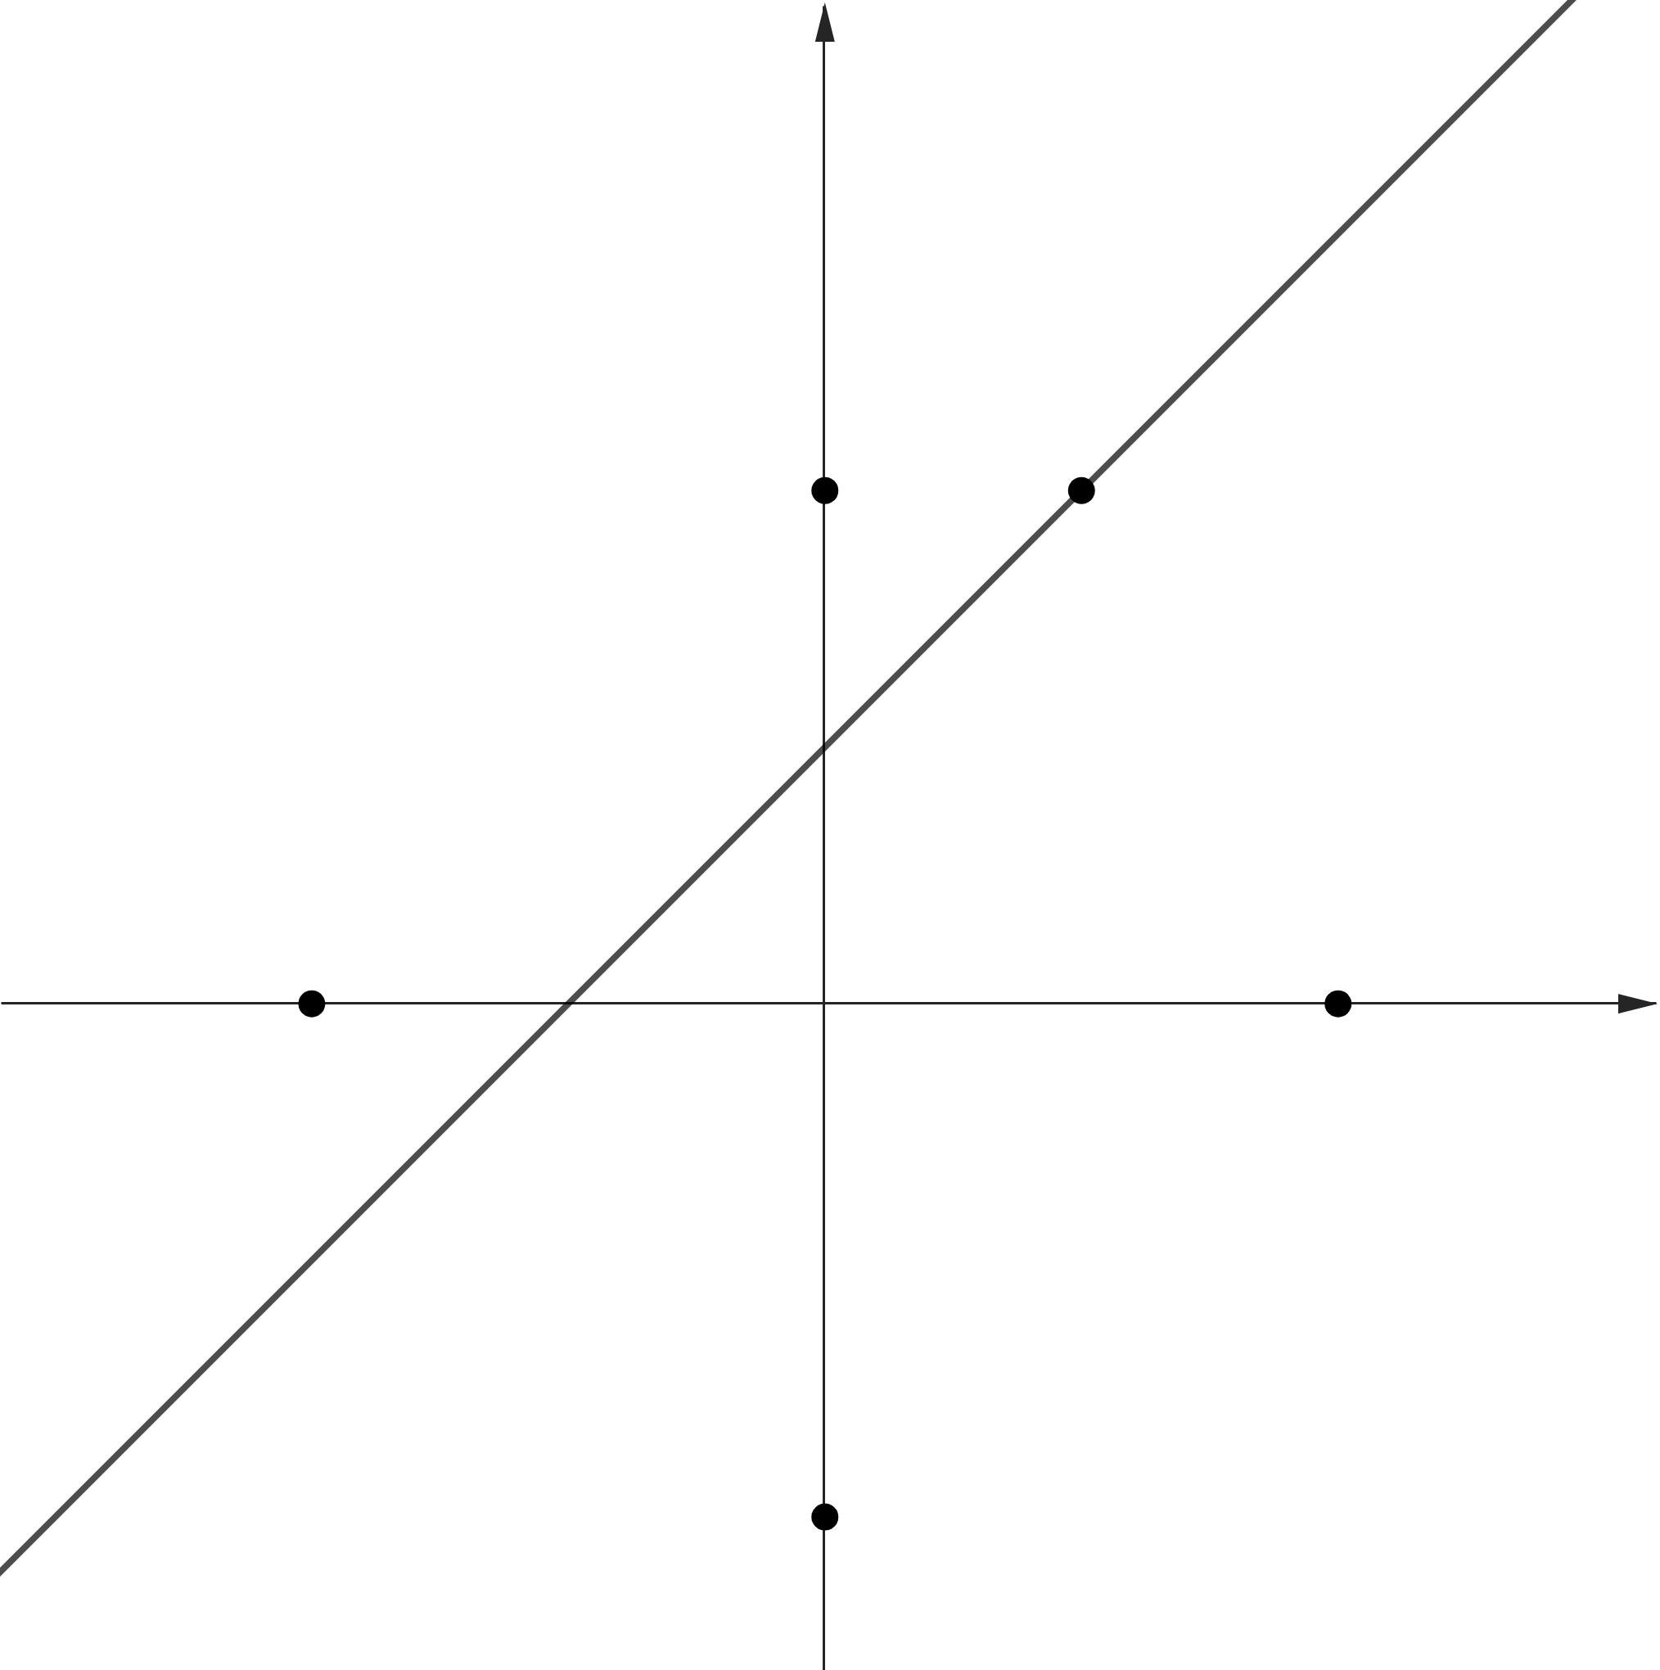








$$y$$
$$C(0, 2)$$
$$B(1, 2)$$
$$D(−2, 0)$$
$$A(2, 0)$$
$$x$$
$$O$$
$$x−y+1=0$$
$$E(0, −2)$$

Slide 6
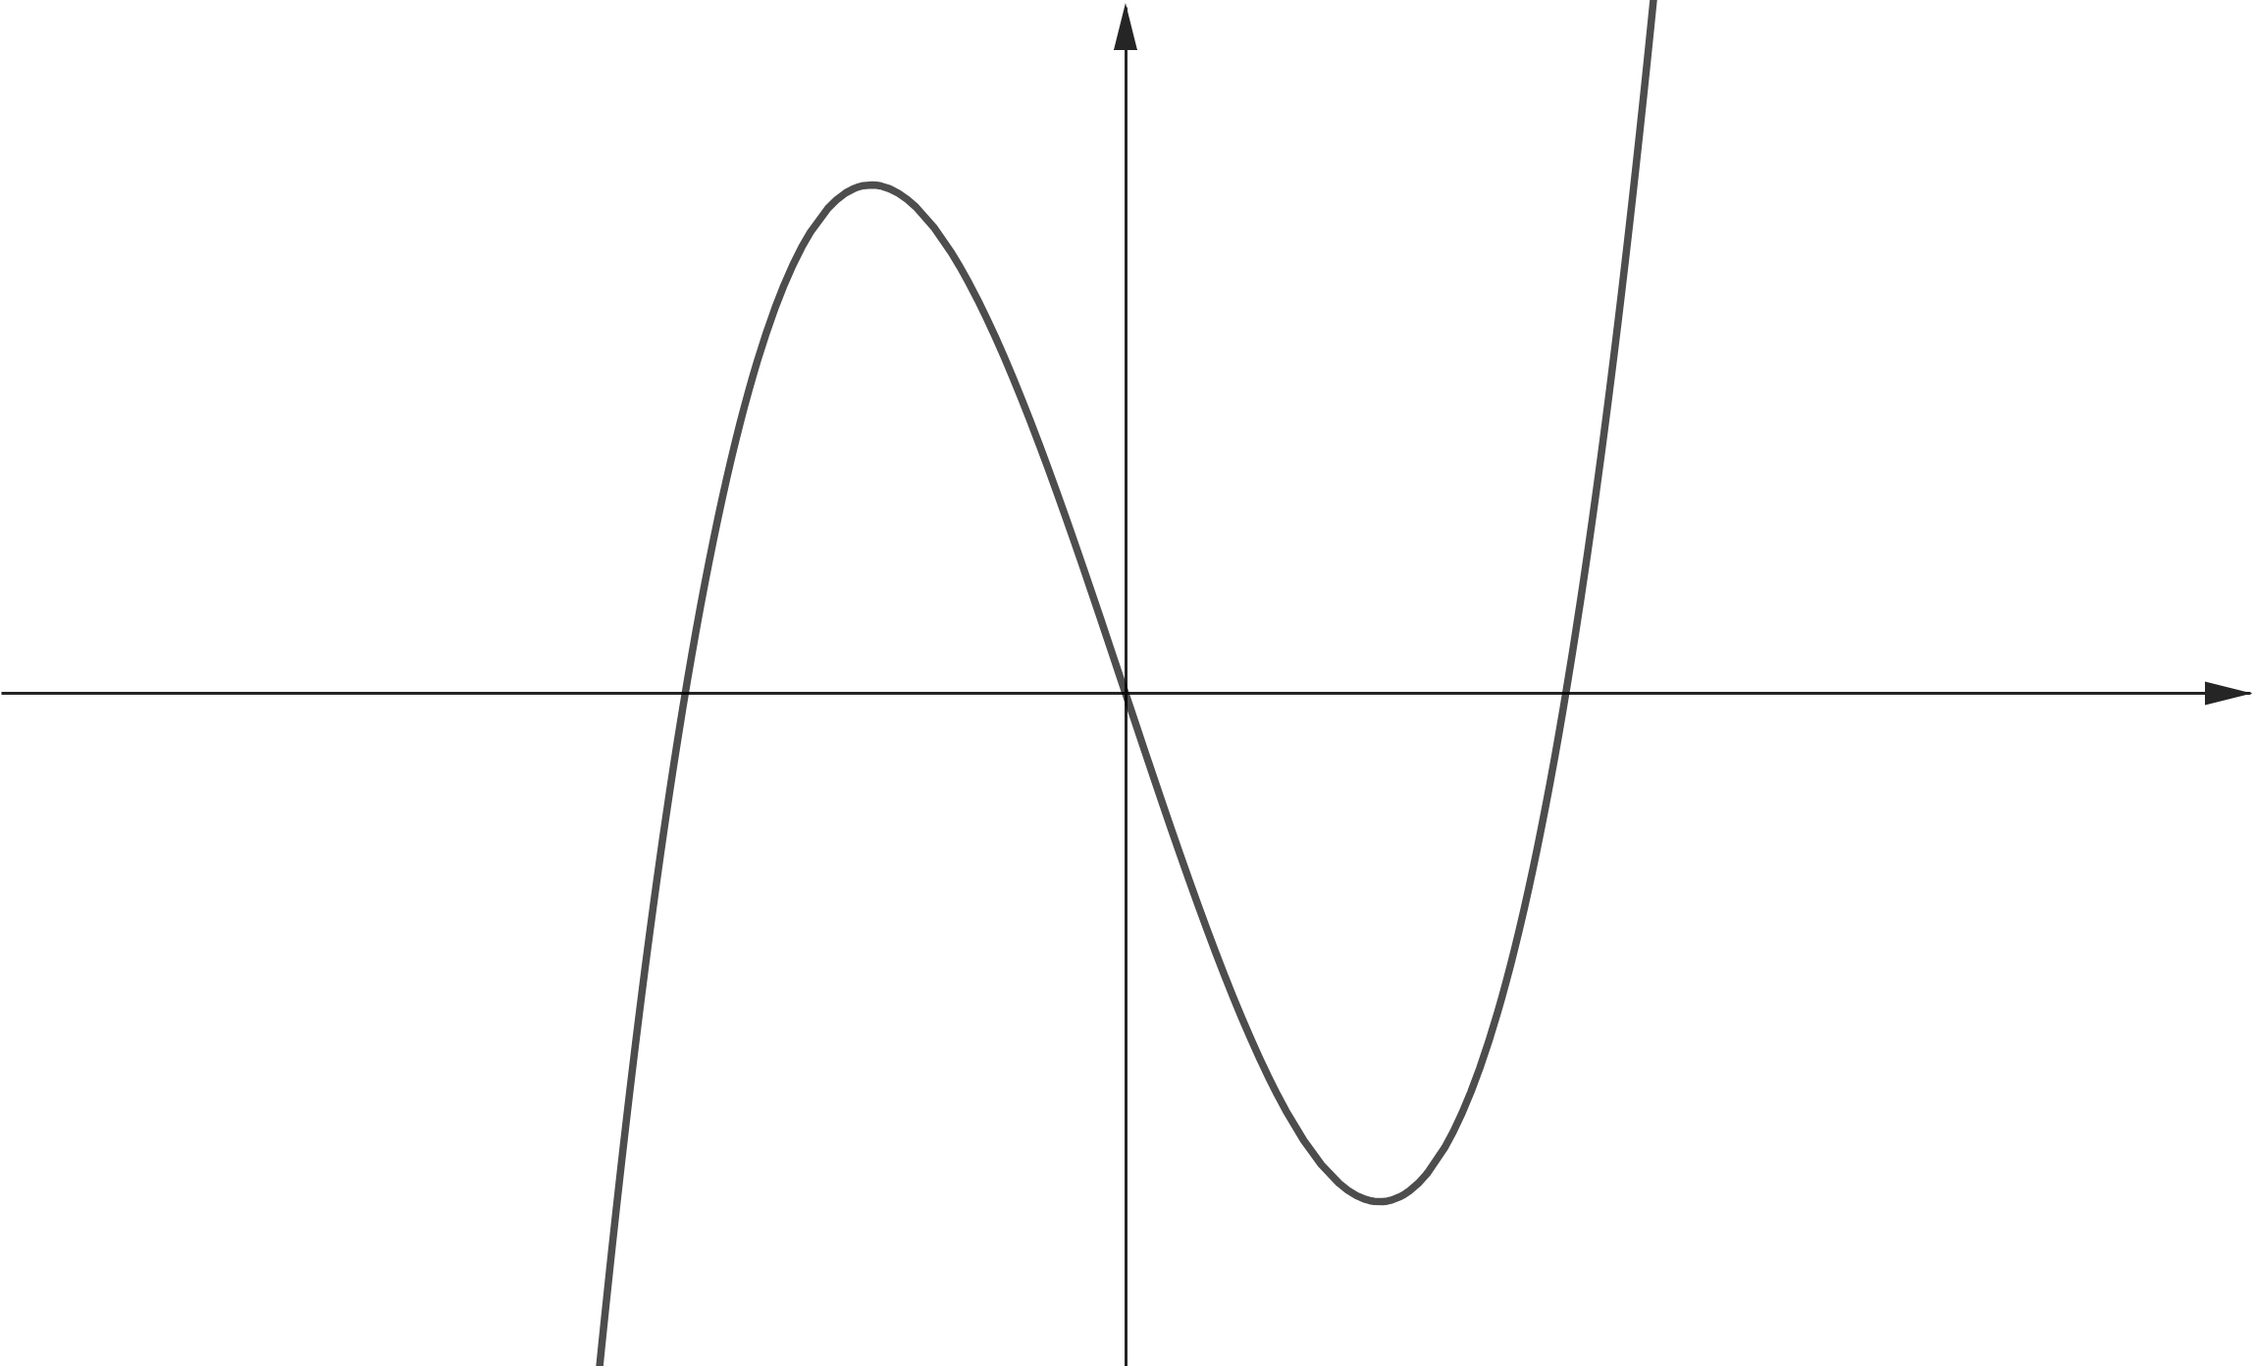
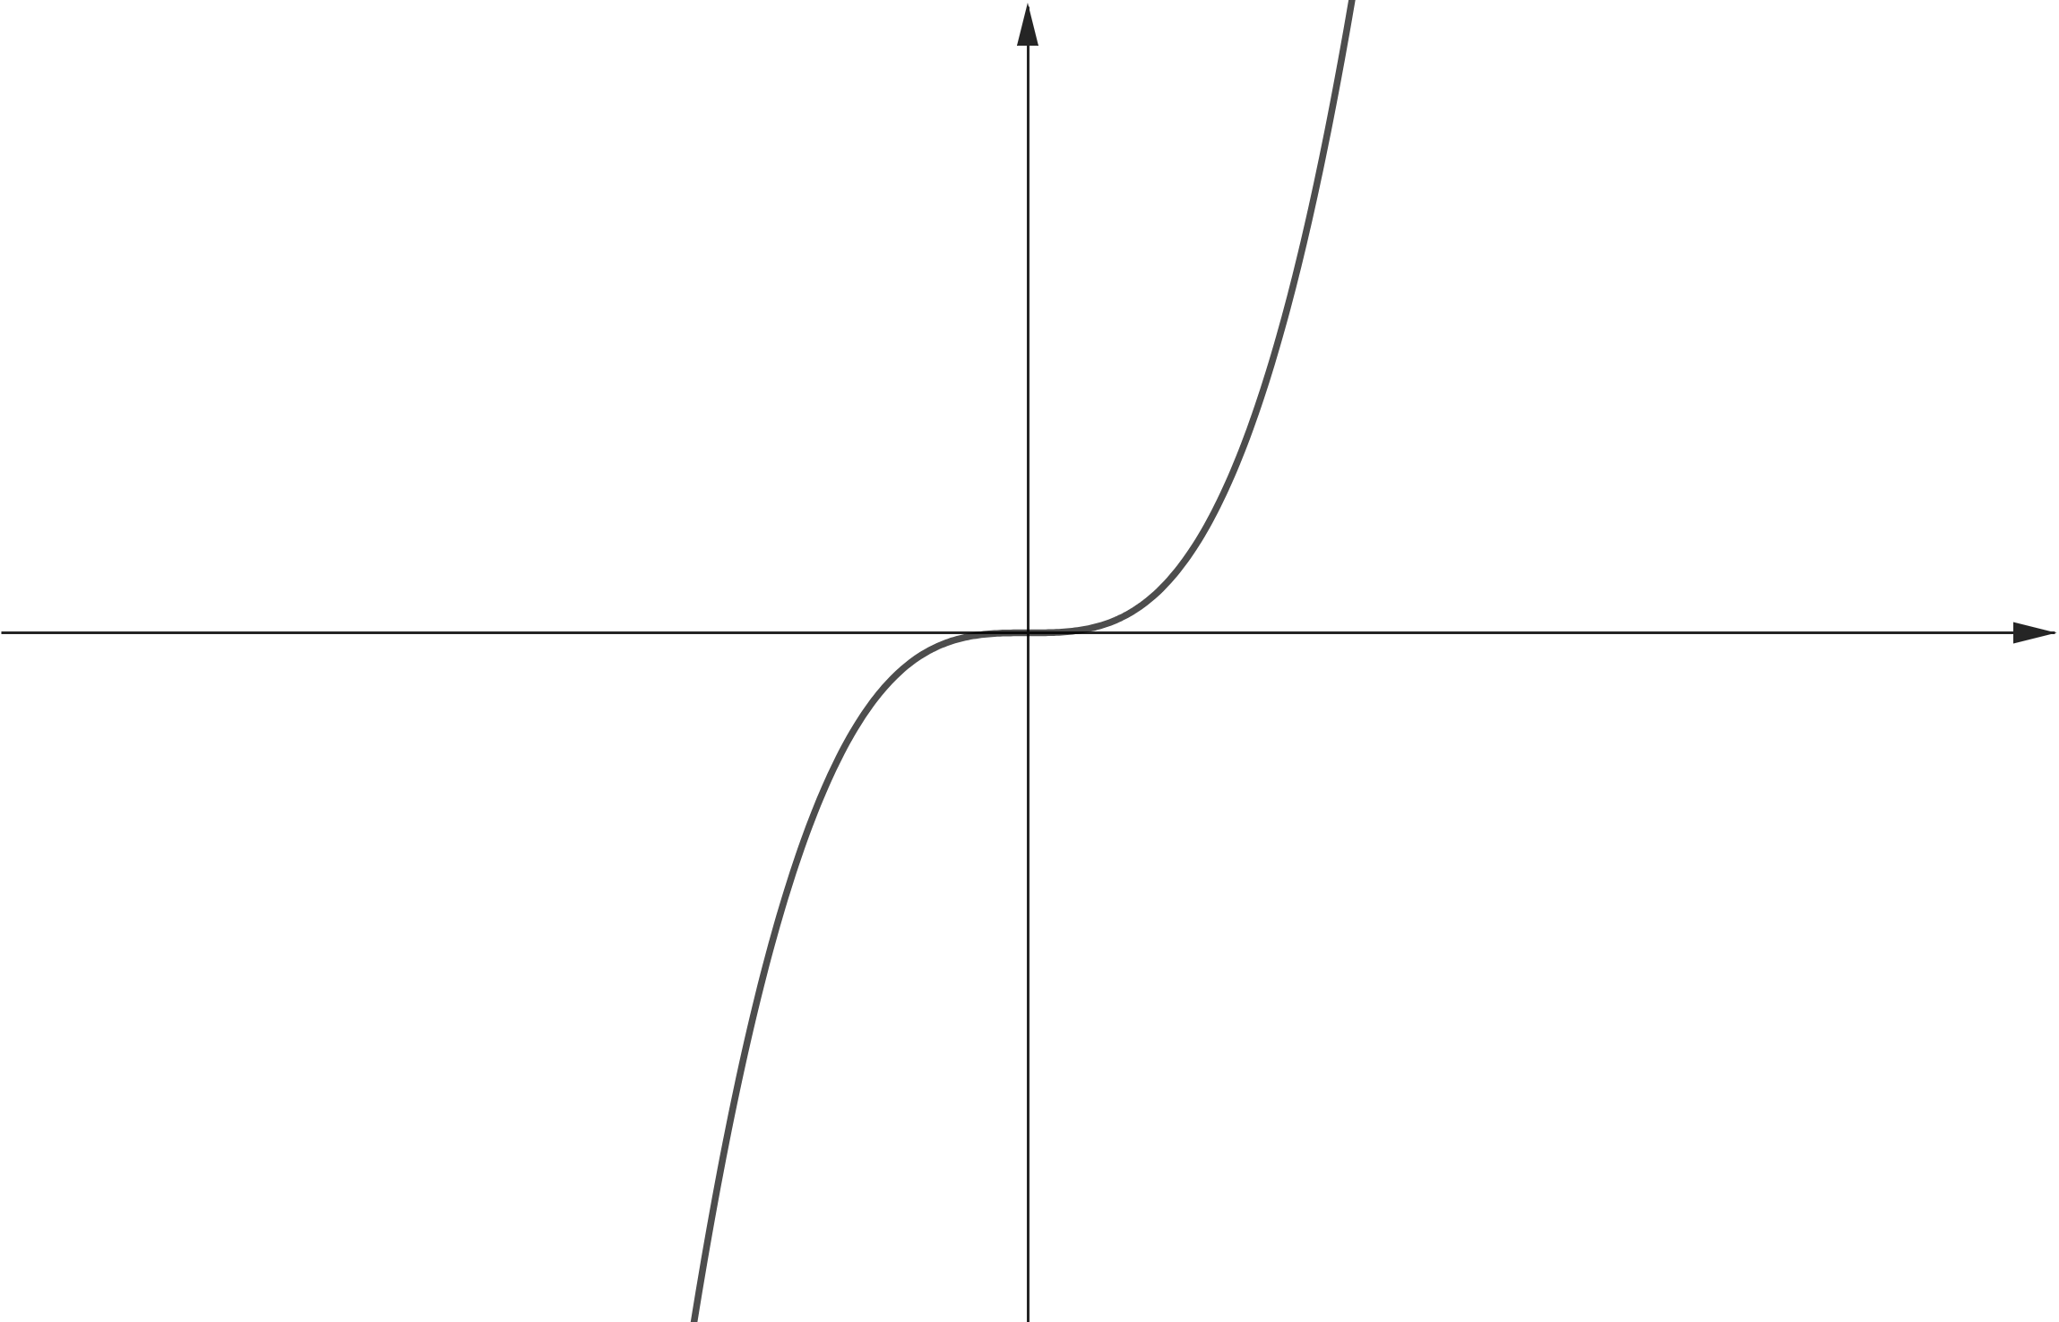
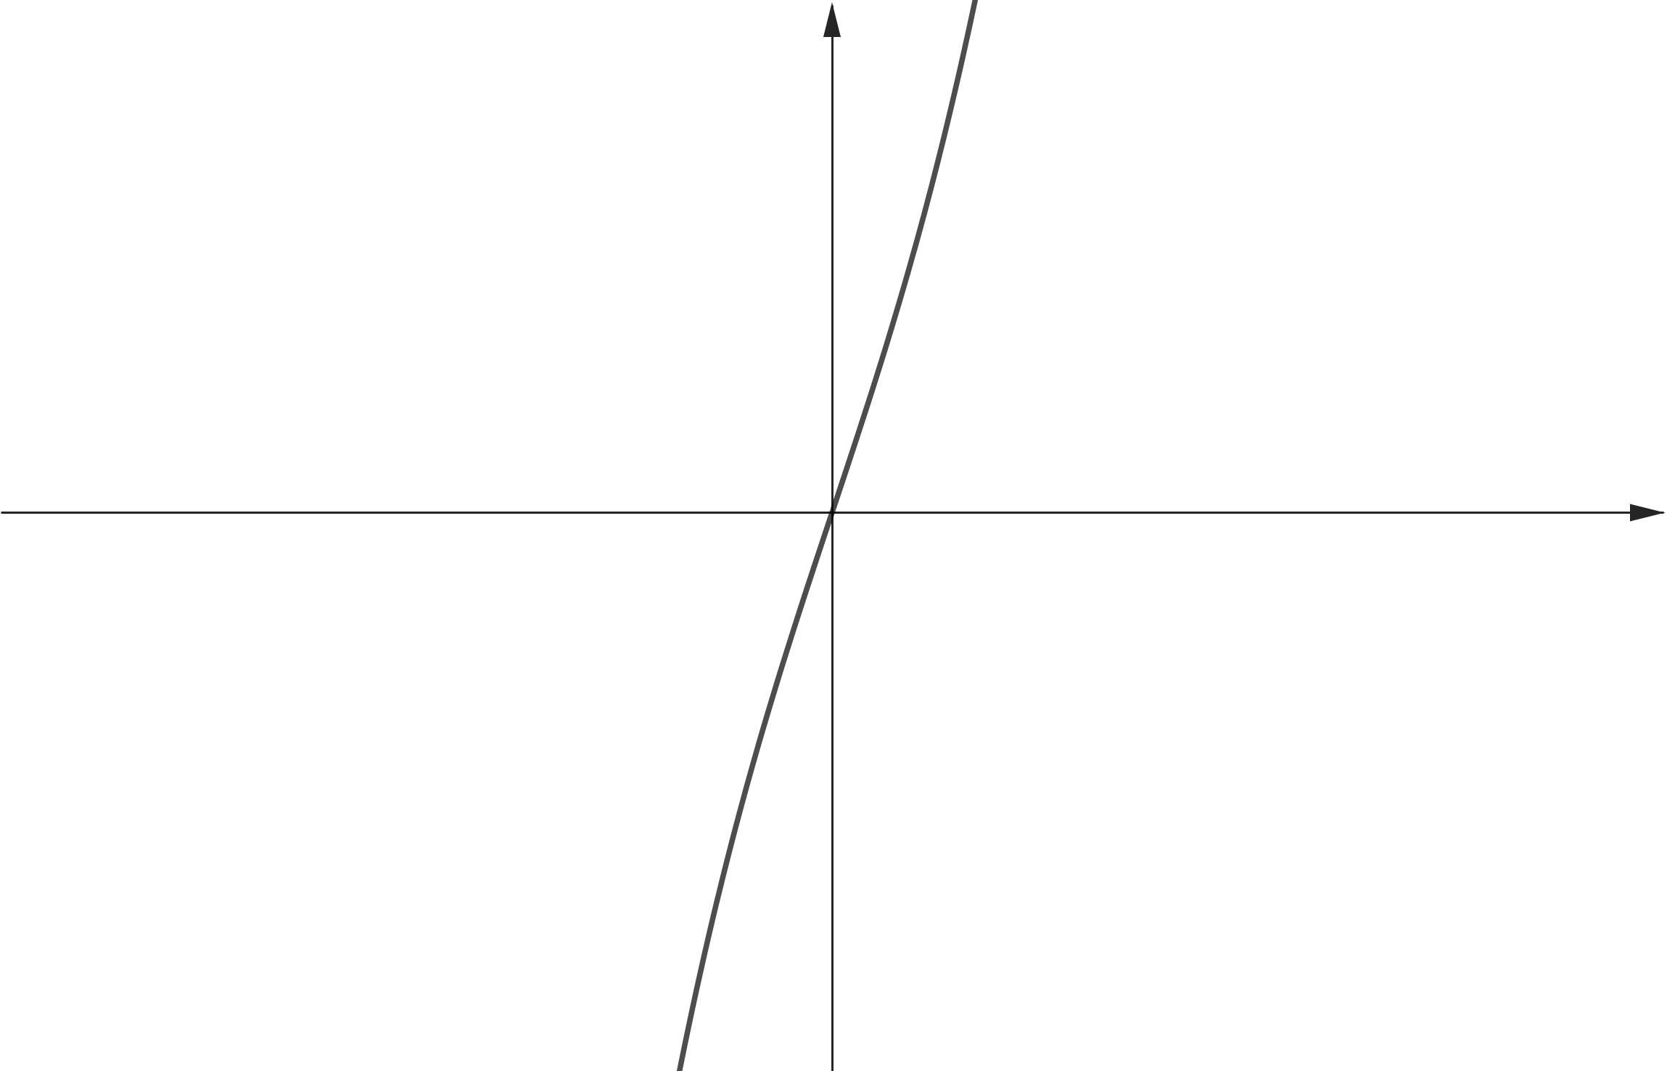
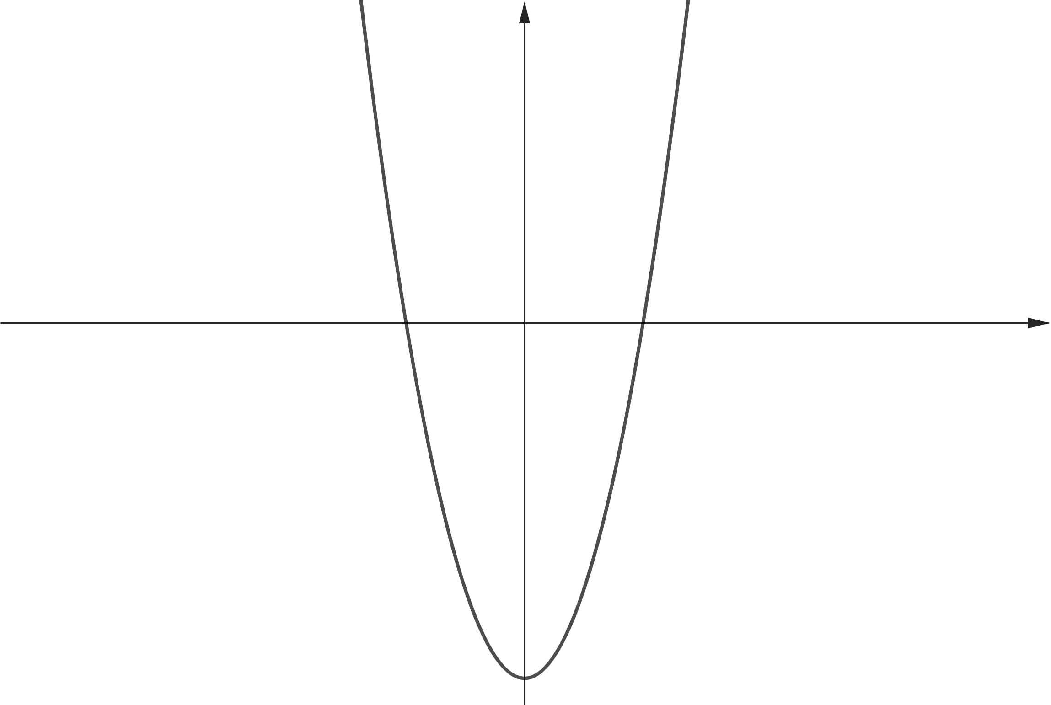
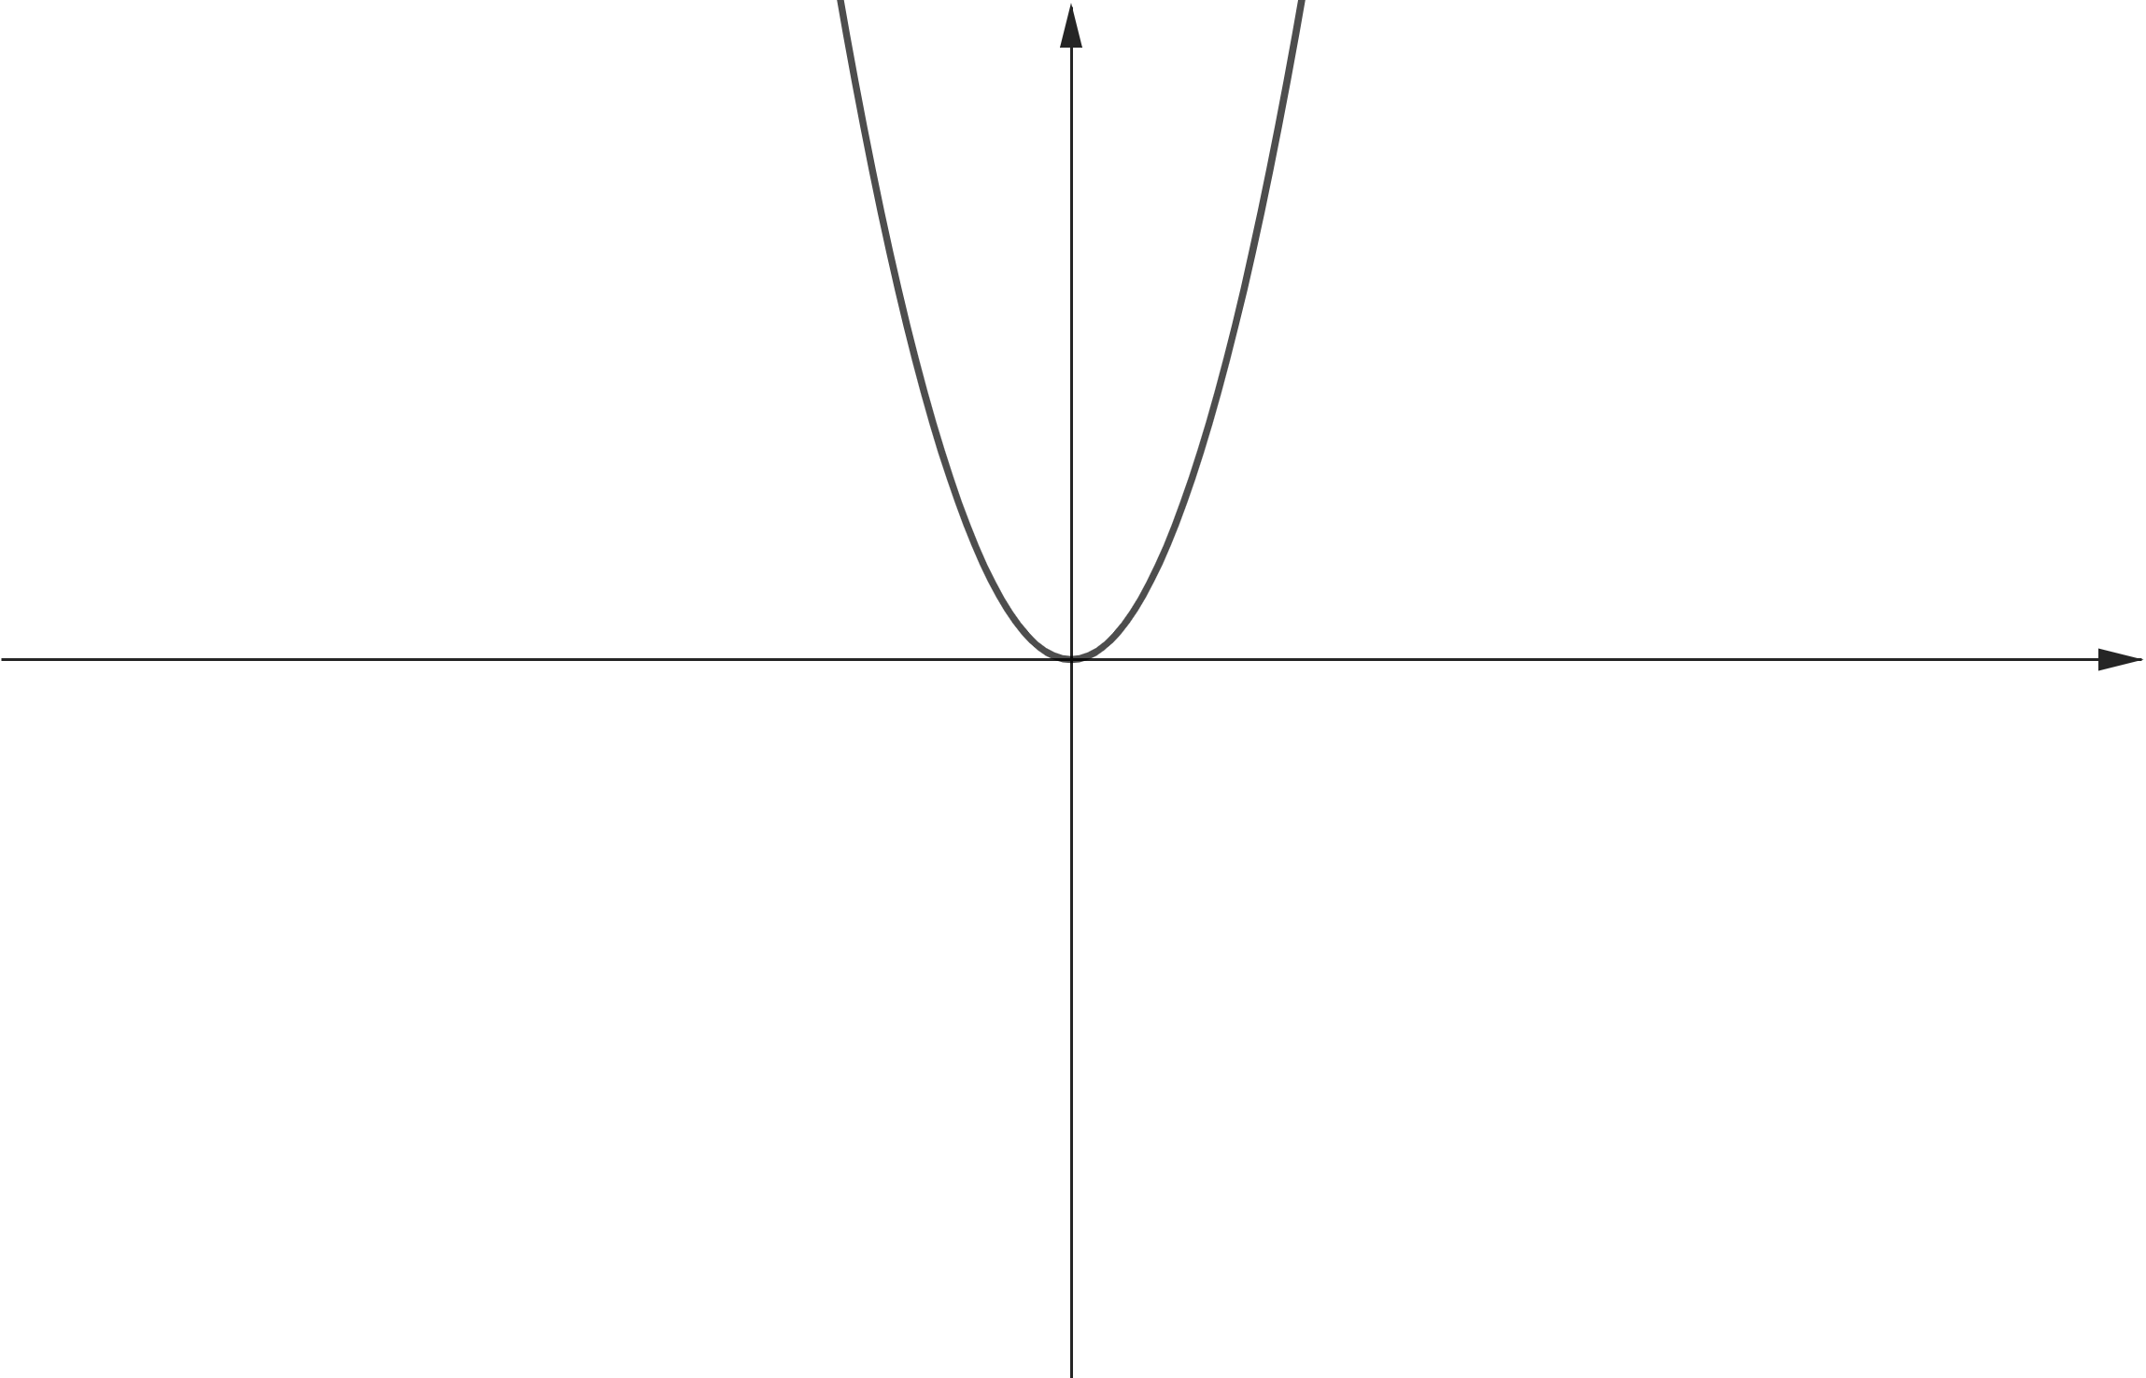
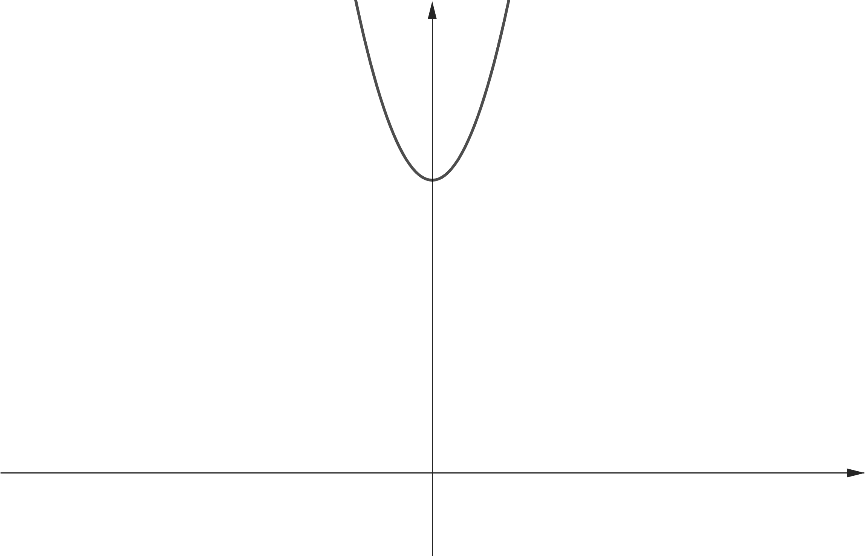


















$$y$$
$$y$$
$$y$$
$$x$$
$$x$$
$$x$$
$$O$$
$$O$$
$$O$$
$$y$$
$$y$$
$$y$$
$$O$$
$$x$$
$$O$$
$$x$$
$$O$$
$$x$$

Slide 7
$$y$$
$$C(0, 2)$$
$$B(1, 2)$$
$$D(−2, 0)$$
$$A(2, 0)$$
$$x$$
$$O$$
$$x−y+1=0$$
$$E(0, −2)$$

Slide 8
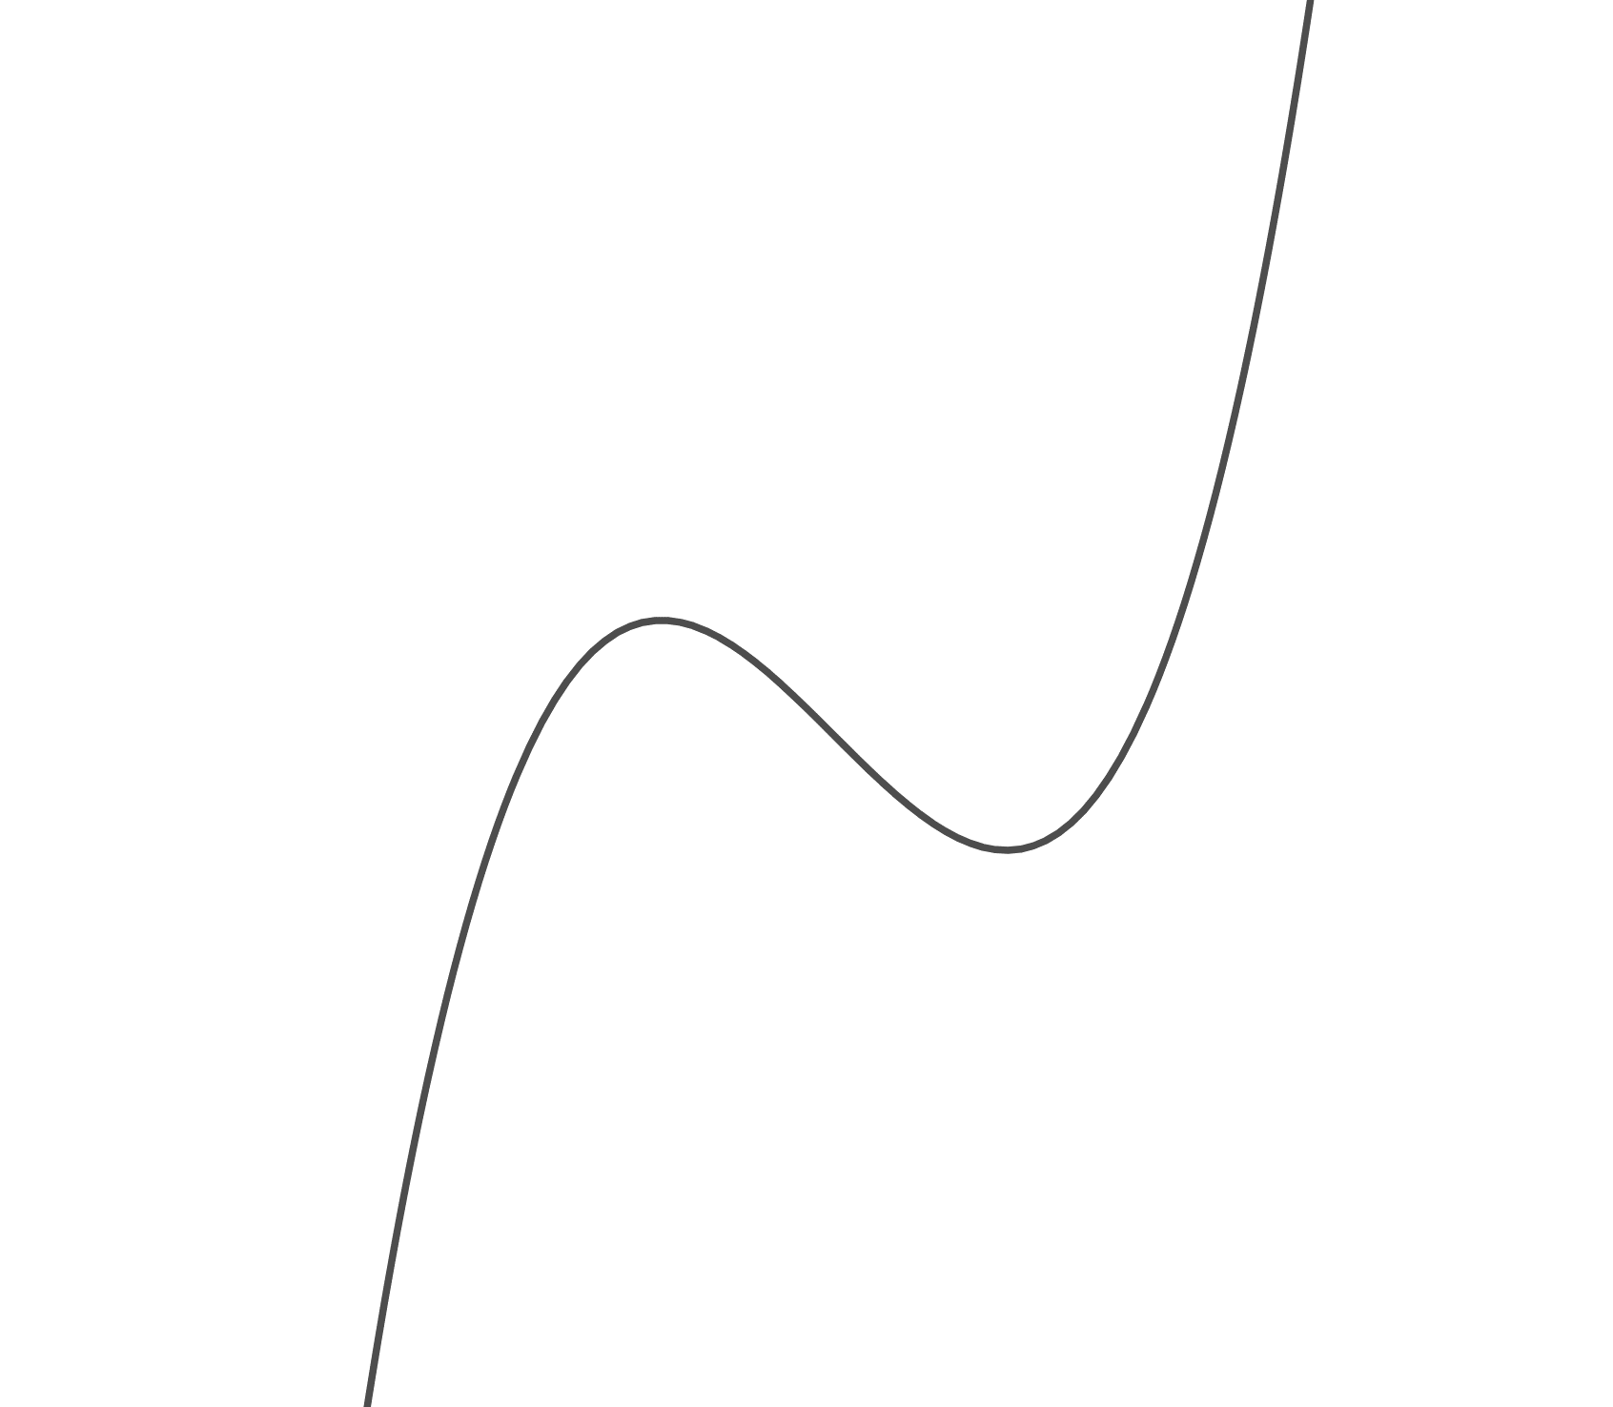
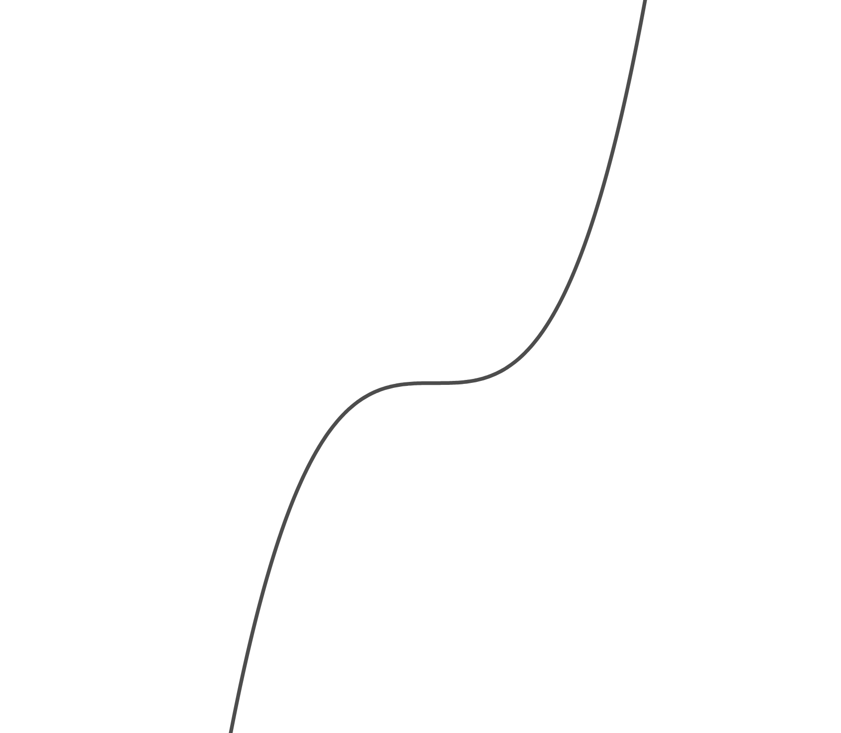
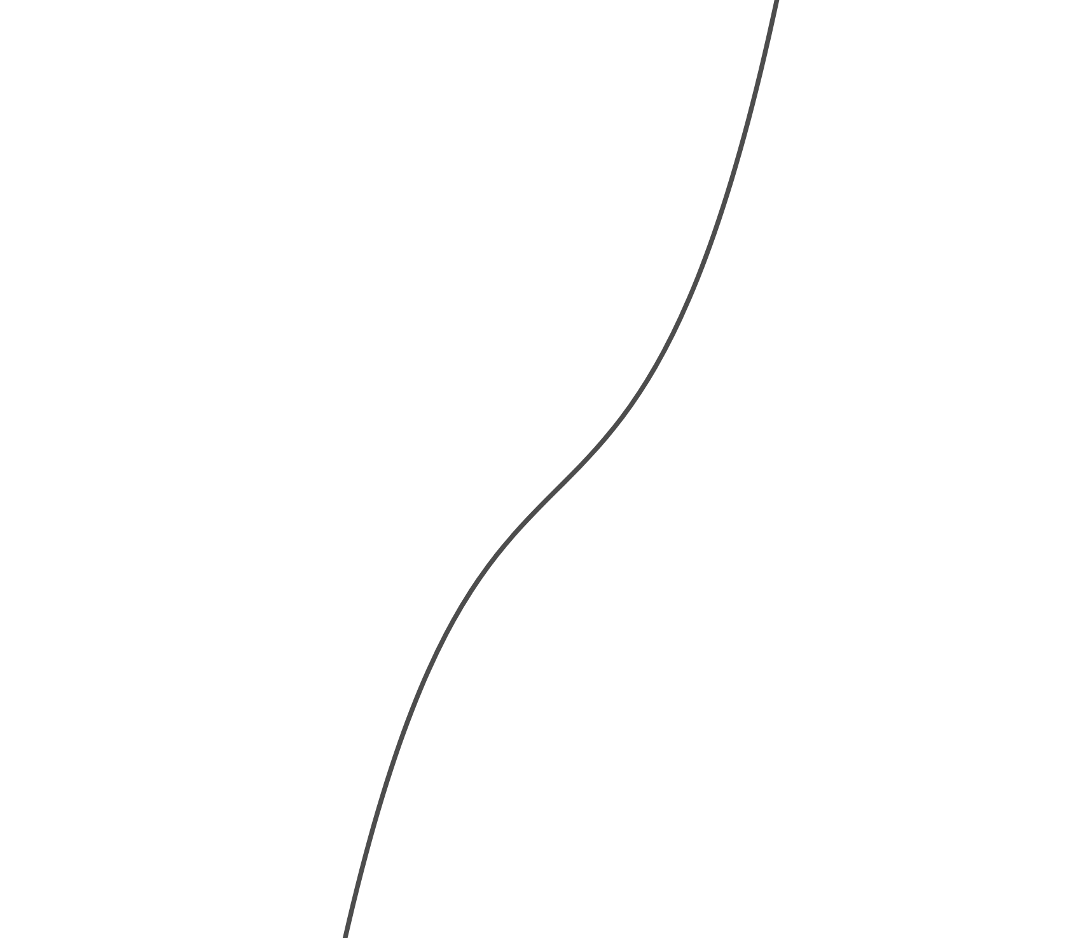
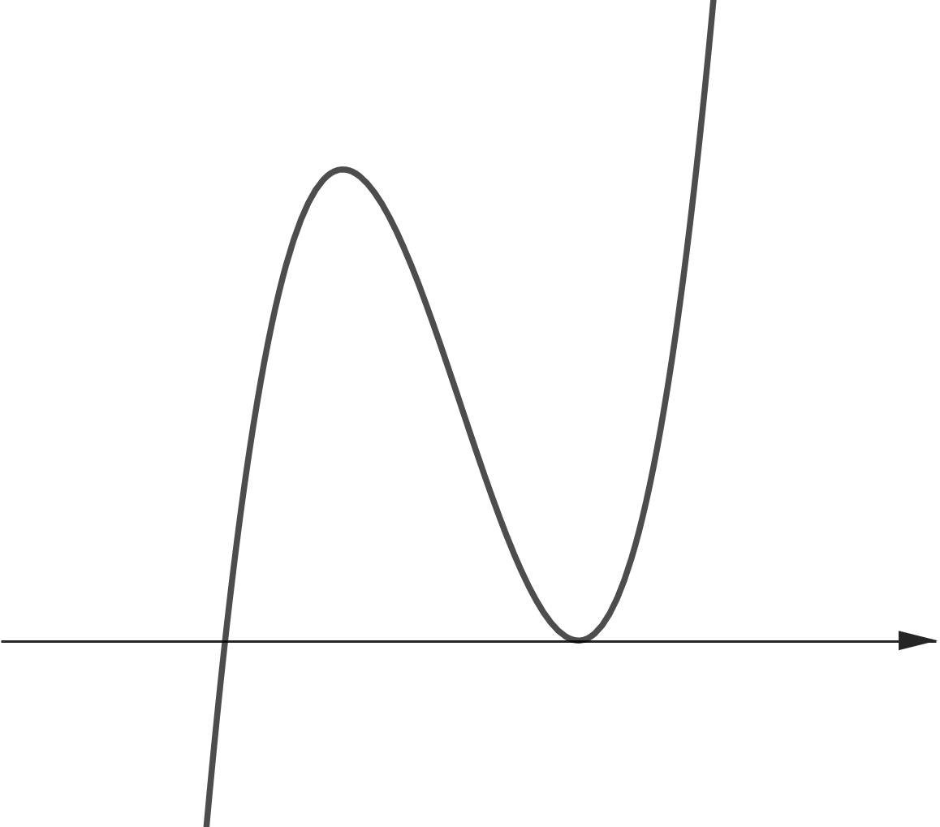
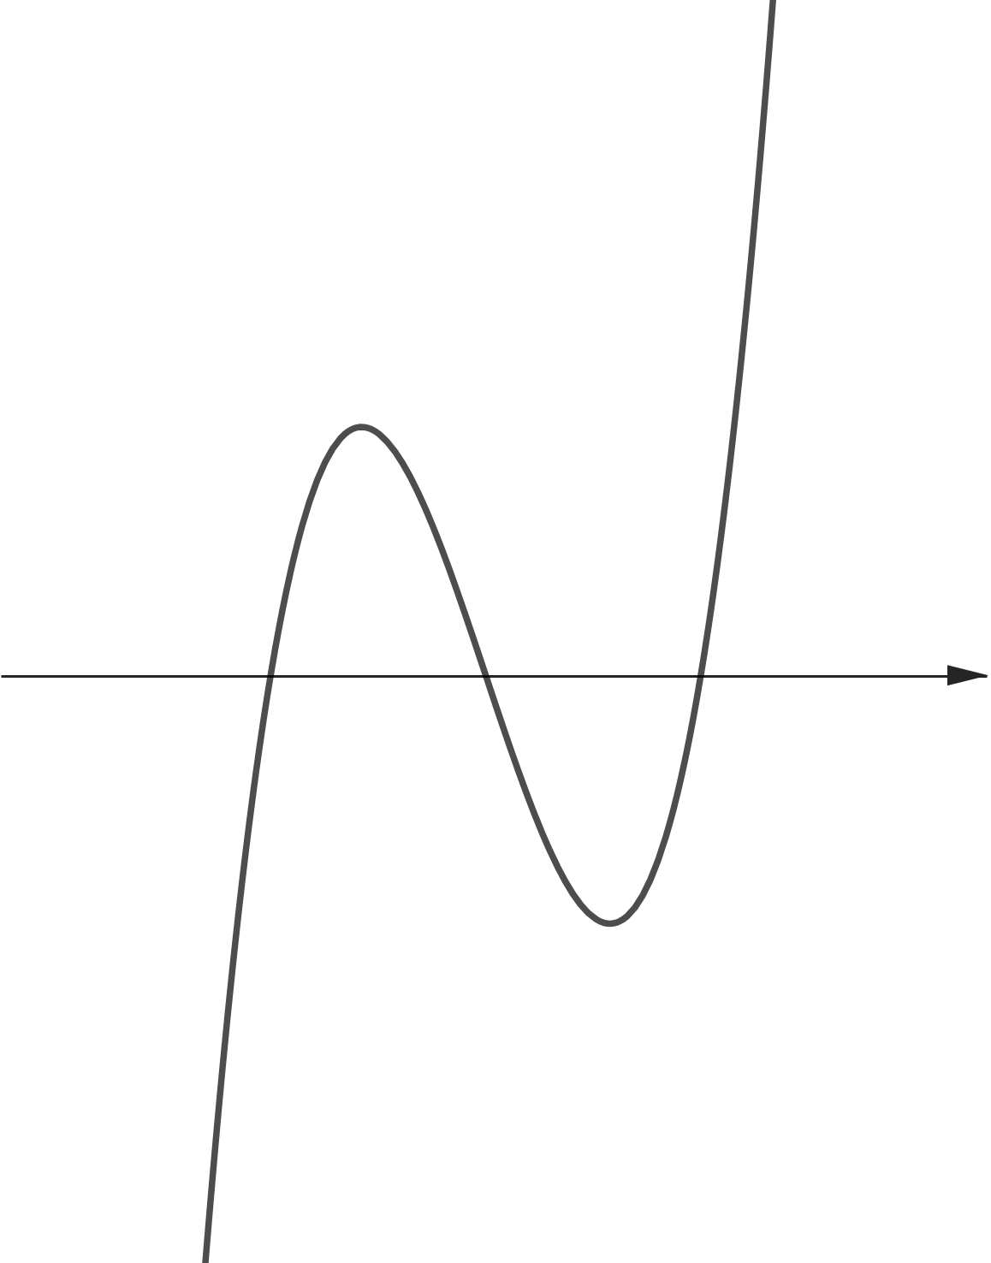
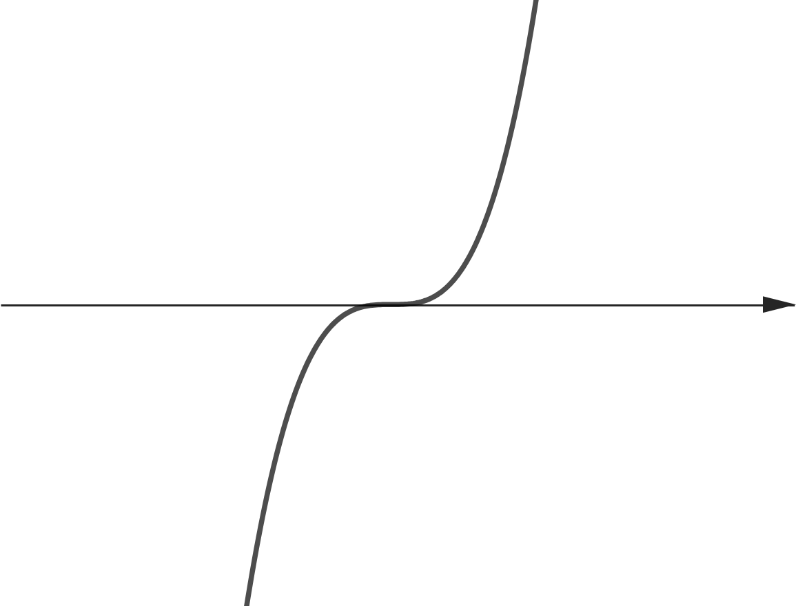
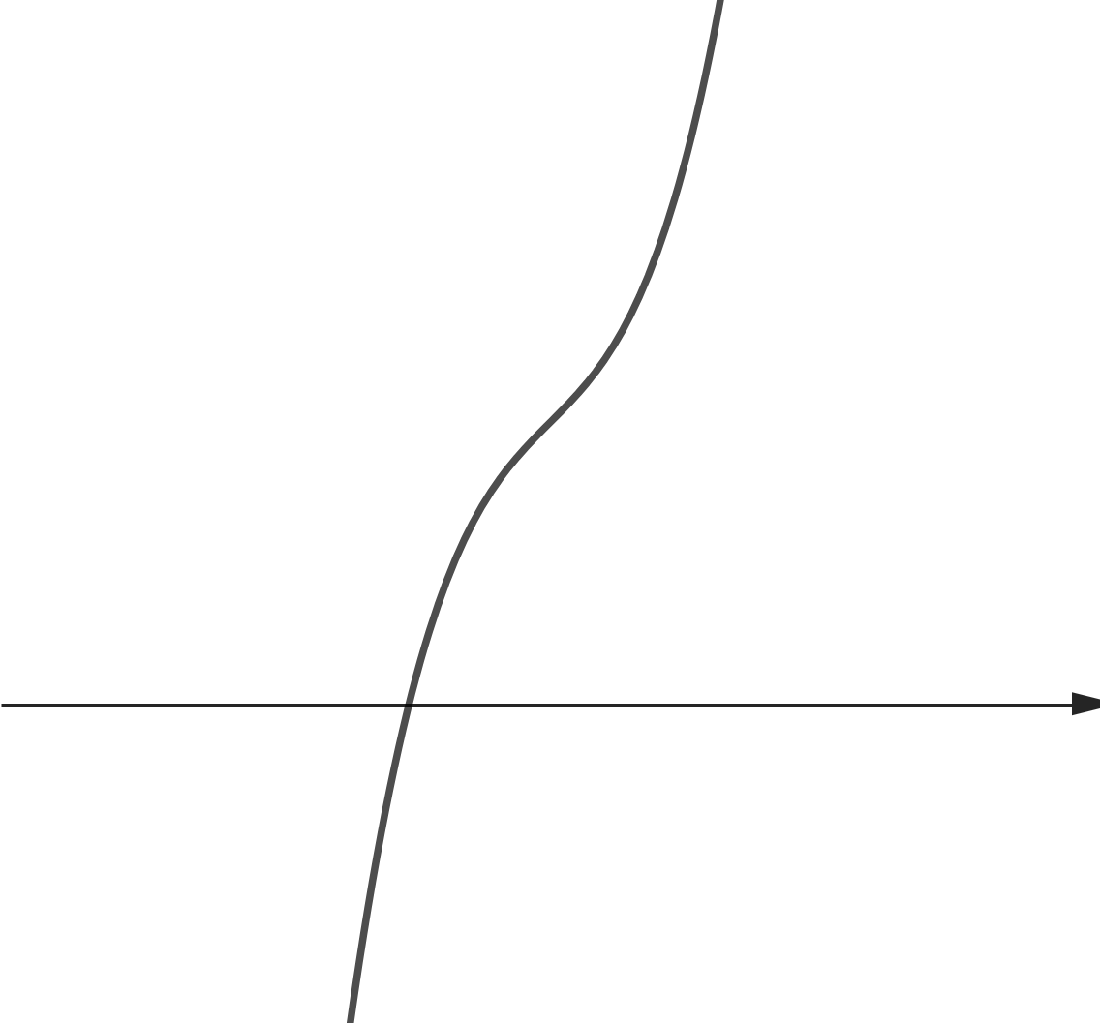
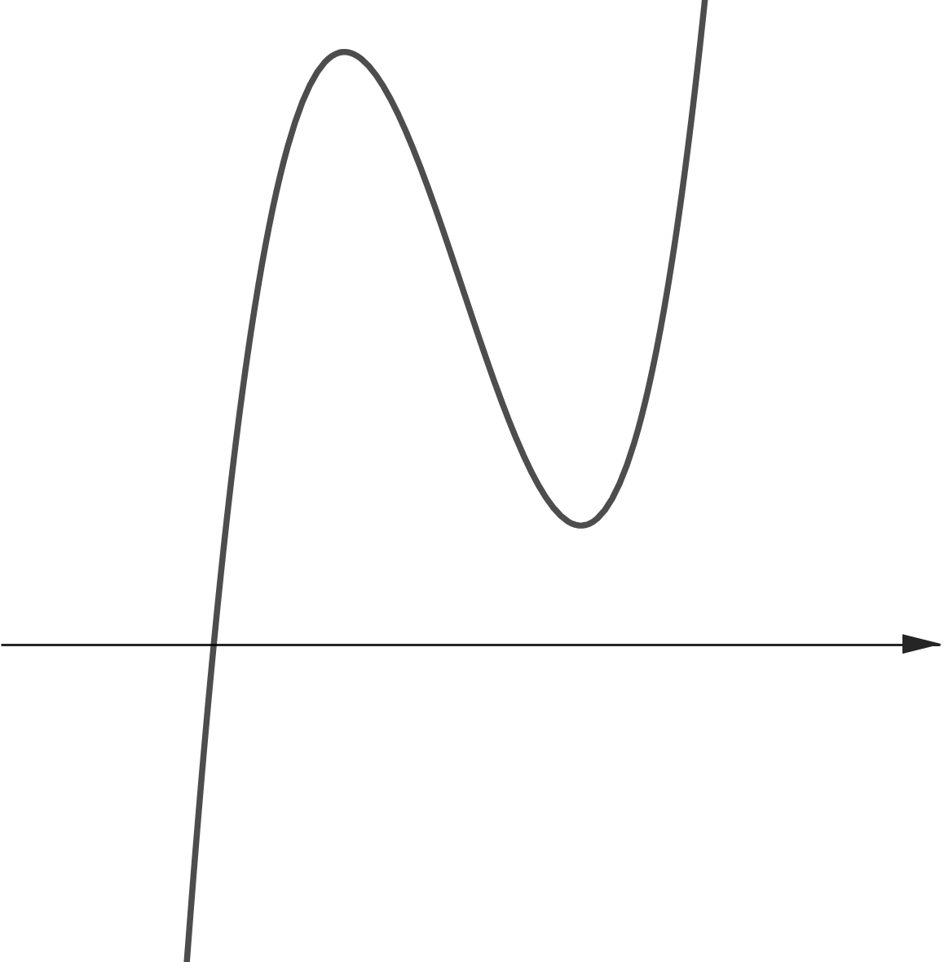
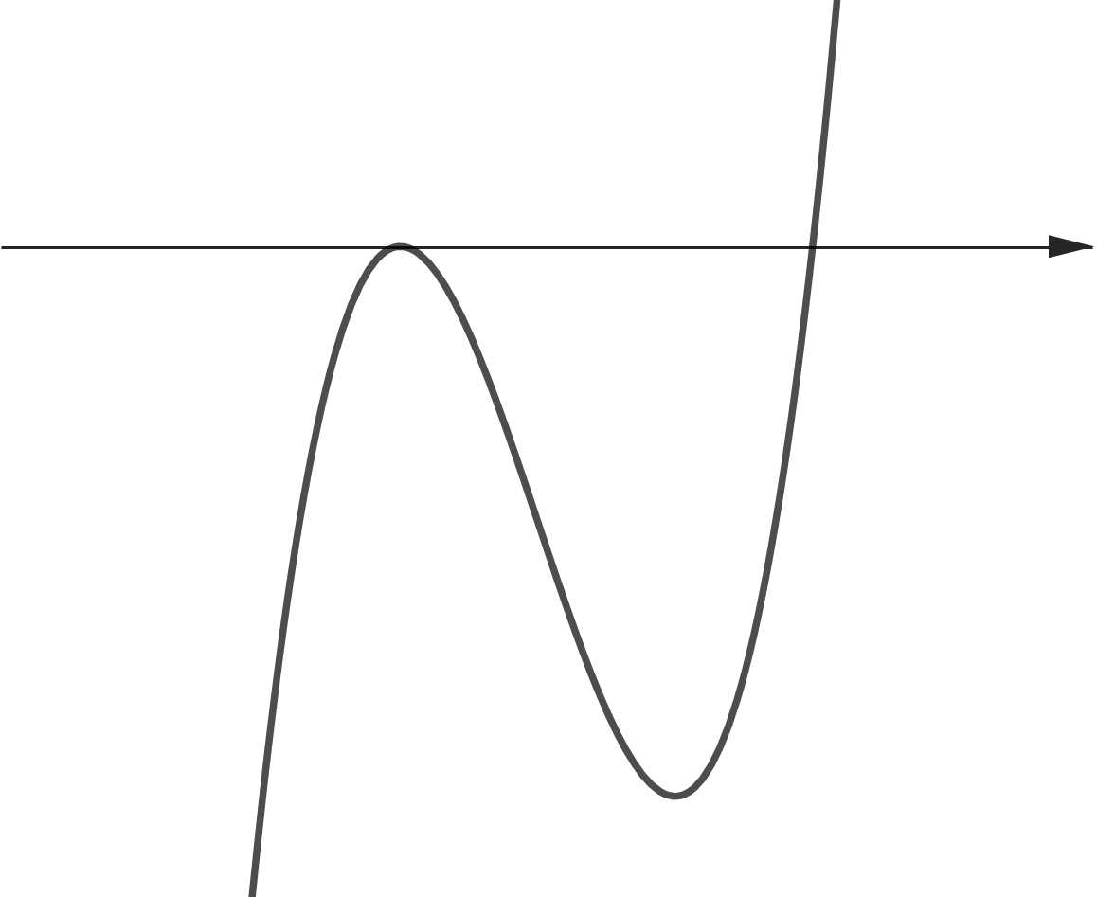
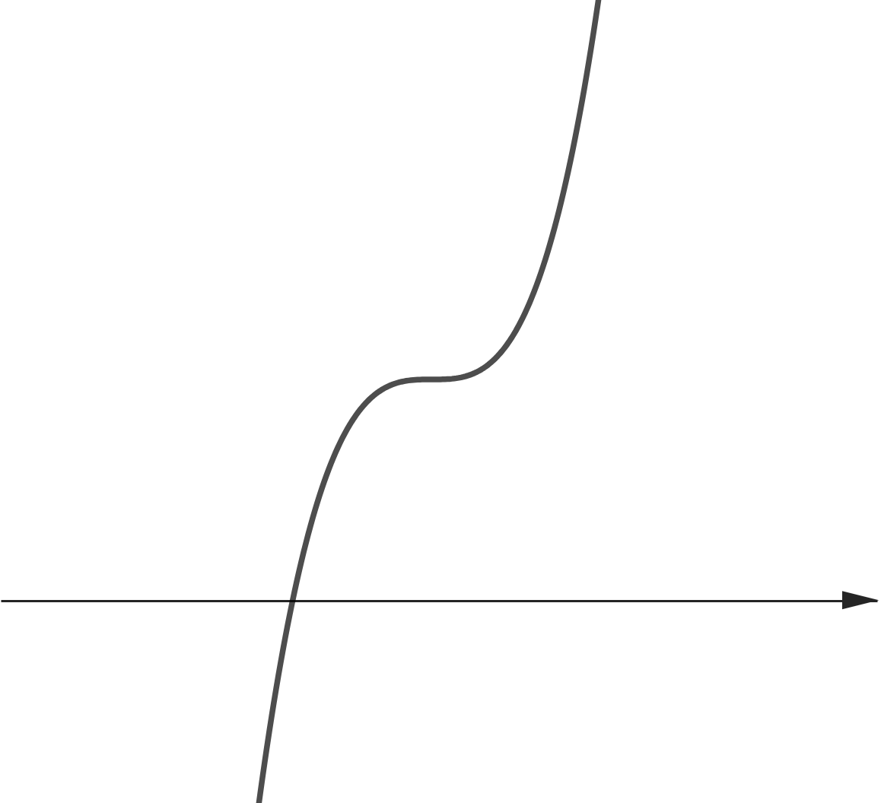











실근 2개
$$y=a(x−α){(x−β)}^{2}$$
실근 3개
$$y=a(x−α)(x−β)(x−γ)$$
실근 1개
$$y=a{(x−α)}^{3}$$
실근 1개
실근 1개
$$x$$
$$x$$
$$x$$
$$x$$
$$x$$
$$x$$
$$x$$
실근 2개
$$y=a{\left(x−α\right)}^{2}(x−β)$$
실근 1개

Slide 9
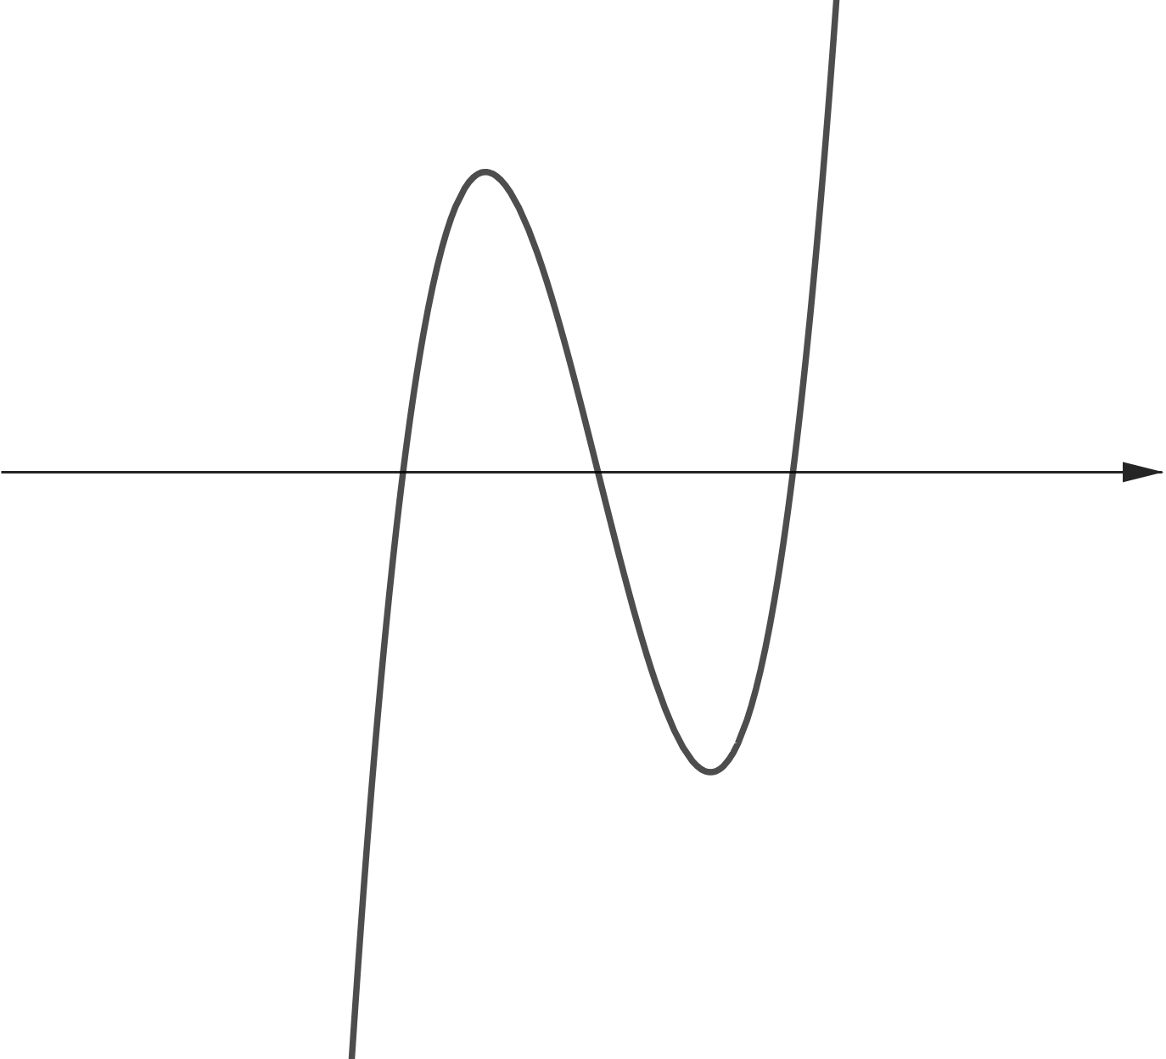
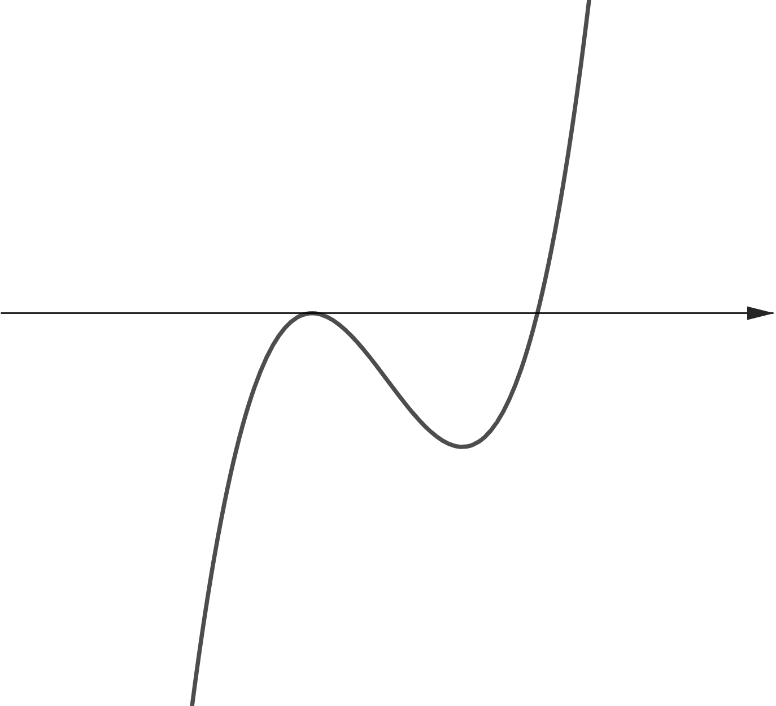
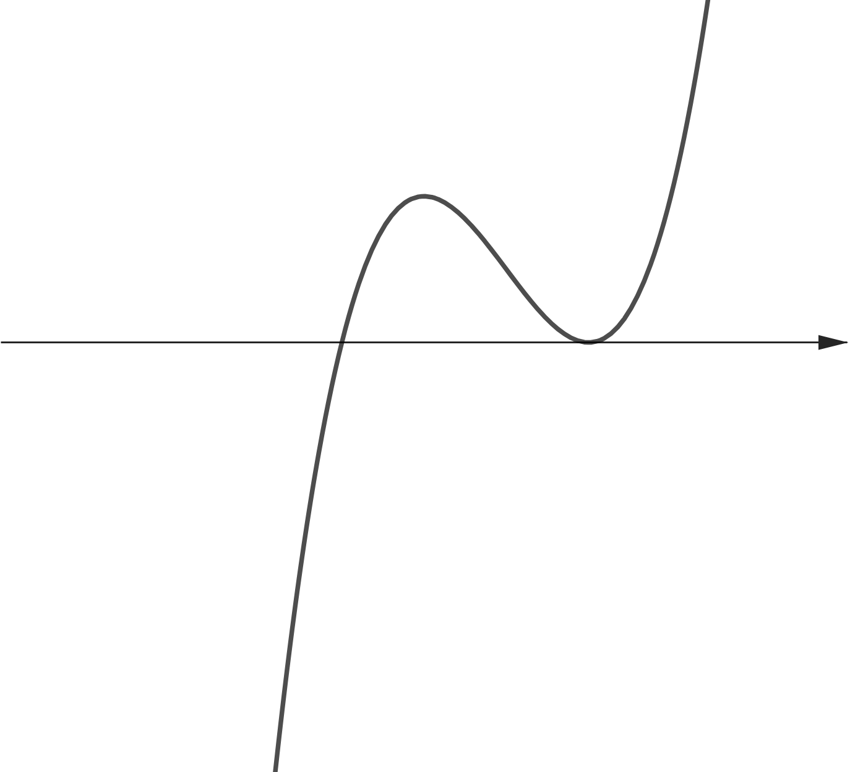
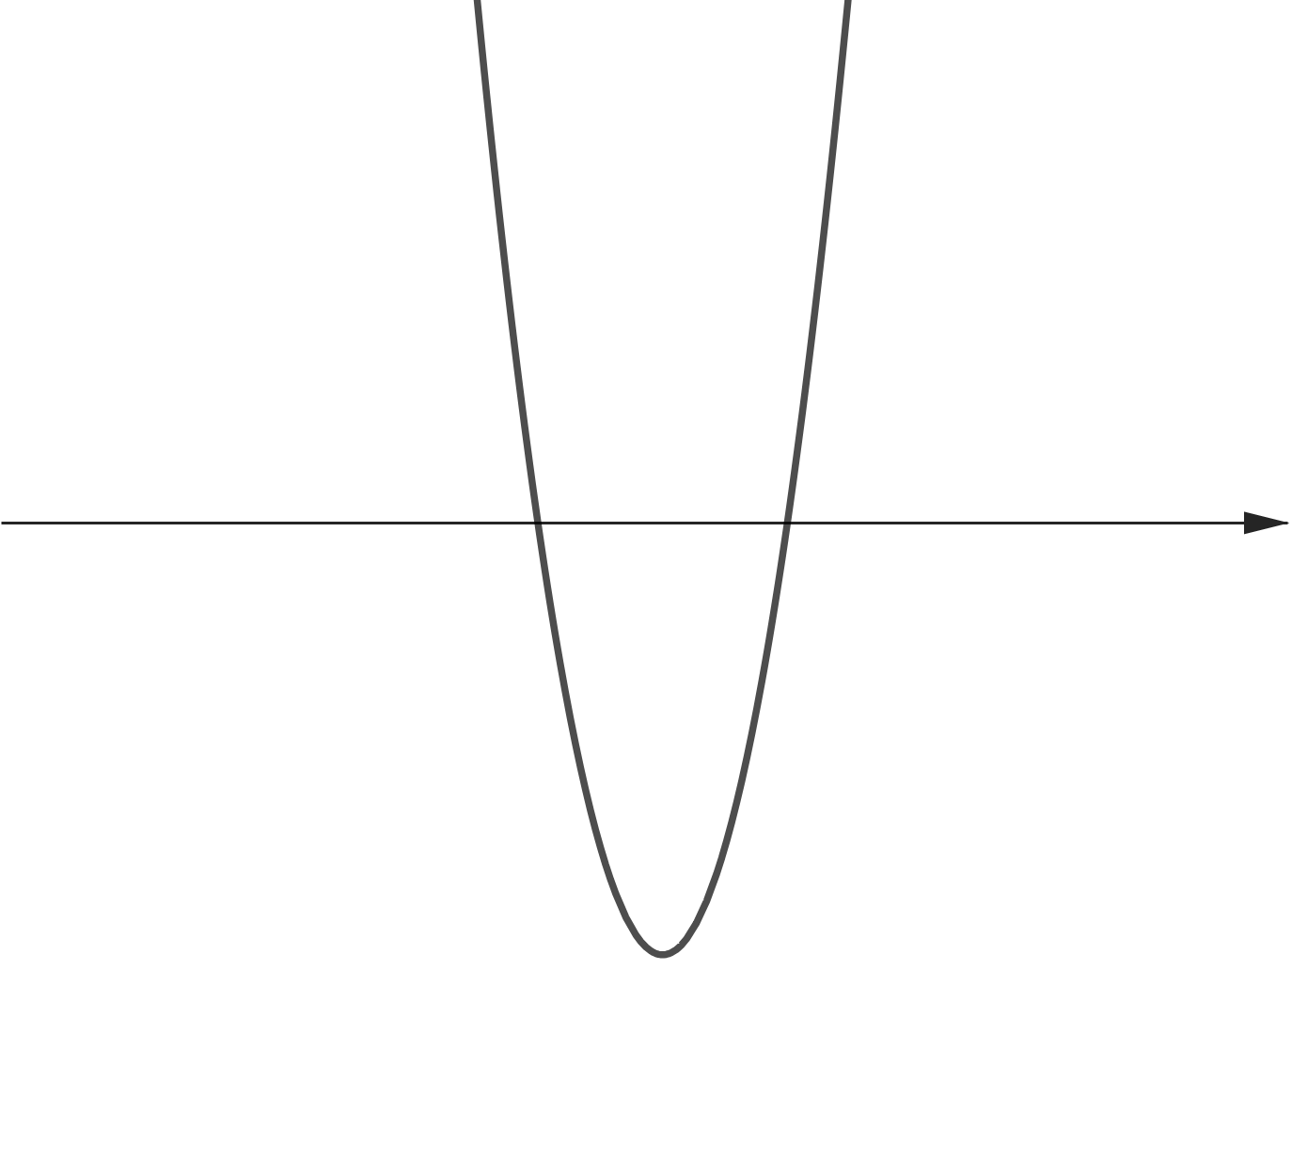
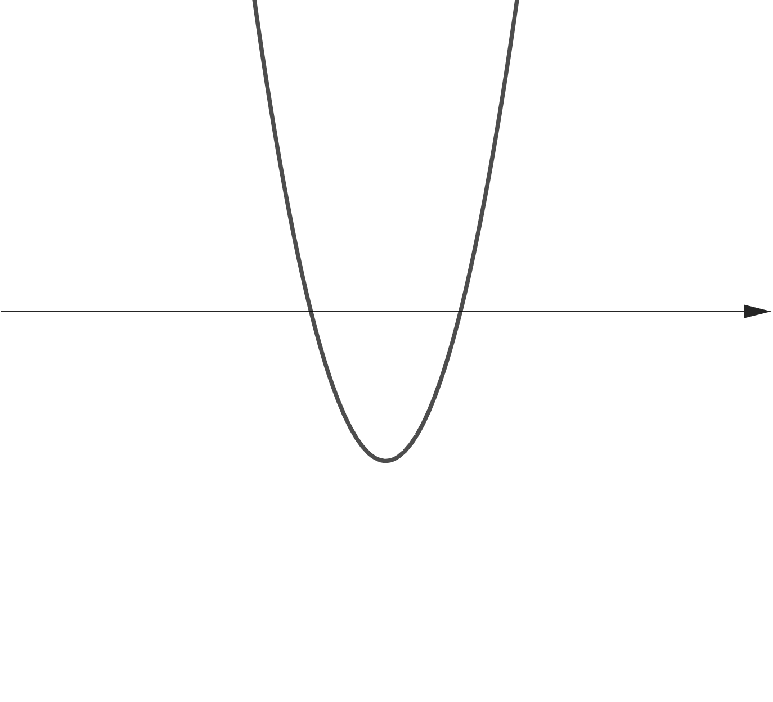
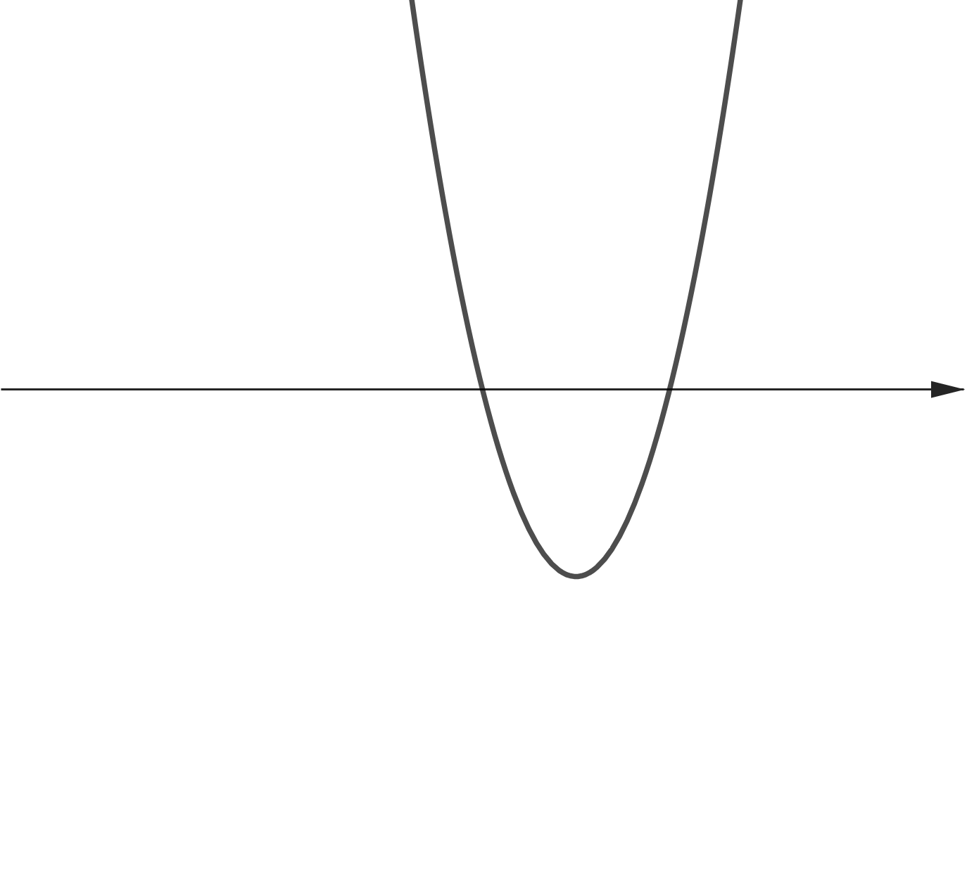



































$$y=f(x)$$
$$y=f(x)$$
$$y=f(x)$$
$$y=f(x)$$
$$y=f(x)$$
$$1$$
$$1$$
$$3$$
$$α$$
$$x$$
$$1$$
$$α$$
$$3$$
$$x$$
$$α$$
$$1$$
$$3$$
$$x$$
$$3$$
$$x$$
$$1$$
$$3$$
$$x$$
$$x$$
$$x$$
$$x$$
$$1$$
$$x$$
$$3$$
$$x$$
$$y=f′(x)$$
$$y=f′(x)$$
$$y=f′(x)$$
$$y=f′(x)$$
$$y=f′(x)$$

Slide 10




$$1$$
$$3$$
$$α$$
$$x$$
$$x$$

Slide 11
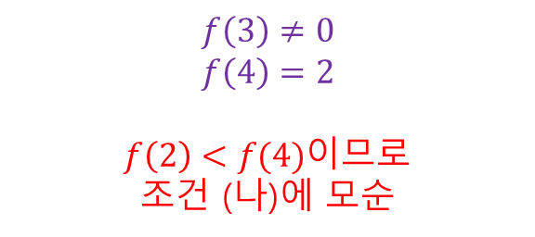
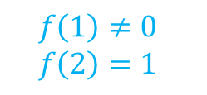


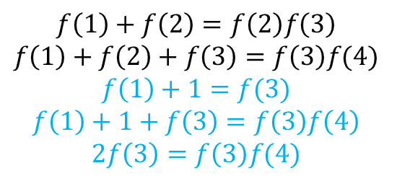
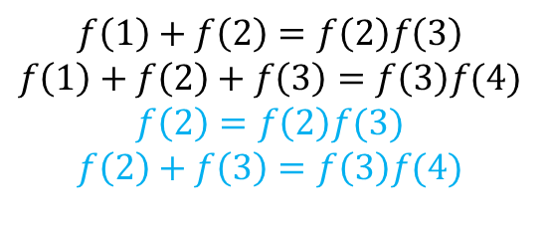
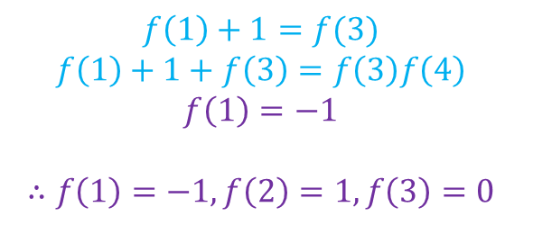
$$f\left(1\right)=f\left(1\right)f(2)$$
$$f\left(1\right)=0$$
$$f\left(1\right)≠0$$
$$f\left(2\right)=1$$
$$f\left(1\right)+f\left(2\right)=f\left(2\right)f\left(3\right)$$
$$f\left(1\right)+f\left(2\right)+f\left(3\right)=f\left(3\right)f(4)$$
$$f\left(2\right)=f\left(2\right)f(3)$$
$$f\left(2\right)+f\left(3\right)=f\left(3\right)f(4)$$
$$f\left(1\right)+f\left(2\right)=f\left(2\right)f\left(3\right)$$
$$f\left(1\right)+f\left(2\right)+f\left(3\right)=f\left(3\right)f(4)$$
$$f\left(1\right)+1=f(3)$$
$$f\left(1\right)+1+f\left(3\right)=f\left(3\right)f\left(4\right)$$
$$2f\left(3\right)=f\left(3\right)f(4)$$
$$f\left(3\right)=0$$
$$f\left(3\right)≠0$$
$$f\left(4\right)=2$$
$f\left(2\right)<f(4)$이므로
조건 (나)에 모순
$$f\left(1\right)+1=f(3)$$
$$f\left(1\right)+1+f\left(3\right)=f\left(3\right)f\left(4\right)$$
$$f\left(1\right)=−1$$
$$∴f\left(1\right)=−1, f\left(2\right)=1, f\left(3\right)=0$$

Slide 12
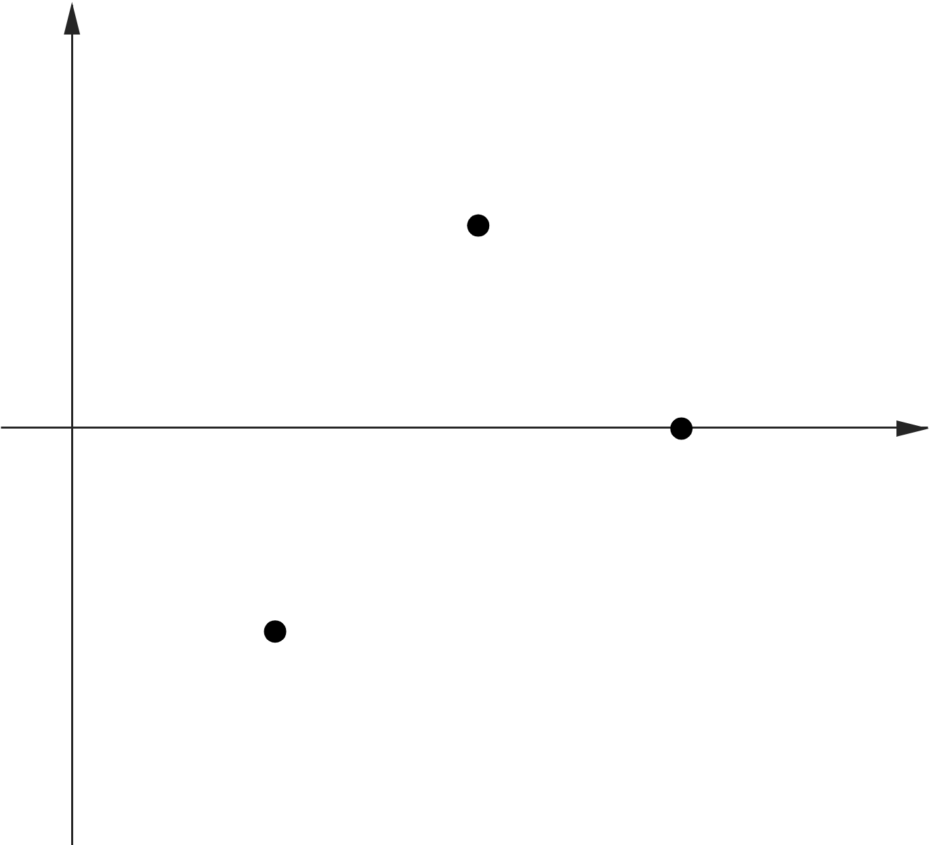

















$$y$$
$$y$$
$$y=f(x)$$
$$1$$
$$1$$
$$1$$
$$3$$
$$1$$
$$3$$
$$O$$
$$2$$
$$x$$
$$O$$
$$2$$
$$x$$
$$−1$$
$$−1$$

Slide 13
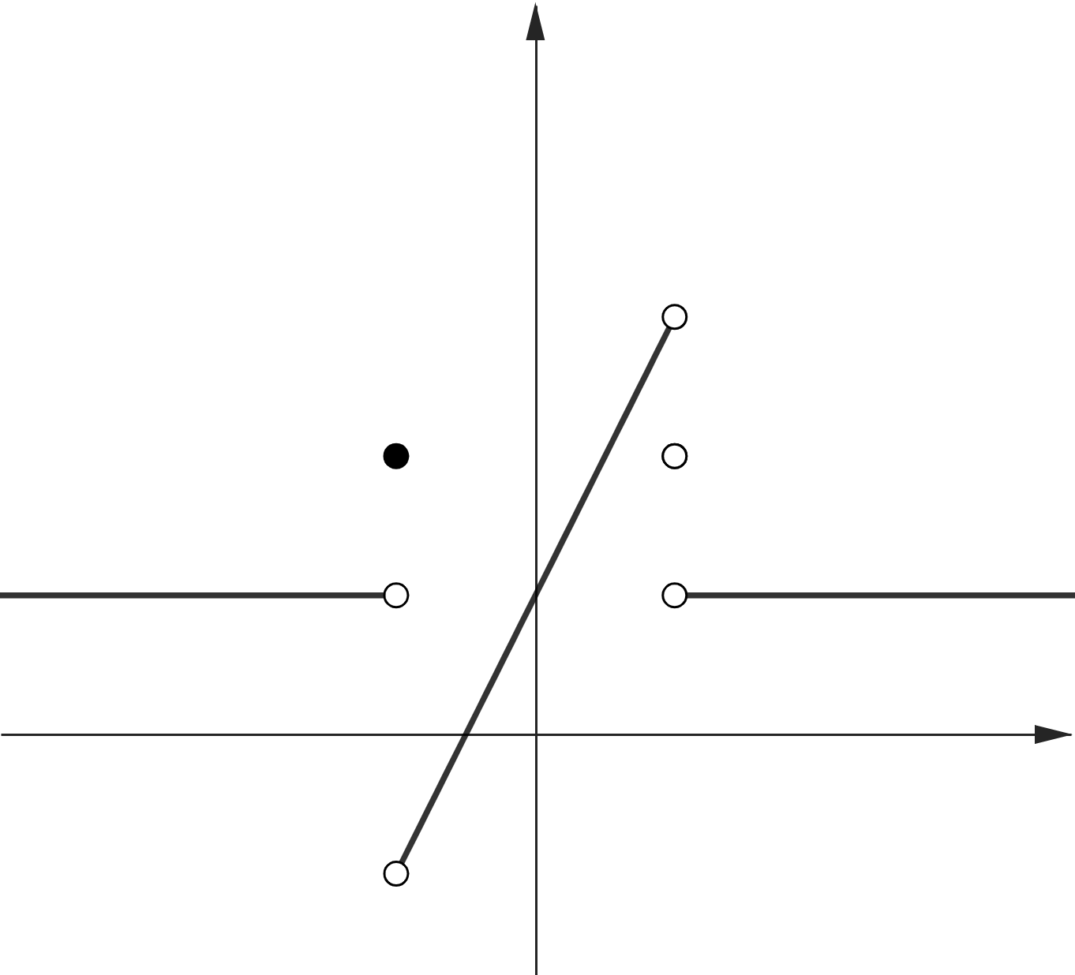







$$y$$
$$3$$
$$2$$
$$1$$
$$−1$$
$$O$$
$$1$$
$$x$$

Slide 14
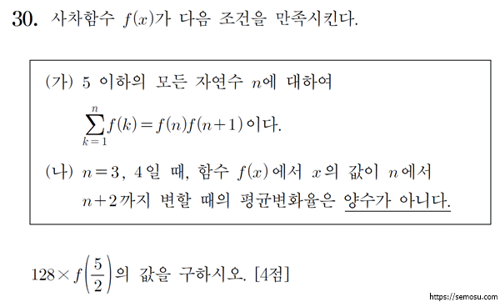

Slide 15
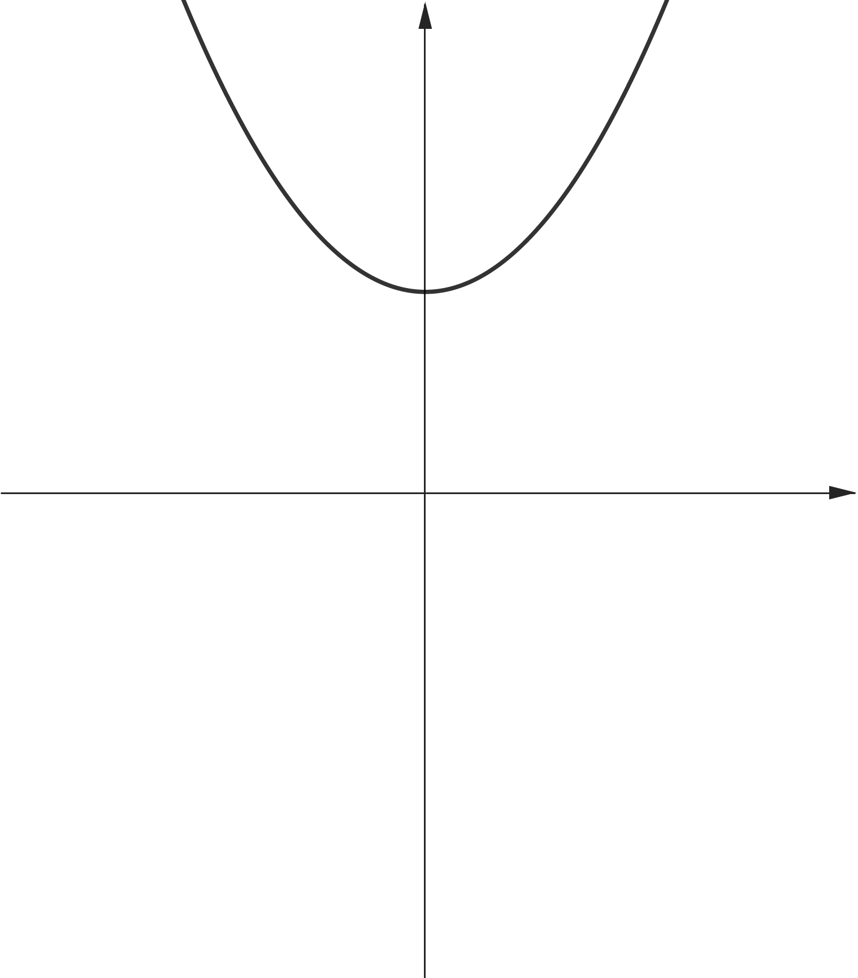
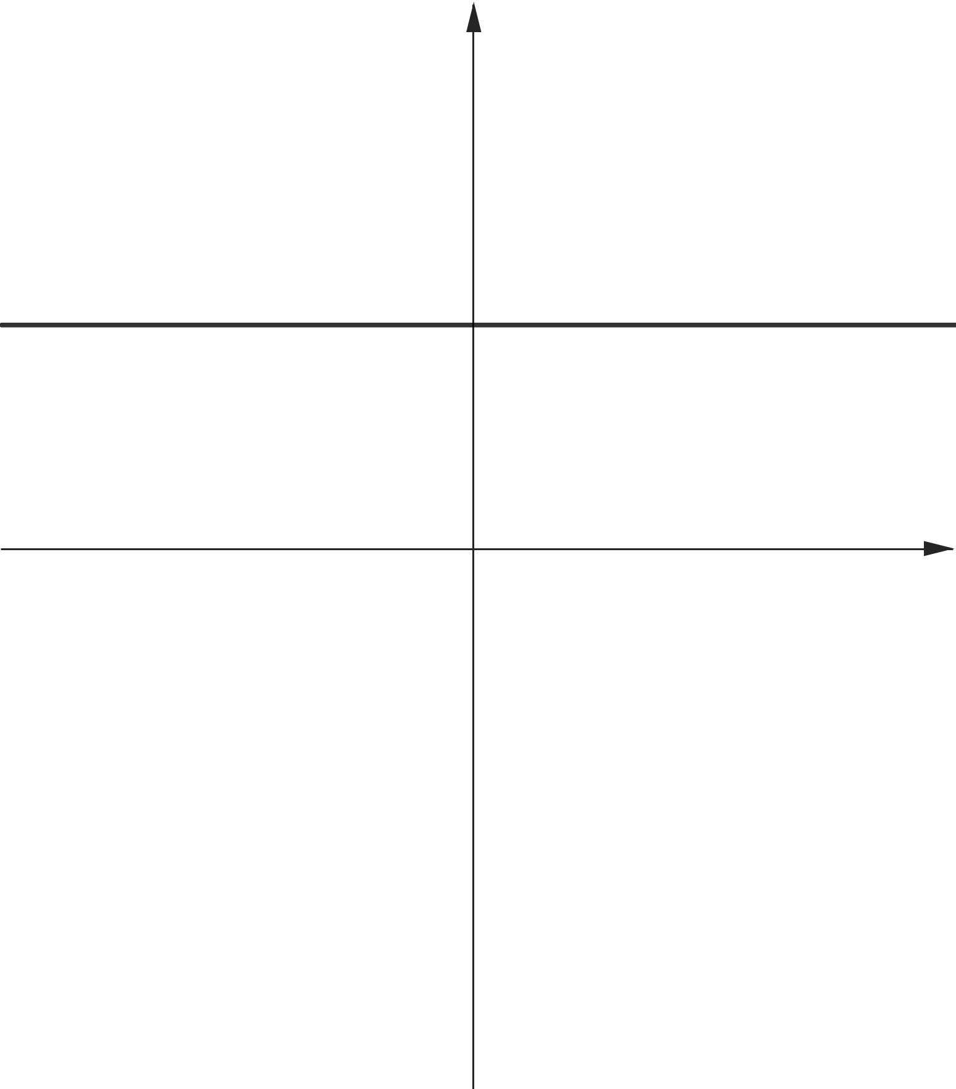
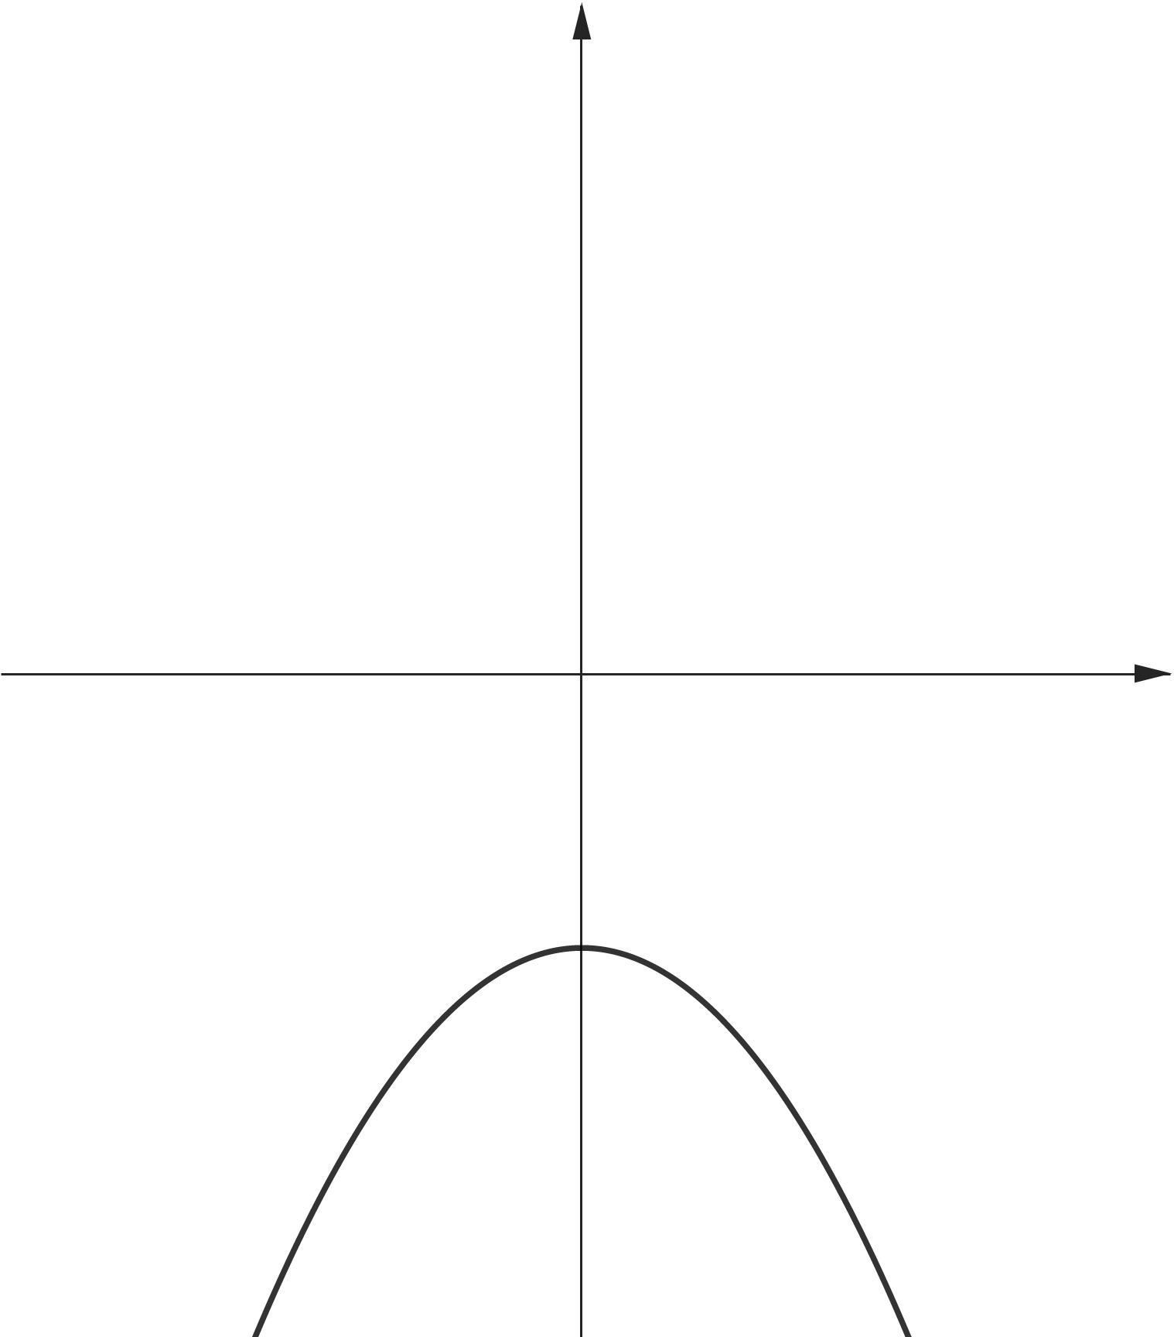
















$$y$$
$$y$$
$$y$$
$$y$$
$$y={ax}^{2}+c$$
$$a=0$$
$$y=x^{2}+c$$
$$y={ax}^{2}+c$$
$$a>0$$
$$O$$
$$x$$
$$O$$
$$x$$
$$O$$
$$x$$
$$O$$
$$x$$
$$y={ax}^{2}+c$$
$$a<0$$

Slide 16
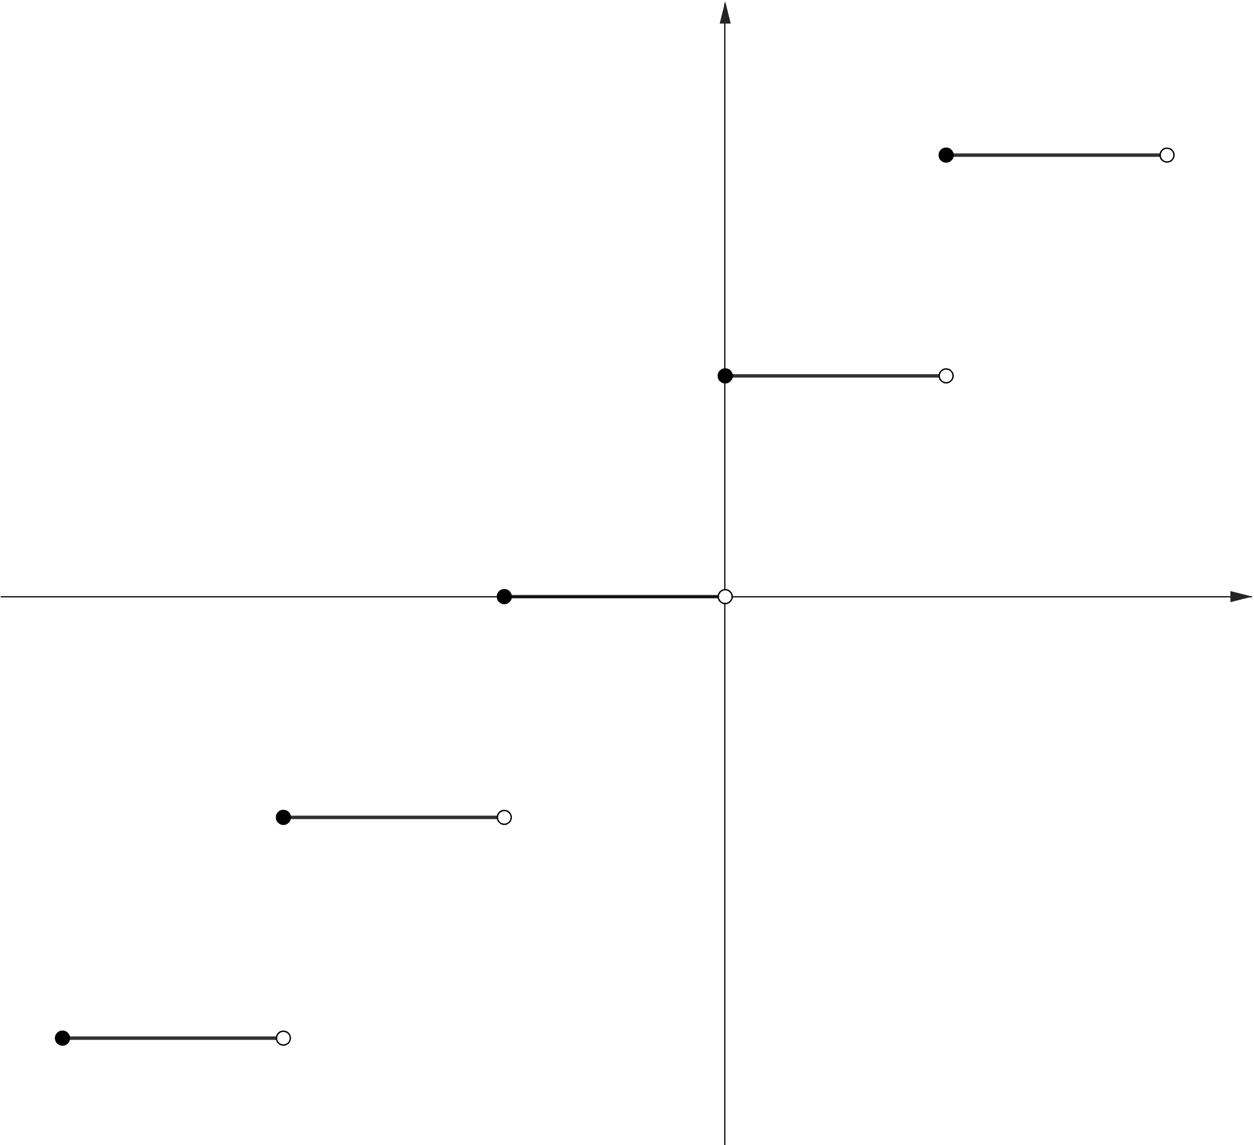













$$y$$
$$y=f(x)$$
$$2$$
$$1$$
$$−3$$
$$−2$$
$$−1$$
$$O$$
$$1$$
$$2$$
$$x$$
$$−1$$
$$−2$$

Slide 17
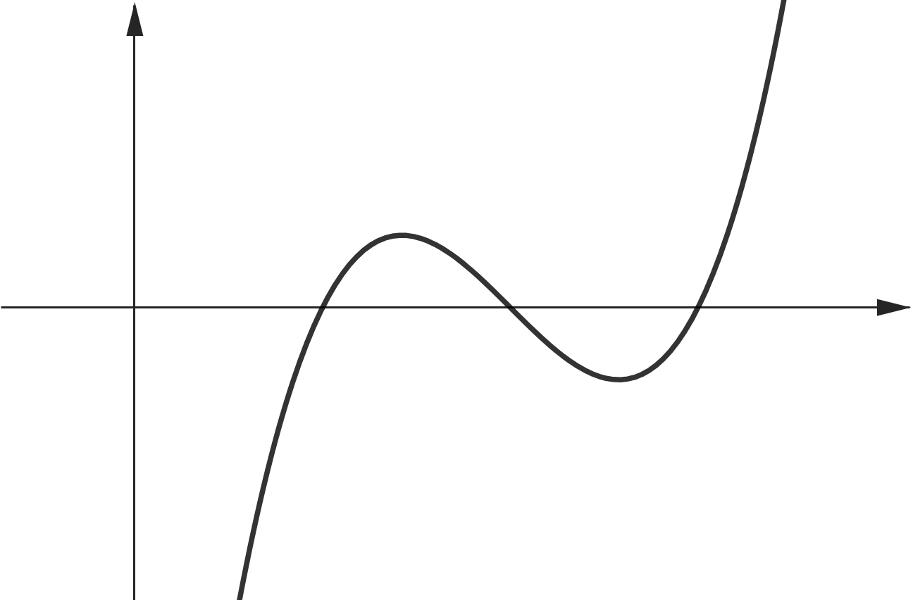



$$y$$
$$O$$
$$x$$

Slide 18
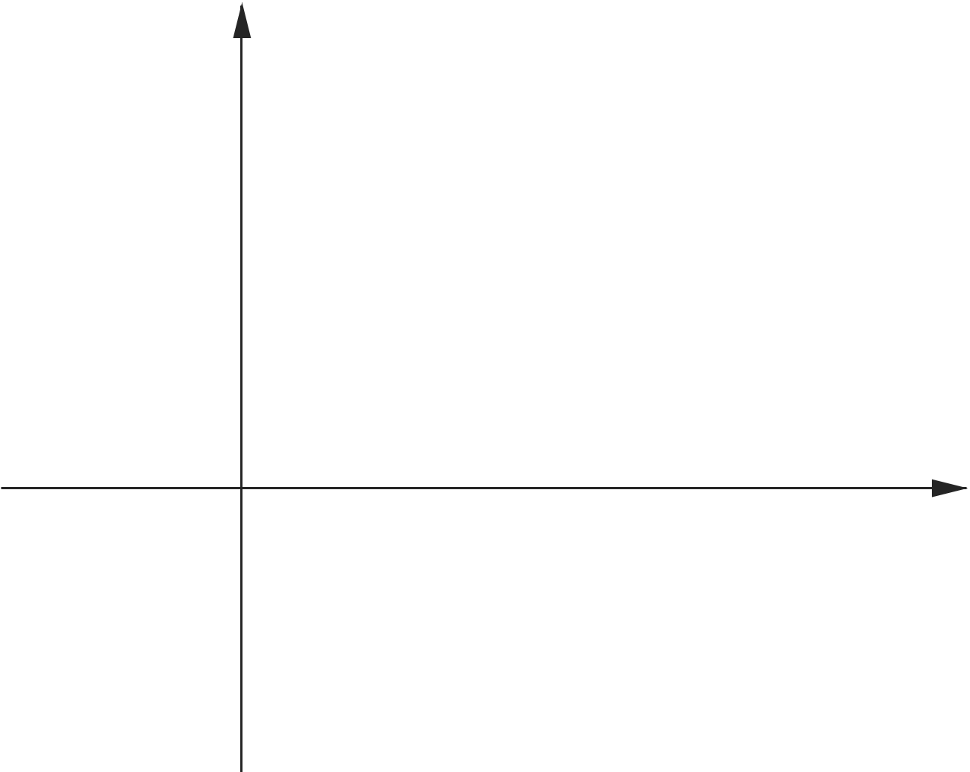






$$y$$
$$y=f(x)$$
$$y=x$$
$$(1, 1)$$
$$O$$
$$x$$

Slide 19
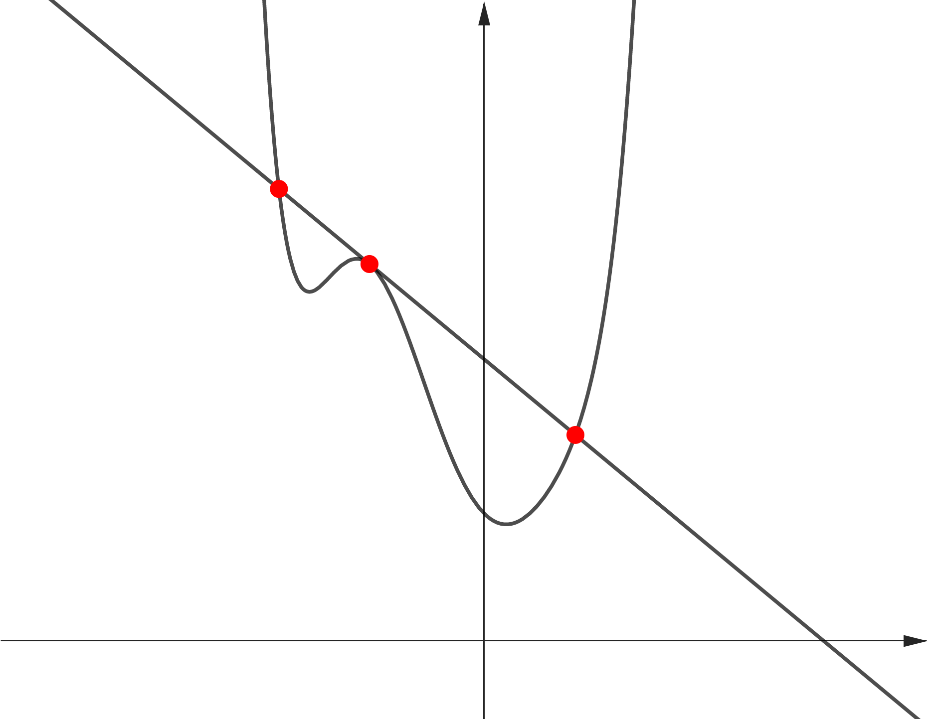





$$y$$
$$y=f(x)$$
$$(−1, f(1))$$
$$O$$
$$x$$

Slide 20
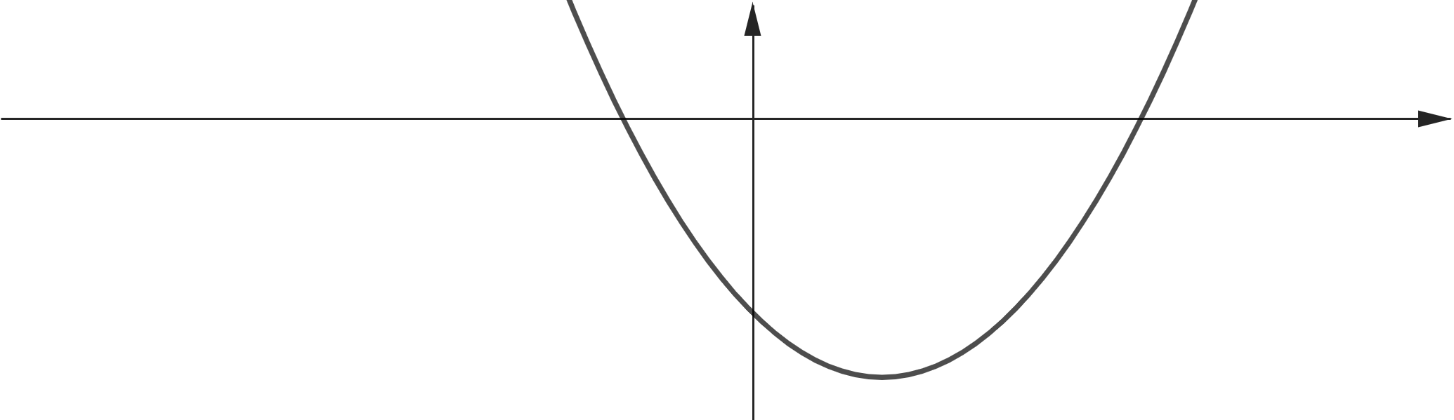
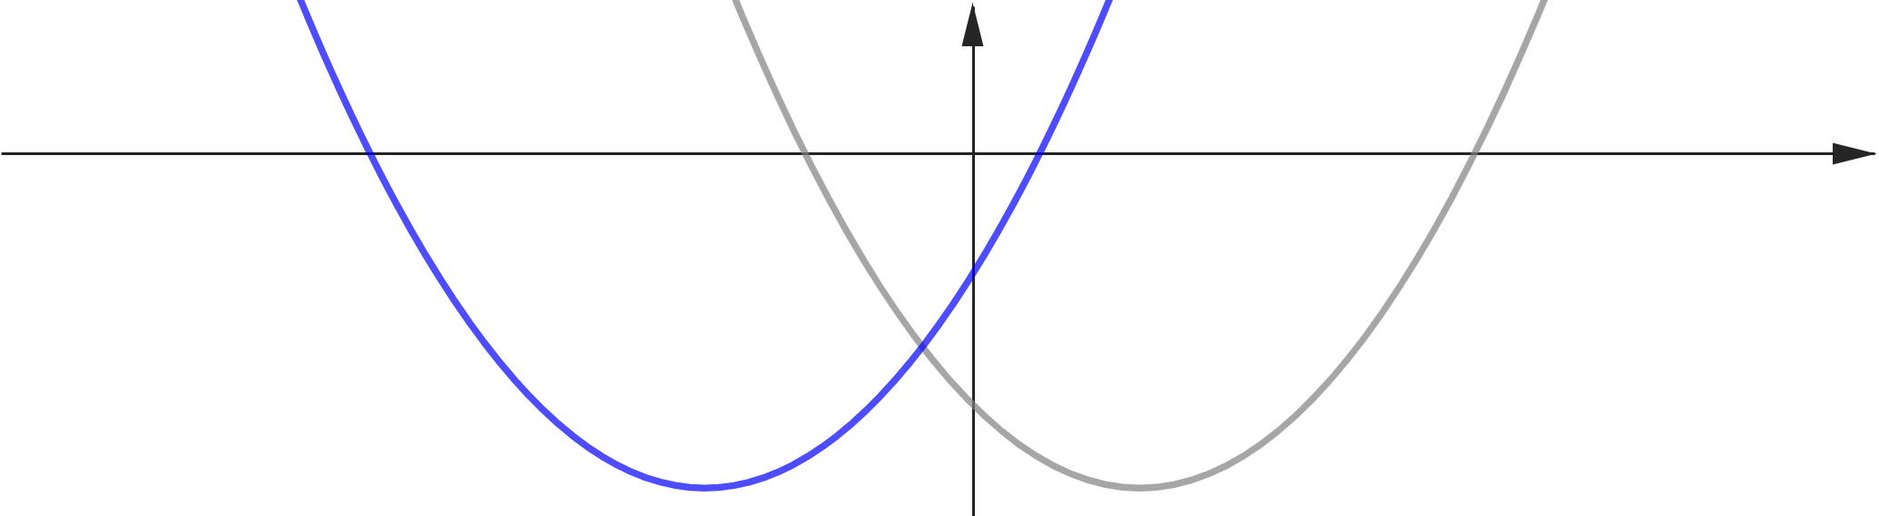
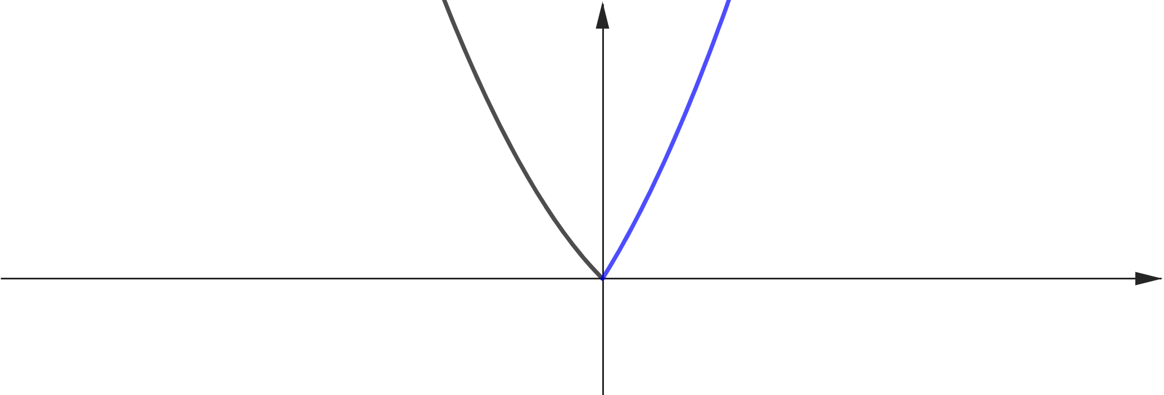










$$y$$
$$x$$
$$O$$
$$y=f(x)$$
$$y=f(x+t)$$
$$x$$
$$O$$
$$y=g(x)$$
$$x$$
$$O$$

Slide 21































$$0$$
$$1$$
$$t$$
$$t+2$$
$$x$$
$$0$$
$$1$$
$$t$$
$$t+2$$
$$x$$
$$0$$
$$1$$
$$t$$
$$t+2$$
$$x$$
$$0$$
$$1$$
$$t$$
$$t+2$$
$$x$$
$$0$$
$$1$$
$$2$$
$$t$$
$$t+2$$
$$x$$
$$0$$
$$1$$
$$2$$
$$t$$
$$t+2$$
$$x$$

Slide 22










$$0$$
$$1$$
$$g\left(t\right)=0$$
$$t$$
$$t+2$$
$$x$$
$$1$$
$$2$$
$$g\left(t\right)=0$$
$$t$$
$$t+2$$
$$x$$

Slide 23

























$$0$$
$$α$$
$$0$$
$$2$$
$$t$$
$$t+2$$
$$x$$
$$t$$
$$t+2$$
$$x$$
$$0$$
$$1$$
$$0$$
$$2$$
$$t$$
$$t+2$$
$$x$$
$$t$$
$$t+2$$
$$x$$
$$0$$
$$1$$
$$0$$
$$2$$
$$t$$
$$t+2$$
$$x$$
$$t$$
$$t+2$$
$$x$$

Slide 24







$$0$$
$$α$$
$$t$$
$$t+2$$
$$x$$
$$0$$
$$1$$
$$t$$
$$t+2$$
$$x$$
$$0$$
$$1$$
$$t$$
$$t+2$$
$$x$$

Slide 25










?
?
$$0$$
$$α$$
?
?
$$t$$
$$t+2$$
$$x$$
?
$$0$$
$$α$$
?
$$t$$
$$t+2$$
$$x$$
$$0$$
$$α$$
$$t$$
$$t+2$$
$$x$$

Slide 26









$$y$$
$$2$$
$$1$$
$$−2$$
$$−1$$
$$O$$
$$1$$
$$x$$

