Slide 1
Buying Points
The Cost and Value of a Points, Rebounds, and Assists in the NBA
By: Troy Foster

Slide 2
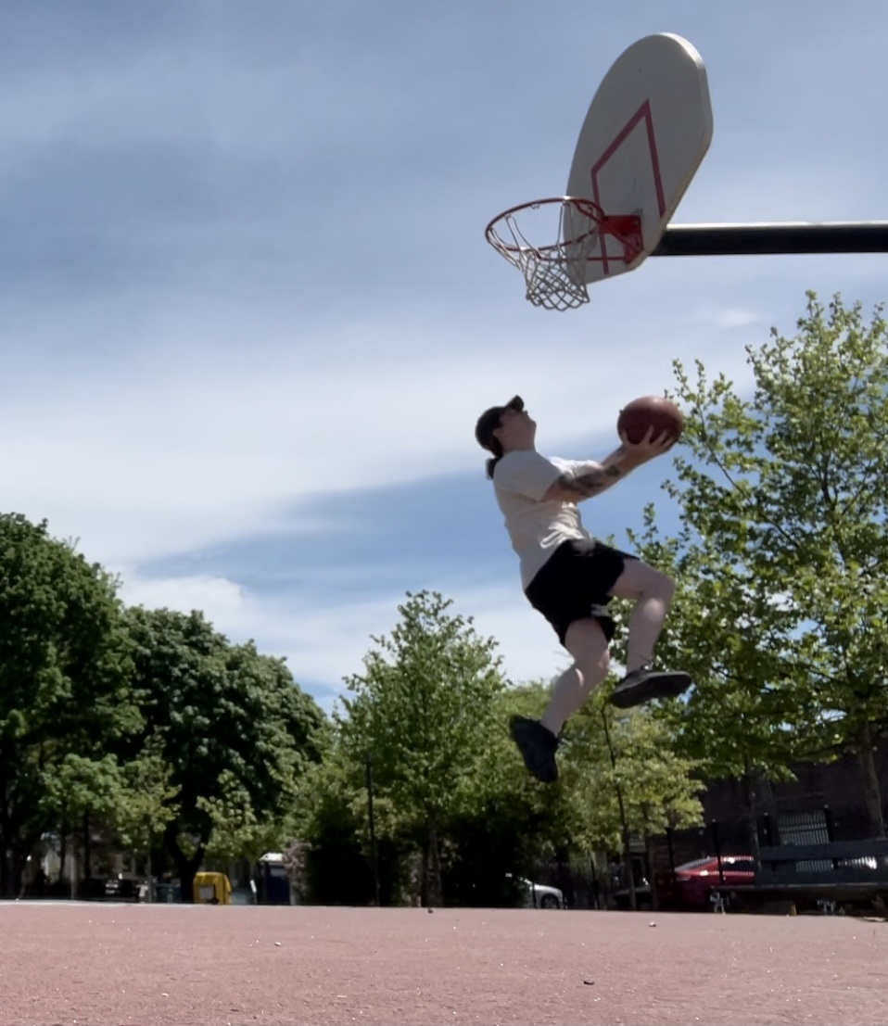
Name: Troy Foster
Worked for W.S.C. Sports Technologies for 8 years as Video Analyst – Video Manager – Training and Development Manager
Wrote for Fansided.com
Maintained and self-produced podcast and blog on NBA
B.A. in Philosophy
Notes:
Leading in tease the scenario

Slide 3
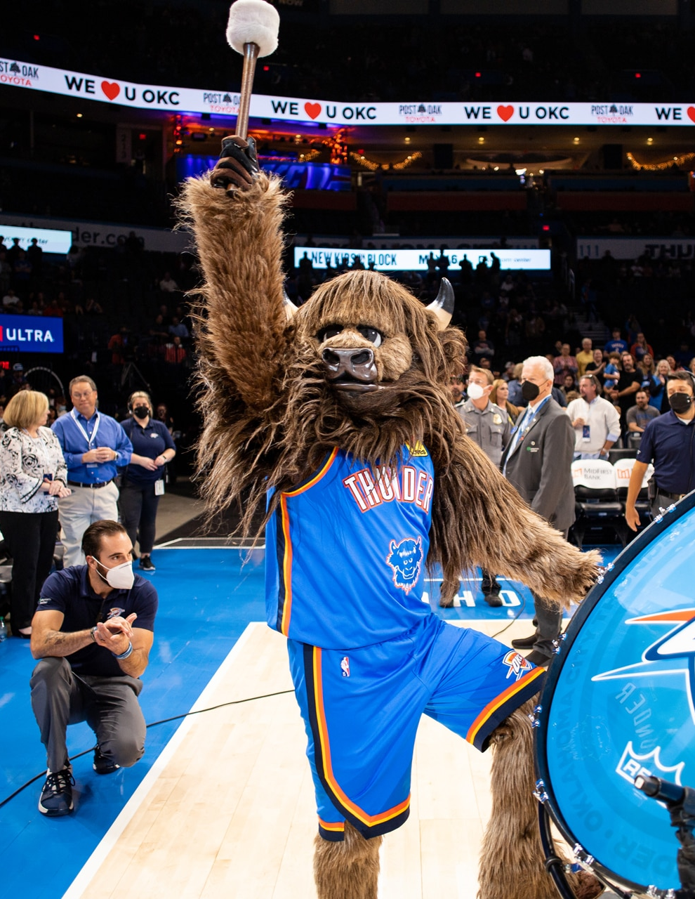
Congratulations You Have Been Hired by OKC!
Record in 2021-2022 season was 24-58
4th worst record in league
Last in points per game
3rd to Last in Assists per game
6th in league in rebounding
$34,000,000 Dead Cap
Notes:
Been Hired by Oklahoma City Thunder to handle their Roster Decisions
24-58 = Bad Team
Dead Cap wait a minute What is a cap? What does that Mean? Basketball is a Business, a 10 billion dollar’s a year business

Slide 4

How is Salary Calculated?
Revenue Converted to BRI
44.7% of BRI is Salary Cap
Contracts are structed as % of Salary Cap
Notes:
10 billion dollars Perspective: 11 billion Spotify 10 Billion Ebay 9 Billion Hershey
Revenue to BRI = Basketball Related Income
44.7% of BRI is for Player Salary divided into Teams for their Salary Cap
Contracts are structed as Percentages of Salary Caps
Helps to understand money in basketball not completely as numbers but as percentages of Revenue
Now that we understand our Salaries lets look into our data
Revenue data companiesmarketcap.com

Slide 5
Understanding Our Data
Stats | Price per
Point | $14,080.15
Assist | $63,187.22
Rebound | $35,039.10
605 Players played in NBA in the 2021-2022 NBA Season
Total Salary $3.8 Billion
Average Salary is $6.3 Million
Notes:
Basketball Reference Totals include basic counting stats for 605 Players
Hoops Hype Table scrapped has salary information
I’m going to use Price Per in subsequent charts but Median as better data than average, extreme outlier from players who were paid but got injured so their Price Per Point might be 4 Million

Slide 6
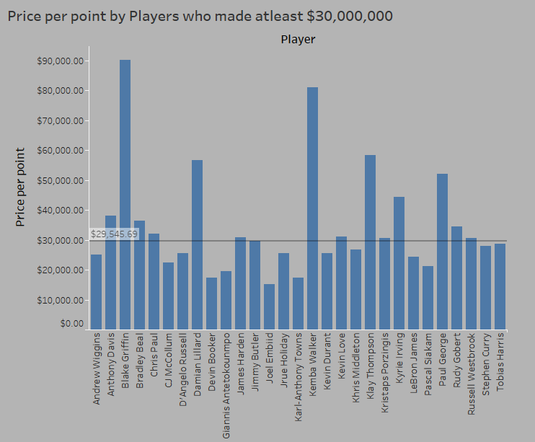
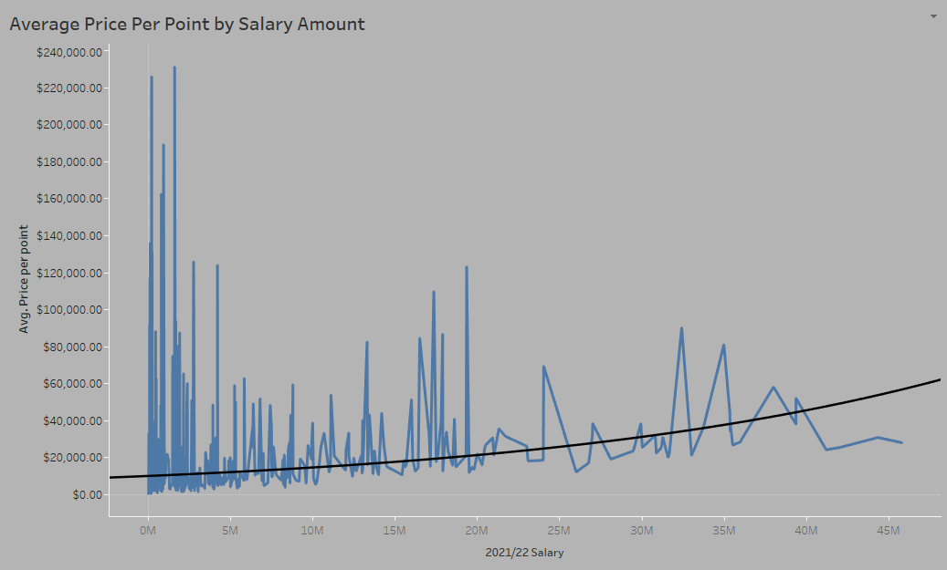
Price Per Point Data
Notes:
Trend line is exponential
It looks unwieldy I could of excluded some to get a better picture of exponential trend line but I want to outline that with low salary comes high variance in results.
Second Chart is only of it’s kind I made but 6 million is average but 30 million is what is considered a Max contracts and the have the worst value in terms of Price per Point

Slide 7
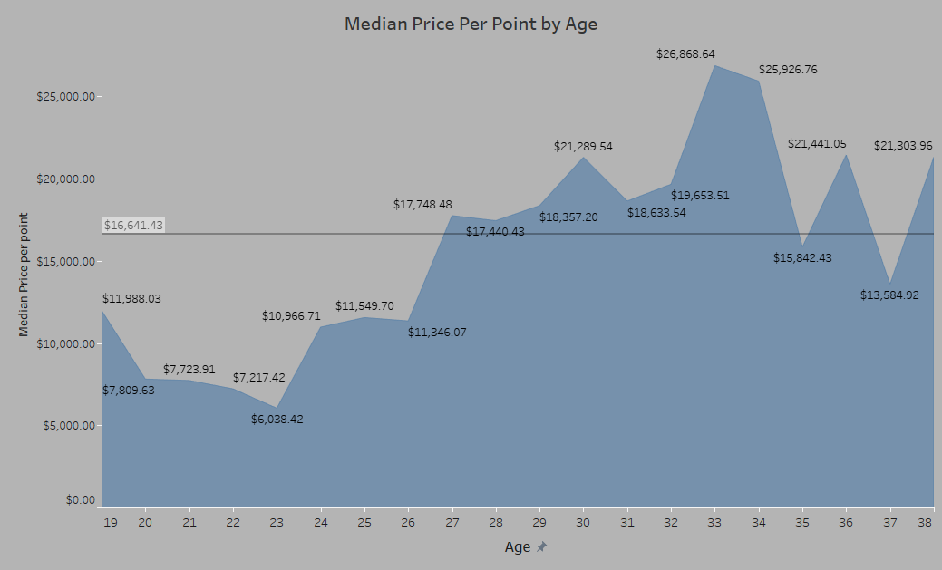
Price per Point by Age and Best Value
A two-way contract price is set at $502,000
When filtering to players with a salary lower than $502,000 the Median Price Per Point is at it’s lowest of $14,165
Notes:
The smallest contracts in the league and 2 way contracts with minor leagues and 10 day contract, filtered to salaries less than 502,000

Slide 8
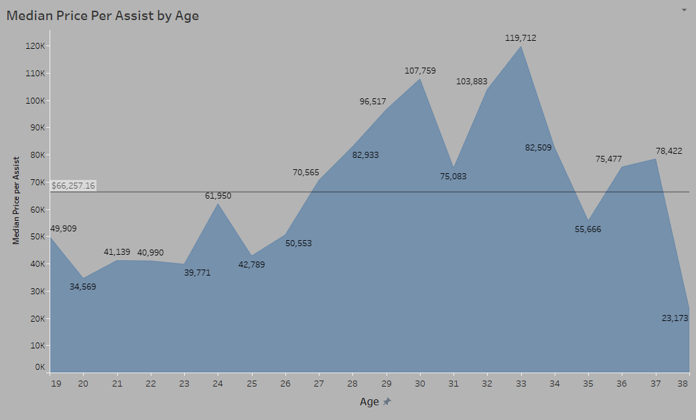
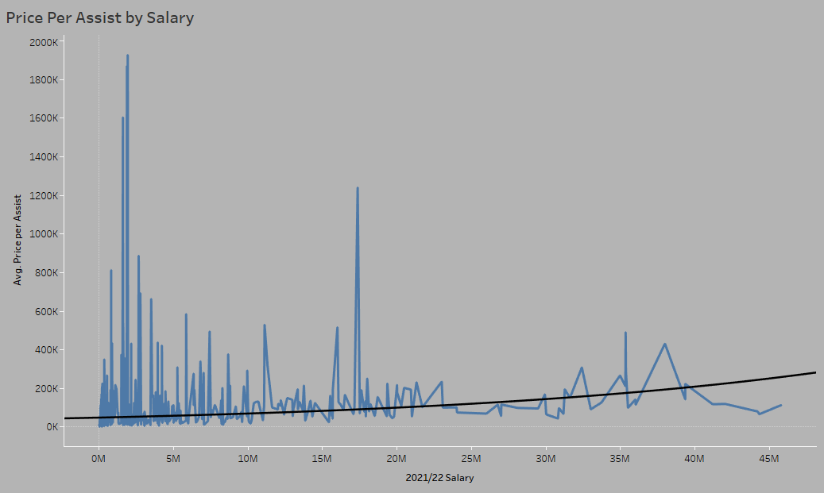
Buying Assists
Notes:
Largely the trends repeat over the 3 stats however with assists the trend line does not have as steep of a slope

Slide 9
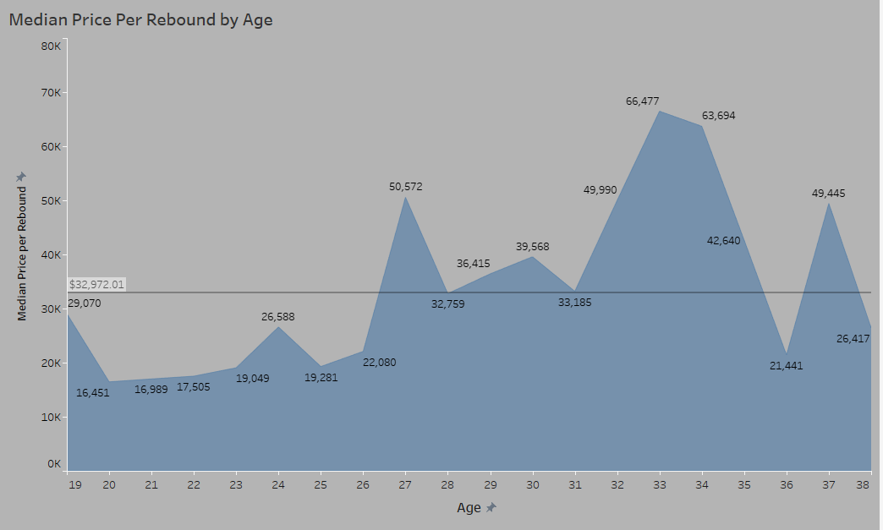
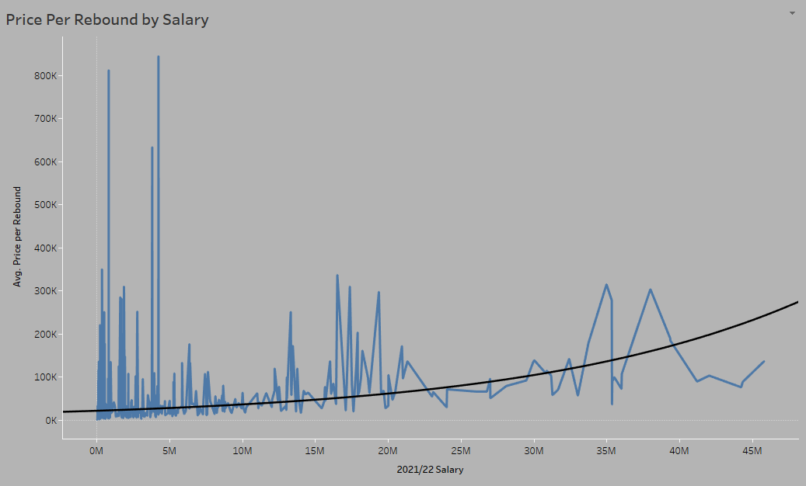
Buying Rebounds
Notes:
More of the same with rebounds except our slope in salary is the steepest of the 3 stats

Slide 10
Pareto Principle?
Does the NBA Follow our 80/20 Rule?
No there is more parody among our counting stats of Points, Rebound, and Assist
Stats | The Top 20% production
Points | 53%
Assists | 60%
Rebounds | 52%
Notes:
20% of effort is 80% of results

Slide 11
Conclusion
When Shopping for players of highest value look for youth
Though they have higher variance, the smaller contracts have more value in the aggregate.
Large Contracts have the lowest Value in counting stats.
Parody is higher than one might assume. Does not follow 80/20 rule

Slide 12
Thank You!
Email: tfost71@gmail.com
Tools Used: Python, Tableau, Excel
Sources: Basketball Reference, Hoops Hype, 2016 NBA CBA

