Slide 1
NTFS Structure
Excellent reference:
http://www.cs.fsu.edu/~baker/devices/lxr/http/source/linux/fs/ntfs/attrib.h
http://data.linux-ntfs.org/ntfsdoc.pdf

Slide 2
NTFS Partition
MBR
VBR
$Mft
Directories and Files
Measured in
Sectors
Measured in Clusters

Slide 3
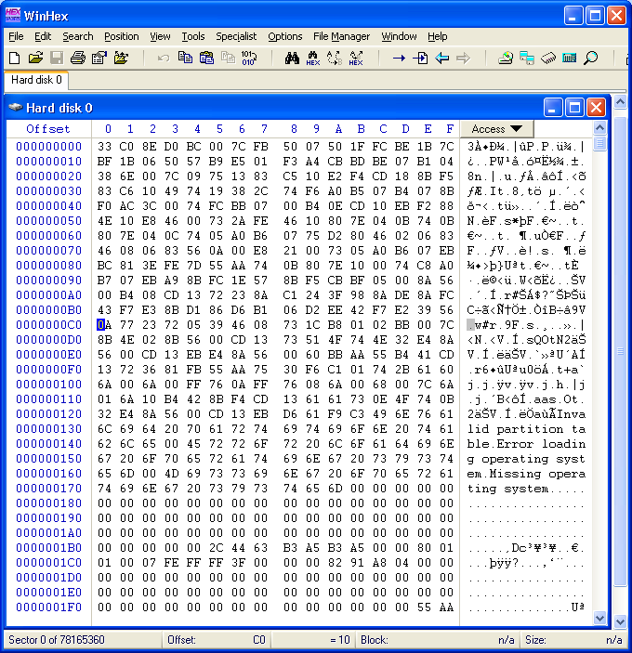
MBR
Offset to 1st partition
In sectors = 0x7E00 bytes

Slide 4
NTFS
Everything is a file
    Directories, files
    Bootstrap data
    File allocation bitmaps
    Metadata
Master File Table is the heart of NTFS
Start of the MFT is in the VBR
VBR is $Boot entry in the MFT

Slide 5
VBR for NTFS
Byte Offset | Field Length | Sample Value | Field Name
0x00 | 3 |  | Jump to boot code
0s03 | 8 | NTFS | OEM Name
0x0B | 2 | 0x0200 | Bytes Per Sector
0x0D | 1 | 0x08 | Sectors Per Cluster
0x0E | 2 | 0x0000 | Reserved Sectors
0x10 | 3 | 0x000000 | always 0
0x13 | 2 | 0x0000 | not used by NTFS
0x15 | 1 | 0xF8 | Media Descriptor
0x16 | 2 | 0x0000 | always 0
0x18 | 2 | 0x3F00 | Sectors Per Track
0x1A | 2 | 0xFF00 | Number Of Heads
0x1C | 4 | 0x3F000000 | Hidden Sectors
0x20 | 4 | 0x00000000 | not used by NTFS
0x24 | 4 | 0x80008000 | not used by NTFS
0x28 | 8 | 0x4AF57F0000000000 | Total Sectors
0x30 | 8 | 0x0000000000040000 | Logical Cluster Number for the file $MFT
0x38 | 8 | 0x54FF070000000000 | Logical Cluster Number for the file $MFTMirr
0x40 | 4 | 0xF6000000 | Clusters Per File Record Segment
0x44 | 4 | 0x01000000 | Clusters Per Index Block
0x48 | 8 | 0x14A51B74C91B741C | Volume Serial Number
0x50 | 4 | 0x00000000 | Checksum
0x54 | 426 |  | Bootstrap program code
0xFE | 2 | 0x55AA | Signature bytes

Slide 6
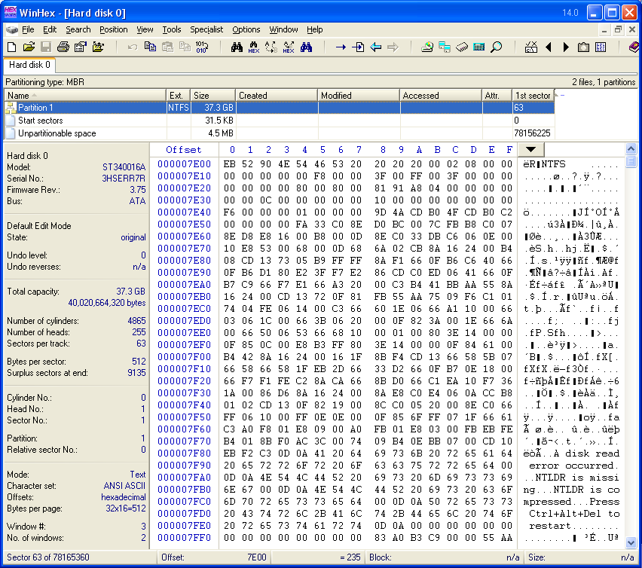
VBR
Location of
$MFT
Little Endian
0x0C0000 * 8 + 0x3F =
Sector count of $MFT

Slide 7
MFT
The MFT is an array of file records
Each record is 1024 bytes
The first record in the MFT is for the MFT itself
The name of the MFT is $MFT
The first 16 records in the MFT are reserved for metadata files

Slide 8
MFT
Sector 0
MBR
VBR
$MFT – Clusters 32 - 34, 48 - ...
Cluster 32
Cluster 33
Cluster 34
Cluster 48

Slide 9
MFT Entry
Consists of
    Entry header
    Attributes
      Attribute header
      Attribute data
    Attributes are free form
      Fixed list of attributes

Slide 10
MFT Entry Layout
MFT Entry
Header
Attributes
Unused
Space
1024 Bytes

Slide 11
MFT Entry Fields
1 - Entry signature
2, 3 – Fixup arrays (later)
4 – The logical sequence number(LSN) for this record/entry is incremented each time this entry is modified. It is an index into $LogFile used for journaling.
5 – Sequence value is used the keep track of how many times this entry has been used
6 – Link count keeps track of the number of hard links to directories, i.e. The number of directories referencing this record/entry
7 – Offset to first attribute address of first attribute relative to start of entry. Others are found by advancing the size of the first one. The end of attributes is 0xffff ffff, ie end of file

Slide 12
MFT Entry Fields
8 – Flags
9 – Used size of the MFT entry
10 – Allocated size of MFT entry
11 – File reference to base record is used when the attribute list requires more than one MFT entry. 0 indicates that this is the base record.
12 – Next attribute ID - the attributes are numbered sequentially if
another is assigned. Therefore there are ID – 1 attributes assigned
to this MFT entry.

Slide 13
Fixup Values
For Large Structures
Signature: 0x0000
Array: 0x0000, 0x0000, 0x0000
MFT Entry
Header
0x3596
0x7A12
0xBF81
Sector 0
Sector 1
Sector 2
In memory
Signature: 0x0001
Array: 0x3596, 0x7A12, 0xBF81
MFT Entry
Header
0x0001
0x0001
0x0001
Sector 0
Sector 1
Sector 2
On Disk

Slide 14
MFT Entry Header
0x0 0 – 3 Signature (“FILE”) if good otherwise (“BAAD”) No
0x4 4 – 5 Offset to fixup array Yes
0x6 6 – 7 Number of entries in fixup array Yes
0x8 8 – 15 $LogFile LSN No
0x10 16 – 17 Sequence value No
0x12 18 – 19 Link Count No
0x14 20 – 21 Offset to first attribute Yes
0x16 22 – 23 Flags (in-use and directory) Yes
0x18 24 – 27 Used size of MFT entry Yes
0x1A 28 – 31 Allocated size of MFT entry Yes
0x20 32 – 39 File reference to base record No
0x28 40 – 41 Next attribute ID No
0x2A 42 – 1023 Attributes and fixup areas Yes

Slide 15
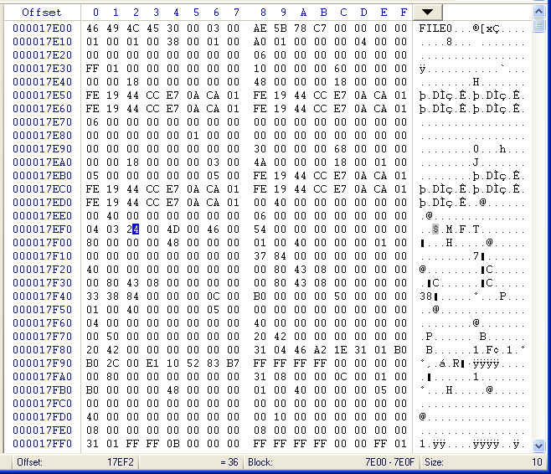
Fixups
Location of fixup array = 0x30
Number of entries in the fixup array = 3
Signature
Fixup array – all zeros

Slide 16
MFT Entry Header
0x0 0 – 3 Signature (“FILE”) if good otherwise (“BAAD”) No
0x4 4 – 5 Offset to fixup array Yes
0x6 6 – 7 Number of entries in fixup array Yes
0x8 8 – 15 $LogFile LSN No
0x10 16 – 17 Sequence value No
0x12 18 – 19 Link Count No
0x14 20 – 21 Offset to first attribute Yes
0x16 22 – 23 Flags (in-use and directory) Yes
0x18 24 – 27 Used size of MFT entry Yes
0x1A 28 – 31 Allocated size of MFT entry Yes
0x20 32 – 39 File reference to base record No
0x28 40 – 41 Next attribute ID No
0x2A 42 – 1023 Attributes and fixup areas Yes

Slide 17
$MFT Header
Sequence value
Link count

Slide 18
MFT Entry Header
0x0 0 – 3 Signature (“FILE”) if good otherwise (“BAAD”) No
0x4 4 – 5 Offset to fixup array Yes
0x6 6 – 7 Number of entries in fixup array Yes
0x8 8 – 15 $LogFile LSN No
0x10 16 – 17 Sequence value No
0x12 18 – 19 Link Count No
0x14 20 – 21 Offset to first attribute Yes
0x16 22 – 23 Flags (in-use and directory) Yes
0x18 24 – 27 Used size of MFT entry Yes
0x1A 28 – 31 Allocated size of MFT entry Yes
0x20 32 – 39 File reference to base record No
0x28 40 – 41 Next attribute ID No
0x2A 42 – 1023 Attributes and fixup areas Yes

Slide 19
$MFT
Sequence number :
Incremented by one every time the MFT is used (deleted).
In Use flag
00 - File deleted
01 - File allocated
- Dir deleted
- Dir allocated

Slide 20
$MFT
0x14 - Offset to first
attribute =0x38
0x28 - Next attribute ID
= 0x6, therefore there
Are 5 attributes to the
$MFT entry.
Beginning of the first attribute.

Slide 21
MFT Attribute Layout
MFT Entry
Header
Attributes
Unused
Space
Attribute
Headers

Slide 22
MFT Attribute Header
First 16 Bytes
0x0 0 – 3 Attribute type identifier Yes
0x4 4 – 7 Lenght of attribute Yes
0x8 8 – 8 Non-resident flag Yes
0x9 9 – 9 Length of name Yes
0xA 10 – 11 Offset to name Yes
0xC 12 – 13 Flags Yes
0xE 14 – 15 Attribute identifier Yes
Attributes can be either resident or non-resident
Resident – The data is contained in the MFT entry
Non-resident – The data is contained in clusters not in the MFT entry
Attribute identifier – the sequence number of each of these types of identifier. There might be more than one of this type.

Slide 23
Header Values
Size is used to locate next attribute
Next entry after last attribute is 0xffff ffff
Resident flag = 0
  Attribute is contained within the MFT entry
Non-resident flag = 1
  Attribute is contained elsewhere
Flag value
  0x0001 – Attribute is compressed
  0x4000 – Attribute is encrypted
  0x8000 – Attribute is sparse
Attribute identifier is the sequential number unique to this attribute in this MFT entry

Slide 24
Attribute Header
Beginning of the first attribute.
Type = 0x10
Length of the attribute
= 0x60
Offset to next attribute
Beginning of the next attribute.
Type = 0x30
Length of this attribute
= 0x68
Offset to next attribute

Slide 25
Resident Attribute Header
0x0 0 – 15 General header (Previous slide) Yes
0x10 16 – 19 Size of content Yes
0x14 20 – 21 Offset to content Yes

Slide 26
General Attribute Header
Beginning of the first attribute.
Type = 0x10
Length of the attribute
= 0x60
Offset to content
= 0x18
Size of content
= 0x48

Slide 27
Non-Resident Attribute Header
0x0 0 – 15 General header (Previous slide) Yes
0x10 16 – 23 Starting Virtual Cluster Number (VCN) of the runlist Yes
0x18 24 – 31 EndingVCN of the runlist Yes
0x20 32 – 33 Offset to the runlist Yes
0x22 34 – 35 Compression unit size Yes
0x24 36 – 39 Unused No
0x28 40 – 47 Allocated size of attribute content No
0x30 48 – 55 Actual size of attribute content Yes
0x38 56 – 63 Initialized size of attribute content No

Slide 28
VCN to LCN and back
VCN – Virtual Cluster Number
    1st, 2nd, etc cluster of the file/attribute regardless of where it is in the file system
LCN – Logical Cluster Number
    Cluster number relative to the first cluster after the VBR

Slide 29
Non-Resident Attribute Header
Values
Starting and ending VCNs are used when multiple MFT entries are needed to describe a single attribute
Offset to the runlist is relative to the start of attribute
The run list is a sequence of cluster runs that contain the data for this file
Byte 1
Byte 2
Byte 3
Byte 4
Number of bytes in the length field
Number of bytes in the run offset field

Slide 30
Runlists
0 1 2 3 4
48
49
50
51
52
LCNs
1
Start: 48 Len: 5
2
Start: 80 Len: 2
7 8 9 10
VCNs
3
Start: 56 Len: 4
56
57
58
59
5 6
80
81

Slide 31
Standard Attributes

Slide 32
Standard Attributes
Type IDs
16(0x10) $STANDARD_INFORMATION
    Contains basic metadata for the dile or directory
48(0x30) $FILE_NAME
    File’s name and parent OR directory index
128(0x80) $DATA
    Raw content
32(0x20) $ATTRIBUTE_LIST
    Location of other attributes
64(0x40) $OBJECT_ID
    Global object identifier
192(0xC0) $REPARSE_POINT
    Used for reparse points –soft links Win 2000+

Slide 33
$STANDARD_INFORMATION
Type Identifier – 16 (0x10)
Times are in 100-nanoseconds from 1/1/1601
Same time fields are in the $FILE_NAME attribute
These are shown in file properties
ID values used for application-level features or security
Security ID is the index to the $Secure file not the Windows SID value

Slide 34
$STANDARD_INFORMATION
Attribute
0x0 0 – 7 Creation time
0x8 8 – 15 File altered time
0x10 16 – 23 MFT altered time - not shown in file properties
0x18 24 – 31 File accessed time
0x20 32 – 35 Flags
0x26 36 -39 Maximum number of versions
0x2A 40 – 43 Version number
0x2C 44 – 47 Class ID
0x30 48 -51 Owner ID
0x34 52 – 55 Security ID
0x38 56 – 63 Quota charged
0x40 64 – 71 Update Sequence Number(USN)

Slide 35
$STANDARD_INFORMATION attribute
MFT creation time
File altered time
MFT accessed time
MFT altered time
Next attribute

Slide 36
$STANDARD_INFORMATION
Flag Values
0x0001 Read Only
0x0002 Hidden
0x0004 System
0x0008 ???
0x0010 Directory
0x0020 Archive
0x0040 Device
0x0080 Normal
0x0100 Temporary
0x0200 Sparse file
0x0400 Reparse point
0x0800 Compressed
0x1000 Offline
0x2000 Content is not indexed
0x4000 Encrypted

Slide 37
$FILE_NAME
Attribute
Type Identifier – 48 (0x30)
Stores the file’s name
Parent directory
Directory index
For standard files or directories $FILE_NAME is the second attribute and is resident
If a file requires multiple MFT entries the $ATTRIBUTE_LIST occurs second

Slide 38
$FILE_NAME
Attribute
0x0 0 – 7 File reference of a parent directory
0x8 8 – 15 File Creation time
0x10 16 -23 File modification time
0x18 24 – 31 MFT modification time - not shown in file properties
0x20 32 – 39 File access time
0x28 40 – 47 Allocated size of file
0x30 48 – 55 Real size of file
0x38 56 – 59 Flags (same as $STANDARD_INFORMATION flags)
0x3C 60 – 63 Reparse value
0x40 64 – 64 Lengthe of name
0x41 65 – 65 Namespace
0x42 66+ Name

Slide 39
$FILE_NAME attribute
General attribute header
File reference to parent directory
File creation time
MFT modification time
File modification time
File accessed time
File name
Length of file name
Next attribute

Slide 40
$FILE_NAME attribute
File reference to parent directory
5 * 1024 from this $MFT Record
???

Slide 41
$FILE_NAME
Namespace
0 Posix: Case sensitive, all Unicode characters except ‘/’ and NULL
Win32: Case sensitive, all Unicode characters except ‘/’, ‘\’, ‘:’, ‘<‘, ‘>’, and ‘?’
DOS: Case insensitive, upper case and no special characters
Win32 & DOS: Used when the original name already fits in the DOS namespace and two names are not needed

Slide 42
$DATA
Attribute
Type ID – 128 (0x80)
Still has the generic attribute header fields
The first $DATA attribute does not have a name
Additional $DATA attributes can be used for Alternate Data Streams and as such each must have a name.
C:\>echo “Hello world” > file.txt:stuff
If the contents > 700 bytes it goes non-resident
Directories can have $DATA attributes

Slide 43
Harlan Carvey http://windowsir.blogspot.com/2010/05/analysis-tips.html
MFT
I've worked a number of incidents where malware has been placed on a system and it's MAC times 'stomped', either through something similar to timestomp, or through copying the times from a legitimate file. In such cases, extracting $FILE_NAME attribute times for the file from the MFT have been essential for establishing accuracy in a timeline. Once this has been done, everything has fallen into place, including aligning the time with other data sources in the timeline (Scheduled Task log, Event Logs,

Slide 44
$ATTRIBUTE_LIST
Attribute
Type ID – 32 (0x20)
Used when there are more attributes than can fit in one MFT
Contains a list of where other attributes can be found
Each entry in the list has 7 fields in addition to the standard fields common to every attribute

Slide 45
$ATTRIBUTE_LIST
Structure
0x0 0 – 3 Attribute type
0x4 4- 5 Length of this entry
0x6 6 – 6 Length of name of this attribute
0x7 7 – 7 Offset to name (relative to start of this entry)
0x8 8 – 15 Starting VCN in attribute
0x10 16 – 23 File reference where attribute is located
0x18 24 – 24 Attribute ID

Slide 46
Example
First 5152 cluster descriptions
4919
$Mft
$DATA (VCN: 0)
5009
$Mft
$STD_INFO
$ATTRIBUTE_LIST
$FILE_NAME
$FILE_NAME
Type: 16 Entry: 5009
Type: 48 Entry: 5009
Type: 128 Entry: 4919
Type: 128 Entry: 5037
Remaining cluster descriptions
5037
$Mft
$DATA (VCN: 5152)

Slide 47
$OBJECT_ID
Type ID – 64 (0x40)
The file’s 128 bit Global Object Identifier
Used in place of file name
Remains constant with file name change
The $Volume metadata file has a $OBJECT_ID attribute

Slide 48
$OBJECT_ID
Structure
0x0 0 – 15 Object ID
0x10 16 – 31 Birth volume ID
0x20 32 – 47 Birth object ID
0x40 48 – 63 Birth Domain ID

Slide 49
$REPARSE_POINT
Type ID – 192 (0xC0)
Used for files that are reparse points
    Symbolic links
    Junctions
    Mount points for volumes
Most attribute fields a \re application specific

Slide 50
$REPARSE_POINT
Fields
0x0 0 – 3 Reparse type flags
0x4 4 – 5 Size of reparse data
0x6 6 – 7 Unused
0x8 8 – 9 Offset to target name (relative to byte 16)
0xA 10 – 11 Length of target name
0xC 12 – 13 Offset to print name of target (relative to byte 16)
0xD 14 – 15 Length of print name

Slide 51
Other Attributes

Slide 52
Other Attributes
80(0x50) $SECURITY_DESCRIPTOR
    Access control and security properties of the file
96(0x60) $VOLUME_VERSION
    Volume name
112(0x70) $VOLUME_INFORMATION
    File system version adn other flags
144(0x90) $INDEX_ROOT
    Root node of an index tree
160(0xA0) $INDEX_ALLOCATION
    Nodes of an index tree rooted in $INDEX_ROOT attribute
176(0xB0) $BITMAP
    A bitmap for the $MFT file and for indexes

Slide 53
Other Attributes cont’d
192(0xC0) $SYMBOLIC_LINK
    Soft link information. Windows NT version 1.2 anad lesser
208(0xD0) $EA_INFORAMTION
    Used for backward compatibility with version 1.2 applications (HPFS)
224(0xE0) $EA
    Used for backward compatibility with version 1.2 applications (HPFS)
256(0xF0) $LOGGED_UTILTIY_STREAM
    Contains keys and information about encrypted attributes in version 3.0+

Slide 54
Index Attributes & Data Structures
Attributes and data structures for indexes
Index
    Structure in a sorted tree
Tree
    One or more nodes
Node
    One or more index entries
Root of tree is in the $INDEX_ROOT Attributte
The rest of the nodes are in the $INDEX_ALLOCATION attribute
$BITMAP attribute is used to manage the allocation status

Slide 55
$INDEX_ROOT
Attribute
Type ID – 144 (0x90)
Always resident
Can only store a small list of index entries
16 byte header
Node header
A list of index entries

Slide 56
$INDEX_ROOT
Structure
0x0 0 – 3 Type of attribute in index (0 if entry does not use an attribute)
0x4 4 – 7 Collation sorting rule
0x8 8 – 11 Size of each index record in bytes
0xC 12 – 12 Size in clusters
0xD 13 – 15 Unused
0x10 16+ Node header
$INDEX_ROOT
Header
Node Header
Index Entry 1
Index Entry 2
Index Entry 3
Index Entry 4

Slide 57
$INDEX_ALLOCATION
Attribute
Type ID – 160 (0xA0)
Large directories need a non-resident $INDEX_ALLOCATION attribute
Filled with index records
Index record has a static size defined in the $INDEX_ROOT attribute header
Index record contains one node in the sorted tree
Typical size is 4096 bytes

Slide 58
$INDEX_ALLOCATION
Index Record Header
0x0 0 – 3 Signature value (“INDX”)
0x4 4 – 5 Offset to fixup array
0x6 6 – 7 Number of entries in fixup array
0x8 8 – 15 $LogFile Sequence Number (LSN)
0x10 16 – 23 VCN of this record in the full index stream
0x18 24+ Node header
Index Record
Header
Node Header
Index Entries
Index Record 0
Index Record 1

Slide 59
$I30 Files
$INDEX_ROOT and $INDEX_ALLOCATION Attributes for a directory are typically refered to as the $I30 files
More later

Slide 60
Index Node Header
0x0 0 – 3 Offset to start of index entry list
Relative to start of node header
0x4 4 – 7 Offset to end of used portion of index entry list
Relative to start of node header
0x8 8 – 11 Offset to end of allocated index entry list buffer
Relative to start of node header
0xC 12 – 15 Flags - 0x01 is set when there are children nodes

Slide 61
Index Entry
Generic
0x0 0 – 7 Undefined
0x8 8 – 9 Length of this entity
0xA 10 – 11 Length of content
0xC 12 – 15 Flags
0x10 16+ Content
Last 8 bytes of entry VCN of child node in $INDEX_ALLOCATION
Flags
0x01 Child node exists
0x02 Last entry in list

Slide 62
Index Entry
Directory
0x0 0 – 7 MFT file reference for file name
0x8 8 – 9 Length of this entity
0xA 10 – 11 Length of $FILE_NAME attribute
0xC 12 – 15 Flags
0x10 16+ $FILE_NAME attribute
Last 8 bytes of entry VCN of child node in $INDEX_ALLOCATION
Provided flag && 0x01 = 0x01
Flags
0x01 Child node exists
0x02 Last entry in list

Slide 63
$BITMAP
Attribute
Keeps track of which index records are in use in the $INDEX_ALLOCATION attribute
Index records become unused when files are deleted

Slide 64
