Slide 1
Transition System
Lei Bu
bulei@nju.edu.cn

Slide 2
Definitions and notations
Reactive System
The intuition is that a transition system consists of a set of possible states for the system and a set of transitions - or state changes - which the system can effect.
When a state change is the result of an external event or of an action made by the system, then that transition is labeled with that event or action.
Particular states or transitions in a transition system can be distinguished.

Slide 3
model to describe the behavior of systems
digraphs where nodes represent states, and edges model transitions
state:
the current color of a traffic light
the current values of all program variables + the program counter
the value of register and output
transition: (“state change”)
a switch from one color to another
the execution of a program statement
the change of the registers and output bits for a new input

Slide 4
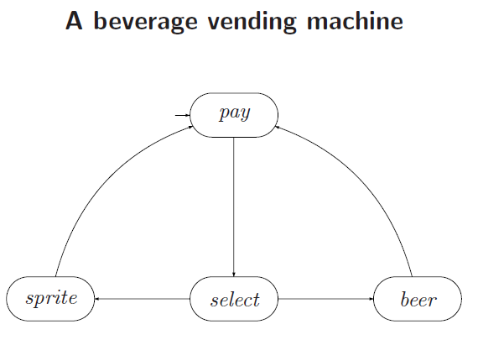

Slide 5
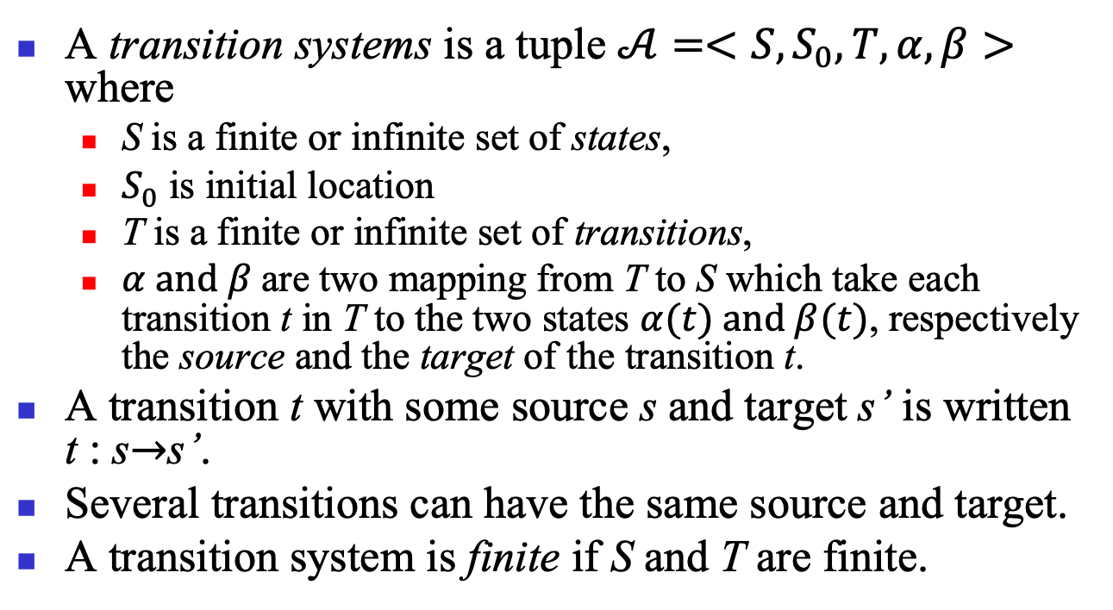
Transition systems
A transition systems is a tuple $𝒜=<S,S_{0},T,α,β>$ where
S is a finite or infinite set of states,
$S_{0}$ is initial location
T is a finite or infinite set of transitions,
$α and β$are two mapping from T to S which take each transition t in T to the two states $α(t) and β(t)$, respectively the source and the target of the transition t.
A transition t with some source s and target s’ is written t : s$→$s’.
Several transitions can have the same source and target.
A transition system is finite if S and T are finite.

Slide 6
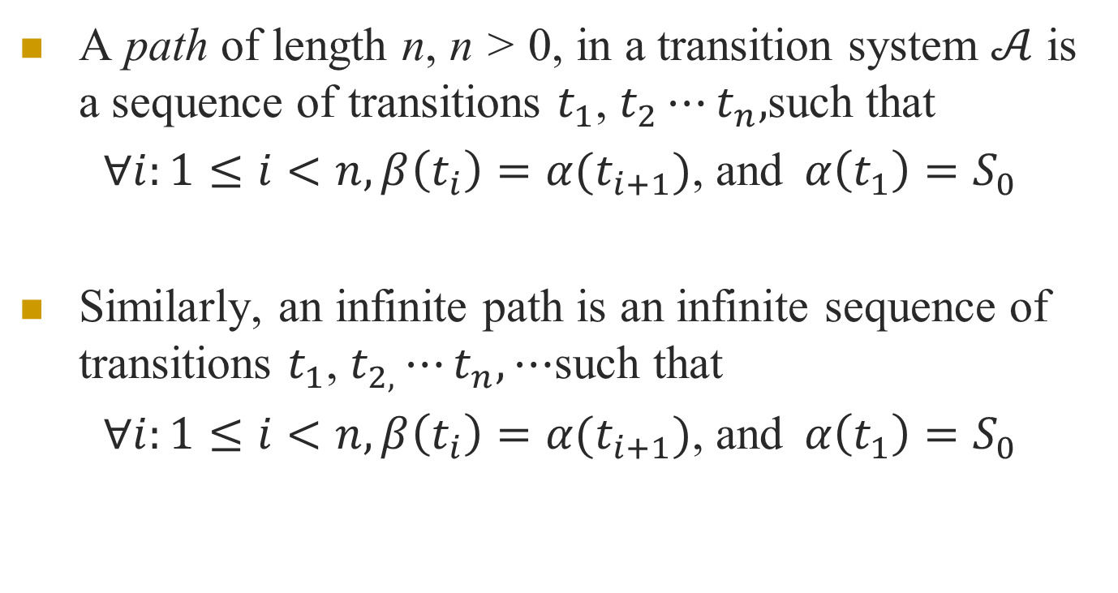
Paths
A path of length n, n > 0, in a transition system $𝒜$ is a sequence of transitions $t_{1}$, $t_{2}⋯t_{n},$such that
$∀i:1≤i<n,β\left(t_{i}\right)=α(t_{i+1})$, and$α\left(t_{1}\right)=S_{0}$
Similarly, an infinite path is an infinite sequence of transitions $t_{1}$, $t_{2,}⋯t_{n},⋯$such that
$∀i:1≤i<n,β\left(t_{i}\right)=α(t_{i+1})$, and$α\left(t_{1}\right)=S_{0}$

Slide 7
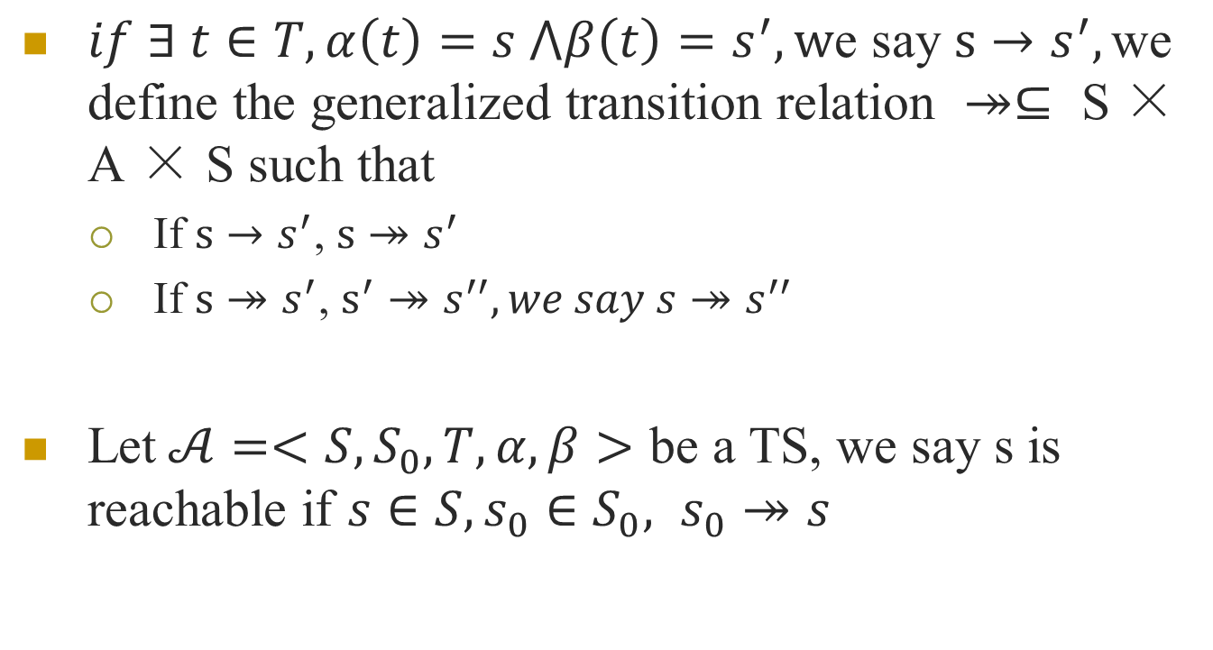
$if ∃ t∈T, α\left(t\right)=s ⋀β\left(t\right)=s^{′},\text{w}\text{e} \text{say} s→s^{′},\text{we} \text{define} \text{the} \text{generalized} \text{transition} \text{relation} ↠⊆ \text{S}\text{ × }\text{A}\text{ × }\text{S} \text{such} \text{that}$
If $s→s^{′}$, $s↠s^{′}$
If $s↠s^{′}$, $s^{′}↠s^{′′}, we say s↠s^{′′}$
Let$𝒜=<S,S_{0},T,α,β>$ be a TS, we say s is reachable if $s∈S, s_{0}∈S_{0}, s_{0}↠s$

Slide 8
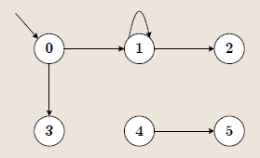
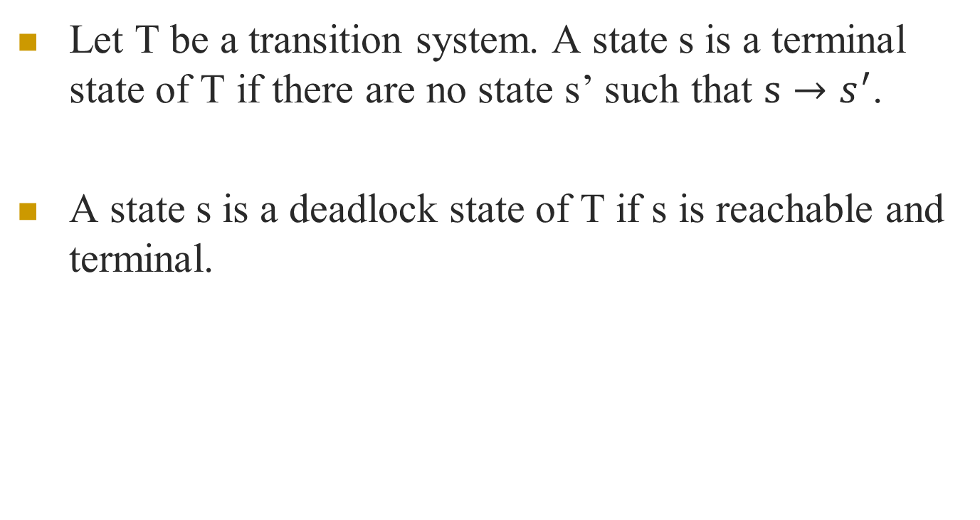
Let T be a transition system. A state s is a terminal state of T if there are no state s’ such that $s→s^{′}$.
A state s is a deadlock state of T if s is reachable and terminal.

Slide 9
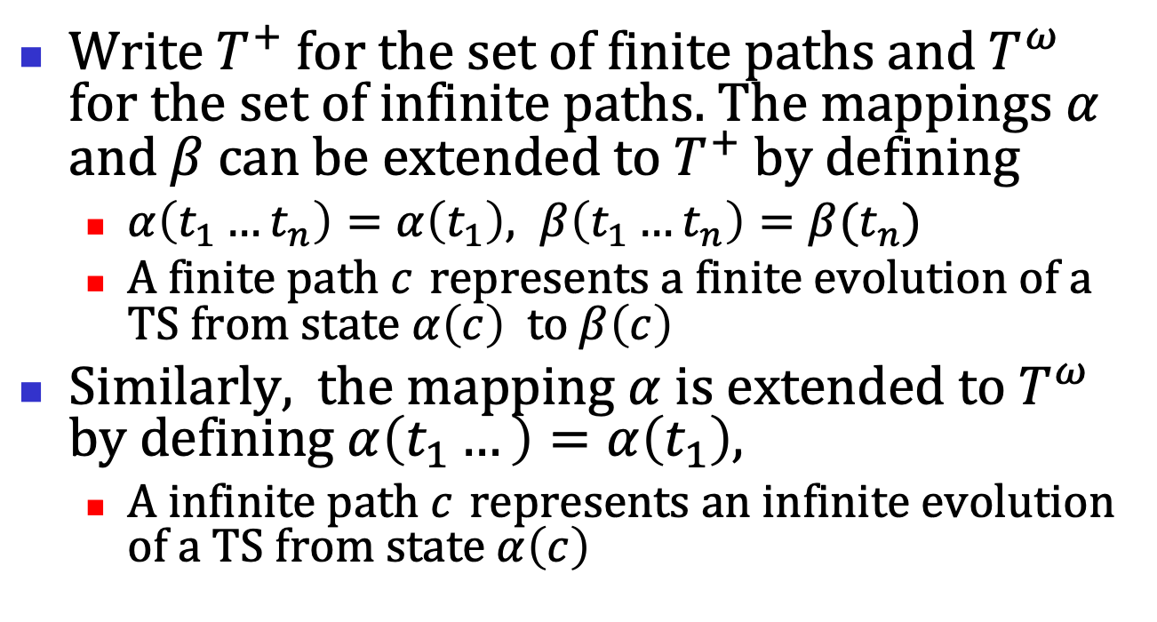
Write$T^{+}$ for the set of finite paths and $T^{ω}$ for the set of infinite paths. The mappings $α$ and$β$ can be extended to $T^{+}$ by defining
$α\left(t_{1}…t_{n}\right)=α\left(t_{1}\right), β\left(t_{1}…t_{n}\right)=β(t_{n})$
A finite path $c$ represents a finite evolution of a TS from state$α\left(c\right)$to$β\left(c\right)$
Similarly, the mapping$α$ is extended to $T^{ω}$ by defining$α\left(t_{1}…\right)=α\left(t_{1}\right),$
A infinite path $c$ represents an infinite evolution of a TS from state$α\left(c\right)$

Slide 10
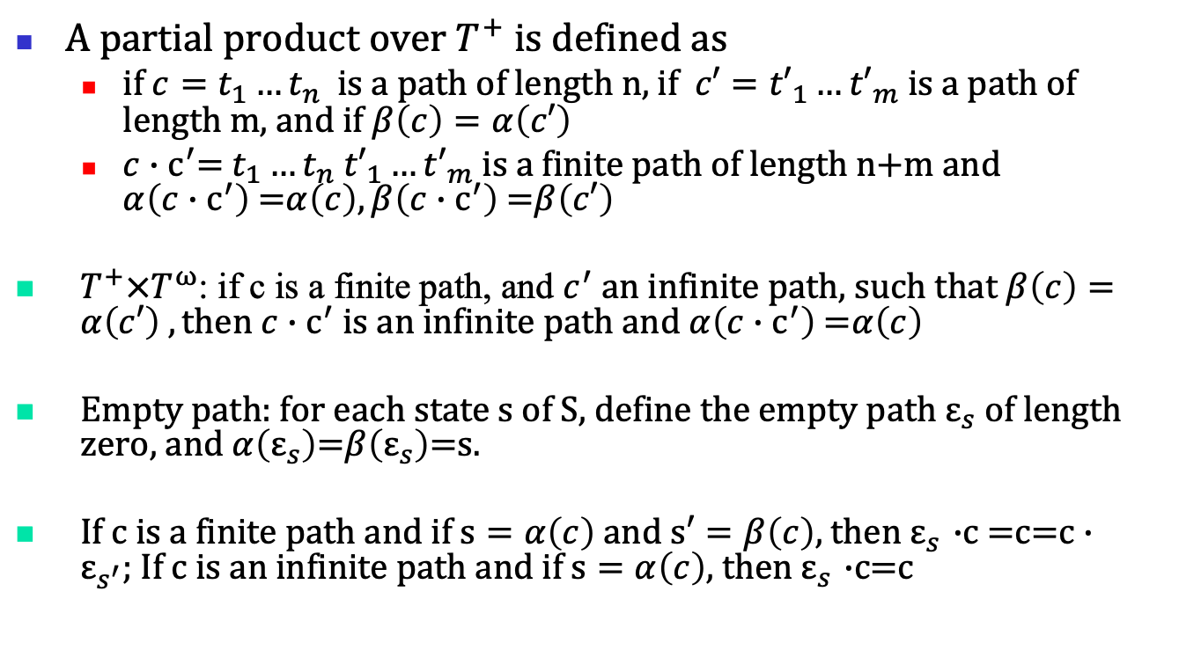
A partial product over $T^{+}$ is defined as
if ${c=t}_{1}…t_{n}$ is a path of length n, if ${c′=t′}_{1}…{t′}_{m}$is a path of length m, and if $β\left(c\right)=α\left(c′\right)$
$c{∙c}^{′}=$ $t_{1}…t_{n}$ ${t′}_{1}…{t′}_{m}$ is a finite path of length n+m and $α\left(c{∙c}^{′}\right)$=$α\left(c\right), β\left(c{∙c}^{′}\right)$=$β\left(c′\right)$
$T^{+}×T^{ω}$: if c is a finite path, and $c^{′}$an infinite path, such that $β\left(c\right)=α\left(c′\right) , then c{∙c}^{′}$ is an infinite path and$α\left(c{∙c}^{′}\right)$=$α\left(c\right)$
Empty path: for each state s of S, define the empty path $ε_{s}$of length zero, and$α\left(ε_{s}\right)$=$β\left(ε_{s}\right)$=s.
If c is a finite path and if $s=α\left(c\right)$ and $s′=β\left(c\right)$, then $ε_{s}$ $∙$c =c=$c∙ε_{s^{′}};$If c is an infinite path and if $s=α\left(c\right)$, then $ε_{s}$ $∙$c=c

Slide 11
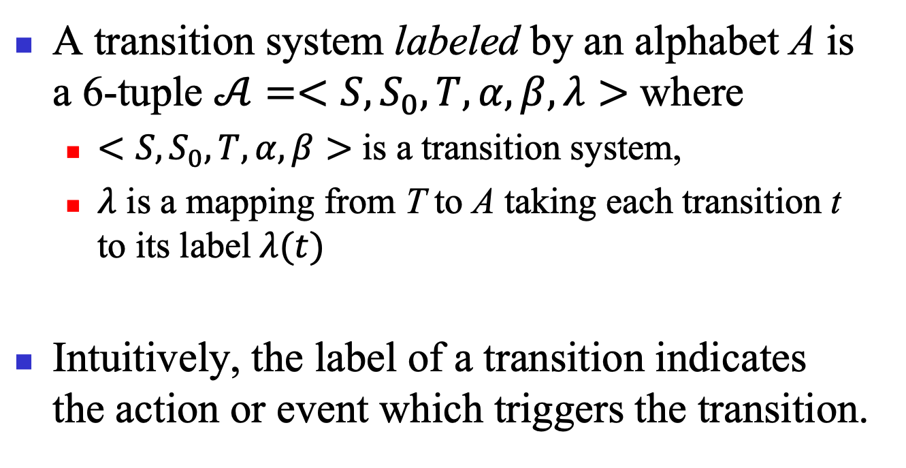
Labeled transition systems
A transition system labeled by an alphabet A is a 6-tuple $𝒜=<S,S_{0},T,α,β,λ>$ where
$<S,S_{0},T,α,β>$ is a transition system,
$λ$ is a mapping from T to A taking each transition t to its label$λ(t)$
Intuitively, the label of a transition indicates the action or event which triggers the transition.

Slide 12
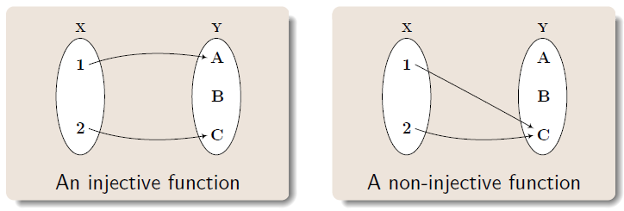
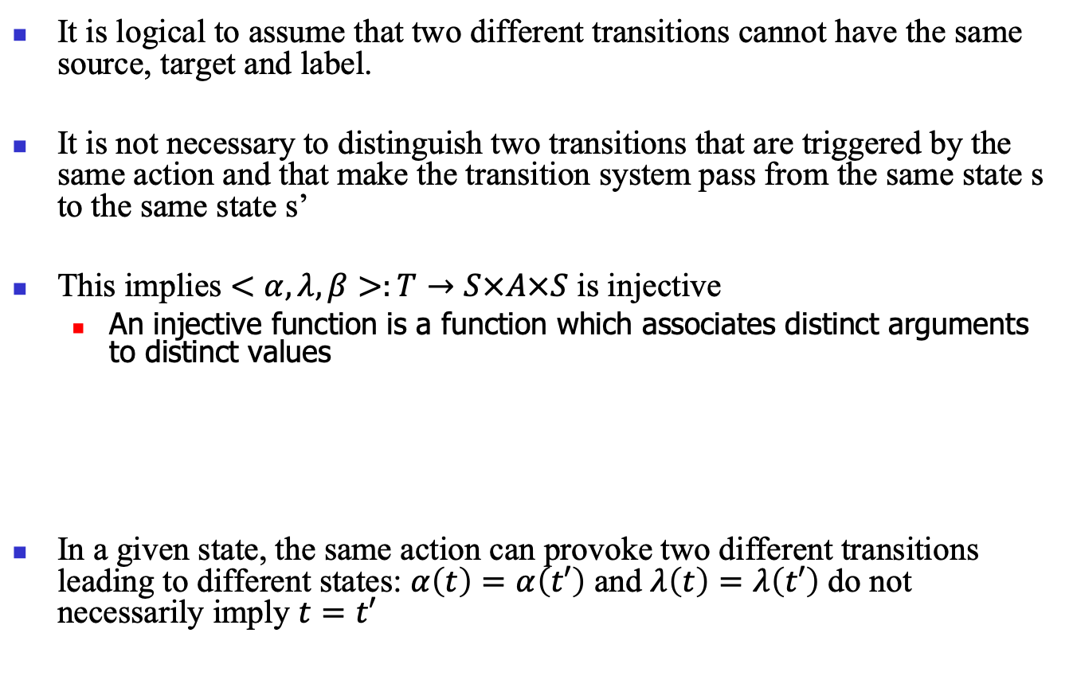
It is logical to assume that two different transitions cannot have the same source, target and label.
It is not necessary to distinguish two transitions that are triggered by the same action and that make the transition system pass from the same state s to the same state s’
This implies $<α,λ,β>:T→S×A×S$ is injective
An injective function is a function which associates distinct arguments to distinct values
In a given state, the same action can provoke two different transitions leading to different states: $α\left(t\right)=α\left(t′\right)$ and $λ\left(t\right)=λ\left(t′\right)$ do not necessarily imply $t=t′$
Notes:
单射

Slide 13
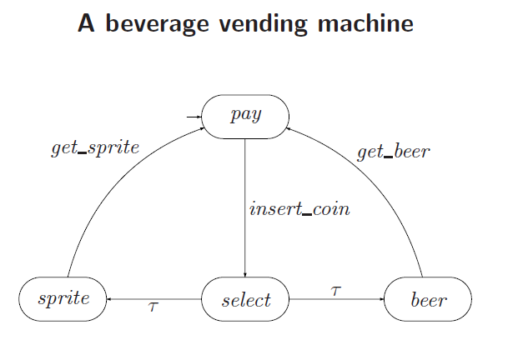

Slide 14

Traces
If c = $t_{1}$, $t_{2}⋯,$is a path in a labeled transition system, the sequence of actions trace(c) = ${λ(t}_{1})$, $λ(t_{2})⋯$is called the trace of the path.

Slide 15
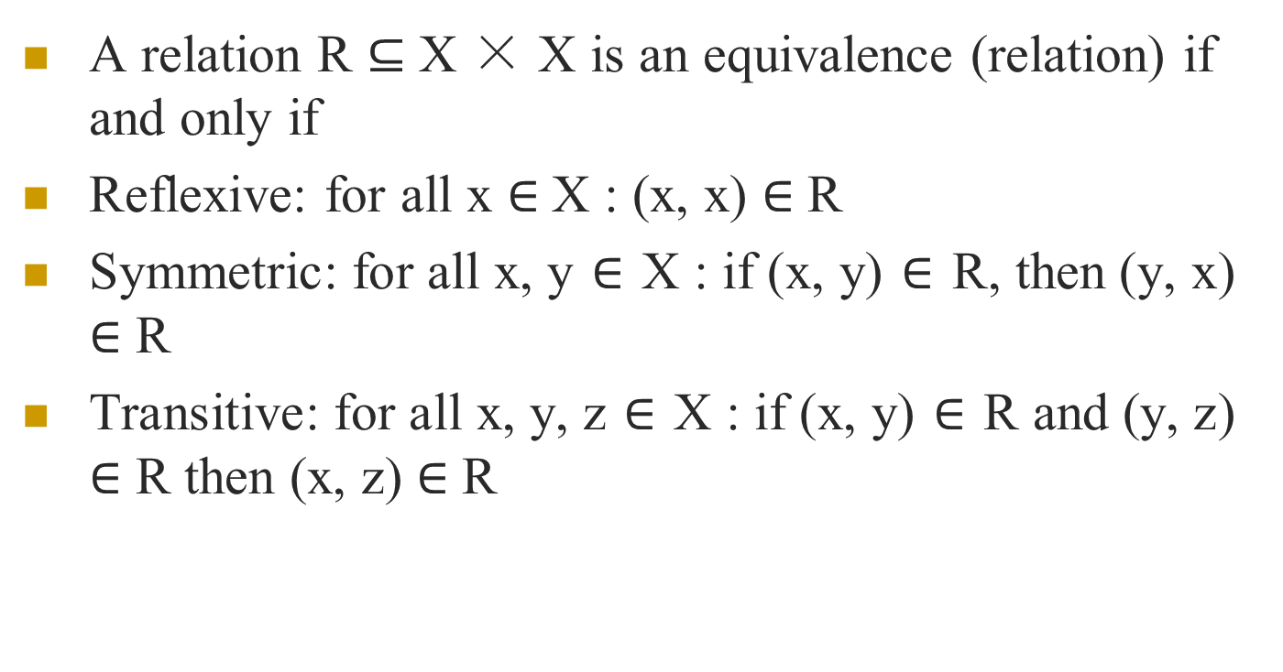
Equivalence Relation
A relation R $⊆$ X × X is an equivalence (relation) if and only if
Reflexive: for all x $∈$X : (x, x) $∈$ R
Symmetric: for all x, y $∈$ X : if (x, y) $∈$ R, then (y, x) $∈$ R
Transitive: for all x, y, z $∈$ X : if (x, y) $∈$ R and (y, z) $∈$ R then (x, z) $∈$ R

Slide 16
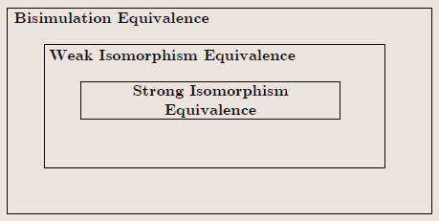
There are numerous notions of equivalency for transition systems
We consider the following:
Strong isomorphism
Weak isomorphism
Bisimulation equivalence

Slide 17
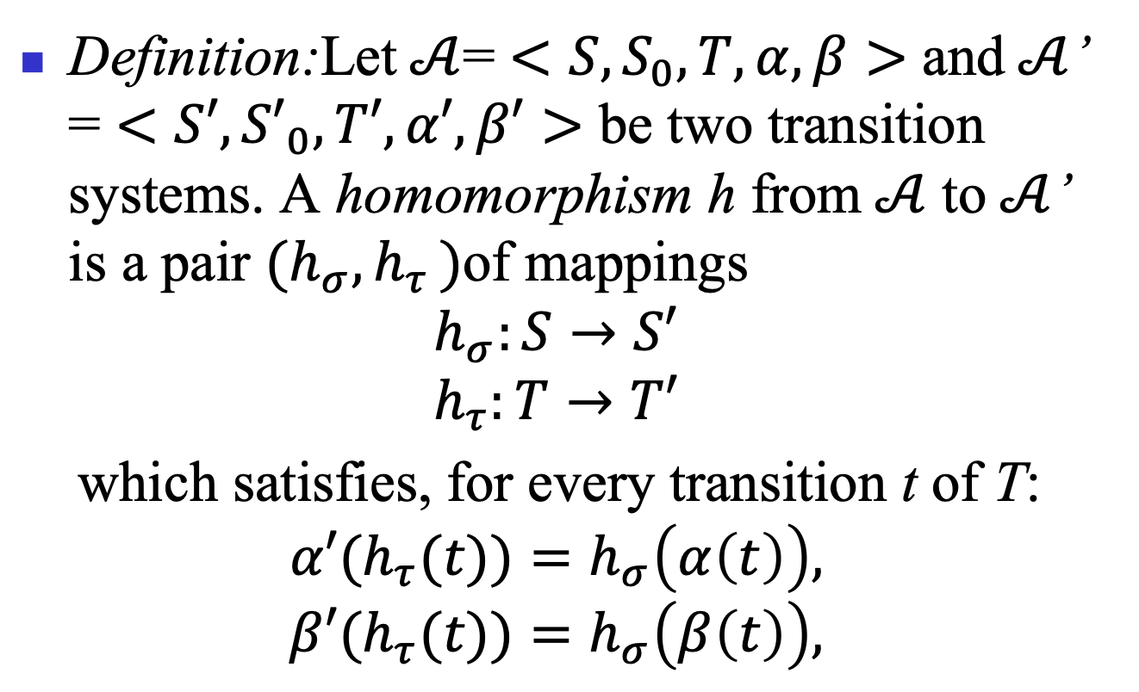
Transition system homomorphism
Definition:Let$𝒜$= $<S,S_{0},T,α,β>$ and$𝒜$’ = $<S′,{S′}_{0},T′,α′,β′>$ be two transition systems. A homomorphism h from$𝒜$ to$𝒜$’ is a pair $(h_{σ}{,h}_{τ})$of mappings
$$h_{σ}:S→S′$$
$$h_{τ}:T→T′$$
which satisfies, for every transition t of T:
$${α′(h}_{τ}{(t))=h}_{σ}\left(α\left(t\right)\right),$$
$${β′(h}_{τ}{(t))=h}_{σ}\left(β\left(t\right)\right),$$

Slide 18
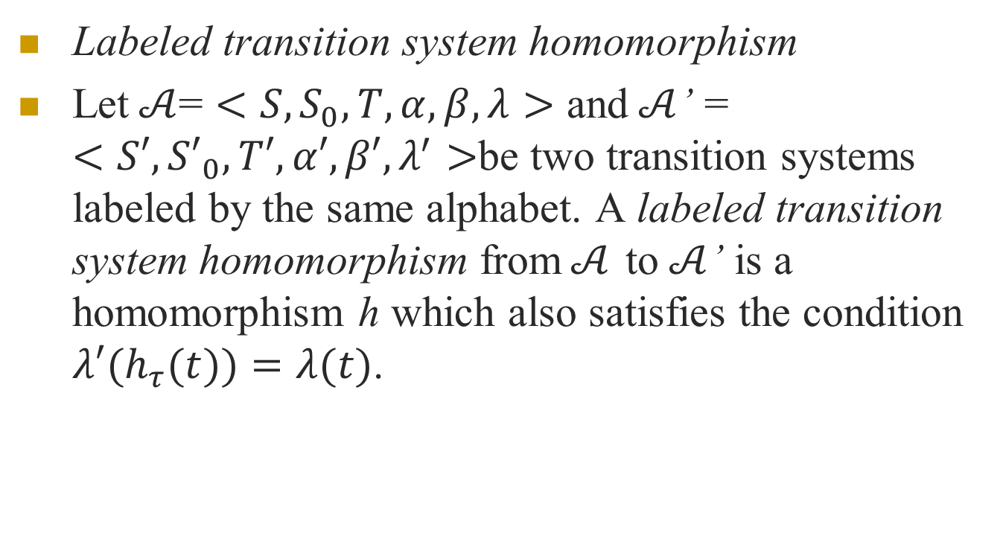
Labeled transition system homomorphism
Let$𝒜$= $<S,S_{0},T,α,β, λ>$ and$𝒜$’ = $<S′,{S′}_{0},T′,α′,β′,λ^{′}>$be two transition systems labeled by the same alphabet. A labeled transition system homomorphism from$𝒜$ to$𝒜$’ is a homomorphism h which also satisfies the condition ${λ′(h}_{τ}(t))=λ(t)$.

Slide 19
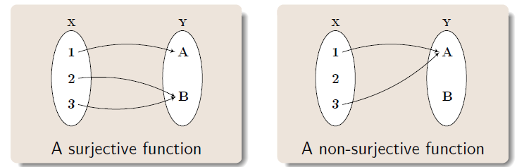
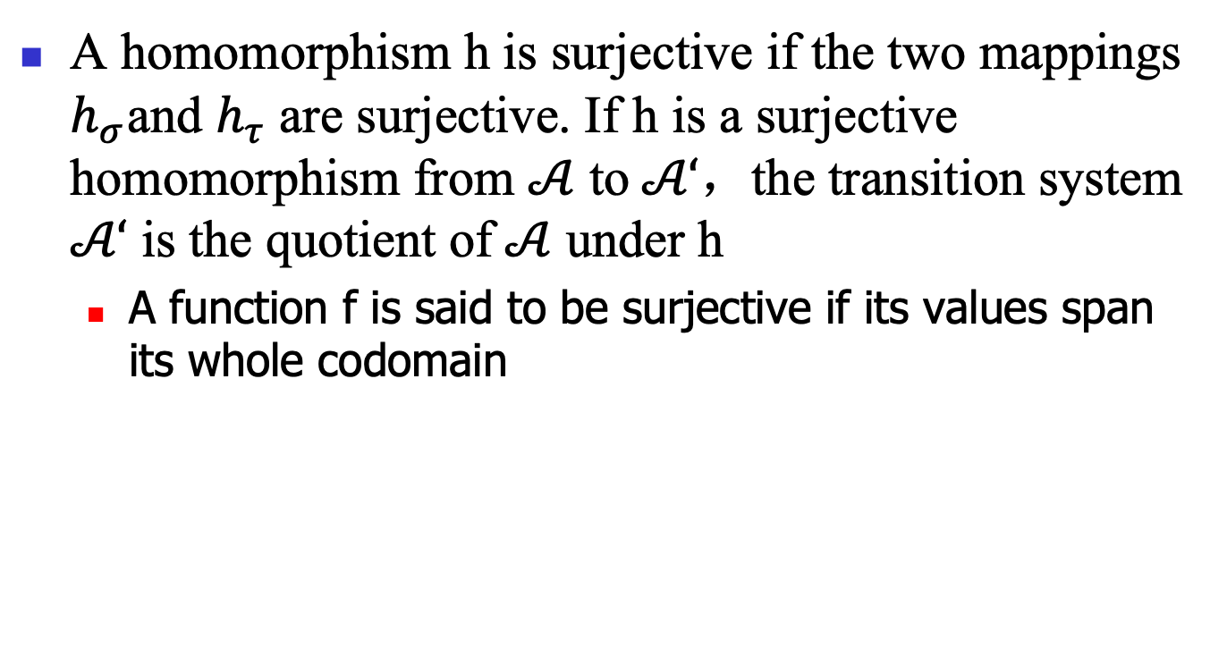
A homomorphism h is surjective if the two mappings $h_{σ}{\text{and} h}_{τ}$ are surjective. If h is a surjective homomorphism from $𝒜$ to$𝒜‘$，the transition system $𝒜‘$ is the quotient of$𝒜$ under h
A function f is said to be surjective if its values span its whole codomain
Notes:
满射

Slide 20
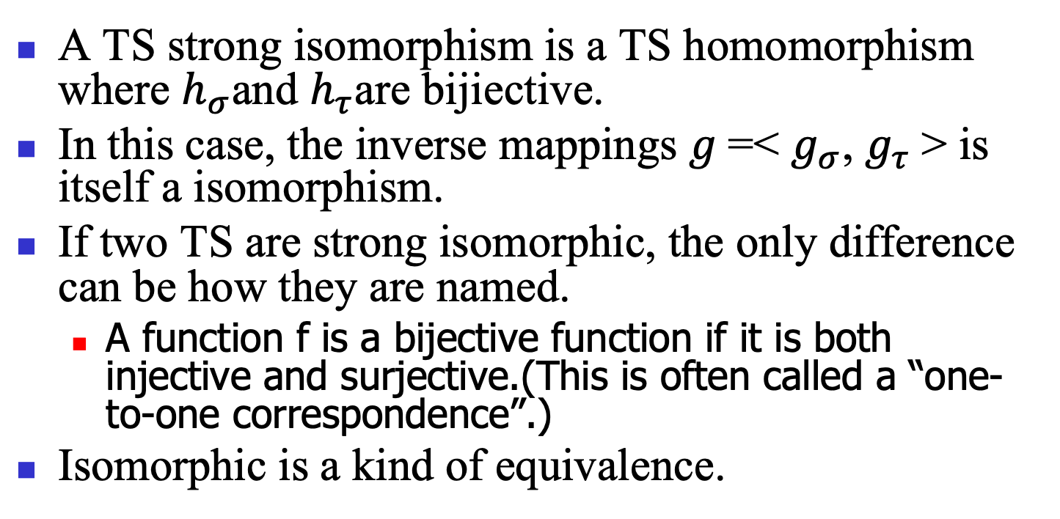
A TS strong isomorphism is a TS homomorphism where $h_{σ}{\text{and} h}_{τ}$are bijiective.
In this case, the inverse mappings $g$=< $g_{σ}{\text{,} g}_{τ}$> is itself a isomorphism.
If two TS are strong isomorphic, the only difference can be how they are named.
A function f is a bijective function if it is both injective and surjective.(This is often called a “one-to-one correspondence”.)
Isomorphic is a kind of equivalence.

Slide 21
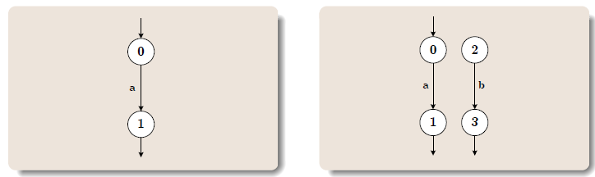
Are these two systems isomorphic?

Slide 22
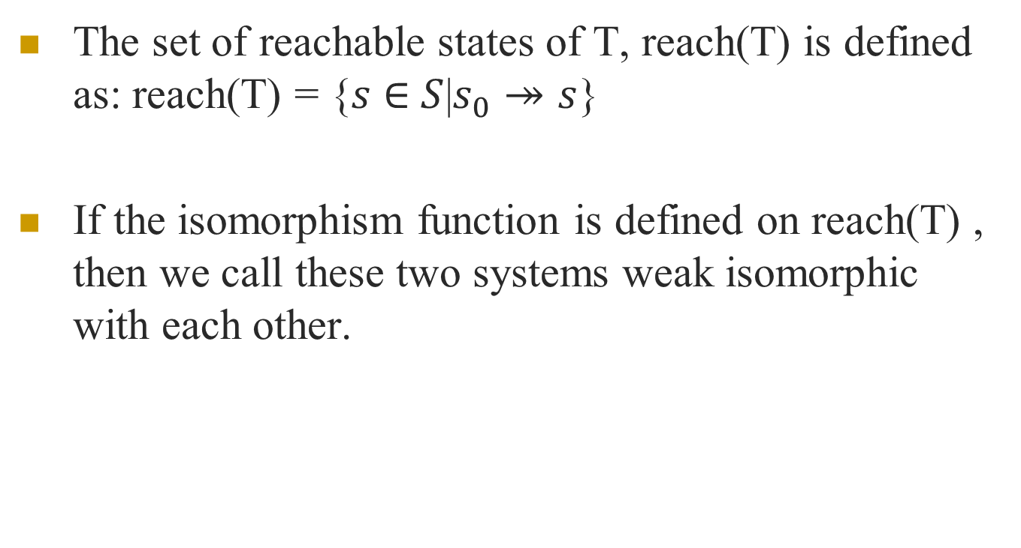
Weak Isomorphism
The set of reachable states of T, reach(T) is defined as: reach(T) = {$s$ $∈$ $S$|$s_{0}↠s$}
If the isomorphism function is defined on reach(T) , then we call these two systems weak isomorphic with each other.

Slide 23
These two systems are weak isomorphic
Theorem:
If two transition systems are isomorphic, then they are weakly isomorphic.
Weak isomorphism is an equivalence relation

Slide 24
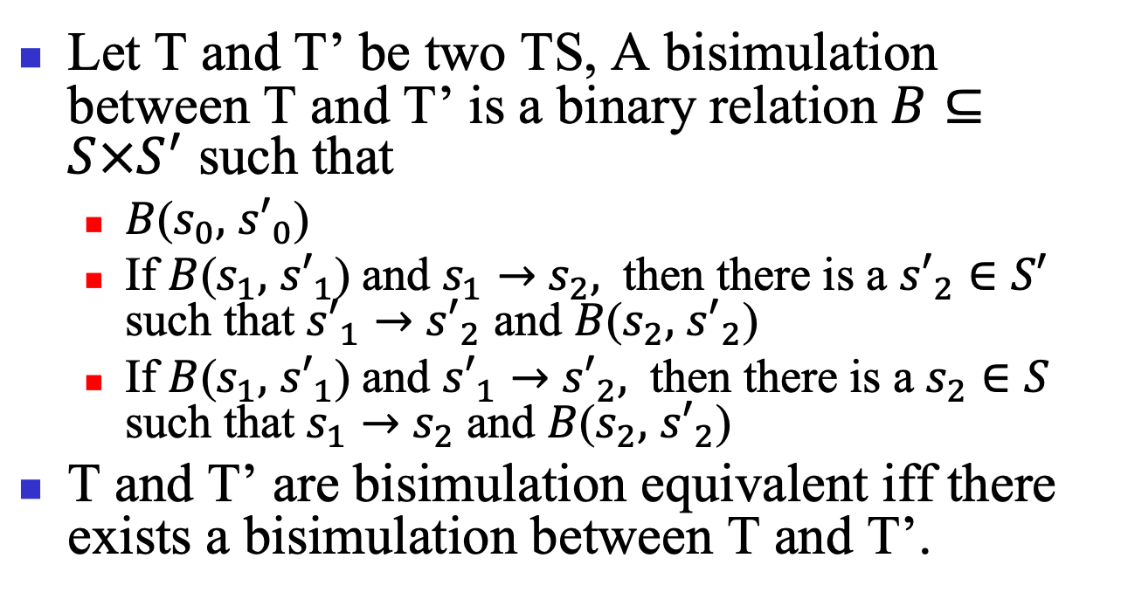
Let T and T’ be two TS, A bisimulation between T and T’ is a binary relation $B⊆S×S^{′}$ such that
$B$($s_{0},$ ${s′}_{0}$)
If $B$($s_{1},$ ${s′}_{1}$) and $s_{1}→$ $s_{2},$ then there is a ${s′}_{2}∈S′$ such that ${s′}_{1}→$ ${s′}_{2}$ and $B$($s_{2},$ ${s′}_{2}$)
If $B$($s_{1},$ ${s′}_{1}$) and ${s′}_{1}→$ ${s′}_{2},$ then there is a $s_{2}∈S$ such that $s_{1}→$ $s_{2}$ and $B$($s_{2},$ ${s′}_{2}$)
T and T’ are bisimulation equivalent iff there exists a bisimulation between T and T’.

Slide 25
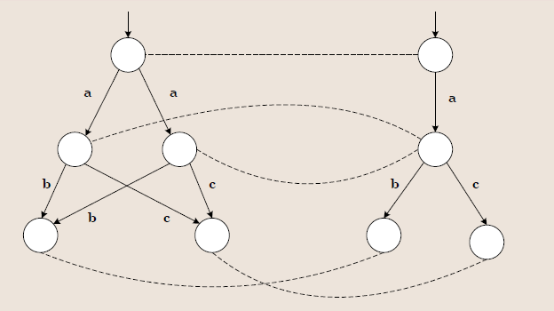
Example
two isomorphic TS are bisimilar, but bisimilar TS are not necessarily isomorphic

Slide 26
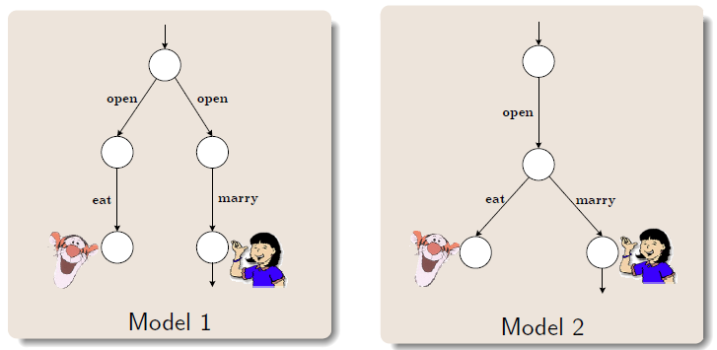
The lady or the tiger

Slide 27
Strong Isomorphism: the transition systems are identical except for the names of the states.
Weak Isomorphism: the transition systems are strongly isomorphic provided that the transition systems are restricted to the reachable states.
Bisimulation Equivalence: the transition systems have the same behavior, and make choice at same time.

Slide 28
Use TS to present the behavior of all the modeling language
Then Use TS to prove the equivalence respectively

Slide 29
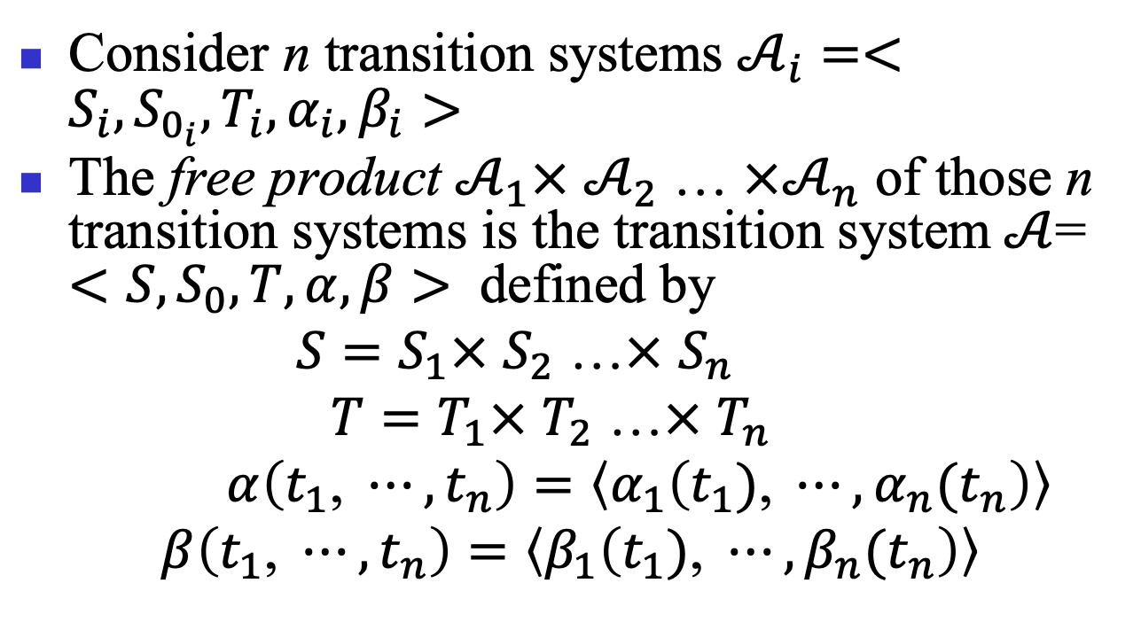
The free product of transition systems
Consider n transition systems $𝒜_{i}=<S_{i},S_{0_{i}},T_{i},α_{i},β_{i}>$
The free product $𝒜_{1}×$ $𝒜_{2}$ … $×𝒜_{n}$ of those n transition systems is the transition system$𝒜$= $<S,S_{0},T,α,β>$ defined by
${S=S}_{1}×$ $S_{2}$ …$×$ $S_{n}$
${T=T}_{1}×$ $T_{2}$ …$×$ $T_{n}$
$α\left(t_{1}\text{, }⋯,t_{n}\right)=\left\langle α_{1}\left(t_{1})\text{, }⋯,{α_{n}(t}_{n}\right)\right\rangle$
$$β\left(t_{1}\text{, }⋯,t_{n}\right)=\left\langle β_{1}\left(t_{1})\text{, }⋯,{β_{n}(t}_{n}\right)\right\rangle$$

Slide 30
p,s
p
s
q
t
p,t
q,s
q,t

Slide 31

If, in addition, each $𝒜_{i }$is labeled by an alphabet $A_{i }$, the free product is a transition system labeled by the alphabet $A_{1}×$ $A_{2}$ … $×A_{n}$; transitions are labeled as follows:$λ\left( t_{1}\text{, }⋯,t_{n}\right)=\left\langle λ_{1}\left(t_{1})\text{, }⋯,{λ_{n}(t}_{n}\right)\right\rangle$

Slide 32
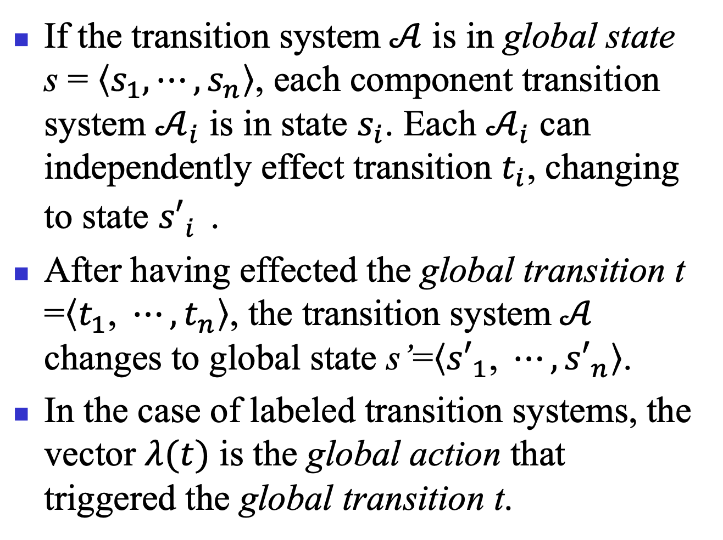
If the transition system$𝒜$ is in global state s = $\left\langle s_{1}\text{,}⋯,s_{n}\right\rangle$, each component transition system $𝒜_{i}$ is in state $s_{i}$. Each $𝒜_{i}$ can independently effect transition $t_{i}$, changing to state ${s′}_{i}^{}$.
After having effected the global transition t =$\left\langle t_{1}\text{, }⋯,t_{n}\right\rangle$, the transition system$𝒜$ changes to global state s’=$\left\langle {s′}_{1}\text{, }⋯,{s′}_{n}\right\rangle$.
In the case of labeled transition systems, the vector $λ(t)$ is the global action that triggered the global transition t.

Slide 33
The synchronous product of transition systems
When processes interact, not all possible global actions are useful, since the interaction is subject to communication and synchronization constraints.
The transition system associated with the system of processes must therefore be a subsystem of the free product of the component transition systems.
The communication and synchronization constraints that define the subsystem can always be simply expressed by the synchronous product, formally defined below.

Slide 34
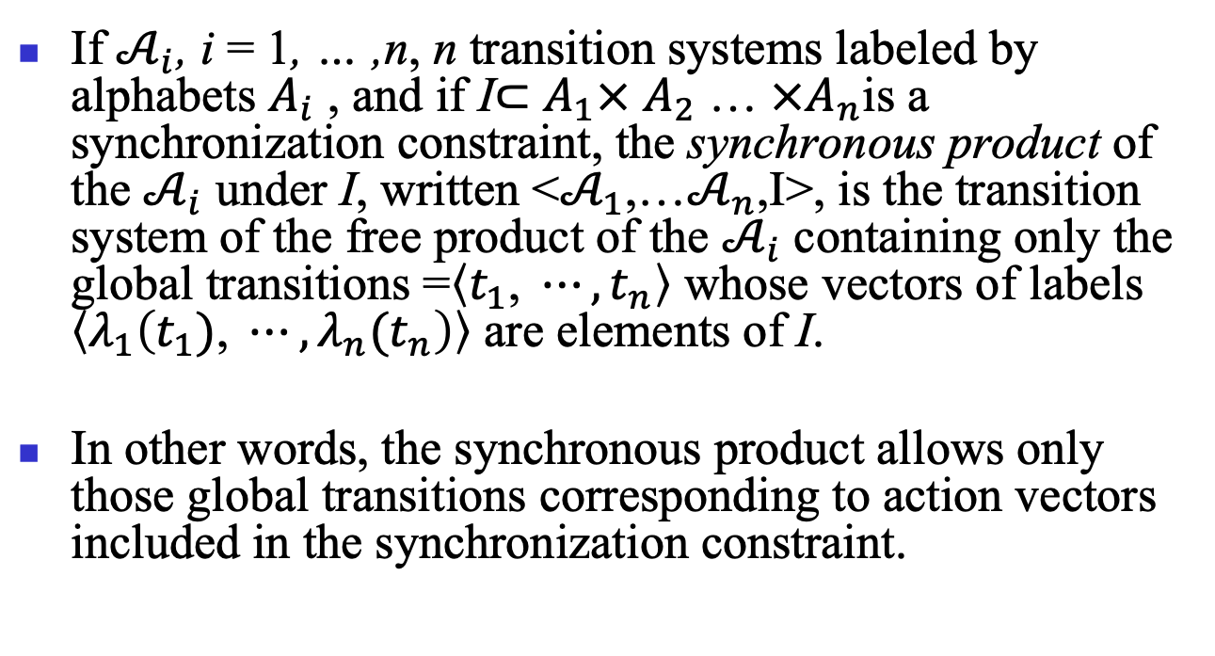
If $𝒜_{i}$, i = 1, … ,n, n transition systems labeled by alphabets $A_{i}$ , and if I$⊂$ $A_{1}×$ $A_{2}$ … $×A_{n}$is a synchronization constraint, the synchronous product of the $𝒜_{i}$ under I, written <$𝒜_{1}$,…$𝒜_{n}$,I>, is the transition system of the free product of the $𝒜_{i}$ containing only the global transitions =$\left\langle t_{1}\text{, }⋯,t_{n}\right\rangle$ whose vectors of labels $\left\langle λ_{1}\left(t_{1})\text{, }⋯,{λ_{n}(t}_{n}\right)\right\rangle$ are elements of I.
In other words, the synchronous product allows only those global transitions corresponding to action vectors included in the synchronization constraint.

Slide 35
p,s
p
s
p,k
q,s
q
t
k
p,t
q,k
q,t

Slide 36
p,s
a b c <a,b> <a,c>
p
s
p,k
q
q,s
t
k
p,t
q,k
q,t

Slide 37
p,s
a b c <a,b>
p
s
p,k
q
q,s
t
k
p,t
q,k
q,t

Slide 38
The free product assumes that in a global system, all component systems execute their transitions simultaneously,
it is possible to divide time into intervals in such a way that during each of those intervals each component executes exactly one transition. In other words, the same ‘clock’ drives the different transition systems forming the product.

Slide 39


$$τ Transition$$
$τ Transition, stuttering loop$
p,s
p
s
q
t
p,t
q,s
q,t

Slide 40
Shared label

