Slide 1

Theoretical Foundations of Software Engineering
Lei Bu
bulei@nju.edu.cn

Slide 2
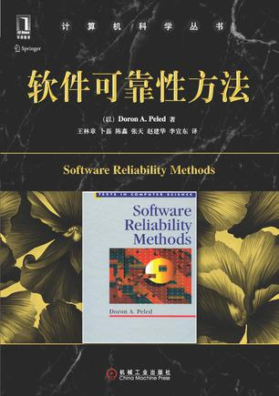
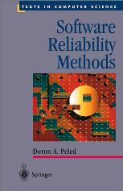
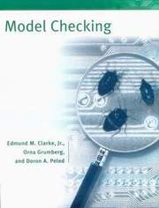
Some related books:
Mainly:
Also:

Slide 3


Goal: software reliability
Use software engineering methodologies to develop the code.
Use formal methods during code development
Notes:
2

Slide 4
What are formal methods?
Techniques for analyzing systems, based on some mathematics.
This does not mean that the user must be a mathematician.
Some of the work is done in an informal way, due to complexity.

Slide 5
Examples for FM
Deductive verification:
Using some logical formalism, prove formally that the software satisfies its specification.
Model checking:
Use some software to automatically check that the software satisfies its specification.
Testing:
Check executions of the software according to some coverage scheme.

Slide 6
Typical situation:
Boss: Mark, I want that the new internet marketing software will be flawless. OK?
Mark: Hmmm. Well, ..., Aham, Oh! Ah??? Where do I start?
Bob: I have just the solution for you. It would solve everything.

Slide 7
Some concerns
Which technique?
Which tool?
Which experts?
What limitations?
What methodology?
At which points?
How expensive?
How many people?
Needed expertise.
Kind of training.
Size limitations.
Exhaustiveness.
Reliability.
Expressiveness.
Support.

Slide 8
Myths
Formal methods can only be used by mathematicians.
The verification process is itself prone to errors, so why bother?
Using formal methods will slow down the project.

Slide 9
Some answers...
Formal methods can only be used by mathematicians.
Wrong. They are based on some math but the user should not care.
The verification process is itself prone to errors, so why bother?
We opt to reduce the errors, not eliminate them.
Using formal methods will slow down the project.
Maybe it will speed it up, once errors are found earlier.

Slide 10
Some exaggerations
Automatic verification can always find errors.
Deductive verification can show that the software is completely safe.
Testing is the only industrial practical method.

Slide 11
Our approach
Learn several methods (deductive verification, model checking, testing process algebra).
Learn advantages and limitations, in order to choose the right methods and tools.
Learn how to combine existing methods.

Slide 12
Some emphasis
The process of selecting and using formal methods.
The appropriate notation. In particular, visual notation.
Hands-on experience with tools.

Slide 13
Where do we start?
Boss: Mark, can you verify this for me?
Mark: OK, first I have to ...

Slide 14
Things to do
Check the kind of
software to analyze.
Choose methods and tools.
Express system properties.
Model the software.
Apply methods.
Obtain verification results.
Analyze results.
Identify errors.
Suggest correction.

Slide 15
Different types of software
Sequential.
Concurrent.
Distributed.
Reactive.
Protocols.
Abstract algorithms.
Finite state.

Slide 16
Specification:
Informal, textual, visual
The value of x will be between 1 and 5, until some point where it will become 7. In any case it will never be negative.
(1<=x<=5 U (x=7/\ [] x>=0))
1<=x<=5
X=7
X>=0

Slide 17
Verification methods
Finite state machines. Apply model checking.
Apply deductive verification (theorem proving).
Program too big, too complicated.
Apply testing techniques.
Apply a combination of the above!

Slide 18
Modeling
Use the program text.
Translate to a programming language embedded in some proof system.
Translate to some notation (transition system).
Translate to finite automata.
Use visual notation.
Special case: black box system.

Slide 19
How to credit?
Paper reading and Lecture;
Course report;
Project report.

