Slide 1
Transition System
Lei Bu
bulei@nju.edu.cn

Slide 2
Definitions and notations
Reactive System
The intuition is that a transition system consists of a set of possible states for the system and a set of transitions - or state changes - which the system can effect.
When a state change is the result of an external event or of an action made by the system, then that transition is labeled with that event or action.
Particular states or transitions in a transition system can be distinguished.

Slide 3
model to describe the behavior of systems
digraphs where nodes represent states, and edges model transitions
state:
the current color of a traffic light
the current values of all program variables + the program counter
the value of register and output
transition: (“state change”)
a switch from one color to another
the execution of a program statement
the change of the registers and output bits for a new input

Slide 4
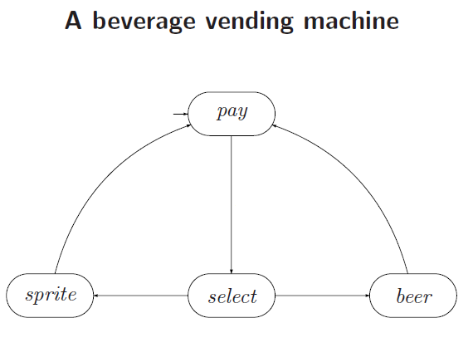

Slide 5
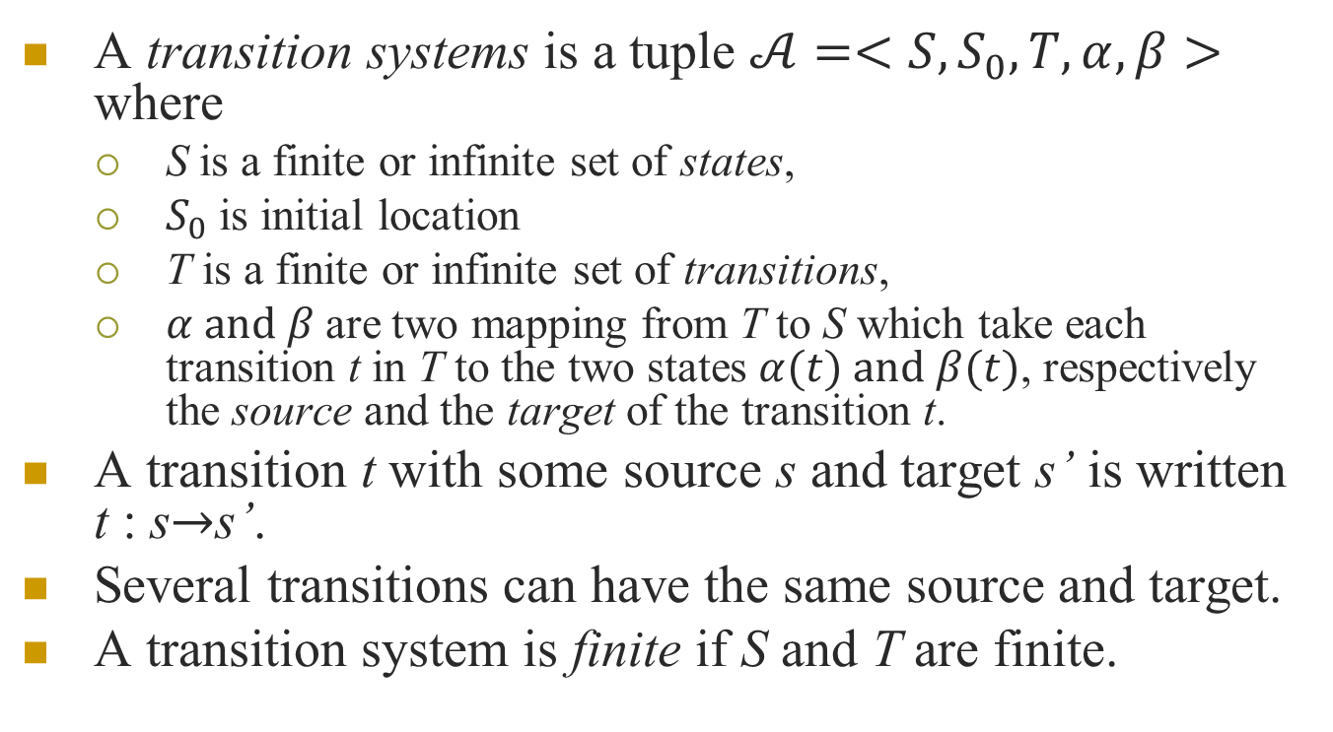
Transition systems
A transition systems is a tuple $𝒜=<S,S_{0},T,α,β>$ where
S is a finite or infinite set of states,
$S_{0}$ is initial location
T is a finite or infinite set of transitions,
$α and β$are two mapping from T to S which take each transition t in T to the two states $α(t) and β(t)$, respectively the source and the target of the transition t.
A transition t with some source s and target s’ is written t : s$→$s’.
Several transitions can have the same source and target.
A transition system is finite if S and T are finite.

Slide 6
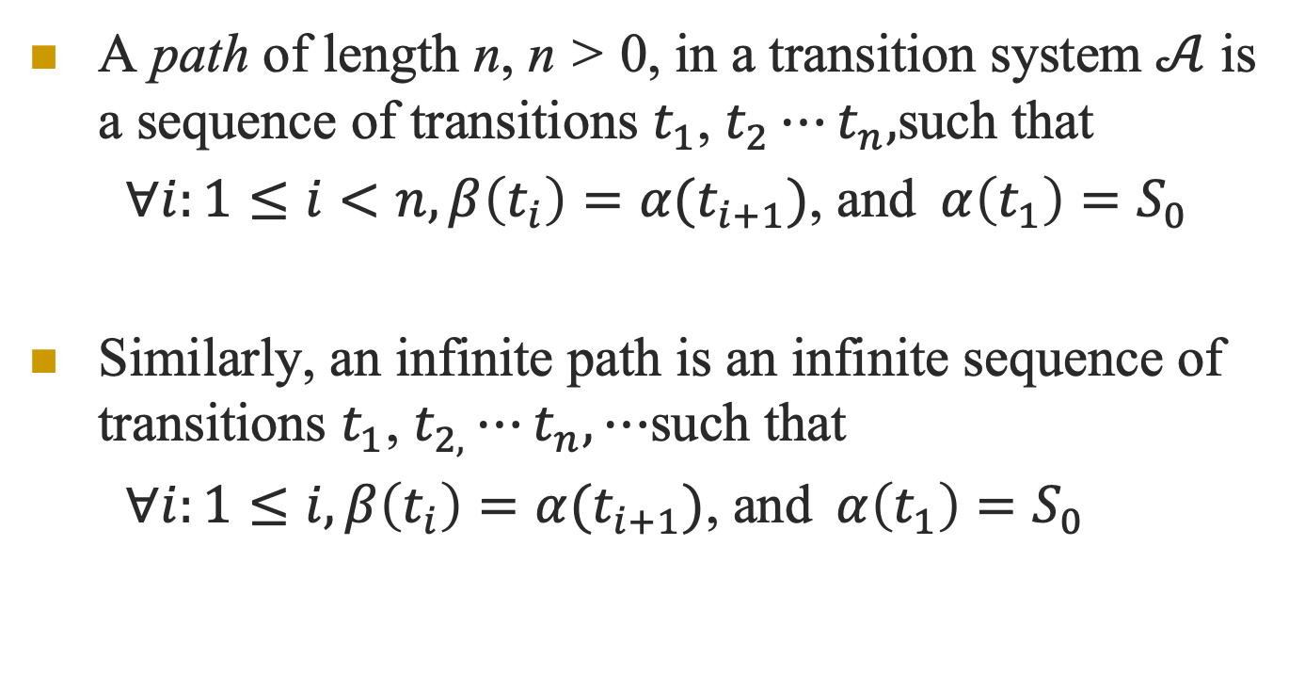
Paths
A path of length n, n > 0, in a transition system $𝒜$ is a sequence of transitions $t_{1}$, $t_{2}⋯t_{n},$such that
$∀i:1≤i<n,β\left(t_{i}\right)=α(t_{i+1})$, and$α\left(t_{1}\right)=S_{0}$
Similarly, an infinite path is an infinite sequence of transitions $t_{1}$, $t_{2,}⋯t_{n},⋯$such that
$∀i:1≤i,β\left(t_{i}\right)=α(t_{i+1})$, and$α\left(t_{1}\right)=S_{0}$

Slide 7
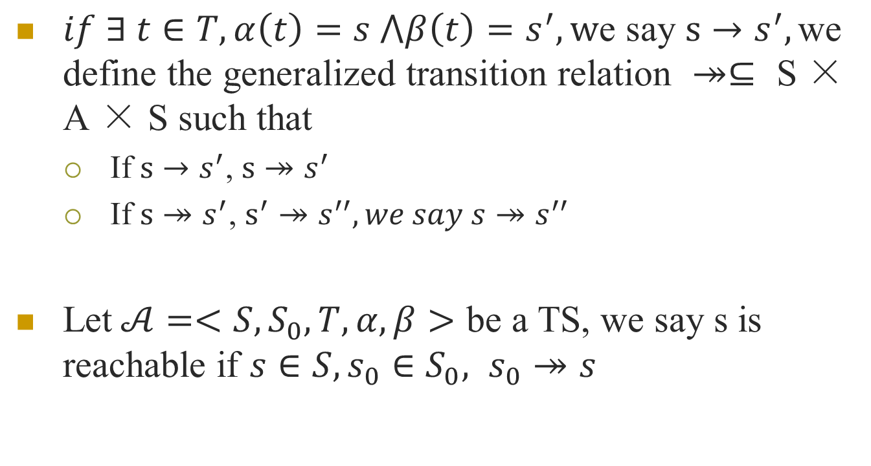
$if ∃ t∈T, α\left(t\right)=s ⋀β\left(t\right)=s^{′},\text{w}\text{e} \text{say} s→s^{′},\text{we} \text{define} \text{the} \text{generalized} \text{transition} \text{relation} ↠⊆ \text{S}\text{ × }\text{A}\text{ × }\text{S} \text{such} \text{that}$
If $s→s^{′}$, $s↠s^{′}$
If $s↠s^{′}$, $s^{′}↠s^{′′}, we say s↠s^{′′}$
Let$𝒜=<S,S_{0},T,α,β>$ be a TS, we say s is reachable if $s∈S, s_{0}∈S_{0}, s_{0}↠s$

Slide 8
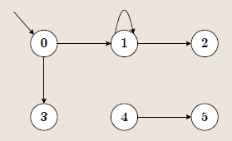
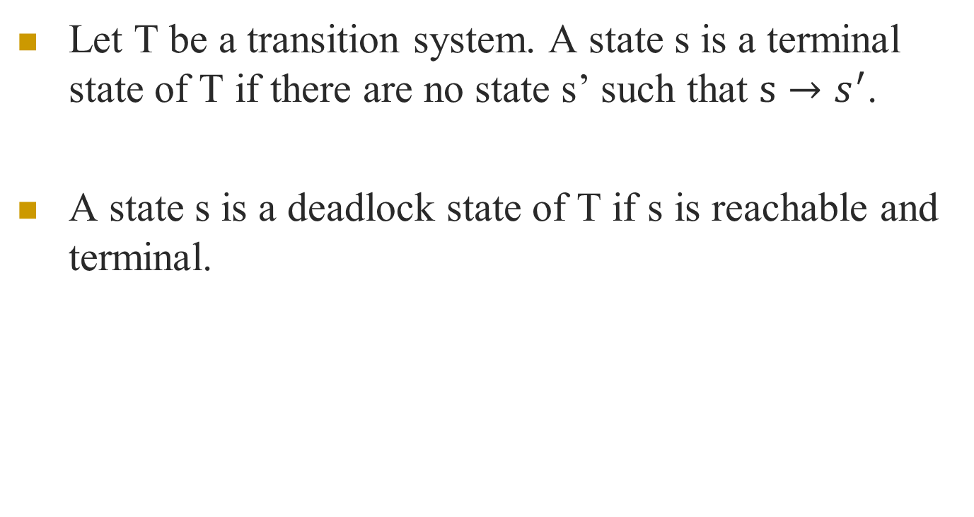
Let T be a transition system. A state s is a terminal state of T if there are no state s’ such that $s→s^{′}$.
A state s is a deadlock state of T if s is reachable and terminal.

Slide 9
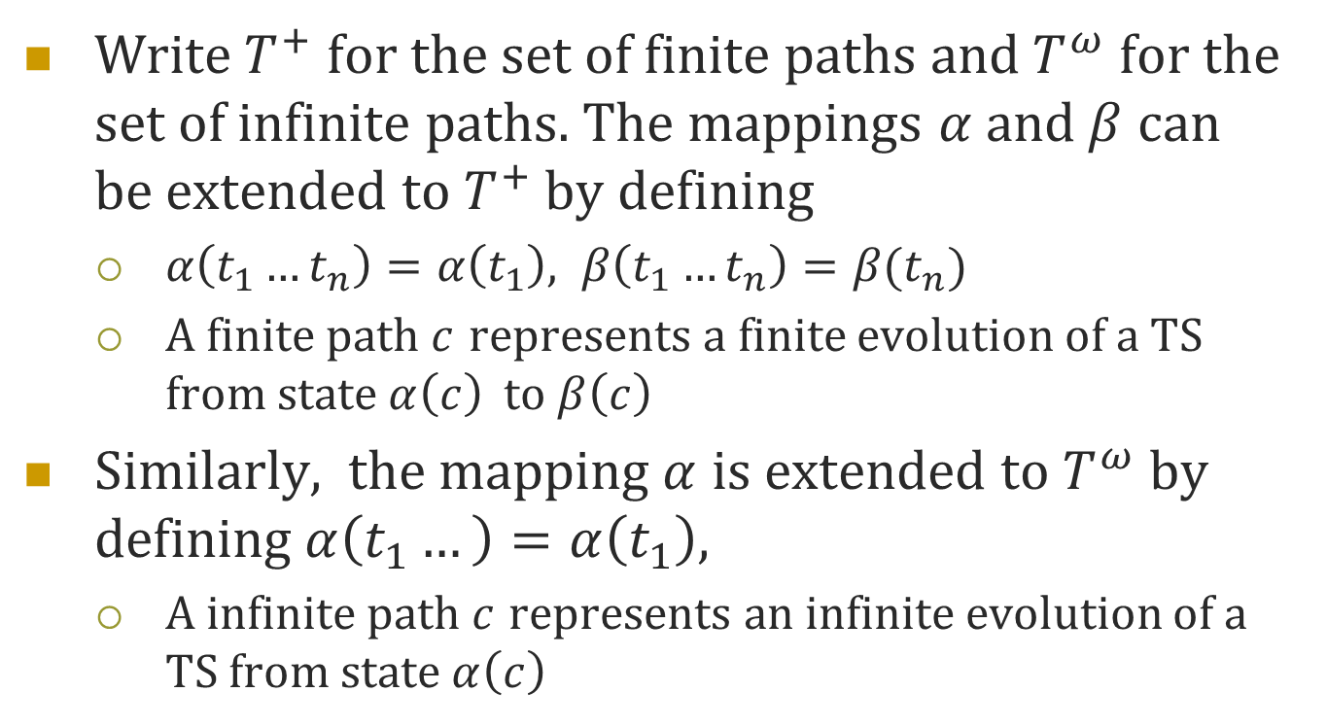
Write$T^{+}$ for the set of finite paths and $T^{ω}$ for the set of infinite paths. The mappings $α$ and$β$ can be extended to $T^{+}$ by defining
$α\left(t_{1}…t_{n}\right)=α\left(t_{1}\right), β\left(t_{1}…t_{n}\right)=β(t_{n})$
A finite path $c$ represents a finite evolution of a TS from state$α\left(c\right)$to$β\left(c\right)$
Similarly, the mapping$α$ is extended to $T^{ω}$ by defining$α\left(t_{1}…\right)=α\left(t_{1}\right),$
A infinite path $c$ represents an infinite evolution of a TS from state$α\left(c\right)$

Slide 10
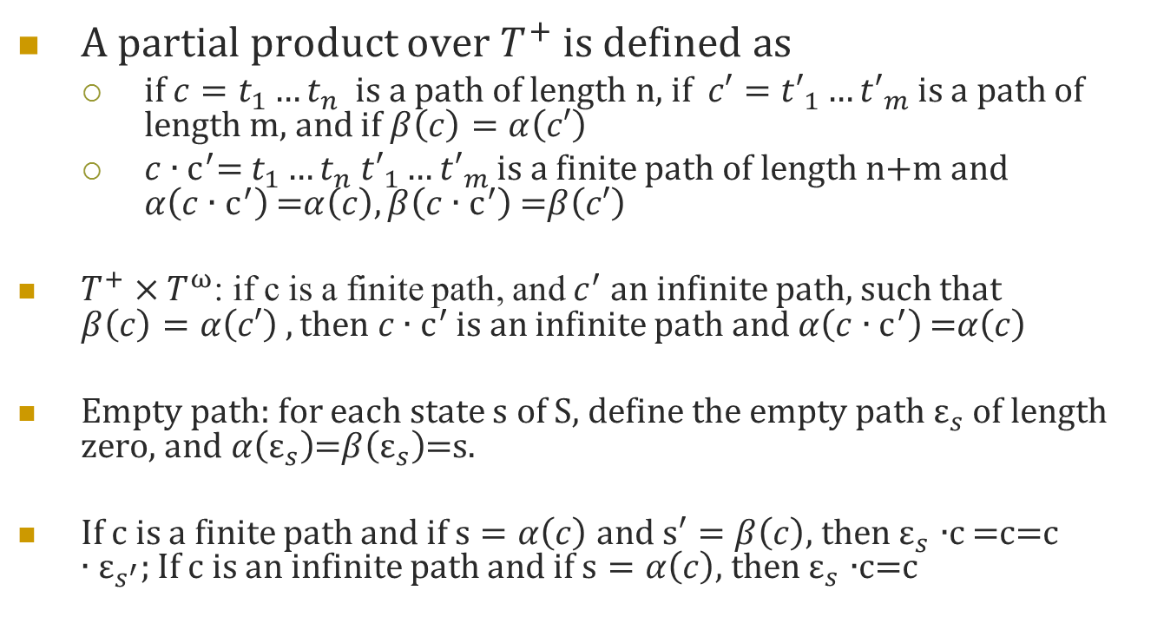
A partial product over $T^{+}$ is defined as
if ${c=t}_{1}…t_{n}$ is a path of length n, if ${c′=t′}_{1}…{t′}_{m}$is a path of length m, and if $β\left(c\right)=α\left(c′\right)$
$c{∙c}^{′}=$ $t_{1}…t_{n}$ ${t′}_{1}…{t′}_{m}$ is a finite path of length n+m and $α\left(c{∙c}^{′}\right)$=$α\left(c\right), β\left(c{∙c}^{′}\right)$=$β\left(c′\right)$
$T^{+}×T^{ω}$: if c is a finite path, and $c^{′}$an infinite path, such that $β\left(c\right)=α\left(c′\right) , then c{∙c}^{′}$ is an infinite path and$α\left(c{∙c}^{′}\right)$=$α\left(c\right)$
Empty path: for each state s of S, define the empty path $ε_{s}$of length zero, and$α\left(ε_{s}\right)$=$β\left(ε_{s}\right)$=s.
If c is a finite path and if $s=α\left(c\right)$ and $s′=β\left(c\right)$, then $ε_{s}$ $∙$c =c=$c∙ε_{s^{′}};$If c is an infinite path and if $s=α\left(c\right)$, then $ε_{s}$ $∙$c=c

Slide 11
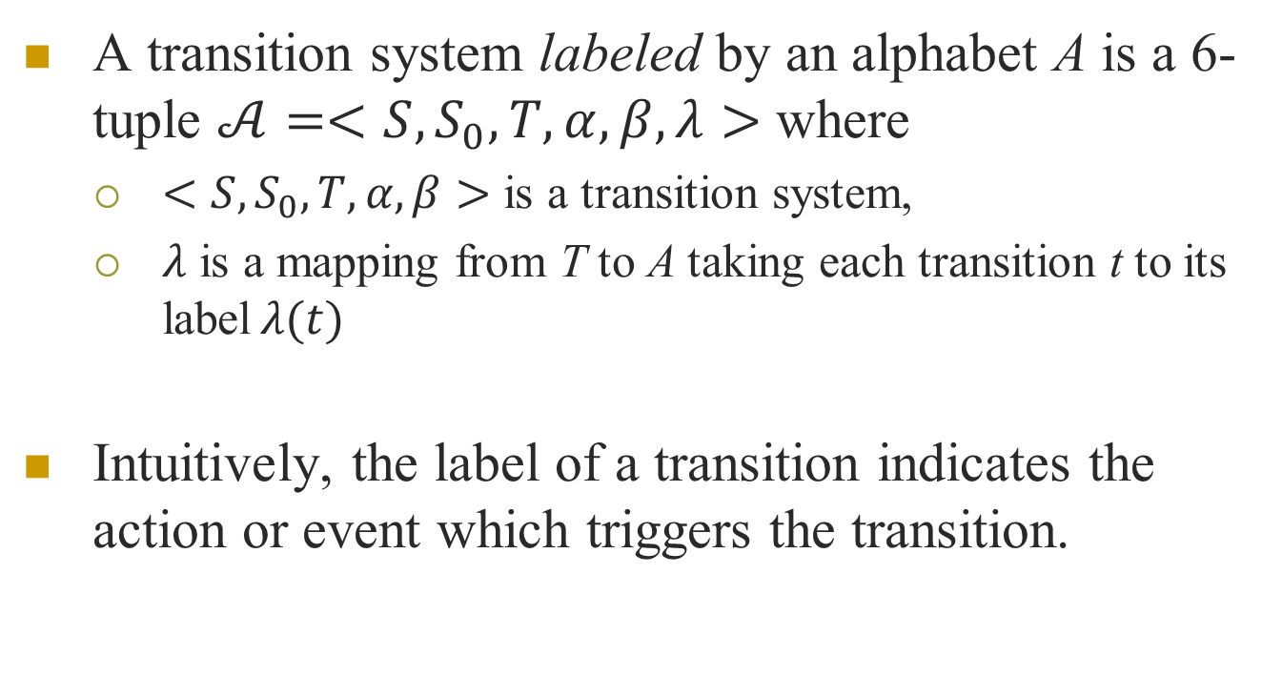
Labeled transition systems
A transition system labeled by an alphabet A is a 6-tuple $𝒜=<S,S_{0},T,α,β,λ>$ where
$<S,S_{0},T,α,β>$ is a transition system,
$λ$ is a mapping from T to A taking each transition t to its label$λ(t)$
Intuitively, the label of a transition indicates the action or event which triggers the transition.

Slide 12
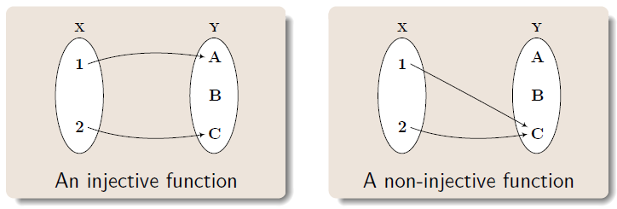
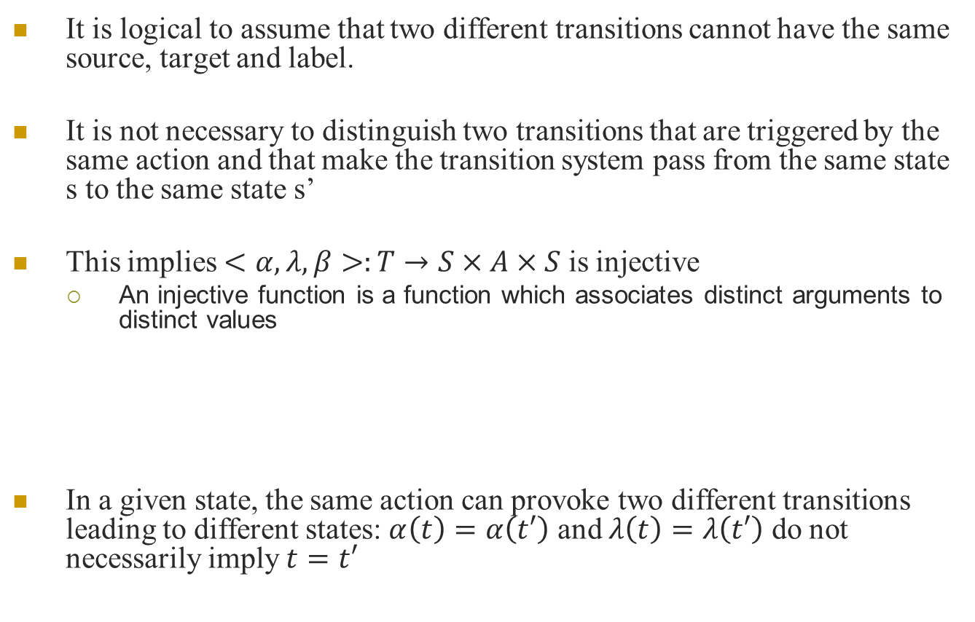
It is logical to assume that two different transitions cannot have the same source, target and label.
It is not necessary to distinguish two transitions that are triggered by the same action and that make the transition system pass from the same state s to the same state s’
This implies $<α,λ,β>:T→S×A×S$ is injective
An injective function is a function which associates distinct arguments to distinct values
In a given state, the same action can provoke two different transitions leading to different states: $α\left(t\right)=α\left(t′\right)$ and $λ\left(t\right)=λ\left(t′\right)$ do not necessarily imply $t=t′$
Notes:
单射

Slide 13
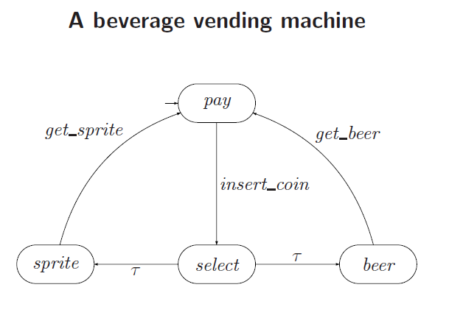

Slide 14

Traces
If c = $t_{1}$, $t_{2}⋯,$is a path in a labeled transition system, the sequence of actions trace(c) = ${λ(t}_{1})$, $λ(t_{2})⋯$is called the trace of the path.

Slide 15
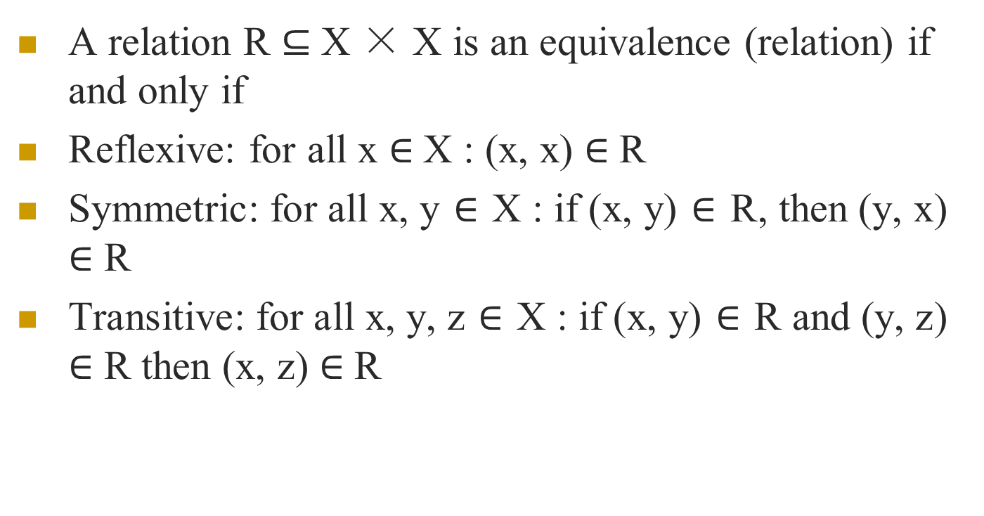
Equivalence Relation
A relation R $⊆$ X × X is an equivalence (relation) if and only if
Reflexive: for all x $∈$X : (x, x) $∈$ R
Symmetric: for all x, y $∈$ X : if (x, y) $∈$ R, then (y, x) $∈$ R
Transitive: for all x, y, z $∈$ X : if (x, y) $∈$ R and (y, z) $∈$ R then (x, z) $∈$ R

Slide 16
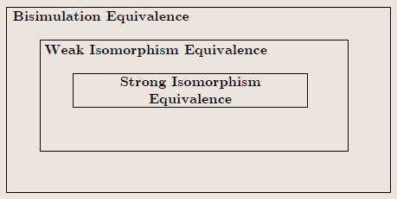
There are numerous notions of equivalency for transition systems
We consider the following:
Strong isomorphism
Weak isomorphism
Bisimulation equivalence

Slide 17
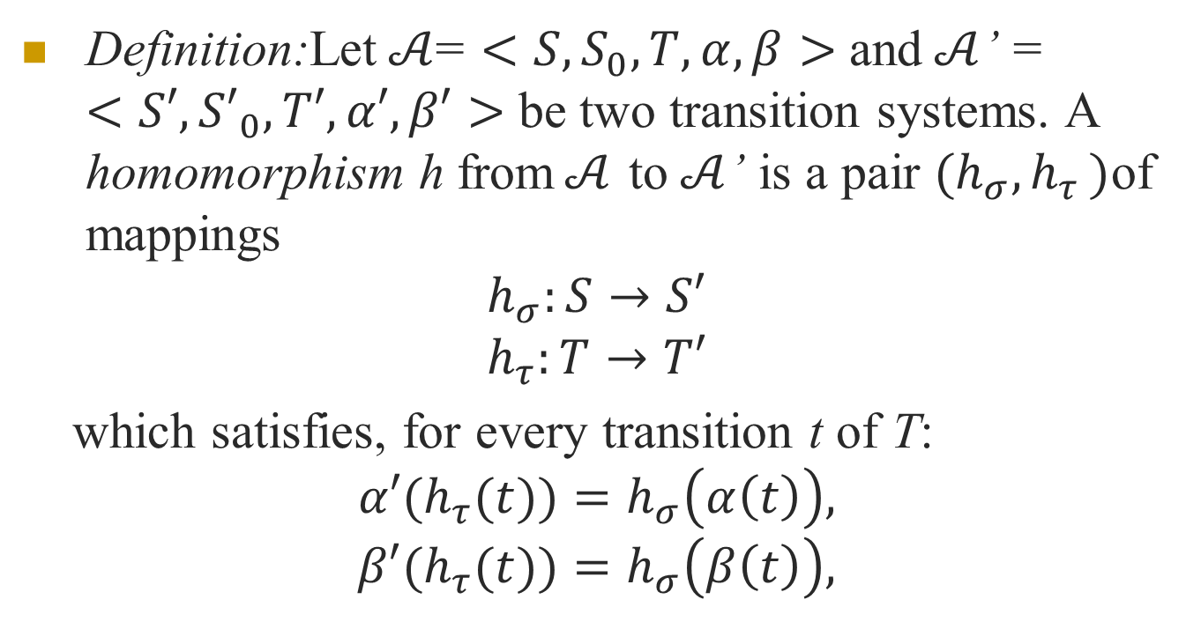
Transition system homomorphism
Definition:Let$𝒜$= $<S,S_{0},T,α,β>$ and$𝒜$’ = $<S′,{S′}_{0},T′,α′,β′>$ be two transition systems. A homomorphism h from$𝒜$ to$𝒜$’ is a pair $(h_{σ}{,h}_{τ})$of mappings
$$h_{σ}:S→S′$$
$$h_{τ}:T→T′$$
which satisfies, for every transition t of T:
$${α′(h}_{τ}{(t))=h}_{σ}\left(α\left(t\right)\right),$$
$${β′(h}_{τ}{(t))=h}_{σ}\left(β\left(t\right)\right),$$

Slide 18
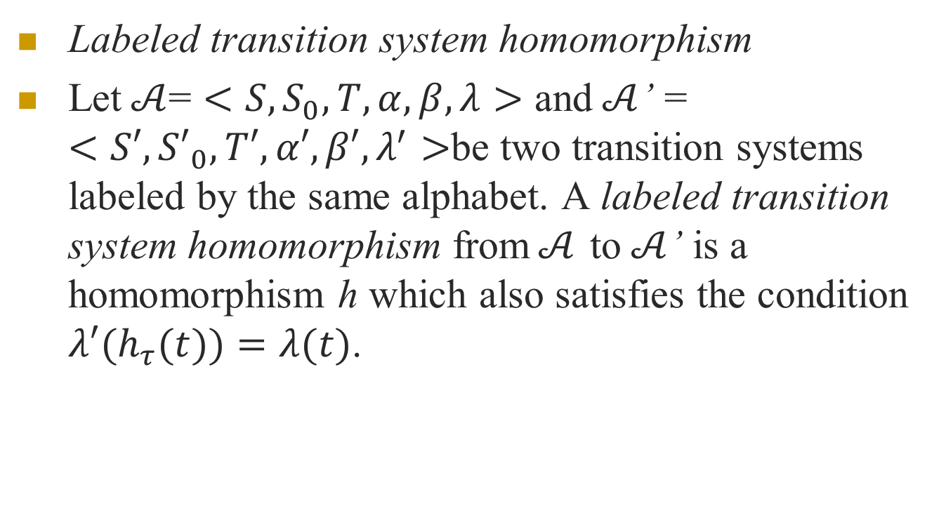
Labeled transition system homomorphism
Let$𝒜$= $<S,S_{0},T,α,β, λ>$ and$𝒜$’ = $<S′,{S′}_{0},T′,α′,β′,λ^{′}>$be two transition systems labeled by the same alphabet. A labeled transition system homomorphism from$𝒜$ to$𝒜$’ is a homomorphism h which also satisfies the condition ${λ′(h}_{τ}(t))=λ(t)$.

Slide 19
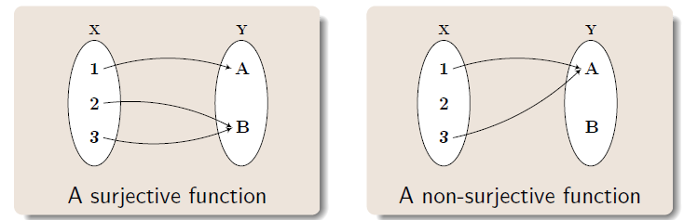
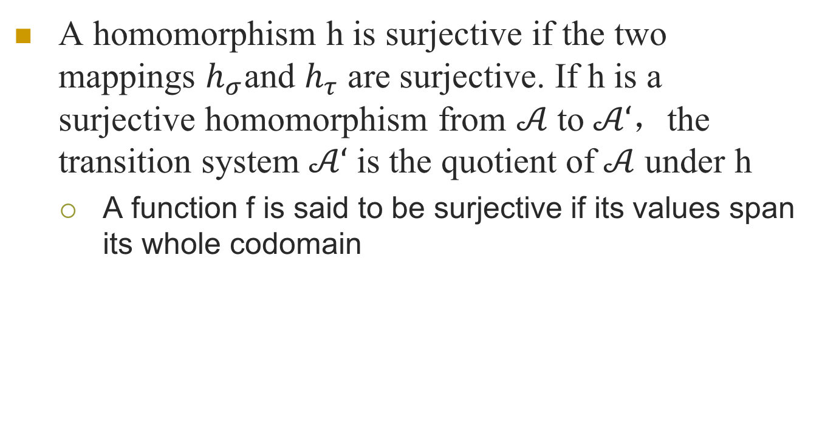
A homomorphism h is surjective if the two mappings $h_{σ}{\text{and} h}_{τ}$ are surjective. If h is a surjective homomorphism from $𝒜$ to$𝒜‘$，the transition system $𝒜‘$ is the quotient of$𝒜$ under h
A function f is said to be surjective if its values span its whole codomain
Notes:
满射

Slide 20
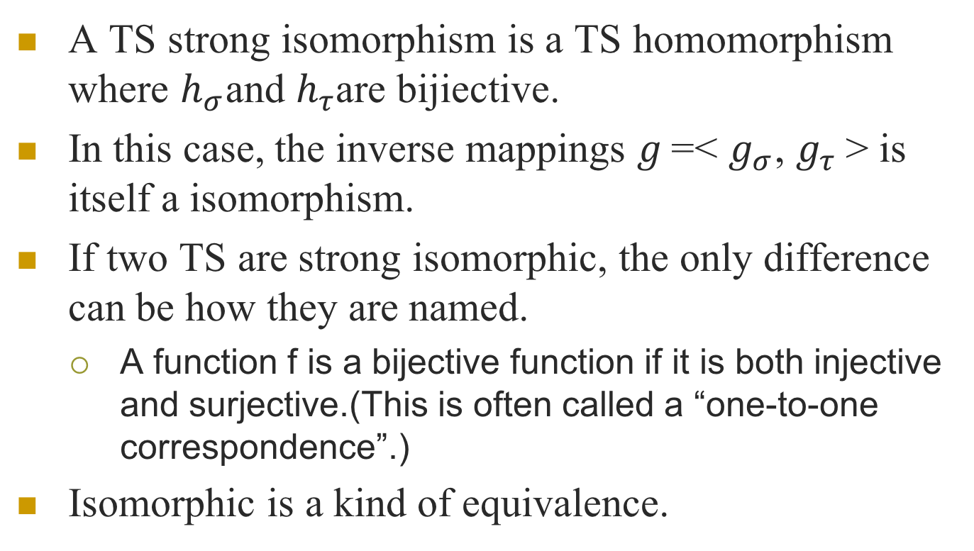
A TS strong isomorphism is a TS homomorphism where $h_{σ}{\text{and} h}_{τ}$are bijiective.
In this case, the inverse mappings $g$=< $g_{σ}{\text{,} g}_{τ}$> is itself a isomorphism.
If two TS are strong isomorphic, the only difference can be how they are named.
A function f is a bijective function if it is both injective and surjective.(This is often called a “one-to-one correspondence”.)
Isomorphic is a kind of equivalence.

Slide 21
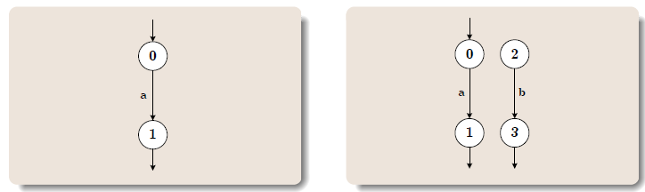
Are these two systems isomorphic?

Slide 22
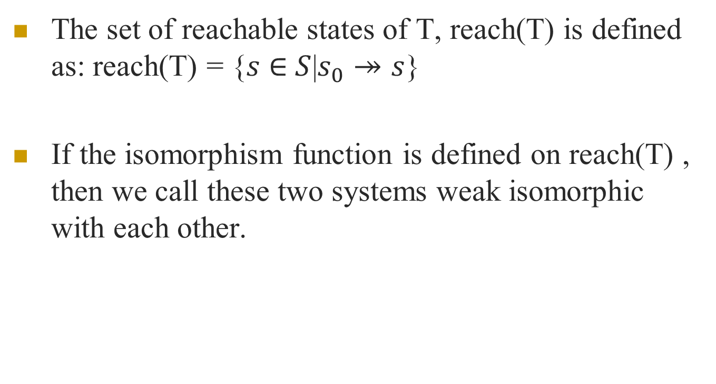
Weak Isomorphism
The set of reachable states of T, reach(T) is defined as: reach(T) = {$s$ $∈$ $S$|$s_{0}↠s$}
If the isomorphism function is defined on reach(T) , then we call these two systems weak isomorphic with each other.

Slide 23
These two systems are weak isomorphic
Theorem:
If two transition systems are isomorphic, then they are weakly isomorphic.
Weak isomorphism is an equivalence relation

Slide 24
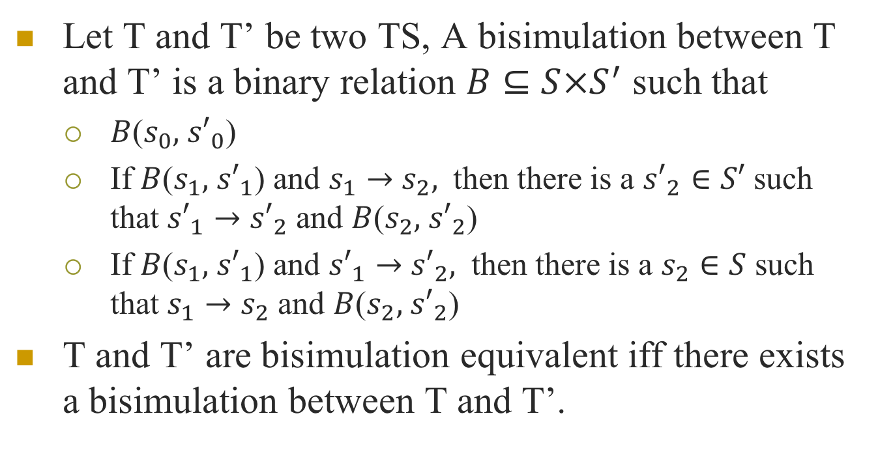
Let T and T’ be two TS, A bisimulation between T and T’ is a binary relation $B⊆S×S^{′}$ such that
$B$($s_{0},$ ${s′}_{0}$)
If $B$($s_{1},$ ${s′}_{1}$) and $s_{1}→$ $s_{2},$ then there is a ${s′}_{2}∈S′$ such that ${s′}_{1}→$ ${s′}_{2}$ and $B$($s_{2},$ ${s′}_{2}$)
If $B$($s_{1},$ ${s′}_{1}$) and ${s′}_{1}→$ ${s′}_{2},$ then there is a $s_{2}∈S$ such that $s_{1}→$ $s_{2}$ and $B$($s_{2},$ ${s′}_{2}$)
T and T’ are bisimulation equivalent iff there exists a bisimulation between T and T’.

Slide 25
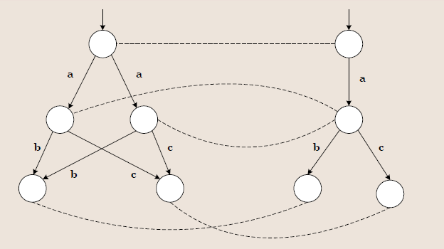
Example
two isomorphic TS are bisimilar, but bisimilar TS are not necessarily isomorphic

Slide 26
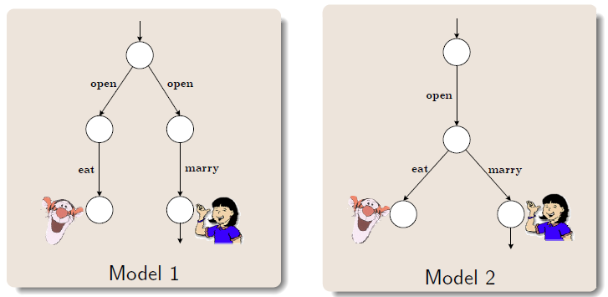
The lady or the tiger

Slide 27
Strong Isomorphism: the transition systems are identical except for the names of the states.
Weak Isomorphism: the transition systems are strongly isomorphic provided that the transition systems are restricted to the reachable states.
Bisimulation Equivalence: the transition systems have the same behavior, and make choice at same time.

Slide 28
Use TS to present the behavior of all the modeling language
Then Use TS to prove the equivalence respectively

Slide 29
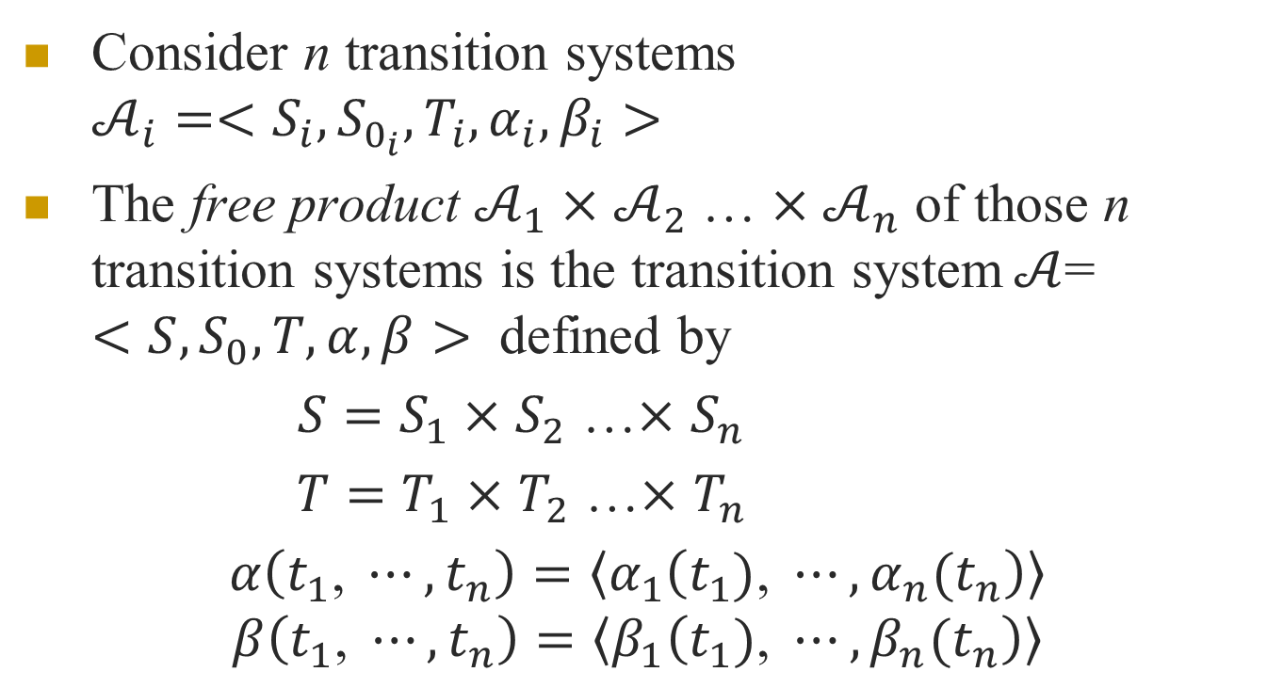
The free product of transition systems
Consider n transition systems $𝒜_{i}=<S_{i},S_{0_{i}},T_{i},α_{i},β_{i}>$
The free product $𝒜_{1}×$ $𝒜_{2}$ … $×𝒜_{n}$ of those n transition systems is the transition system$𝒜$= $<S,S_{0},T,α,β>$ defined by
${S=S}_{1}×$ $S_{2}$ …$×$ $S_{n}$
${T=T}_{1}×$ $T_{2}$ …$×$ $T_{n}$
$α\left(t_{1}\text{, }⋯,t_{n}\right)=\left\langle α_{1}\left(t_{1})\text{, }⋯,{α_{n}(t}_{n}\right)\right\rangle$
$$β\left(t_{1}\text{, }⋯,t_{n}\right)=\left\langle β_{1}\left(t_{1})\text{, }⋯,{β_{n}(t}_{n}\right)\right\rangle$$

Slide 30
p,s
p
s
q
t
p,t
q,s
q,t

Slide 31

If, in addition, each $𝒜_{i }$is labeled by an alphabet $A_{i }$, the free product is a transition system labeled by the alphabet $A_{1}×$ $A_{2}$ … $×A_{n}$; transitions are labeled as follows:$λ\left( t_{1}\text{, }⋯,t_{n}\right)=\left\langle λ_{1}\left(t_{1})\text{, }⋯,{λ_{n}(t}_{n}\right)\right\rangle$

Slide 32
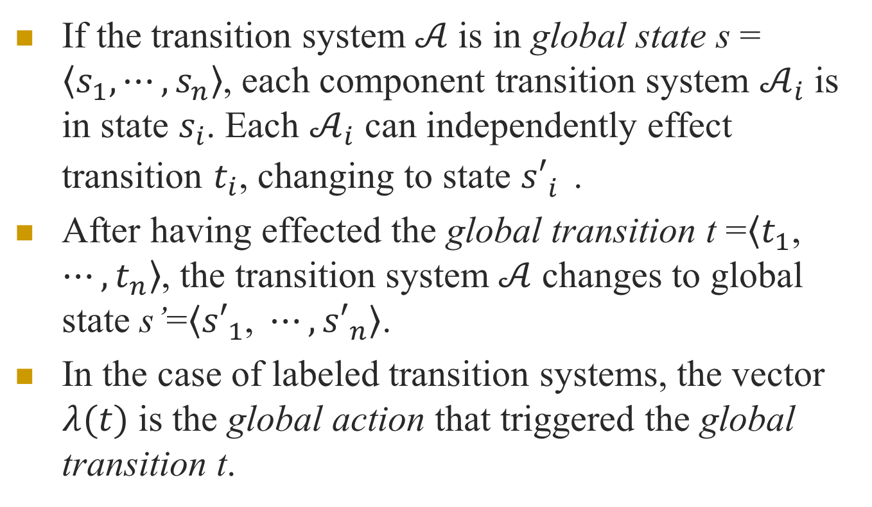
If the transition system$𝒜$ is in global state s = $\left\langle s_{1}\text{,}⋯,s_{n}\right\rangle$, each component transition system $𝒜_{i}$ is in state $s_{i}$. Each $𝒜_{i}$ can independently effect transition $t_{i}$, changing to state ${s′}_{i}^{}$.
After having effected the global transition t =$\left\langle t_{1}\text{, }⋯,t_{n}\right\rangle$, the transition system$𝒜$ changes to global state s’=$\left\langle {s′}_{1}\text{, }⋯,{s′}_{n}\right\rangle$.
In the case of labeled transition systems, the vector $λ(t)$ is the global action that triggered the global transition t.

Slide 33
The synchronous product of transition systems
When processes interact, not all possible global actions are useful, since the interaction is subject to communication and synchronization constraints.
The transition system associated with the system of processes must therefore be a subsystem of the free product of the component transition systems.
The communication and synchronization constraints that define the subsystem can always be simply expressed by the synchronous product, formally defined below.

Slide 34
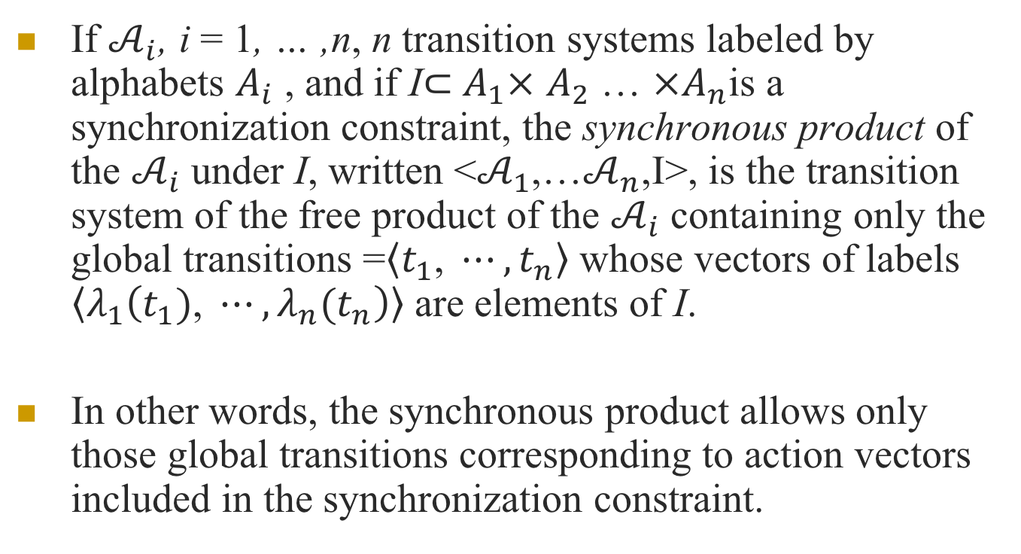
If $𝒜_{i}$, i = 1, … ,n, n transition systems labeled by alphabets $A_{i}$ , and if I$⊂$ $A_{1}×$ $A_{2}$ … $×A_{n}$is a synchronization constraint, the synchronous product of the $𝒜_{i}$ under I, written <$𝒜_{1}$,…$𝒜_{n}$,I>, is the transition system of the free product of the $𝒜_{i}$ containing only the global transitions =$\left\langle t_{1}\text{, }⋯,t_{n}\right\rangle$ whose vectors of labels $\left\langle λ_{1}\left(t_{1})\text{, }⋯,{λ_{n}(t}_{n}\right)\right\rangle$ are elements of I.
In other words, the synchronous product allows only those global transitions corresponding to action vectors included in the synchronization constraint.

Slide 35
p,s
p
s
p,k
q,s
q
t
k
p,t
q,k
q,t

Slide 36
a b c <a,b> <a,c>
p,s
p
s
p,k
q
q,s
t
k
p,t
q,k
q,t

Slide 37
a b c <a,b>
p,s
p
s
p,k
q
q,s
t
k
p,t
q,k
q,t

Slide 38
The free product assumes that in a global system, all component systems execute their transitions simultaneously,
it is possible to divide time into intervals in such a way that during each of those intervals each component executes exactly one transition. In other words, the same ‘clock’ drives the different transition systems forming the product.

Slide 39


$$τ Transition$$
$τ Transition, stuttering loop$
p,s
p
s
q
t
p,t
q,s
q,t

Slide 40
Shared label

Slide 41
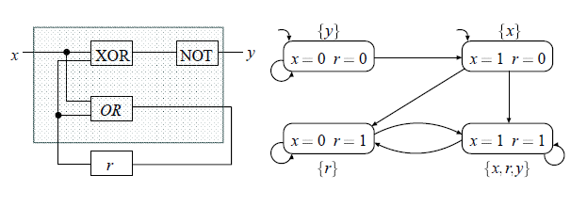

Modeling sequential circuits
Input variable x, output variable y, and register r
Output function $¬(x⊕r)$ and register evaluation function $x∨r$

Slide 42
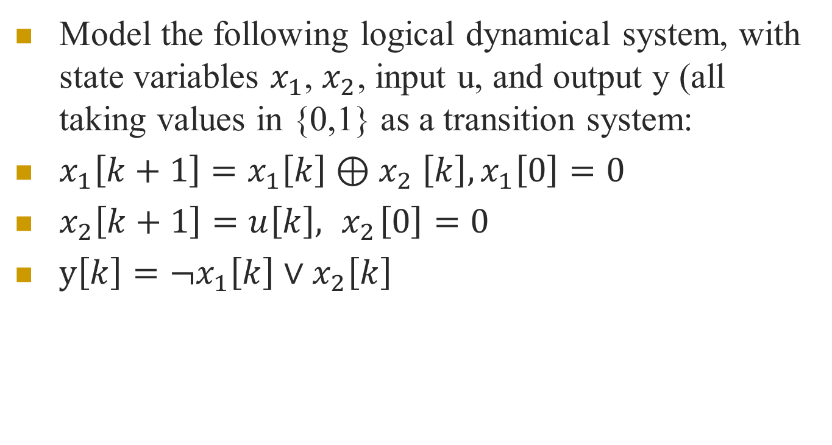
Model the following logical dynamical system, with state variables $x_{1}$, $x_{2}$, input u, and output y (all taking values in {0,1} as a transition system:
$x_{1}\left[k+1\right]=x_{1}\left[k\right]{⊕x}_{2}\left[k\right], x_{1}\left[0\right]=0$
$x_{2}\left[k+1\right]=u\left[k\right], { x}_{2}\left[0\right]=0$
$y\left[k\right]=¬x_{1}\left[k\right]∨x_{2}\left[k\right]$

Slide 43
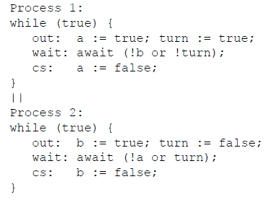
A Mutual Exclusion Protocol
Two concurrently executing processes are trying to enter a critical section without violating mutual exclusion

Slide 44
State Space
The state space of a program can be captured by the valuations of the variables and the program counters
For our example, we have
two program counters: pc1, pc2, domains of the program counters: {out, wait, cs}
three boolean variables: turn, a, b, boolean domain: {True, False}
Each state of the program is a valuation of all the variables

Slide 45
Each state can be written as a tuple (pc1,pc2,turn,a,b)
Initial states: {(o,o,F,F,F), (o,o,F,F,T), (o,o,F,T,F), (o,o,F,T,T), (o,o,T,F,F), (o,o,T,F,T), (o,o,T,T,F), (o,o,T,T,T)}
– initially: pc1=o and pc2=o
How many states total?
3 * 3 * 2 * 2 * 2 = 72
exponential in the number of variables and the
number of concurrent components

Slide 46
Transition Relation specifies the next-state relation, i.e., given a state what are the states that can come immediately after that state
For example, given the initial state (o,o,F,F,F)
Process 1 can execute:
out: a := true; turn := true;
or Process 2 can execute:
out: b := true; turn := false;
If process 1 executes, the next state is (w,o,T,T,F)
If process 2 executes, the next state is (o,w,F,F,T)
So the state pairs ((o,o,F,F,F),(w,o,T,T,F)) and ((o,o,F,F,F),(o,w,F,F,T)) are included in the transition relation

Slide 47
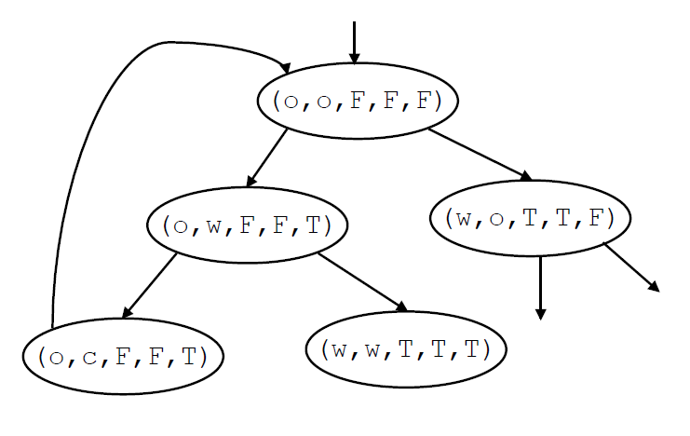

Slide 48
P =m: cobegin P0 || P1 coend m’
P0:: l0: while True do
NC0: wait (turn =0);
CR0: turn :=1;
end while
l0’
P1: l1: while True do
NC1: wait (turn =1);
CR1: turn :=0;
end while
l1’

Slide 49
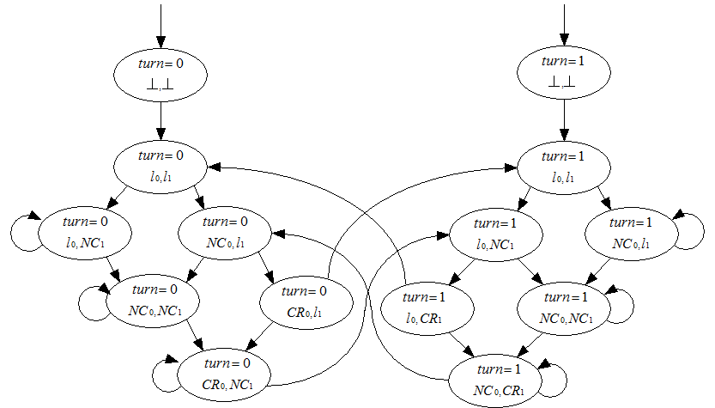

Slide 50
Temporal Properties
once r is 1, it will be 1 forever
Two program cannot in the critical section together
If you choose sprite, you cannot get beer unless you pay again
No deadlock

Slide 51
Introduction
Temporal logic is a formalism for describing sequences of transitions between states in a reactive system.
Properties like eventually or never are specified using special temporal operators.
CTL*
Notes:
路径量词 时序操作符

Slide 52
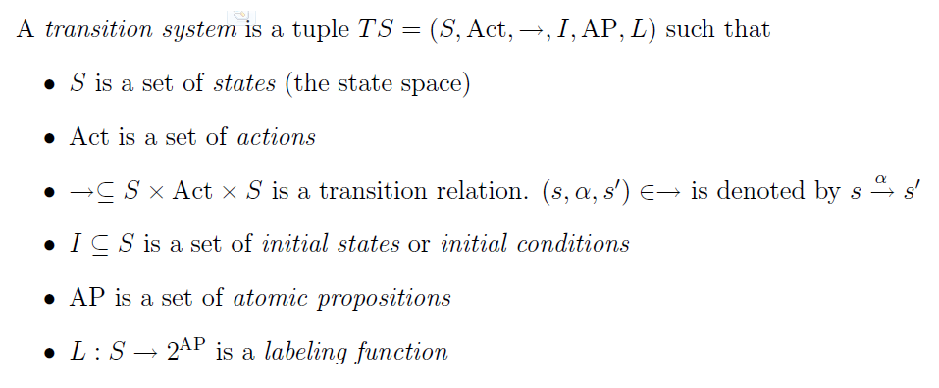

Slide 53
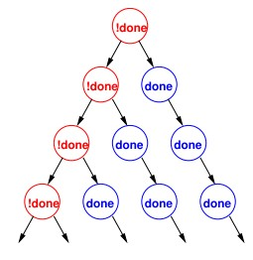
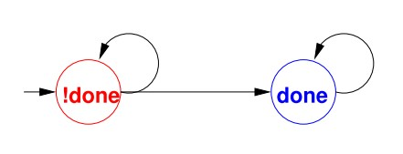
CTL*
CTL* formulas describe properties of computation trees.
The computation tree shows all of the possible executions starting from the initial state.

Slide 54
Path quantifiers and Temporal operators
Path quantifiers:
A ( for all computation path )
E ( for some computation path )
Temporal operators:
X, F, G, U, R

Slide 55
X (next time) requires the property holds in the second state of the path
F (eventually) the property will hold at some state on the path
G (always) the property holds at every state on the path
U (until) if there is a state on the path where the second property holds, at every preceding state, the first one holds
R (release) the second property holds along the path up to and including the first state where the first property holds. However, the first property is not required to hold eventually

Slide 56
two types of formulas in CTL*
state formulas ( which are true in a special state )
path formulas ( which are true along a special path )
syntax of state formulas rules:
if then p is sf
if f and g are sf, are sf
if f is a pf, then E f and A f are sf

Slide 57
syntax of path formulas:
if f is a sf, then f is also a pf
if f and g are pf, , X f, F f, G f,
f U g and f R g are pf
CTL* is the set of state formulas generated by the above rules
semantics of CTL*
if f is a sf, M, s ->f means that f holds at state s in the M
if g is a pf, M, π-> g means that g holds along path π in the M

Slide 58
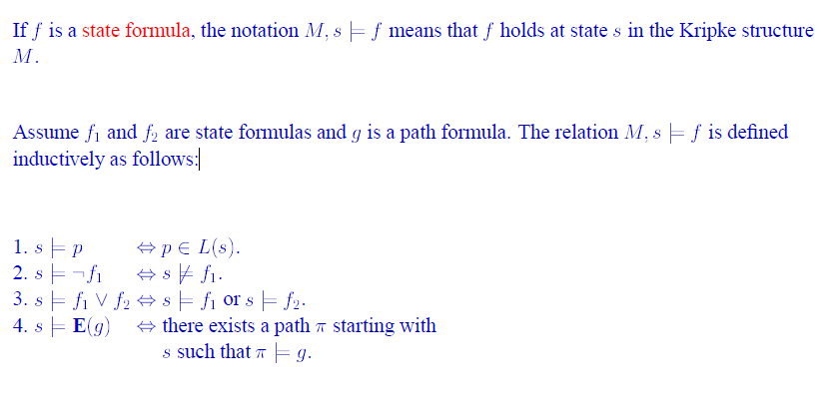

Slide 59
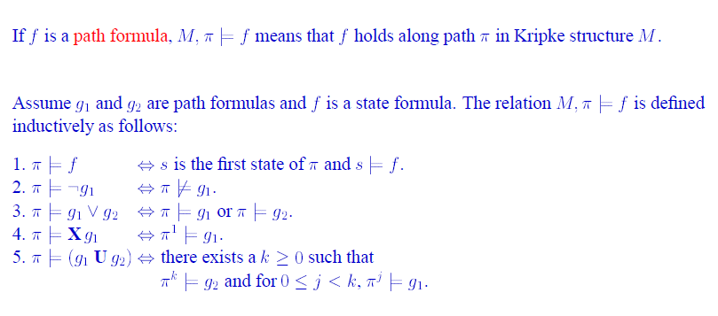

Slide 60
CTL and LTL
two sublogics of CTL*
branching-time logic
the temporal operators quantify over the paths that are possible from a given state.
Temporal operators must be immediately preceded by a path quantifier.
if f and g are sf, X f, F f, G f, f U g and f R g are pf
A(FG p)
Linear temporal logic
operators are provided for describing events along a single computation path.
LTL implicitly quantifies universally over paths.
If , then p is pf , Af where f is a pf
AG(EF p)

Slide 61
CTL
ten basic CTL operators:
AX and EX
AF and EF
AG and EG
AU and EU
AR and ER

Slide 62
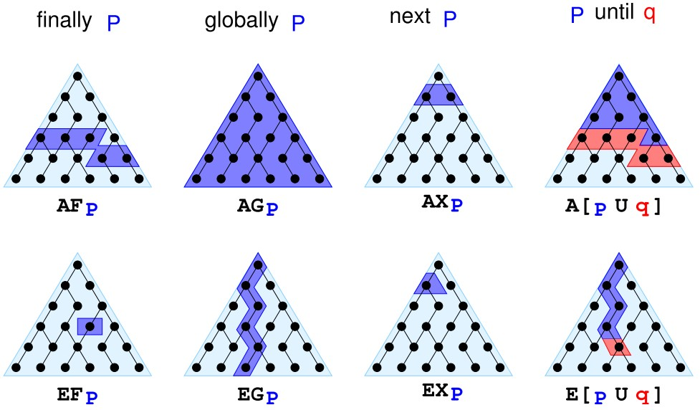
CTL

Slide 63
Each of the ten operators can be expressed in terms of EX, EG and EU
AX f= ! EX(!f)
EF f= E[True U f]
AG f =!EF(!f)
AF f= !EG(!f)
A[f U g]= !E[!gU(!f ^ !g)] ^ !EG !g
A[f R g] = !E[!f U !g]
E[f R g] = !A[!f U !g]

Slide 64
Examples
Let "P" mean "I like chocolate" and Q mean "It's warm outside."
AG.P "I will like chocolate from now on, no matter what happens.“
EF.P "It's possible I may like chocolate some day, at least for one day."
AF.EG.P "It's always possible (AF) that I will suddenly start liking chocolate for the rest of time." (Note: not just the rest of my life, since my life is finite, while G is infinite).
EG.AF.P "This is a critical time in my life. Depending on what happens next (E), it's possible that for the rest of time (G), there will always be some time in the future (AF) when I will like chocolate. However, if the wrong thing happens next, then all bets are off and there's no guarantee about whether I'll ever like chocolate."

Slide 65
A(PUQ)
"From now until it's warm outside, I will like chocolate every single day. Once it's warm outside, all bets are off as to whether I'll like chocolate anymore. Oh, and it's guaranteed to be warm outside eventually, even if only for a single day."
E((EX.P)U(AG.Q))
"It's possible that: there will eventually come a time when it will be warm forever (AG.Q) and that before that time there will always be some way to get me to like chocolate the next day (EX.P)."

Slide 66
Express Properties
Safety: something bad will not happen
Typical examples:
AG ( reactor_temp < 1000 )
Usually:
AG

Slide 67
Express Properties
Liveness: something good will happen
Typical examples:
AF( rich )
AF( x > 5 )
AG( start -> AF terminate )
Usually:
AF

Slide 68
Express Properties
Fairness: something is successful/allocated infinitely often.
Typical examples:
AGAF ( enabled )
Usually:
AGAF

Slide 69
