Slide 1
Specification Formalisms
(Book: Chapter 5)
Notes:
1

Slide 2
Properties of formalisms
Formal. Unique interpretation.
Intuitive. Simple to understand (visual).
Succinct. Spec. of reasonable size.
Effective.
  Check that there are no contradictions.
  Check that the spec. is implementable.
  Check that the implementation satisfies spec.
Expressive.
May be used to generate initial code.
Specifying the implementation or its properties?

Slide 3
A transition system
A (finite) set of variables V.
A set of states Σ.
A (finite) set of transitions T, each transition e➔t has
  an enabling condition e and a transformation t.
An initial condition I.
Denote by R(s, s’) the fact that s’ is a successor of s.
Notes:
2
11

Slide 4
The interleaving model
An execution is a finite or infinite sequence of states s₀, s₁, s₂, …
The initial state satisfies the initial condition, I.e., I (s₀).
Moving from one state s_{i} to s_{i+1} is by executing a transition e➔t:
  e(s_{i}), I.e., s_{i} satisfies e.
  s_{i+1} is obtained by applying t to s_{i}.
Lets assume all sequences are infinite by extending finite ones by “stuttering” the last state.
Notes:
3
13

Slide 5
Temporal logic
Dynamic, speaks about several “worlds” and the relation between them.
Our “worlds” are the states in an execution.
There is a linear relation between them, each two sequences in our execution are ordered.
Interpretation: over an execution, later over all executions.

Slide 6
LTL: Syntax
ϕ ::= (ϕ) | ¬ϕ | ϕ /\ ϕ | ϕ \/ ϕ | ϕ U ϕ |
[] ϕ | <>ϕ |O ϕ | p
[] ϕ −− “box”, “always”, “forever”
<>ϕ −− “diamond”, “eventually”, “sometimes”
O ϕ −− “nexttime”
ϕ U ψ −− “until”
Propositions p, q, r, … Each represents some state property (x>y+1, z=t, at_CR, etc.)
Notes:
2

Slide 7
Semantics over suffixes of execution
[] ϕ
<>ϕ
O ϕ
ϕU ψ
ϕ
ϕ
ϕ
ϕ
ϕ
ϕ
ϕ
ϕ
ϕ
ϕ
ϕ
ϕ
ϕ
ϕ
ψ
Notes:
3

Slide 8
Can discard some operators
Instead of <>p, write true U p.
Instead of []p, we can write ¬(<>¬p),
or ¬(true U ¬p).
Because []p=¬¬[]p.
¬[]p means it is not true that p holds forever, or at some point ¬p holds or <>¬p.

Slide 9
Combinations
[]<>p “p will happen infinitely often”
<>[]p “p will happen from some point forever”.
([]<>p) → ([]<>q) “If p happens infinitely often, then q also happens infinitely often”.
Notes:
4

Slide 10
Some relations:
[](ϕ/\ψ)=([]ϕ)/\([]ψ)
But <>(ϕ/\ψ)≠(<>ϕ)/\(<>ψ)
<>(ϕ\/ψ)=(<>ϕ)\/(<>ψ)
But [](ϕ\/ψ)≠([]ϕ)\/([]ψ)
ψ
ϕ
ϕ
ϕ
ψ
ψ
ϕ
ψ
ϕ
ψ
ψ

Slide 11
What about
([]<>ϕ)/\([]<>ψ)=[]<>(ϕ/\ψ)?
([]<>ϕ)\/([]<>ψ)=[]<>(ϕ\/ψ)?
(<>[]ϕ)/\(<>[]ψ)=<>[](ϕ/\ψ)?
(<>[]ϕ)\/(<>[]ψ)=<>[](ϕ\/ψ)?
No, just ←
Yes!!!
Yes!!!
No, just →

Slide 12
Formal semantic definition
Let σ be a sequence s₀ s₁ s₂ …
Let σ^{i} be a suffix of σ: s_{i} s_{i+1} s_{i+2} … (σ⁰ =σ )
σ^{i} |= p, where p a proposition, if s_{i}|=p.
σ^{i} |= ϕ/\ψ if σ^{i} |= ϕ and σ^{i} |= ψ.
σ^{i} |= ϕ\/ψ if σ^{i} |= ϕ or σ^{i} |= ψ.
σ^{i} |= ¬ϕ if it is not the case that σ^{i} |= ϕ.
σ^{i} |= <>ϕ if for some j≥i, σ^{j} |= ϕ.
σ^{i} |= []ϕ if for each j≥i, σ^{j} |= ϕ.
σ^{i} |= ϕU ψ if for some j≥i, σ^{j}|=ψ.
and for each i≤k<j, σ^{k} |=ϕ.

Slide 13
Then we interpret:
For a state:
s|=p as in propositional logic.
For an execution:
σ|=ϕ is interpreted over a sequence, as in previous slide.
For a system/program:
P|=ϕ holds if σ|=ϕ for every sequence σ of P.

Slide 14
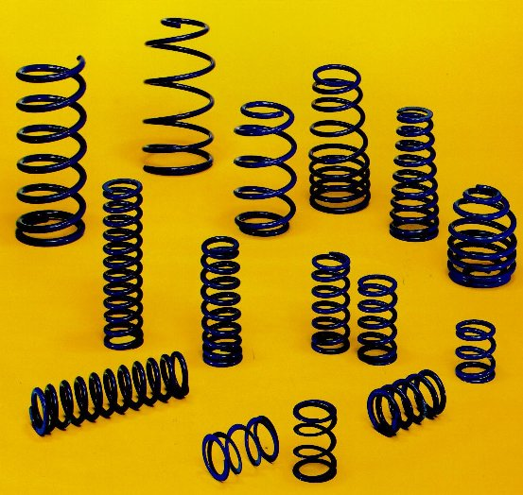
Spring Example
release
s₁
s₂
s₃
pull
release
extended
extended
malfunction
r₀ = s₁ s₂ s₁ s₂ s₁ s₂ s₁ …
r₁ = s₁ s₂ s₃ s₃ s₃ s₃ s₃ …
r₂ = s₁ s₂ s₁ s₂ s₃ s₃ s₃ …
…

Slide 15
LTL satisfaction by a single sequence
r₂ = s₁ s₂ s₁ s₂ s₃ s₃ s₃ …
release
s₁
s₂
s₃
pull
release
extended
extended
malfunction
r₂ |= extended ??
r₂ |= O extended ??
r₂ |= O O extended ??
r₂ |= <> extended ??
r₂ |= [] extended ??
r₂ |= <>[] extended ??
r₂ |= ¬ <>[] extended ??
r₂ |= (¬extended) U malfunction ??
r₂ |= [](¬extended->O extended) ??

Slide 16
LTL satisfaction by a system
release
s₁
s₂
s₃
pull
release
extended
extended
malfunction
P |= extended ??
P |= O extended ??
P |= O O extended ??
P |= <> extended ??
P|= [] extended ??
P |= <>[] extended ??
P |= ¬ <>[] extended ??
P |= (¬extended) U malfunction ??
P |= [](¬extended->O extended) ??

Slide 17
More specifications
[] (PC0=NC0 → <> PC0=CR0)
[] (PC0=NC0 U Turn=0)
Try at home:
- The processes alternate in entering their critical sections.
- Each process enters its critical section infinitely often.

Slide 18
Proof system
¬<>p<-->[]¬p
[](p→q)→([]p→[]q)
[]p→(p/\O[]p)
O¬p<-->¬Op
[](p→Op)→(p→[]p)
(pUq)<-->(q\/(p/\O(pUq)))
(pUq)→<>q
+ propositional logic axiomatization.
+ proof rule:
_p_
[]p

Slide 19

Traffic light example
Green ➔ Yellow ➔ Red
Always has exactly one light:
[](¬(gr/\ye)/\¬(ye/\re)/\¬(re/\gr)/\(gr\/ye\/re))
Correct change of color:
[]((grU ye)\/(yeU re)\/(reU gr))

Slide 20
Traffic light example
Green➔Yellow➔Red➔Yellow
First attempt:
[](((gr\/re) U ye)\/(ye U (gr\/re)))
Correct specification:
[]( (gr→(gr U (ye /\ ( ye U re ))))
/\(re→(re U (ye /\ ( ye U gr ))))
/\(ye→(ye U (gr \/ re))))
Needed only when we
can start with yellow

Slide 21
Properties of sequential programs
init-when the program starts and satisfies the initial condition.
finish-when the program terminates and nothing is enabled.
Partial correctness: init/\[](finish→ψ)
Termination: init/\<>finish
Total correctness: init/\<>(finish/\ ψ)
Invariant: init/\[]ϕ

Slide 22
Path quantifiers and Temporal operators
Path quantifiers:
  A ( for all computation path )
  E ( for some computation path )
Temporal operators:
  X, F, G, U, R

Slide 23
X (next time) requires the property holds in the second state of the path
F (eventually) the property will hold at some state on the path
G (always) the property holds at every state on the path
U (until) if there is a state on the path where the second property holds, at every preceding state, the first one holds
R (release) the second property holds along the path up to and including the first state where the first property holds. However, the first property is not required to hold eventually

Slide 24


two types of formulas in CTL*
  state formulas ( which are true in a special state )
  path formulas ( which are true along a special path )
syntax of state formulas rules:
  if then p is sf
  if f and g are sf, are sf
  if f is a pf, then E f and A f are sf

Slide 25
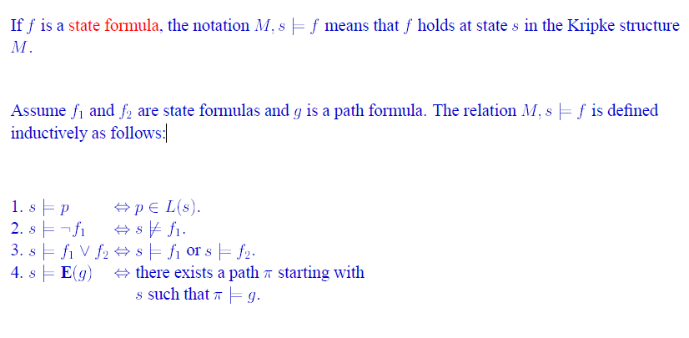

Slide 26
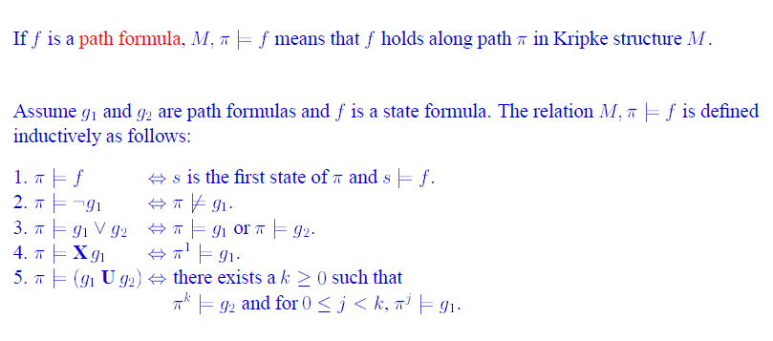

Slide 27
CTL and LTL
two sublogics of CTL*
  branching-time logic
    the temporal operators quantify over the paths that are possible from a given state.
    Temporal operators must be immediately preceded by a path quantifier.
    if f and g are sf, X f, F f, G f, f U g and f R g are pf
    A(FG p)
  Linear temporal logic
    operators are provided for describing events along a single computation path.
    LTL implicitly quantifies universally over paths.
    If , then p is pf , Af where f is a pf
    AG(EF p)

Slide 28
CTL
ten basic CTL operators:
  AX and EX
  AF and EF
  AG and EG
  AU and EU
  AR and ER

Slide 29
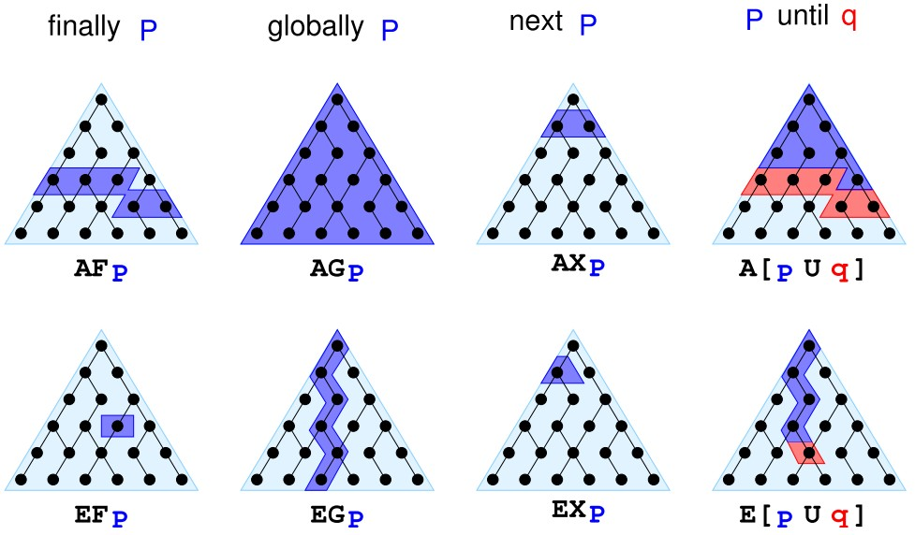
CTL

Slide 30
  Each of the ten operators can be expressed in terms of EX, EG and EU
  AX f= ! EX(!f)
  EF f= E[True U f]
  AG f =!EF(!f)
  AF f= !EG(!f)
  A[f U g]= !E[!gU(!f ^ !g)] ^ !EG !g
  A[f R g] = !E[!f U !g]
  E[f R g] = !A[!f U !g]

Slide 31
Examples
Let "P" mean "I like chocolate" and Q mean "It's warm outside."
  AG.P "I will like chocolate from now on, no matter what happens.“
  EF.P "It's possible I may like chocolate some day, at least for one day."
  AF.EG.P "It's always possible (AF) that I will suddenly start liking chocolate for the rest of time." (Note: not just the rest of my life, since my life is finite, while G is infinite).
  EG.AF.P "This is a critical time in my life. Depending on what happens next (E), it's possible that for the rest of time (G), there will always be some time in the future (AF) when I will like chocolate. However, if the wrong thing happens next, then all bets are off and there's no guarantee about whether I'll ever like chocolate."

Slide 32
A(PUQ)
"From now until it's warm outside, I will like chocolate every single day. Once it's warm outside, all bets are off as to whether I'll like chocolate anymore. Oh, and it's guaranteed to be warm outside eventually, even if only for a single day."
E((EX.P)U(AG.Q))
"It's possible that: there will eventually come a time when it will be warm forever (AG.Q) and that before that time there will always be some way to get me to like chocolate the next day (EX.P)."

Slide 33
Express Properties
Safety: something bad will not happen
Typical examples:
  AG ( reactor_temp < 1000 )
Usually:
  AG

Slide 34
Express Properties
Liveness: something good will happen
Typical examples:
  AF( rich )
  AF( x > 5 )
  AG( start -> AF terminate )
Usually:
  AF

Slide 35
Express Properties
Fairness: something is successful/allocated infinitely often.
Typical examples:
  AGAF ( enabled )
Usually:
  AGAF

Slide 36
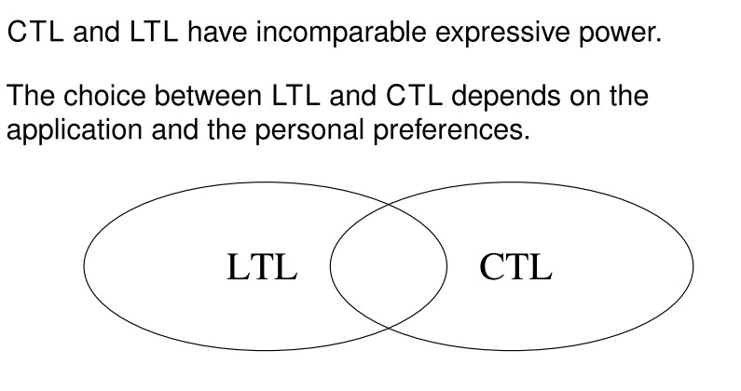

Slide 37
Automata over finite words
A=<Σ, S, Δ, I, F>
Σ (finite) - the alphabet.
S (finite) - the states.
Δ ⊆ S x Σ x S - the transition relation.
I ⊆ S - the starting states.
F ⊆ S - the accepting states.
a
a
s₀
s₁
b
b
Notes:
5

Slide 38
The transition relation
(s₀, a, s₀)
(s₀, b, s₁)
(s₁, a, s₀)
(s₁, b, s₁)
a
a
s₀
s₁
b
b
Notes:
6

Slide 39
A run over a word
A word over Σ, e.g., abaab.
A sequence of states, e.g. s₀ s₀ s₁ s₀ s₀ s₁.
Starts with an initial state.
Follows the transition relation (s_{i}, c_{i} , s_{i+1}).
Accepting if ends at accepting state.
a
a
s₀
s₁
b
b
Notes:
7

Slide 40
The language of an automaton
The words that are accepted by the automaton.
Includes aabbba, abbbba.
Does not include abab, abbb.
What is the language?
a
a
s₀
s₁
b
b
Notes:
8
(a+b)*a^{ω}

Slide 41
Nondeterministic automaton
Transitions: (s₀,a ,s₀), (s₀,b ,s₀),
(s₀,a ,s₁),(s₁,a ,s₁).
What is the language of this automaton?
s₀
s₁
a
a
a,b
Notes:
9

Slide 42
Equivalent deterministic automaton
s₀
s₁
a
a,b
a
a
s₀
s₁
a
b
b
Notes:
10

Slide 43
Automata over infinite words
Similar definition.
Runs on infinite words over Σ.
Accepts when an accepting state occurs infinitely often in a run.
a
a
s₀
s₁
b
b
Notes:
12

Slide 44
Automata over infinite words
Consider the word abababab…
There is a run s₀s₀s₁s₀s₁s₀s₁ …
This run in accepting, since s₀ appears infinitely many times.
a
a
s₀
s₁
b
b
Notes:
13

Slide 45
Other runs
For the word bbbbb… the run is
s₀ s₁ s₁ s₁ s₁… and is not accepting.
For the word aaabbbbb …, the
run is s₀ s₀ s₀ s₀ s₁ s₁ s₁ s₁ …
What is the run for ababbabbb …?
a
a
s₀
s₁
b
b
Notes:
14

Slide 46
Nondeterministic automaton
What is the language of this automaton?
What is the LTL specification if
b -- PC0=CR0, a =¬b?
s₀
s₁
a
a
a,b
Can you find a deterministic automaton with same language?
Can you prove there is no such deterministic automaton?
Notes:
15

Slide 47
No deterministic automaton for (a+b)*a^{ω}
In a deterministic automaton there is one run for each word.
After some sequence of a’s, i.e., aaa…a must reach some accepting state.
Now add b, obtaining aaa…ab.
After some more a’s, i.e., aaa…abaaa…a must reach some accepting state.
Now add b, obtaining aaa…abaaa…ab.
Continuing this way, one obtains a run that has infinitely many b’s but reaches an accepting state
(in a finite automaton, at least one would repeat) infinitely often.

Slide 48
Specification using Automata
Let each letter correspond to some propositional property.
Example: a -- P0 enters critical section,
b -- P0 does not enter section.
[]<>PC0=CR0
a
a
s₀
s₁
b
b
Notes:
16

Slide 49
Mutual Exclusion
a -- PC0=CR0/\PC1=CR1
b -- ¬(PC0=CR0/\PC1=CR1)
c -- true
[]¬(PC0=CR0/\PC1=CR1)
b
s₀
s₁
c
a
Notes:
17

Slide 50
Apply now to our program:
T0:PC0=L0➔PC0=NC0
T1:PC0=NC0/\Turn=0➔
PC0:=CR0
T2:PC0=CR0➔
(PC0,Turn):=(L0,1)
T3:PC1==L1➔PC1=NC1
T4:PC1=NC1/\Turn=1➔
PC1:=CR1
T5:PC1=CR1➔
(PC1,Turn):=(L1,0)
L0:While True do
NC0:wait(Turn=0);
CR0:Turn=1
endwhile ||
L1:While True do
NC1:wait(Turn=1);
CR1:Turn=0
endwhile
Initially: PC0=L0/\PC1=L1
Notes:
5
17

Slide 51
The state space
Turn=0
L0,L1
Turn=1
L0,L1
Turn=0
L0,NC1
Turn=0
NC0,L1
Turn=1
L0,NC1
Turn=1
NC0,L1
Turn=0
NC0,NC1
Turn=0
CR0,L1
Turn=1
L0,CR1
Turn=1
NC0,NC1
Turn=0
CR0,NC1
Turn=1
NC0,CR1
Notes:
18

Slide 52
[]¬(PC0=CR0/\PC1=CR1)
(Mutual exclusion)
Turn=0
L0,L1
Turn=1
L0,L1
Turn=0
L0,NC1
Turn=0
NC0,L1
Turn=1
L0,NC1
Turn=1
NC0,L1
Turn=0
NC0,NC1
Turn=0
CR0,L1
Turn=1
L0,CR1
Turn=1
NC0,NC1
Turn=0
CR0,NC1
Turn=1
NC0,CR1
Notes:
19

Slide 53
[](Turn=0 →<>Turn=1)
Turn=0
L0,L1
Turn=1
L0,L1
Turn=0
L0,NC1
Turn=0
NC0,L1
Turn=1
L0,NC1
Turn=1
NC0,L1
Turn=0
NC0,NC1
Turn=0
CR0,L1
Turn=1
L0,CR1
Turn=1
NC0,NC1
Turn=0
CR0,NC1
Turn=1
NC0,CR1
Notes:
20

Slide 54
Interleaving semantics:
Execute one transition at a time.
Turn=0
L0,L1
Turn=0
L0,NC1
Turn=1
L0,NC1
Turn=0
NC0,NC1
Turn=1
L0,CR1
Turn=0
CR0,NC1
Need to check the property
for every possible interleaving!
Notes:
20

Slide 55
[](Turn=0 → <>Turn=1)
Turn=0
L0,L1
Turn=1
L0,L1
Turn=0
L0,NC1
Turn=0
NC0,L1
Turn=1
L0,NC1
Turn=1
NC0,L1
Turn=0
NC0,NC1
Turn=0
CR0,L1
Turn=1
L0,CR1
Turn=1
NC0,NC1
Turn=0
CR0,NC1
Turn=1
NC0,CR1
Notes:
8
20

Slide 56
Correctness condition
We want to find a correctness condition for a model to satisfy a specification.
Language of a model: L(Model)
Language of a specification: L(Spec).
We need: L(Model) ⊆ L(Spec).
Notes:
21

Slide 57
Correctness
Sequences satisfying Spec
Program executions
All sequences
Notes:
22

Slide 58
Incorrectness
Counter
examples
Sequences satisfying Spec
Program executions
All sequences
Notes:
22

