Slide 1


LUV vs the WRLD

Slide 2
Content
Our team.
How we did the project?
What is it about?
Future plans.

Slide 3
Our Team
Made by: | Roles:
Hristo Hristov | Scrum Trainer
Teodor Smolev | Frontend Developer
Nikola Stoyanov | Designer
Veselin Dimitrov | Backend Developer

Slide 4



How did we do the project?

Slide 5
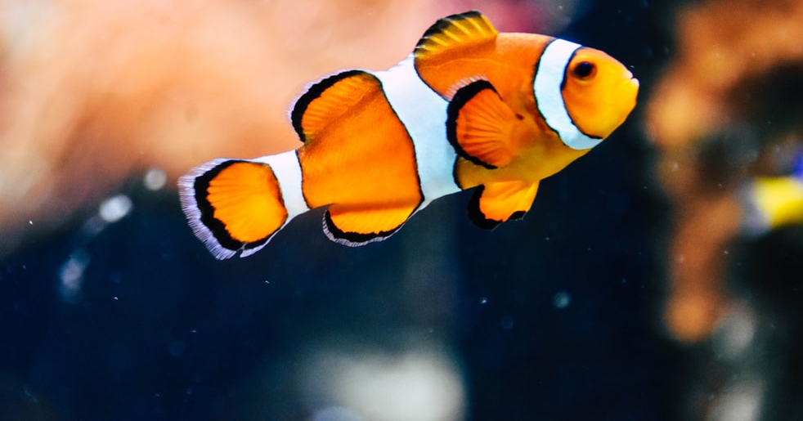
What is our goal?
Our goal is to spread awareness about the rising water pollution and extinction of marine animals.

Slide 6
Let’s continue to the site!

