Slide 1
Machine Predictive Maintenance
Failure Classification
December, 2022

Slide 2
Project objective:
Deliver a product to Northrup Grumman to predict types of machine failure
Notes:
We are predicting machine failure to

Slide 3
Data
Northrup Grumman Machine Failure
Notes:
Where does the informatio come from?

Slide 4
Data
Northrup Grumman
Northrup Grumman Machine Failure
Contains a data point for each product run through the machine
10000 points in dataset accounting for about 76 days of machine time
Includes information on air temp, process temp, rotational speed, torque, tool wear, failure, and type of failure

Slide 5
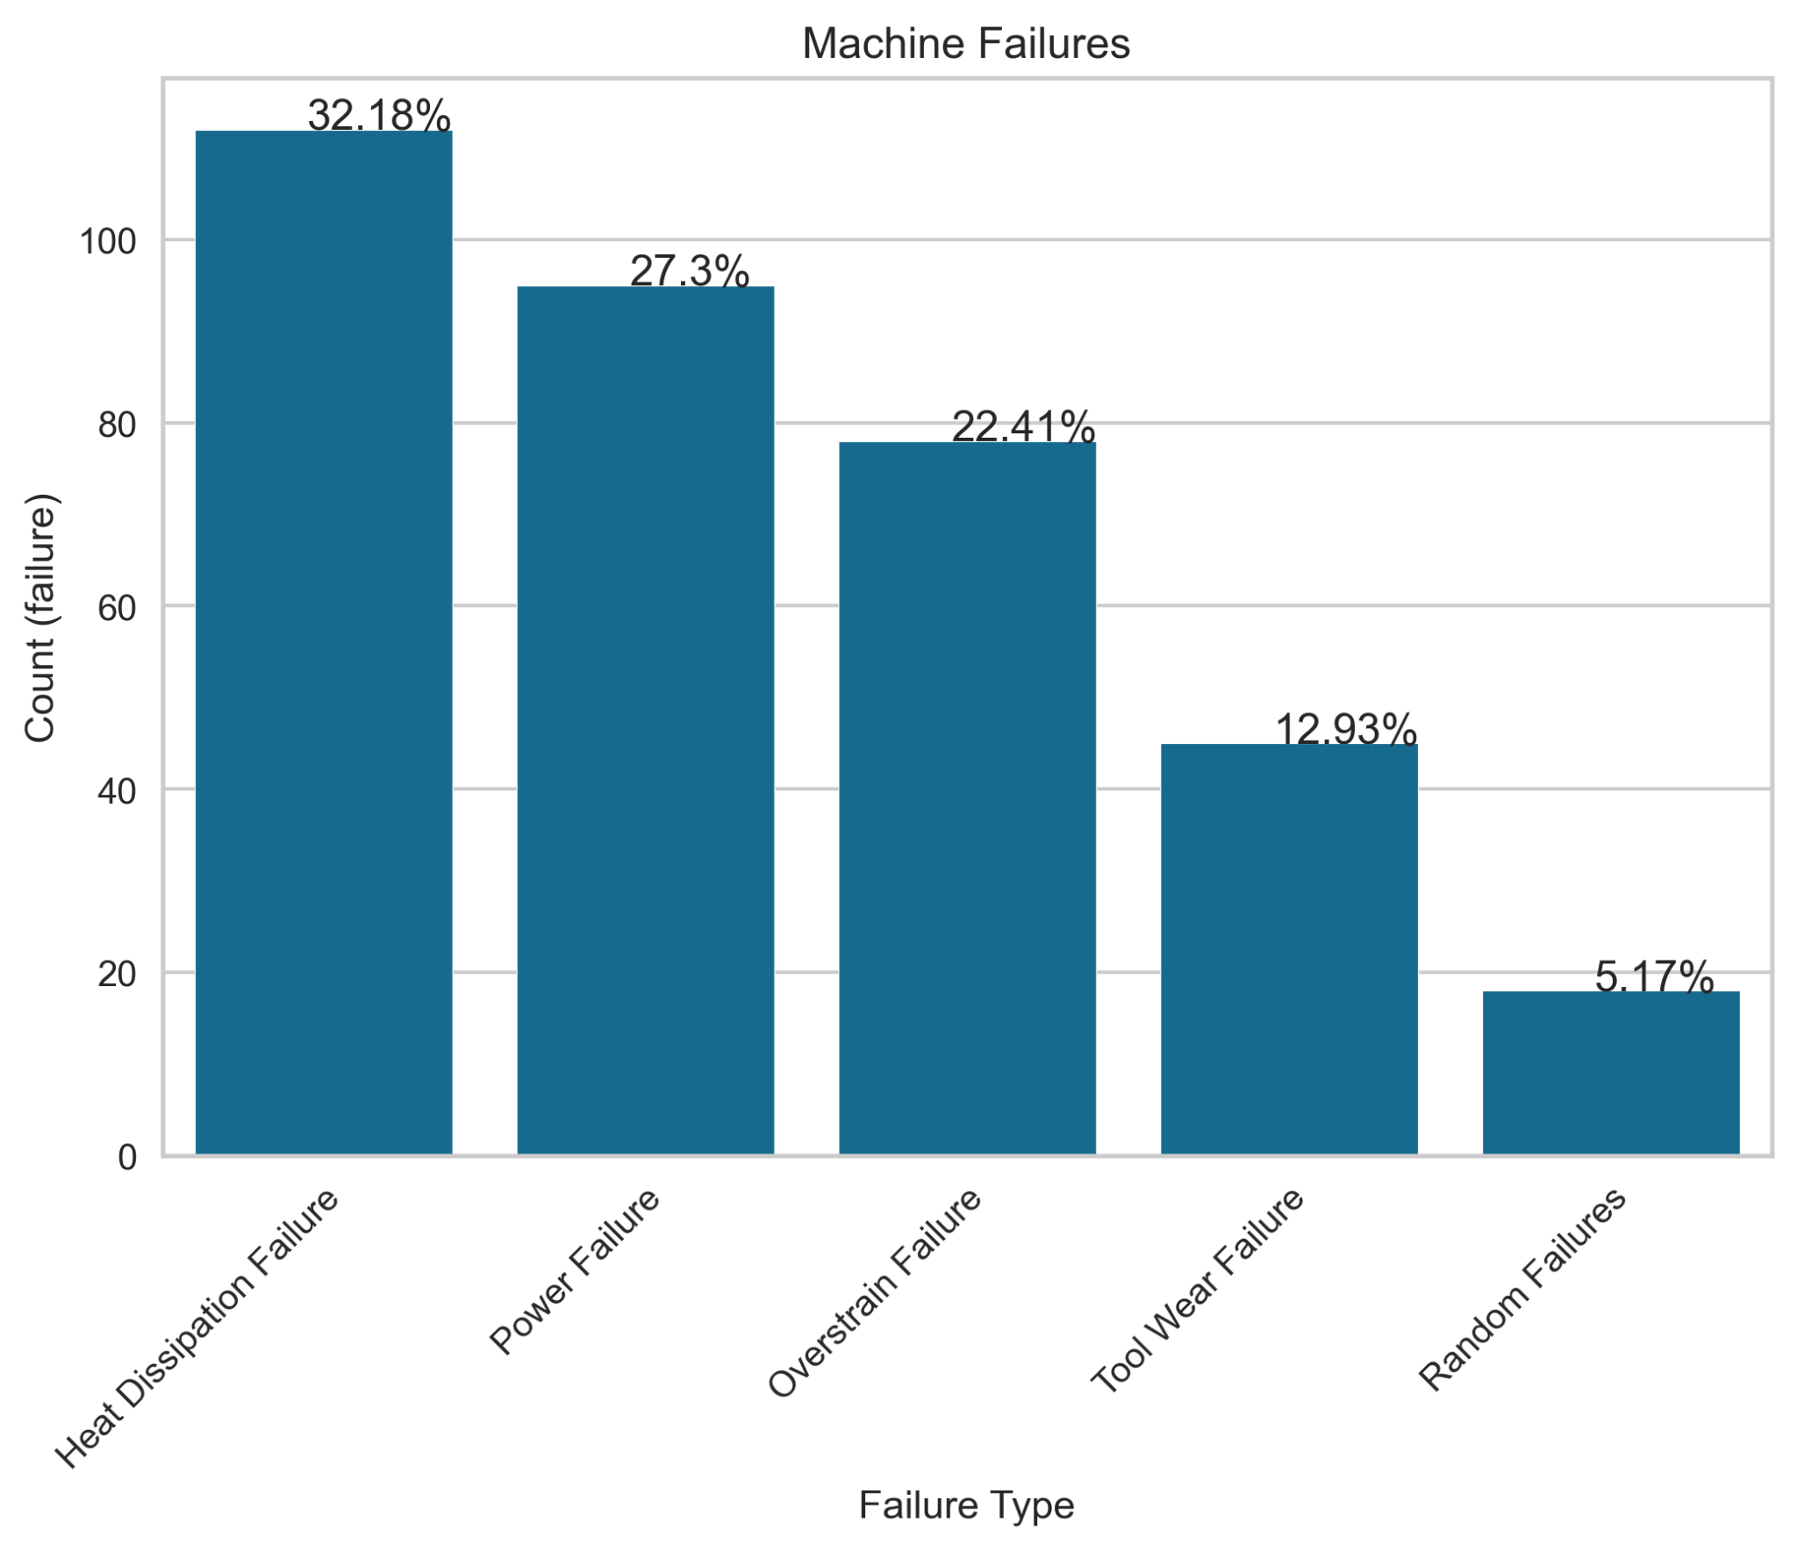
Range
These machine failures are what was provided to us in the dataset
9661 No failure data points
339 Failure data points (3.39%)
Heat Dissipation, Power Failure, and Overstrain Failure are most common failures

Slide 6
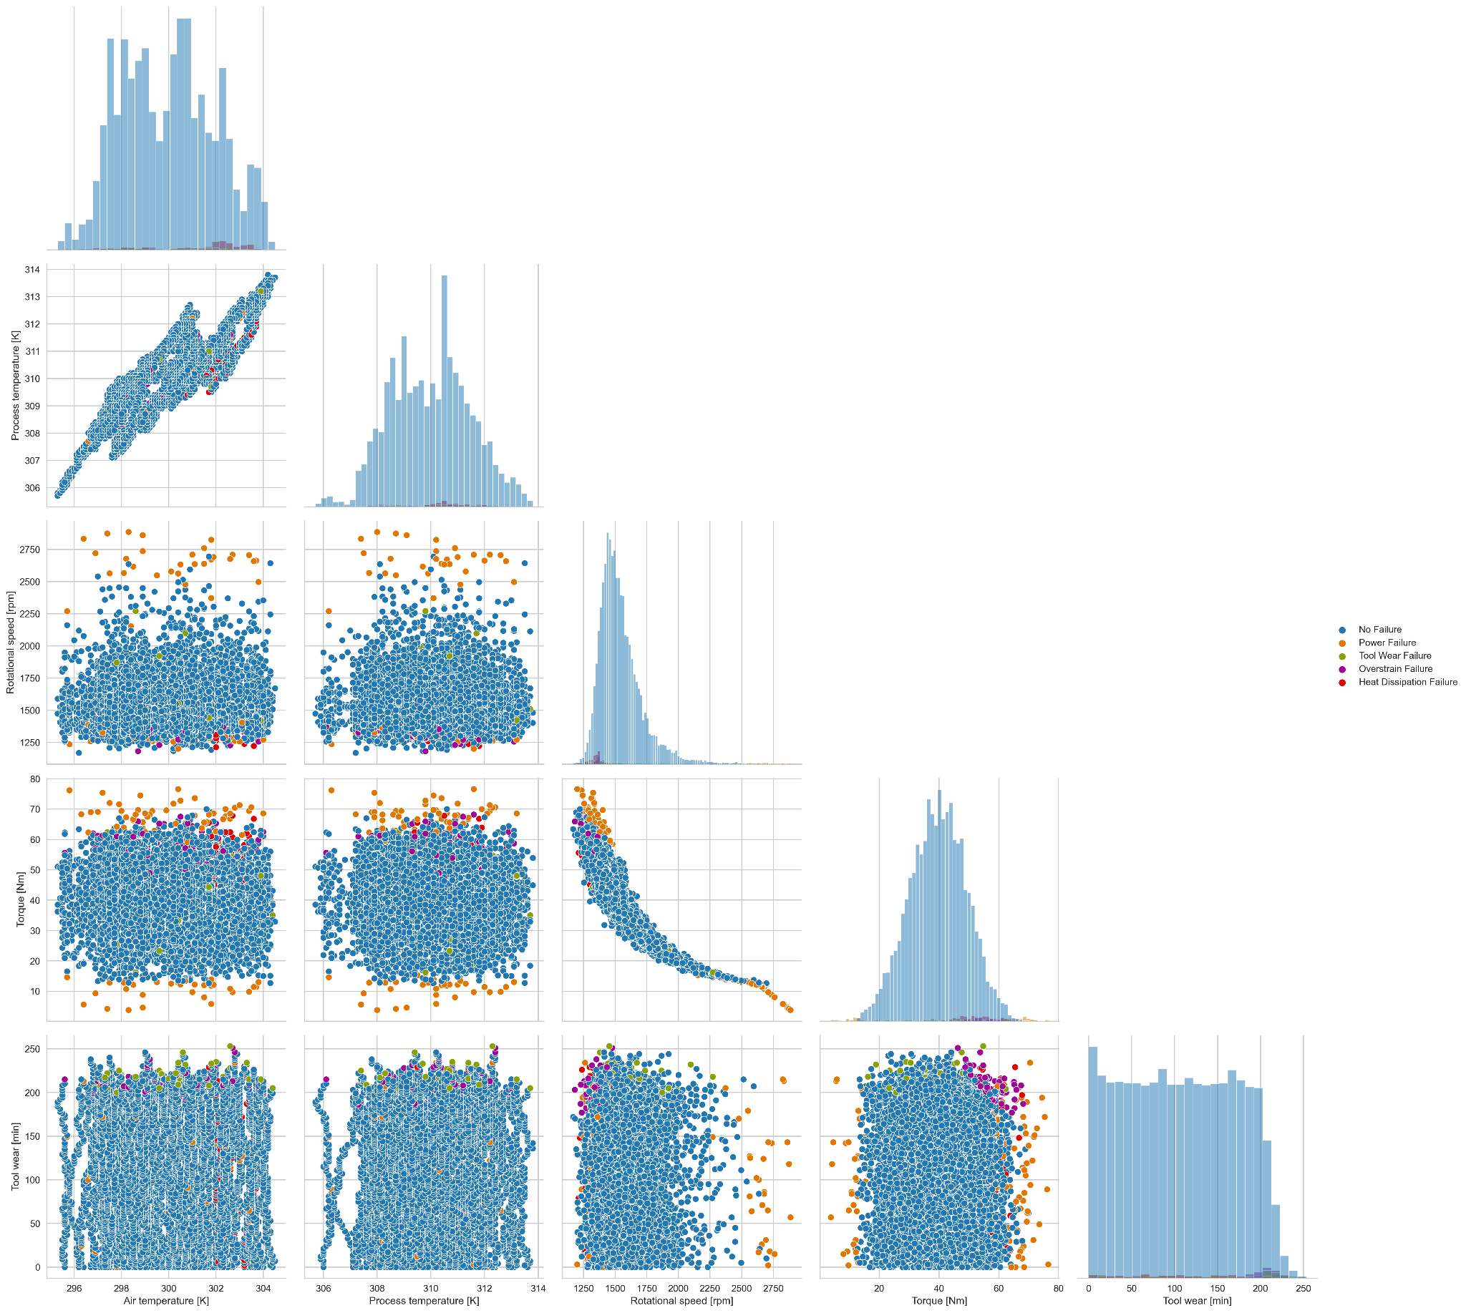
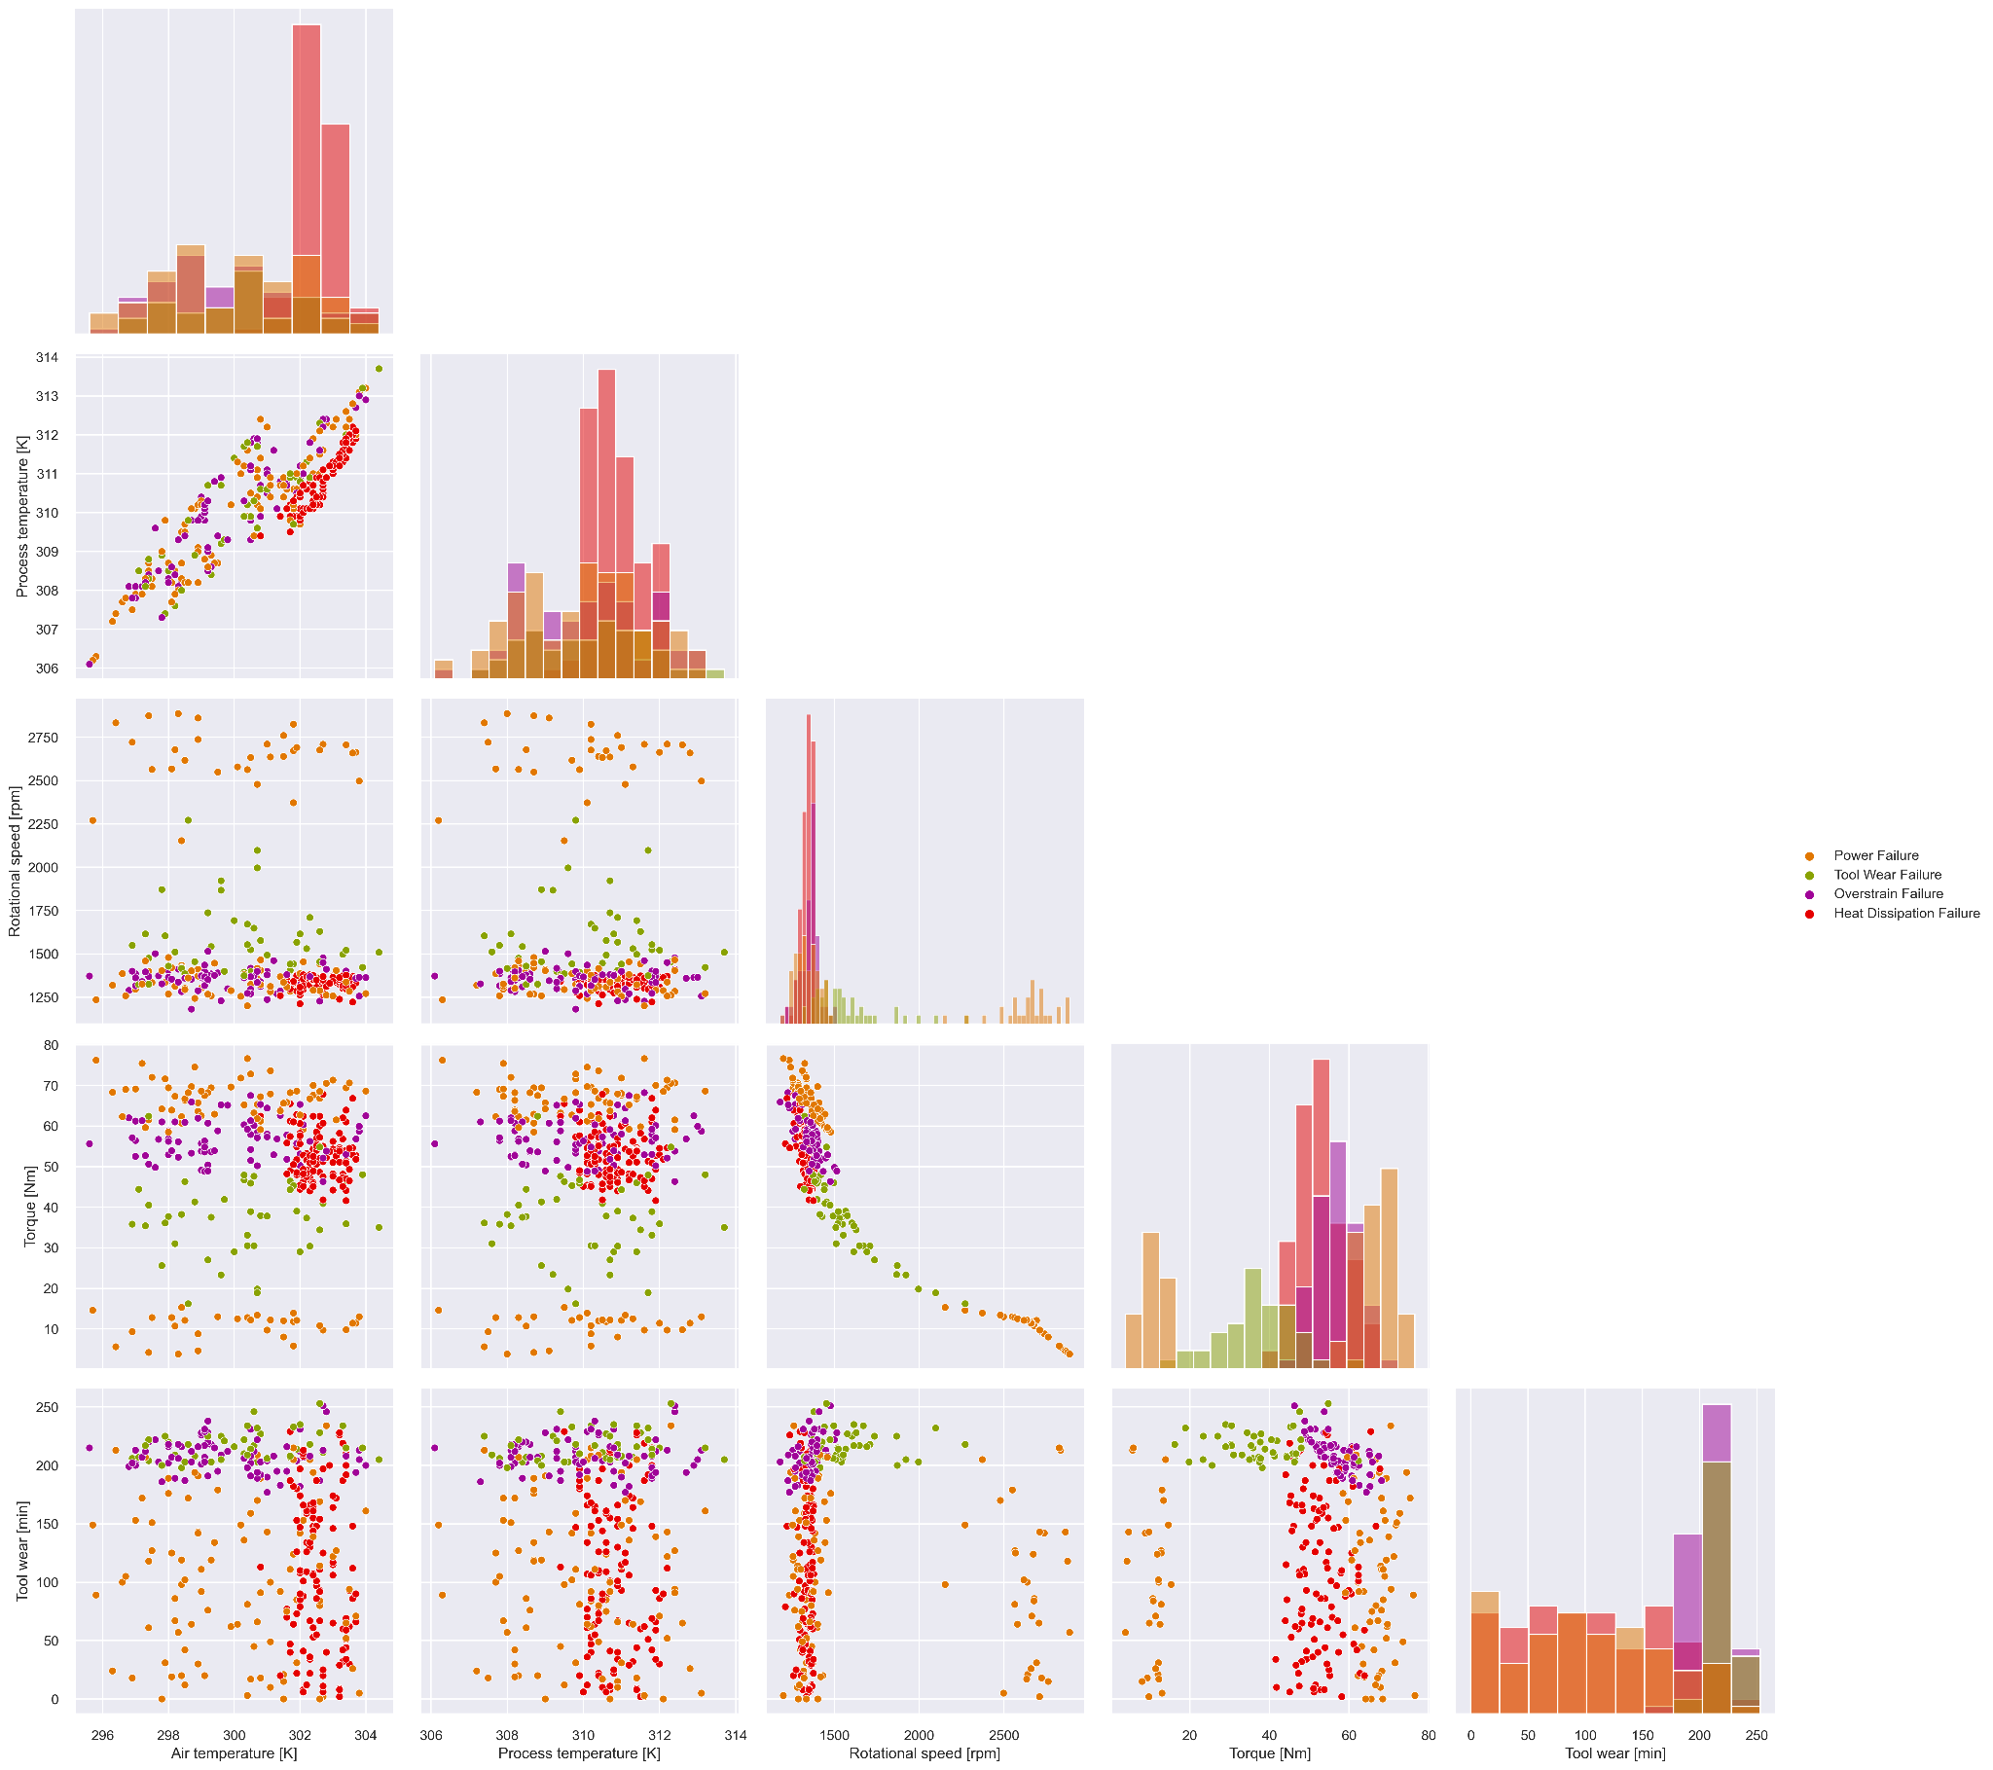
Relationships
Feature Pair Plot
Grouping between features show correlation between type of recorded data and type of failure

Slide 7
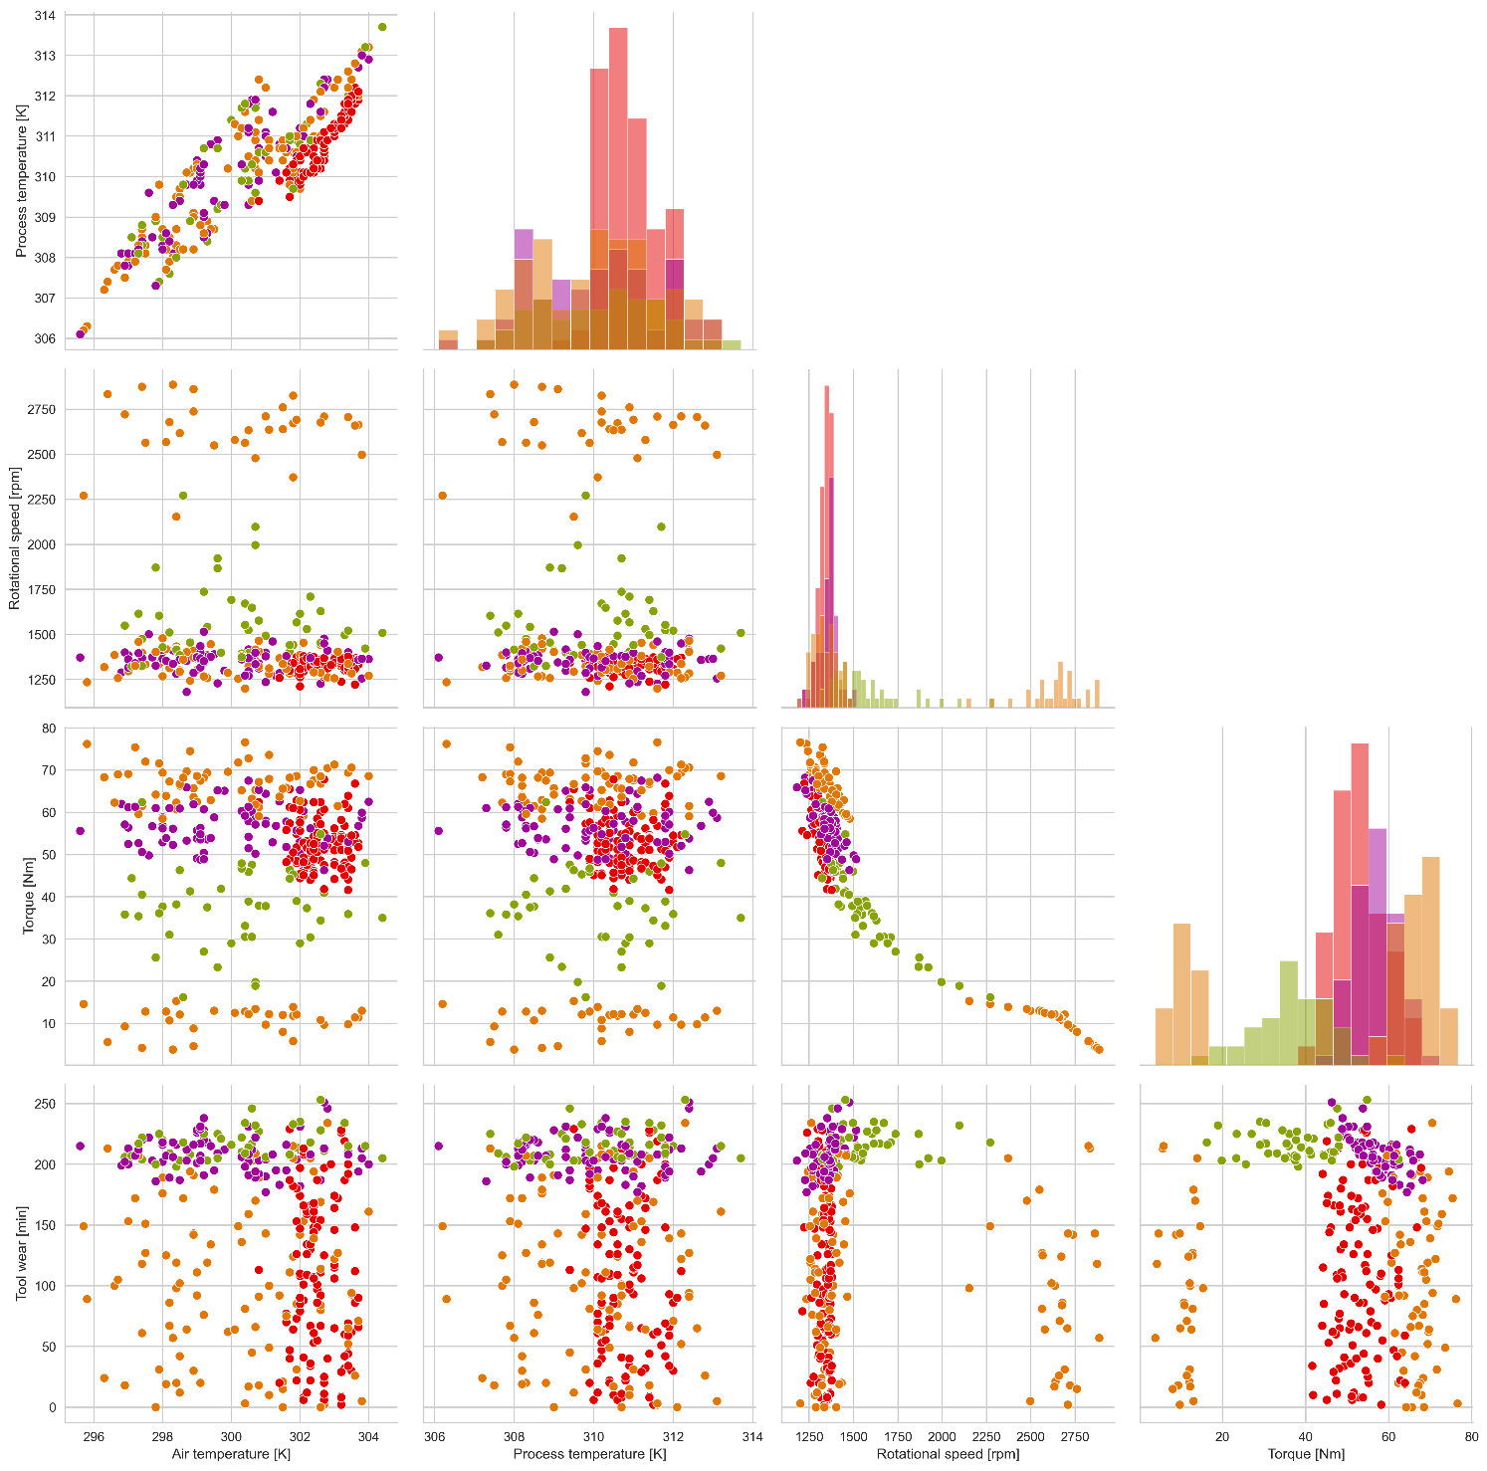
Relationships
Feature Pair Plot
Grouping between features show correlation between type of recorded data and type of failure

Slide 8
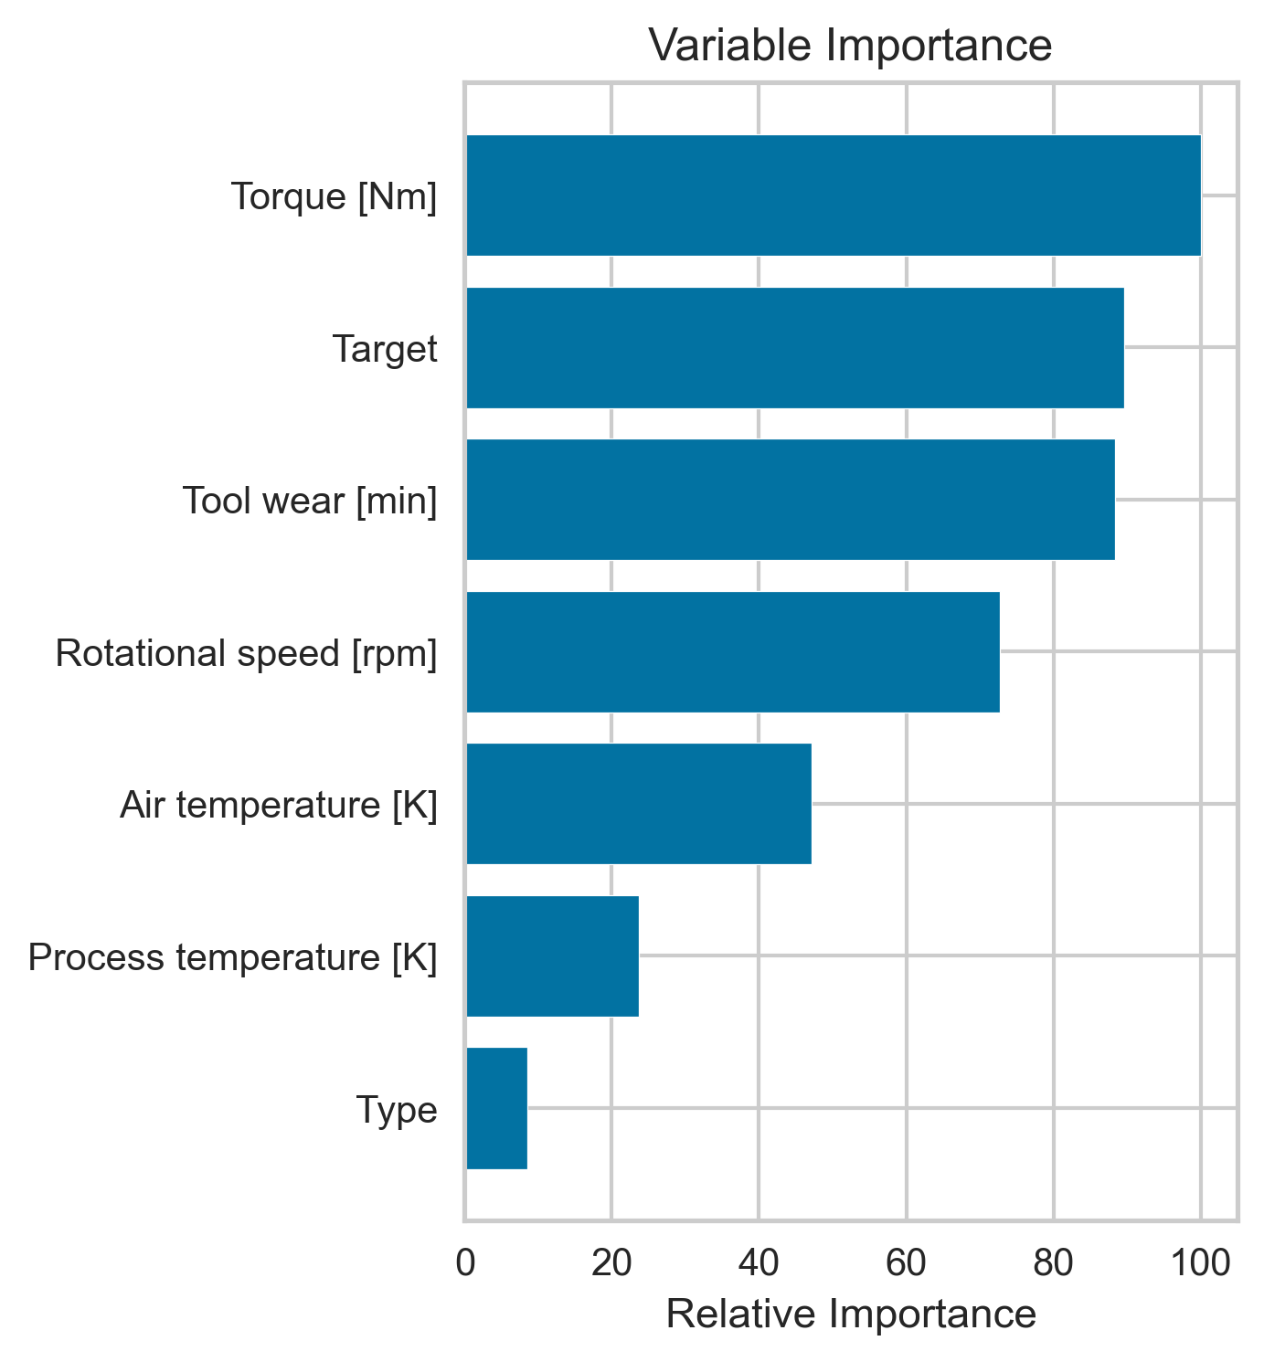
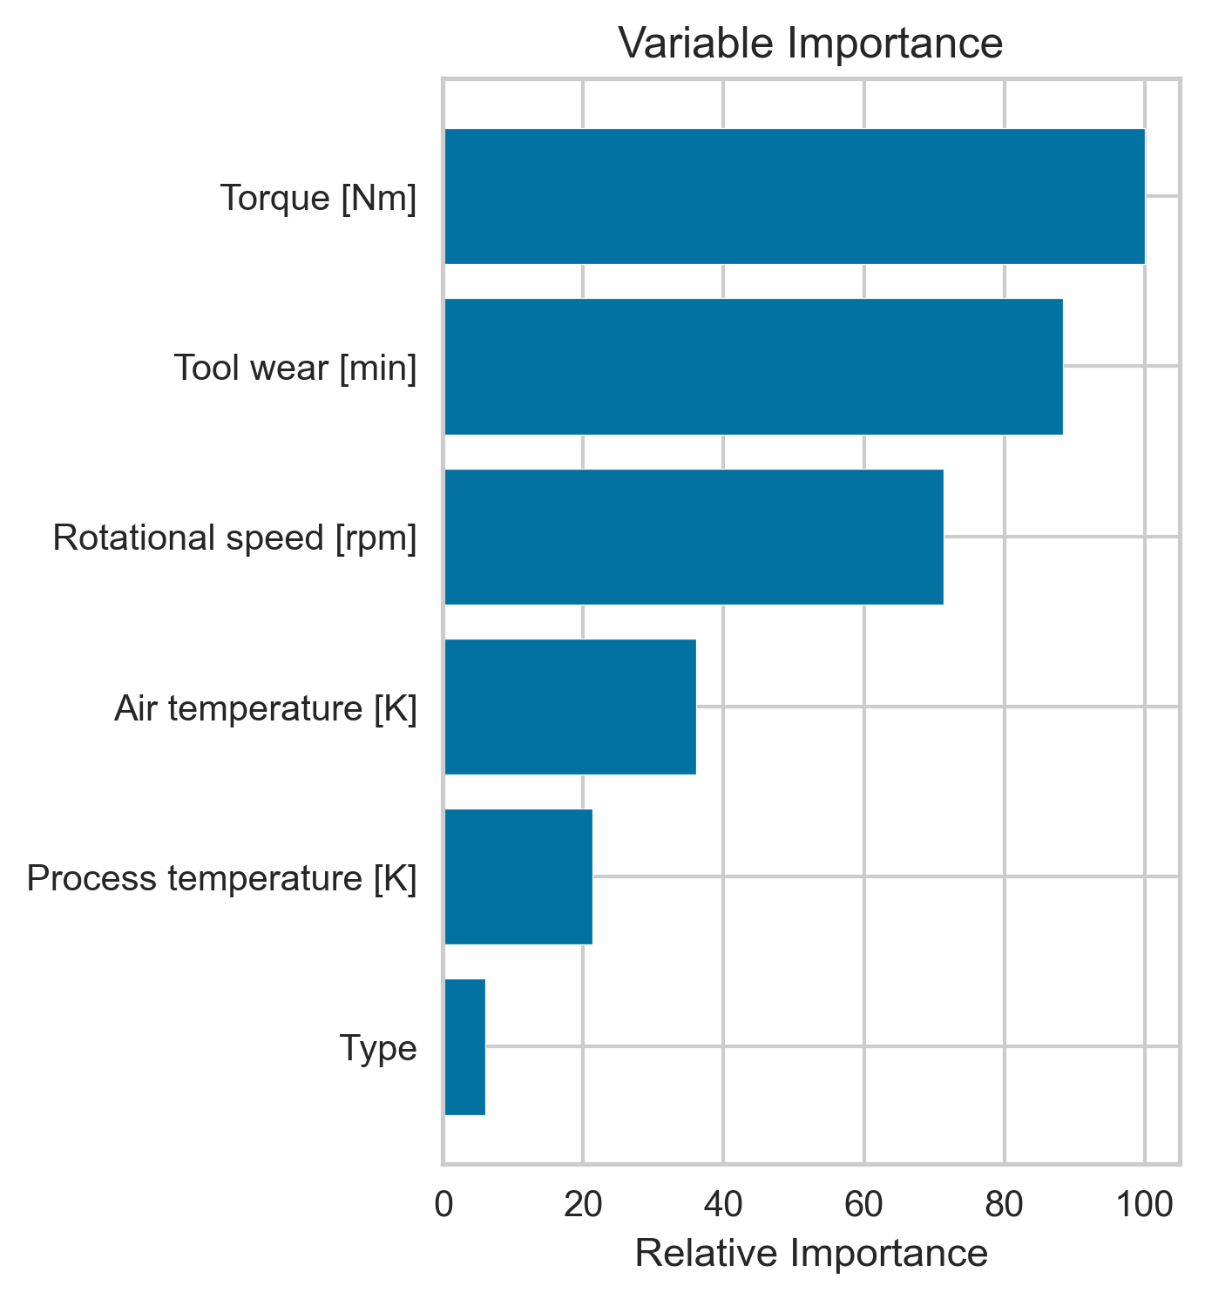
Relationships
Feature Pair Plot
Notes:
Torque, tool wear and rotational speed most important.
Want to avoid the following:
Torque (related to power failure): less than 20 Nm or more than 58 Nm
Tool Wear(related to tool wear failure): more than 190 minutes of use
Rotational speed (overstrain and heat dissipation failure): less than 1200 rpm

Slide 9
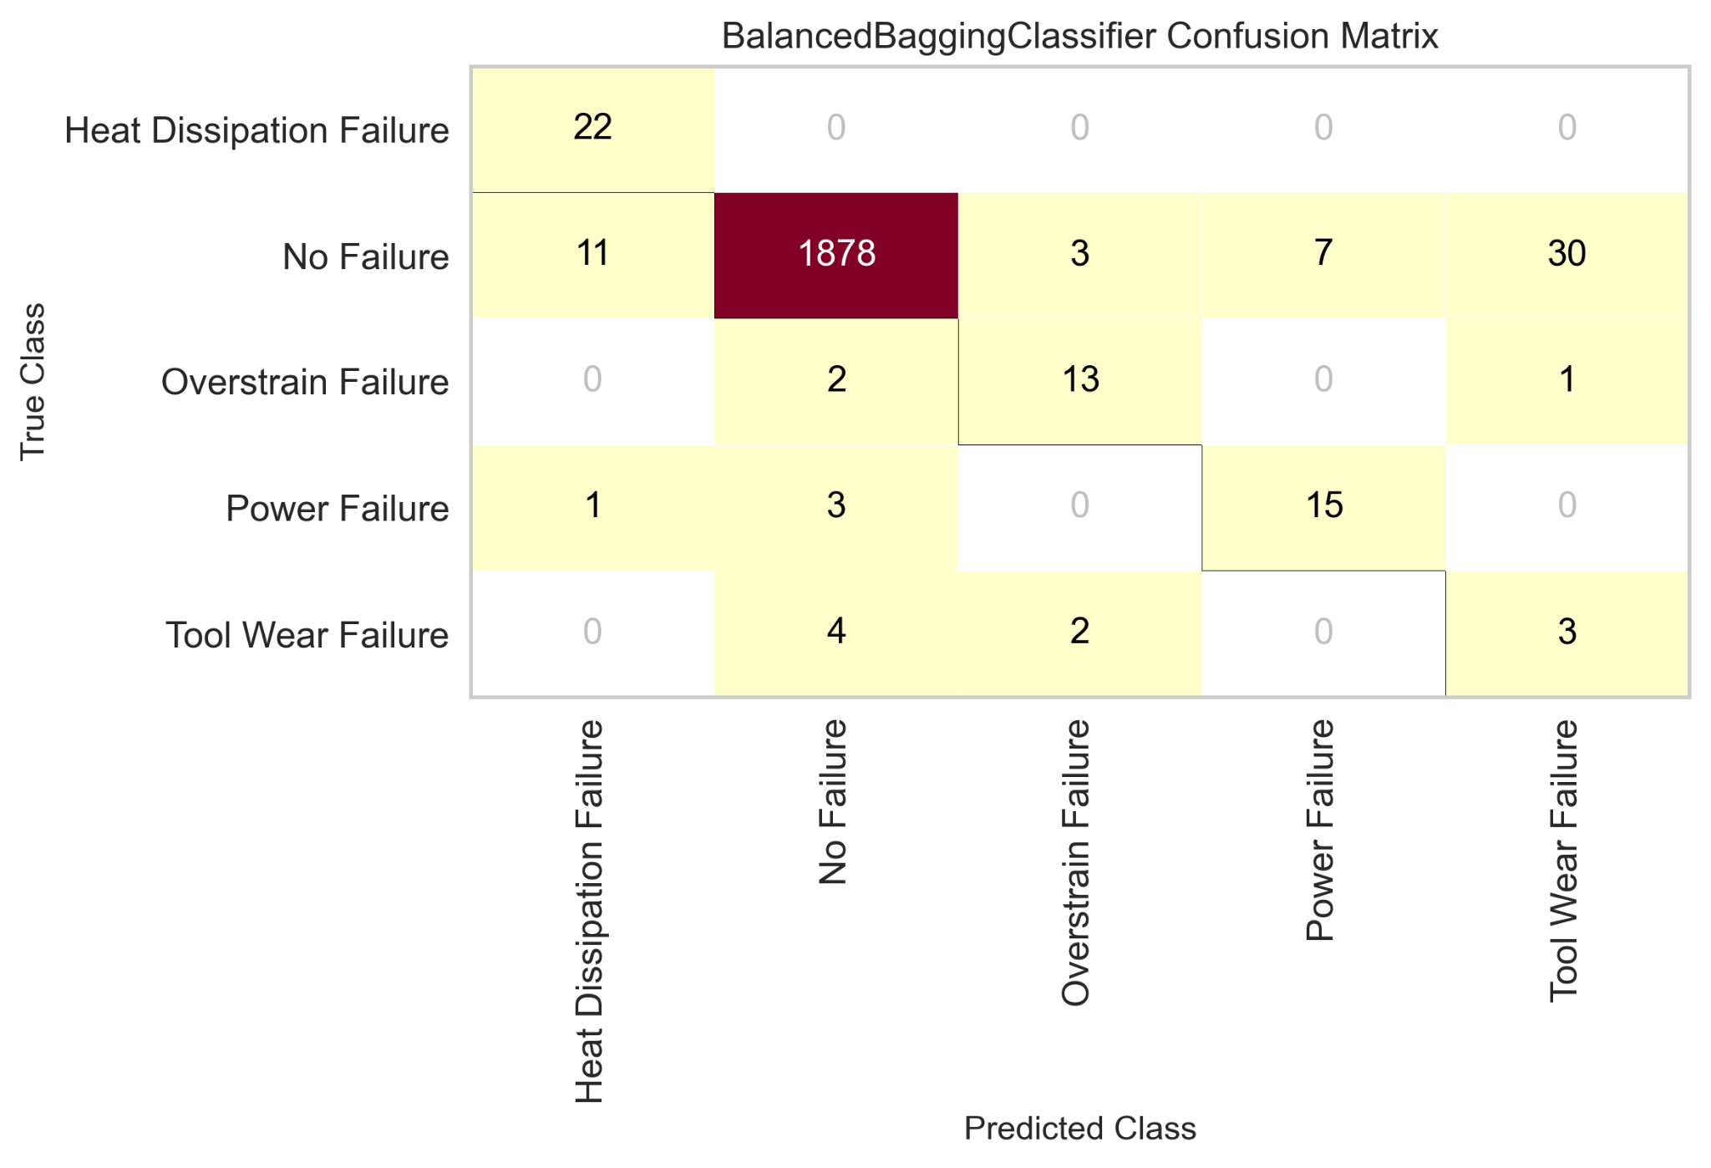
RESULTS
Final Model has the most incorrect predictions in no failure at 9 out of 1995

Slide 10
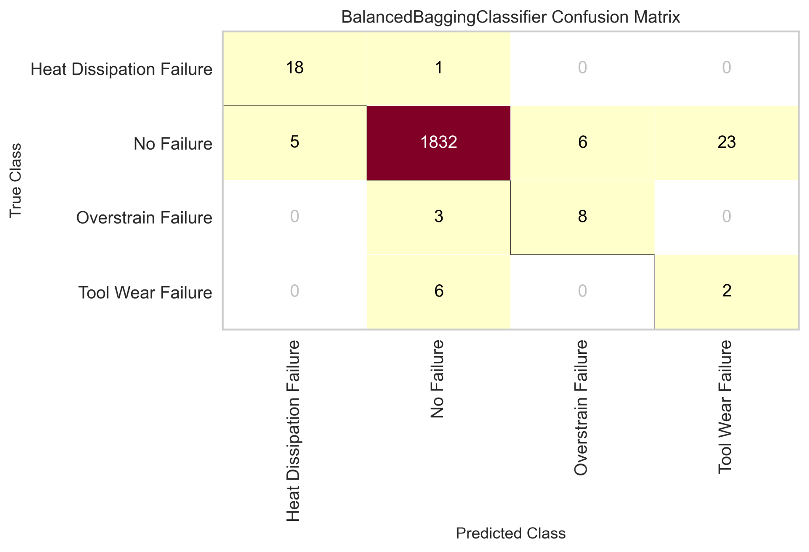
RESULTS
Final Model has the most incorrect predictions in no failure at 9 out of 1995
Final Model after removing 2.25% of data at the upper and lower bounds of torque (data above

Slide 11
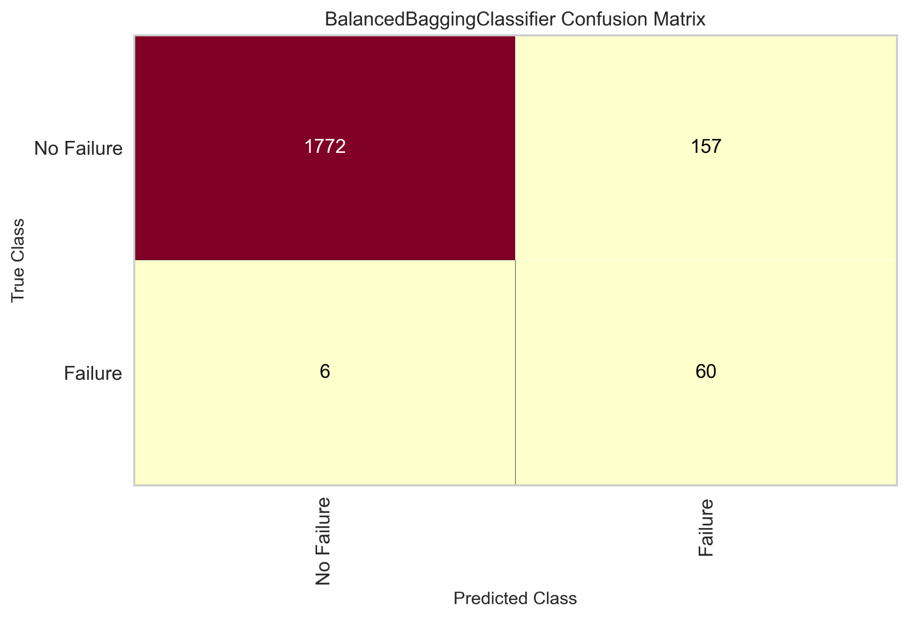


Slide 12
CONCLUSIONS
All types of failure have varying relationships with multiple features in the data
Highest counts of failure in order are: Heat dissipation, Power failure, Overstrain failure, and Tool Wear.
By removing outliers in torque feature, final model was able to predict only one incorrect false negative out of 1904 data points.

Slide 13
FUTURE WORK
1. Expand Dataset to confirm results
2. Predict Maintenance for other machines in the facility
Notes:
Need to collect additional data on the current machine to test model performance more to ensure the model operates well
Will have to create new and different models for different machines as they are added

Slide 14
THANK YOU

