Slide 1
Microsoft Movie Studio
June, 2022

Slide 2
Project objective:
Analyze and deliver recommendations to Microsoft on what makes past blockbuster hits successful.
Notes:
The goal of this project is to research/analyze movie data from multiple sources in order to make a recommendation to a new movie studio company (Microsoft) on what types of movies they should pursue.
The primary ask from the company is that the type of movies they pursue are similar to the ones "doing best at the box office." From a business perspective, I believe that they are looking to receive the greatest return on the investment that is placed in the movie. To understand what has given the best ROI in the past, we must dig into the data on previous movies and analyze the metrics. We will also analyze the budgets of these movies to determine what the range of spending will be for a movie project.

Slide 3
Understanding the problem
Budget
Profit
Types
How much money should be allocated to a movie production budget?
What kind of profit can microsoft intend to see from this endeavour?
What types of movies will be most successful in providing a high return on investment?

Slide 4
Understanding the problem
Budget
Profit
Movie Types
Average Budget
Typical Budget range (from 25% to 75% quartile with more than 200% ROI)
Average Profit
Typical Profit range (from 25% to 75% quartile with more than 200% ROI)
Hard recommendation on Runtime, Genre from previous data
Soft recommendation on Director and Movie Rating based on viewer rating

Slide 5
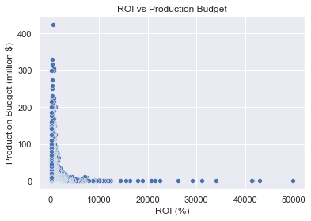
Notes:
3657 movies analyzed.
Cut off, want from the 25% quartile to 75% quartile and over 200% ROI

Slide 6
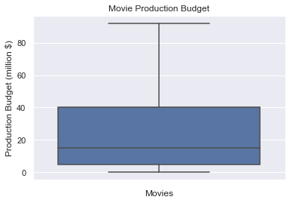
Notes:
5 million at 25% quartile to 40 million at 75% quartile

Slide 7
200% ROI
$40,000,000
$5,000,000
Notes:
Cut off, want from the 25% quartile to 75% quartile and over 200% ROI

Slide 8
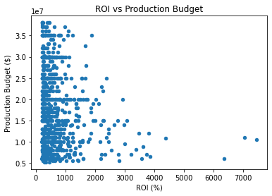
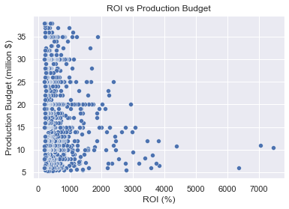
Notes:
Profit range anywhere from 12 million to 130 million dollars in profit

Slide 9
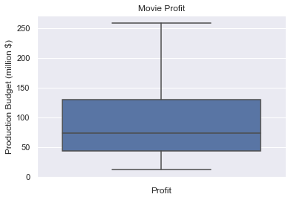
Notes:
Profit range anywhere from 12 million to 782 million dollars in profit

Slide 10
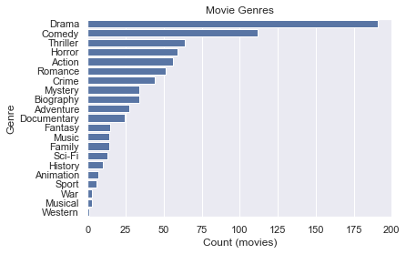
Notes:
It looks like the most successful genre categories are Drama, Comedy, and Thriller. With Drama being almost double in frequency as compared to the the next sucessful genre.

Slide 11
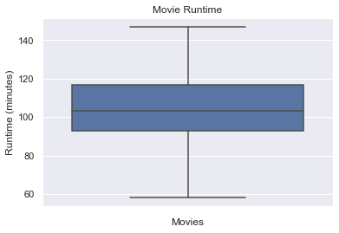
Notes:
Looks like the average runtime is at around 104 minutes, and the times can vary from the 93 minutes at the 25% quartile to 116.5 minutes at the 75% quartile

Slide 12
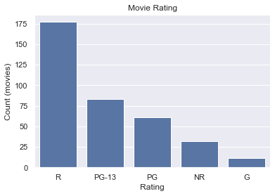
Notes:
The following was based on viewer reviews that were out of ten. The following analysis in the next two slides show the movies that were rated 7 or better out of 10.
Looks like the most popular movie ratings are R, PG-13, and PG. The R rating bets the next movie rating by about double in frequency.

Slide 13
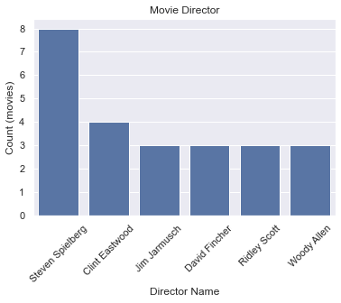
Notes:
In experimenting with the number above it looks like there are over 30 directors who have done 2 or more movies, but there are 6 directors who have only done 3 or more movies. Sa we will use that list as our recommendation for the directors that should be used.

Slide 14
RESULTS
Financial
Budget between
5 to 40 million dollars
Profit to be
12 to 260 million dollars
Types of Movies to pursue
Genre
Drama
Comedy
Thriller
Runtime
Between 93 to 116.5 minutes.
104 minutes on average
Movie Rating
R
PG-13
PG
Director
Steven Spielberg
Clint Eastwood, Ridley Scott, Jim Jamusch, David Fincher

Slide 15
FUTURE WORK
If given more time the following could be pursued:
Perform analysis on the soft recommendation categories to correlate to the budget and profit of movies
Look at other categories that would be relevant to pursue to understand movie success such as movie studio, domestic vs foreign gross, and movie writer
Integrate marketing spending vs profit

Slide 16
THANK YOU

