Slide 1
Reynolds and Klein Appraisal
Appraisal Inferences
September, 2022
Notes:
We are helping Reynolds and klein to draw inferences on housing market prices

Slide 2
Project objective:
Deliver a product to Reynolds and Klein to assist in inferring house prices for new and current employee training purposes
Notes:
Training new employees initially without assistance from other employees to get a general feel of how to price homes
Training current employees on areas they are unfamiliar with
High price vs low price
Geographical areas (which also correlate to price as we will see later)

Slide 3
Data
King County Assessor’s Office
Notes:
Where does the informatio come from?

Slide 4
Data
King County Assessor’s Office
Houses sold from 2014 to 2015
21597 points in dataset
Includes information on price and other features of sale
Notes:
Wide dataset to work with for houses purchased in 2014 and 2015

Slide 5
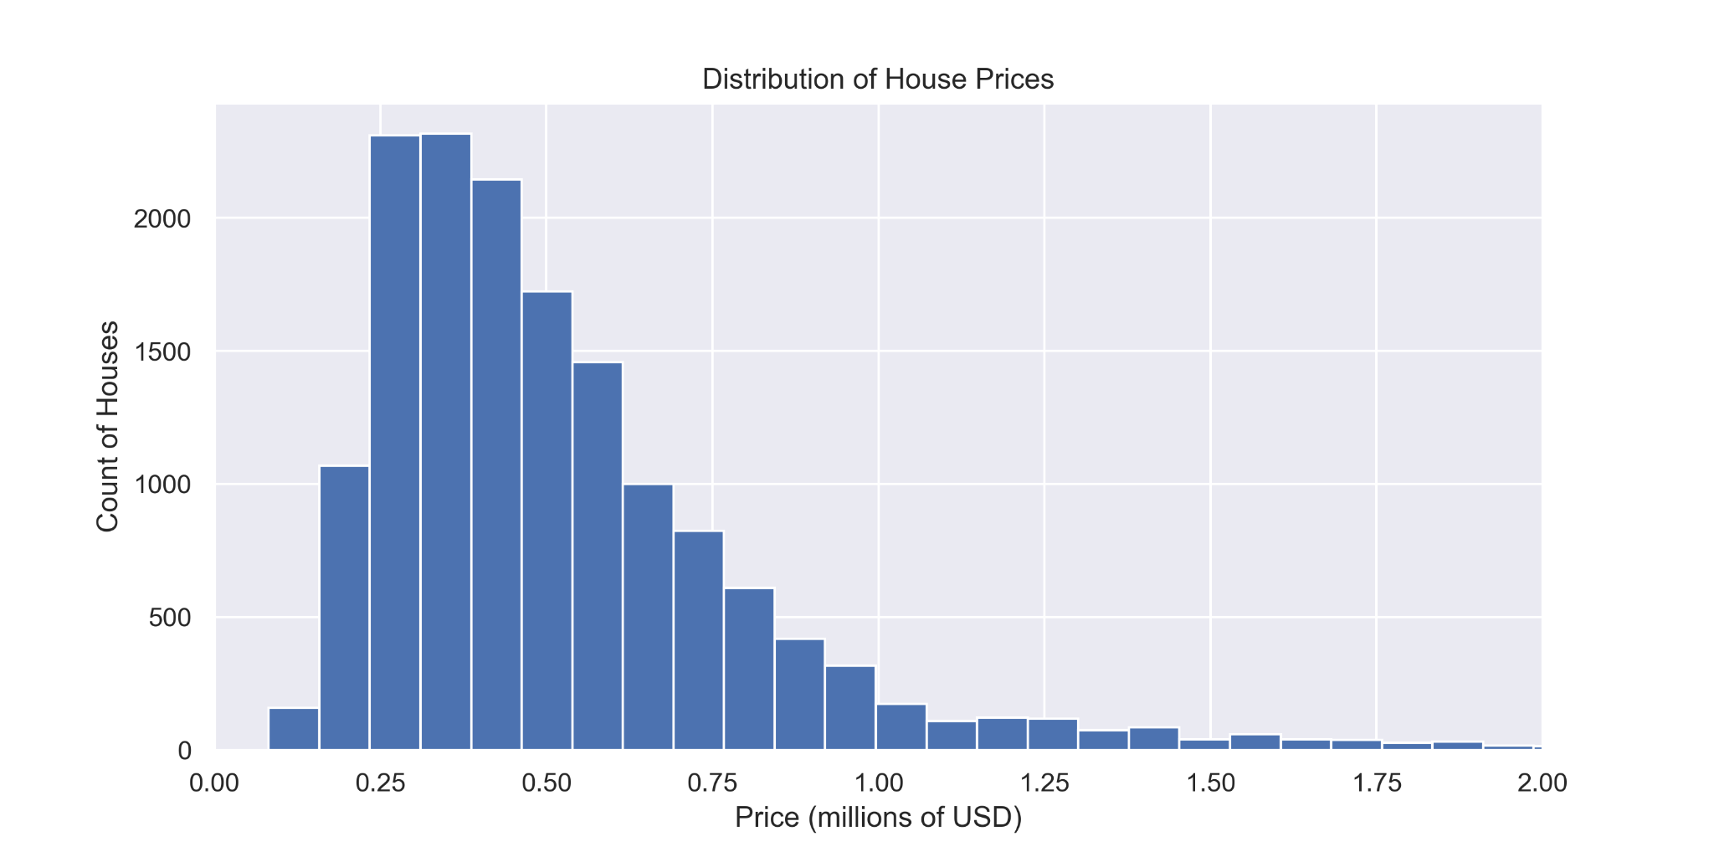
Range
Notes:
Range from 100,000 to around 8 million dollars.
Most centered from 300,000 to about 800,000

Slide 6
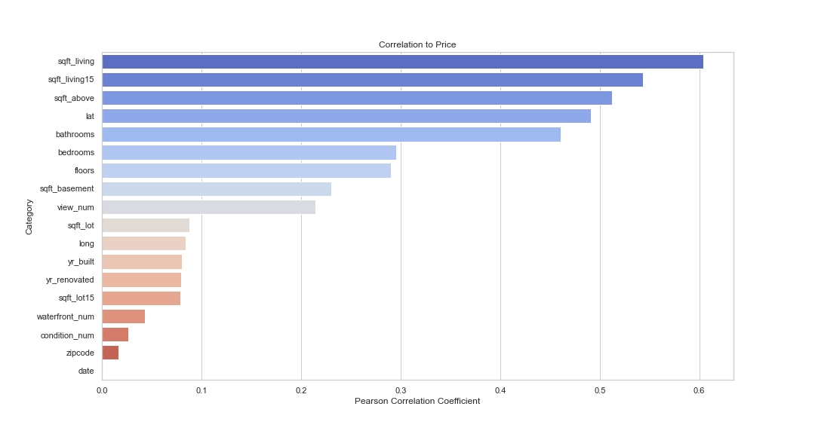
Relationships
Notes:
4 strongest categories
Sqft_living 15 same as sqft living
Sqft_above not same as living, could have sun or mudroom that is sqft but not considered part of living space

Slide 7
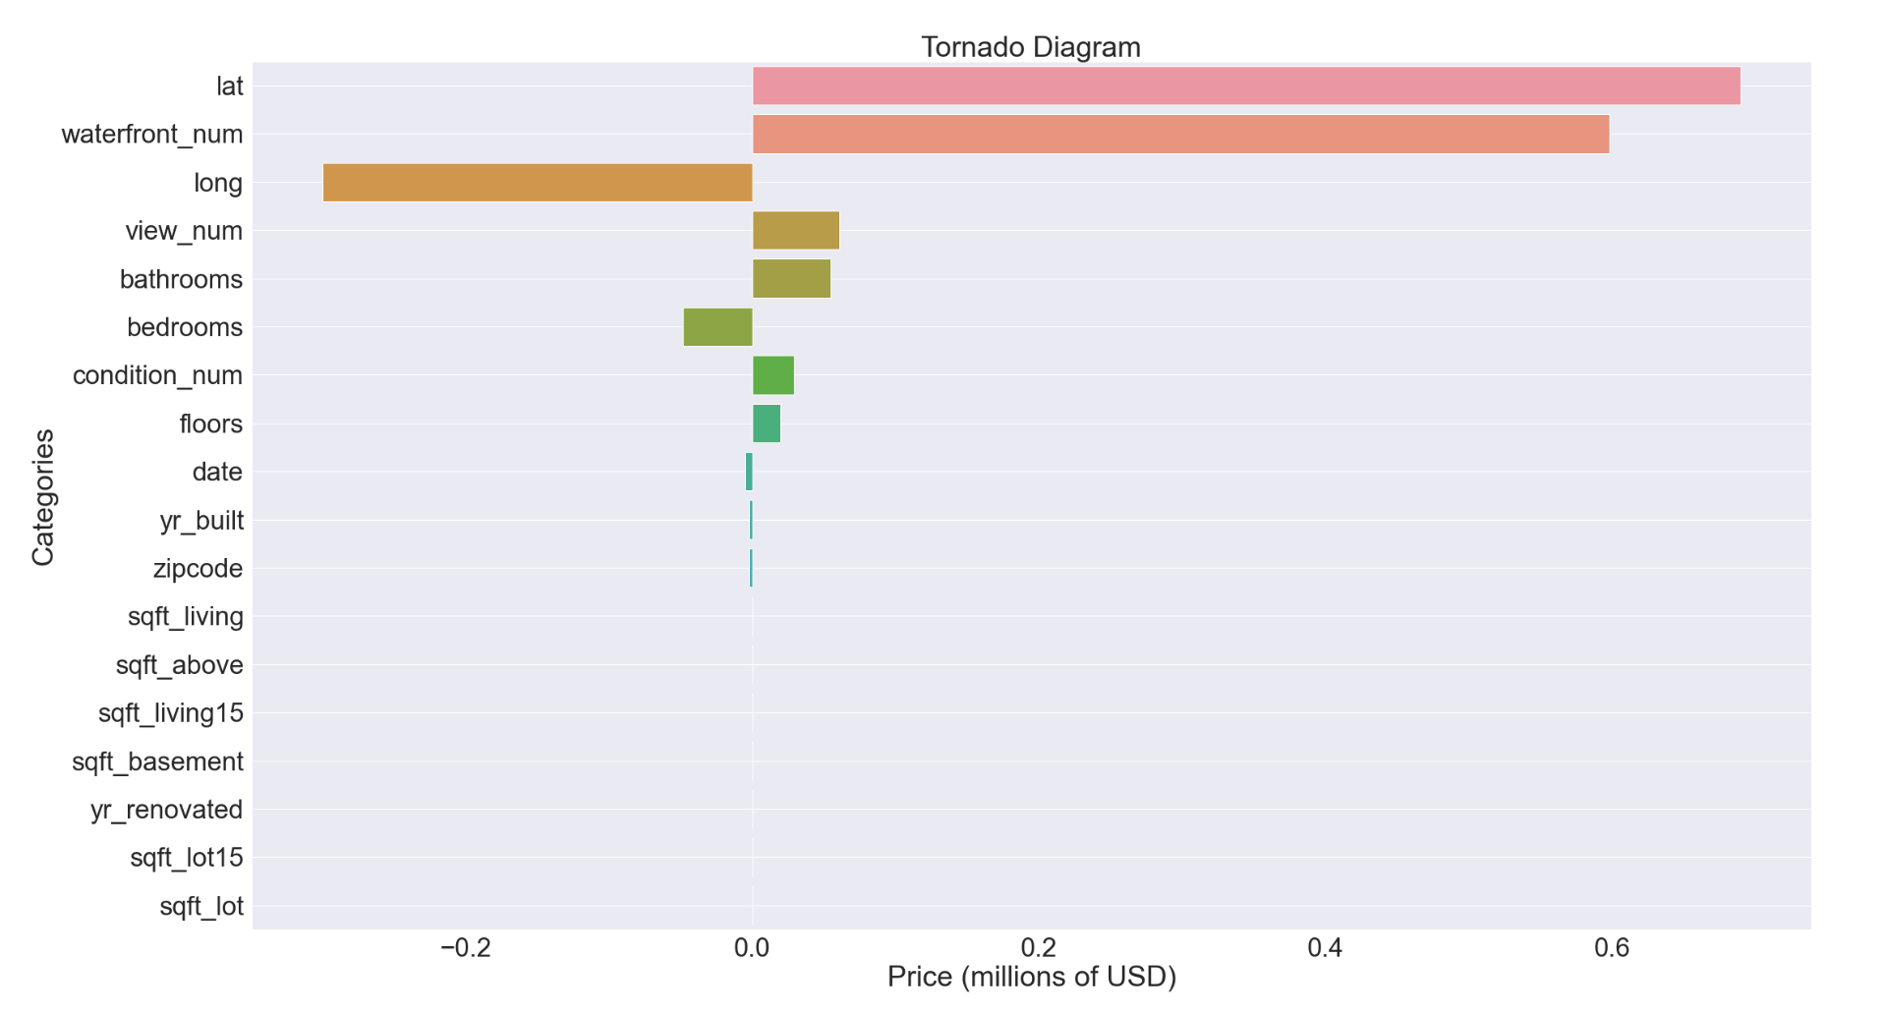
Relationships
Price ($)
689,672
598,222
-299,796
60,705
55,011
-48,208
29,012
19,416
-4,985
-1,999
-1,813
148
107
61
41
27
-0
0
lat
waterfront_num
long
view_num
bathrooms
bedrooms
condition_num
floors
date
yr_built
zipcode
sqft_living
sqft_above
sqft_living15 sqft_basement
yr_renovated
sqft_lot15
sqft_lot

Slide 8
RESULTS
Final Model
Error within
$109,000
All features
Notes:
Got error within $109000

Slide 9
FUTURE WORK
1. Outliers
2. Testing
3. Tiers of data
4. Housing Market over time
Notes:
Determine which houses the model does not account for currently, and determine what variables we can add in to account for these outliers.
Release the model as a test model to Reynolds and Klein. After some testing, determine what they see that can be improved or what variables may be introduced into the model
The sales of higher end houses have more variables that are involved in the sale due to the size of the home and the features being sold in the house. The next step could be to make a model for different tiers of houses being appraised
Does not include variables such as fluctuations in housing market price over time

Slide 10
CONCLUSIONS
Strongest correlated features to price:
Sqft_living
Sqft_above
Latitude
Bathrooms
Strongest impact on price:
Latitude
Waterfront
Longitude
View
Bathrooms
Final Model Error within $109,000

Slide 11
THANK YOU

