Slide 1
Introduction to TFW
The FrameWork for building highly scalable and maintainable applications

Slide 2
Project Information
Located at: http://www.sourceforge.net/projects/theframework
Licensed under the Lesser GNU Public License (LGPL).

Slide 3
What is TFW?
Intra-application framework.
Based on the principles of Dataflows and Component Based Software Engineering (CBSE)
Highly scalable and maintainable.
Transaction-based.
Adapts easily to other frameworks (e.g. JavaBeans).

Slide 4
What else is TFW?
Framework for componentizing algorithms that work on arrays of information (not discussed in this presentation).

Slide 5
What TFW is not
An inter-application framework (e.g. JNDI).
A server framework (e.g. EJB).

Slide 6
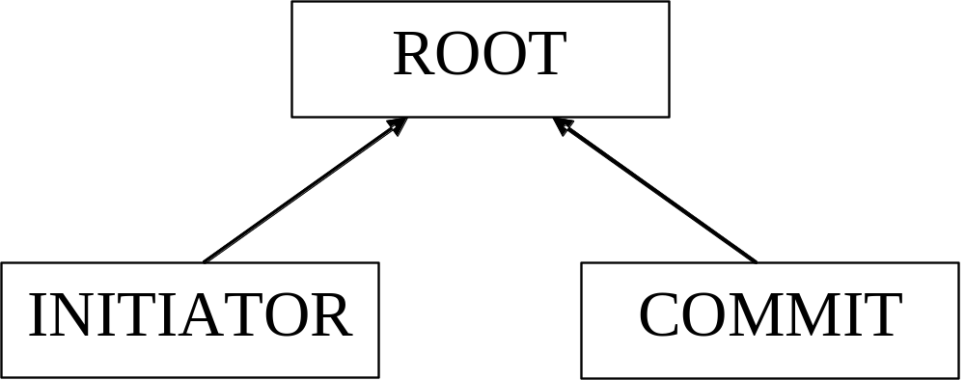
Hello World Example

Slide 7
Hello World Source Code
StatelessTriggerECD triggerECD = new StatelessTriggerECD("trigger");
RootFactory rf = new RootFactory();
rf.addEventChannel(triggerECD);
Root r = rf.create("Hello World Root", new BasicTransactionQueue());
Initiator i = new Initiator("Hello World Initiator",
new EventChannelDescription[] {triggerECD});
TriggeredCommit c = new TriggeredCommit("Hello World Commit",
triggerECD,
null,
null)
{
protected void commit()
{
System.out.println("HelloWorld");
}
};
r.add(i);
r.add(c);
i.trigger(triggerECD);

Slide 8
EventChannels
Publish-and-subscribe event dispatch.
Manages a single piece of state.
Highly recommended that the state be immutable since multiple subscribers could be receiving it.

Slide 9
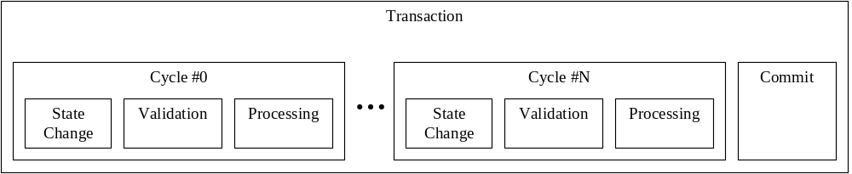
TFW Transaction

Slide 10
Description of TFW Transactions
Successful TFW Transactions consists of one or more Cycles and a Commit.
TFW Transactions can be rolled back during any validation or processing phase.
Cycles are added whenever a processor sets a new value on an event channel.

Slide 11
TFW Components
Structural Components
  Branch
  MultiplexedBranch
  Root
Functional Components
  Commit
  TriggeredCommit
  Converter
  TriggeredConverter
  Initiator
  Synchronizer
  Validator

Slide 12
Branch
Has one parent
Has zero or more children.
Defines event channels that are known to any child, grandchild, etc.
Created with a BranchFactory.

Slide 13
MultiplexedBranch
Solves the “Array to Element/Element to Array” problem.
Will not be used or discussed in this presentation.
Created with a MultiplexedBranchFactory.

Slide 14
Root
Has no parent.
Has zero or more children.
Defines event channels that are known to any child, grandchild, etc.
Defines the Transaction Queue and Thread to be used to execute all transactions involving its children, grandchildren, etc.
Created with a RootFactory

Slide 15
Commit
Executes only if a transaction was successful.
Executes only if one of its reactive event channels changed.
Usually used to notify non-TFW code that something happened and/or state changed within TFW.

Slide 16
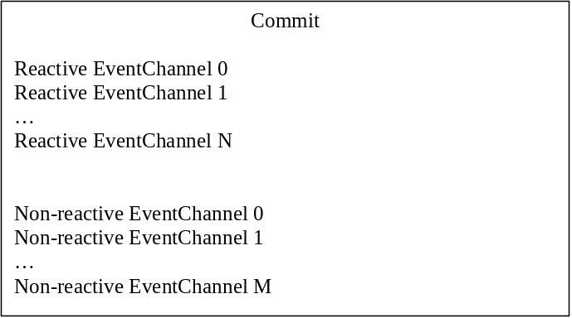
Commit Specification
Commit(
String name,
ObjectECD[] reactiveECDs,
ObjectECD[] nonReactiveECDs)

Slide 17
TriggeredCommit
Executes only if a transaction was successful.
Executes only if its StatelessTrigger event channel changed.
Usually used to notify non-TFW code that something happened and/or state changed within TFW.

Slide 18
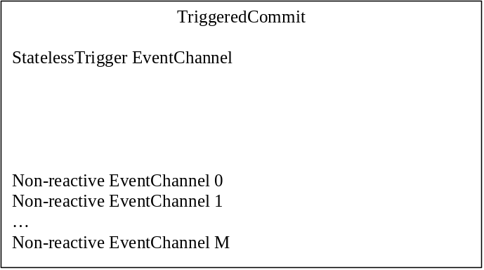
TriggeredCommit Specification
TriggeredCommit(
String name,
StatelessTriggerECD trigger,
ObjectECD[] nonReactiveECDs)

Slide 19
Converter
Executes during the processing phase of a Cycle.
Executes only if one of its reactive event channels changed.

Slide 20
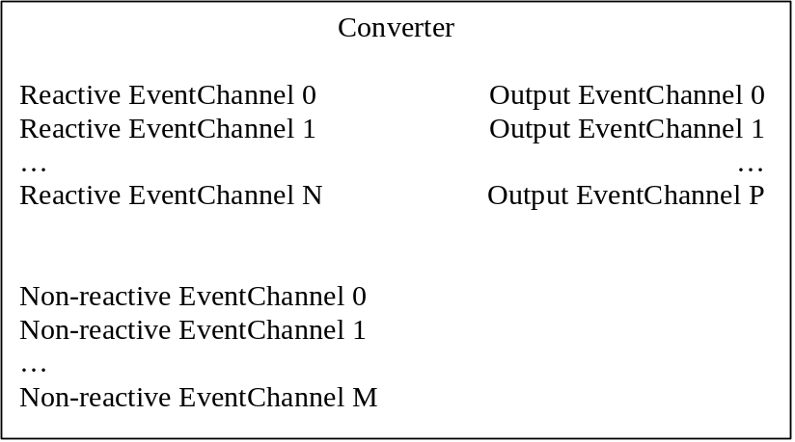
Converter Specification
Converter(
String name,
ObjectECD[] reactiveECDs,
ObjectECD[] nonReactiveECDs,
EventChannelDescription[] outputECDs)

Slide 21
TriggeredConverter
Executes during the processing phase of a Cycle.
Executes only if its StatelessTrigger event channel changed.

Slide 22
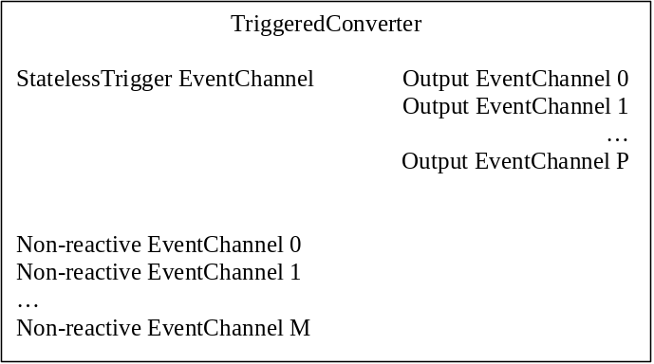
TriggeredConverter Specification
TriggeredConverter(
String name,
StatelessTriggerECD trigger,
ObjectECD[] nonReactiveECDs,
EventChannelDescription[] outputECDs)

Slide 23
Initiator
Changes the state or triggers one or more event channels.

Slide 24
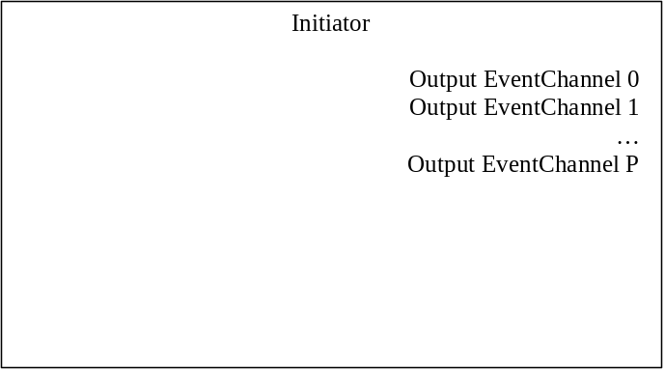
Initiator Specification
Initiator(
String name,
EventChannelDescription[] outputECDs)

Slide 25
Synchronizer
Keeps two sets of event channels in sync with each other.
Executes during the processing phase of a Cycle.
Executes different actions depending on which set of event channels (a or b) changed.
Only one set of event channels (a or b) can change during a Cycle.

Slide 26
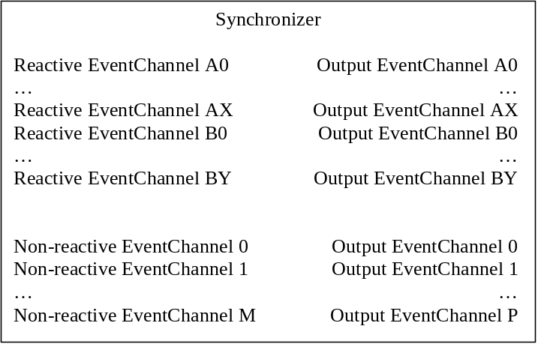
Synchronizer Specification
Synchronizer(String name,
ObjectECD[] aReactiveECDs,
ObjectECD[] bReactiveECDs,
ObjectECD[] nonReactiveECDs,
EventChannelDescription[] outputECDs)

Slide 27
Validator
Validates the state changes that just occurred in the state change phase of a Cycle.
Takes no action if changes are ok.
Performs a rollback if changes are not ok.

Slide 28
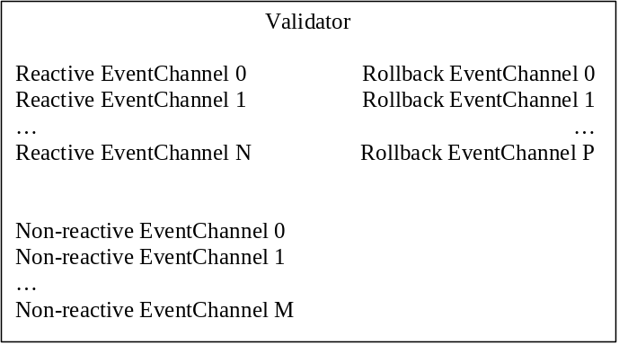
Validator Specification
Validator(String name,
ObjectECD[] reactiveECDs,
ObjectECD[] nonReactiveECDs,
RollbackECD[] rollbackECDs)

Slide 29
AdditionDemo
Simple GUI application that adds two numbers.
Implement it using standard Swing.
Implement it using TFW and Swing.
Compare implementations.

Slide 30
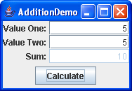
AdditionDemo Screen Shot

Slide 31
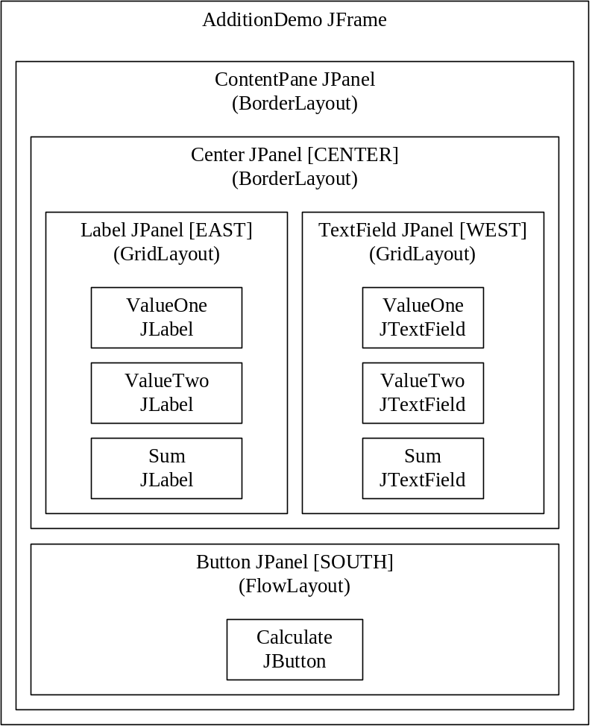
AdditionDemo Graphical Hierarchy

Slide 32
Step 1: Create Label Panel
JLabel valueOneL = new JLabel("Value One:");
valueOneL.setHorizontalAlignment(JLabel.RIGHT);
JLabel valueTwoL = new JLabel("Value Two:");
valueTwoL.setHorizontalAlignment(JLabel.RIGHT);
JLabel sumL = new JLabel("Sum:");
sumL.setHorizontalAlignment(JLabel.RIGHT);
JPanel labelPanel = new JPanel();
labelPanel.setLayout(new GridLayout(3, 1));
labelPanel.add(valueOneL);
labelPanel.add(valueTwoL);
labelPanel.add(sumL);

Slide 33
Step 2: Create TextField Panel
final JTextField valueOneTF = new JTextField(“0”);
valueOneTF.setColumns(10);
valueOneTF.setHorizontalAlignment(JTextField.RIGHT);
final JTextField valueTwoTF = new JTextField(“0”);
valueTwoTF.setColumns(10);
valueTwoTF.setHorizontalAlignment(JTextField.RIGHT);
final JTextField sumTF = new JTextField(“0”);
sumTF.setColumns(10);
sumTF.setEnabled(false);
sumTF.setHorizontalAlignment(JTextField.RIGHT);
JPanel textFieldPanel = new JPanel();
textFieldPanel.setLayout(new GridLayout(3, 1));
textFieldPanel.add(valueOneTF);
textFieldPanel.add(valueTwoTF);
textFieldPanel.add(sumTF);

Slide 34
Step 3: Create Button Panel
JButton calculateB = new JButton();
calculateB.setText("Calculate");
JPanel buttonPanel = new JPanel();
buttonPanel.add(calculateB);

Slide 35
Step 4: Create JFrame
JPanel centerPanel = new JPanel();
centerPanel.setLayout(new BorderLayout());
centerPanel.add(labelPanel, BorderLayout.WEST);
centerPanel.add(textFieldPanel, BorderLayout.EAST);
JPanel contentPane = new JPanel();
contentPane.setLayout(new BorderLayout());
contentPane.add(centerPanel, BorderLayout.CENTER);
contentPane.add(buttonPanel, BorderLayout.SOUTH);
final JFrame frame = new JFrame();
frame.setContentPane(contentPane);
frame.setTitle("AdditionDemo");
frame.setDefaultCloseOperation(JFrame.DISPOSE_ON_CLOSE);
frame.pack();

Slide 36
Step 5: Add Functionality
calculateB.addActionListener(new ActionListener()
{
public void actionPerformed(ActionEvent e)
{
String valueOneString = valueOneTF.getText();
String valueTwoString = valueTwoTF.getText();
int valueOne = Integer.MIN_VALUE;
int valueTwo = Integer.MIN_VALUE;
try
{
valueOne = Integer.parseInt(
valueOneString);
}
catch (NumberFormatException nfe)
{
JOptionPane.showMessageDialog(frame,
"Bad Value for ValueOne ("+
valueOneString+")", "Error",
JOptionPane.ERROR_MESSAGE);
return;
}
try
{
valueTwo = Integer.parseInt(
valueTwoString);
}
catch (NumberFormatException nfe)
{
JOptionPane.showMessageDialog(frame,
"Bad Value for ValueTwo ("+
valueTwoString+")", "Error",
JOptionPane.ERROR_MESSAGE);
return;
}
sumTF.setText("" + (valueOne + valueTwo));
}
});

Slide 37
Step 6: Show JFrame
frame.setVisible(true);

Slide 38
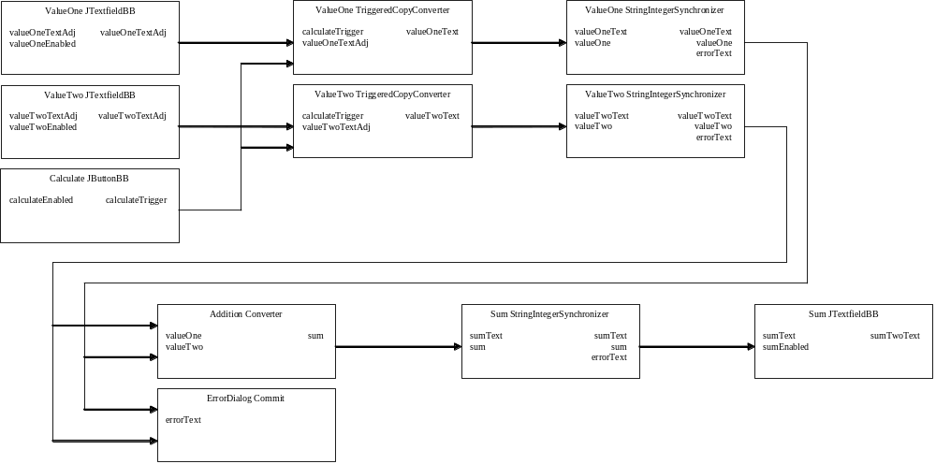
AdditionDemo TFW Components

Slide 39
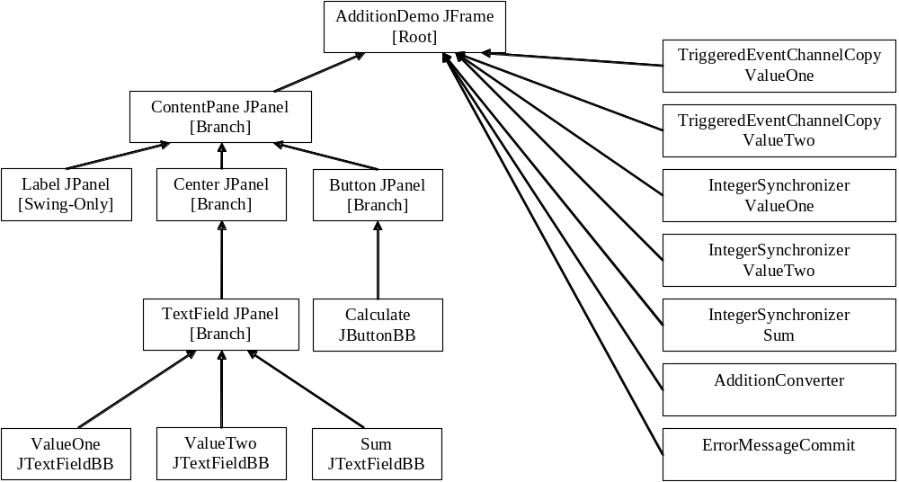
AdditionDemo TFW Structure

Slide 40
Step 1: Define EventChannelDescriptions
final BooleanECD CALCULATE_ENABLED_ECD = new BooleanECD("calculateEnabled");
final StatelessTriggerECD CALCULATE_TRIGGER_ECD =
new StatelessTriggerECD("calculateTrigger");
final StringRollbackECD ERROR_TEXT_ECD = new StringRollbackECD("errorText");
final IntegerECD SUM_ECD = new IntegerECD("sum");
final BooleanECD SUM_ENABLED_ECD = new BooleanECD("sumEnabled");
final StringECD SUM_TEXT_ECD = new StringECD("sumText");
final IntegerECD VALUE_ONE_ECD = new IntegerECD("valueOne");
final BooleanECD VALUE_ONE_ENABLED_ECD = new BooleanECD("valueOneEnabled");
final StringECD VALUE_ONE_TEXT_ECD = new StringECD("valueOneText");
final StringECD VALUE_ONE_TEXT_ADJ_ECD = new StringECD("valueOneTextAdj");
final IntegerECD VALUE_TWO_ECD = new IntegerECD("valueTwo");
final BooleanECD VALUE_TWO_ENABLED_ECD = new BooleanECD("valueTwoEnabled");
final StringECD VALUE_TWO_TEXT_ECD = new StringECD("valueTwoText");
final StringECD VALUE_TWO_TEXT_ADJ_ECD = new StringECD("valueTwoTextAdj");

Slide 41
Step 2: Create Root and JFrame
RootFactory rootFactory = new RootFactory();
rootFactory.addEventChannel(CALCULATE_ENABLED_ECD, Boolean.TRUE);
rootFactory.addEventChannel(CALCULATE_TRIGGER_ECD);
rootFactory.addEventChannel(ERROR_TEXT_ECD);
rootFactory.addEventChannel(SUM_ECD);
rootFactory.addEventChannel(SUM_ENABLED_ECD, Boolean.FALSE);
rootFactory.addEventChannel(SUM_TEXT_ECD);
rootFactory.addEventChannel(VALUE_ONE_ECD);
rootFactory.addEventChannel(VALUE_ONE_ENABLED_ECD, Boolean.TRUE);
rootFactory.addEventChannel(VALUE_ONE_TEXT_ECD, “0");
rootFactory.addEventChannel(VALUE_ONE_TEXT_ADJ_ECD, “0");
rootFactory.addEventChannel(VALUE_TWO_ECD);
rootFactory.addEventChannel(VALUE_TWO_ENABLED_ECD, Boolean.TRUE);
rootFactory.addEventChannel(VALUE_TWO_TEXT_ECD, “0");
rootFactory.addEventChannel(VALUE_TWO_TEXT_ADJ_ECD, “0");
Root root = rootFactory.create("AdditionDemo", new BasicTransactionQueue());
JFrameBB frame = new JFrameBB(root);

Slide 42
Step 3: Create Label Panel
JLabel valueOneL = new JLabel("Value One:");
valueOneL.setHorizontalAlignment(JLabel.RIGHT);
JLabel valueTwoL = new JLabel("Value Two:");
valueTwoL.setHorizontalAlignment(JLabel.RIGHT);
JLabel sumL = new JLabel("Sum:");
sumL.setHorizontalAlignment(JLabel.RIGHT);
JPanel labelPanel = new JPanel();
labelPanel.setLayout(new GridLayout(3, 1));
labelPanel.add(valueOneL);
labelPanel.add(valueTwoL);
labelPanel.add(sumL);

Slide 43
Step 4: Create TextField Panel
JTextFieldBB valueOneTF = new JTextFieldBB("valueOne",
VALUE_ONE_TEXT_ADJ_ECD, VALUE_ONE_ENABLED_ECD);
valueOneTF.setColumns(10);
valueOneTF.setHorizontalAlignment(JTextFieldBB.RIGHT);
JTextFieldBB valueTwoTF = new JTextFieldBB("valueTwo",
VALUE_TWO_TEXT_ADJ_ECD, VALUE_TWO_ENABLED_ECD);
valueTwoTF.setColumns(10);
valueTwoTF.setHorizontalAlignment(JTextFieldBB.RIGHT);
JTextFieldBB sumTF = new JTextFieldBB("sum",
SUM_TEXT_ECD, SUM_ENABLED_ECD);
sumTF.setColumns(10);
sumTF.setHorizontalAlignment(JTextFieldBB.RIGHT);
JPanelBB textFieldPanel = new JPanelBB("textField");
textFieldPanel.setLayout(new GridLayout(3, 1));
textFieldPanel.addToBoth(valueOneTF);
textFieldPanel.addToBoth(valueTwoTF);
textFieldPanel.addToBoth(sumTF);

Slide 44
Step 5: Create Button Panel
JButtonBB calculateB = new JButtonBB("calculate",
CALCULATE_ENABLED_ECD, CALCULATE_TRIGGER_ECD);
calculateB.setText("Calculate");
JPanelBB buttonPanel = new JPanelBB("button");
buttonPanel.addToBoth(calculateB);

Slide 45
Step 6: Add Functionality
root.add(new TriggeredEventChannelCopy("ValueOne",
CALCULATE_TRIGGER_ECD, VALUE_ONE_TEXT_ADJ_ECD, VALUE_ONE_TEXT_ECD));
root.add(new TriggeredEventChannelCopy("ValueTwo",
CALCULATE_TRIGGER_ECD, VALUE_TWO_TEXT_ADJ_ECD, VALUE_TWO_TEXT_ECD));
root.add(new IntegerSynchronizer("sum",
SUM_ECD, SUM_TEXT_ECD, ERROR_TEXT_ECD));
root.add(new IntegerSynchronizer("valueOne",
VALUE_ONE_ECD, VALUE_ONE_TEXT_ECD, ERROR_TEXT_ECD));
root.add(new IntegerSynchronizer("valueTwo",
VALUE_TWO_ECD, VALUE_TWO_TEXT_ECD, ERROR_TEXT_ECD));
root.add(new AdditionConverter(VALUE_ONE_ECD, VALUE_TWO_ECD, SUM_ECD));
root.add(new ErrorMessageCommit(frame, ERROR_TEXT_ECD));

Slide 46
Step 7: Configure JFrame and Show
JPanelBB centerPanel = new JPanelBB("center");
centerPanel.setLayout(new BorderLayout());
centerPanel.add(labelPanel, BorderLayout.WEST);
centerPanel.addToBoth(textFieldPanel, BorderLayout.EAST);
JPanelBB contentPane = new JPanelBB("contentPane");
contentPane.setLayout(new BorderLayout());
contentPane.addToBoth(centerPanel, BorderLayout.CENTER);
contentPane.addToBoth(buttonPanel, BorderLayout.SOUTH);
frame.setContentPaneForBoth(contentPane);
frame.setTitle("AdditionDemo");
frame.setDefaultCloseOperation(JFrameBB.DISPOSE_ON_CLOSE);
frame.pack();
frame.setVisible(true);

Slide 47
IntegerSynchronizer
private static class IntegerSynchronizer
extends Synchronizer
{
private final String name;
private final IntegerECD integerECD;
private final StringECD textECD;
private final StringRollbackECD errorECD;
public IntegerSynchronizer(String name,
IntegerECD integerECD, StringECD textECD,
StringRollbackECD errorECD)
{
super("IntegerSynchronizer["+name+"]",
new ObjectECD[] {integerECD},
new ObjectECD[] {textECD},
null,
new ObjectECD[] {errorECD});
this.name = name;
this.integerECD = integerECD;
this.textECD = textECD;
this.errorECD = errorECD;
}
protected void convertAToB() {
int i = ((Integer)get(
integerECD)).intValue();
set(textECD, Integer.toString(i));
}
protected void convertBToA() {
String s = (String)get(textECD);
try {
set(integerECD,
new Integer(Integer.parseInt(s)));
}
catch (NumberFormatException nfe) {
rollback(errorECD,
"Bad Value for "+name+" ("+s+")");
}
}
}

Slide 48
Addition Converter
private static class AdditionConverter extends Converter {
private final IntegerECD valueOneECD;
private final IntegerECD valueTwoECD;
private final IntegerECD sumECD;
public AdditionConverter(IntegerECD valueOneECD,
IntegerECD valueTwoECD, IntegerECD sumECD) {
super("AdditionConverter",
new ObjectECD[] {valueOneECD, valueTwoECD},
null,
new ObjectECD[] {sumECD});
this.valueOneECD = valueOneECD;
this.valueTwoECD = valueTwoECD;
this.sumECD = sumECD;
}
protected void convert() {
int v1 = ((Integer)get(valueOneECD)).intValue();
int v2 = ((Integer)get(valueTwoECD)).intValue();
set(sumECD, new Integer(v1 + v2));
}
}

Slide 49
ErrorMessageCommit
private static class ErrorMessageCommit extends Commit
{
private final Component component;
private final StringRollbackECD errorMessageECD;
public ErrorMessageCommit(Component component,
StringRollbackECD errorMessageECD)
{
super("ErrorMessageConverter",
new ObjectECD[] {errorMessageECD});
this.component = component;
this.errorMessageECD = errorMessageECD;
}
protected void commit()
{
final String errorMessage = (String)get(errorMessageECD);
EventQueue.invokeLater(new Runnable()
{
public void run()
{
JOptionPane.showMessageDialog(component, errorMessage,
"Error", JOptionPane.ERROR_MESSAGE);
}
});
}
}

Slide 50
TriggeredEventChannelCopy
private static class TriggeredEventChannelCopy extends TriggeredConverter
{
private final ObjectECD inputECD;
private final ObjectECD outputECD;
public TriggeredEventChannelCopy(String name,
StatelessTriggerECD trigger, ObjectECD inputECD,
ObjectECD outputECD)
{
super("TriggeredEventChannelCopy["+name+"]",
trigger,
new ObjectECD[] {inputECD},
new EventChannelDescription[] {outputECD});
this.inputECD = inputECD;
this.outputECD = outputECD;
}
protected void convert()
{
set(outputECD, get(inputECD));
}
}

Slide 51
Comparison: Testing
The Swing-only application must be functionally tested by executing the application.
The TFW-Swing application can have each functional component (i.e. IntegerSynchronizer, AdditionConverter and TriggeredEventChannelCopy) unit tested without executing the application.

Slide 52
Comparison: Reuse
The ActionListener in the Swing-only application cannot be reused without potentially significant rework due to directly referencing the widgets.
The functional components in the TFW-Swing application are easily reused because they don’t have external references to other components or widgets.

Slide 53
Comparison: Multi-threaded
The Swing-only application is doing it’s work in the AWT Thread (i.e. the applications is single-threaded).
The functional components in the TFW-Swing application are executed in a different thread than the AWT Thread (i.e. the application is multi-threaded).
The Swing wrappers safely pass data between Swing and TFW and safely call methods on Swing widgets.

Slide 54
Other Benefits of TFW
Applications written using TFW decompose into functional components, which tend to be small, loosely-coupled and highly-cohesive.
Applications written using TFW tend to be easier to maintain because it is based on only ten components, which makes all of the code look very similar.

Slide 55
Other Benefits of TFW (con’t)
Moving from Analysis (platform-independent solution) to Design (platform-dependent solution) to Implementation goes very quickly.
Obtaining the Design and Analysis from the Implementation is straightforward.

