Slide 1

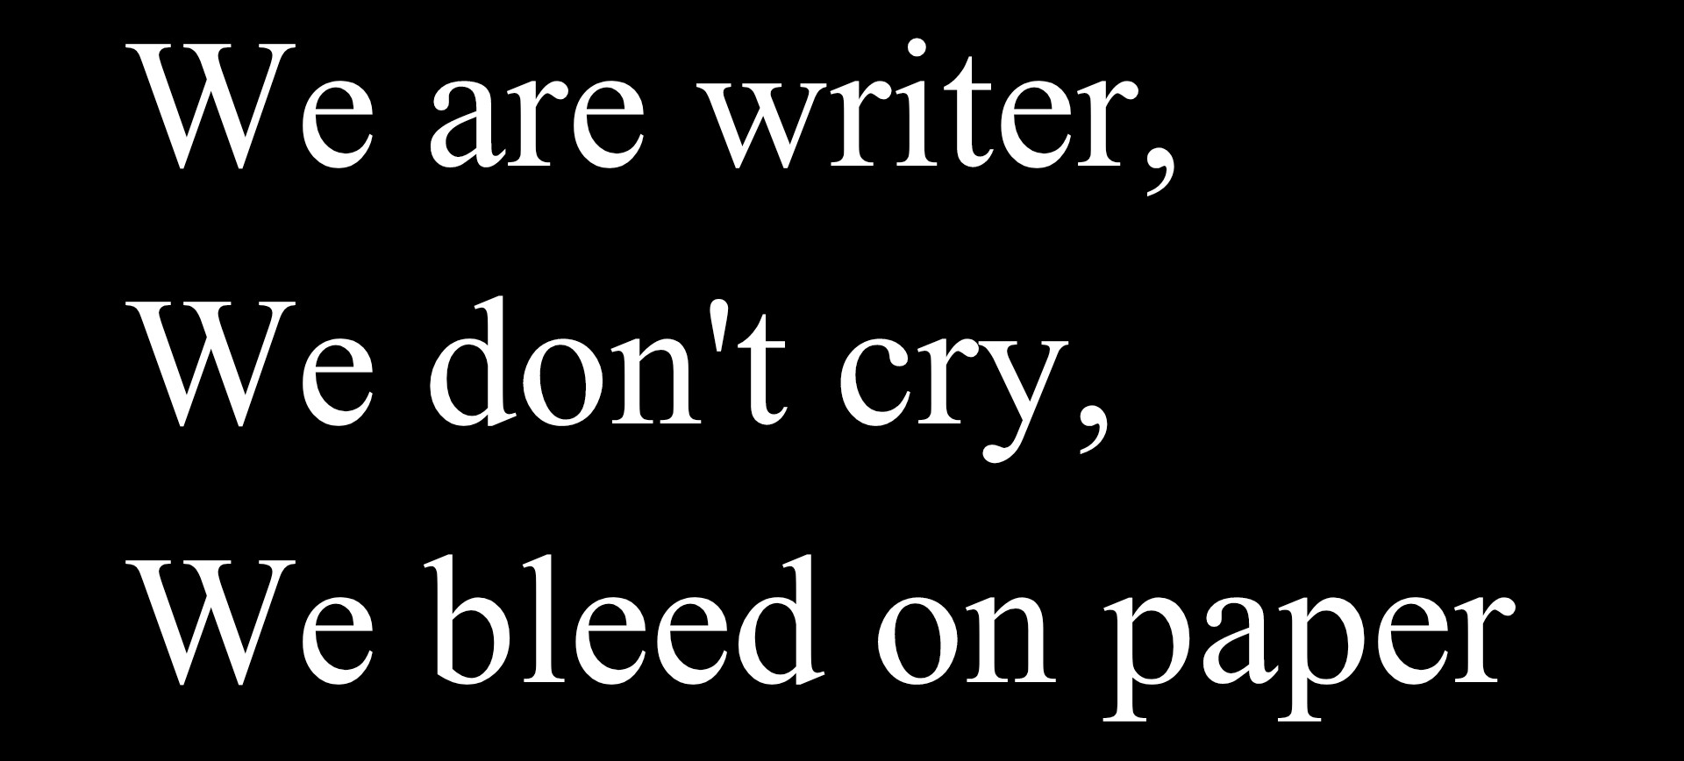
Entrepreneurship
Female entrepreneur
Nemrah Ahmad Niazi
,
We write so we can breathe

Slide 2

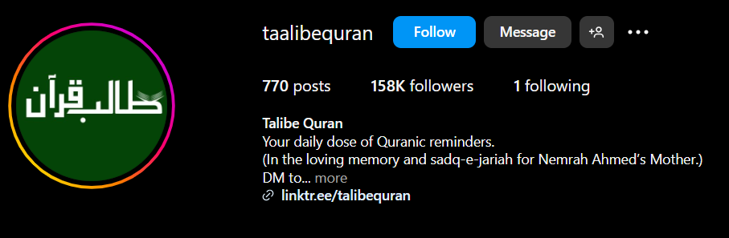


Nemrah Ahmed: A Journey as an entrepreneur
Zanjabeel – A bookstore founded by Nemrah Ahmed in March 2016.
Name Meaning – Derived from Arabic, meaning ginger, symbolizing a spring in Jannah (Paradise) and knowledge.
Books Available – Offers a range of books, including Nemrah Ahmed’s novels.
Goal – Provides quality literature at affordable prices.
Taalib-e-Quran – An initiative by Nemrah Ahmed for Quranic education.
Meaning – Translates to "Seeker of the Quran.“
Offerings – Provides daily Quranic reminders and courses for deeper understanding.
Purpose – A Sadaqah Jariyah (continuous charity) in memory of Nemrah Ahmed’s mother.
Through Zanjabeel and Taalib-e-Quran, Nemrah Ahmed endeavors to enrich readers' lives by providing access to quality literature and fostering a deeper connection with the Quran.

Slide 3
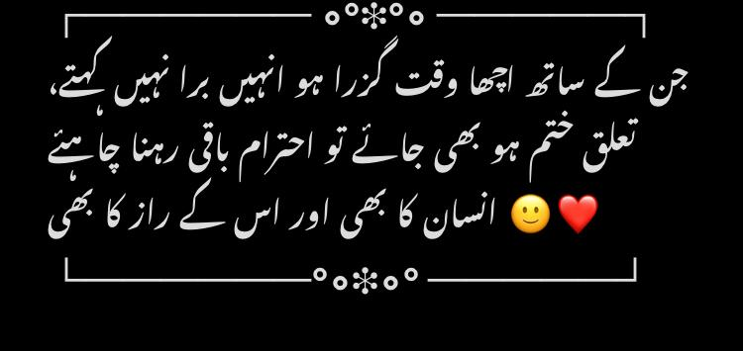
❝ Duniya maazi k ghum or mustaqbil k khof se azaad logon ki ha - Haalim❞
Why I choose Nemrah Ahmed as a Struggling Entrepreneur?
She keeps trying everything in a desparate way and after 2 flopped novels she still proved that if you have a dream you can always start again because “khaab agr epne hathon se tore jaein to ungliyan bhi zakhmi hoti hein” - JKP

Slide 4



Introduction
Nemrah Ahmad NiAzi – novel writer
Over the years, Nemrah has authored several notable works, including:
"Mus'haf" (2011)
"Jannat Kay Pattay" (2013)
"Namal" (2014)
"Haalim" (2017)
"Maala" (2022-2024)
Her writing is distinguished by the seamless integration of Islamic teachings and thorough research, which has garnered her a substantial readership in Pakistan and beyond.
In addition to her literary pursuits, Nemrah Ahmed is the CEO of "Zanjabeel," a bookstore she launched in March 2016. The name "Zanjabeel" is derived from the Arabic word for ginger and represents one of the springs in Jannah (Paradise), symbolizing a source of knowledge and enlightenment.
Beyond her writing, Nemrah engages with her audience through various platforms. She maintains an active presence on Instagram, where she shares insights into her work and personal reflections. Her unique storytelling and ability to weave spiritual elements into her narratives have solidified her status as a prominent figure in contemporary Urdu literature.

Slide 5




First Novel – ‘Mere Khwab Mere Jugnu’ (2007) She published her first novel Mere Khwab Mere Jugnu at the age of 16. This novel was well-received and marked the beginning of her literary journey.
Rise to Fame Her novel Jannat Kay Pattay became a huge success and gained her immense popularity. The novel, which discusses the themes of hijab, faith, and personal struggles, touched the hearts of many readers.
Other Popular Novels After Jannat Kay Pattay, she continued to write several other famous novels, including:
Namal (A crime-thriller with deep Islamic and moral lessons)
Mushaf (A novel centered around the Quran and its impact on the protagonist’s life)
Haalim (A fantasy-based novel with elements of time travel and mystery)
Pahari Ka Qaidi (A short but powerful novel)
Unique Writing Style
She often combines Islamic teachings with strong storytelling.
Her novels include suspense, drama, and deep moral lessons.
She creates strong female characters who undergo personal growth.

Slide 6

Nemrah Ahmed: A Journey to Becoming a Writer
The Dream: As a book lover, she once daydreamed of signing books for eager readers. That moment inspired her to become a writer.
Early Writing: At age 9, she wrote her first story about a queen whose kingdom was struck by disease. Despite her brother's jokes, she continued writing. She attempted three English novels but left them incomplete due to boredom.
Introduction to Urdu Novels: A maid at her aunt’s house loved reading digests, sparking Nemrah’s curiosity. She borrowed books secretly and got hooked.
First Publishing Attempt: Inspired by ongoing stories like Dil Se Niklay Hain Jo Lafz by Farhat Ishtiaq, she wrote her first novel and submitted it to Khawateen Digest. Initially, they found her too young but later recognized her talent. Senior editor Antul Saboor predicted: "Your name will shine like a star in this country after 10 years."
Challenges & Success: Her first published story gained fame, but two later stories flopped. However, she remained passionate and evolved as a writer.

Slide 7
Why She Writes
Writing gives her peace and keeps her sane.
She aims to comfort people, empower women, and change perspectives towards positivity.
She wants to connect people with Allah through simple words, calling it an investment for her afterlife.
Her Most Loved Work
She loves Namal, but Haalim is closest to her heart.
Her characters reflect real struggles—Taliya from Haalim represents a part of herself.
Connecting Quran to Her Stories
While studying at Al Huda, she deeply connected with the Quran.
Mus’haf was written during this phase and is inspired by her own journey, not just Mehmal Ibrahim’s.
Her View on Literature & Dramas
She believes life itself is more dramatic than fiction.
Thinks digests today don’t deserve her stories.
Prefers books over TV dramas, as her characters engage better in writing.

Slide 8
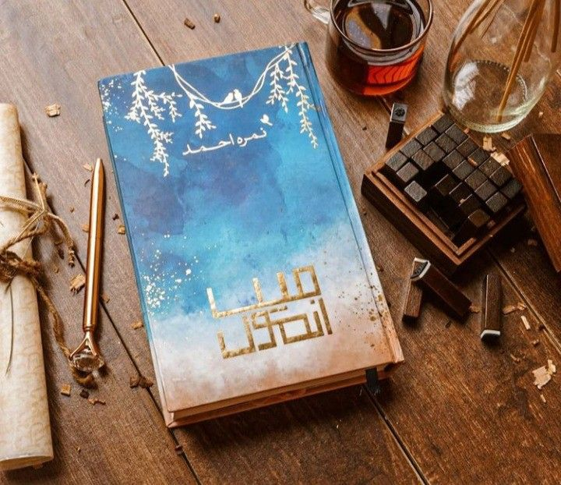
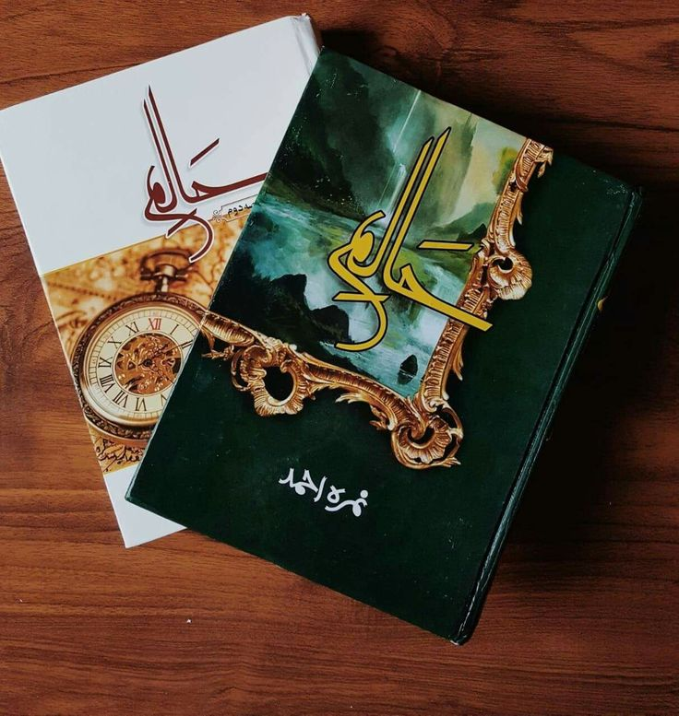
Why She Never Allowed Dramas on Her Books
She believes her characters are too deep and complex to be portrayed accurately in TV dramas.
She feels that books have a stronger impact than dramatized versions, which often lose the essence of the story.
She fears that commercialization would change the true message of her novels.
She mentioned her struggles in “Mein Anmol”
1. Financial Struggles
Came from a lower-class background and didn’t have money to publish books.
Publishers tricked her by buying her novels at a low price and earning from every sale.
Learned the hard way → Now she doesn’t sell her stories before publication so she earns from every book purchase.
2. Her Journey with Al-Huda & Mushaf
Joined Al-Huda Institute and deeply connected with the Quran.
Realized that she had never truly understood the Quran before.
Mushaf was not just a story—it was her personal journey.
Mehmal Ibrahim = Nemrah Ahmed → Mehmal’s struggles reflect her own life
3. Learning from Her Own Characters
Taliya (Haalim) taught her a lot → She created situations, then compared her own solutions with her character’s reactions.
Used this technique to learn, grow, and evolve through her writing.
4. Biggest Lesson in Writing
Never sell work before publication → Own the rights and earn from each sale.
Faith & learning go hand in hand → Writing should be meaningful, not just entertaining.
Struggles make stories real → Her hardships shaped her unique and impactful writing style.

Slide 9


Famous Dialogues
F a m o u s
D I a l o g u e s
Saudi Yousaf and gheebat – Namal
Insan ko koi cheez ni hra skti jb tk k wo khud haar na maan le - JKP
Achi lrkiyan kabootar ni bntin, wo idhr ki bt udhar ni krtin - JKP
Insan to kisi cheez ka sila ni dete to un k raweyon ka afsos kesa – Iblees
Hum jaane walon ko rok ni skte ku k wo jaane k liae to aate hein - JKP
Jo jitna acha jhoot bolta ha Baharay, yh duniya usi ki hoti ha lkn phr uski akhirat ni hoti – JKP
Ap mein itni self respect or waqar hona chahya k kisi ko khud pr trs na khaane dein – mein Anmol
Kisi ki muhabbat ya khouf apki izzet se bara ni hona chahya –mein Anmol
Allah or us k bnde (Adam ki aulad) – mein Anmol
Hum itne be-qasoor ni hote jitna khud ko smjhte hein –Mus’haf

Slide 10
Famous Dialogues
F a m o u s
D I a l o g u e s
Ap jinnon se drti hein jb k insan zyada khatarnaak hein - Maala
Yousaf or Zulekha – Mus’haf
Humein sbse zyada zroort apni nzron mn moetbar bnne ki hoti ha – mein Anmol
Agr koi apki izzet pe war kre to never react just make them bleed - Namal
Sbr krlo insan ko utni hi takleef milti ha jitni wo seh ske - JKP
Mn Che Taliya se dast-brdaar hota hn - Haalim
Plan A na kaam kre to plan C, Taliya k plans Taliya ki mrzi - Haalim
Kch Khwab poore hone k liae ni bs dil ko khush krne k liae hote hein - Haalim
Mere zmane ki lrkiyon ko apni takmeel k liae kisi mrd ki zroort ni ha – Haalim
Apne gunahon pr doosron ko gawah ni bnate Mehmal – Mus’haf
Dil ko maarey begheir noor ni milta - JKP

Slide 11



Nemrah Ahmed’s Writing Style & Plot Themes
Writing Style
Blend of Fiction & Reality: Her stories feel real because they are inspired by everyday life, yet they have dramatic and engaging plots.
Strong Female Characters: Her protagonists, like Haya Suleman (Jannat Kay Pattay) and Taliya (Haalim), have flaws but grow throughout the story.
Islamic & Spiritual Themes: She connects her stories with Islamic teachings, often quoting the Quran (Mus'haf is a prime example).
Suspense & Thrill: She masterfully uses mystery and unexpected twists (Namal has a crime-thriller element).
Philosophical & Psychological Depth: Her characters struggle with deep questions about life, morality, and faith.
Emotional & Relatable Writing: Her writing evokes strong emotions, making readers feel connected to the characters.
Poetic & Metaphorical Touch: She often includes thought-provoking lines and metaphors, making her work deeply impactful.
2. Common Plot Themes
Self-Discovery & Growth: Her protagonists learn life-changing lessons through their journeys.
Women Empowerment: She challenges stereotypes about women being fragile (She wants to remove the "fragile" label from women).
Faith & Divine Connection: Many characters find guidance through religion (Mus'haf, Haalim).
Love Beyond Romance: Her stories emphasize self-respect, family, and personal growth rather than just love stories.
Mystery & Suspense: Her novels often have investigative or suspenseful elements (Namal, Haalim).
Historical & Cultural Influences: She weaves history and global cultures into her narratives (Haalim explores Malaysian history and politics).
Examples of Her Writing Style in Novels:
Mus'haf → Spiritual journey, Quranic connection.
Jannat Kay Pattay → Identity, modesty, and self-respect.
Namal → Crime-thriller, revenge, and justice.
Haalim → Time travel, self-improvement, and destiny.
Maala → Women’s struggles and societal change

Slide 12


Favorite characters (Male)
Hashim Kardar (Namal)
Hashim Kardar is one of the best antagonists in Urdu literature, a character that represents the dark side of intelligence, power, and ambition. His presence in Namal adds tension, mystery, and depth to the novel, known for “Hashim sb snbhal lega”.
Why is Hashim Kardar a Great Villain?
Well-Written & Realistic: He is not just "bad for the sake of being bad"—he has motivations and depth.
Psychologically Thrilling: His manipulations keep the readers engaged and shocked.
His famous Dialogues:
Mn bht emaandar hn or bht emaandari se dhoka deta hn
Hashim k liae alfaz taash k pattay the, mrzi k samne lata mrzi k chupa leta
Jihan Sikander (JKP)
The Mysterious & Charismatic Hero of Jannat Kay Pattay. a perfect mix of mystery, charm, strength, and faith. His presence in Jannat Kay Pattay makes the novel unforgettable, leaving readers captivated by his brilliant mind and hidden emotions, known for “Mjhe raaz rkhne aate hein”.
Why is Jihan Sikander a Great Character?
His mystery keeps readers intrigued—we keep wanting to know more about him.
His chemistry with Haya is realistic and meaningful, not just romance but also spiritual growth.
He represents a powerful male lead—not controlling, but inspiring.
He is deeply relatable—despite being strong, he has emotional vulnerabilities that make him human.
His famous Dialogues:
Jannat k pattay thamne walon ko Allah kbhi ruswa ni krta.
ARP bt kr rha hn or bt krne ki ijaazet chahta hn.
Besides all these, he also played three hidden roles for his wife’s protection which was a plot twist in this story, they are Abdul Rehman Pasha aka ARP, Dolly, Major Ahmad

Slide 13
Favorite characters (Female)
Nemrah Ahmed is known for writing strong, realistic, and inspiring female characters who go through emotional, psychological, and spiritual transformations. Unlike stereotypical heroines, her protagonists are flawed yet resilient, making them relatable and empowering.
Haya Suleman (JKP) - She teaches that real beauty is in character, not appearance.
Mehmal Ibrahim (Mus’haf) - she represents those who feel lost but eventually find their way through faith
Zumar Yousuf (Namal) - She proves that women can be both intelligent and emotionally strong in tough situations.
Taliya Bint-e-Murad (Haalim) - She shows that courage is not in tricking others but in facing your own fears.
Haneen Yousuf (Namal) - She teaches the power of patience and self-control.
Why Are Nemrah Ahmed’s Female Characters Different?
They don’t fit into “typical romance novel heroines.”
They grow mentally, emotionally, and spiritually throughout their stories.
They inspire readers to improve their own lives, not just dream about fictional love.
And most of them Ayeshay Gul and Jihan’s mother (Sabeen Sikander)
Their dialogues are
Achi lrkiyan lmbe nakhun ni rkhtin, lmbe nakhun billiyon k hote hein insanon k ni.
Jo jitna acha jhoot bolta ha yh duniya uski utni hoti ha mgr phr uski akhirat ni hoti.
Nfrt gunaah se krni chahya, gunehgaar se ni
Epne dukh mn doosron ka dil ni dukhate
Gum ishtehar lgane k liae ni hot, unse kamayi ni ki jati.
Agr sbr itna asan hota to hr koi doosre ko krne ko na hota, sb khud hi kr lete.

Slide 14
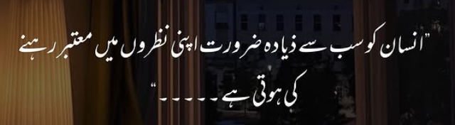
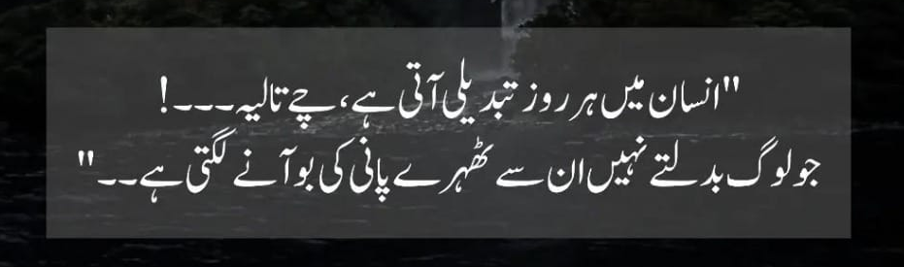
Haalim is an Urdu novel with its title meaning "A Dreamer" in Arabic. The story follows ambitious and mysterious characters who embark on a journey filled with challenges, dreams, and destiny. It explores themes of self-discovery, struggle, ambition, and faith, encouraging readers to chase their dreams despite obstacles.

Slide 15

Thank you !!!
Thank you !!!

