Slide 1

Psychology
Mental Models in Artificial Intelligence
"When Machines Begin to Think Like Minds"

Slide 2

Presented by
"AI is not the future of thinking. It is
a reflection of how we think today."

Slide 3

Introduction
AI is not just about algorithms and data. At its core, artificial intelligence is a human creation — a product of how we, as humans, think intelligence works. Every AI system we build is shaped by our own mental models of thinking, learning, decision-making, and perception.
Why This Topic Matters !?
Because these underlying mental models directly affect how AI behaves in the real world. Whether it's a chatbot, a recommendation engine, or a self-driving car, the logic behind its behavior is rooted in how developers imagine intelligence. If those assumptions are flawed or biased, the AI system will be too.
Understanding mental models in AI helps us:
Interpret why AI systems behave a certain way.
Improve AI design by making better assumptions about intelligence.
Identify potential biases and ethical concerns early in development.
This topic matters because it connects psychology, philosophy, and computer science — giving us a deeper lens into not just how AI works, but why it works the way it does.

Slide 4

What Are Mental Models?
Mental models are psychological constructs—basically, how our minds represent the world around us. They are internal cognitive maps that help us make sense of reality.
We rely on these models to predict outcomes, make decisions, and learn from experiences.
For example, when you see dark clouds, your mental model might suggest, “It’s going to rain soon,” even before checking the weather.
These models are often unconscious—we don’t even realize we’re using them.
They’re based on experience, culture, education, and personal beliefs.
Famous psychologist Kenneth Craik (1943) first described mental models as "small-scale models of reality" that help humans navigate complex environments.
Quote: “We don’t see reality—we interpret it through our mental models.” — a central idea in cognitive psychology

Slide 5



Mental Models in the Mind of a Developer
Developers use their own mental models of intelligence when designing AI systems.
These models shape how they define problems, choose algorithms, and design data flows.
If a developer sees intelligence as logic-based → they might prefer symbolic AI.
If they see intelligence as learning from experience → they'll lean toward machine learning.
Mental models influence how much control is given to the system vs. hard-coded logic.
Biases and limitations in a developer’s mental model can unintentionally shape AI behavior.
Example: A developer who believes that language is rule-based might design a chatbot differently than one who views language as contextual and probabilistic.

Slide 6


Developers Don’t Just Code — They Think in Abstractions
Good developers don’t write code line-by-line like instructions — they design abstract mental models of the problem first.
These abstractions help them break down complexity and imagine how systems behave before implementation.
AI design begins with high-level thinking: What does “intelligence” mean? How should it respond? What does learning look like?
These abstractions guide architecture choices — like whether to use rules, trees, or neural networks.
Just like artists start with a concept, developers start with a mental blueprint of the system.
Quote : "Code is just the shadow. The real work happens in the mind."

Slide 7


Flawed Mental Models → Flawed AI
An AI system is only as good as the mental model behind its design.
If a developer’s understanding of intelligence is narrow or biased, the AI will inherit those flaws.
This can lead to unintended consequences: biased decisions, ethical blind spots, or limited problem-solving.
Example: If a mental model sees intelligence only as logic, the AI might fail in emotionally sensitive contexts (like healthcare or counseling).
Flawed models = flawed assumptions = flawed results.
Real-world Echo: Facial recognition systems trained on biased data have misidentified minorities at higher rates — because of flawed assumptions during development.

Slide 8



Feedback Loops in AI Design
Feedback loops are core to how AI learns, evolves, and adapts.
A developer’s mental model shapes the AI → the AI makes decisions → results are observed → developer interprets and adjusts the model.
This loop can reinforce good design or amplify existing flaws.
In machine learning, feedback often comes through performance metrics, user interaction, or error correction.
If flawed mental models aren't questioned, the feedback loop just feeds the flaw.
“AI doesn’t just reflect its designer’s mind — it reflects how that mind learns from the world.”

Slide 9

Cognitive Biases in Developer Thinking
Developers are human — and humans have cognitive biases that shape how we think, design, and build.
These biases influence how problems are framed, what data is chosen, and how success is defined.
Common biases in AI development:
Confirmation Bias – favoring data or outputs that confirm one’s assumptions.
Overconfidence Bias – believing the model is more accurate than it really is.
Anchoring Bias – relying too heavily on initial designs or first impressions.
Availability Heuristic – basing decisions on recent experiences rather than real patterns.
These invisible biases can lead to biased training data, flawed evaluation, and even ethical issues.
Quote: "When you build AI with a blind spot, the machine inherits your vision."

Slide 10


Misalignment Between User & Developer Mental Models
Users and developers often have very different mental models of how an AI system should work.
Developers think in terms of systems, logic, and architecture. Users think in terms of goals, simplicity, and trust.
Misalignment can cause:
Confusing interfaces
Unexpected behaviors
Broken trust (especially with “black box” systems)
Example: A medical AI might give accurate results, but if it can’t explain its reasoning in simple terms, patients and doctors may not trust it.
Bridging this gap is essential for usability, adoption, and ethical design.
Quote: “When AI doesn’t think like its users, it fails them — no matter how smart it is.”

Slide 11

Explainable AI (XAI) — A Bridge Between Minds
XAI (Explainable AI) aims to make AI decisions transparent, understandable, and trustable to humans.
It’s the bridge between the developer’s technical mental model and the user’s intuitive one.
XAI helps users answer:
“Why did it do that?”
“Can I trust this output?”
“What would happen if…?”
Developers use tools like:
Feature importance graphs
Visualizations of decision paths
Natural language explanations
This helps users build mental models of how AI thinks, which increases adoption, trust, and collaboration.
Quote: “XAI doesn’t just explain the AI — it explains it in a language the human mind understands.”

Slide 12

Tools to Build Better Developer Mental Models
A better AI starts with a better mental model in the developer’s mind.
Developers can train their thinking, just like they train models.
Key Tools & Approaches:
System Thinking
View the AI as a system of interconnected parts — not just isolated code.
Cross-Disciplinary Learning
Exposure to psychology, ethics, and human behavior enriches technical models.
User-Centered Design
Build models with end-user experience in mind from the start.
Feedback Audits
Set up structured loops for user & stakeholder feedback → refine mental model.
Model Visualization Tools
Tools like TensorBoard, LIME, SHAP, etc., help devs "see" how models think.
Cognitive Bias Checklists
Use prompts/checklists to actively challenge assumptions during design.
Quote: "AI improves when the mind behind it evolves."

Slide 13

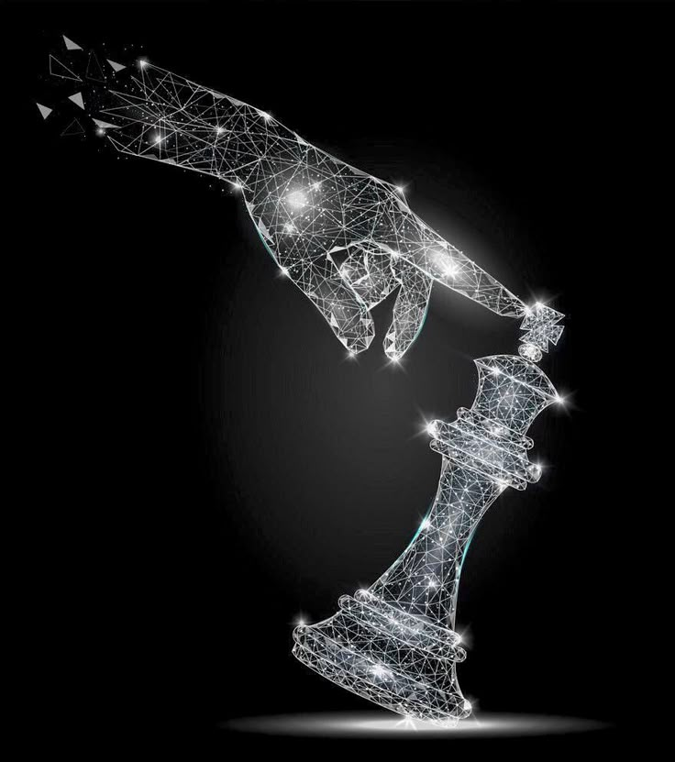
Shared Mental Models in Team Environments
A single dev’s mental model isn’t enough — AI development is a team sport.
Teams with shared mental models:
Communicate better
Predict each other’s actions
Make faster, more aligned decisions
Misaligned mental models in teams lead to:
Miscommunication
Fragmented systems
Conflicting interpretations of what “intelligence” or “ethics” means
Building shared models requires:
Open dialogue
Transparent documentation
Collaborative design sessions
Agile feedback loops
Quote: "Strong AI begins with shared understanding — not just shared code."

Slide 14
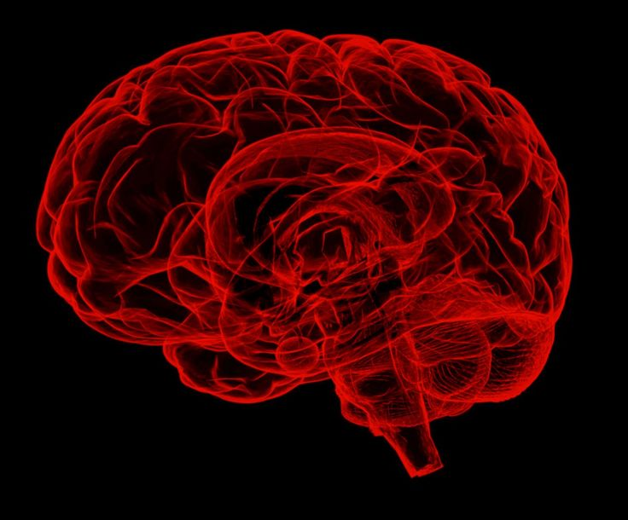
Case Study — Self-Driving Cars & Mental Models
Self-driving cars show how misaligned mental models can cause real-world danger.
Developers often build with a model of the car as a predictive machine: “If A happens, then do B.”
But users may think the car is fully autonomous, capable of human-like reasoning.
This gap leads to:
Overtrust or misuse (e.g., drivers sleeping while on autopilot)
Delayed reactions during critical handoffs
Confusion during edge cases (construction zones, ethical decisions)
Real Case: Tesla Autopilot incidents have shown how the mismatch between “driver assist” vs. “full autonomy” led to accidents.
Mental Model Breakdowns in Self-Driving Cars:
Role | Mental Health | Result
Developer | Logic-driven automation | Focus on precision & prediction
User | Human like co-pilot | Expects intuition & emotions
Car | Data patterns & sensors | Can’t explain or justify its “thoughts”

Slide 15


The Future — Can AI !?
Can AI...
Think like us?
Understand us?
Align with our minds — or drift away?
Learn what it means to be human… without being one?
The answer depends not just on the data we feed it… but on the minds that build it.
As developers, designers, and dreamers — our mental models shape the machine’s soul.
“In the mirror of AI, we may see not the future — but a reflection of ourselves.”

Slide 16

Thought-Provoking Questions
Ask not just what AI can do — but what we are teaching it to become.
Are we designing AI to reflect human wisdom — or just our shortcuts?
If mental models guide design… whose minds are we modeling?
Can we truly trust machines that we don’t fully understand?
What happens when AI inherits our biases — but not our empathy?
Will AI ever form its own mental models? And if it does… will we understand them?
Can we build AI that aligns with humanity — without losing what makes us human?
“The more intelligent machines become… the more deeply we must understand ourselves.”

Slide 17



Conclusion — The Mind Behind the Machine
Key Takeaways:
Mental models are the invisible architecture of AI.
A flawed mental model → a flawed system.
Developers are not just coders — they are mind crafters.
Misalignment between user, developer, and AI thinking leads to mistrust and failure.
Tools, reflection, and explainability (XAI) help us bridge the gap.
The future of AI is not just about intelligence — it's about understanding.
“AI will not surpass us because it thinks faster —
it will change us because it reflects how we think.”

