Slide 1

FINAL PRESENTATION
Airport Data Warehouse & Power BI Dashboard
Big Data Management and Visualization
A practical ETL scenario: source airport data, analytical Data Warehouse, scheduled incremental synchronization, and Power BI reporting.
Core thesis We do not reload the whole database. We load only the next closed business day and then refresh Power BI.
Prepared for a 10-minute project discussion
Airport Data Warehouse | MySQL ETL | Power BI

Slide 2
WHY THIS DESIGN
The project starts from a realistic reporting problem.
The source database, airportdb, behaves like an operational system: flights, bookings, airlines, airports and weather are stored as raw transactional tables. Power BI could connect directly to those tables, but that would push joins, aggregation and heavy calculations into the BI layer.
1
airportdb
Raw source / production-like system
2
airportdw
Fact and dimension model for analysis
3
Power BI
Dashboard reads prepared views
Decision Create airportdw as a separate analytical Data Warehouse, then expose clean summary views to Power BI.
Airport Data Warehouse | MySQL ETL | Power BI

Slide 3
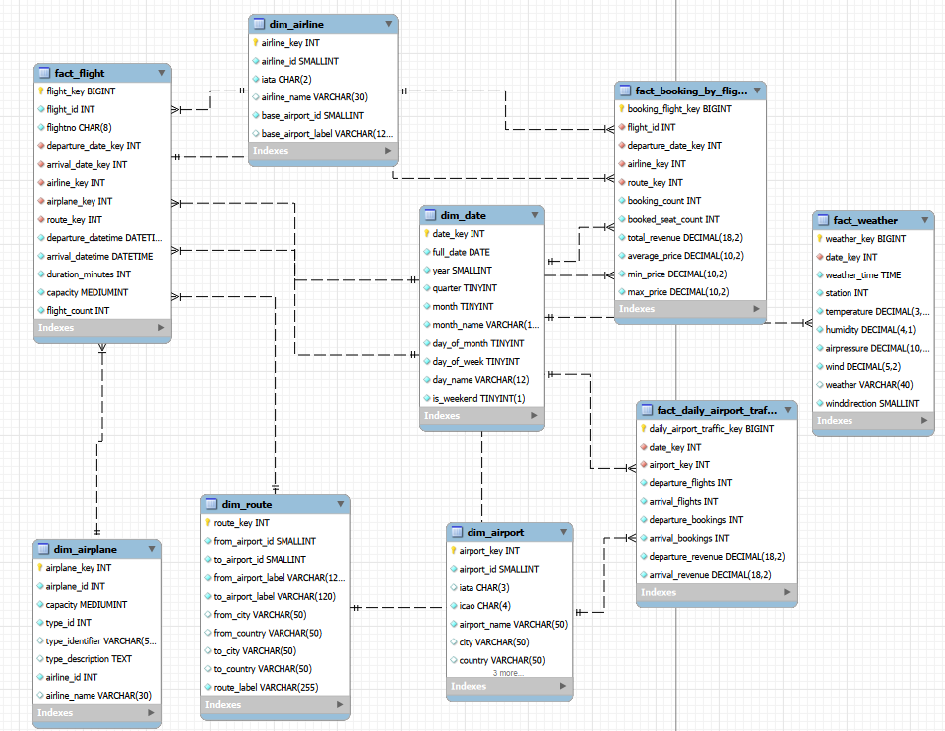
DW DESIGN
The Data Warehouse separates facts from business context.
Main dimensions: dim_date, dim_airport, dim_airline, dim_airplane, dim_route Main facts: fact_flight, fact_booking_by_flight, fact_daily_airport_traffic, fact_weather
Why this matters Facts keep measurable events. Dimensions describe how we group and filter them: date, airport, airline, aircraft and route.
Airport Data Warehouse | MySQL ETL | Power BI

Slide 4
SYNCHRONIZATION LOGIC
The ETL does not rebuild everything; it loads the next closed day.
The most important design choice is incremental synchronization. The Data Warehouse remembers its state and only adds new data that is safe to report.
1
Read ETL state
3
Load missing range
etl_control stores last_loaded_date and safety_delay_hours.
The procedure inserts only the next closed day into the DW facts.
2
Calculate closed day
4
Log the result
A day is closed after the next day passes plus a 3-hour safety delay.
etl_run_log stores status, duration and rows loaded per fact table.
Professor question answer We did not add a true/false flag to every flight row. We implemented ETL control logic that decides when a business day is closed.
Airport Data Warehouse | MySQL ETL | Power BI

Slide 5
CLOSED-DAY RULE
A business day is “closed” by ETL rule, not by manual guessing.
In a real airport system, data can arrive late: delayed flights, booking corrections, and weather rows may be updated after midnight. So the DW waits for a safety delay before considering a day stable.
Key control fields
etl_control • simulated_now • closed_until_date • last_loaded_date • batch_days • safety_delay_hours • last_status
etl_run_log • run_id • loaded_from_date / loaded_to_date • rows loaded • duration_seconds • SUCCESS / FAILED
Example If simulated_now = 2015-07-04 03:00 and safety_delay = 3 hours, then 2015-07-03 is considered closed and can be loaded.
Airport Data Warehouse | MySQL ETL | Power BI

Slide 6
SCHEDULER
MySQL Event Scheduler automates the ETL trigger.
The scheduler does not transform data by itself. It simply triggers the stored procedure on a schedule.
CREATE EVENT ev_refresh_airportdw_closed_days ON SCHEDULE EVERY 1 DAY DO CALL airportdw.refresh_airportdw_next_closed_days();
In a production scenario: 02:30 - MySQL Event Scheduler runs ETL 03:00 - Power BI Service / Gateway refreshes report In our local demo: We manually call the procedure and then click Power BI Home -> Refresh.
Main procedure refresh_airportdw_next_closed_days()
Airport Data Warehouse | MySQL ETL | Power BI

Slide 7
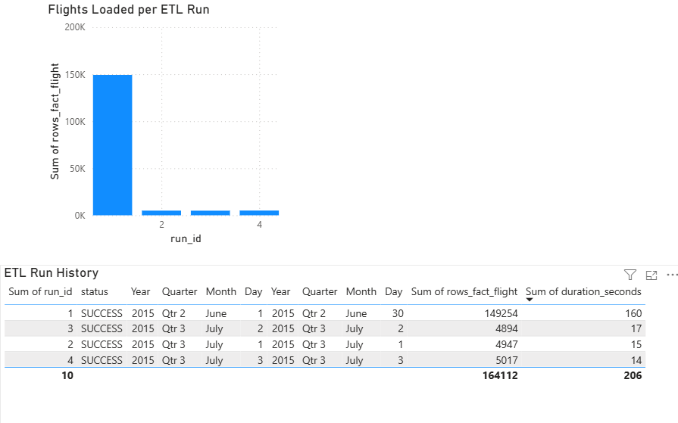
VALIDATION
The ETL evidence shows the warehouse growing incrementally.
Run 1 loaded the initial month. Each next run loaded one additional closed day. This proves the scenario is incremental and not a full reload.
Current demo state Initial month + 3 daily refreshes Total fact_flight rows: 164,112 Missing flights in loaded window: 0
Validation query checks that every source flight up to last_loaded_date exists in fact_flight.
Airport Data Warehouse | MySQL ETL | Power BI

Slide 8
BI MODEL
Power BI reads prepared views, not raw operational tables.
To keep the dashboard simple and stable, MySQL creates summary views for the visuals. This avoids complex relationships between raw tables inside Power BI.
Dashboard views used:
Important fix Power BI auto-relationships between summary views caused duplicate-value errors. We removed those relationships and used each summary view independently.
vw_top20_airport_map_traffic vw_top_countries_by_revenue vw_top_airlines_by_revenue vw_monthly_revenue_trend vw_price_range_distribution vw_etl_current_status vw_etl_run_history
That is acceptable because the views are already aggregated for reporting.
Airport Data Warehouse | MySQL ETL | Power BI

Slide 9
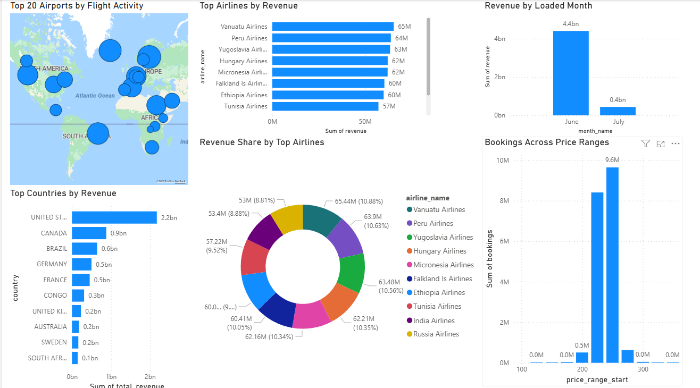
POWER BI OUTPUT
The dashboard shows business results and refresh impact.
What this demonstrates Airport activity, revenue leaders, airline contribution, monthly load movement, and booking price distribution.
Airport Data Warehouse | MySQL ETL | Power BI

Slide 10
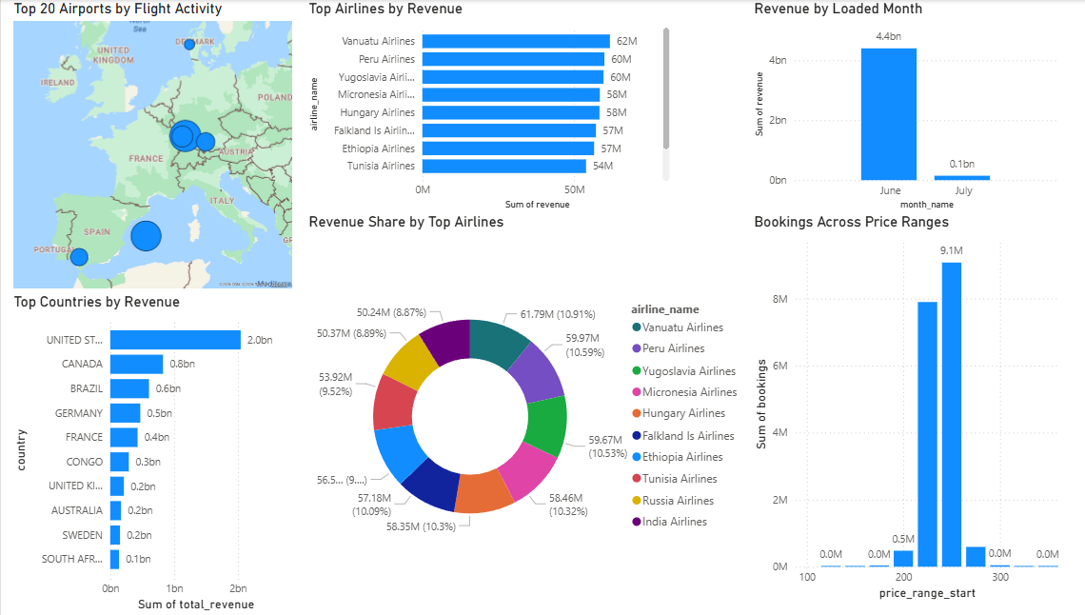
DEMO STORY
What changed after refresh: the visuals receive new closed-day data.
After refresh / updated dashboard state
Presentation line We run the ETL, the DW receives the next closed business day, then Power BI refresh shows the updated measures.
Before / first dashboard state
Airport Data Warehouse | MySQL ETL | Power BI

Slide 11
CONCLUSION
Final status: the project covers DW design, synchronization, and BI reporting.
Completed:
Main idea to defend The solution is realistic because operational data stays in airportdb, analytical data is prepared in airportdw, and synchronization happens incrementally after a business day is safe to report.
• Designed airportdw fact/dimension schema • Loaded source airportdb into MySQL • Implemented incremental refresh with ETL control tables • Added MySQL Event Scheduler scenario • Created Power BI dashboard views and visuals • Documented the workflow in Word, SQL files and GitHub
Optional next step: add the AI/ML analysis requirement later, for example predicting delay risk or revenue patterns.
Airport Data Warehouse | MySQL ETL | Power BI

