Slide 1
Lung Cancer Risk Prediction with Deep Learning
Comparison with Dritsas & Trigka (2022) — Same dataset, neural networks vs classical ML

Slide 2
Objective
Same task as the 2022 paper: predict lung cancer risk (YES/NO) from survey data.
Same dataset: lung cancer survey (habits, symptoms, ~309 samples, 15 features).
Their approach: classical ML (Rotation Forest) — 97.1% accuracy, 99.3% AUC.
Our approach: deep learning (7 MLP architectures) — compare performance.

Slide 3
Data
Source: survey lung cancer.csv (data/raw/).
Features: age, gender, smoking, yellow fingers, anxiety, peer pressure, chronic disease,
fatigue, allergy, wheezing, alcohol, coughing, shortness of breath, swallowing, chest pain.
Target: LUNG_CANCER (YES/NO).
Preprocessing: standard scaling, stratified splits, class weights for imbalance.

Slide 4
Pipeline — steps we followed
1. Load data (survey lung cancer.csv) and encode labels (YES/NO → 1/0).
2. Preprocess: StandardScaler (zero mean, unit variance), stratified train/test split.
3. Train 7 architectures with the same hyperparameters (lr, batch, epochs, early stopping).
4. Evaluate: single 80/20 split, 5-fold CV, 10-fold CV; report accuracy, F1, ROC-AUC.
5. Compare with Dritsas & Trigka (2022): same dataset, different models (DL vs Rotation Forest).

Slide 5
Methods — 7 deep learning architectures
Standard (128-64-32): 3-layer MLP, ReLU, BatchNorm, Dropout 0.3.
Simple (64-32): 2-layer (64→32), ReLU, BatchNorm, Dropout 0.2.
Minimal (32): 1 hidden layer (32 units), ReLU, BatchNorm, Dropout 0.2.
Deep (5 layers): 5 hidden layers (64 each), ReLU, BatchNorm, Dropout 0.3.
ELU Activation: same as Standard but ELU instead of ReLU.
LayerNorm: same as Standard but LayerNorm instead of BatchNorm.
Residual: skip connections, hidden size 128, Dropout 0.3.

Slide 6
Training setup (same for all architectures)
Learning rate: 0.001 (Adam optimizer).
Batch size: 32.
Max epochs: 100; early stopping if no improvement for 15 epochs.
Loss: weighted Cross-Entropy (class weights for imbalanced YES/NO).
Learning rate scheduler: ReduceLROnPlateau (factor 0.5, patience 10 epochs).
Random seed: 42 (reproducibility).
Input: 15 features, standardized (zero mean, unit variance).

Slide 7
Evaluation — what we report
Single 80/20 split: We split the data once — 80% for training, 20% held out for testing.
Train each model on the 80%, report accuracy on the 20%. One number per model.
5-fold CV: Data split into 5 parts. 5 rounds: each round, 4 parts train, 1 part test.
Report mean and standard deviation of the 5 test accuracies. More stable.
10-fold CV: Same idea with 10 parts. More rounds, often a bit more stable estimate.
Metrics: accuracy, precision, recall, F1-score, ROC-AUC.

Slide 8
5-fold vs 10-fold CV — what is the difference?
5-fold: 5 train/test rounds; 10-fold: 10 rounds. Same idea: average over rounds.
More folds → more stable mean and std; results are usually similar.
We run both so you can compare and cite standard practice (both are common in papers).

Slide 9
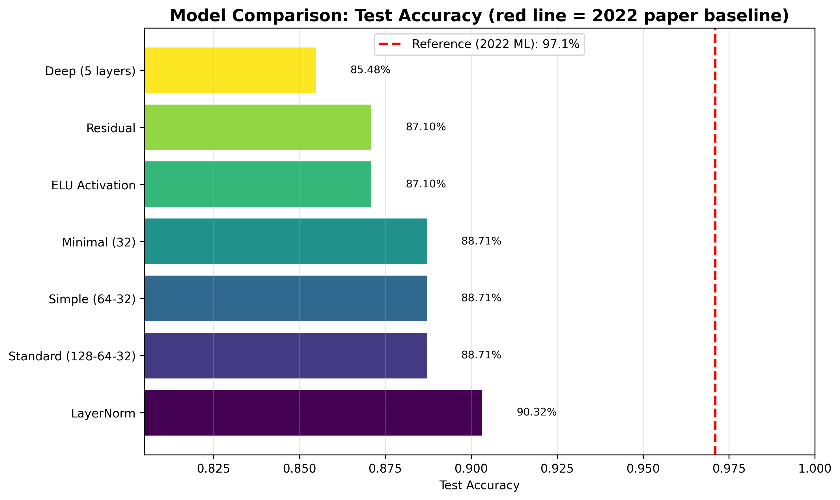
Results — Single 80/20 split
Test accuracy by model (red line = 2022 reference 97.1%).

Slide 10
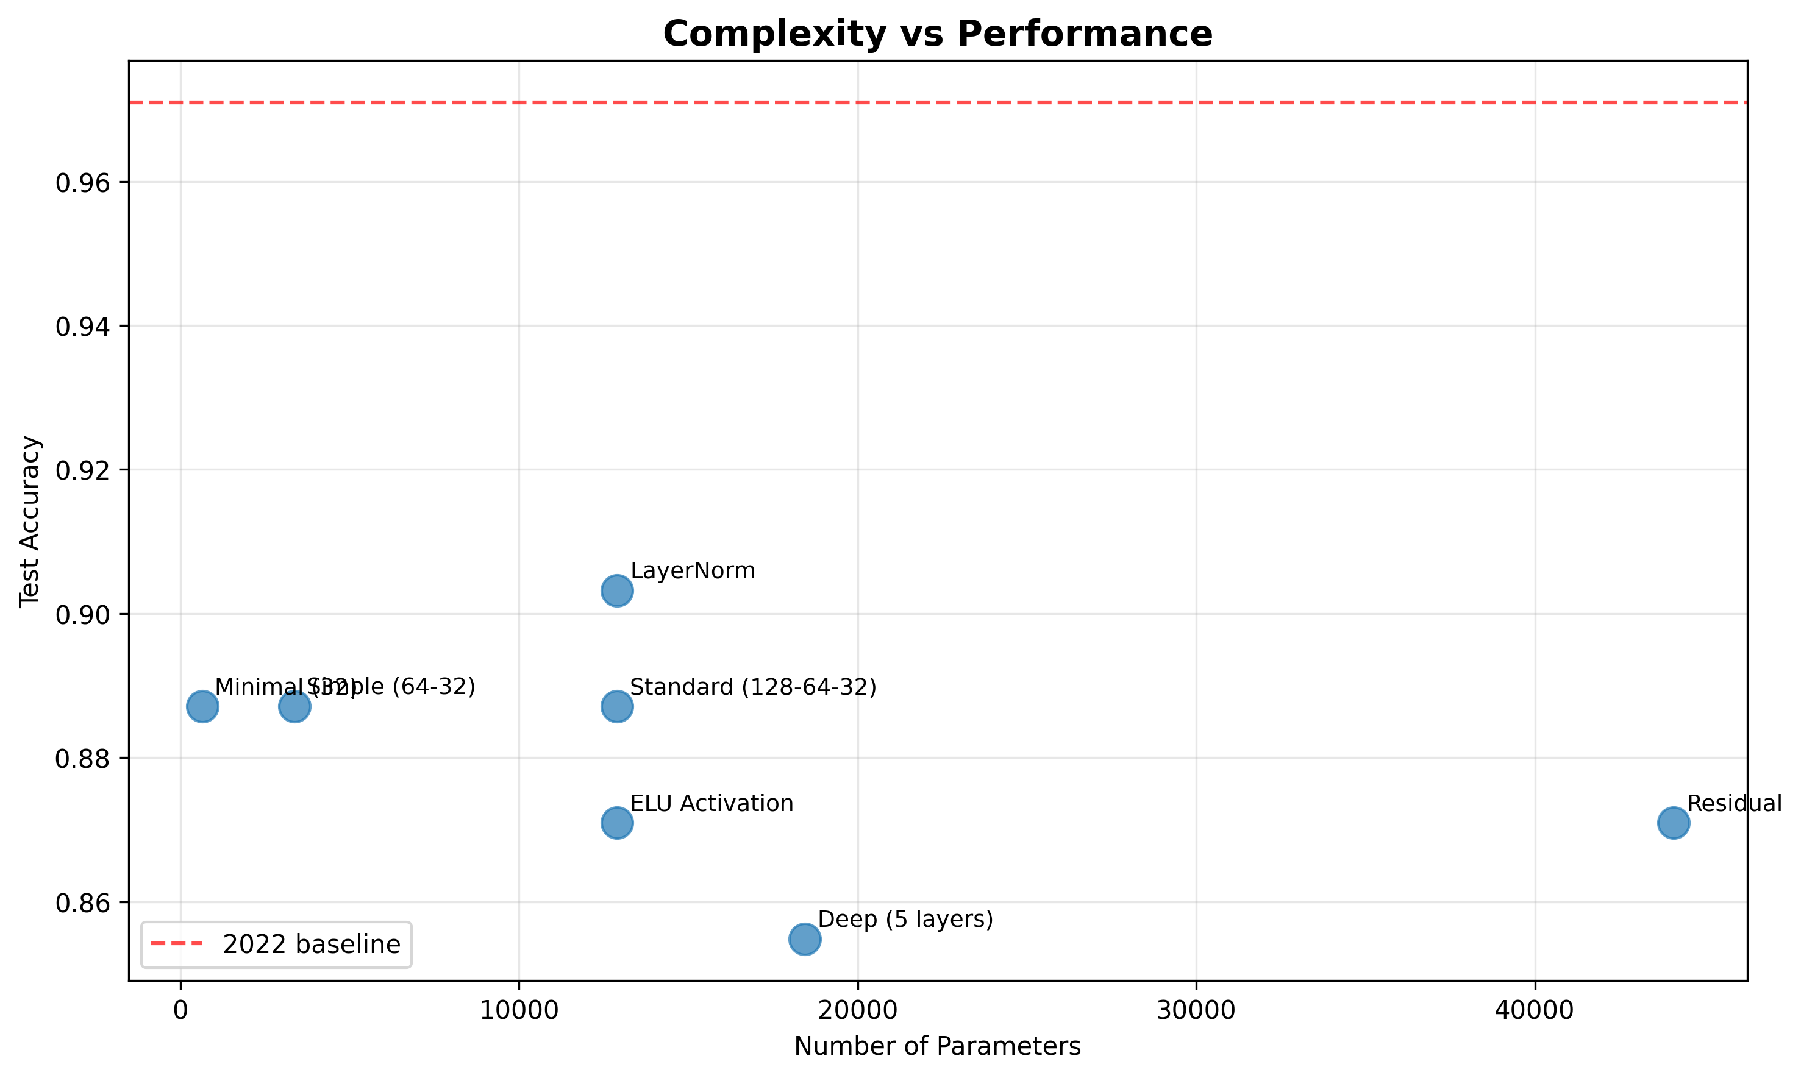
Results — Single split: complexity vs performance
Parameters vs test accuracy.

Slide 11
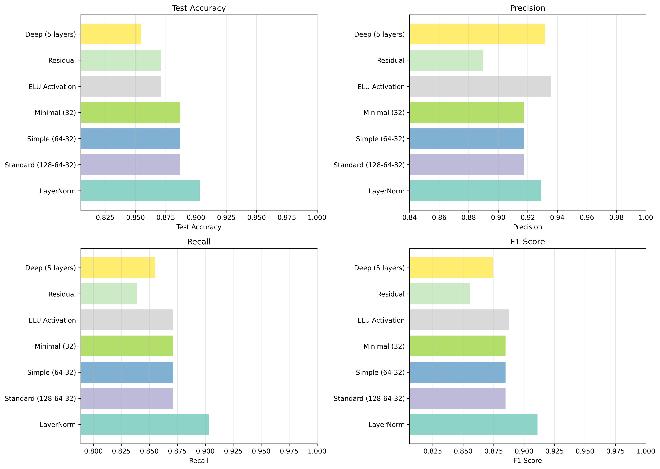
Results — Metrics: Accuracy, Precision, Recall, F1 (single split)
All four metrics per model (single 80/20 run).

Slide 12
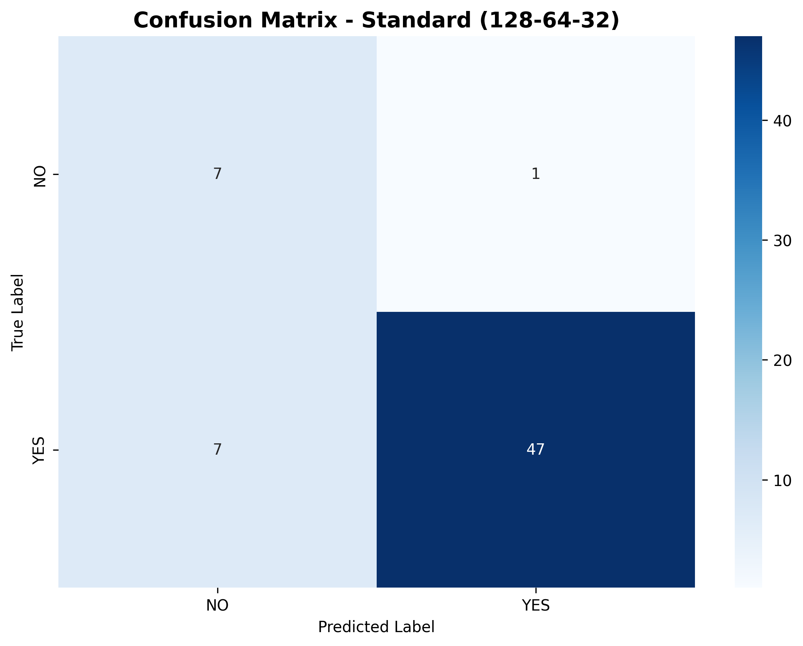

Results — Confusion matrix — Standard (128-64-32) & Simple (64-32)
Standard (128-64-32)
Simple (64-32)

Slide 13


Results — Confusion matrix — Minimal (32) & Deep (5 layers)
Minimal (32)
Deep (5 layers)

Slide 14


Results — Confusion matrix — ELU Activation & LayerNorm
ELU Activation
LayerNorm

Slide 15

Results — Confusion matrix — Residual
True vs predicted (NO/YES). Diagonal = correct.

Slide 16
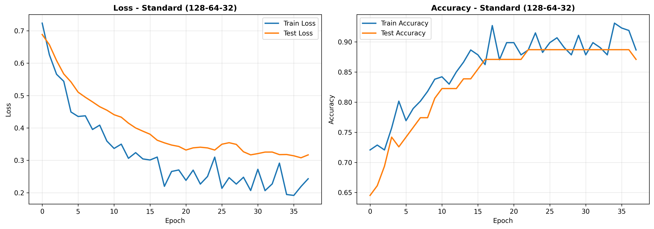
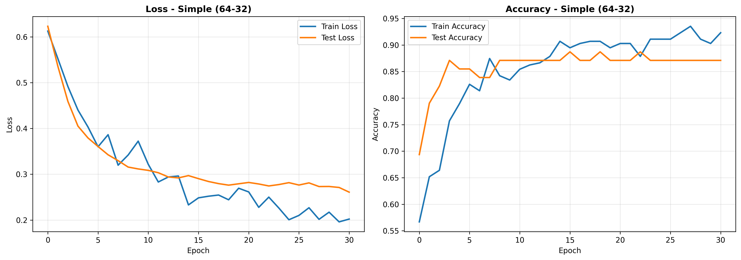
Results — Training curves — Standard (128-64-32) & Simple (64-32)
Standard (128-64-32)
Simple (64-32)

Slide 17
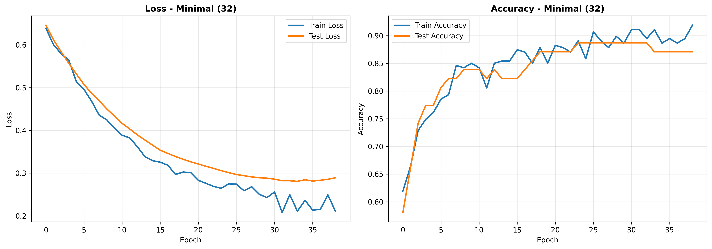
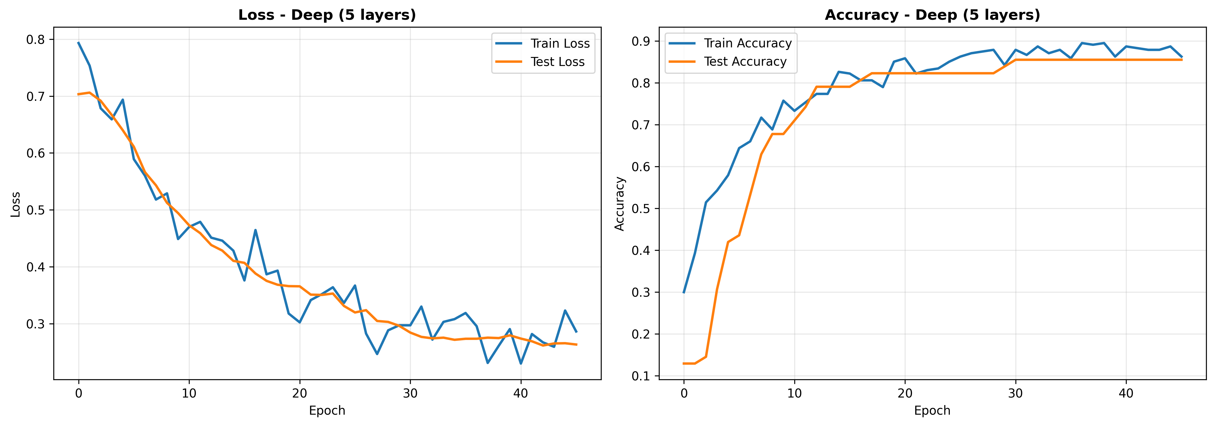
Results — Training curves — Minimal (32) & Deep (5 layers)
Minimal (32)
Deep (5 layers)

Slide 18
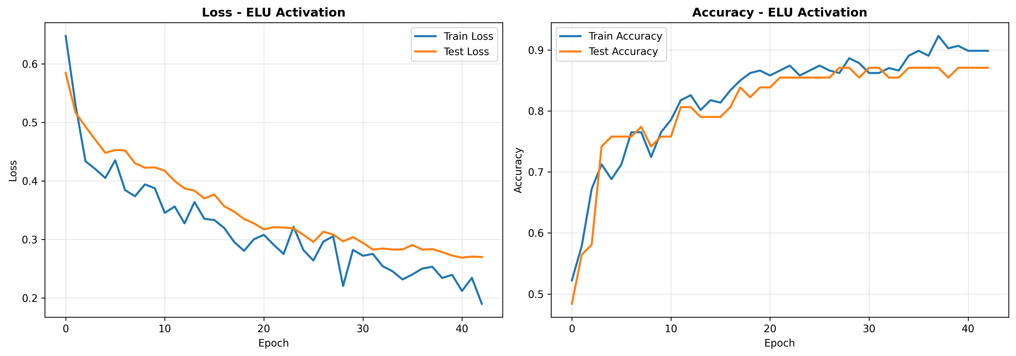
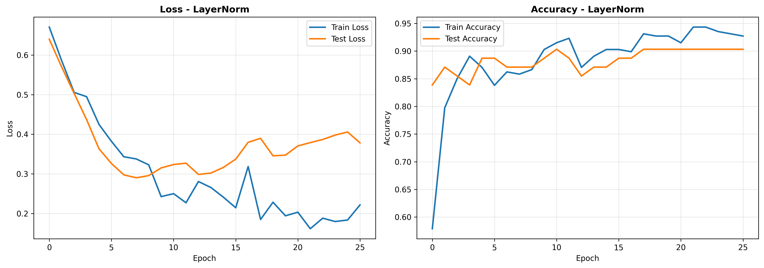
Results — Training curves — ELU Activation & LayerNorm
ELU Activation
LayerNorm

Slide 19
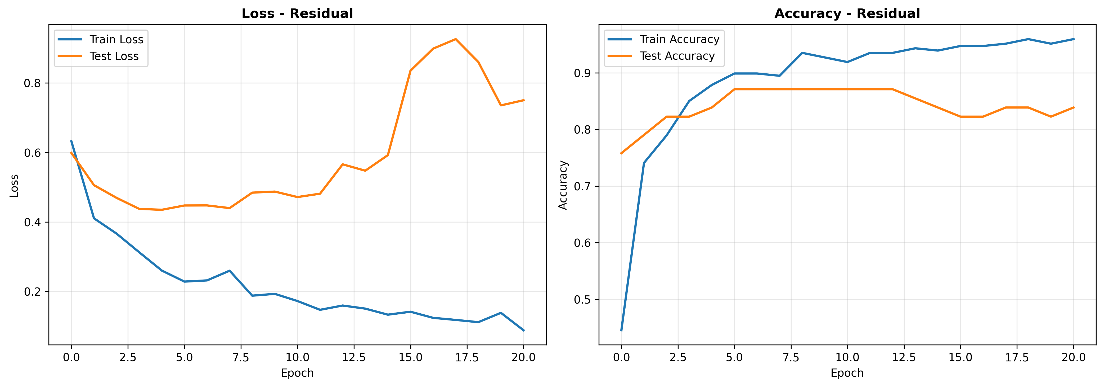
Results — Training curves — Residual
Loss and accuracy over epochs; early stopping 15.

Slide 20
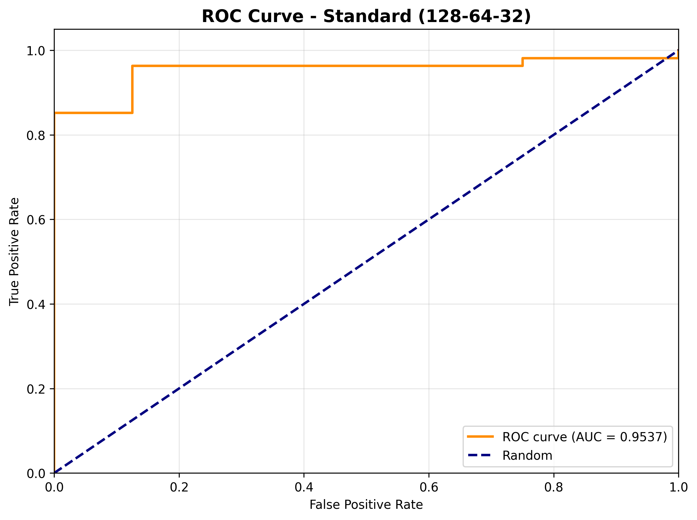
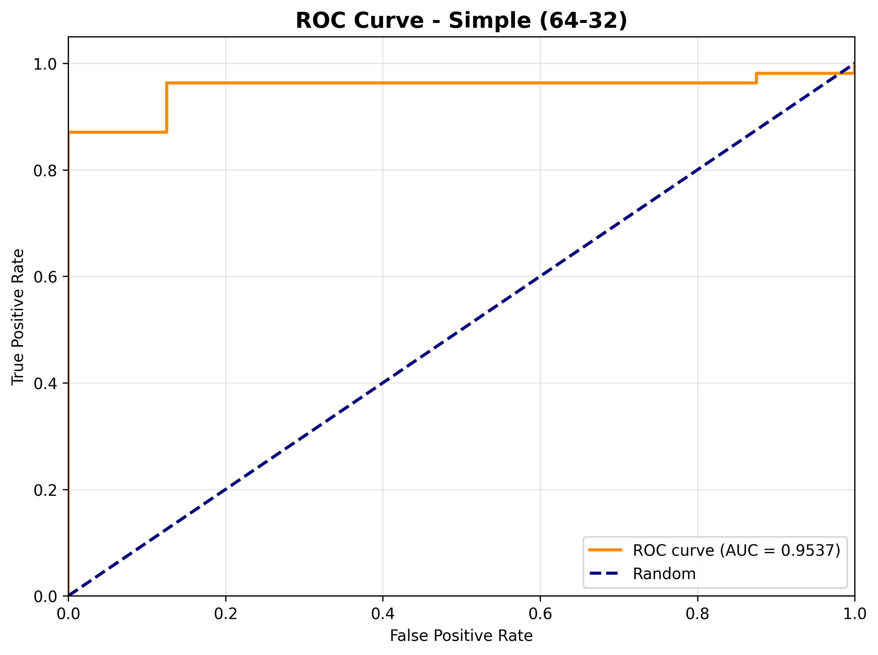
Results — ROC curve — Standard (128-64-32) & Simple (64-32)
Standard (128-64-32)
Simple (64-32)

Slide 21


Results — ROC curve — Minimal (32) & Deep (5 layers)
Minimal (32)
Deep (5 layers)

Slide 22

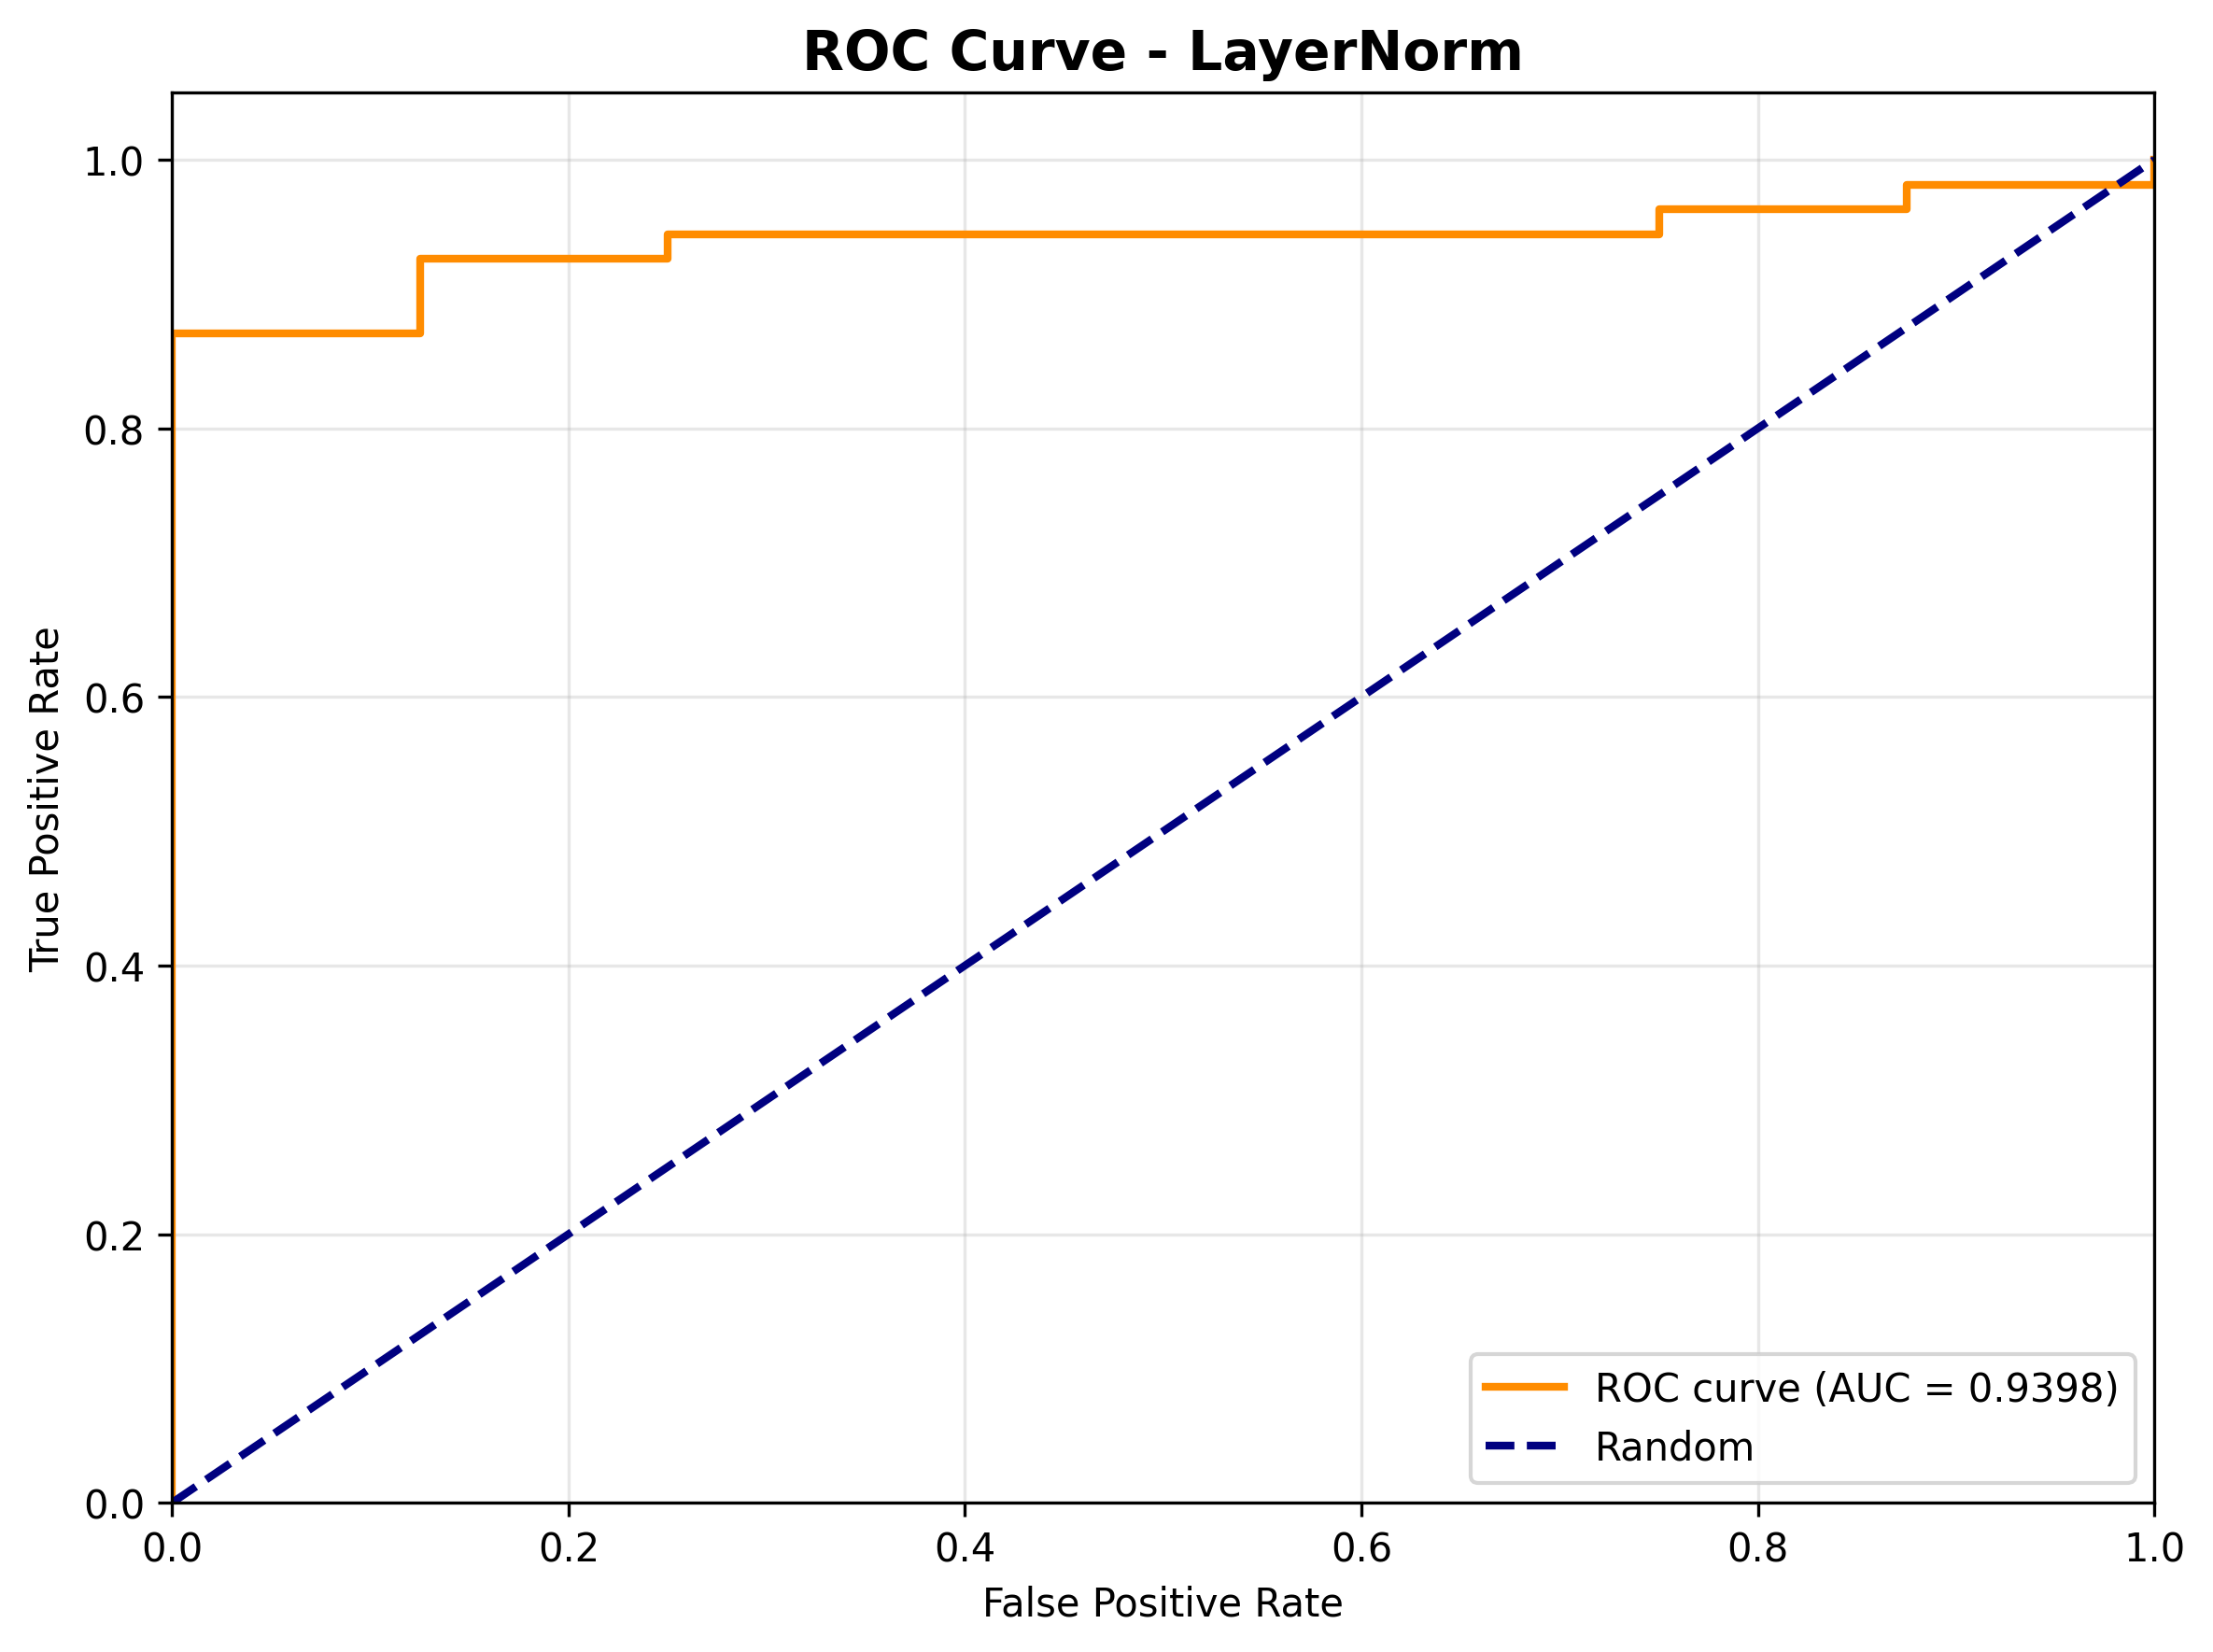
Results — ROC curve — ELU Activation & LayerNorm
ELU Activation
LayerNorm

Slide 23
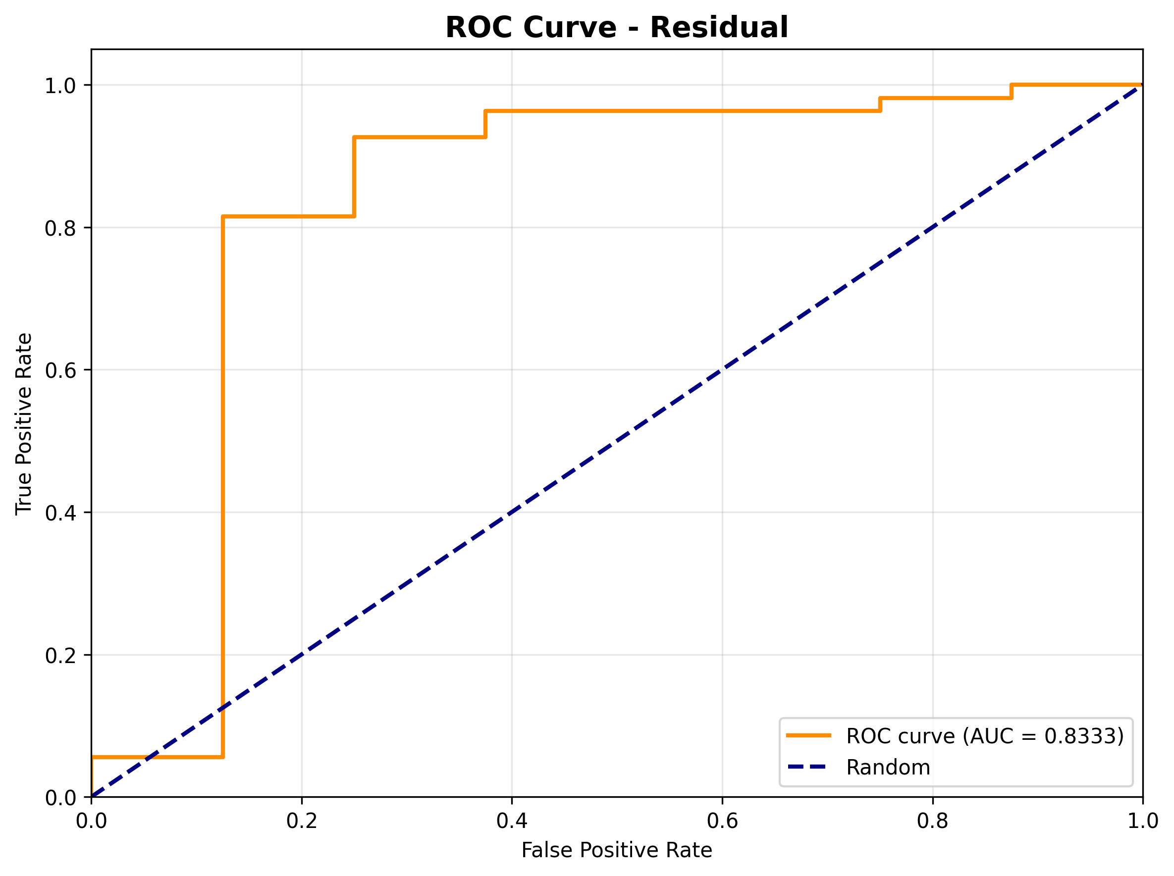
Results — ROC curve — Residual
True Positive Rate vs False Positive Rate; AUC in legend.

Slide 24
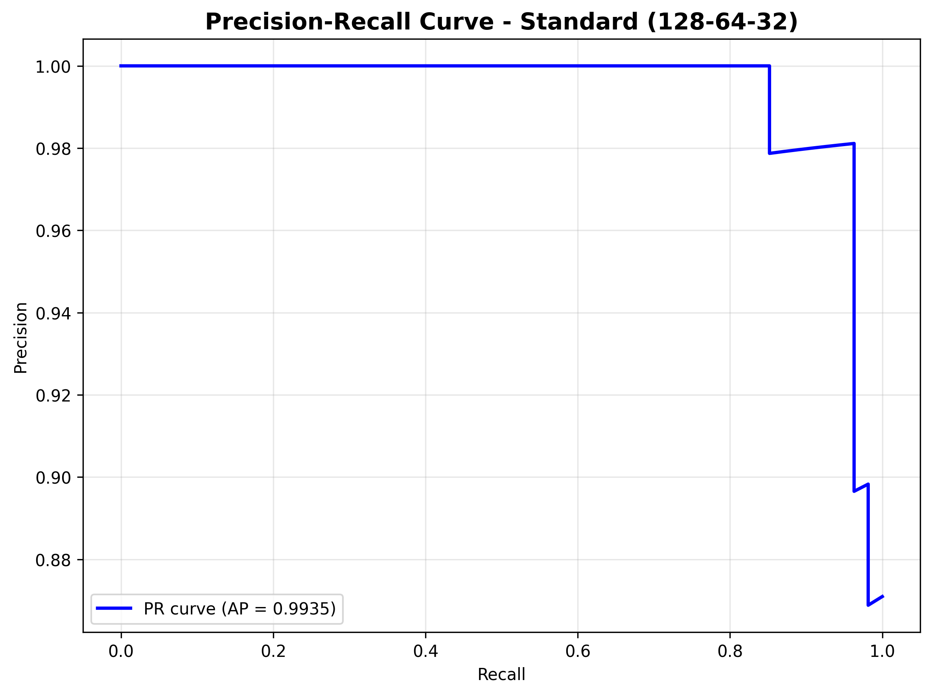
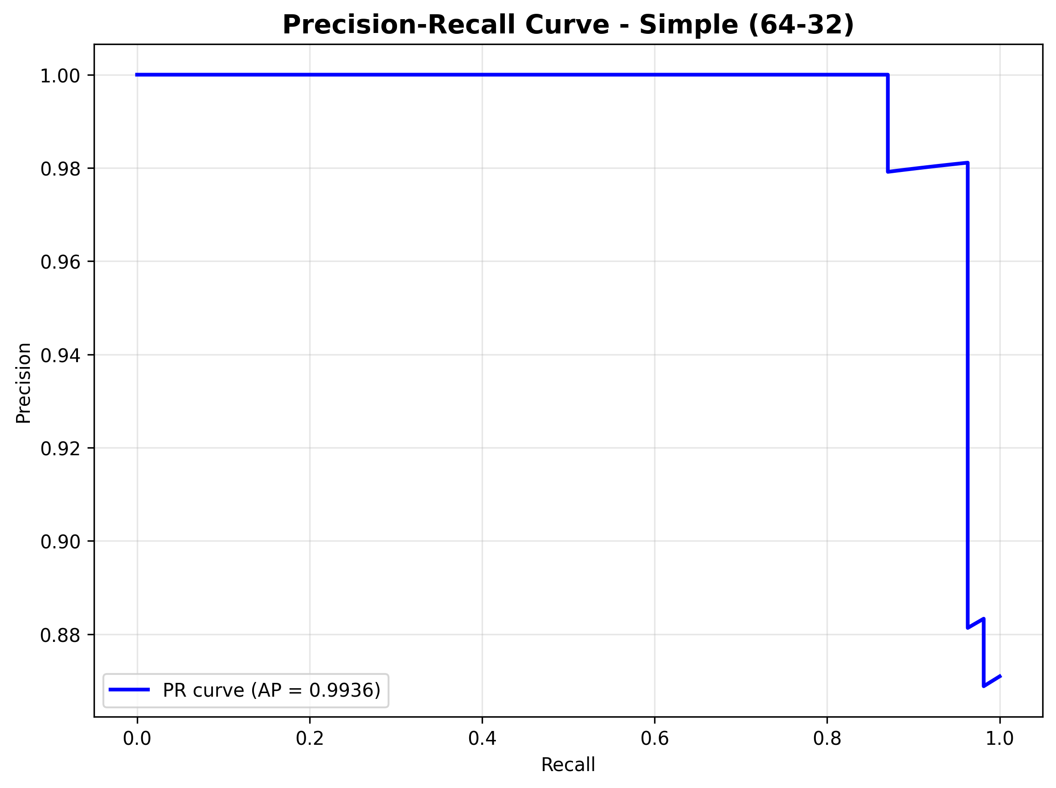
Results — Precision-Recall curve — Standard (128-64-32) & Simple (64-32)
Standard (128-64-32)
Simple (64-32)

Slide 25
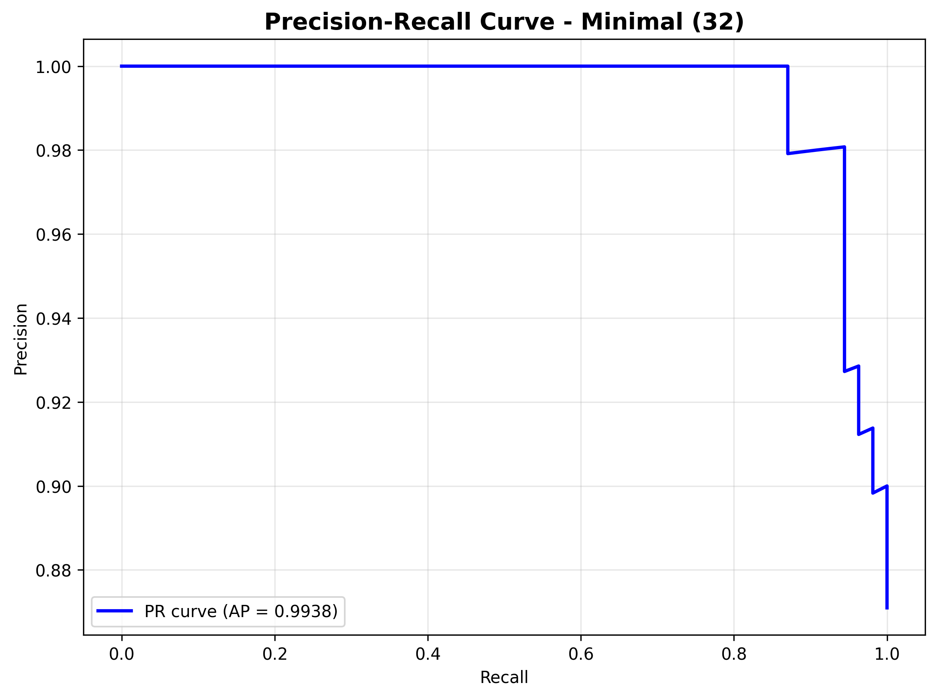

Results — Precision-Recall curve — Minimal (32) & Deep (5 layers)
Minimal (32)
Deep (5 layers)

Slide 26

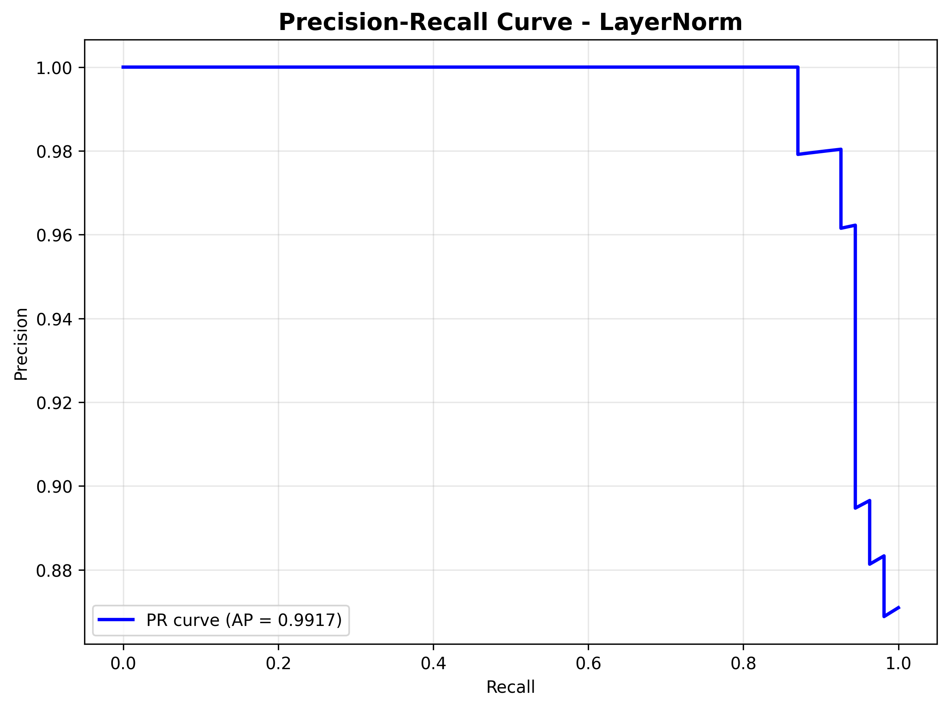
Results — Precision-Recall curve — ELU Activation & LayerNorm
ELU Activation
LayerNorm

Slide 27
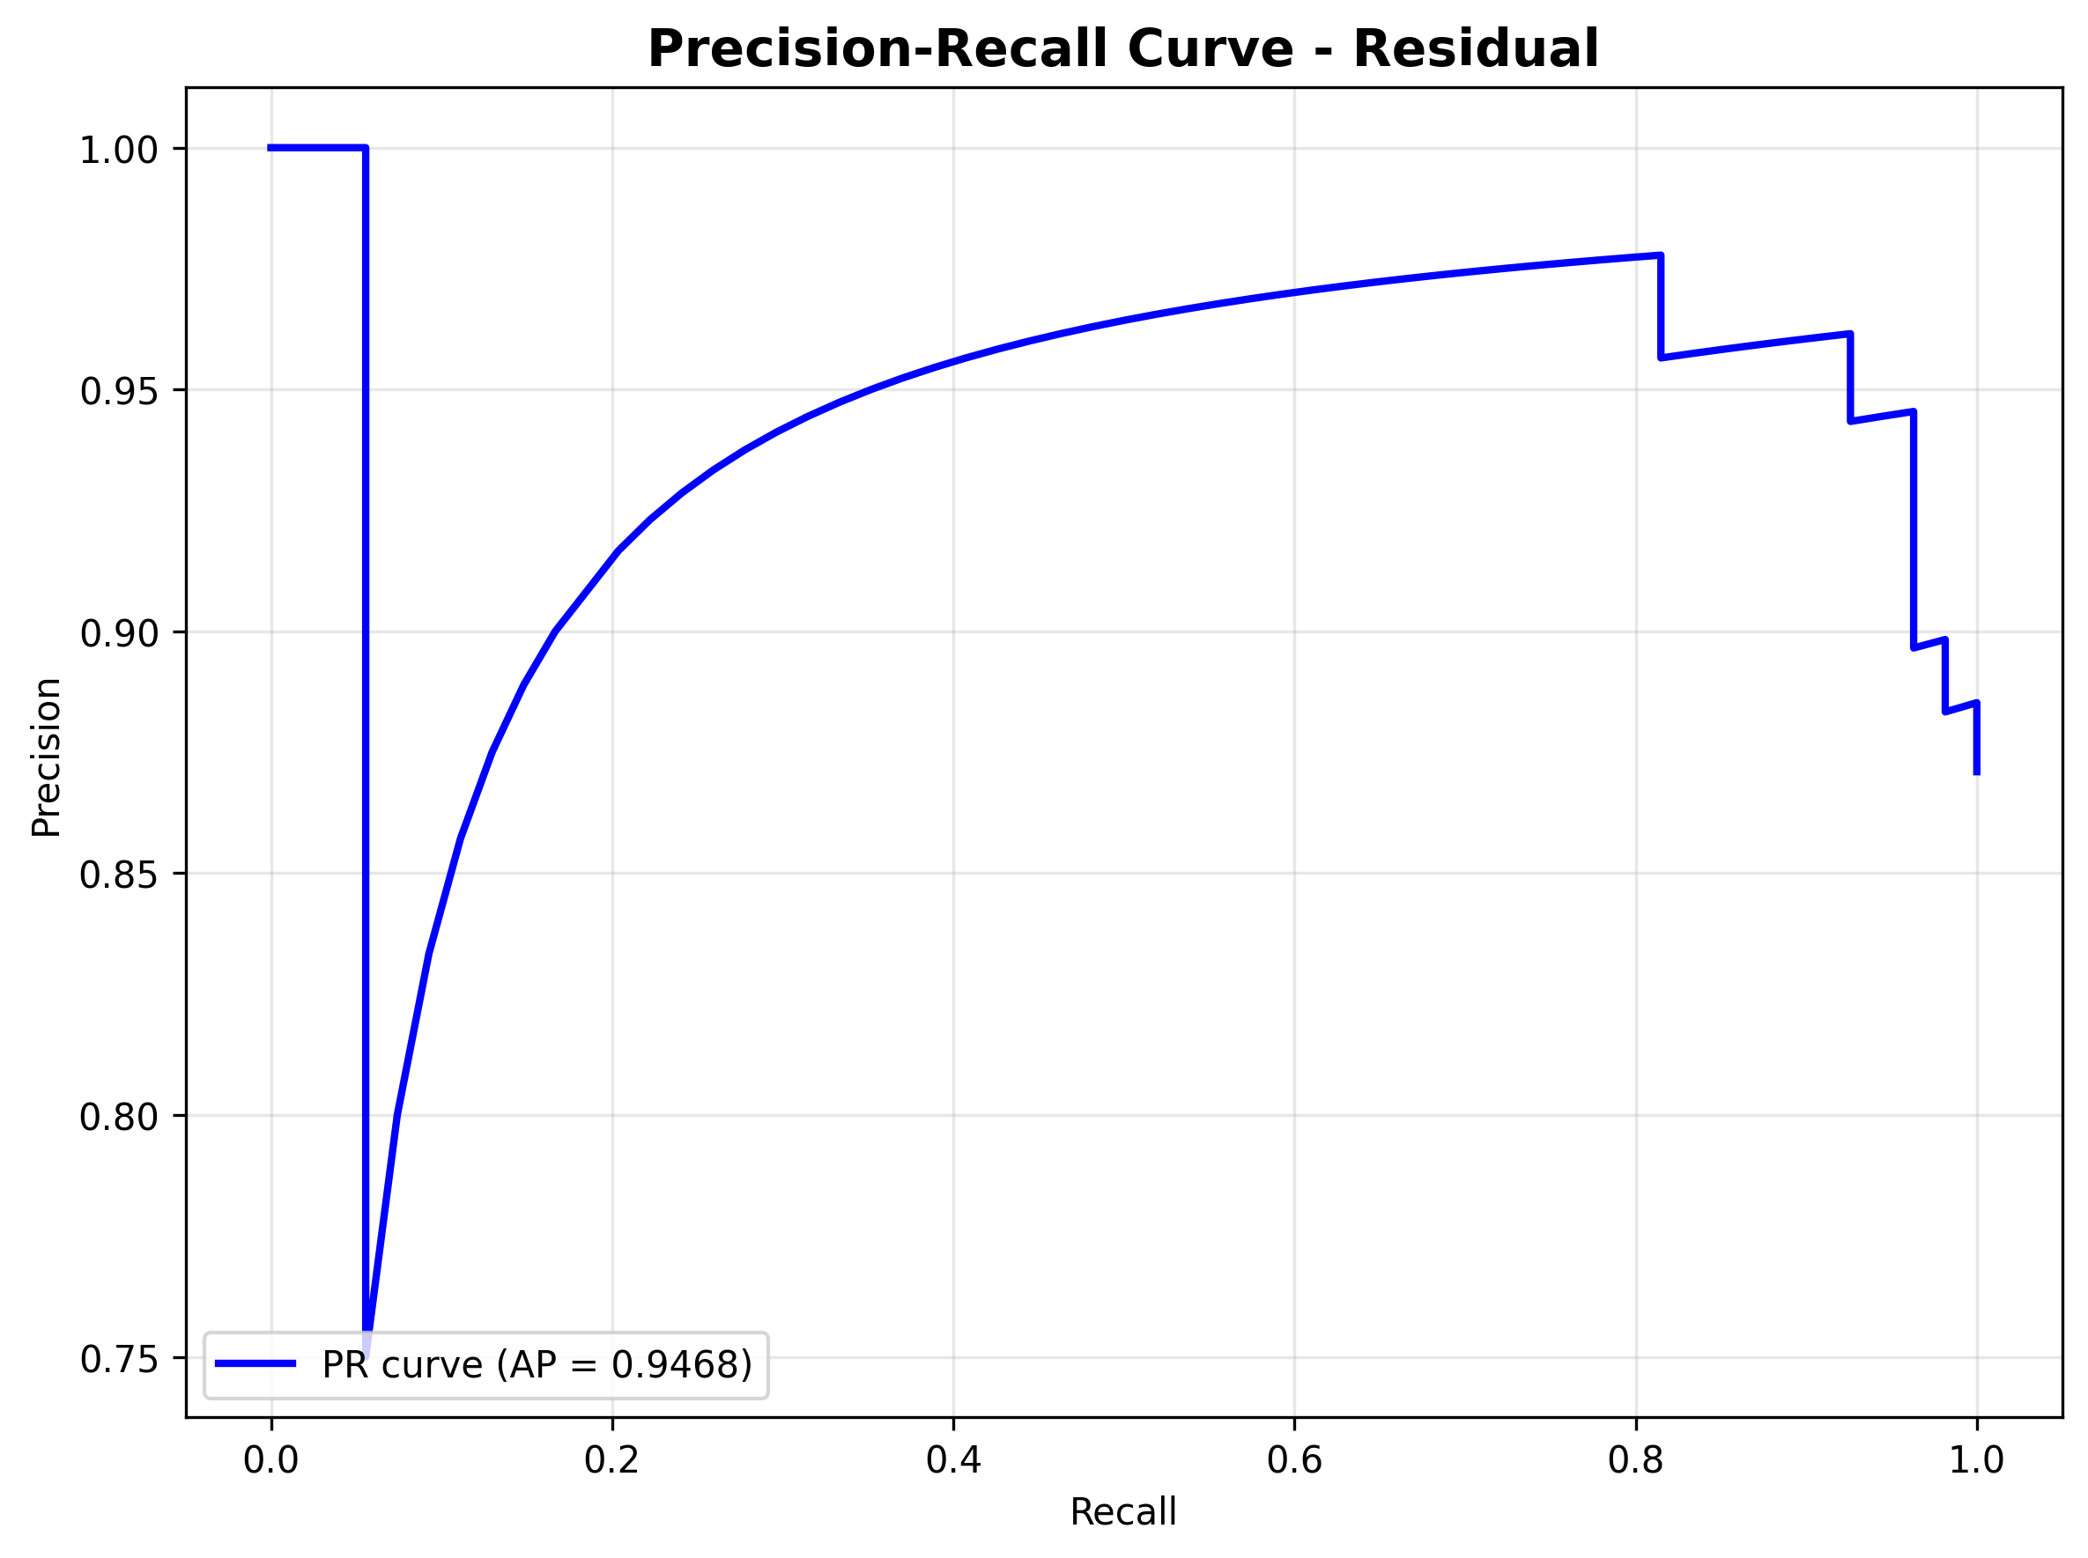
Results — Precision-Recall curve — Residual
Precision vs Recall; AP in legend.

Slide 28
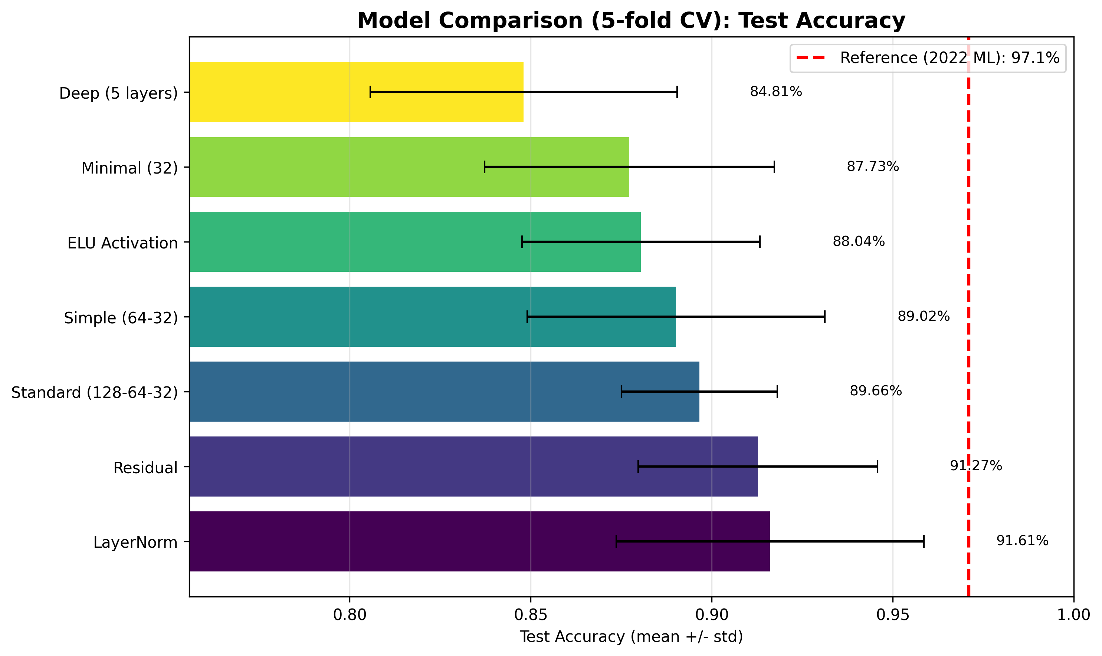
Results — 5-fold cross-validation (mean ± std)
More stable estimate; comparable to how the 2022 paper likely reported results.

Slide 29
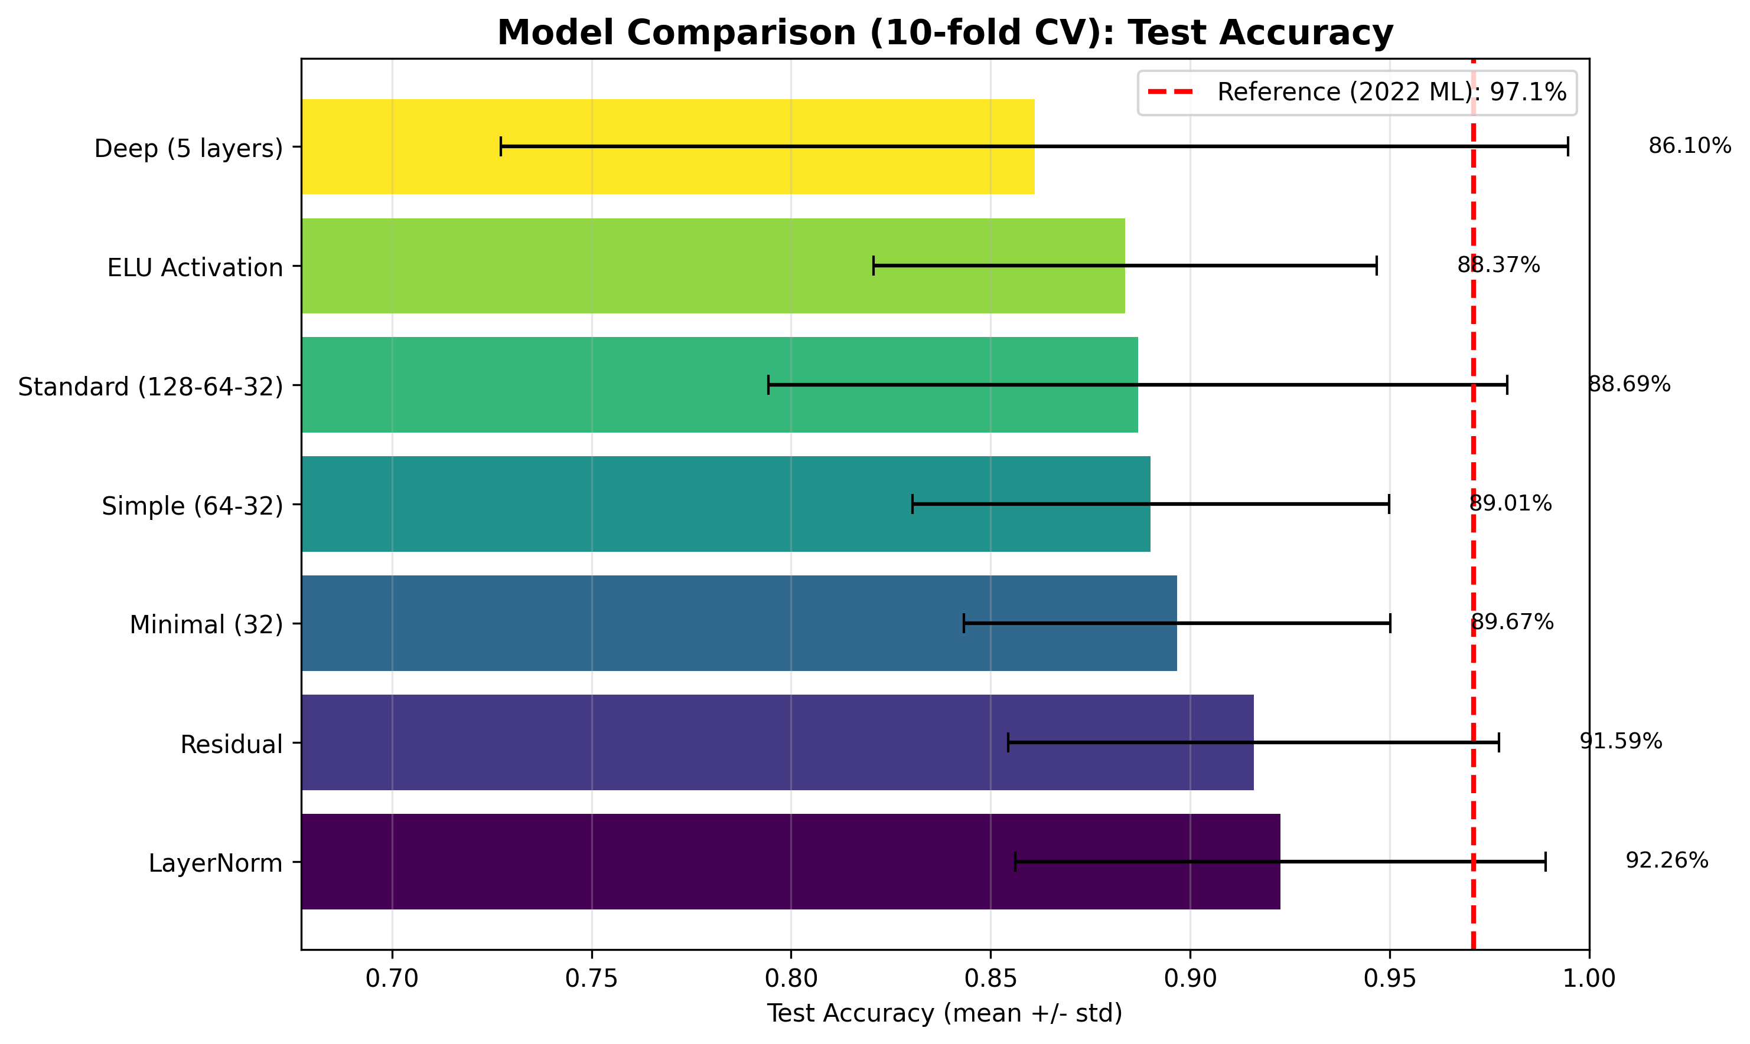
Results — 5-fold vs 10-fold CV
5-fold CV
10-fold CV

Slide 30
Comparison with Dritsas & Trigka (2022)
Reference: Rotation Forest — 97.1% accuracy, 99.3% AUC.
Our best (e.g. LayerNorm with 5-fold CV): ~92% accuracy, ~94% AUC.
Gap is expected: on small tabular data, tree ensembles often outperform neural nets.
We use the same dataset and same task; we compare a different family of models (DL).
Conclusion: DL is viable; classical ML remains strong on this dataset.

Slide 31
Summary
Same lung cancer survey data and classification task as the 2022 paper.
Seven DL architectures trained and compared (single split + 5-fold and 10-fold CV).
Training: lr 0.001, batch 32, early stopping 15; same setup for all models.
Best DL performance ~92% accuracy (vs 97.1% Rotation Forest).
All visuals and CSVs in reports/single_split, reports/cv5, reports/cv10.

Slide 32
Thank you
Questions?

