Slide 1
🚀 ResumeAI Pro
AI Resume Analyzer • ATS Checker • Career Advisor • Resume Builder
IBM Pbel Program Project Developed by: Tanish Gahoi
(CSE-AI&ML Student) Tech Stack: Python • Streamlit • Gemini AI • Scikit-Learn

Slide 2
Problem Statement
• Applicants lose opportunities due to poor ATS compatibility.
• Manual resume reviews are slow.
• No personalized career guidance.
• Resume optimization is time-consuming.

Slide 3
Solution
• Upload a PDF resume.
• Extract skills automatically.
• Calculate ATS score.
• Identify missing skills.
• Generate AI recommendations.
• Build a professional resume.

Slide 4
Technology Stack
• Python
• Streamlit
• Google Gemini AI
• Scikit-Learn
• Plotly
• PDFPlumber
• ReportLab

Slide 5
System Architecture
• PDF Upload → Text Extraction → Skill Detection → ATS Engine → Career Matching → AI Recommendation → Resume Builder → PDF Export

Slide 6
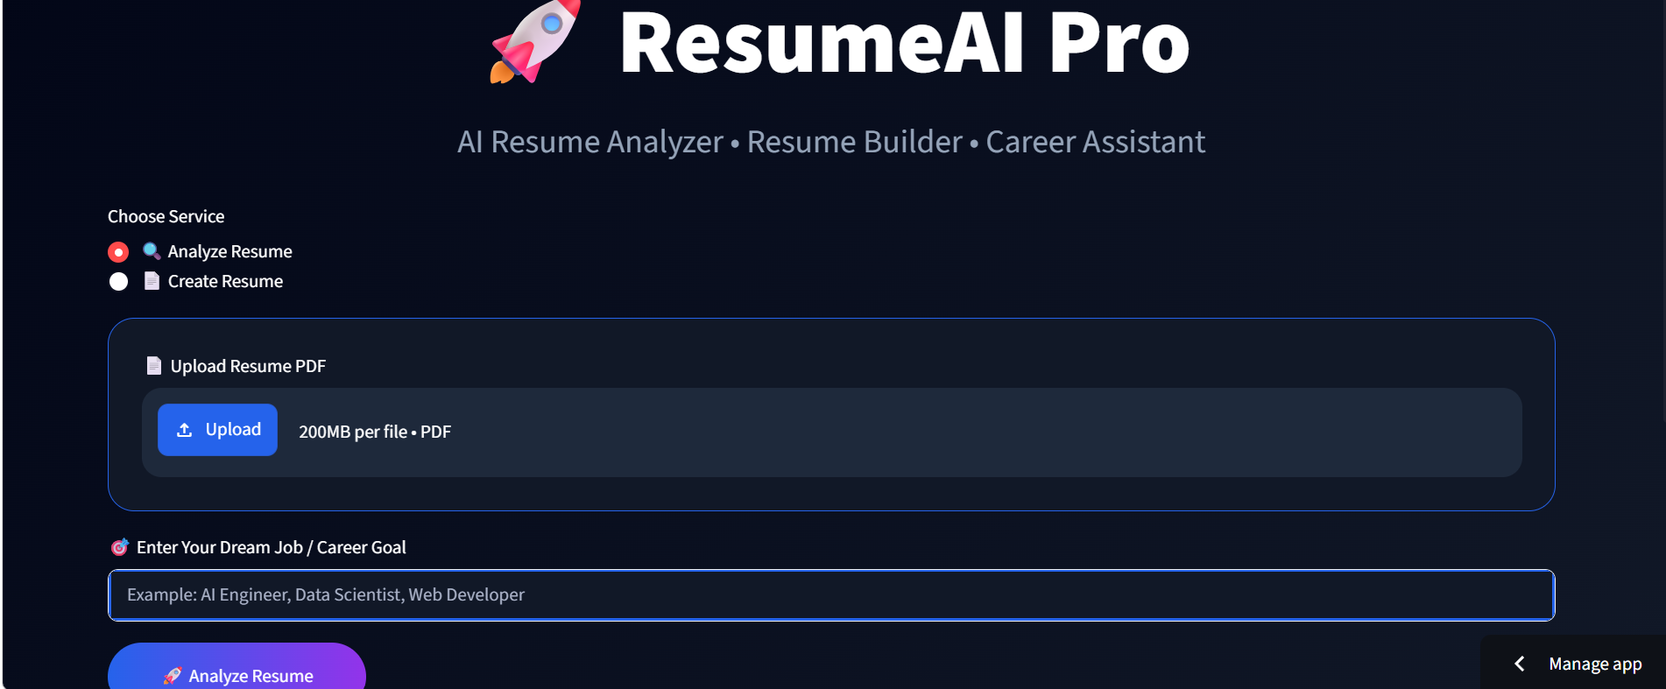
Home Interface
• Modern Streamlit interface for uploading resumes and selecting a target career.

Slide 7
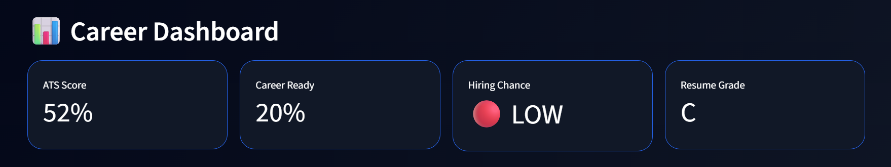
Career Dashboard
• Displays ATS Score, Career Readiness, Hiring Chance and Resume Grade.

Slide 8

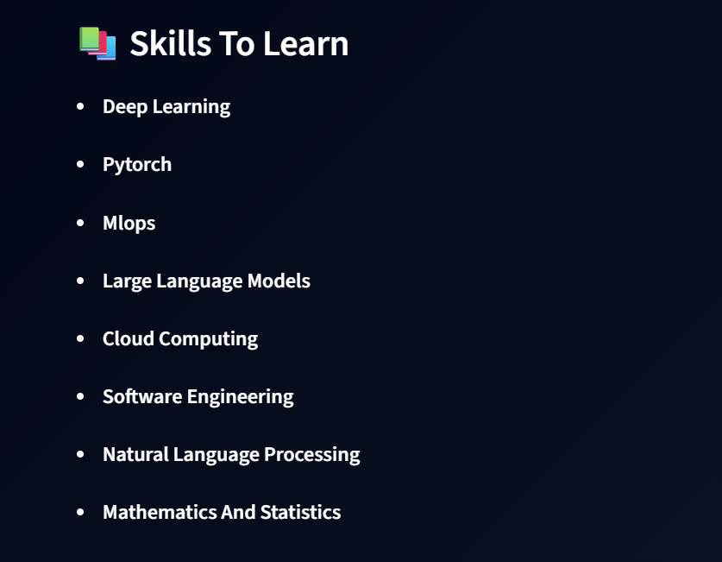
Skills Analysis
• Shows detected technical skills and highlights missing skills required for the selected career.

Slide 9
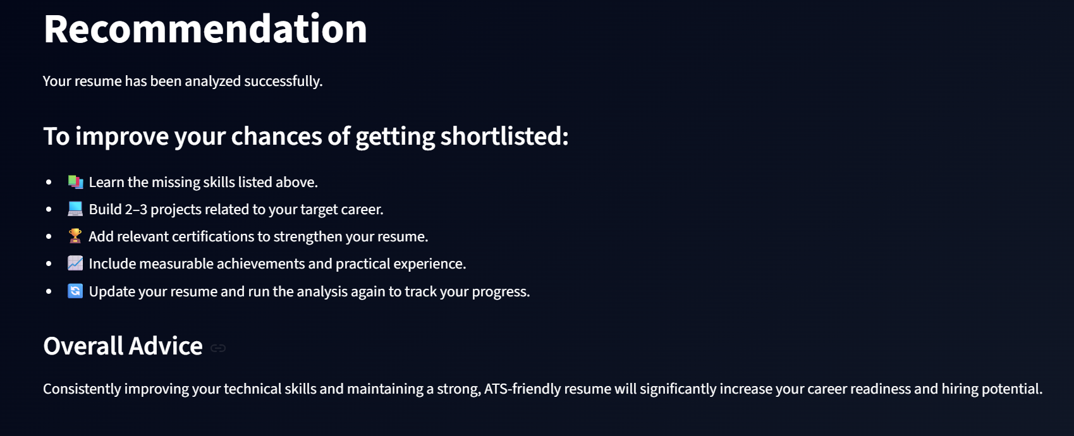
AI Recommendations
• Provides personalized recommendations to improve resume quality and employability.

Slide 10
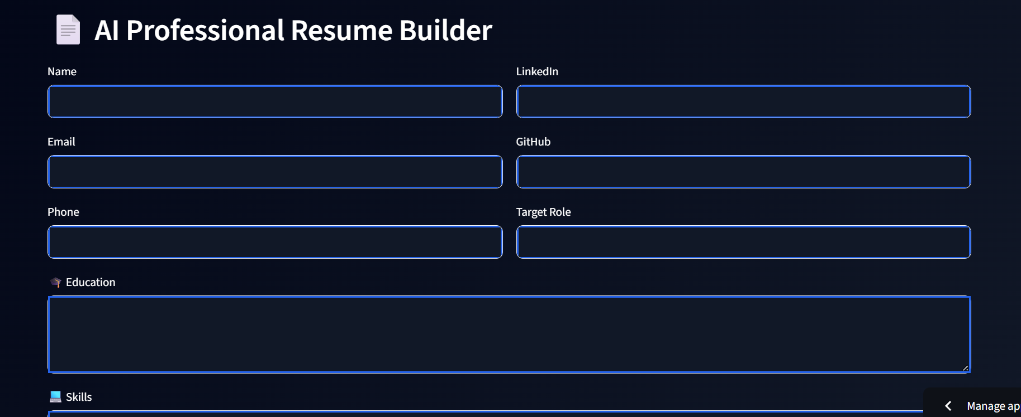
Resume Builder
• Create an ATS-friendly resume directly from the application.

Slide 11
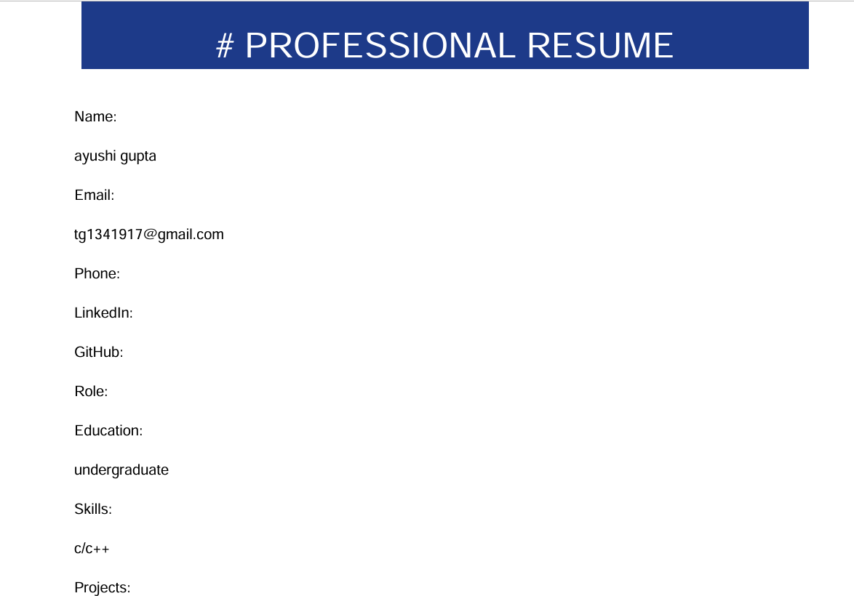
Generated Resume
• Professional PDF resume generated automatically.

Slide 12
Workflow
• Upload Resume
• Extract Text
• Analyze Skills
• ATS Evaluation
• AI Insights
• Generate Resume
• Download PDF

Slide 13
Challenges & Solutions
• PDF parsing → PDFPlumber
• Career mapping → Skill database
• Resume scoring → Cosine similarity
• AI guidance → Gemini integration

Slide 14
Future Scope
• LinkedIn Profile Analysis
• Interview Preparation
• Job Recommendation
• DOCX Support
• Resume Ranking

Slide 15
Conclusion
• AI-powered resume analysis improves ATS readiness and helps users build stronger resumes efficiently.

Slide 16
Thank You
• Questions?

