Slide 1
Program Adaptations
Zachary Thoroughgood

Slide 2


Fetch.py Program
Brief overview and generalization of the Fetch.py program

Slide 3
Demo program used for contacting PurpleAir Monitors
Grabs information through servers/api’s listed
Returns these through the command prompt
Introduction

Slide 4
Basis on how the fetch.py functions
Contacts five different server’s/api’s for data
TWO ARE DEFUNCT (Plainjson & datajson)
.ini file can be manipulated to which one’s you wish to contact
Just change the Boolean of false to true in the .ini file created
The program should return an output on the given ID name’s

Slide 5
Packages used
Json (JavaScript Object Notation)
Data format used for structured data to be transmitted over a network connection
Urllib.request
Fetches Url’s
Time
Used for representing time
Datetime
Used to represent date and time
Pytz
Calculates time-zones and daylight savings times
Pprint (Pretty Print)
Prints directly to the interpreter
Pp (Parallel Python)
Allows for parallel programming

Slide 6
Functions and uses for them
Readini()
Attempts to open a FETCH.ini that’ll be in the same file location as Fetch.py to use as a configuration such as ID names and which server/api to contact
If it doesn’t exist it will make a default one in that file location to go off of
Doplainjson()
NO LONGER NEED
Dodatajson()
NO LONGER NEED
Dothingspeak()
Fetches data from thingspeak server for .ini ID tags given and brings back the Json file to be converted to a string (to be printed)
Doapi()
Same function as Dothingspeak() just now it uses the PurpleAir’s API instead of Thingspeak’s API.
PurpleAir is going to be cutting them out in the future
Should be relied on heavily in the future as PurpleAir cuts out Thingspeak

Slide 7
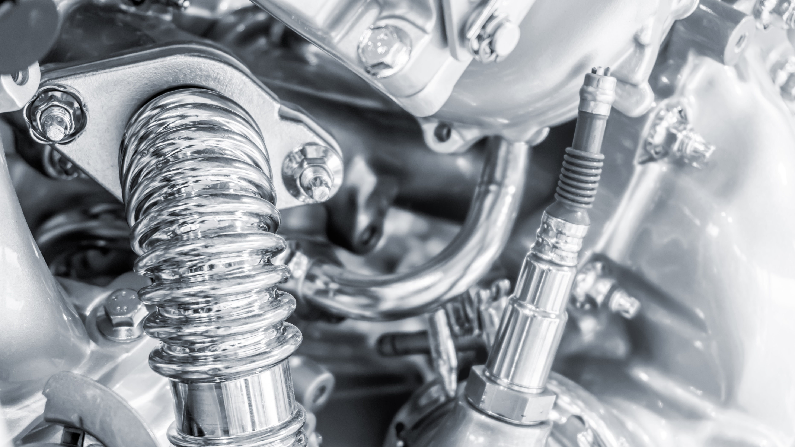

Why is fetch.py so important?
It’s our engine block (Fetch.py)
Has the capabilities to call and receive data from an API via JSON files
The .ini file
Is the transmission and with it can direct where the power from the engine needs to go
The JSON file
Is the CV joint and connects the transmission to the drive shaft
The CSV file
Is the drive shaft that interprets the JSON file and communicates directly with the wheel
The HTML file
Is the wheel and shows the user direct feedback on the performance of drive shaft and the system as a whole

Slide 8
MapMaker.py Program
Brief overview and generalization of the MapMaker.py program

Slide 9

Before we start
MapMaker.py is Keene State’s fully built vehicle built from the Fetch.py engine block
Manipulating and running this program will affect the performance directly with their vehicle produced
MapMaker.py is a model that we can replicate and tweak to make our own model
We can use the same engine and instead of creating a Chevy; we’ll instead make a Ford
Both have similar executions that get you from Point A to Point B
However, they have different details/features that tell them apart
We’ll have our Mustang, and they’ll have their Corvette

Slide 10
Basis on how the MapMaker.py functions
Creates a .csv file on startup to use to constantly write to
The Research method of ArchMain() is defunct
The .ini file is read and this pulling process is automated via a while loop that’s always true unless an error occurs, or you manually stop it
This program constantly loops with no real end on an obsolete computer
The program will update their website Based on the Json data collected by PurpleAir with their woodsmoke conversion factor applied to the data.
Then this will be used to update the .html file embedded

Slide 11
Packages Used via Imports
Arcpy – Used for creating a geographic map
Urllib.request – Fetches Url’s
Json – Encodes and Decodes files via Unicode
Datetime – Formats the date/time correctly
CSV – (Comma Separated Values) Is a text file used to store data
OS – Provides Operating System Interfaces
Smtplib – Creates an SMTP client session to communicate to any IoT

Slide 12
Functions and Uses for Them
PurpleAirDataCorrection():
Corrects a previously wrong data value.
This function is used on raw data before it’s finalized.
HumidityCalc():
Simple function which intakes the temperature variable and the dewpoint variable, converts them to float values, and implements the formula to achieve the rounded percent humidity.
Gatherdata():
Creates the data collection text file of PurplePoints.csv and implicates a template using the writerow builtin function.
Grabs every PurpleAir using it’s unique given ID from the .ini file verified by the Fetch.py.
If no ID is configured in the .ini; a default one is given

Slide 13
Functions and Uses for Them
PurpleAirDataCorrection()
Woodsmoke correction factor for the data
HumidityCalc()
Converts the temperature and dewpoint to percent humidity by the airport weather server
Gatherdata()
Creates a new PurplePoints.csv file and rights into it from the data collected by the PurpleAir Json and the weather server from the Keene Airport
Gatherarchdata() *DEFUNCT*
Take parse data through the memory buffer(intake) and writes it to the .CSV
Makemap()
Creates an Arcmap based on the .csv data compiled
Makemovie()
Uses an open-source tool of FFMPEG to create a .mp4 video of all the map pictures complied so far

Slide 14
Functions and Uses for Them (Continued.)
Ftpresults()
Transfers the .jpg map, .mp4 video, and the .txt console to the website server using the ftp protocol
Cleanup()
Deletes the images/videos that are expired to help clean up the data storage (10 minutes for images, 60 minutes for videos)
Sendalert()
Alerts JC and Dr. Traviss via email of high values of PM
Sendreport()
Everyday a report will be emailed to JC and Dr. Traviss notifying them of any errors encountered during the day
Archmain() *DEFUNCT*
Was a testing method to make sure the code worked properly
Mapmain()
Main method that creates a .csv file on startup and using a while loop constantly populates it every ten minutes as well as the map/video which is put right into the html file that is embedded on the website
Readini()
Creates and reads an .ini file to configure the units needed for pulling

Slide 15
Key Points
MapMaker.py is the finished model for Keene State University
Fetch.py is the starting point for NHDES’s model

