Slide 1
Testing Environment Phase 1
Zachary Thoroughgood

Slide 2
Demo.py
Has four helper methods
createCSV()
createJson()
updateJson()
readJson()
Two Main Methods
Jsonmyhero()
Main()

Slide 3
Helper Methods

Slide 4
createCSV() Method
Takes in the Json dictionary object (has the Keys/Values)
Also takes in the Boolean variable of Statement
Writes the given Keys and/or values to our .CSV
If statement Boolean is TRUE
This means that a .CSV exists with the headers; so, we’ll just add on our new values
If the statement Boolean is FALSE
This means that a .CSV file will be freshly created; so, we start a fresh one with the header

Slide 5
Createjson() Method
Takes in the current date and time as a stamp
Expresses a filename (can be changed) and a names list which is the collection of Keys : Values
Opens file name and creates the file with the built-in function dump
Syntax for json.dump( *Collection of Keys : Values Name* , *Arbitrary name given to the opening portal via the json.open method*, *indentation*)
Always close the json once you’re done

Slide 6
Updatejson() method
Takes the date and time to create a stamp
Mimics that of createJson() method
Why?
Because this needed to be called in readJson() to update the time stamp
But couldn’t you just call createJson() method because they’re the same?
I tried that and it jammed it up; *noted* to look into it

Slide 7
Readjson() method
Try and catch to handle exceptions without breaking the code
Attempts to open the current Demo.json
If it can this means that our file has already been started for the day with a header
Updates the json file to match the current time stamp of pull
Pulls the dictionary (Keys/Values) with the json.load method from the file and assigns it to a json object
Json object is then converted to a string for printing purposes
Make statement equal to true because a file already exists, and we don’t need a header for the .CSV file
Return the dictionary and the Boolean statement for our CSV creation method to look at
If the attempt results in failure
The Boolean statement is false because we need a header since no .CSV file exists yet for the day
Create this .JSON file for the day
Complete now the same steps as a success and return the dictionary/Boolean variables for the creation of .CSV file

Slide 8
Two main methods

Slide 9
Jsonmyhero() Method
Try and catch allows for us to maintain an exception without breaking the code
Assigns global variables of datadictionary and statement to the returned values given by the readJson() method
Uses these two variables to input into the createCSV() method

Slide 10
Main() method
Calls Jsonmyhero() method
Just a simple driver method for the program

Slide 11
Special Writing Characters in Open method for csv

Slide 12
‘w’ or ‘w+’
Writes a completely new/fresh thing and/or file
‘a’ or ‘a+’
Appends to the last saved version
‘r’ or ‘r+’
Writes and reads file but starts at the beginning like ‘w’ or ‘w+’

Slide 13
Automation of demo.py

Slide 14
Starting.bat
Is a Batch file
Used for executing the program of Demo.py by itself every scheduled timeframe
Contains command prompt commands

Slide 15
Steps for automation
Search Task Scheduler on Windows Computer
Click on Task Scheduler (local) in the left-hand column
Right click on Task Scheduler (local) or click on Action with Task Scheduler (local) highlighted
Click create basic task
Fill in name/description of task (Automation of collecting Purple Air Data)
Hit next and the Trigger will be daily
Hitting next will display a scheduler (pick the correct interval and start time)

Slide 16
Steps for automation (Continued.)
Select the correct trigger schedule and hit next
Now keep the default option of start a program and hit next
Click the browse option and find the .bat (batch file)
Select that .bat (batch file) and continue
Select finish

Slide 17
Advanced steps for automation (Final)
Now you’re finished, click on Task Scheduler Library
Scroll in the window until you find this automation task you just created
Double click on it
In the General Tab
Change the configure to Windows 10
Run whether the user is logged on or not
In the Trigger Tab
Double click the task
Click repeat task every *how every amount we need*
Click stop task if it runs longer than 30 minutes
In the Conditions Tab
Click ‘Wake the computer to run this task’
In the Settings Tab
Click ‘if the task fails, restart every:’ and fill it out to your liking

Slide 18
Keep an eye on the automation
Make sure the batch file is set up to run the python file
Make sure it exits at the end
Check the logs on the Task Scheduler including:
Last time run
Succeeds and failures

Slide 19
important

Slide 20
Do not
Have the .CSV file and/or the .JSON file open when this program executes
It will not update them or atleast the .CSV file
Also
Be careful of running/creating a .batch file
These are the same files used in the operating systems for most computers
One wrong move and you can mess up your computer in an instant

Slide 21
What I have thus far?

Slide 22

Testing environment thus far
7/5/2022
Currently have a demo program updating the Json with a current timestamp
Pulls from Json and gives information to .CSV
Awaiting the next stage which will be pulling/looking at the PurpleAir Json that the servers give when called upon
Automates the program I created with a batch file every five minutes
Is a basis for the starting cornerstone of this project

Slide 23
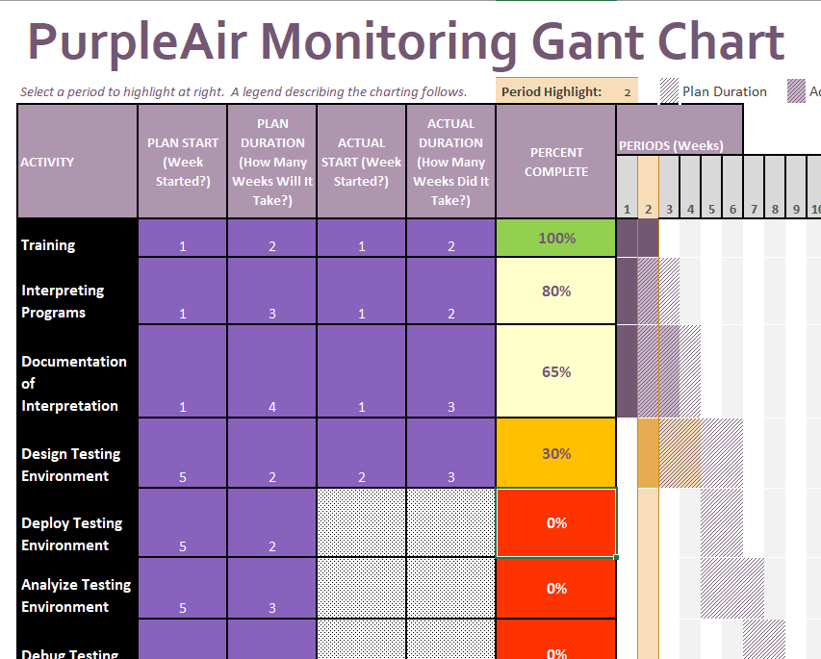
Updated Gant Chart
Training is accomplished
Interpreting programs is nearly complete and I’m feeling confident in my knowledge of them
Documentation is on the back burner as I let my idea’s flow for the design of this testing environment
Testing environment is now on standstill until the applications come in for my work PC

Slide 24
Phase 2 Ideas

Slide 25
Phase 2 will
Contain atleast one PurpleAir Monitor to scalp data off from
Run atleast twice overnight to experiment that environment’s behavior

Slide 26
Phase 3 predictions

Slide 27
The goal for phase 3 is to
Having a fully functioning automation done every day on a computer
Look to archive the data effectively

