Slide 1
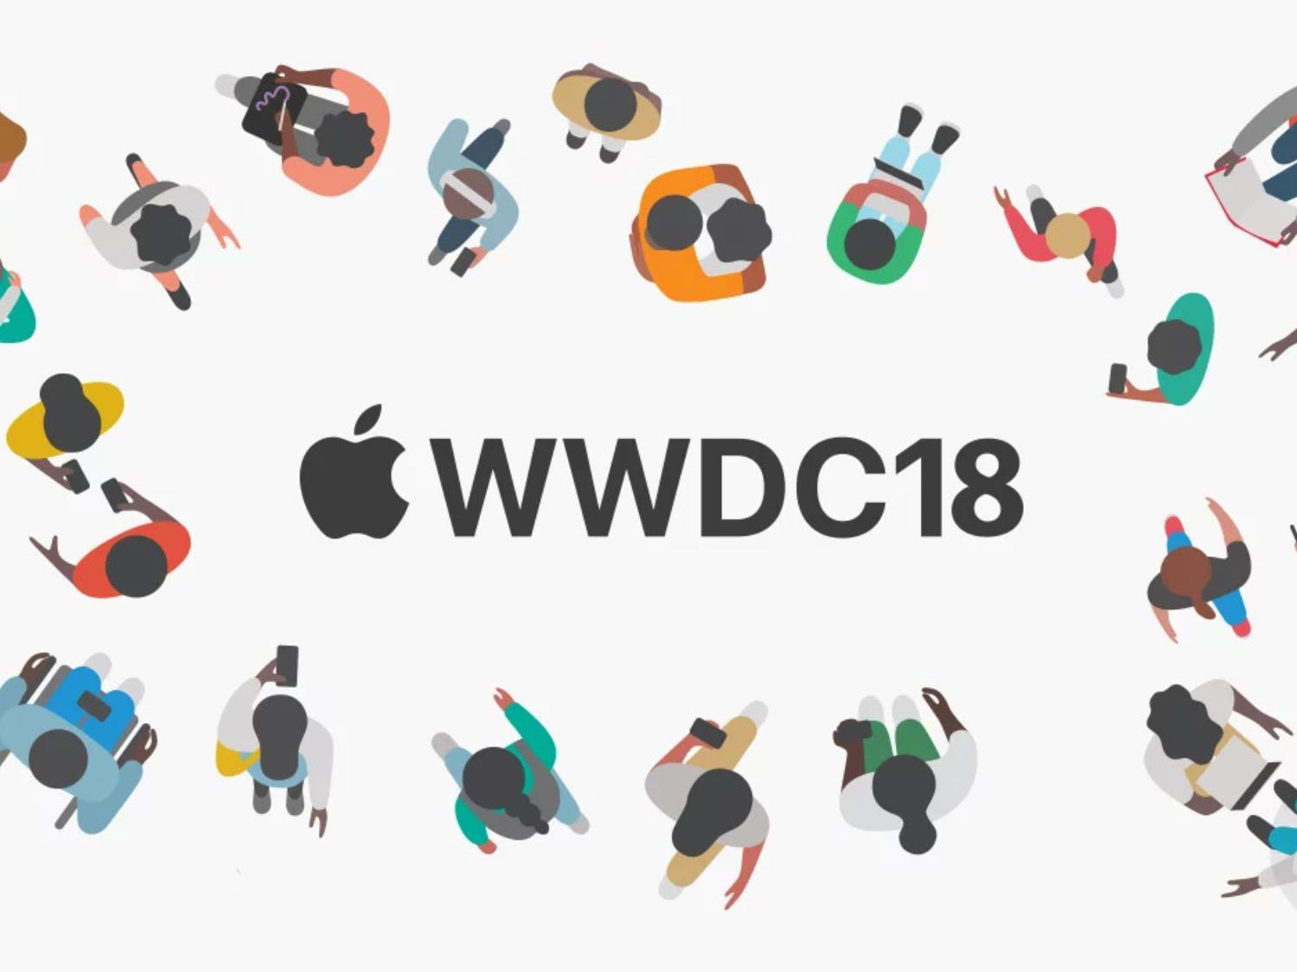

Slide 2

WWDC, or Worldwide Developer Conference, or 'Dub-dub DC', is Apple's yearly conference aimed at developers.
The event is used by Apple to showcase its new software and technologies for software developers. Attendees can participate in hands-on labs with Apple engineers, and in-depth sessions covering a wide variety of topics.
WWDC 2018 will be held from June 4 to June 8, 2018 at the San Jose Convention Center in San Jose, California.
Conference 会议(n) session阶段(n)

Slide 3
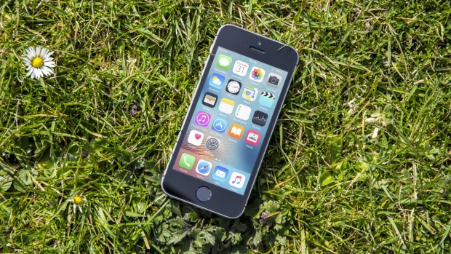
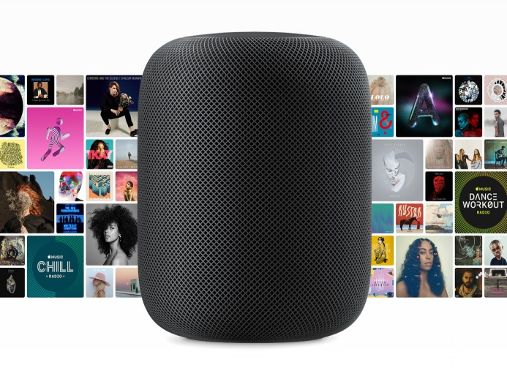
Hardware
While WWDC tends to focus on Apple's software offerings, rumours often swirl around new hardware announcements. Last year the company lifted the lid on its HomePod speaker system, and this year the talk is about a potential follow up to the iPhone SE.
rumour 谣言 swirl 漩涡(n/v) lid 盖子(n)
Potential 潜力(n/adj)

Slide 4
SOFTWARE?!

Slide 5

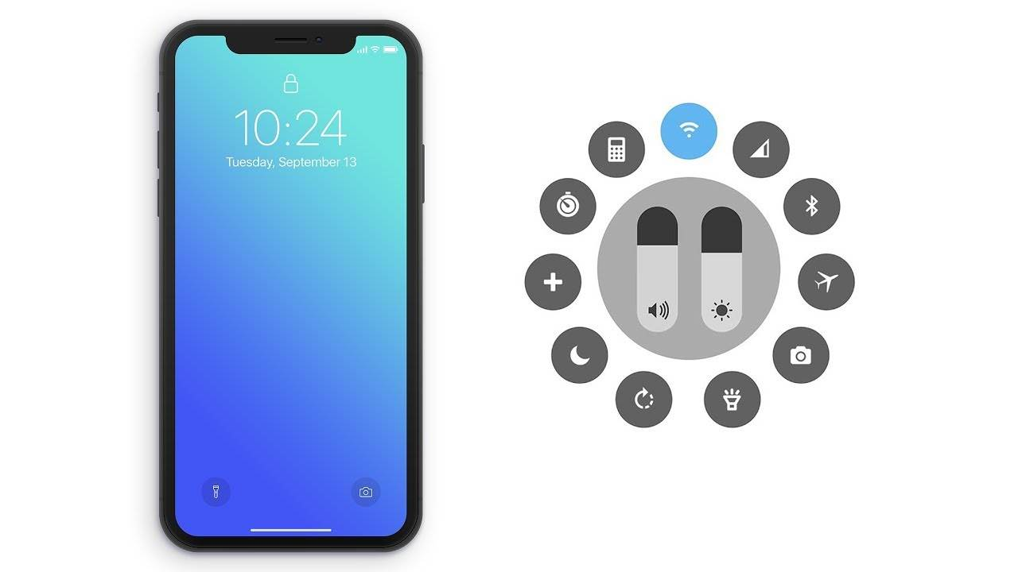
iOS 12
the rumours are currently
saying it will be a relatively
sedate upgrade, with a focus on
security and performance over
substantial design changes.
Sedate 镇定的(adj) substantial大量的(adj)

Slide 6
macOS 10.14
Perhaps the biggest addition with macOS 10.14 will be the ability for iOS 12 apps to work with Mac computers.

Slide 7
watchOS 5
With watchOS 5, we may see Apple's purchase of sleep
tracking company Beddit come to fruition with some
integrated sleep monitoring in the Apple Watch.
There will also probably be some new watch faces,
and tweaks to the Control Center.
purchase 购买(v)fruition实现(n) integrated综合的(adj)
tweak 拧,扭(n/v)

Slide 8

tvOS 12
We‘re now up to tvOS 12, Apple could well unveil new partnerships and new apps to lay the groundwork for a push into movies and shows .
be up to 面对 unveil 推出(v)

Slide 9

Watch this space!

