Slide 1

Visualizing Air Quality Trends in Los Angeles and New York
By
Tarun Kumar Reddy Gade
Vijesh Medikonda
Data Visualization – May 2025

Slide 2
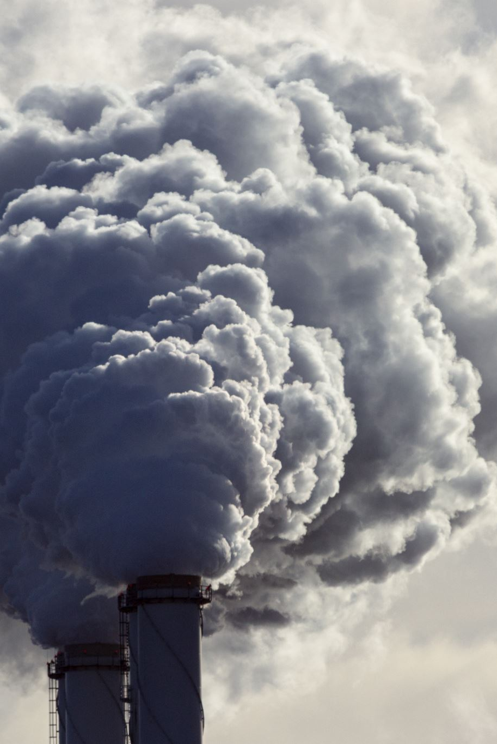
Why Air Quality Matters
• AQI = critical measure of air pollution
• Visualizes AQI trends for LA and NY (2023–2024)
• Combines Python, Processing, and CSV data
• Goal: Make data engaging and actionable

Slide 3

Understanding the Dataset
• Raw Columns: Month, City, AQI, PM2.5, NO2, Year
• Issues: Missing values, irrelevant pollutant data
• Cleaned Columns: Month, AQI (per city & year)
• Tools: Pandas for preprocessing

Slide 4

Cleaning the Dataset with Python
• Dropped columns: PM2.5, NO2
• Filtered: Cities = LA, NY | Years = 2023, 2024
• Filled missing AQI with city-year mean
• Saved 4 cleaned CSV files

Slide 5

Creating Interactive Visualizations
• Tools: Processing 4 + FloatTable & Integrator
• Visuals: Bar graph (AQI colors), Line graph
• Code: loadDataset(), drawBarGraph(), drawLineGraph()

Slide 6
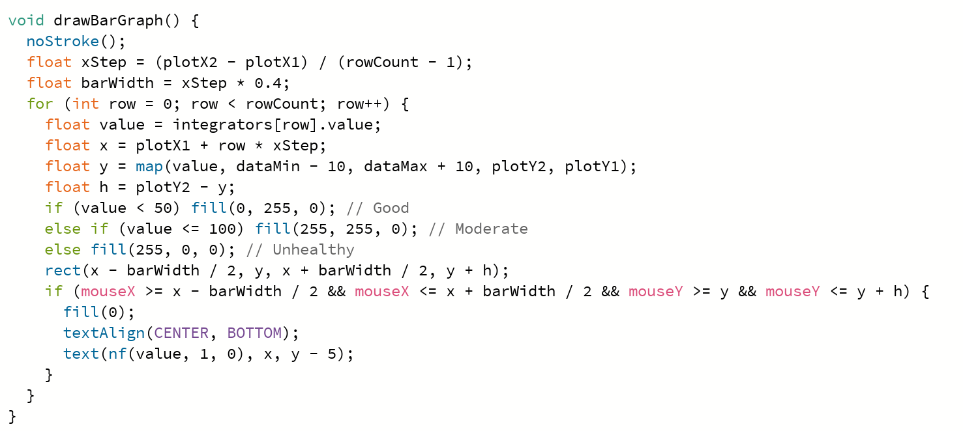
drawBarGraph()

Slide 7
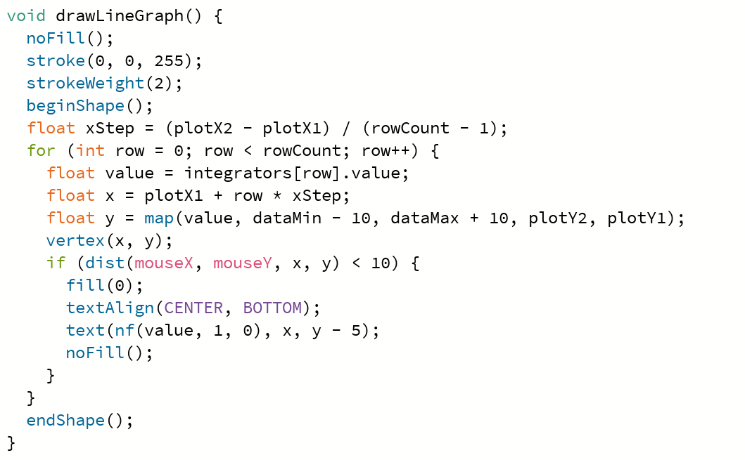
drawLineGraph()

Slide 8

User Interactivity Features
• Keyboard: 'b'=bar, 'l'=line, '1/2'=switch cities
• Mouse: Hover = AQI tooltip, Scroll = Zoom
• Tab click = Switch dataset
• Interactive Legend and Labels

Slide 9
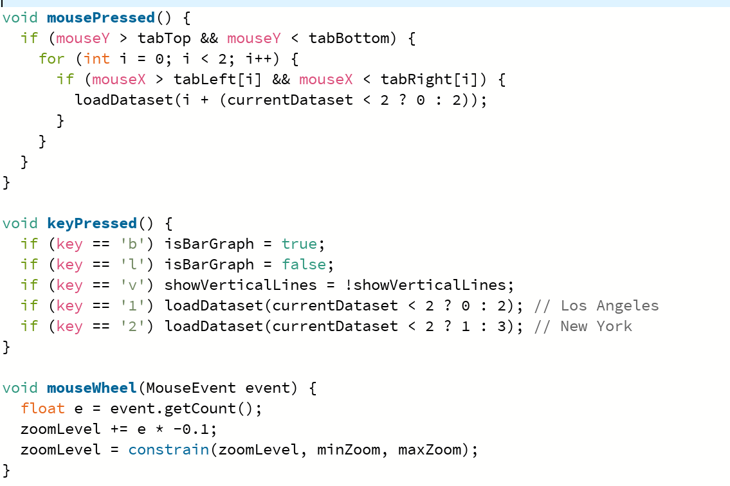
Interactive code

Slide 10

Heatmap Visualization in Python
• Tool: Seaborn + Matplotlib
• Shows monthly AQI per city/year as color grid
• Green = Good AQI, Red = Poor AQI
• Plots via pivot_table and sns.heatmap()

Slide 11
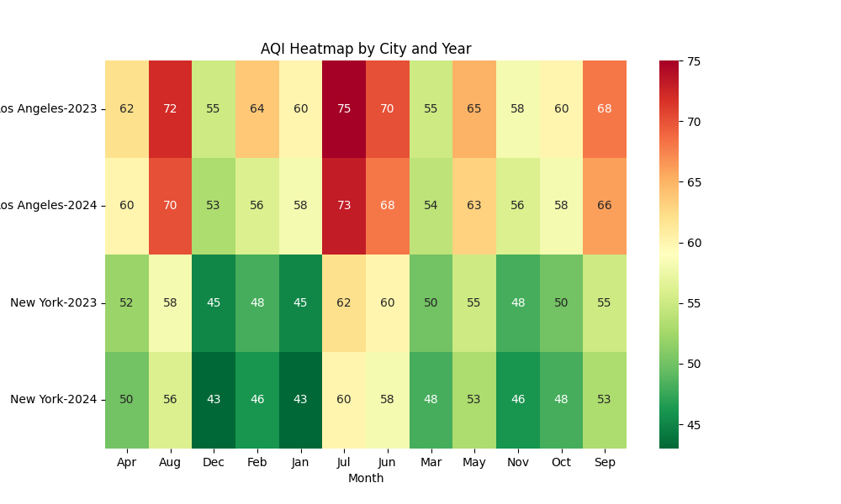

Slide 12

Troubleshooting Challenges
• Missing CSV in Processing: fixed with data re-export
• FileNotFoundError in Python: fixed path in heatmap script
• Lesson: Consistent naming and directories = key

Slide 13
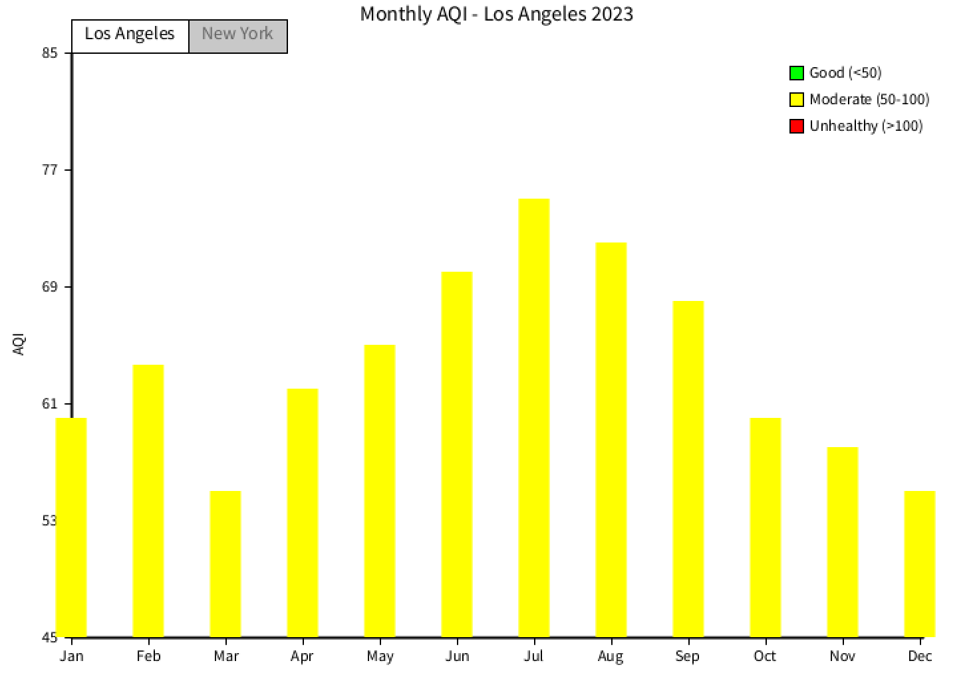
Visual Output bar graph

Slide 14
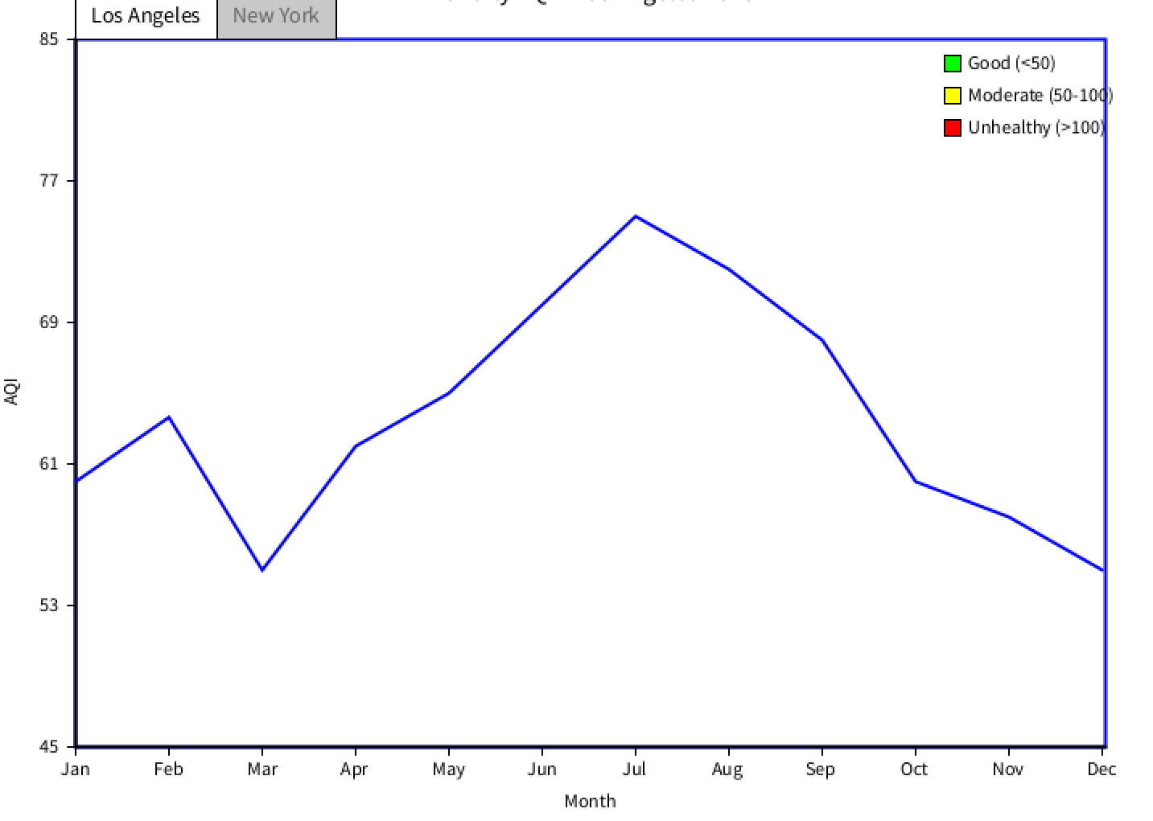
Visual output line graph

Slide 15
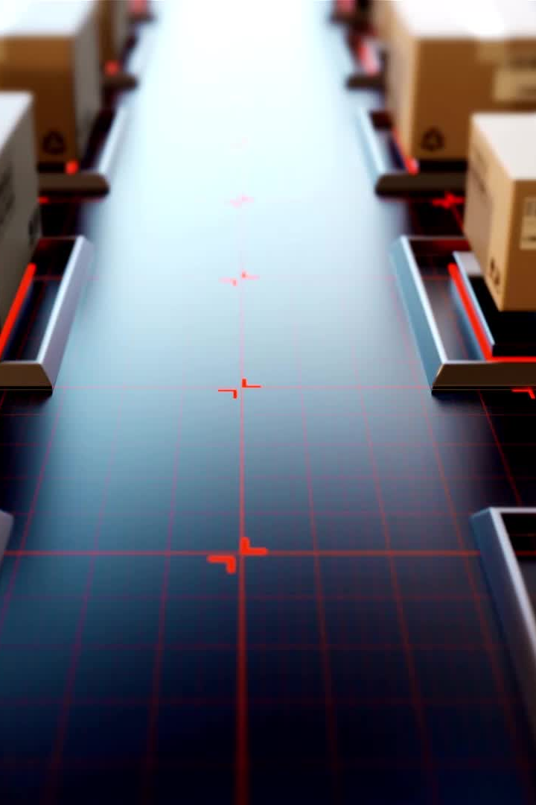
Conclusion
This project demonstrates proficiency in:
- Data loading and validation
- Graphical animation with Integrators
- Building interactive user experiences in Processing
Switching datasets and visual formats allows better insights into correlations

