Slide 1

AKASOFT · UNREAL ENGINE EDITOR AUTOMATION
Blueprint
Automation Toolkit
Control Unreal Editor through a secure, typed localhost API.
UE 5.5–5.8 · WIN64 · EDITOR-ONLY · VERSION 1.0.0
Notes:
[Sources]
- BAT BlueprintAutomationToolkit.uplugin — version, module type, platform and target allow lists.
- BAT README.md — product positioning and localhost API description.
- BAT Resources/Icon128.png — product icon.
[/Sources]

Slide 2
Stop automating pixels. Start automating intent.
UI-DRIVEN AUTOMATION
BLUEPRINT AUTOMATION TOOLKIT
Fragile by default
Structured by design
Coordinates drift.
State stays implicit.
Retries are risky.
Errors arrive as screenshots.
Typed JSON requests.
Discoverable capabilities.
Stable object references.
Explicit success and error models.
BLUEPRINT AUTOMATION TOOLKIT
02
Notes:
[Sources]
- BAT README.md — typed HTTP bridge, reflective primitives, structured diagnostics and JSON error model.
[/Sources]

Slide 3
Agents move reliably from intent to saved assets.
01 · DISCOVER
02 · ACT
03 · VALIDATE
Know the gates
Change real editor state
Persist with proof
Confirm the editor, safe-mode state, permissions, and recommended route flow.
Resolve objects, mutate properties, edit graphs, spawn actors, and control levels.
Compile, inspect normalized diagnostics, and save assets or levels explicitly.
GET /engine/discover
GET /health
POST /object/resolve
POST /blueprint/graph/apply
POST /blueprint/compile_save
POST /asset/save
BLUEPRINT AUTOMATION TOOLKIT
03
Notes:
[Sources]
- BAT README.md — preferred workflow, agent handshake flow and canonical routes.
[/Sources]

Slide 4
One bridge reaches the editor surfaces that matter.
Blueprints
Reflected objects
Actors & levels
Assets
Read, edit, compile, and save graphs.
Inspect fields and call exposed UFunctions.
Spawn, destroy, audit, load, and save.
Resolve, create, mutate, save, and delete.
Editor context
Play In Editor
Materials
Extensibility
Selection, focus, map, and scene state.
Start and stop PIE through permissioned routes.
Texture samples, geometry, and skeleton data.
Register commands from other editor plugins.
BLUEPRINT AUTOMATION TOOLKIT
04
Notes:
[Sources]
- BAT README.md — core API, preferred endpoints and level automation helpers.
- BAT Docs/openapi.yaml — route inventory.
[/Sources]

Slide 5
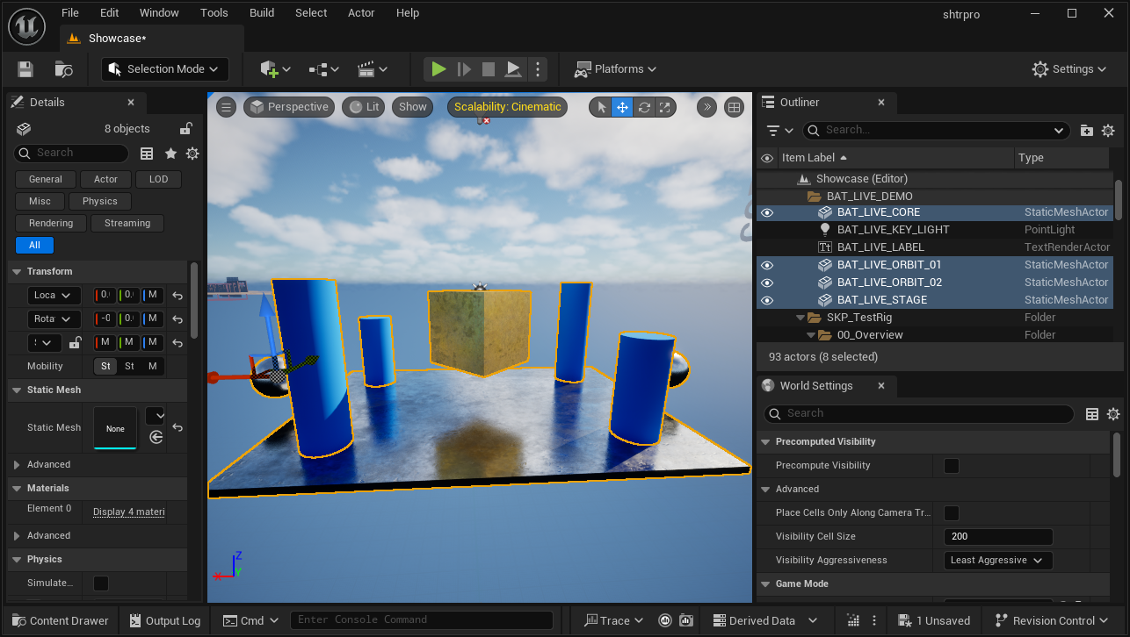
This Codex command produced the Unreal scene.
ACTUAL CODEX COMMAND
This is the command Codex executed.
“Create a BAT demo in the Showcase map: a metallic stage, four blue pillars, two chrome spheres, a gold core, a title, and a key light. Group it under BAT_LIVE_DEMO.”
BAT RESULT · 10 created · 0 rejected · Unreal 5.5
BLUEPRINT AUTOMATION TOOLKIT
05
Notes:
[Sources]
- Blueprint Automation Toolkit README.md — POST /ai/editor/layout/apply route and actor-layout request format.
- unreal-bat-live-command-final.png — authentic Unreal Editor 5.5 capture produced after the live BAT request; no token is shown.
- Visible Codex command — the natural-language scene instruction translated into the authenticated BAT layout payload.
[/Sources]

Slide 6
Local by design. Permissioned by default.
01
02
03
Network boundary
Identity & consent
Policy gates
Loopback-only listener
Non-local requests rejected
No required cloud service
Bearer-token authentication
Start-listener permission prompt
Optional scoped tokens
Server disabled by default
Safe mode enabled by default
Exec and Python disabled by default
Request-size limits and per-client rate limits protect the automation surface.
BLUEPRINT AUTOMATION TOOLKIT
06
Notes:
[Sources]
- BAT README.md — security model, marketplace-safe defaults, permission prompt, rate limits and scoped tokens.
[/Sources]

Slide 7
Built for Unreal Editor, without an external stack.
A focused editor plugin with explicit platform boundaries and only built-in Unreal dependencies.
AREA | SUPPORTED | WHAT IT MEANS
Unreal Engine | 5.5 · 5.6 · 5.7 · 5.8 | Validated source-only packages for each engine version
Development platform | Windows / Win64 | PlatformAllowList limits the editor module to Win64
Module | EditorNoCommandlet | Loaded in Unreal Editor; excluded from packaged games
Built-in dependencies | PCG · GeometryProcessing · GeometryScripting | Enabled through the plugin descriptor
External stack | None | No external SDK, DLL, package manager, or cloud service
Distribution | Source-only | Unreal compiles the plugin for the selected engine version
BLUEPRINT AUTOMATION TOOLKIT
07
Notes:
[Sources]
- BAT BlueprintAutomationToolkit.uplugin — EditorNoCommandlet module, Win64 PlatformAllowList, Editor TargetAllowList and built-in plugin dependencies.
- BAT Resources/Docs/FabTechnicalInformation.md — supported engine versions and editor-only distribution details.
- Fab remediation package audit — source-only UE 5.5–5.8 packages validated with BuildPlugin.
[/Sources]

Slide 8
START WITH A SAFE, REVERSIBLE CHECK
Give your tools an
Unreal-native control plane.
1 Clone or install · 2 Enable BAT · 3 Start Server · 4 Call /engine/discover
github.com/tgameengine/blueprint-automation-toolkit
github.com/tgameengine/blueprint-automation-toolkit/releases/tag/v1.0.0
UE 5.5–5.8
Notes:
[Sources]
- BAT README.md — installation steps and start-server workflow.
- GitHub repository and v1.0.0 release URLs.
[/Sources]

