Slide 1

Live Streaming Data Analysis By Distributed Technology Hive
- Thirupathi Gandla, Saivivek Therala

Slide 2
Introduction
Mobile phones have become an essential companion in our day to day lives. They helps us to keep in touch with friends, family, colleagues, access email, browse internet etc.
Mobile phones were brought to life with the help of an operating system. In the present world, Android and IOS are having the major mobile operating systems market share in the world.
According to International Data Corporation statistics, Google's Android mobile operating system had a 74% share of all users globally. Apple's iOS had just 19%.
IDC predicts that in 2020 Android will claim 78.2% of users and only 20.8% will be on Apple's iOS system. So keeping these facts in mind we are inspired to perform big data analytics on tweets related to android keyword.

Slide 3
Hadoop is an open source implementation of Map Reduce which is widely used to store and process large amount of data in a distributed fashion.
Apache Hive is a data warehousing solution which is built over Hadoop.
It is powered by HiveQL which is a declarative SQL language compiled directly into Map Reduce jobs which are executed over the underlying Hadoop architecture.
Apache Hive allows programmers who are familiar with the MapReduce framework to be able to plug in their custom mappers and reducers to perform more sophisticated analysis that may not be supported by the built-in capabilities of the language

Slide 4
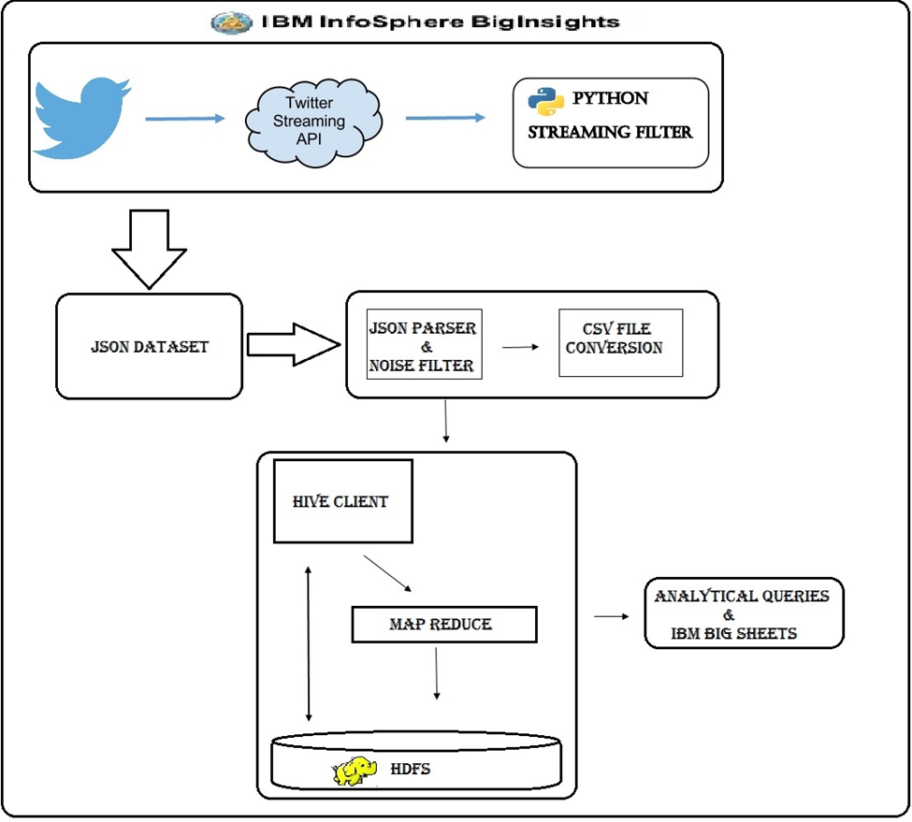
Design Architecture

Slide 5
Steps:
Collect twitter dataset for keyword “android” using Twitter Streaming API.
Noise data is filtered from json formatted tweets and converted into csv format.
These csv files are loaded in to hive database.
Android tweet data is analyzed by running hive analytic queries. Later the results are visualized

Slide 6
Stage 1:
A twitter application is created to access the streaming tweets from twitter website.
Required authorizations were created for connecting to the API’s from python code.
A library named tweepy from python is used to download streaming tweets from twitter with a streaming filter i.e., ‘android’.
All the streaming tweets were collected into a json file to the local machine.

Slide 7
Stage 2:
A JSON2CSV.java class file is developed to filter the noise and convert the json file to csv format.

Slide 8
Stage 3:
A Hive table named master_tweets is created using Row Format as csv serde.
All the Tweets were loaded into the above hive table.
Again, three tables named data_tweet, user_info, user_count_info were created to store the individual data from master table.
Analytical queries were executed in hive shell to view and analyze the data.

Slide 9
Stage 4:
All the Analytical queries output is stored in external hive tables.
External table data is copied from Hadoop file system to local system using hadoop fs – copyToLocal command.
We used IBM Big Sheets for visualization of the results. Once the results are available in local, We uploaded that results in to the Infosphere files tab.
In the tool we convert the comma separated text format data in to sheet format. Then we select the line reader as comma separated value data.
We save this as a master workbook then the control is redirected to bigsheets tab. Here we select the required visualization for our results data.

Slide 10
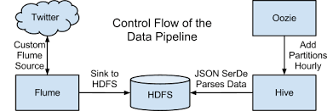

Slide 11
System requirements
Environment: IBM Info Sphere Big Insights v3.0
NoSQL Tool: Hive
Visualization: IBM Big Sheets, Google Fusion Tables, Google Earth.
Programming Languages: Python, Java
Data Source : Twitter Data on keyword “android”
Volume of Data : 783,876 Tweets
Data Size : 3.87 GB
Data Format : json

Slide 12
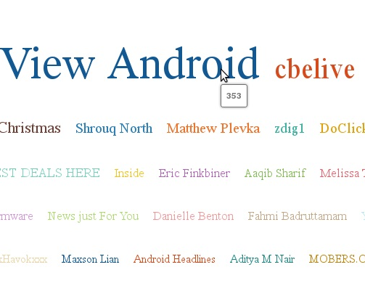
Query1
Description: To find the users contribution towards tweets in dataset.
select count(ti.text), ui.user_id, ui.user_name, ui.user_screen_name From data_tweet ti JOIN user_info ui ON (ti.user_id = ui.user_id) GROUP BY ui.user_id, ui.user_name, ui.user_screen_name;

Slide 13
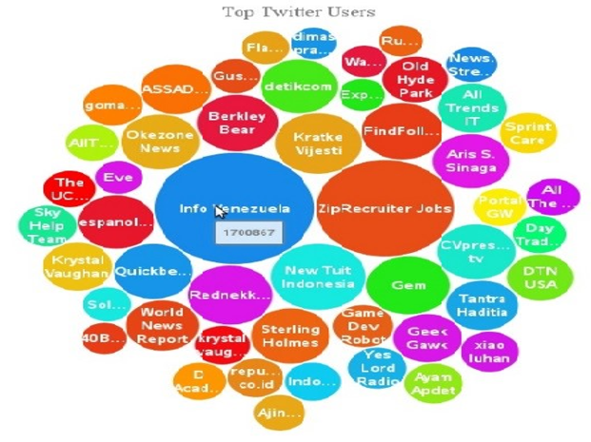
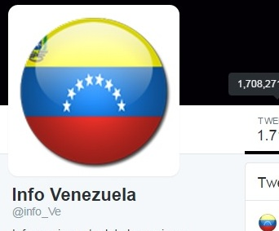
Query2
Description: To identify Active Users in twitter from the given users dataset.
Select ui.user_id,ui.user_name,ui.user_screen_name,
uci.user_statuses_count from user_info ui JOIN user_count_info uci ON (ui.user_id=uci.user_id) ORDER BY uci.user_statuses_count DESC;

Slide 14
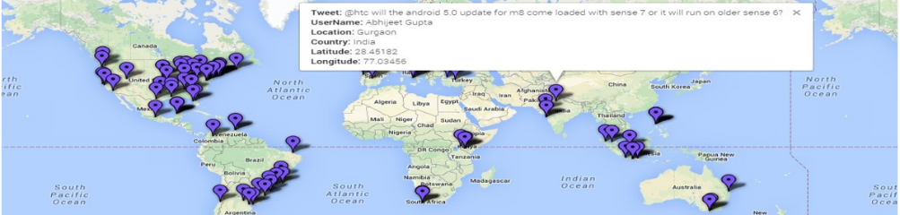
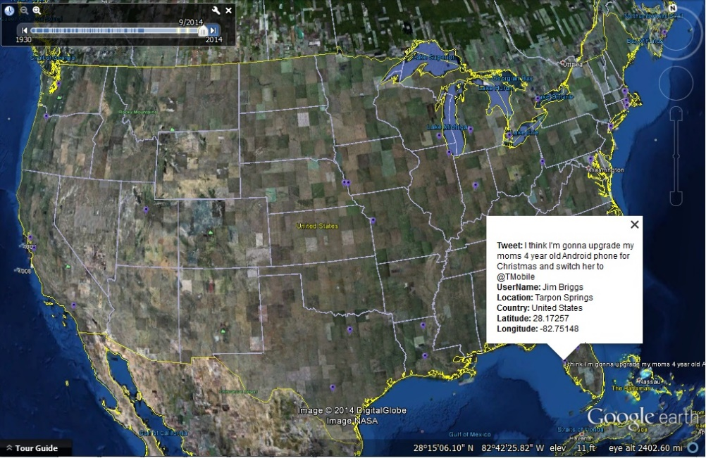
Query3
Description: To plot the geographical locations of tweets from dataset
Select ti.text,ui.user_name,ti.place_name,ti.place_country, ti.geo_coord_lat,ti.geo_coord_long from data_tweet ti JOIN user_info ui ON (ti.user_id = ui.user_id) where geo_coord_lat is not null and geo_coord_long is not null;

Slide 15
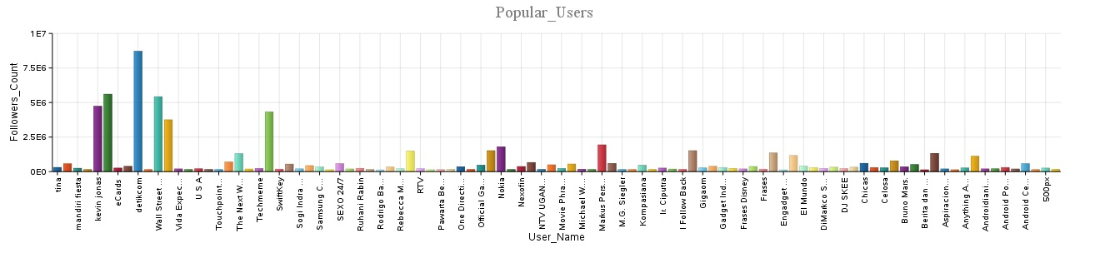
Query4
Description: To list out the popular users from the given dataset.
select ui.user_name,ui.user_screen_name,uci.user_followers_count from user_info ui JOIN user_count_info uci ON(ui.user_id=uci.user_id) ORDER BY uci.user_followers_count DESC;

Slide 16
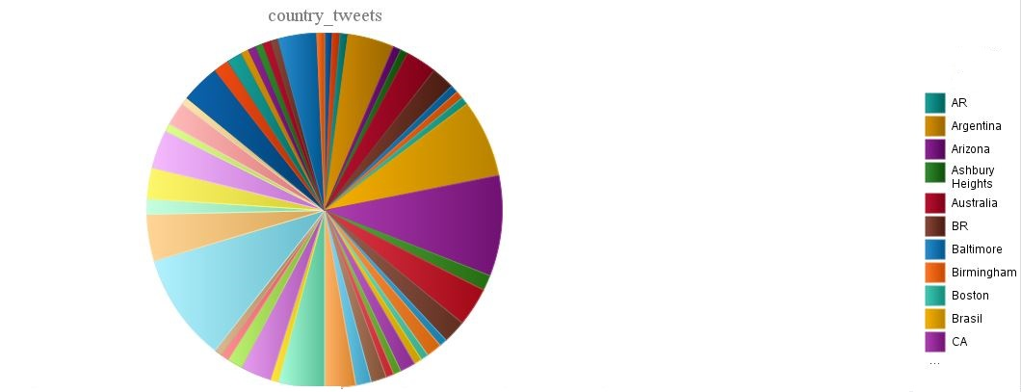
Query5
Description: To find the tweet contribution from various countries.
select place_country country,count(*) count from data_tweet group by place_country;

Slide 17
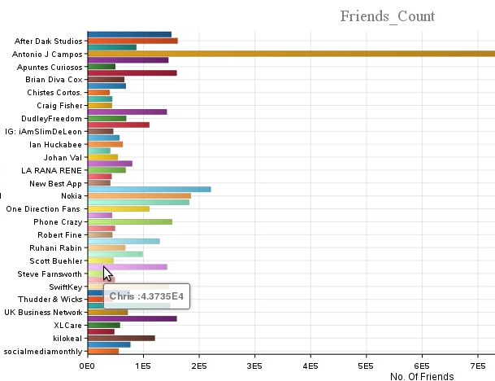
Query6
Description: To find the top Friends Count from a given dataset
select ui.user_name,ui.user_screen_name,uci.user_friends_count from user_info ui JOIN user_count_info uci ON(ui.user_id=uci.user_id) ORDER BY uci.user_friends_count DESC;

Slide 18
Conclusion
Social media provides valuable datasets, but the challenge is in collecting and analyzing the data quickly. In this project we’ve analyzed and visualized twitter data on a particular keyword.

Slide 19
Future work
In future work, we would like to perform domain specific analysis and try to capture valuable insights from data, which can become handy for decision makers in the business process.

Slide 20
References
[1] http://infolab.stanford.edu/~ragho/hive icde2010.pdf
[2] https://hive.apache.org/
[3] Claudio Cioffi-Revilla “Computational social science”, WILEY Interdisciplinary Reviews:
Computational Statistics, Vol. 2, no. 3, May/June 2010:pp.259–271
[4] Gaurav D Rajurkar, Rajeshwari M Goudar “A speedy data downloading approach for Twitter Trend and Sentiment analysis using HADOOP”, 2015 International Conference on Computing Communication Control and Automation.
[5] Andreas M. Kaplan , Michael Haenlein “Users of the world, unite! The challenges and opportunities of Social Media”, Business Horizons (2010) 53, 59—68 ELSEVIER

Slide 21
THANK YOU…….

