Slide 1
CS 4700:
Foundations of Artificial Intelligence
Carla P. Gomes
gomes@cs.cornell.edu
Module:
SVM
(Reading: Chapter 20.6)
Adapted from Martin Law’s slides
http://www.henrykautz.org/ai/intro_SVM_new.ppt

Slide 2
Support Vector Machines (SVM)
→ Supervised learning methods for classification and regression
relatively new class of successful learning methods -
→they can represent non-linear functions and they have an efficient training algorithm
→ derived from statistical learning theory by Vapnik and Chervonenkis
(COLT-92)
→ SVM got into mainstream because of their exceptional performance in Handwritten Digit Recognition
    1.1% error rate which was comparable to a very carefully constructed (and complex) ANN
Notes:
First introduced in COLT-92 by Boser, Guyon and Vapnik
COLT = computational learning theory

Slide 3
Two Class Problem: Linear Separable Case
Many decision boundaries can separate these two classes
Which one should we choose?
Class 2
Class 1
Notes:
Perceptron learning rule can be used to find any decision boundary between class 1 and class 2

Slide 4
Example of Bad Decision Boundaries
Class 2
Class 2
Class 1
Class 1

Slide 5
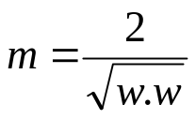
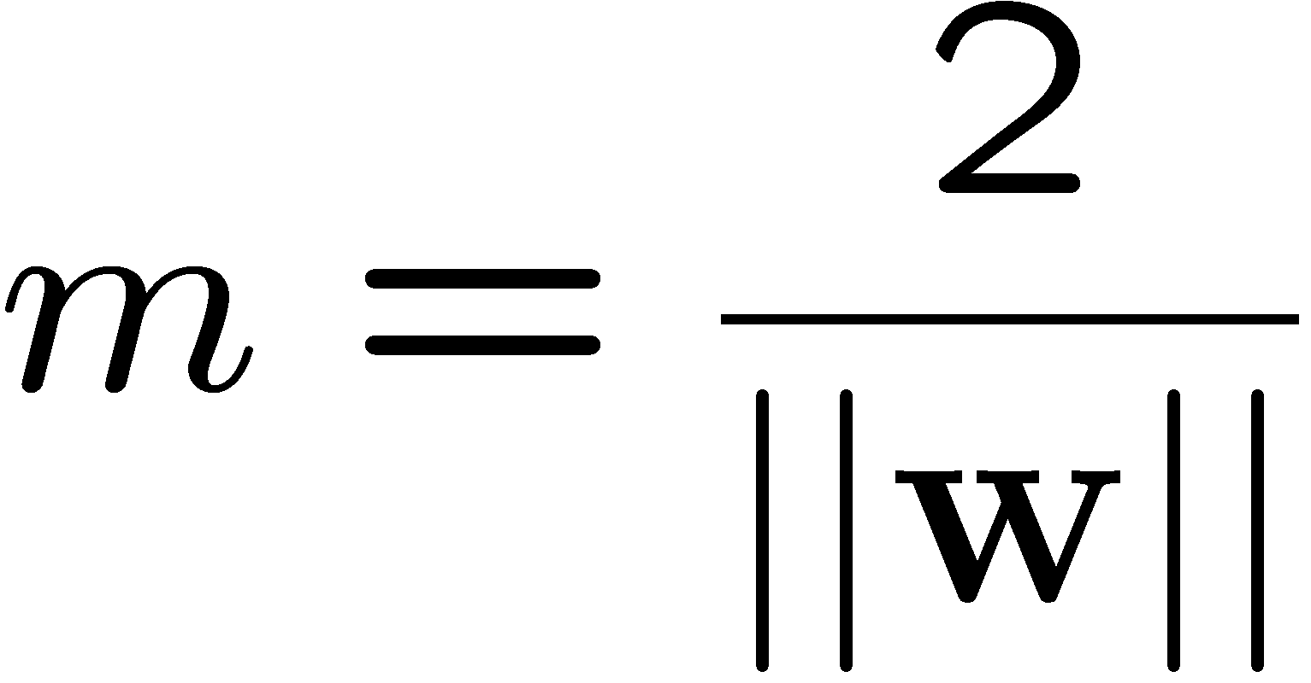


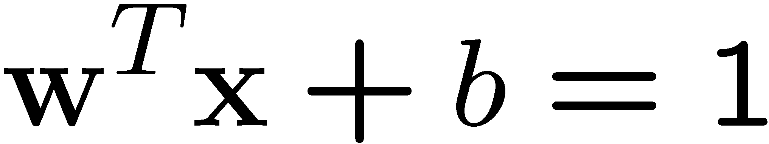
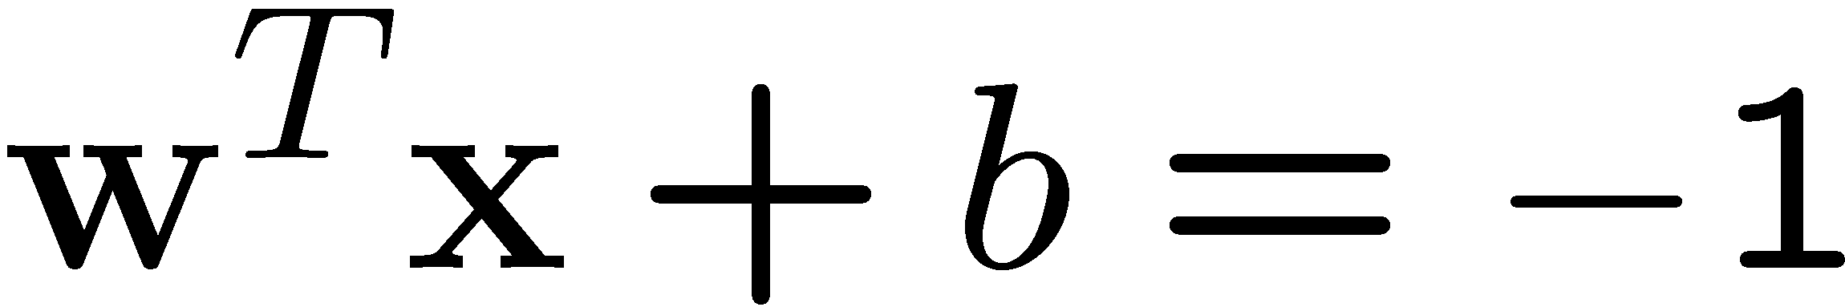
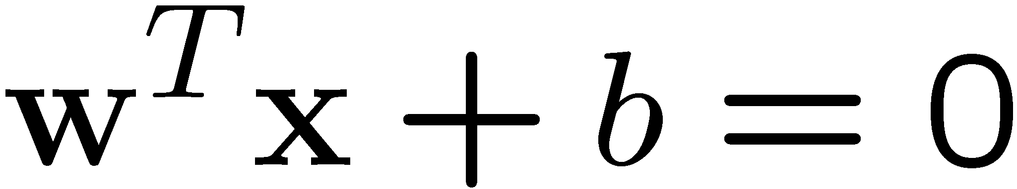
Good Decision Boundary: Margin Should Be Large
The decision boundary should be as far away from the data of both classes as possible
  We should maximize the margin, m
Support vectors
datapoints that the margin
pushes up against
Class 2
The maximum margin linear
classifier is the linear classifier
with the maximum margin.
This is the simplest kind of
SVM (Called an Linear SVM)
m
Class 1

Slide 6
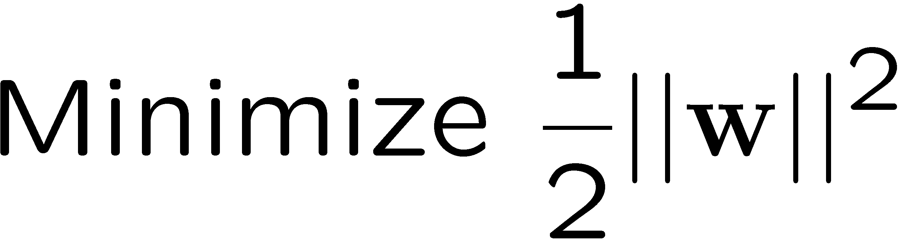
The Optimization Problem
Let {x₁, ..., x_{n}} be our data set and let y_{i} ∈ {1,-1} be the class label of x_{i}
The decision boundary should classify all points correctly ⇒
A constrained optimization problem
  ||w||² = w^{T}w

Slide 7
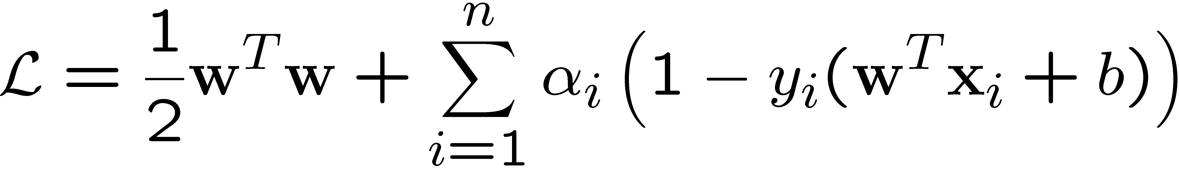

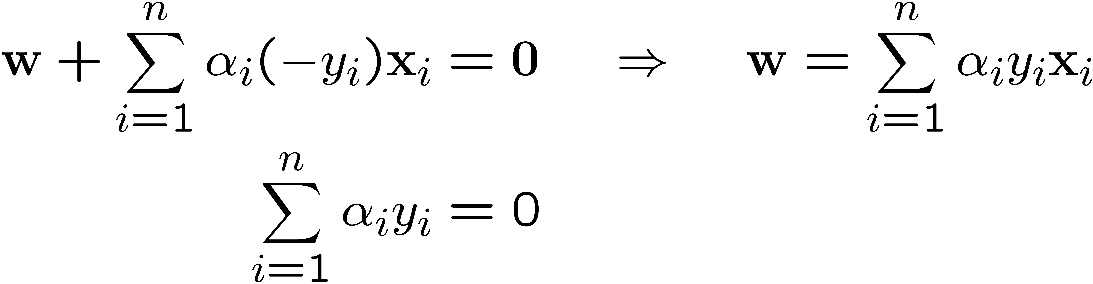
Lagrangian of Original Problem
The Lagrangian is
  Note that ||w||² = w^{T}w
Setting the gradient of w.r.t. w and b to zero, we have
Lagrangian multipliers
α_{i}≥0

Slide 8
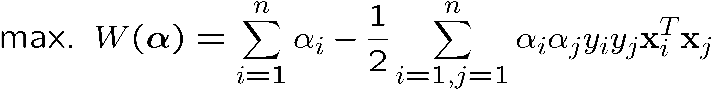
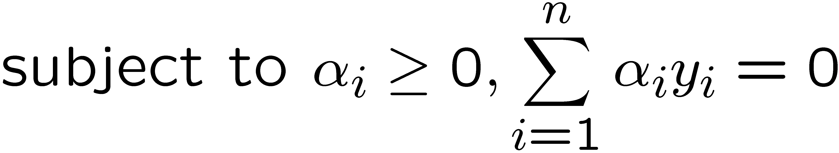
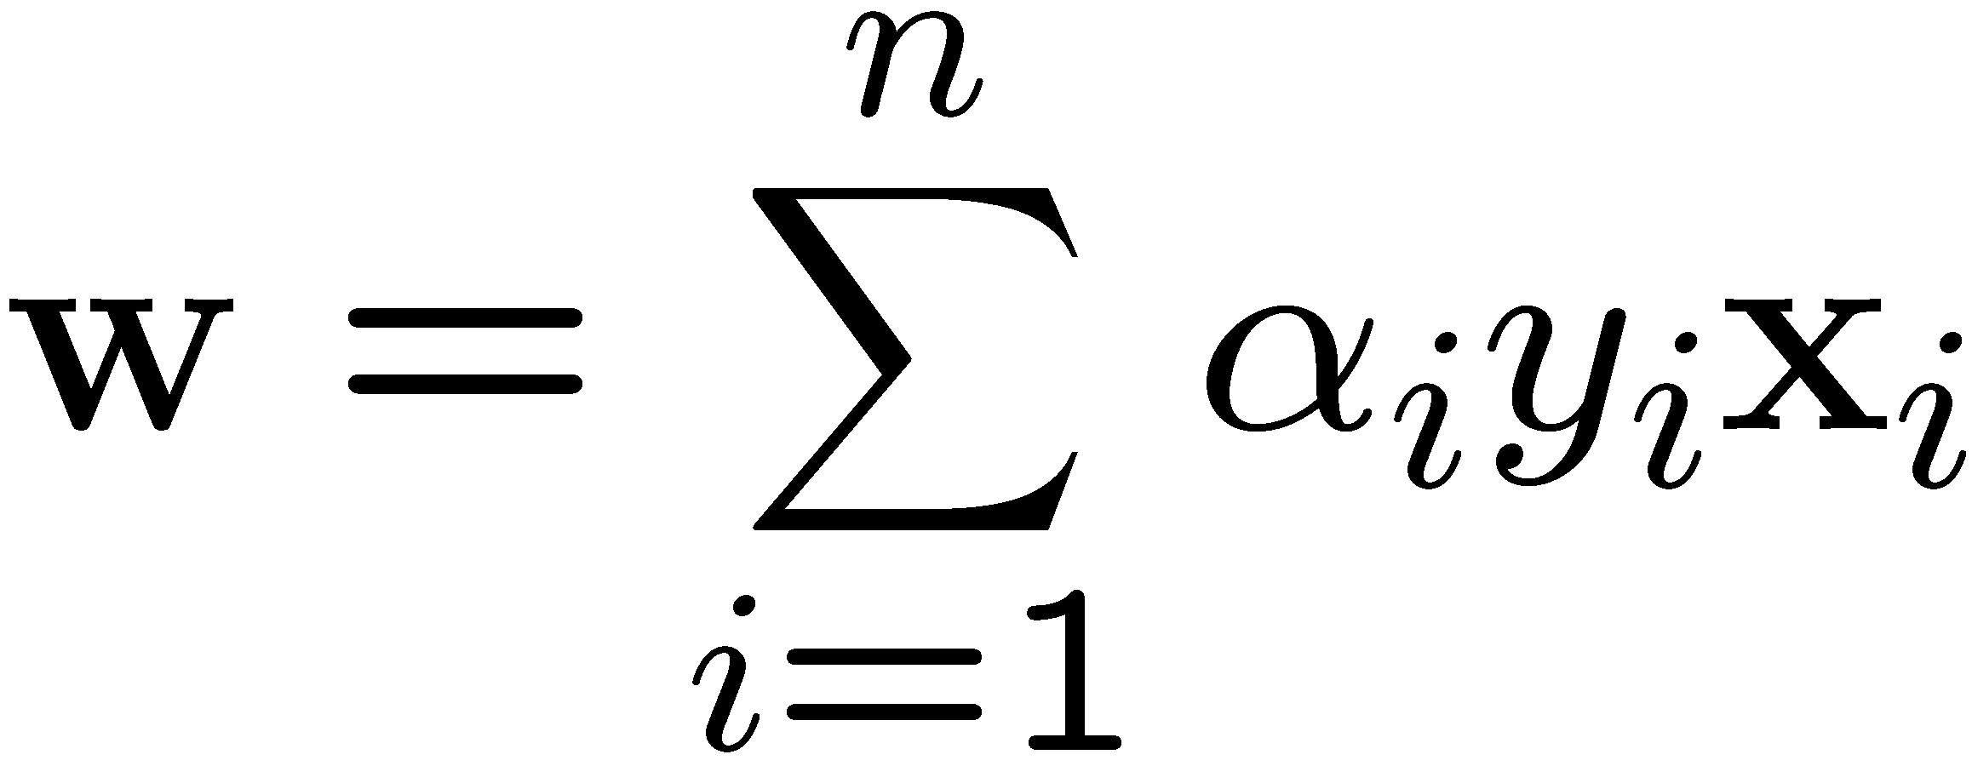
The Dual Optimization Problem
We can transform the problem to its dual
This is a convex quadratic programming (QP) problem
  Global maximum of α_{i} can always be found
  →well established tools for solving this optimization problem (e.g. cplex)
Note:
Dot product of X
α’s → New variables
(Lagrangian multipliers)
Notes:
Let x(1) and x(-1) be two S.V.
Then b = -1/2( w^T x(1) + w^T x(-1) )

Slide 9
A Geometrical Interpretation
Class 2
Support vectors
→α’s with values
different from zero
(they hold up the
separating plane)!
α₁₀=0
α₈=0.6
α₇=0
α₂=0
α₅=0
α₁=0.8
α₄=0
α₆=1.4
α₉=0
α₃=0
Class 1
Notes:
So, if change internal points, no effect on the decision boundary

Slide 10

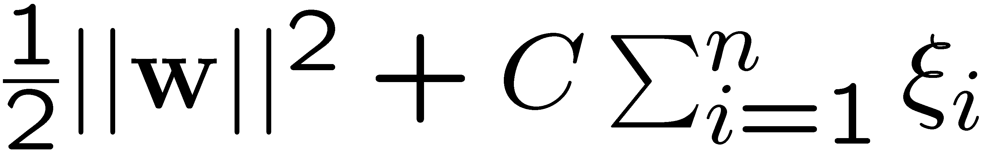
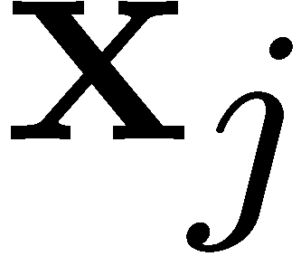
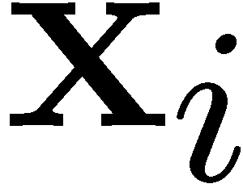

Non-linearly Separable Problems
We allow “error” ξ_{i} in classification; it is based on the output of the discriminant function w^{T}x+b
ξ_{i} approximates the number of misclassified samples
New objective function:
Class 2
  C : tradeoff parameter between
  error and margin;
  chosen by the user;
  large C means a higher
  penalty to errors
Class 1

Slide 11
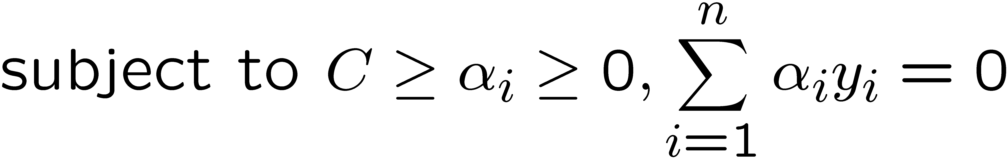
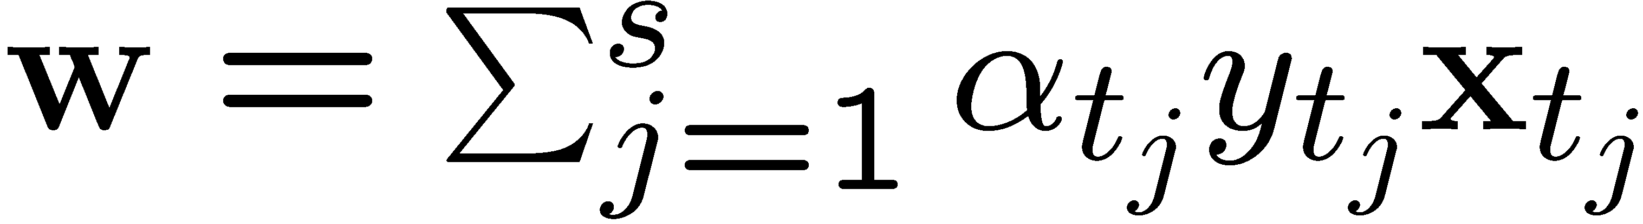
The Optimization Problem
The dual of the problem is
w is also recovered as
The only difference with the linear separable case is that there is an upper bound C on α_{i}
Once again, a QP solver can be used to find α_{i} efficiently!!!
Notes:
Note also, everything is done by inner-products

Slide 12
Extension to Non-linear SVMs
(Kernel Machines)

Slide 13
Non-Linear SVM
How could we generalize this procedure to non-linear data?
Vapnik in 1992 showed that transforming input data x_{i} into a higher dimensional makes the problem easier.
  We know that data appears only as dot products (x_{i∙}x_{j})
  Suppose we transform the data to some (possibly infinite dimensional) space H via a mapping function Φ such that the data appears of the form Φ(x_{i})Φ(x_{j})
Why?
  Linear operation in H is equivalent to non-linear operation in input space.
Similar to Hidden Layers in ANN

Slide 14
Non-linear SVMs: Feature Space
General idea: the original input space (x) can be mapped to some higher-dimensional feature space (φ(x) )where the training set is separable:
x=(x₁,x₂)
√2x₁x₂
φ(x) =(x₁²,x₂²,√2x₁x₂₎
Φ: x → φ(x)
x₂²
x₁²
If data are mapped into higher a space of sufficiently high dimension,
then they will in general be linearly separable;
N data points are in general separable in a space of N-1 dimensions or more!!!
This slide is courtesy of www.iro.umontreal.ca/~pift6080/documents/papers/svm_tutorial.ppt

Slide 15
Transformation to Feature Space
Possible problem of the transformation
  High computation burden due to high-dimensionality and hard to get a good estimate
SVM solves these two issues simultaneously
  “Kernel tricks” for efficient computation
  Minimize ||w||² can lead to a “good” classifier
φ( )
φ( )
φ( )
φ( )
φ( )
φ(.)
φ( )
φ( )
φ( )
φ( )
φ( )
φ( )
φ( )
φ( )
φ( )
φ( )
φ( )
φ( )
φ( )
Input space
Feature space

Slide 16
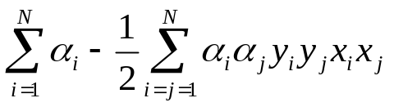
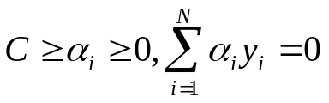

Kernel Trick ☺
Note that data only appears as dot products
Recall:
maximize
subject to
Since data is only represented as dot products, we need not do the mapping explicitly.
Introduce a Kernel Function (*) K such that:
(*)Kernel function – a function that can be applied to pairs of input data to evaluate dot products
in some corresponding feature space

Slide 17
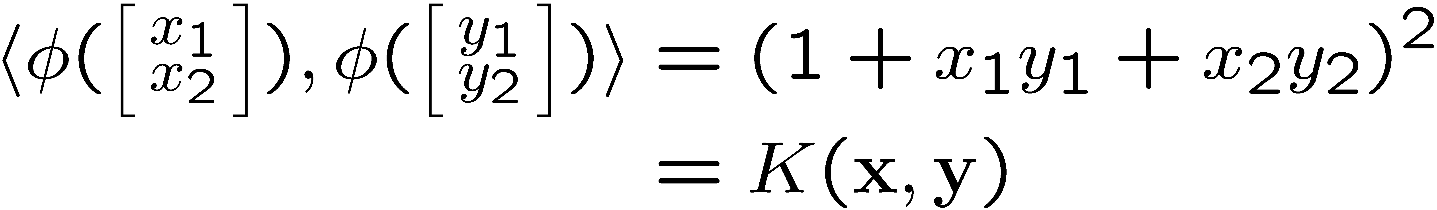
Example Transformation
Consider the following transformation
Define the kernel function K (x,y) as
The inner product φ(.)φ(.) can be computed by K without going through the map φ(.) explicitly!!!

Slide 18
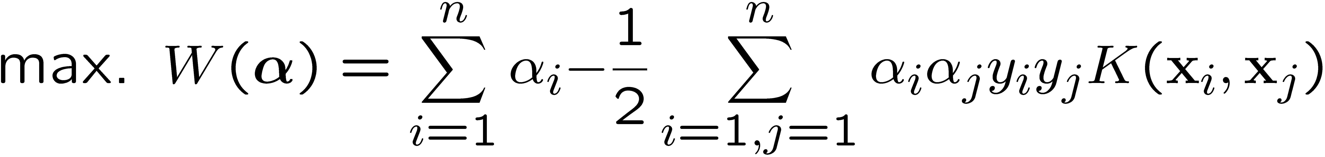
Modification Due to Kernel Function
Change all inner products to kernel functions
For training,
Original
With kernel function

Slide 19
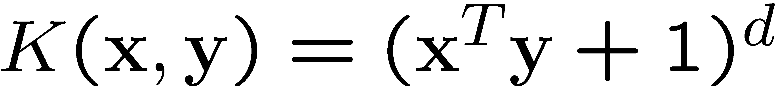
Examples of Kernel Functions
Polynomial kernel with degree d
Radial basis function kernel with width σ
  Closely related to radial basis function neural networks
Sigmoid with parameter κ and θ
  It does not satisfy the Mercer condition on all κ and θ
Research on different kernel functions in different applications is very active
Notes:
Despite violating Mercer condition, the sigmoid kernel function can still work

Slide 20
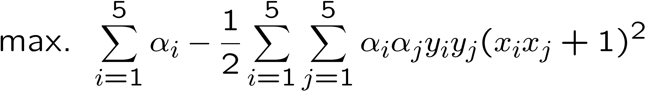
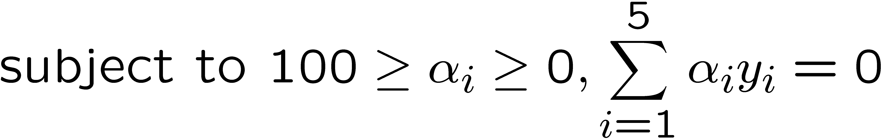
Example
Suppose we have 5 1D data points
  x₁=1, x₂=2, x₃=4, x₄=5, x₅=6, with 1, 2, 6 as class 1 and 4, 5 as class 2 ⇒ y₁=1, y₂=1, y₃=-1, y₄=-1, y₅=1
We use the polynomial kernel of degree 2
  K(x,y) = (xy+1)²
  C is set to 100
We first find α_{i} (i=1, …, 5) by
Notes:
H =
4 9 -25 -36 49
9 25 -81 -121 169
-25 -81 289 441 -625
-36 -121 441 676 -961
49 169 -625 -961 1369

Slide 21
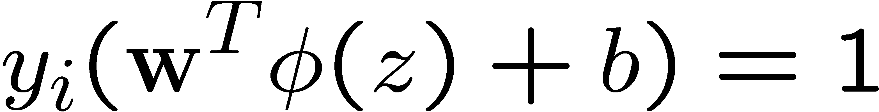
Example
By using a QP solver, we get
  α₁=0, α₂=2.5, α₃=0, α₄=7.333, α₅=4.833
  Verify (at home) that the constraints are indeed satisfied
  The support vectors are {x₂=2, x₄=5, x₅=6}
The discriminant function is
b is recovered by solving f(2)=1 or by f(5)=-1 or by f(6)=1, as x₂, x₄, x₅ lie on and all give b=9
Notes:
The optimization toolbox of matlab contains a quadratic programming solver

Slide 22
Example
Value of discriminant function
class 1
class 2
class 1
1
2
4
5
6

Slide 23
Choosing the Kernel Function
Probably the most tricky part of using SVM.
The kernel function is important because it creates the kernel matrix, which summarizes all the data
Many principles have been proposed (diffusion kernel, Fisher kernel, string kernel, …)
There is even research to estimate the kernel matrix from available information
In practice, a low degree polynomial kernel or RBF kernel with a reasonable width is a good initial try
Note that SVM with RBF kernel is closely related to RBF neural networks, with the centers of the radial basis functions automatically chosen for SVM

Slide 24
Software
A list of SVM implementation can be found at http://www.kernel-machines.org/software.html
Some implementation (such as LIBSVM) can handle multi-class classification
SVMLight is among one of the earliest implementation of SVM
Several Matlab toolboxes for SVM are also available

Slide 25
Recap of Steps in SVM
Prepare data matrix {(x_{i},y_{i})}
Select a Kernel function
Select the error parameter C
“Train” the system (to find all α_{i})
New data can be classified using α_{i} and Support Vectors

Slide 26
Summary
Weaknesses
  Training (and Testing) is quite slow compared to ANN
    Because of Constrained Quadratic Programming
  Essentially a binary classifier
    However, there are some tricks to evade this.
  Very sensitive to noise
    A few off data points can completely throw off the algorithm
  Biggest Drawback: The choice of Kernel function.
    There is no “set-in-stone” theory for choosing a kernel function for any given problem (still in research...)
    Once a kernel function is chosen, there is only ONE modifiable parameter, the error penalty C.

Slide 27
Summary
Strengths
  Training is relatively easy
    We don’t have to deal with local minimum like in ANN
    SVM solution is always global and unique (check “Burges” paper for proof and justification).
  Unlike ANN, doesn’t suffer from “curse of dimensionality”.
    How? Why? We have infinite dimensions?!
    Maximum Margin Constraint: DOT-PRODUCTS!
  Less prone to overfitting
  Simple, easy to understand geometric interpretation.
    No large networks to mess around with.

Slide 28
Applications of SVMs
Bioinformatics
Machine Vision
Text Categorization
Ranking (e.g., Google searches)
Handwritten Character Recognition
Time series analysis
→Lots of very successful applications!!!
Prof. Throsten Joachims

Slide 29
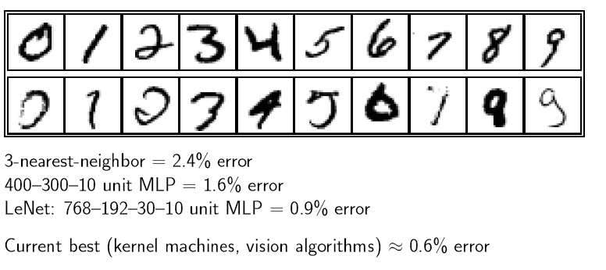
Handwritten digit recognition

Slide 30
References
Burges, C. “A Tutorial on Support Vector Machines for Pattern Recognition.” Bell Labs. 1998
Law, Martin. “A Simple Introduction to Support Vector Machines.” Michigan State University. 2006
Prabhakar, K. “An Introduction to Support Vector Machines”

Slide 31
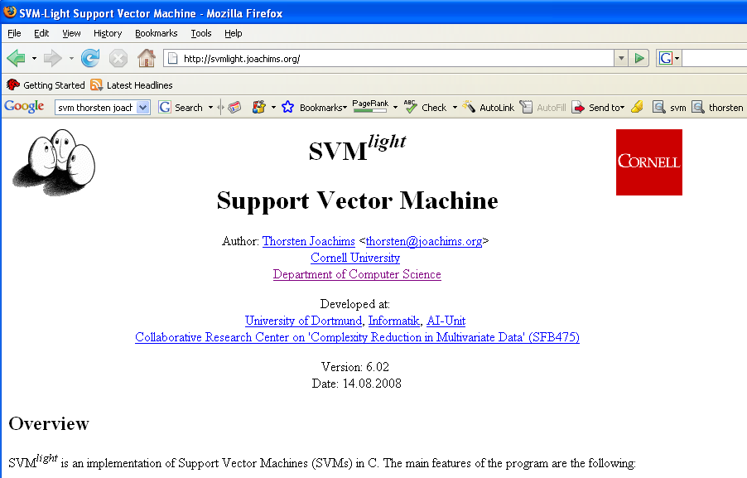
Resources
http://www.kernel-machines.org
http://www.support-vector.net/
http://www.support-vector.net/icml-tutorial.pdf
http://www.kernel-machines.org/papers/tutorial-nips.ps.gz
http://www.clopinet.com/isabelle/Projects/SVM/applist.html
http://www.cs.cornell.edu/People/tj/
http://svmlight.joachims.org/

