Slide 1
Project 1: Hive Querying by Tanka Gautam

Slide 2
Loading data
hdfs dfs -put /home/tgautam/consumerBev.txt /user/tgautam/
create table consumer_table(bev_name STRING, bev_n INT) row format delimited fields terminated by ',' stored as textfile;
LOAD DATA INPATH 'consumerBev.txt' OVERWRITE INTO TABLE consumer_table;

Slide 3
Technologies Used
HDFS (Hadoop Distributed File System)
Hive
HQL

Slide 4

Scenario 1: Total number of consumer for Branch1
select p.bev_num, sum(c.bev_n) from product p
left join consumer_table c on (p.bev_name = c.bev_name)
group by (p.bev_num) having(p.bev_num = 'Branch1');

Slide 5

Scenario 1: Total number of consumer for Branch2
select p.bev_num, sum(c.bev_n) from product p
left join consumer_table c on (p.bev_name = c.bev_name)
group by (p.bev_num) having(p.bev_num = 'Branch2');

Slide 6

Scenario 2: Most consumed beverage on Branch1
select p.bev_name AS branch1_beverage, sum(c.bev_n) AS most_consumed
from product p join consumer_table c on(p.bev_name = c.bev_name)
where p.bev_num = 'branch1' group by p.bev_name
order by most_consumed DESC limit 1;

Slide 7

Scenario 2: Least consumed beverage on Branch2
select p.bev_name AS branch2_beverage, sum(c.bev_n) AS least_consumed
from product p join consumer_table c on(p.bev_name = c.bev_name)
where p.bev_num = 'branch2' group by p.bev_name
order by least_consumed DESC limit 1;

Slide 8
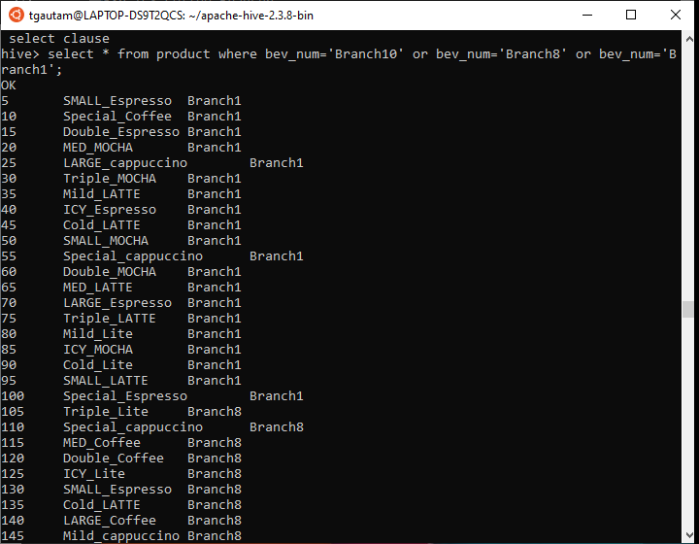
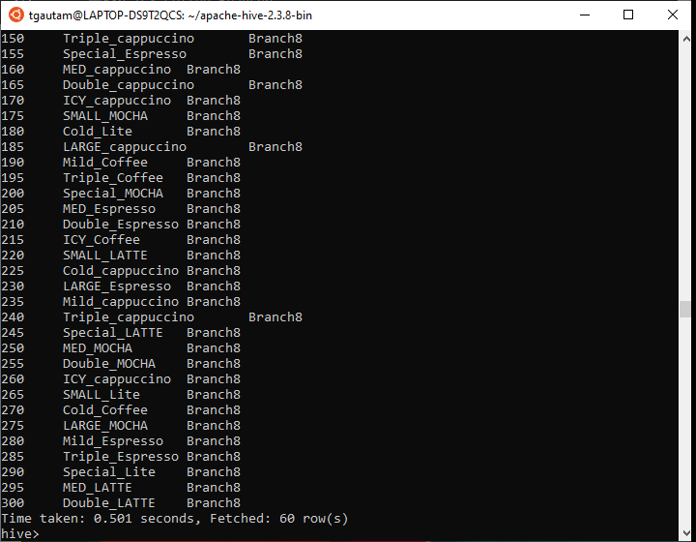
Scenario 3: Beverages available on Branch10, Branch8, and Branch1

Slide 9
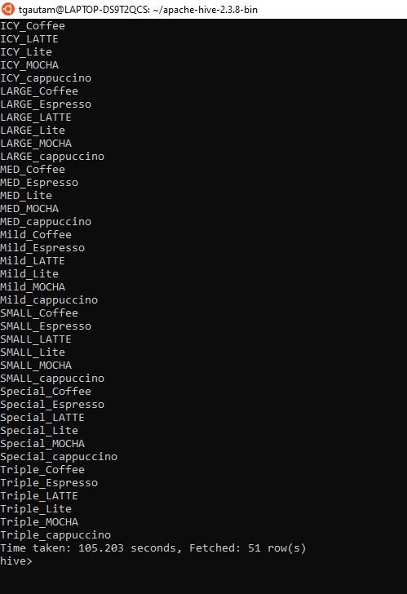
Scenario 3: Common beverages available in Branch4, Branch7
Select bev_name from product where bev_num = ‘Branch4’ INTERSECT (select bev_name from product where bev_num = ‘Branch7’);

Slide 10
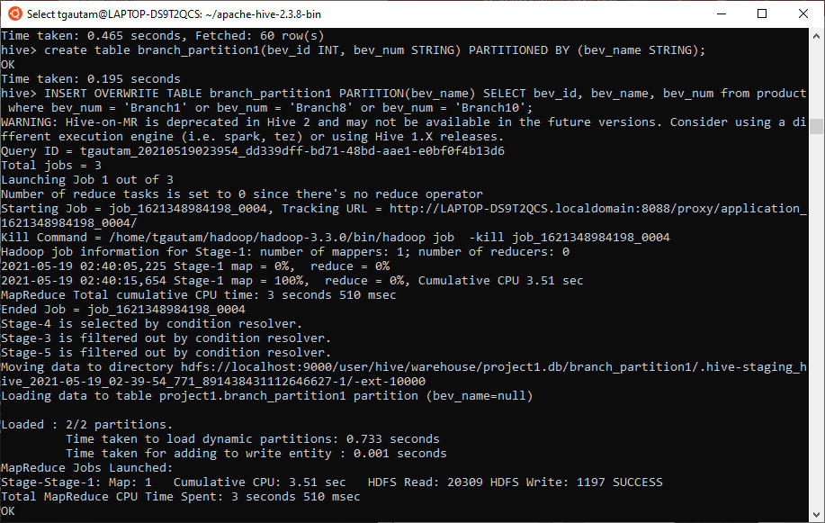
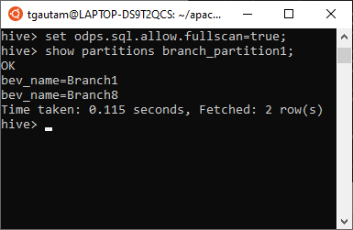
Scenario 4: Partition for Scenario 3

Slide 11
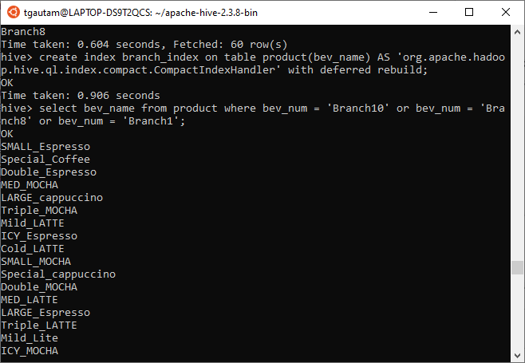
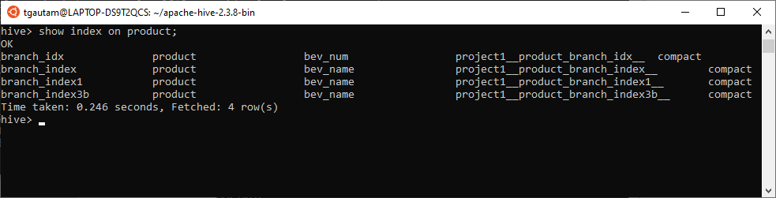
Scenario 4: Index for Scenario 3

Slide 12
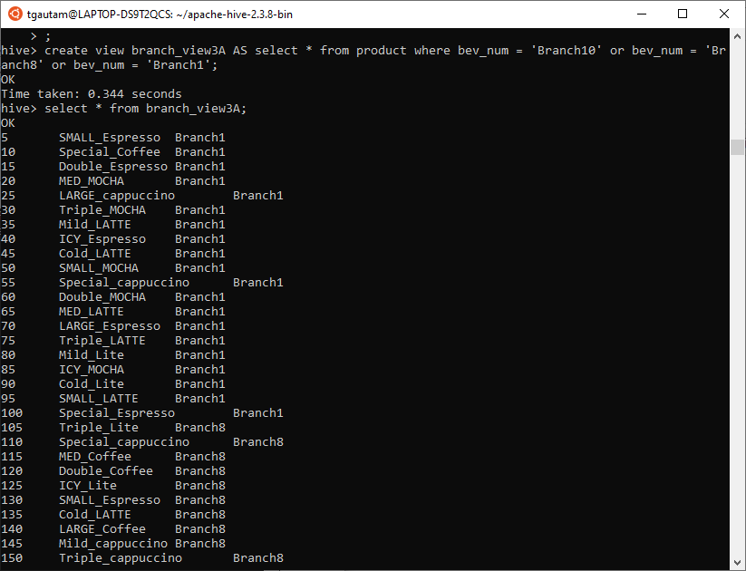
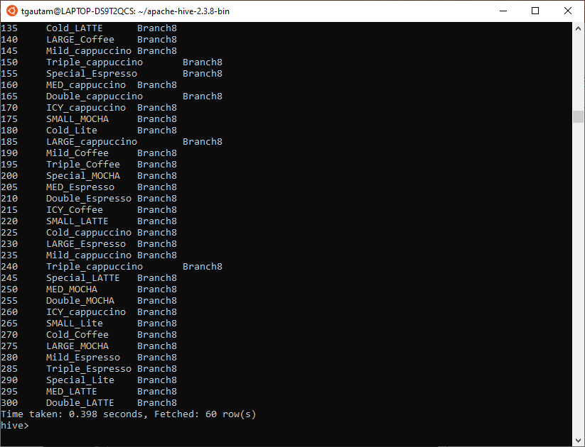
Scenario 4: View for Scenario 3

Slide 13
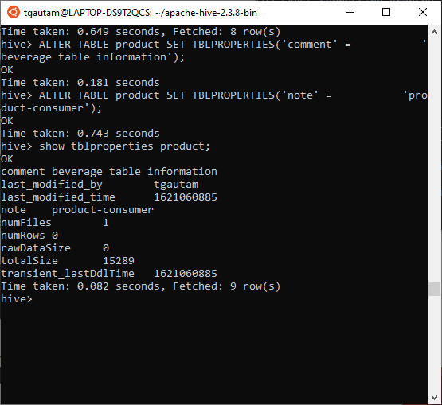
Scenario 5: Alter table properties to add “note” and “comment”

Slide 14
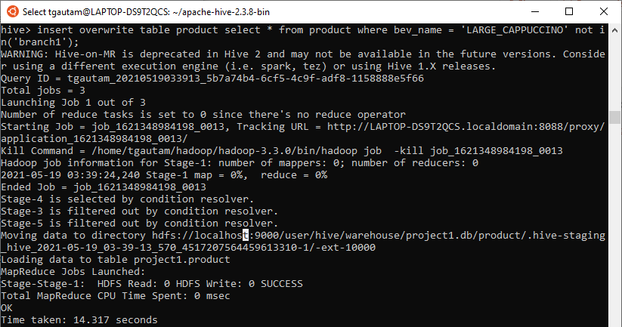
Scenario 5: Remove row 5 from output of Scenario 1

Slide 15
Thank you

