Slide 1
Dense Layers of VGG16
The VGG16 CNN model has 3 Dense layers namely 'fc1' with 4096 neurons and 102764544 parameters, 'fc2' with $4096$ neurons and 16781312 parameters, and 'predictions' with 1000 classes and 4097000 parameters.
These Fully-Connected layers follow a stack of convolutional layers: the first two have 4096 channels each, the third performs 1000-way ILSVRC classification and thus contains 1000 channels (one for each class). The final layer is the soft-max layer.

Slide 2
Visualization of Features in Dense Layers
We tried to visualize the features that were given the highest priority at these 3 dense layers.
We have selected 3 Categories from the VGG16 model, namely, 'Great White Shark', 'Bald Eagle' and 'Assault Rifle'.
We used Activation Maximization method to visualize what a class in your trained model looks like by inverting the process of training in a Neural Network model. It keeps the weights and the desired output constant and modifies the input such that it maximizes certain neurons.

Slide 3
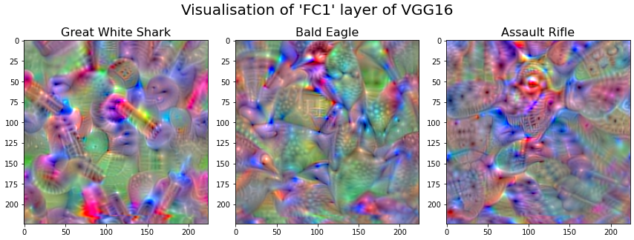
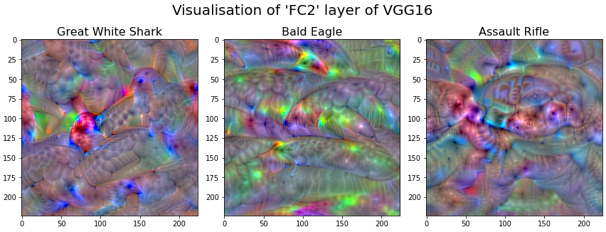
Visualization of ‘FC1’ and ‘FC2’ layers of VGG16

Slide 4
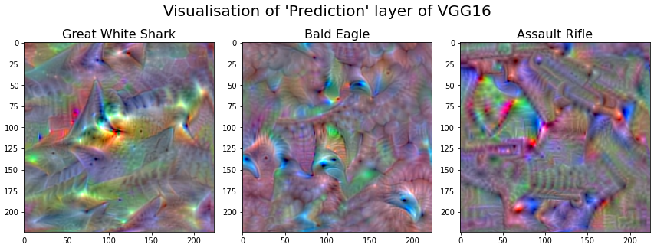
Visualization of ‘Prediction’ layer of VGG16

