Slide 1

Secret Santa
A new app from NetBrutality
Tess Gauthier, Rebecca Rucks, Duncan Silver, and Victor Weiss

Slide 2


Overview
Secret Santa simplifies the gift exchange process for a group of any size
Participants enter their name in a virtual hat
The application randomizes the names and assigns each person a target
Each participant receives an email with the name of their target and the present buying commences!

Slide 3

Main Activity
Home Page
Contact Page
Start Over
Final Page
Meeting Page
Send Emails
Activity Map

Slide 4
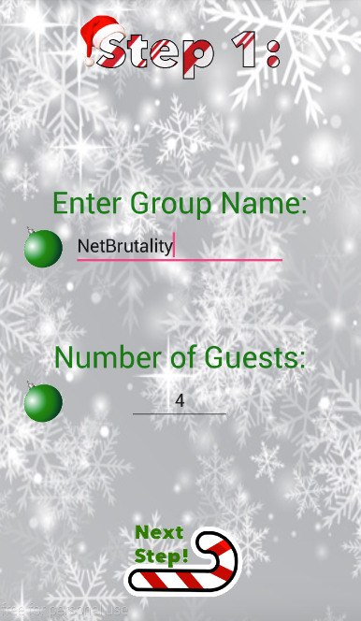
Home Page
String stored in variable
Entered number stored in variable
Sends user to next page

Slide 5
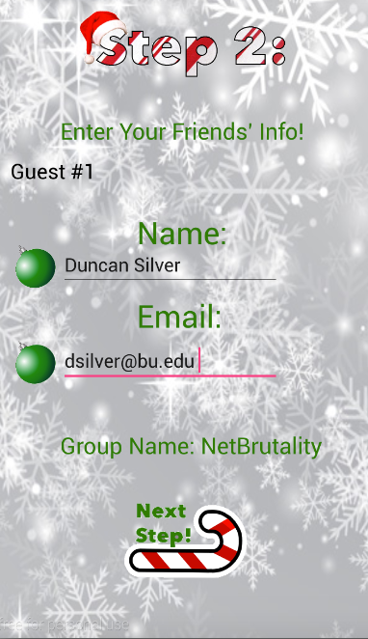
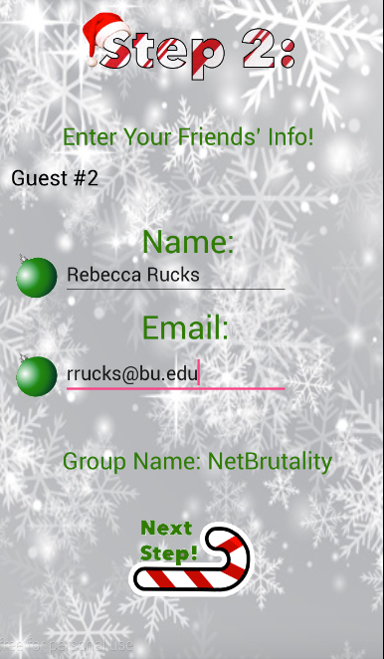
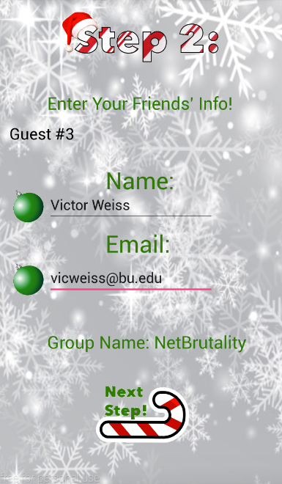
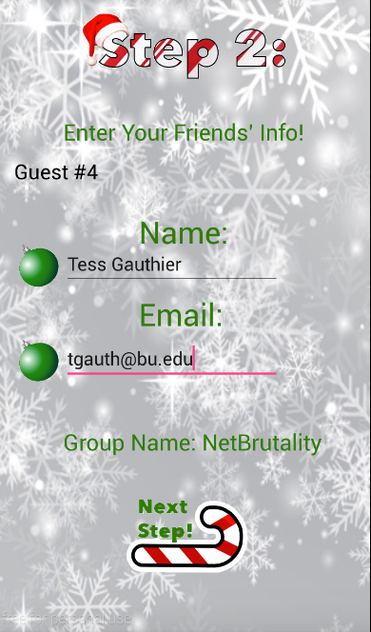
Contact Page
Entered name stored in array
Email stored in the same index of a second array
Number of Guests variable used to repeat process for each contact

Slide 6
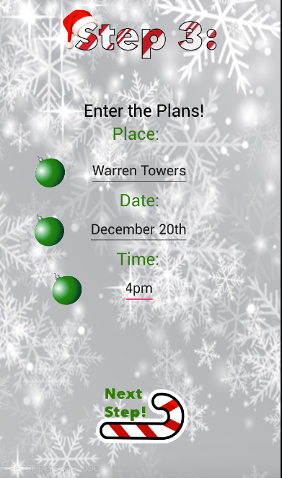
Meeting Page
Page displayed after appropriate number of contact pages
All entered user information stored in variables to be sent out in the email

Slide 7

Back End Overview
App collects information on each person
Stores data in array
Shuffles a random number of names in the matrix
Assigns each person to the next sequential number
Ex: Person 2 gets Person 3, Person 3 gets Person 4
Uses JavaMail API to send emails to each participant
Emails contain their assigned gift recipient as well as the entered data on the location and time of the gift exchange

Slide 8
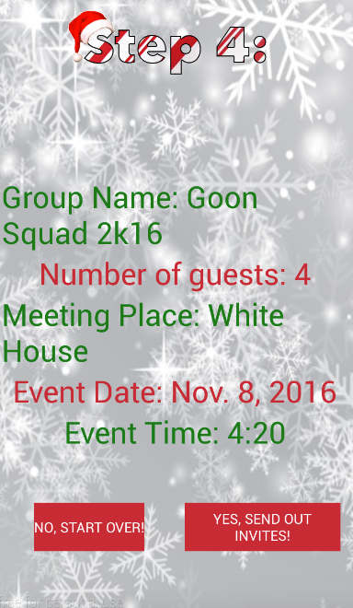
Final Page
Displays all user entered information
If information is incorrect, allows user to return to home page
If everything is correct, sends invites to participants

Slide 9

Happy Holidays!

