Slide 1
CMS – Brief configuration
The Briefs will be a separate menu option in CMS so that we can control the access via the CMS role based access. There will be the following options in the menu
  Create Brief
  View / Edit Brief – Search on Cate/Sub Cate / creation date/Metadata
    Brief wise information having brief name, release date, viewed by , viewed on , assessment score
  Approve Brief
  Publish Brief
  Add to question bank
    Add question (should be able to enter multiple questions manually(
    Upload questions
  Create master data
    Create brief category & sub-category
    Add work schedule
    Add distribution method
    Add distribution type (flat, progressive)

Slide 2
CMS – Brief status state transition
State | Description | Edit | User assignment
Draft | The brief has been entered and saved but not approved | Yes | Yes
Approved | The brief has been approved | Yes | Yes
Saved | The brief has been approved and the users assigned | Yes | Modify users assigned
Scheduled | The brief has been scheduled to be published at a specific date and time | Yes | Yes
Published | The brief has been published for the users to access | No | No
Add a brief distribution type for normal distribution and lieter distribution of briefs .. Phase 2

Slide 3

CMS – Brief configuration
Create Brief
Category:
List of category
Sub -Category:
List of sub- category
Expiry Date:
Phase 2: Video/ppt/pdf/image/lURL/skillmuni content/ assessment
Enter brief (Rich Text option for adding image, video upload / video link and audio)
Add Resources
Add Metadata
Phase 2: Create Question directly and add to brief
Ove-ride DND
Y/N
Add Questions
Y/N
Number: 5
Distribution method
List of methods
If Add Question = Y
Add Question
Category:
List of category
Sub -Category:
List of sub- category
Metadata :
Question / Expiry date | Cat / Sub Cat | View Ans | Complexity | Answered % | Add
What are the leadership styles (27-Dec-2018) | Leadership / Styles | Pop up with ans | Medium | 63%
What are the Leadership approaches (31-Dec-2018) | Leadership/ Styles | Pop up with ans | High | 27%
Expiry date should be less than brief expiry
Save

Slide 4

CMS – View Edit Brief - summary
View / Edit Brief
Category:
List of category
Sub -Category:
List of sub- category
Metadata:
If scheduled , then we should display the expected schedule details
Brief | Cat / Sub Cat | Expiry Date | Status | responses | Edit
leadership styles | Leadership / Styles | 31-oct-2018 | Published 29-Jun-2018 | 71
What are the Leadership approaches (31-Dec-2018) | Leadership/ Styles | 21-nov-2018 | Draft / Scheduled
Metadata
Linked Questions
Resources
Display the creation screen with data populated
Metadata
Linked Questions
Resources
Response Information – Leardership styles (based on the brief selected above and if published)
Summary
Detail
Organisation and team summary on Assessment scores and % split of easy medium and hard questions answered

Slide 5
CMS – View Edit Brief - details
View / Edit Brief
Category:
List of category
Sub -Category:
List of sub- category
Metadata:
If scheduled , then we should display the expected schedule details
Brief | Cat / Sub Cat | Expiry Date | Status | responses | Edit
leadership styles | Leadership / Styles | 31-oct-2018 | Published 29-Jun-2018 | 71
What are the Leadership approaches (31-Dec-2018) | Leadership/ Styles | 21-nov-2018 | Draft / Scheduled
Metadata
Linked Questions
Resources
Display the creation screen with data populated
Metadata
Linked Questions
Resources
Response Information – Leardership styles (based on the brief selected above and if published)
Summary
Detail
User name / Reporting Manager | Completed Date | Score
Ajay ( Deepak ) | 22-sep-2018 | 75%
Mohit (Deepak) | 01-nov-2018 | 91 %
Result Details
Display the question wise information
Result Details

Slide 6


CMS – Publish brief
Assign Users / Publish Brief
Category:
List of category
Sub -Category:
List of sub- category
Metadata:
Brief | Cat / Sub Cat | Expiry Date | Status
leadership styles | Leadership / Styles | 31-oct-2018 | Saved
What are the Leadership approaches (31-Dec-2018) | Leadership/ Styles | 21-nov-2018 | Approved
Display the user assignment screen below
Metadata
Linked Questions
Resources
Modify users
Metadata
Linked Questions
Resources
Assign users
Publish Details - Leardership styles (based on the brief selected above)
Based on the filter the users will be displayed , the admin can select individual or all users (there will be a button to select all users)
All users
Group
Team
Location
Role
users
If schedule is selected, then the admin gets the calendar to schedule the brief
User name / Reporting Manager | Assign
Ajay ( Deepak )
Mohit (Deepak)
Automate the notification so that for every brief a notification goes by default
Schedule
Publish
Add notification

Slide 7

Landing Page – option 1
Briefs
My Dashboard
Dashboard
Latest Brief
Latest Brief
Brief information
Category: Skills
Sub-Category: Excel
Date: 08-Mar18
Expand content
Content Brief to appear here
+
-
Next Brief (greyed if it’s the last brief)
Read:
X
80%
Next Brief (greyed if it’s the first brief)
Read checkbox
Assessment + score if completed

Slide 8

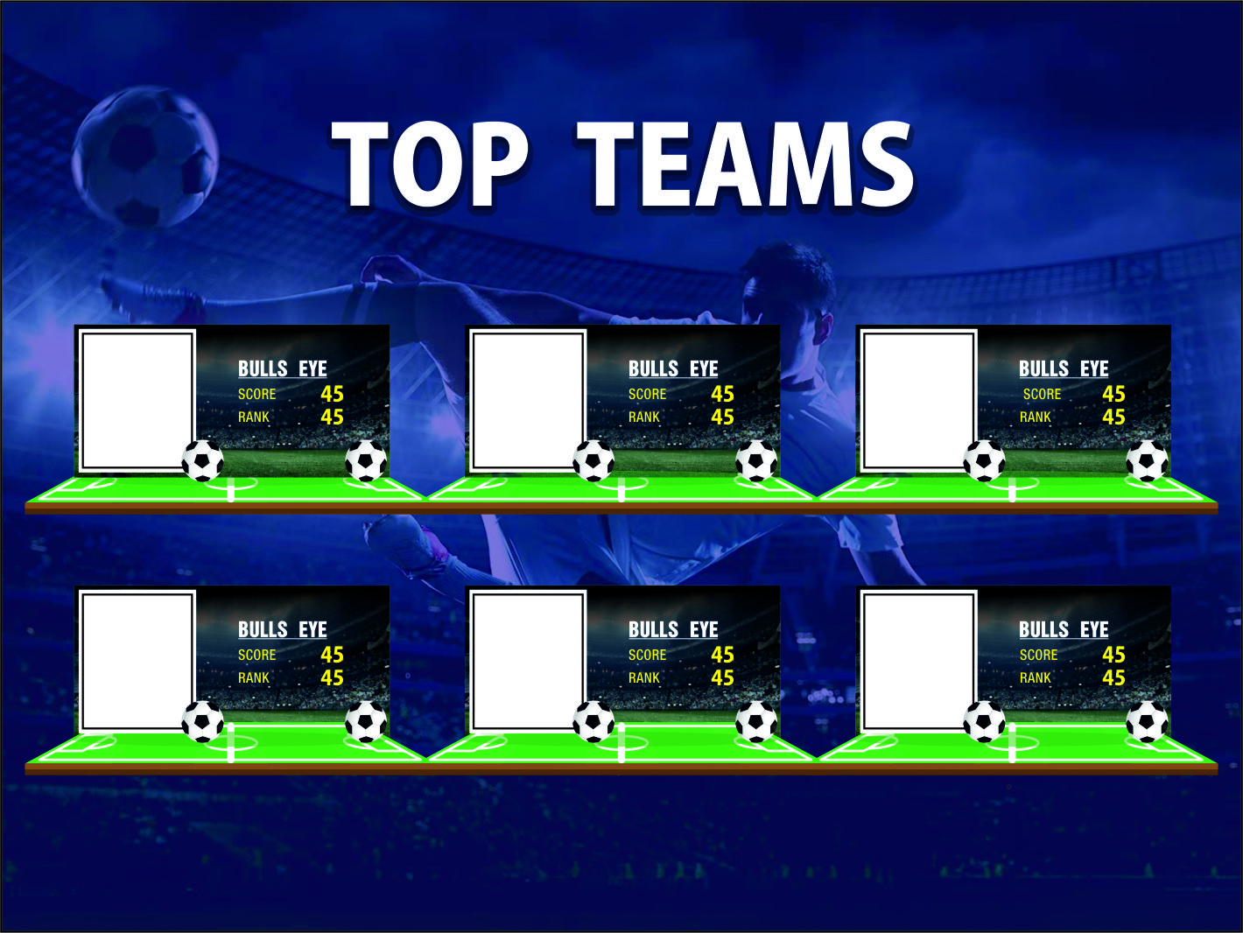

Background is theme specific
Add a hamburger menu. There will be an option for the user to select for DND
Landing Page option 2
Brief information
My Dashboard
New Brieffs
Unread Brieffs
Category: Skills
Sub-Category: Excel
Date: 08-Mar18
Collapse to briefs
Content Brief to appear here
+
Expand to dashboards
Game Dashboard
Overall
Group
Flip for assessment
-
Read:
X
80%

Slide 9

Assessment Questions
Briefs
Dashboard
My Dashboard
Brief information
Category: Skills
Sub-Category: Excel
Date: 08-Mar18
Content Brief to appear here
+
Assessment
Q. 1 – What is the colour of the sky ?
-
Blue
Green
White
Yellow
Q. 2 – What is the colour of the sky ?
-
Blue
Green
White
Yellow
Submit

Slide 10
Assessment Response
Briefs
Dashboard
My Dashboard
Brief information
Category: Skills
Sub-Category: Excel
Date: 08-Mar18
Content Brief to appear here
+
Assessment - Result
Summary
Please copy from Android app
Details
Please copy from Android app. Display the user reponse and if it was right or wrong. For wrong provide the right answer

Slide 11
Check how many question linked to brief
start
User clicks on assessment for the brief
Identify brief linked question
Identify brief linked question
Check any category
Check previous response for this category
Less than 5
No Question found
Identify remaining questions (max 5)
old
Question found
Answered easy question
Answered Medium question
Answered hard question
Yes
Yes
Yes
Identify hard Questions
No
No
No
Identify easy questions
Identify Easy + medium questions
Identify Medium + hard Questions
Create Question Set for the brief
No

Slide 12
Identification of Questions for each brief – Progressive Method
Check how many question linked to brief
start
User clicks on assessment for the brief
Identify brief linked question
Identify category for question depending on number of questions
For each Category
1
Less than X
Identify remaining questions (max defined in brief)
Answered last easy question
Answered last Medium question
Answered last hard question
Yes
Yes
Yes
Identify hard Questions
No
No
No
Identify easy questions
Identify Easy question
Identify Medium question
Yes
Complete set of questions for brief
Completed for each category ?
Add to questions set for brief
No

Slide 13
Identification of Questions for each brief – Progressive Method
Depending on the number of questions to be identified , the number of categories from which questions will be sent will be identified with a max of 4 categories. This will not include the category mapped to the current brief. Given below are examples
The total number of questions linked to the brief is 6 .
  There are 2 directly linked questions hence there are 4 questions to come dynamically.
  There are 7 categories available in the backed (not counting the current brief category). Off these we will randomly select any 4 categories .
  From each category identify 1 questions based on the easy, medium logic in the workflow.
The total number of questions linked to the brief is 5
  There are 0 directly linked questions hence there are 5 questions to come dynamically.
  There are 3 categories available in the backed (not counting the current brief category).
  In such a case 2 questions each will come from 2 categories and 1 questions will come from the 3rd category using the easy, medium and hard logic

Slide 14
Gamification
Once the organisation is created in skillmuni , the data needs to be integrated with the Coroebus organisation
Once the users have been uploaded / modified in Skillmuni the data needs to be integrated with the Coroebus user data. We need to decide which user db will be the master
Game configuration
There will be a new theme type called “Skillmuni Briefs”
Two themes will be created
  SKB-football (all skillmuni briefs themes will have the prefix SKB)
  SKB Theme
The game metrics for the themes are as under
The KPI are Assessment % , # of question answered , Easy Question Answered, medium Question Answered , Hard Question Answered
The game period will be defined in Coroebus. Data will be mapped based on the game dates. For displaying on the user frontend , the game active at that point in time will be taken. For any user there can be only 1 active game.
The game config along with all the other configuration will be done in Coroebus as per the existing process
Theme Name | Metric | Badge
SKB – Football | Goals Scored | Sharp Stopper
 |  | Stunning Striker
 |  | Daring Defender
SKB – Theme | Points | TBD

Slide 15
Gamification
Dashboards
The Following dashboards will be there
Overall DB
Team – Top 6 Teams
Top Player – (daily , weekly monthly)
Badge Winners (3 badges)
This will be replicated for groups
Others
Player Dashboard
  We have a table with all the teams list (copy from IPL)
Captain Dashboard
  We have a table with all the teams list
Data integration between skillmuni B and Coroebus
The following information will be extracted from skillmuni B
  For each brief Overall Assessment score %
  For each brief questions wise answer to identify correctness and complexity of the question answered

Slide 16
Gamification
Calculation for score Option 1 (for launch)
We want to give different scores depending on the complexity of the question. There will be a cumulative score for each brief depending on how the questions of each complexity was answered . Here the calculation of the cumulative score for the brief will be done in the interface as post processing from skillmuni
We need to keep a mapping table to derive the question answered scores based on complexity
For each question we will calculate the score based on the complexity of the questions from the mapping table.
For eg There are 3 questions and the following is the matrix calculation
User code | Brief Name | Question No | Complexity | Right/Wrong | Score
1 | B1 | Q1 | Easy | Right | 10
1 | B1 | Q2 | Easy | Wrong | 0
1 | B1 | Q3 | Medium | Right | 20
Complexity | Score
Easy | 10
Medium | 20
Hard | 30
The KPI-Measure mapping will be ranged based i.e
0 – 30 = 0 goals
31-60 = 1 goals
> 60 = 3 goals
Brief 1 Score = 10+0+20 = 30 = 0 goals
Brief 2 score = 10+0+30 = 40 = 1 goal
User code | Brief Name | Question No | Complexity | Right/Wrong | Score
1 | B2 | Q1 | Easy | Right | 10
1 | B2 | Q2 | Medium | Wrong | 0
1 | B2 | Q3 | Hard | Right | 30

Slide 17
Gamification
Calculation for score Option 2(Phase 2)
We want to give different scores depending on the complexity of the question. We treat each question complexity as a KPI
For eg There are 3 questions and the following is the matrix calculation
User code | Brief Name | Question No | Complexity | Right/Wrong
1 | B1 | Q1 | Easy | Right
1 | B1 | Q2 | Easy | Wrong
1 | B1 | Q3 | Medium | Right
The KPI-Measure mapping will be based on right or wrong answer i.e
Answered easy = 1 goal
Answered medium = 2 goals
Answered hard = 4 gaols
Brief 1 – 1+0+2 = 3 goals
Brief 2 - 1+0+4 = 5 goals
User code | Brief Name | Question No | Complexity | Right/Wrong
1 | B2 | Q1 | Easy | Right
1 | B2 | Q2 | Medium | Wrong
1 | B2 | Q3 | Hard | Right
Config in Skilmuni Briefs
As part of the skillmuni briefs configuration or the game configuration in Coroebus, we need to be to define as to which option has been chosen for the game.

