Slide 1
Post-CRT Segmentation Paper Figures

Slide 2
81 patients with post-treatment imaging obtained at University Hospitals and The Cleveland Clinic
Training and Internal Validation (n = 44)
Acquired in axial plane
Rectal Gel
Annotated by 1 radiologist
Holdout Testing Cohort (n = 20)
ROIs were independently annotated by two radiologists
4 only coronal view available
Excluded Cohort (n = 17)
8 only coronal view available
6 without rectal gel or too much stool in imaging
3 poor quality imaging

Slide 3
CCF
(n = 30)
UHCMC
(n = 51)
VAMC
(n = 16)
Assessment for eligibility
Availability of post-treatment T2w MRI
Availability of at least one expert annotation
Exclusion Criteria
Only coronal view available (n = 8)
Post-treatment imaging acquired without rectal gel or with too much stool (n=6)
Poor image quality (n = 3)
Data following eligibility inclusion-exclusion criteria (n = 44 + 20 + 16)
Training and Internal Validation Cohort
(n = 44)
Holdout Testing Cohort
(n = 53)
Holdout Testing Cohort (n = 20)
ROIs were independently annotated by two radiologists
4 only coronal view available
VAMC Cohort (n = 16)
All patients from VAMC
Excluded Cohort (n = 17)
Patients that met exclusion criteria

Slide 4
CCF
(n = 30)
UHCMC
(n = 51)
VAMC
(n = 16)
Assessment for eligibility
Availability of post-treatment T2w MRI
Availability of at least one expert annotation
Exclusion Criteria
Only coronal view available (n = 8)
Post-treatment imaging acquired without rectal gel or with too much stool (n=6)
Poor image quality (n = 3)
Data following eligibility inclusion-exclusion criteria (n = 44 + 20 + 16)
Training and Internal Validation Cohort
(n = 44)
Holdout Testing Cohort (n = 20)
ROIs were independently annotated by two radiologists
4 only coronal view available
VAMC Cohort (n = 16)
All patients from VAMC
Excluded Cohort (n = 17)
Patients that met exclusion criteria

Slide 5
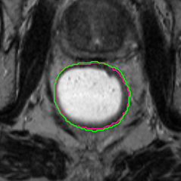
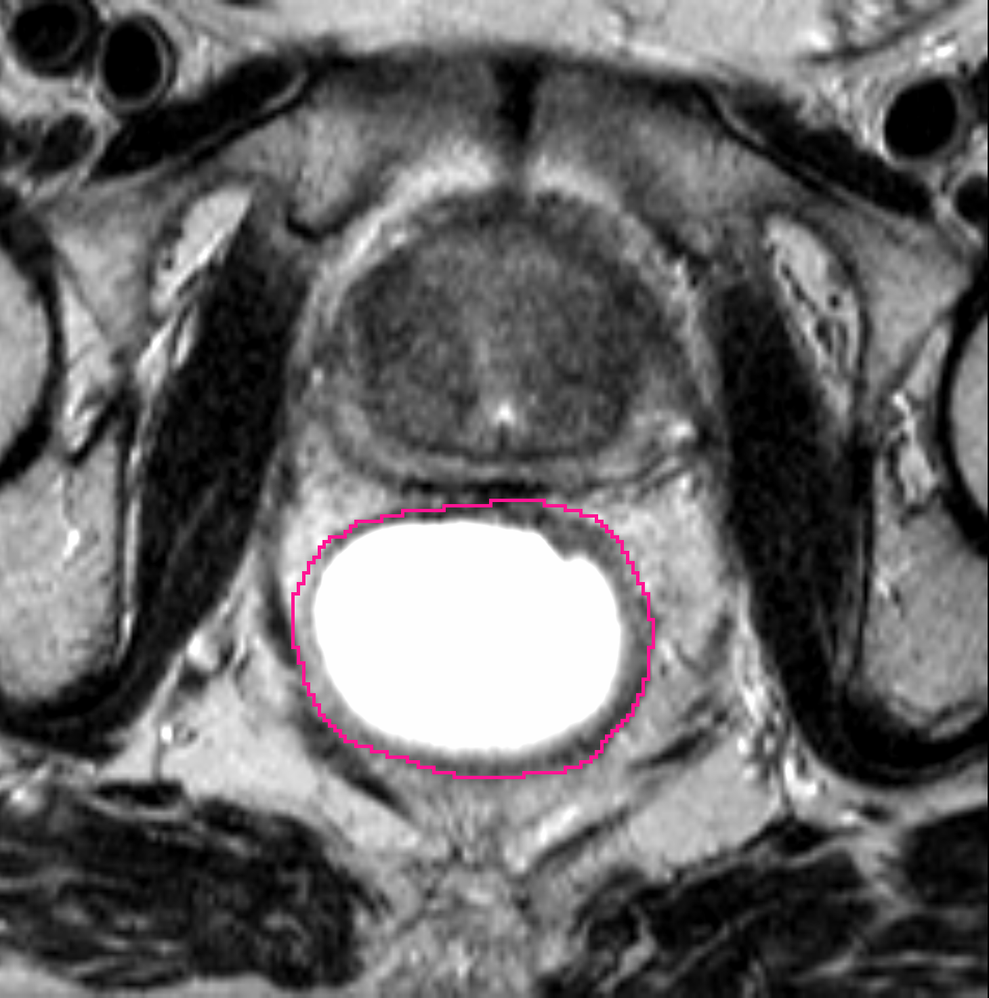
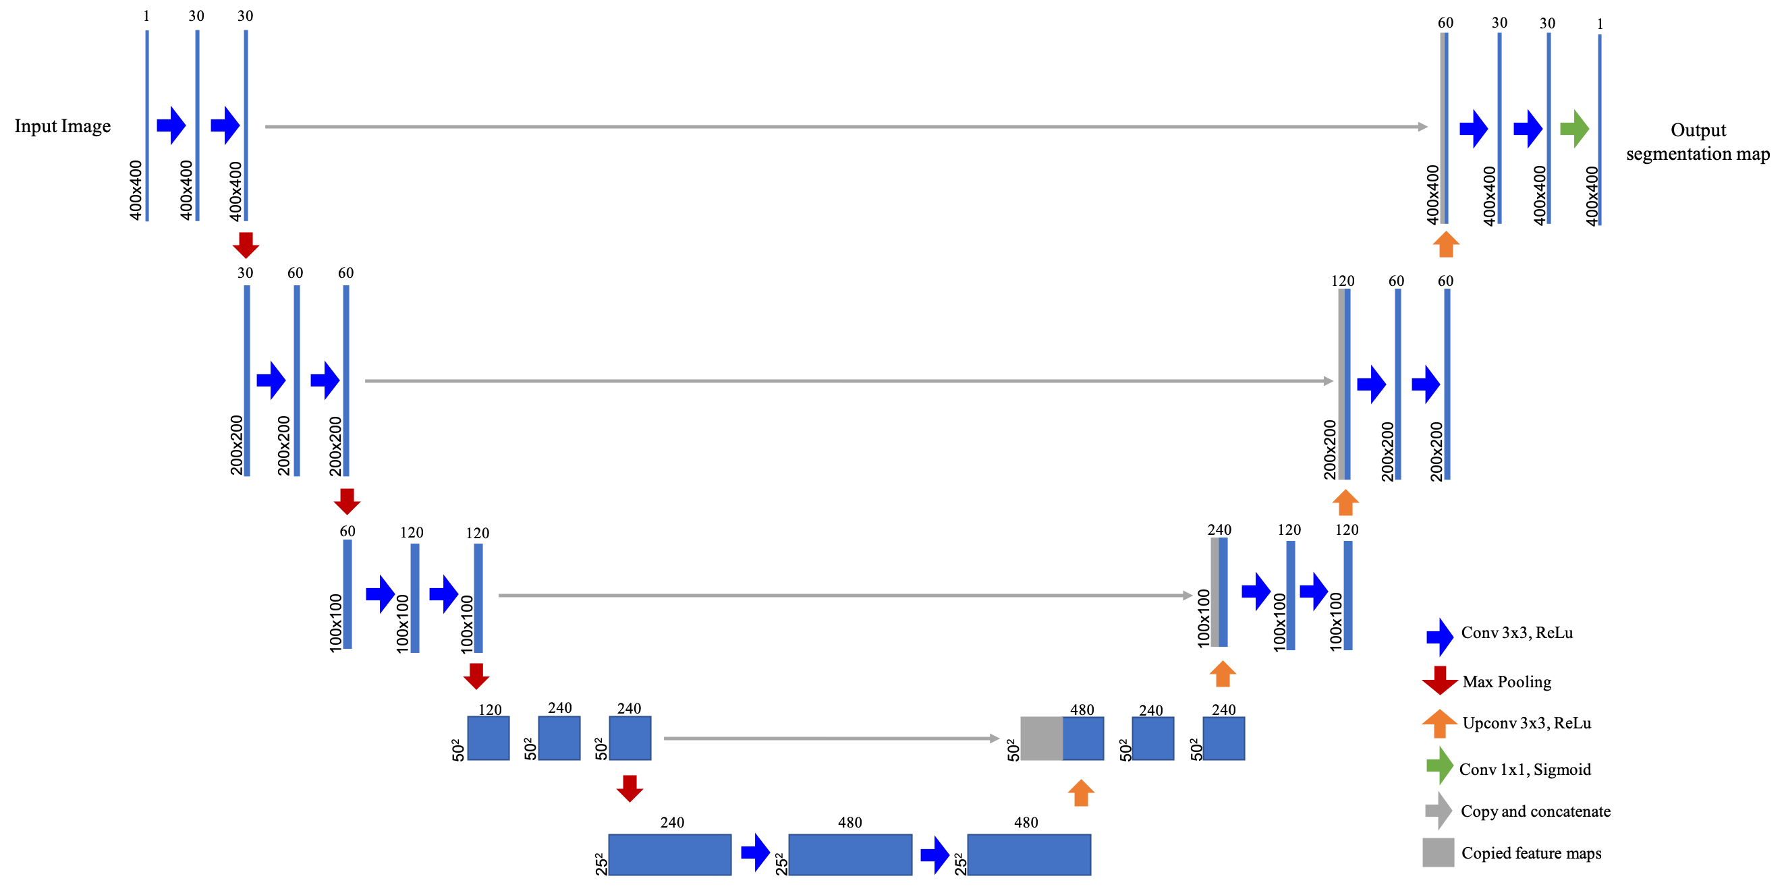
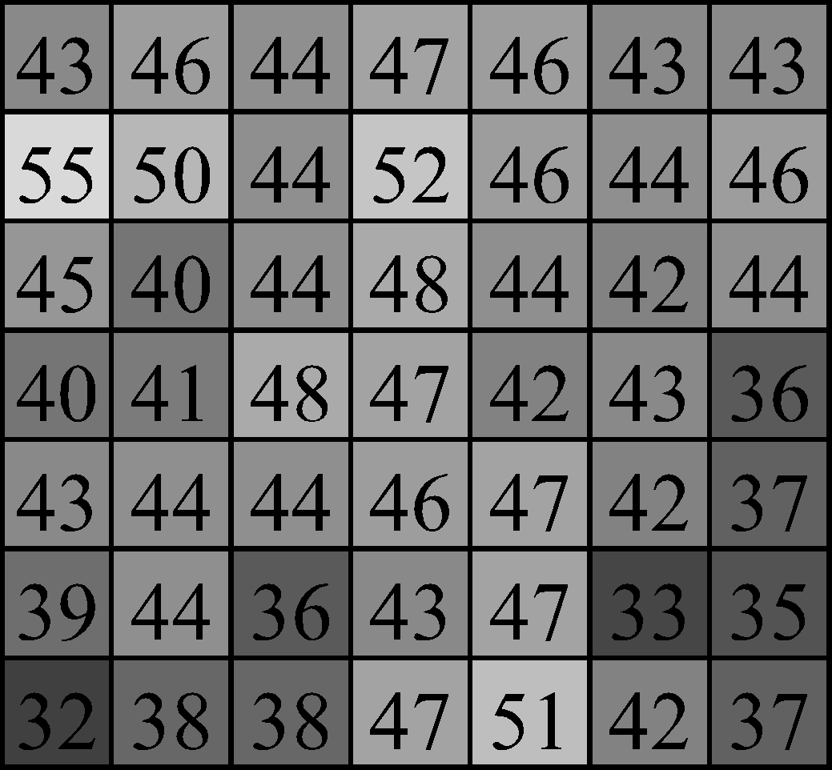
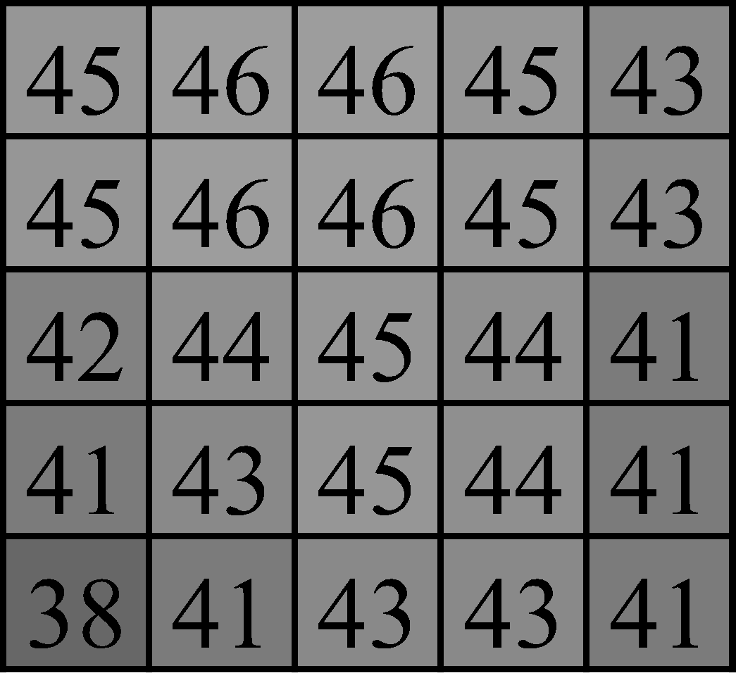
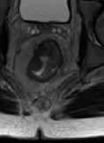
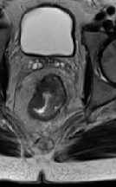
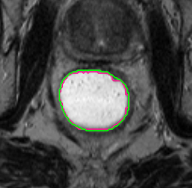
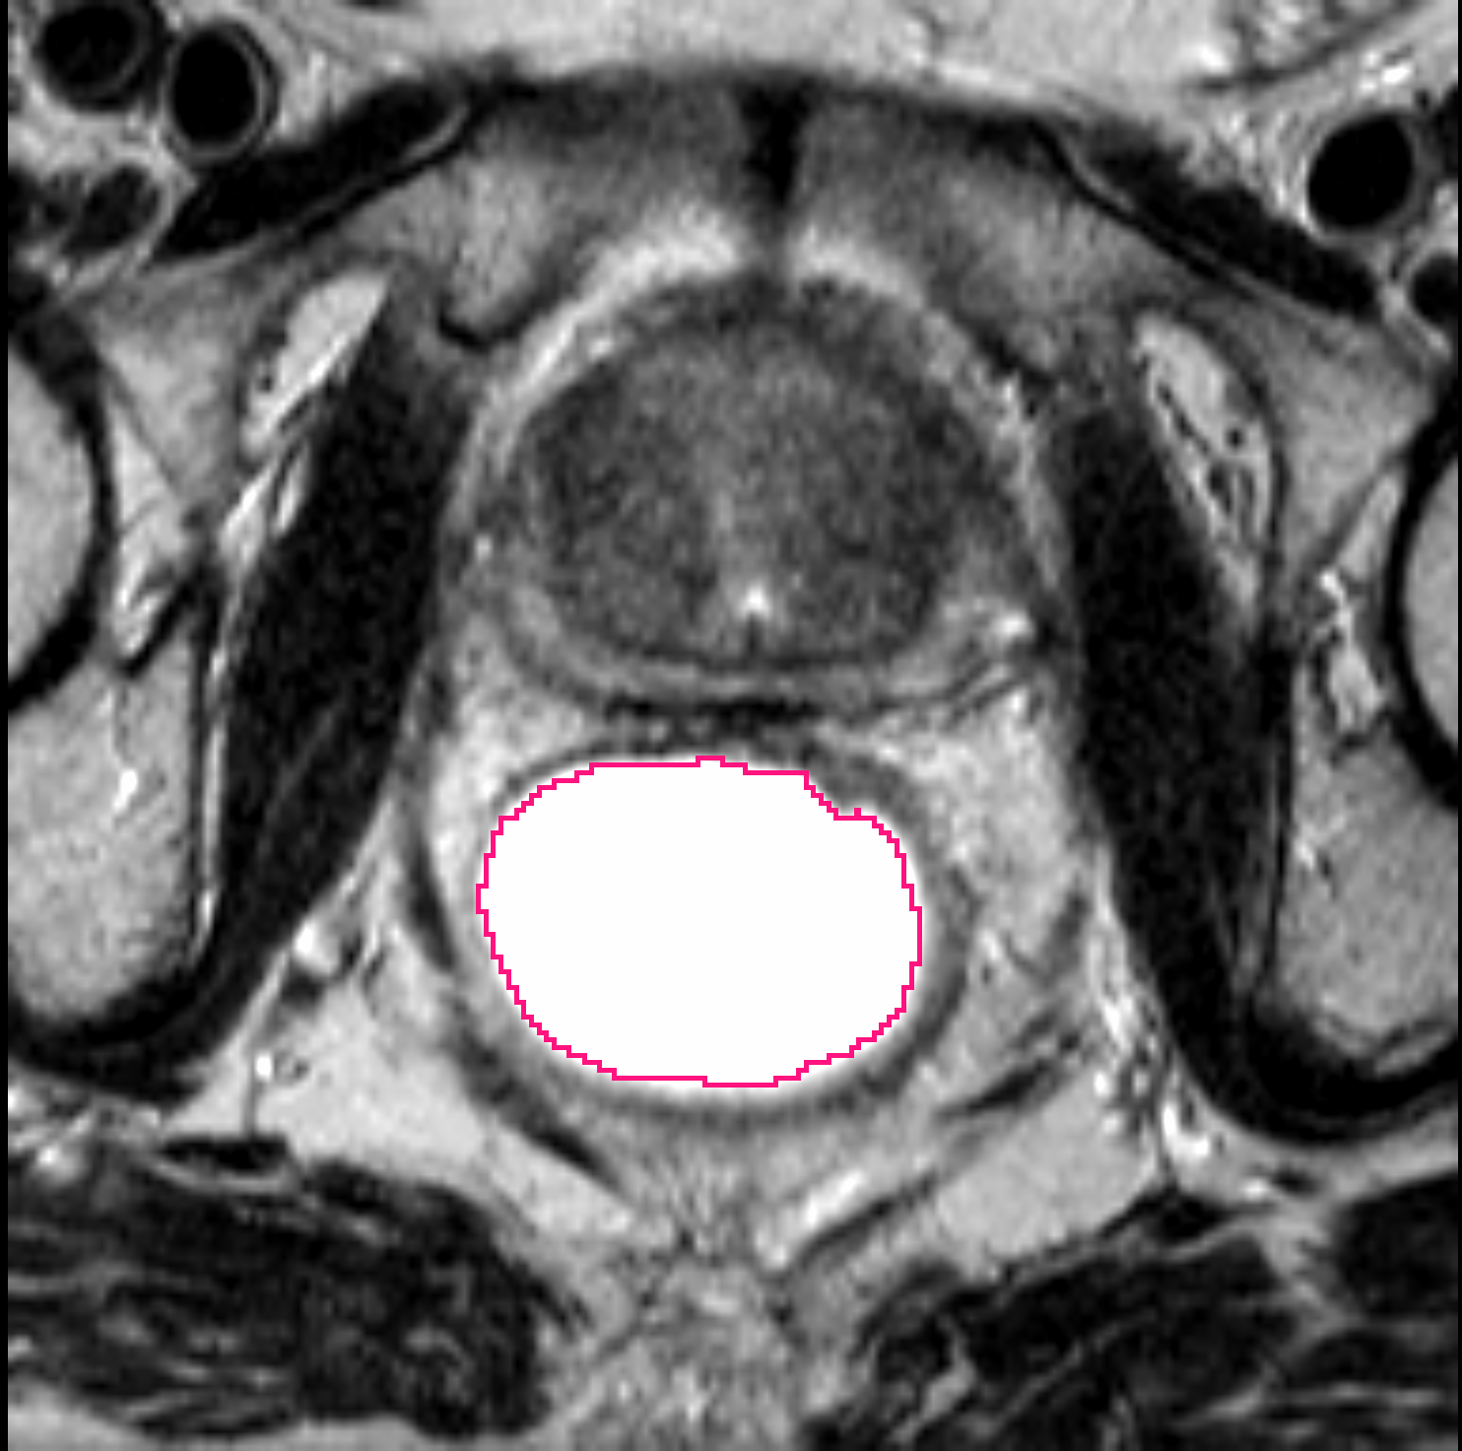
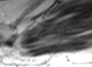
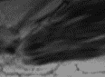
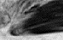
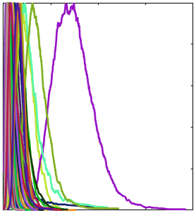
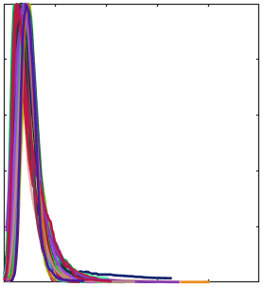
CCF 02 - 21
Post-treatment
Image Acquisition and
ROI Segmentation
Image Pre-processing for Multi-site Differences
U-Net Training and Testing
ROI Segmentation
Resampling
Outer Rectal Wall
Bias Field Correction
Lumen
Intensity Normalization
Before
After
0.25
0.25
0
Raw T2w
OI Muscle Value
1
0
Normalized T2w
OI Muscle Value
1

Slide 6
Table 1: Multiple Experts Comparison
Region | Comparison | Median Dice | Median Hausdorff Distance | Median Frechet Distance
Outer Rectal Wall | Expert 1 vs. Expert 2 | 0.946 ± 0.042 | 2.65 ± 0.584 | 2.83 ± 0.645
Outer Rectal Wall (entire rectum) | U-Net vs. Expert 1 | 0.920 ± 0.060 | 2.65 ± 0.621 | 2.83 ± 0.690
Outer Rectal Wall | U-Net vs. Expert 2 | 0.924 ± 0.066 | 2.65 ± 0.614 | 2.83 ± 0.732
Lumen | Expert 1 vs. Expert 2 | 0.873 ± 0.199 | 2.45 ± 0.601 | 2.83 ± 0.613
Lumen | U-Net vs. Expert 1 | 0.895 ± 0.215 | 2.45 ± 0.733 | 2.65 ± 0.731
Lumen | U-Net vs. Expert 2 | 0.898 ± 0.181 | 2.45 ± 0.656 | 2.45 ± 0.708
Rectum Alone | Expert 1 vs. Expert 2 | 0.791 ± 0.102 | 3.32 ± 0.513 | 3.46 ± 0.634
Rectal Wall (rectum, excluded lumen) | U-Net vs. Expert 1 | 0.717 ± 0.173 | 3.46 ± 0.658 | 3.74 ± 0.810
 | U-Net vs. Expert 2 | 0.703 ± 0.165 | 3.32 ± 0.673 | 3.61 ± 0.803
 | Fusion vs. Expert 1 | 0.750 ± 0.155 | 3.46 ± 0.554 | 3.74 ± 0.692
 | Fusion vs. Expert 2 | 0.739 ± 0.154 | 3.32 ± 0.552 | 3.61 ± 0.687

Slide 7
Table 2: Excluded and VA cohorts
Cohort | Region | Approach | Median Dice | Median Hausdorff Distance | Median Frechet Distance
Excluded | Outer Rectal Wall | U-Net | 0.886 ± 0.148 | 2.83 ± 0.794 | 3.00 ± 0.812
 | Lumen | U-Net | 0.779 ± 0.200 | 2.83 ± 0.798 | 3.00 ± 0.832
 | Rectum Alone | U-Net | 0.645 ± 0.222 | 3.74 ± 0.756 | 4.24 ± 0.824
 |  | Fusion | 0.679 ± 0.208 | 3.74 ± 0.733 | 4.00 ± 0.803
VA | Outer Rectal Wall | U-Net | 0.913 ± 0.056 | 2.45 ± 0.516 | 2.45 ± 0.557
 | Lumen | U-Net | 0.804 ± 0.154 | 2.45 ± 0.690 | 2.65 ± 0.701
 | Rectum Alone | U-Net | 0.713 ± 0.228 | 3.32 ± 0.663 | 3.61 ± 0.753
 |  | Fusion | 0.750 ± 0.159 | 3.16 ± 0.600 | 3.61 ± 0.633

Slide 8
Table 2: Performance of Lumen U-Net on Excluded Subgroups and VA cohort
Cohort | Median Dice | Median Hausdorff Distance | Median Frechet Distance
Excluded - Coronal View | 0.833 ± 0.167 | 2.65 ± 0.622 | 2.65 ± 0.577
Excluded - Dark Lumen | 0.775 ± 0.222 | 3.00 ± 0.833 | 3.16 ± 0.862
Excluded - Poor Quality | 0.678 ± 0.163 | 2.91 ± 0.805 | 3.16 ± 0.914
VA | 0.804 ± 0.154 | 2.45 ± 0.690 | 2.65 ± 0.701
Table 3: Performance of Outer Rectal Wall U-Net on Excluded Subgroups and VA cohort
Cohort | Median Dice | Median Hausdorff Distance | Median Frechet Distance
Excluded - Coronal View
Excluded - Dark Lumen
Excluded - Poor Quality
VA | 0.913 ± 0.056 | 2.45 ± 0.516 | 2.45 ± 0.557

Slide 9
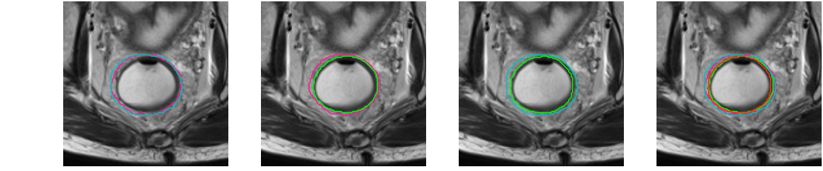
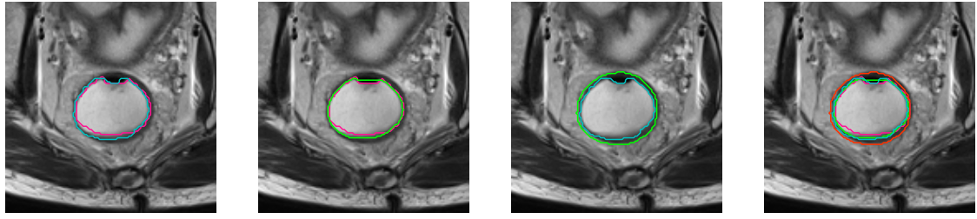
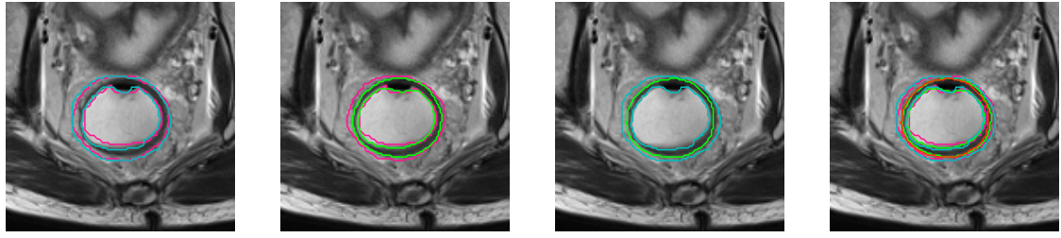
UH 04 22
Expert 1 (Red) vs. Expert 2 (Cyan)
U-Net (green) vs. Expert 2 (blue)
U-Net vs. Expert 1 vs. Expert 2
U-Net (green) vs. Expert 1 (red)
Outer Rectal Wall
Lumen
Rectum alone

Slide 10
Figure – Excluded and VA
Excluded
VA

Slide 11
Figure – Excluded Subgroups
Without Rectal Gel
Coronal View
Poor Quality
VA

Slide 12
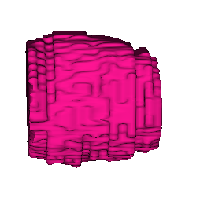
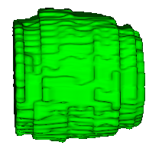
Entire Rectum – Expert 1
Entire Rectum – U-Net

