Slide 1
FeatherEvaluator
Erick Bauman
Tristan Duckworth
Shamila Wickramasuriya

Slide 2
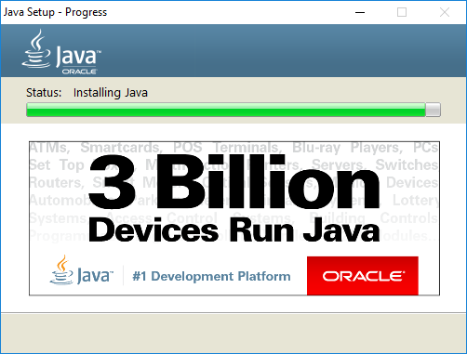
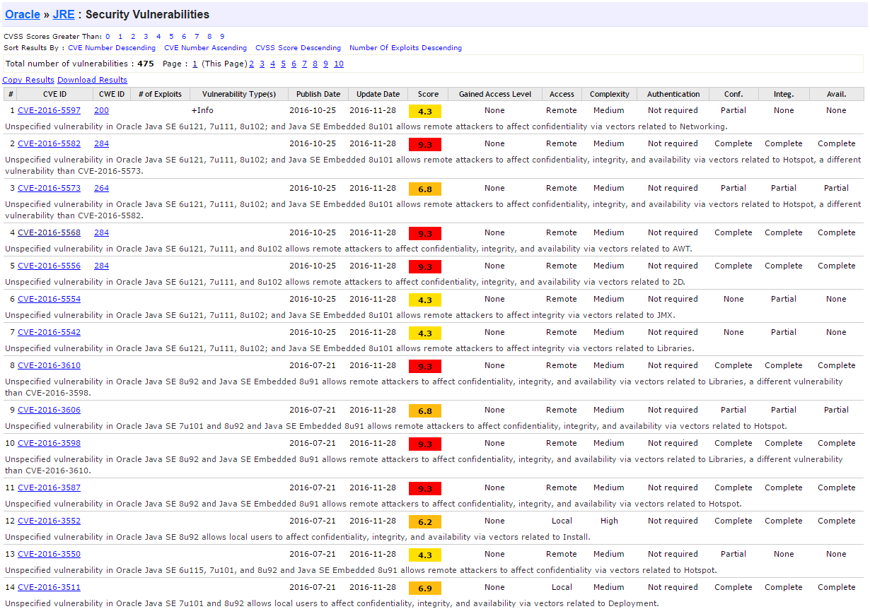

Motivation

Slide 3
Motivation
Formalizations have benefits
Featherweight Java (Igarashi 2001)
“led to the discovery and repair of one bug in the GJ compiler”
Allow rigorous proofs about behavior of programs and languages
Allow us to build better implementations of those languages
Expose the consequences of extensions
Notes:
generic java

Slide 4
Background
Featherweight Java
Omits: assignment, interfaces, overloading, messages to super, null pointers, base types (int, bool, etc.), abstract method declarations, shadowing of superclass fields by subclass fields, access control (public, private, etc.), and exceptions
Includes: mutually recursive class definitions, object creation, field access, method invocation, method override, method recursion through this, subtyping, and casting

Slide 5
Background
Featherweight Java (no casting)
Omits: assignment, interfaces, overloading, messages to super, null pointers, base types (int, bool, etc.), abstract method declarations, shadowing of superclass fields by subclass fields, access control (public, private, etc.), and exceptions
Includes: mutually recursive class definitions, object creation, field access, method invocation, method override, method recursion through this, subtyping, and casting

Slide 6
Background
Featherweight Java (Igarashi 2001)
“A minimal core calculus for Java and GJ”
Three computational rules: field access, method invocation, casts
“just as the slogan for the lambda calculus is ‘everything is a function,’ here the slogan is ‘everything is an object.’”
new Pair(new A(), new B()).snd → new B()
Notes:
Recall that, in the lambda calculus, the betareduction rule for applications assumes that the function is first simplified to a lambda abstraction. Similarly, in FJ the reduction rules assume the object operated upon is first simplified to a new expression. Thus, just as the slogan for the lambda calculus is “everything is a function,” here the slogan is “everything is an object.
There is a direct correspondence between FJ and a purely functional core of Java, in the sense that every FJ program is literally an executable Java program

Slide 7
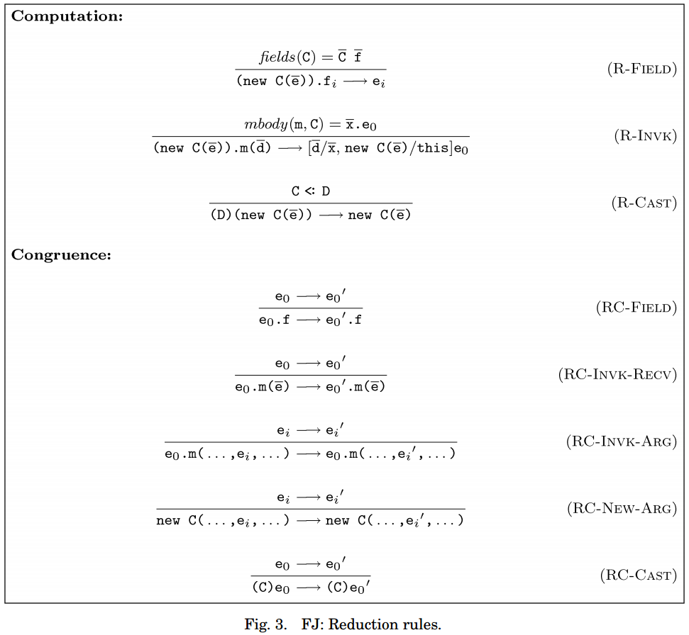
Background
new Pair(new A(), new B()).snd → new B()
Notes:
The single-step semantics of FJ

Slide 8
Background
Variations
Featherweight Java with assignment and immutability (Mackay et al. 2012)
Product Lines of Theorems (Delaware et al. 2011)
Extensible framework for modelling Featherweight Java in Coq
Cast-free Coq implementation by Bruno de Fraine, Erik Ernst, and Mario Sudholt in 2008
Colored Featherweight Java (Kästner and Apel 2008)
Notes:
Core
Casts
Interface
Generic
Generic_Interface
Generic_Cast

Slide 9
Background
Variations
Featherweight Java with assignment and immutability (Mackay et al. 2012)
Product Lines of Theorems (Delaware et al. 2011)
Extensible framework for modelling Featherweight Java in Coq
Cast-free Coq implementation by Bruno de Fraine, Erik Ernst, and Mario Sudholt in 2008
Colored Featherweight Java (Kästner and Apel 2008)
Notes:
Core
Casts
Interface
Generic
Generic_Interface
Generic_Cast

Slide 10
Objectives
Produce a simple functional expression evaluator for core Featherweight Java
Small-step semantics
Prove that if the evaluator maps an expression to a new expression, then the propositional formalization of core Featherweight Java agrees that the single-step evaluation holds
Not total correctness!
Notes:
Small-step possible because there are no side effects in FJ

Slide 11
de Fraine’s Implementation
Inductive exp : Set :=
e_var : var -> exp
| e_field : exp -> fname -> exp
| e_meth : exp -> mname -> list exp -> exp
| e_new : cname -> list exp -> exp
Inductive eval : exp -> exp -> Prop :=
eval_field : forall (C : cname) (fs : flds) (es : list exp) (f : atom)
(e : exp) (fes : list (atom * exp)),
fields C fs ->
env_zip fs es fes -> binds f e fes -> eval (e_field (e_new C es) f) e
| eval_meth : forall (C : cname) (m : mname) (t : typ) (E : env) (e : exp)
(es : list exp) (ves : list (atom * exp)) (es0 : list exp),
method C m (t, E, e) ->
env_zip E es ves ->
eval (e_meth (e_new C es0) m es) (subst_exp ((this, e_new C es0) :: ves) e)
| eval_context : forall (EE : exp -> exp) (e e' : exp),
eval e e' -> exp_context EE -> eval (EE e) (EE e')

Slide 12
Evaluator
Fixpoint feval (e:exp) (ct: ctable) : option exp :=
match e with
| e_var v => None
| e_field (e_new C es) f =>
match (get C ct) with
| Some (_, fs, _) => get f (combine (List.map fst fs) es)
| None => None
end (**R-FIELD**)
| e_meth (e_new C es) m ds =>
match (get C ct) with
| Some (_, _, ms) =>
match (get m ms) with
| Some (_,en,ex) => Some (subst_exp ((this,(e_new C es))::(combine (List.map fst en) ds)) ex)
| None => None
end
| None => None
end (**R-INVK**)
| e_new c es => None
| e_field e f =>
match (feval e ct) with
| Some ex => Some (e_field ex f)
| None => None
end (**RC-FIELD**)
| e_meth e m es =>
match (feval e ct) with
| Some ex => Some (e_meth ex m es)
| None => None
end (**RC_INVK-RECV**)
end.

Slide 13
Theorem Statement
Theorem feval_sound:
forall (e1 e2:exp) (ct:ctable),
feval e1 ct = Some e2 -> eval e1 e2.

Slide 14
Example
class C extends Object {
C() {super();}
}
class D extends Object {
D() {super();}
}
class Pair extends Object {
Object myFst;
Object mySnd;
Pair(Object myFst, Object mySnd) {
super();
this.myFst = myFst;
this.mySnd = mySnd;
}
Pair setFst(Object newFst) {
return new Pair(newFst, this.mySnd);
}
}
Notes:
Notation ctable := (list (cname * (cname * flds * mths))).

Slide 15
Example
Definition ct : ctable := (
(C,(Object,nil,nil))
::(D,(Object,nil,nil))
::(Pair,(
Object,
((myFst, Object)
:: (mySnd, Object)
::nil),
(
(setFst,
(
Pair,
(newFst, Object) :: nil,
e_new Pair (e_var newFst :: e_field (e_var this) mySnd :: nil)
)
)
:: nil
)
))
:: nil).
Notation ctable := (list (cname * (cname * flds * mths))).
Notes:
Notation ctable := (list (cname * (cname * flds * mths))).

Slide 16
Example
Definition ct : ctable := (
(C,(Object,nil,nil))
::(D,(Object,nil,nil))
::(Pair,(
Object,
((myFst, Object)
:: (mySnd, Object)
::nil),
(
(setFst,
(
Pair,
(newFst, Object) :: nil,
e_new Pair (e_var newFst :: e_field (e_var this) mySnd :: nil)
)
)
:: nil
)
))
:: nil).
class C extends Object {
C() {}
}
Notation ctable := (list (cname * (cname * flds * mths))).
Notes:
Notation ctable := (list (cname * (cname * flds * mths))).

Slide 17
Example
Definition ct : ctable := (
(C,(Object,nil,nil))
::(D,(Object,nil,nil))
::(Pair,(
Object,
((myFst, Object)
:: (mySnd, Object)
::nil),
(
(setFst,
(
Pair,
(newFst, Object) :: nil,
e_new Pair (e_var newFst :: e_field (e_var this) mySnd :: nil)
)
)
:: nil
)
))
:: nil).
class D extends Object {
D() {}
}
Notation ctable := (list (cname * (cname * flds * mths))).
Notes:
Notation ctable := (list (cname * (cname * flds * mths))).

Slide 18
Example
Definition ct : ctable := (
(C,(Object,nil,nil))
::(D,(Object,nil,nil))
::(Pair,(
Object,
((myFst, Object)
:: (mySnd, Object)
::nil),
(
(setFst,
(
Pair,
(newFst, Object) :: nil,
e_new Pair (e_var newFst :: e_field (e_var this) mySnd :: nil)
)
)
:: nil
)
))
:: nil).
class Pair extends Object {
Object myFst;
Object mySnd;
Pair(Object myFst, Object mySnd) {
super();
this.myFst = myFst;
this.mySnd = mySnd;
}
Pair setFst(Object newFst) {
return new Pair(newFst, this.mySnd);
}
}
Notation ctable := (list (cname * (cname * flds * mths))).
Notes:
Notation ctable := (list (cname * (cname * flds * mths))).

Slide 19
Example
Definition ct : ctable := (
(C,(Object,nil,nil))
::(D,(Object,nil,nil))
::(Pair,(
Object,
((myFst, Object)
:: (mySnd, Object)
::nil),
(
(setFst,
(
Pair,
(newFst, Object) :: nil,
e_new Pair (e_var newFst :: e_field (e_var this) mySnd :: nil)
)
)
:: nil
)
))
:: nil).
class Pair extends Object {
Object myFst;
Object mySnd;
Pair(Object myFst, Object mySnd) {
super();
this.myFst = myFst;
this.mySnd = mySnd;
}
Pair setFst(Object newFst) {
return new Pair(newFst, this.mySnd);
}
}
Notation ctable := (list (cname * (cname * flds * mths))).
Notes:
Notation ctable := (list (cname * (cname * flds * mths))).

Slide 20
Example
Definition ct : ctable := (
(C,(Object,nil,nil))
::(D,(Object,nil,nil))
::(Pair,(
Object,
((myFst, Object)
:: (mySnd, Object)
::nil),
(
(setFst,
(
Pair,
(newFst, Object) :: nil,
e_new Pair (e_var newFst :: e_field (e_var this) mySnd :: nil)
)
)
:: nil
)
))
:: nil).
class Pair extends Object {
Object myFst;
Object mySnd;
Pair(Object myFst, Object mySnd) {
super();
this.myFst = myFst;
this.mySnd = mySnd;
}
Pair setFst(Object newFst) {
return new Pair(newFst, this.mySnd);
}
}
Notation ctable := (list (cname * (cname * flds * mths))).
Notes:
Notation ctable := (list (cname * (cname * flds * mths))).

Slide 21
Example
Definition ct : ctable := (
(C,(Object,nil,nil))
::(D,(Object,nil,nil))
::(Pair,(
Object,
((myFst, Object)
:: (mySnd, Object)
::nil),
(
(setFst,
(
Pair,
(newFst, Object) :: nil,
e_new Pair (e_var newFst :: e_field (e_var this) mySnd :: nil)
)
)
:: nil
)
))
:: nil).
class Pair extends Object {
Object myFst;
Object mySnd;
Pair(Object myFst, Object mySnd) {
super();
this.myFst = myFst;
this.mySnd = mySnd;
}
Pair setFst(Object newFst) {
return new Pair(newFst, this.mySnd);
}
}
Notation ctable := (list (cname * (cname * flds * mths))).
Notes:
Notation ctable := (list (cname * (cname * flds * mths))).
Constructor is defined by the superclass and the fields of the class

Slide 22
Example
Definition myexp3 : exp := (
e_field
(e_meth
(e_field
(e_new Pair (
(e_new Pair
((e_new C nil)
::(e_new D nil)::nil)
)
::(e_new C nil)::nil)
)
myFst)
setFst
((e_new D nil)::nil)
)
mySnd
).
(((new Pair(new Pair(new C(), new D()), new C())).myFst).setFst(new D())).mySnd
Notes:
Notation ctable := (list (cname * (cname * flds * mths))).

Slide 23
Example
feval myexp3 ct = (
e_field
(e_meth
(e_new Pair (e_new C nil :: e_new D nil :: nil))
setFst
(e_new D nil :: nil))
mySnd
).
(new Pair(new C(), new D()).setFst(new D())).mySnd
Notes:
Notation ctable := (list (cname * (cname * flds * mths))).

Slide 24
Example
feval (feval myexp3 ct) ct = (
e_field
(e_new
Pair
(e_new D nil
:: e_field
(e_new Pair (e_new C nil :: e_new D nil :: nil))
mySnd
:: nil))
mySnd
).
(new Pair(new D(), new Pair(new C(), new D()).mySnd)).mySnd
Notes:
Notation ctable := (list (cname * (cname * flds * mths))).

Slide 25
Example
feval (feval (feval myexp3 ct) ct) ct = (
e_field
(e_new
Pair
(e_new C nil :: e_new D nil :: nil))
mySnd
).
new Pair(new C(), new D()).mySnd
Notes:
Notation ctable := (list (cname * (cname * flds * mths))).

Slide 26
Example
feval (feval (feval (feval myexp3 ct) ct) ct) ct = e_new D nil.
new D()
Notes:
Notation ctable := (list (cname * (cname * flds * mths))).

Slide 27
Difficulties
Understanding evaluation contexts
Concretizing atoms
Handling inheritance
Determining what fields are inherited from the class table
Theorem feval_correct:
forall (e1 e2:exp) (ct:ctable),
feval e1 ct = Some e2 -> eval e1 e2.
Notes:
Done vs to-do

Slide 28
Moving Forward
Total correctness
We hope to prove that our evaluator only produces states that hold under the propositional definition of single-step evaluation for Featherweight Java
What about showing that the evaluator always produces a correct result when one exists?

